Slide 1
USBR Updates:
Green River
CRFS Meeting November 20, 2014

Slide 2
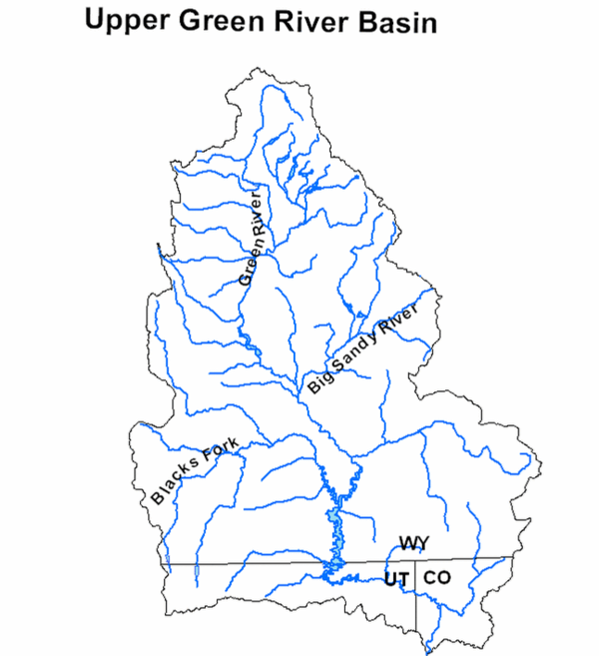
Green River Operations
Fontenelle
Flaming Gorge

Slide 3
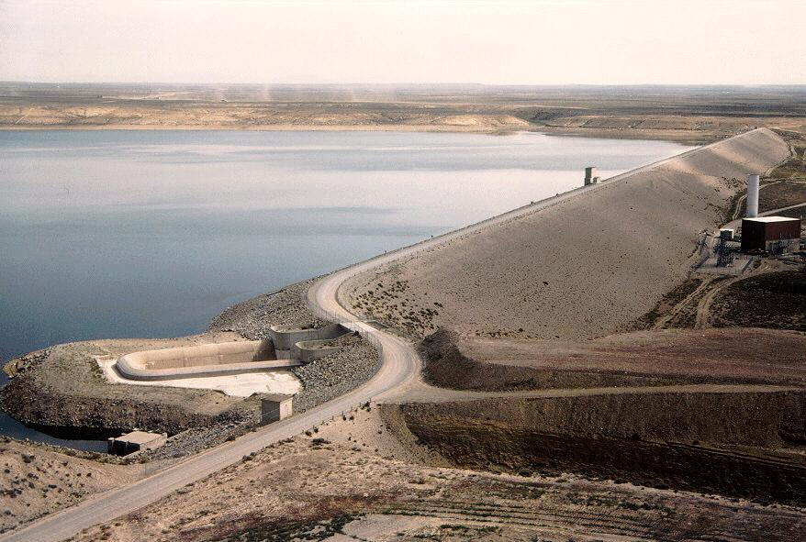
Fontenelle Operations

Slide 4
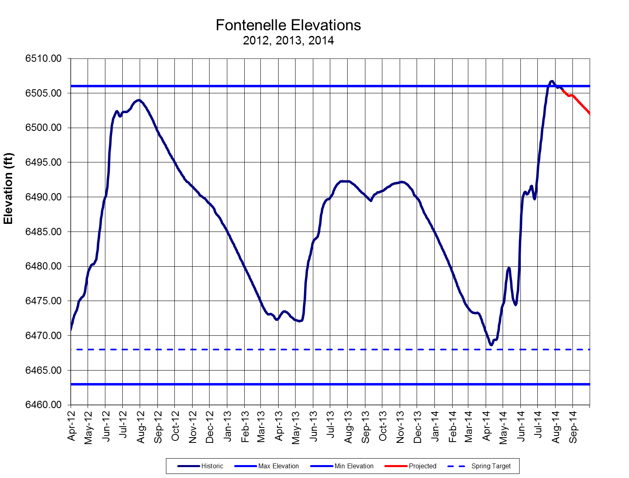
Fontenelle Reservoir Elevation
Notes:
Go to P:\FontenelleOps\FontenelleDailyOps.xls to get most recent plot

Slide 5
Spillway Operation

Slide 6
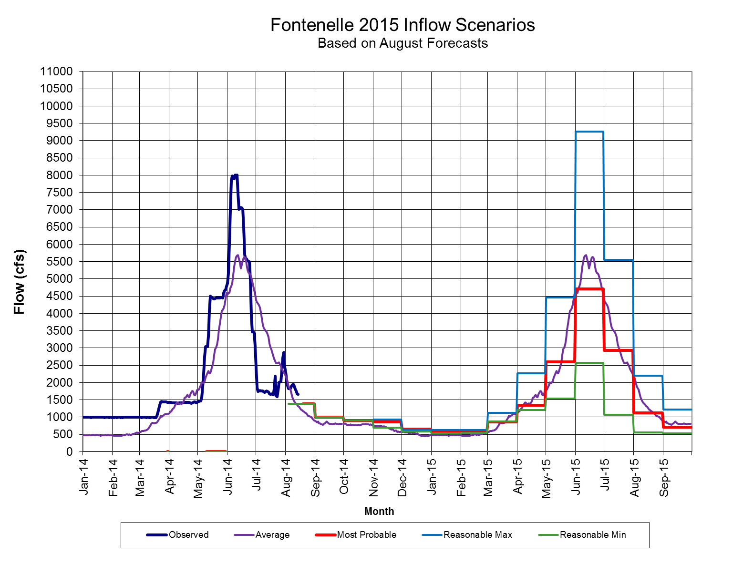
Fontenelle Inflow and Release
Projected releases between 3,000-8,000 cfs over summer, likely longer duration of 8,000 cfs, depends on observed inflow
Apr – Jul Inflow
1,240 KAF (171%)
Notes:
Go to P:\FontenelleOps\FontenelleDailyOps.xls to get most recent plot

Slide 7
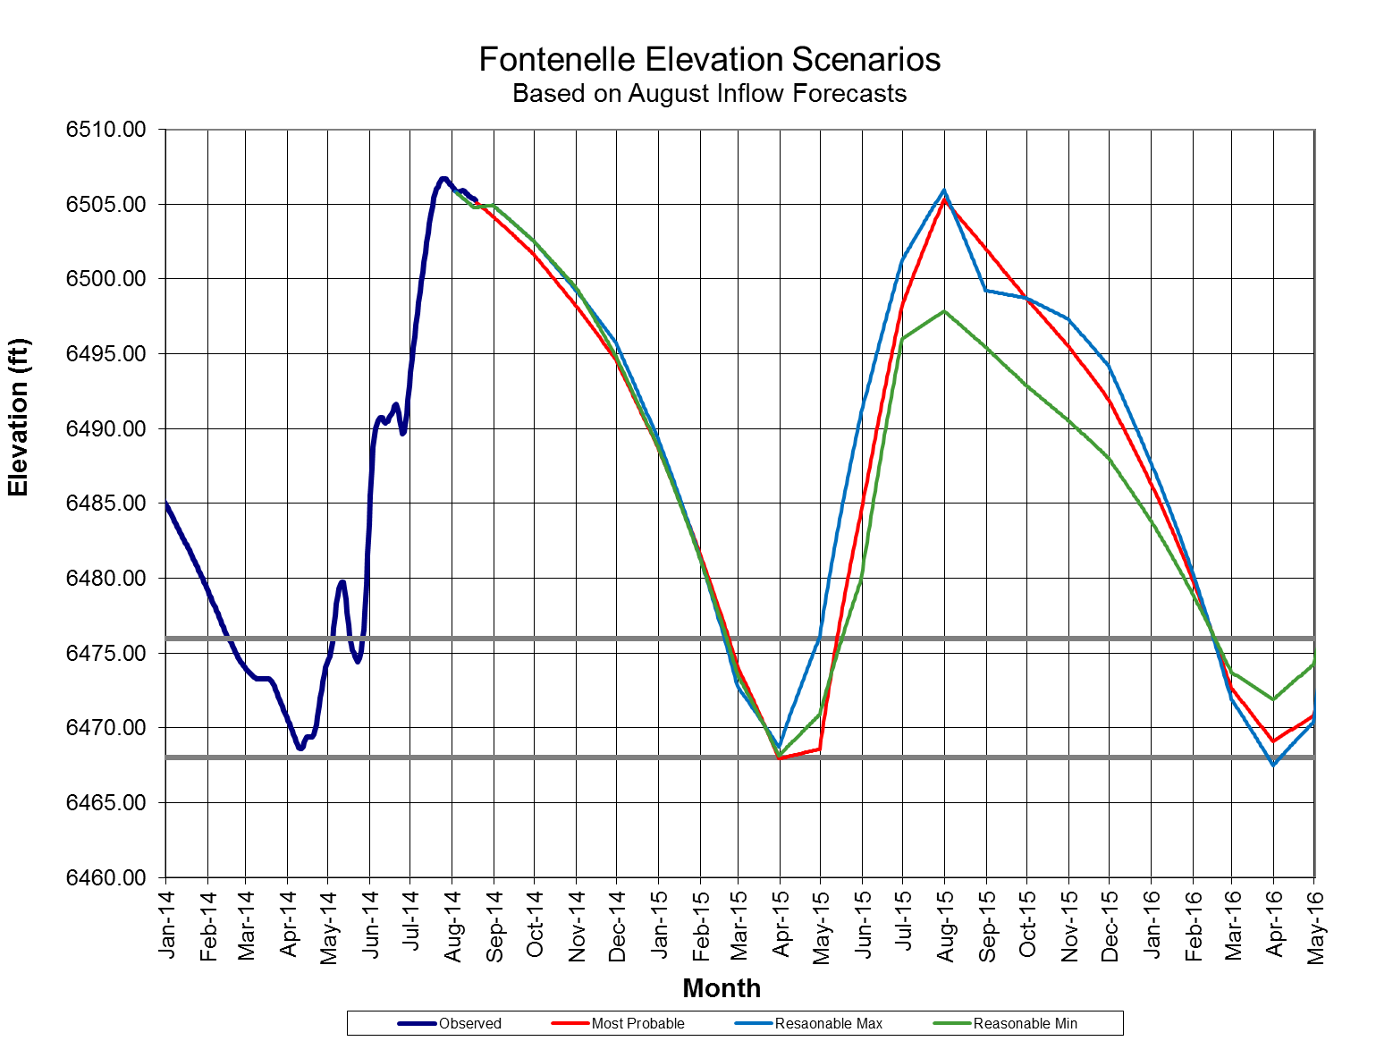
Elevation Scenarios Water Year 2015

Slide 8
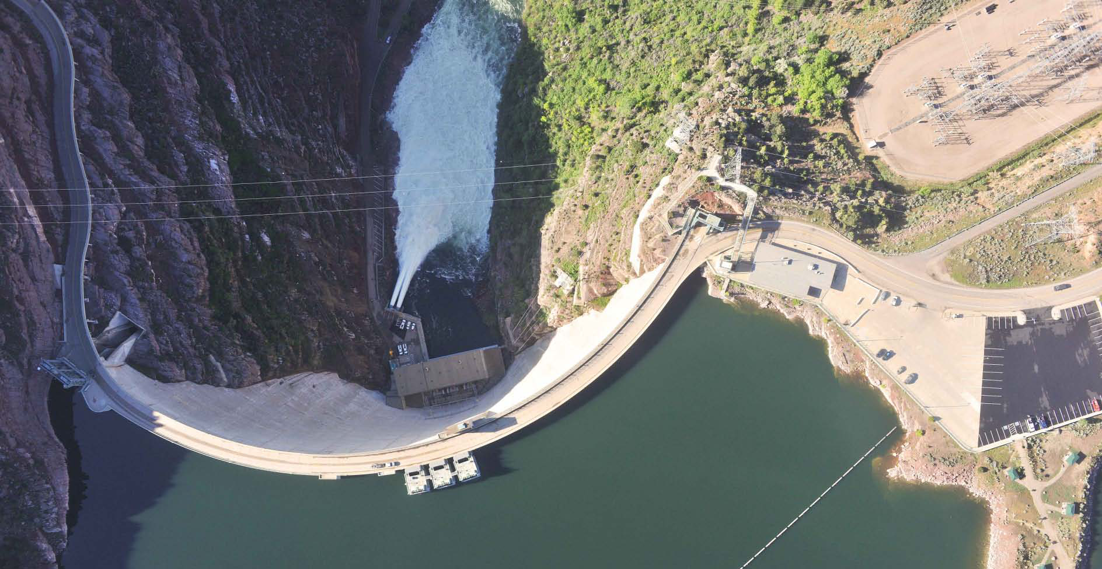
Flaming Gorge Operations

Slide 9
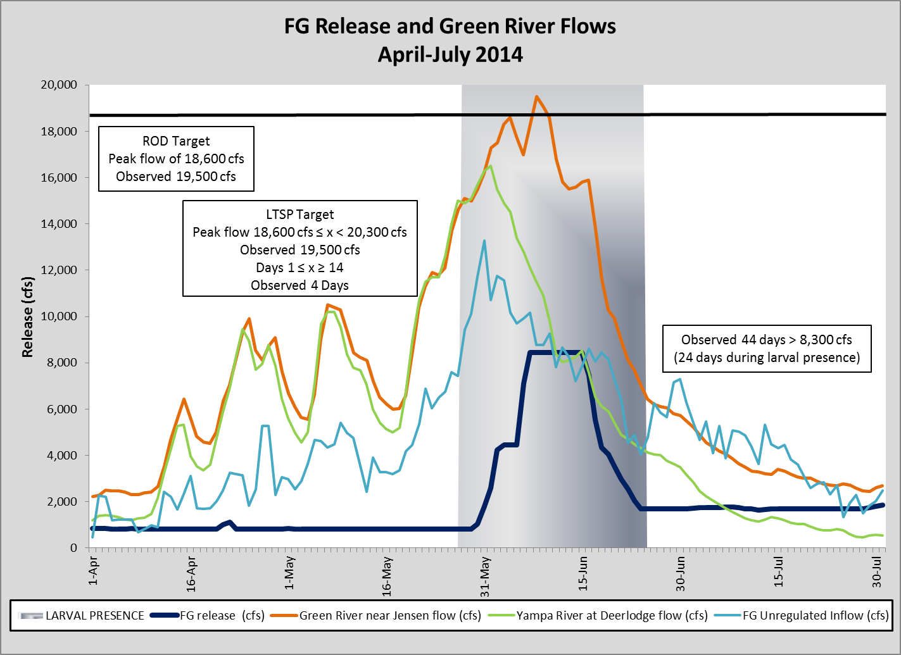
Flaming Gorge Spring Operations

Slide 10
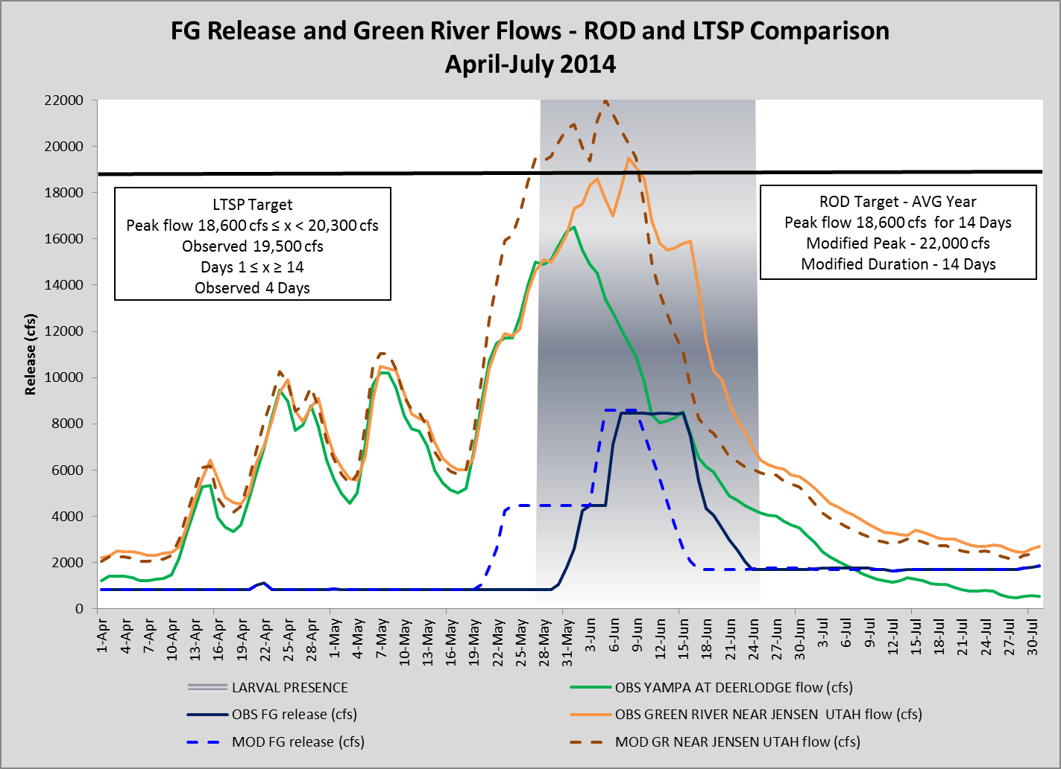
Flaming Gorge Spring Operations
Obs PP = 3 Days
Obs Bypss = 9 Days
Obs Total = 278 kaf
Mod PP = 11 Days
Mod Bypass = 6 Days
Obs Total = 293 kaf

Slide 11
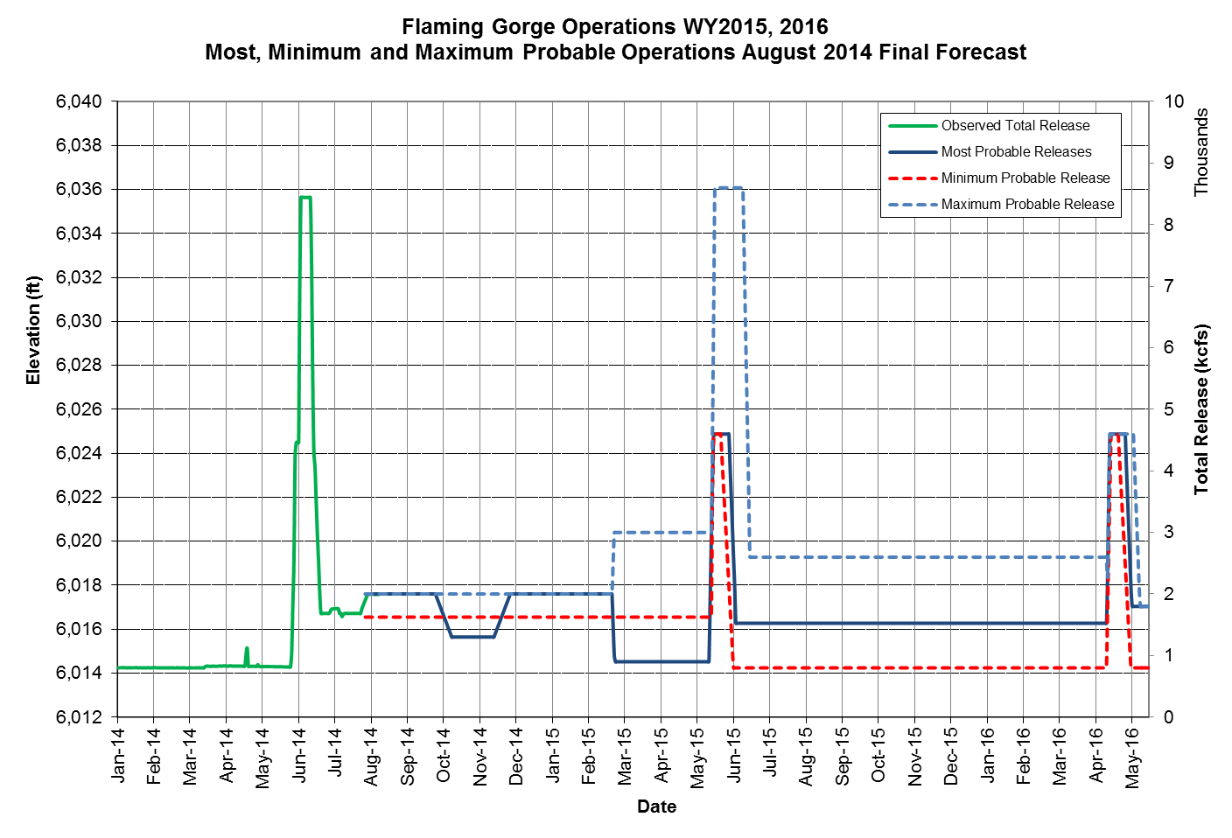
Spring 2015 Hydrograph
Projected peak between 4,600-8,600 cfs for 3-4 weeks during larval drift
Apr – Jul Inflow
1,430 KAF (146%)
Projected releases steady of approximately 2,000 cfs over summer and winter

Slide 12
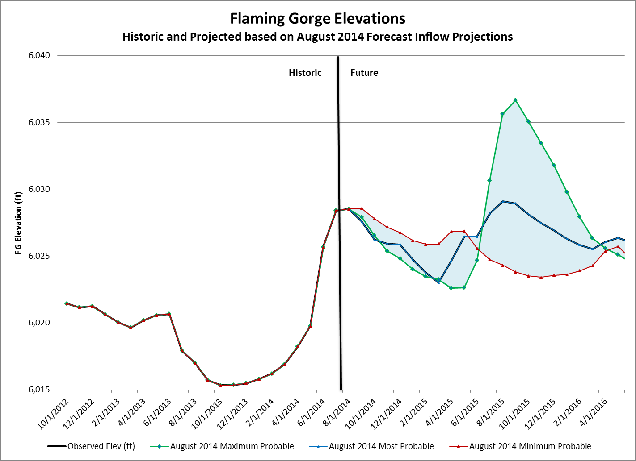
August Projected Elevation Ranges
Unregulated Inflow Forecast Percentage Exceedance Range | May 1 Upper Limit Drawdown Elevation Level
1 to 10 | 6023 ft
10.1 to 30 | 6024 ft
30.1 to 40 | 6025 ft
40.1 to 59.9 | 6027 ft
April Forecast: 1,400 KAF = 143% Average
Observed Volume: 1,159 KAF = 118% Average

