Slide 1
Water Year 2015:
Colorado River Basin
Initial Conditions
CRFS
November 20, 2014

Slide 2
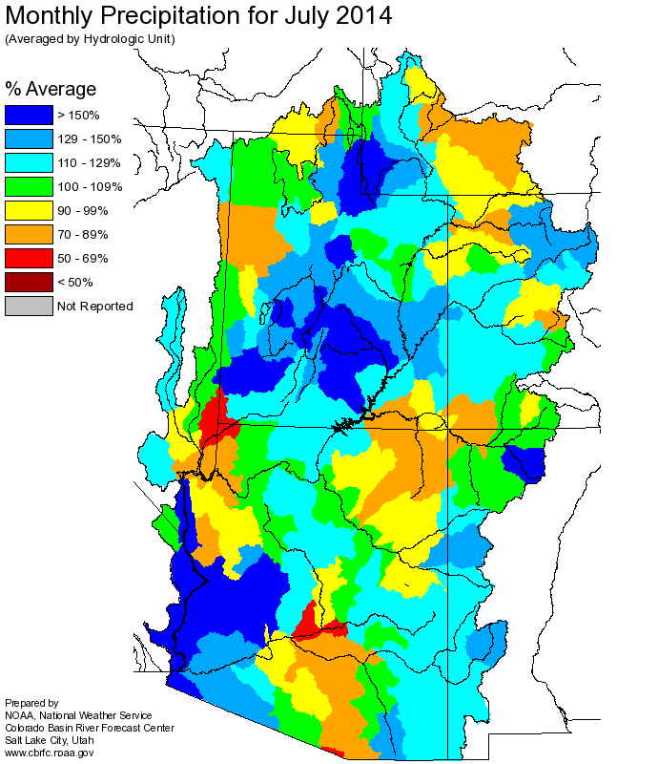
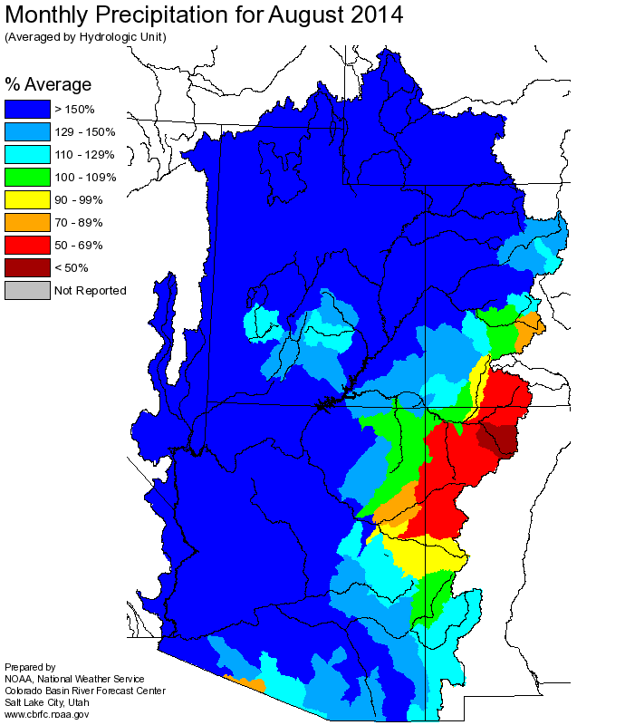
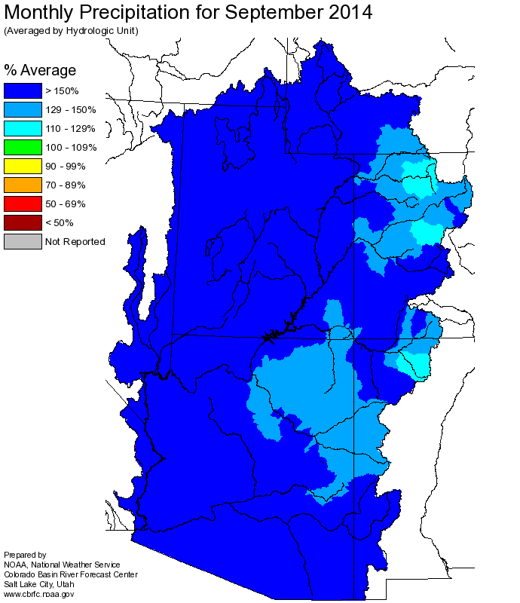
JUL-SEP PRECIPITATION
Good monsoon
- except San Juan…
September 2014 not quite as wet as 2013, but close!
Precipitation above Powell:
- 2014 ~170% of average
- 2013 ~200+%

Slide 3
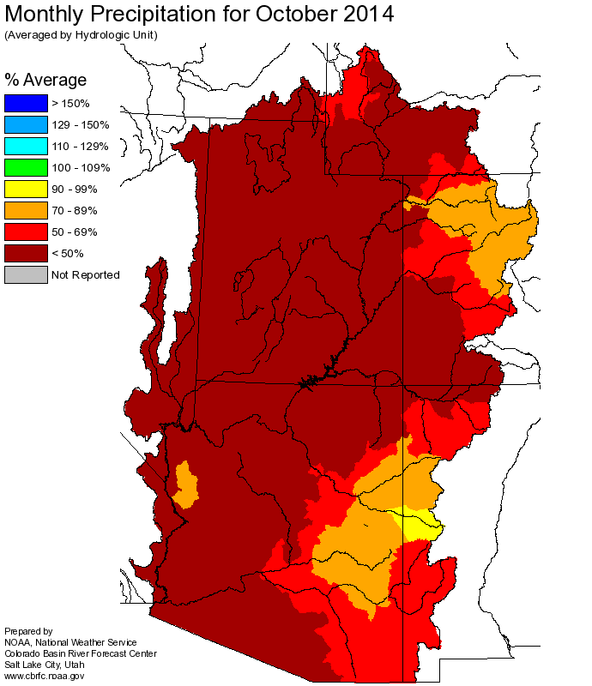
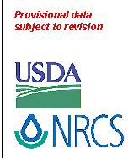
OCT-NOV PRECIPITATION
SNOTEL Current Month to Date Precipitation % of Average
November 19, 2014

Slide 4
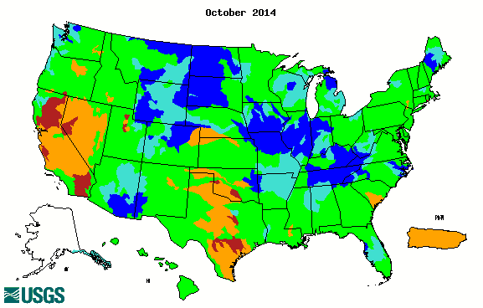
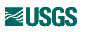

FALL FLOWS
October Regulated Flows

Slide 5
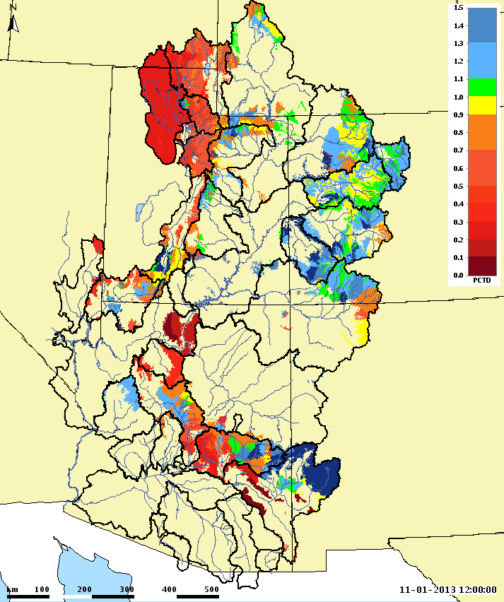
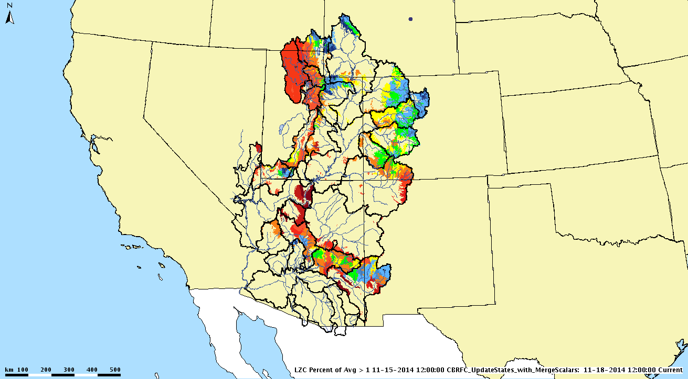
SOIL MOISTURE
CBRFC Model Soil Moisture
November 1, 2013
CBRFC Model Soil Moisture
November 15, 2014
Similar or better than last year
Worse than last year

Slide 6
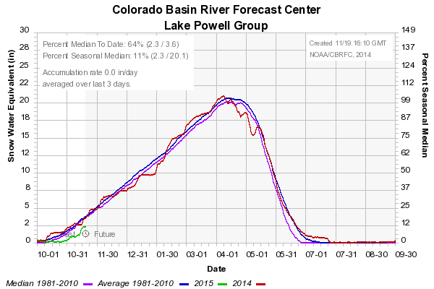
CURRENT SWE
SNOTEL Current Snow Water Equivalent (SWE) % of Median
November 19, 2014

Slide 7
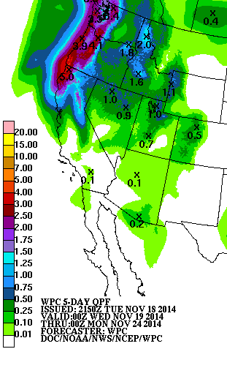
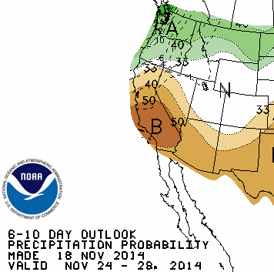
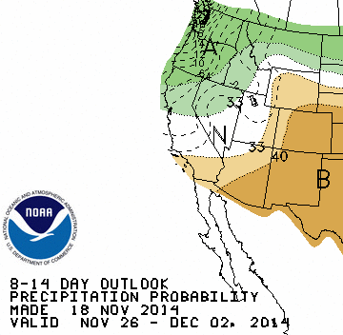
SHORT TERM FORECASTS
UPDATE

Slide 8
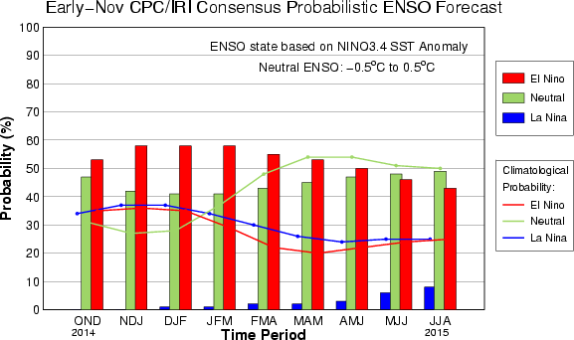
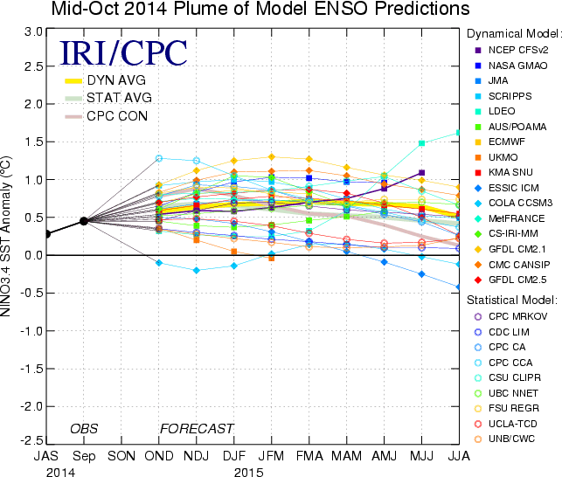
ENSO CONDITIONS
CPC Summary 11/17/2014
The chance of El Niño is 58% during the Northern Hemisphere winter and decreases into spring/summer 2015.
ENSO Alert System Status: El Niño Watch
ENSO-neutral conditions continue.
Positive equatorial sea surface temperature (SST) anomalies continue across most of the Pacific Ocean.
There is a 58% chance of El Niño during the Northern Hemisphere winter, which is favored to last into the Northern Hemisphere spring 2015.
Most models favor El Niño (greater than or equal to +0.5ºC) to develop during October-December 2014 and persist through Northern Hemisphere spring 2015.

Slide 9
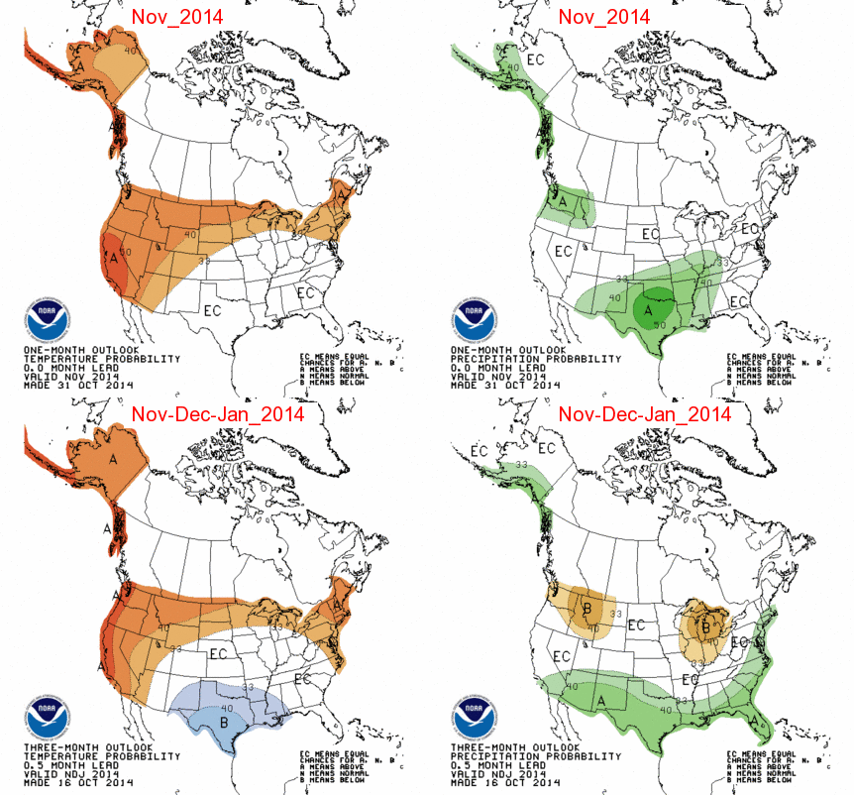
CLIMATE FORECASTS
UPDATE???

Slide 10
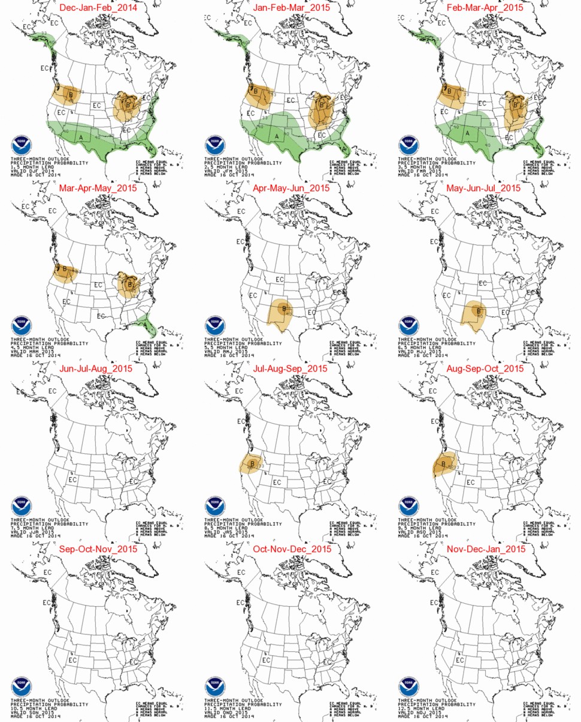
UPDATE???
PRECIPITATION OUTLOOKS

Slide 11
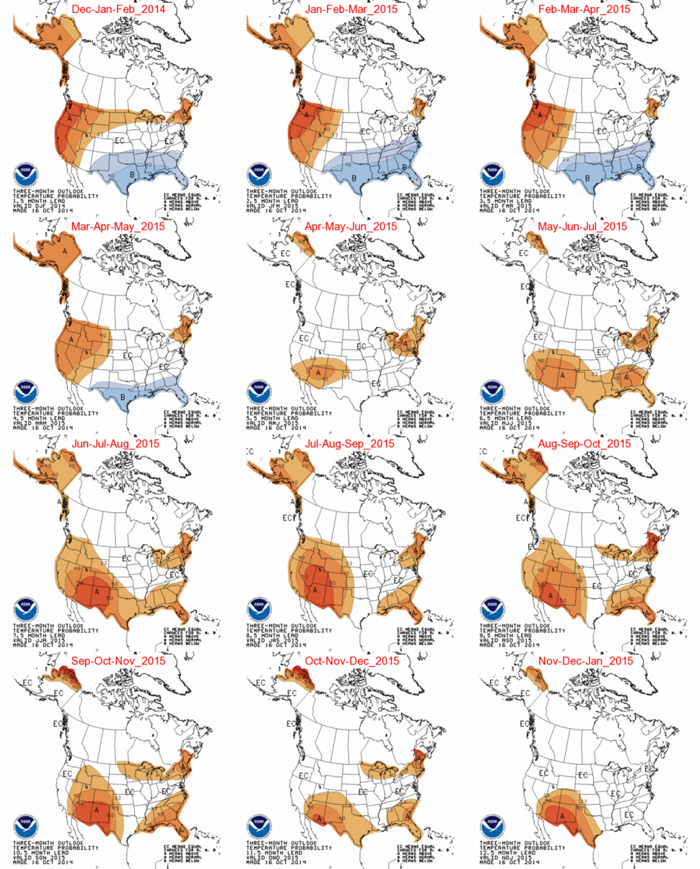
UPDATE???
TEMPERATURE
OUTLOOKS

Slide 12
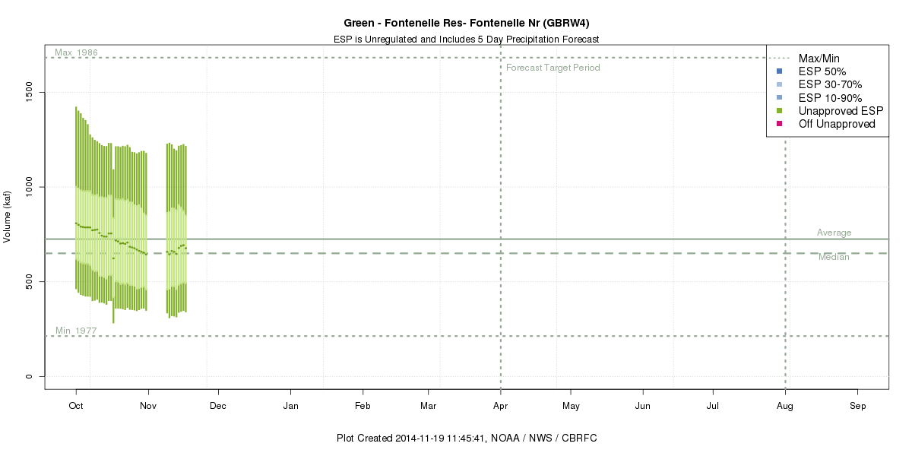
Apr-Jul 2014 Daily ESP
705 kaf
81%

Slide 13
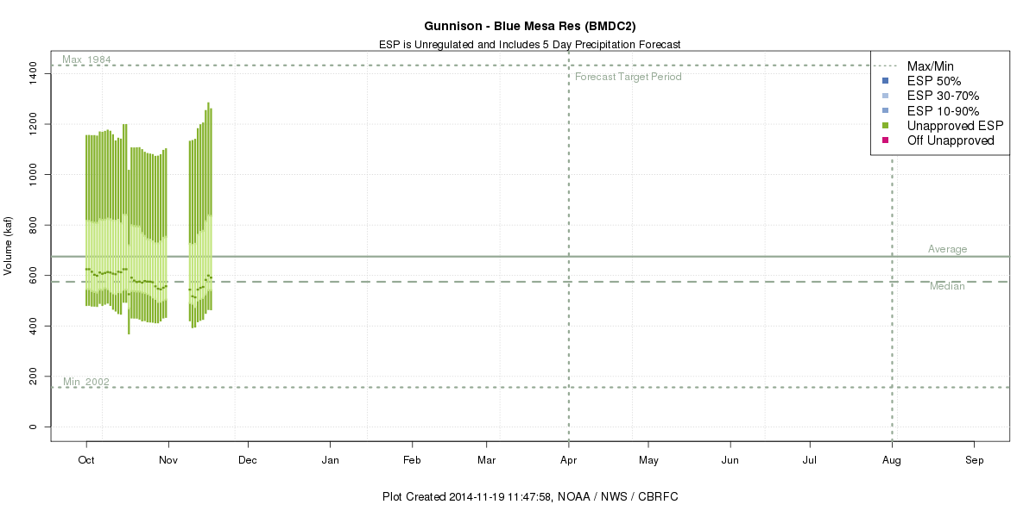
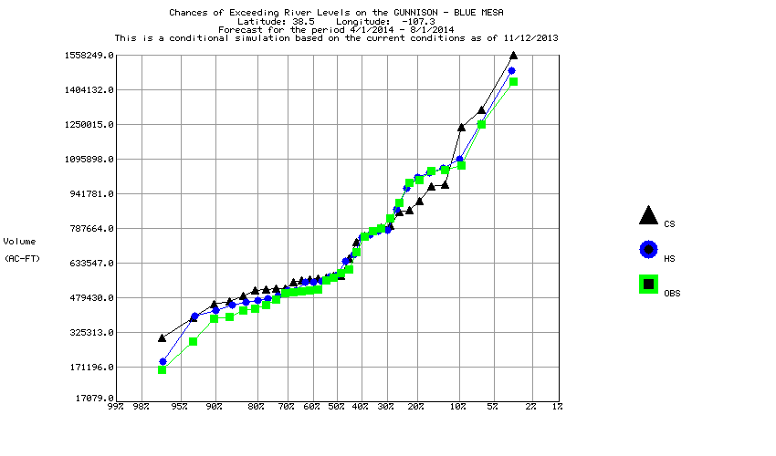
Apr-Jul 2014 Daily ESP
595 kaf
88%
Historical Observed
10%/90% distribution
skewed to higher end
484
kaf
194
kaf

Slide 14
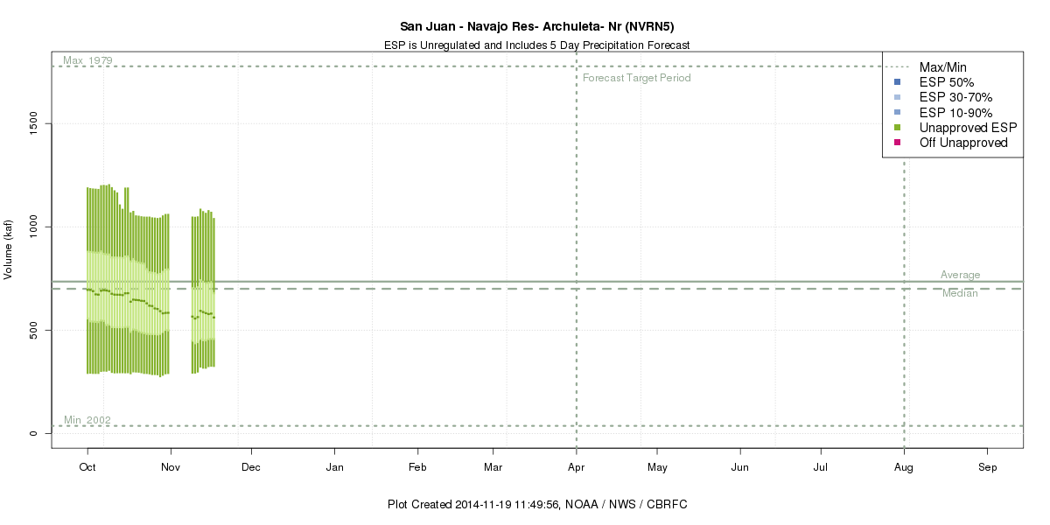
Apr-Jul 2014 Daily ESP
555 kaf
69%

Slide 15
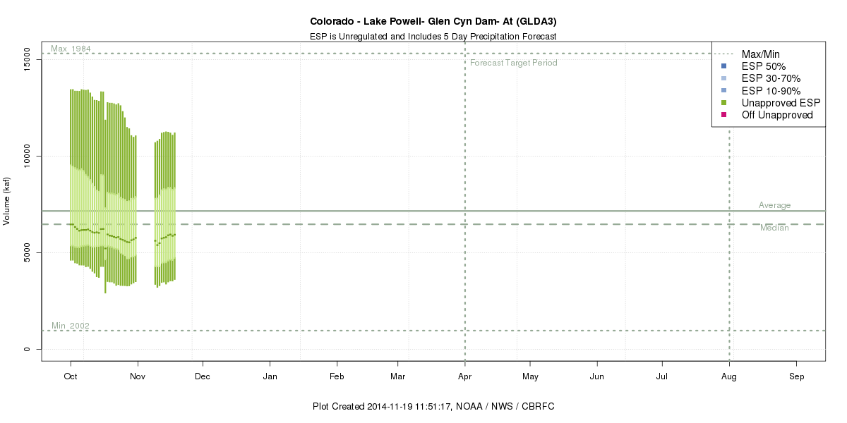
Apr-Jul 2014 Daily ESP
5932 kaf
83%

