Slide 1
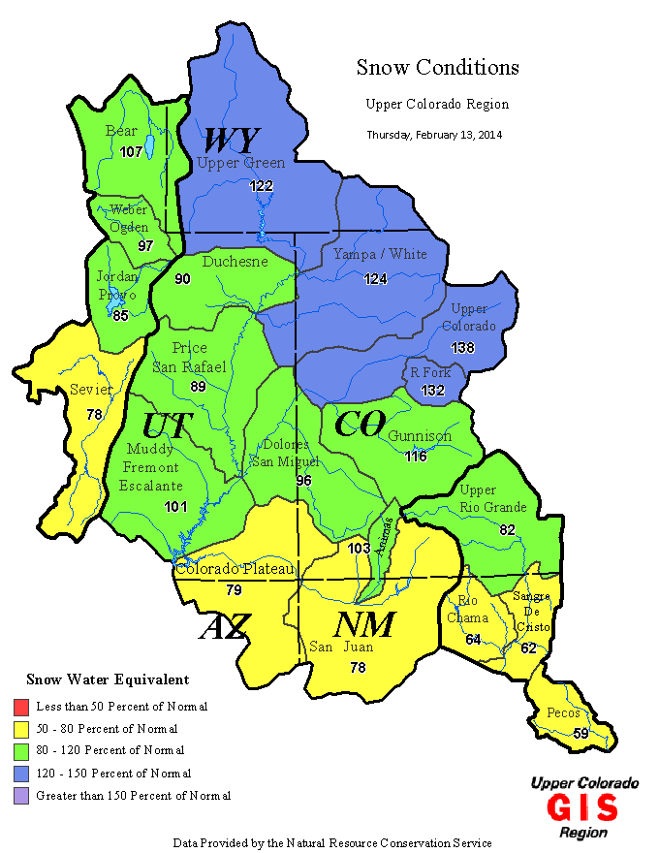
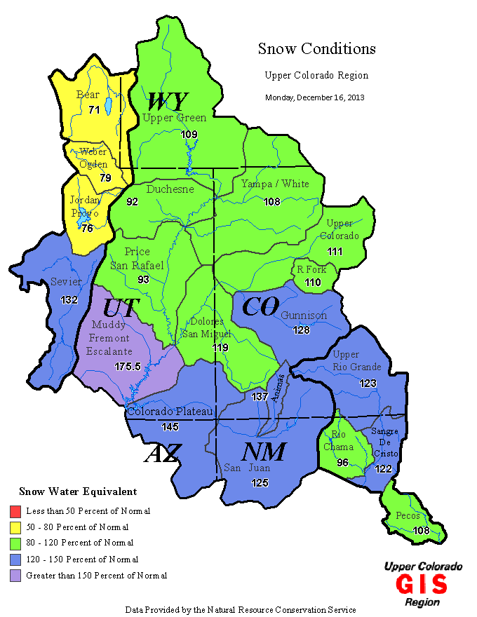
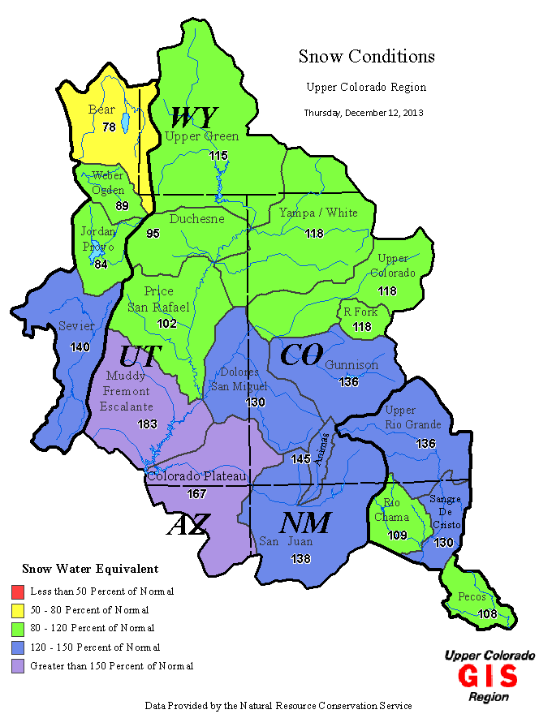
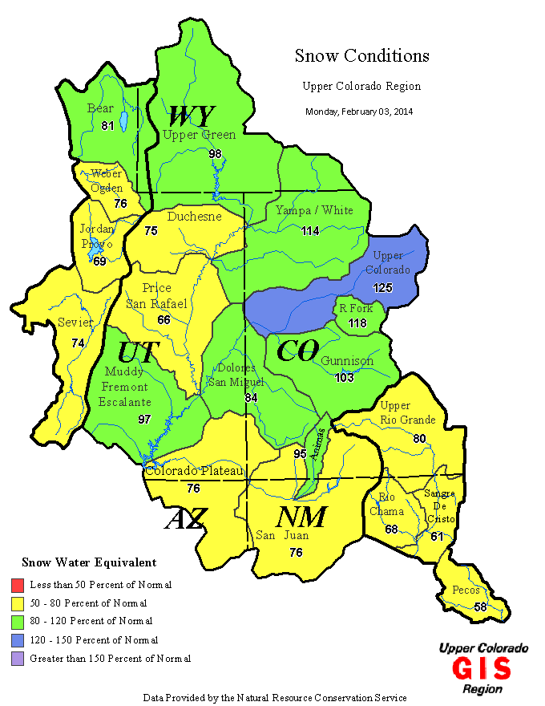
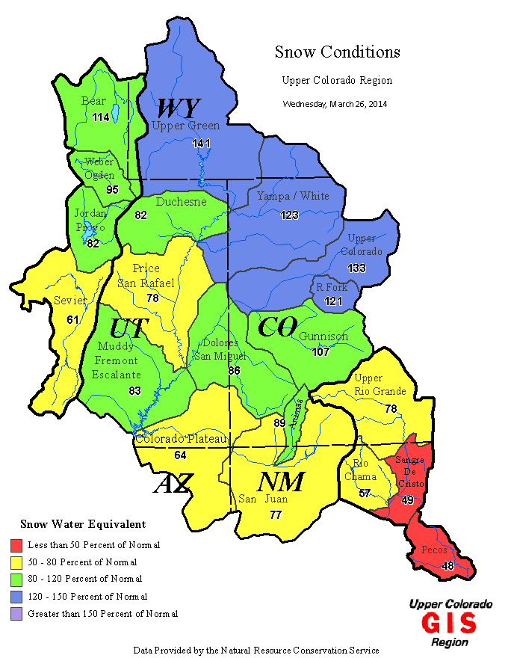
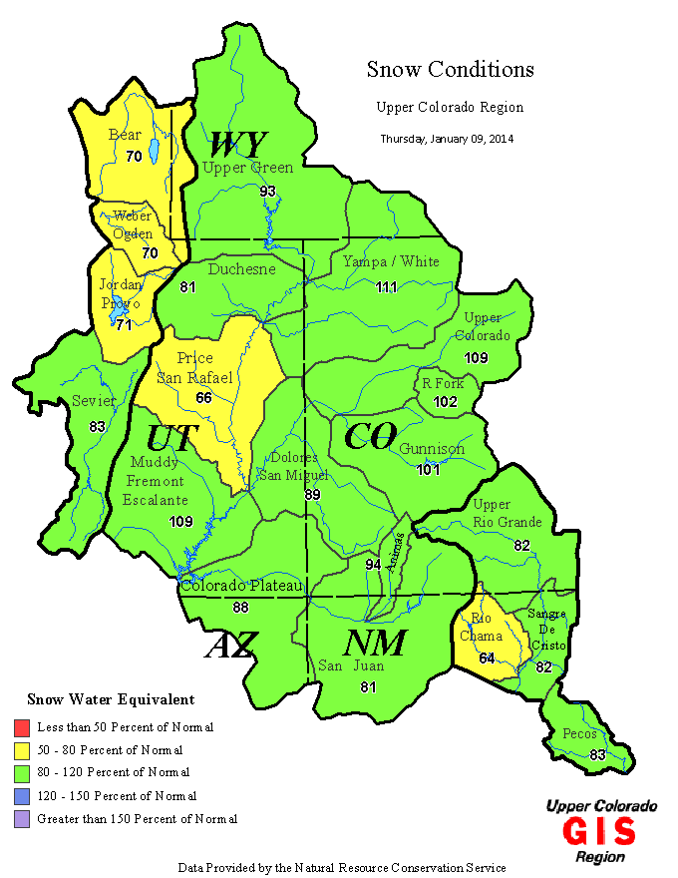
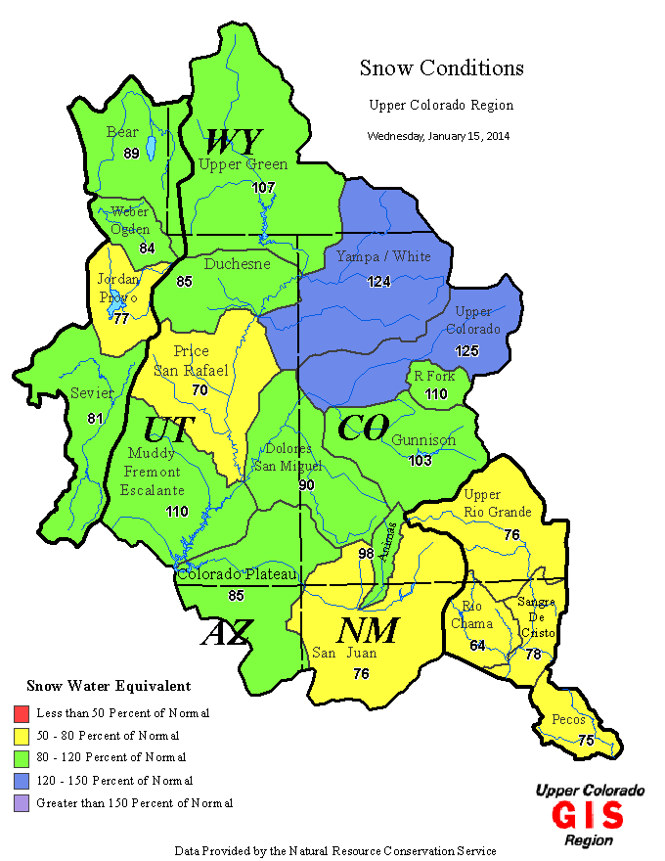
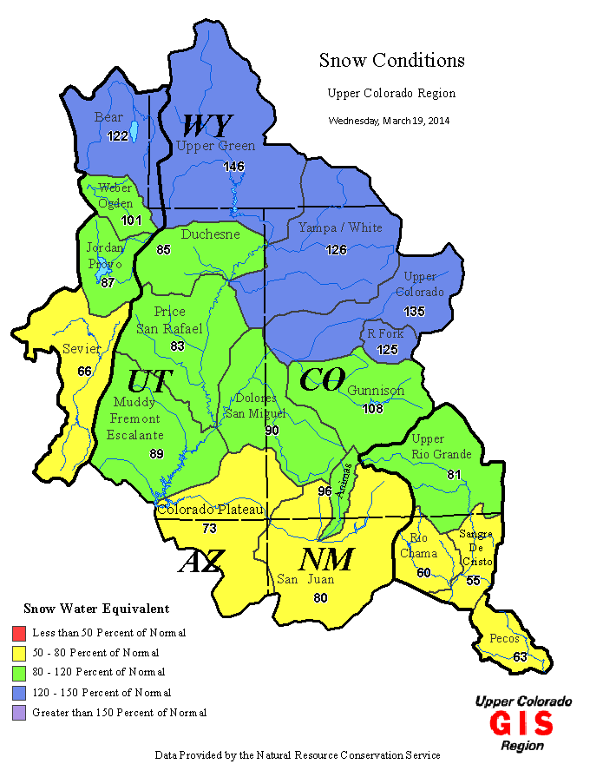
Upper Basin Snowpack as of 3/26/2014
http://www.usbr.gov/uc/water/notice/snowpack.html

Slide 2
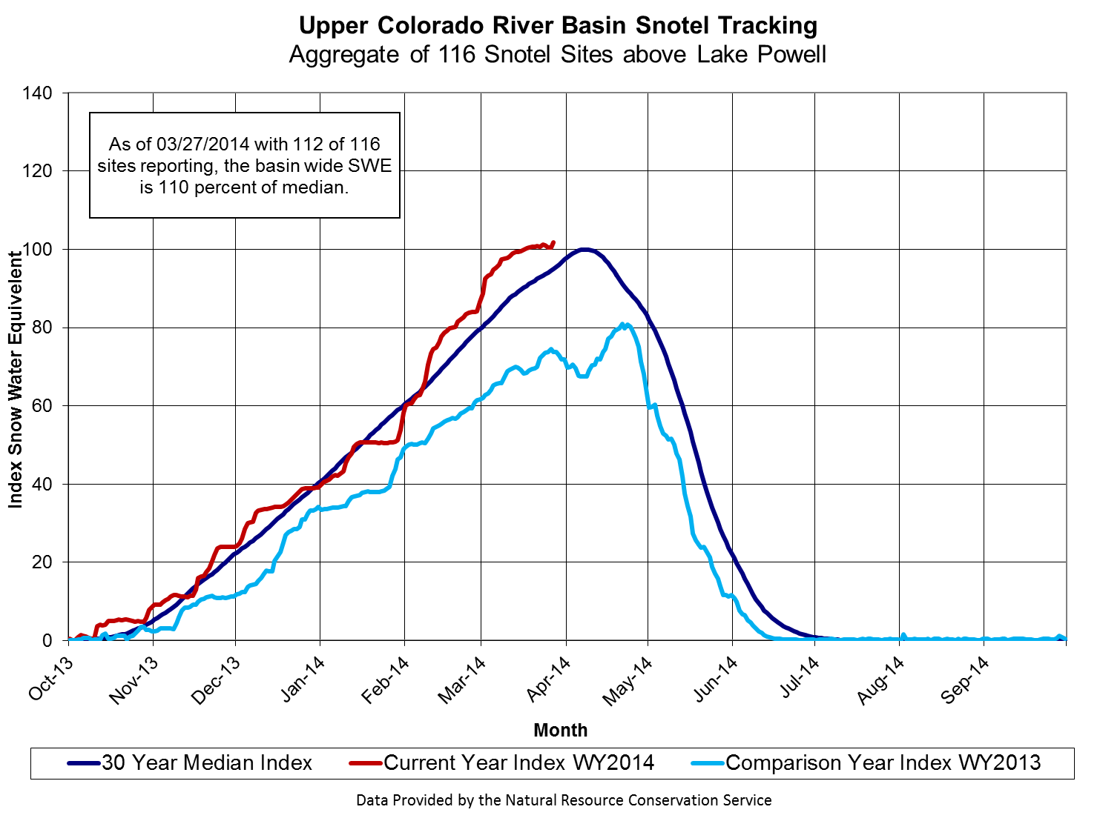
Currently 110% of median
(1981-2010)
http://www.usbr.gov/uc/water/notice/Graphs/Upper_Colorado.html
Notes:
NRCS updated to 1981-2010 (new 30 year record) and also to % of median instead of % of average.. Not a significant change to the statistics, when comparing % of average versus % of median. The shape of the index looks very similar. Peak is now April 8 instead of April 9. The raw values are different (2055.7 in for average ’71-’00 and 1874.9 in for median ‘81-’00: computed as sum for all 116 locations, average/median for the day over 30-year timeperiod, )

Slide 3
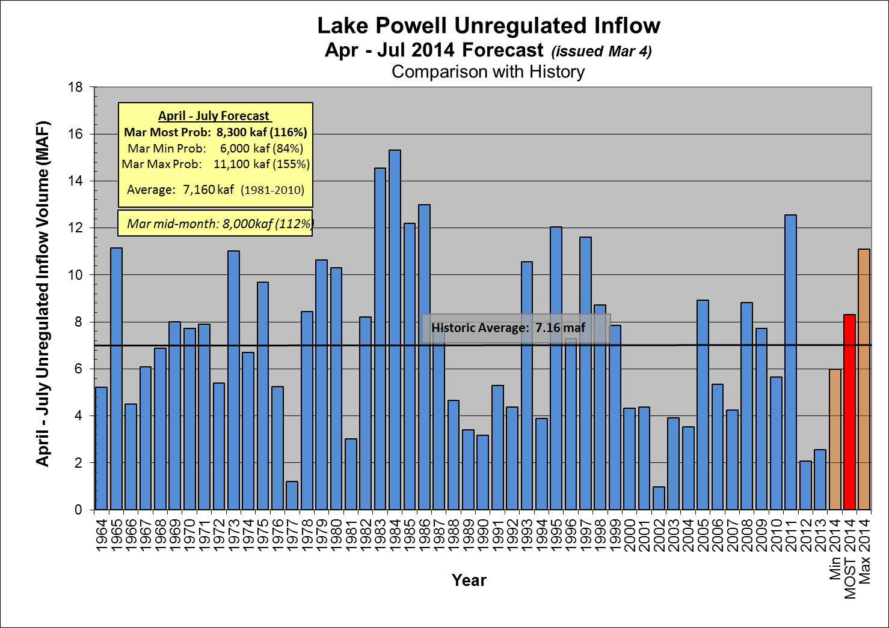

Slide 4
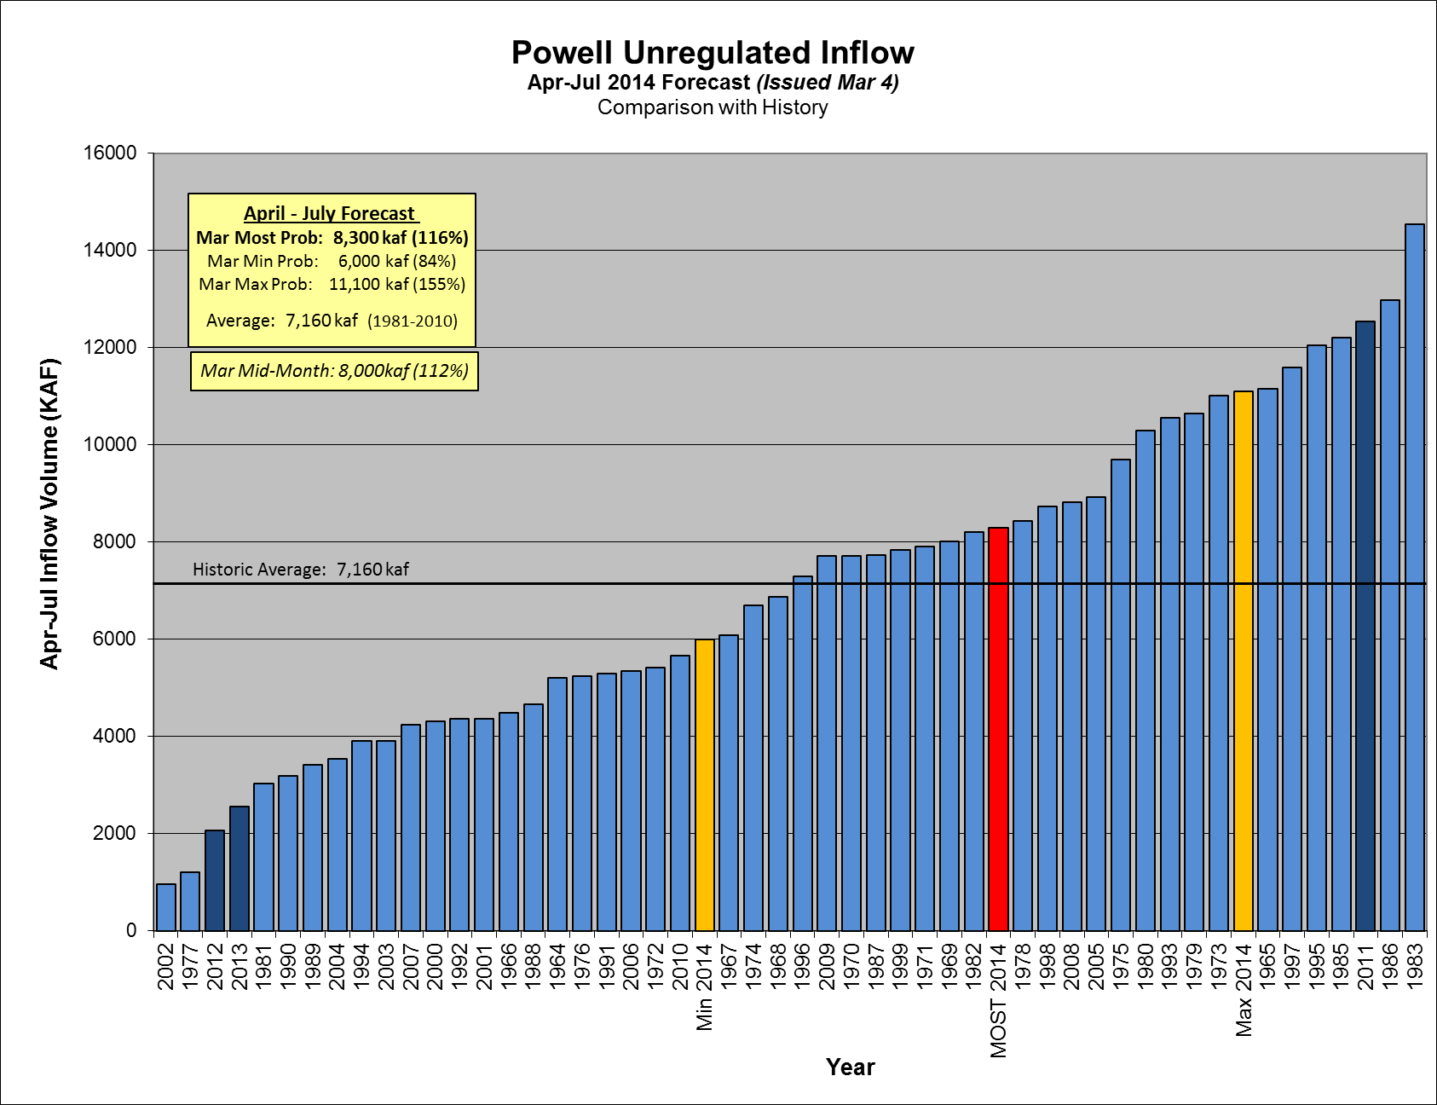
Notes:
Water Year forecast has had a slight decrease (94% to 93%) since December
Last year (2013) April to July forecast was 25% - 61% - 108%
Incrase from Jan to Feb 2104: 440kaf (95% to 101%)

Slide 5
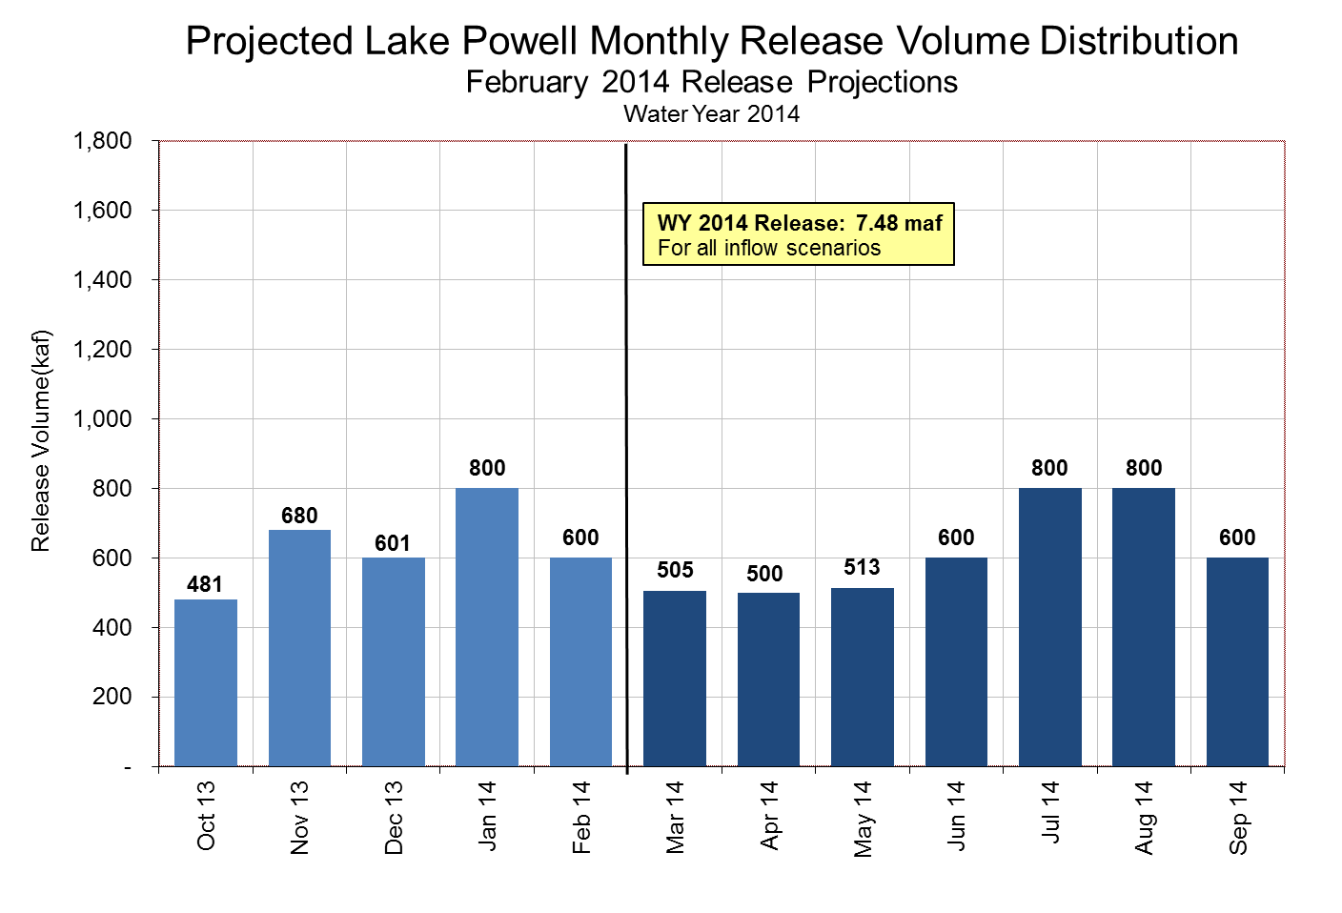

Slide 6
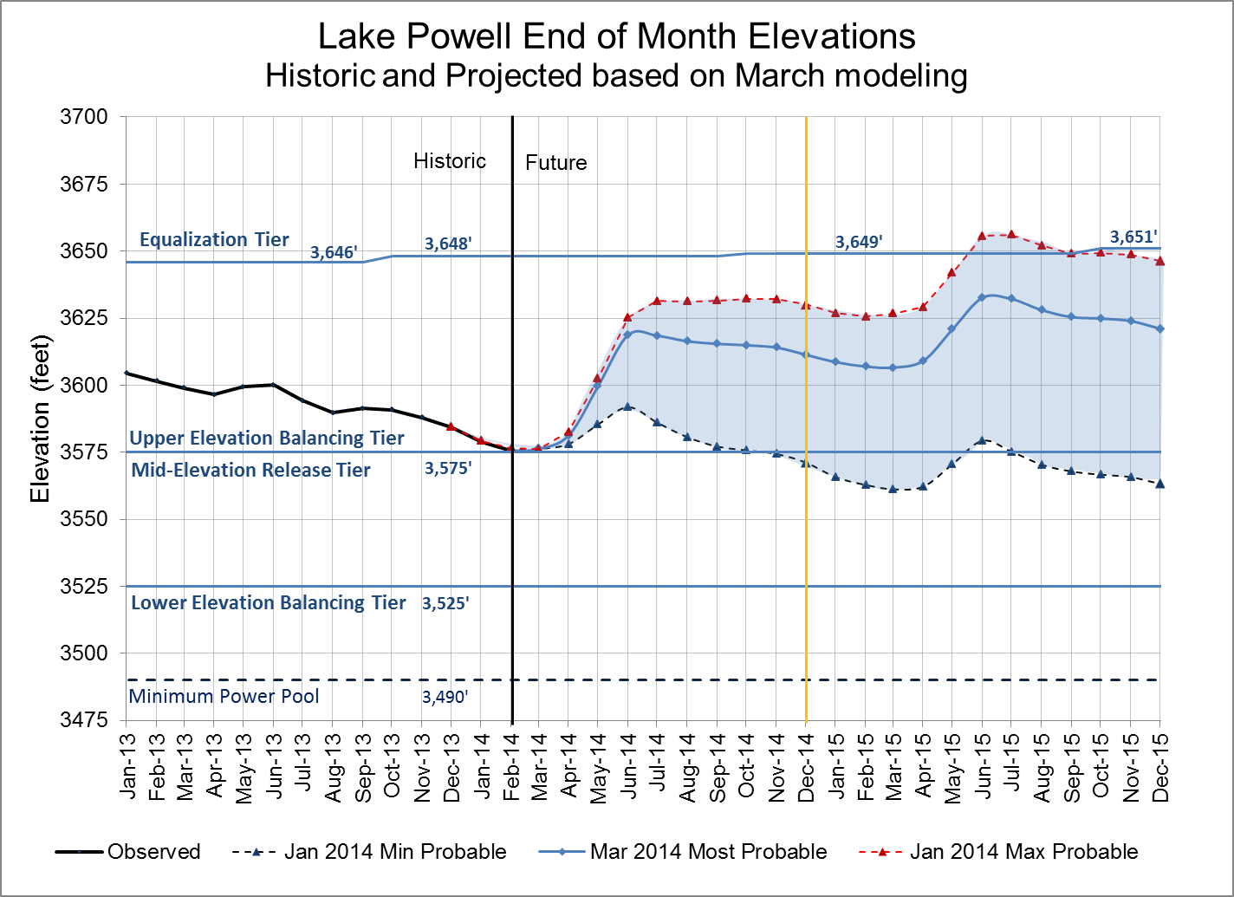
Water Year 2015 projections
Most = 9.0 maf release
Max = ~11 maf release
Min = 7.48 maf release
Notes:
Excel file: U:\1_Powell Ops\5_Spreadsheets\24 Month Study Data\Powell_Projected_Ele_Nov2012.xlsx
65% chance releases will be greater than 8.23 in WY 2014 (3% of another 7.48maf)

Slide 7
Glen Canyon Power Plant Provisional Unit Outage Schedule for Water Year 2014
Unit Number | Oct 2013 | Nov 2013 | Dec 2013 | Jan 2014 | Feb 2014 | Mar 2014 | Apr 2014 | May 2014 | Jun 2014 | Jul 2014 | Aug 2014 | Sep 2014
1
2
3
4
5
6
7
8
Units Available | 5 |  | 6 | 6 |  |  | 6 |  | 6 | 6 |  | 4
Capacity (cfs) | 14,200 |  | 18,000 | 17,900 |  |  | 16,600 |  | 16,600 | 16,600 |  | 10,300
Capacity (kaf/month) | 900 | 1040 | 1120 | 1100 | 750 | 850 | 950 | 940 | 990 | 1020 | 840 | 800
Max (kaf) ¹ | -- | -- | -- | -- | 600 | 505 | 500 | 513 | 600 | 800 | 800 | 600
Most (kaf) ¹ | 481 | 680 | 601 | 800 | 600 | 505 | 500 | 513 | 600 | 800 | 800 | 600
Min (kaf) ¹ | -- | -- | -- | -- | 600 | 505 | 500 | 513 | 600 | 800 | 800 | 600
6
5
4
5
6
5
4
6
6
4
20,000
13,600
10,300
13,600
16,600
14,300
10,300
16,600
16,600
10,300
7.48
Projected release, based on Feb 2014 Inflow Projections and 24-Month Study model runs
(updated 2-13-2014)
Notes:
Annuals 2014
Annual 5-6 start 10/14/2013 finish 11/01/2013
Annual 7-8 start 02/03/2014 finish 02/21/2014 Includes Digital Governor Replacement
Annual 3-4 start 02/24/2014 finish 03/14/2014 Includes Digital Governor Replacement
Annual 4 start 04/28/2014 finish 05/15/2014 Fixed Wheel Gate 8 Year
Annual 1-2 start 09/01/2014 finish 09/19/2014 Includes Digital Governor Replacement
Annual 5-6 start 09/22/2013 finish 10/10/2013 Includes Digital Governor Replacement
Replacements 2014
Unit 3 start 09/23/2013 finish 06/27/2014 Turbine Runner Replacement
Unit 6 start 04/01/2014 finish 04/03/2015 Generator Rebuild
Unit 2 start 07/01/2014 finish 04/06/2015 Turbine Runner Replacement

Slide 8
Glen Canyon Power Plant Provisional Unit Outage Schedule for Water Year 2015
Unit Number | Oct 2014 | Nov 2014 | Dec 2014 | Jan 2015 | Feb 2015 | Mar 2015 | Apr 2015 | May 2015 | Jun 2015 | Jul 2015 | Aug 2015 | Sep 2015
1
2
3
4
5
6
7
8
Units Available | 4 | 6 | 6 | 6 | 4 |  | 6 |  | 6 | 6 | 6 | 6
Capacity (cfs) | 10,300 | 16,800 | 16,800 | 16,800 | 10,300 |  | 17,100 |  | 17,100 | 17,100 | 17,100 | 17,100
Capacity (kaf/month) | 1020 | 1060 | 1040 | 1040 | 1020 | 860 | 1000 | 920 | 1000 | 1040 | 1080 | 1100
Max (kaf) ¹ | 600 | 600 | 800 | 950 | 700 | 700 | 900 | 1100 | 1150 | 1250 | 1250 | 955
Most (kaf) ² | 600 | 600 | 800 | 800 | 650 | 650 | 600 | 650 | 800 | 1000 | 1050 | 800
Min (kaf) ¹ | 480 | 500 | 600 | 800 | 600 | 600 | 500 | 600 | 600 | 800 | 800 | 600
4
6
6
5
10,600
17,100
16,800
13,900
11.0
9.0
7.48
Projected release, based on Jan 2014 Min and Max Probable Inflow Projections and 24-Month Study model runs
Projected release, based on Feb 2014 Most Probable Inflow Projections and 24-Month Study model runs
(updated 2-13-2014)
Notes:
Annuals 2014
Annual 5-6 start 10/14/2013 finish 11/01/2013
Annual 7-8 start 02/03/2014 finish 02/21/2014 Includes Digital Governor Replacement
Annual 3-4 start 02/24/2014 finish 03/14/2014 Includes Digital Governor Replacement
Annual 4 start 04/28/2014 finish 05/15/2014 Fixed Wheel Gate 8 Year
Annual 1-2 start 09/01/2014 finish 09/19/2014 Includes Digital Governor Replacement
Annual 5-6 start 09/22/2013 finish 10/10/2013 Includes Digital Governor Replacement
Replacements 2014
Unit 3 start 09/23/2013 finish 06/27/2014 Turbine Runner Replacement
Unit 6 start 04/01/2014 finish 04/03/2015 Generator Rebuild
Unit 2 start 07/01/2014 finish 04/06/2015 Turbine Runner Replacement

Slide 9
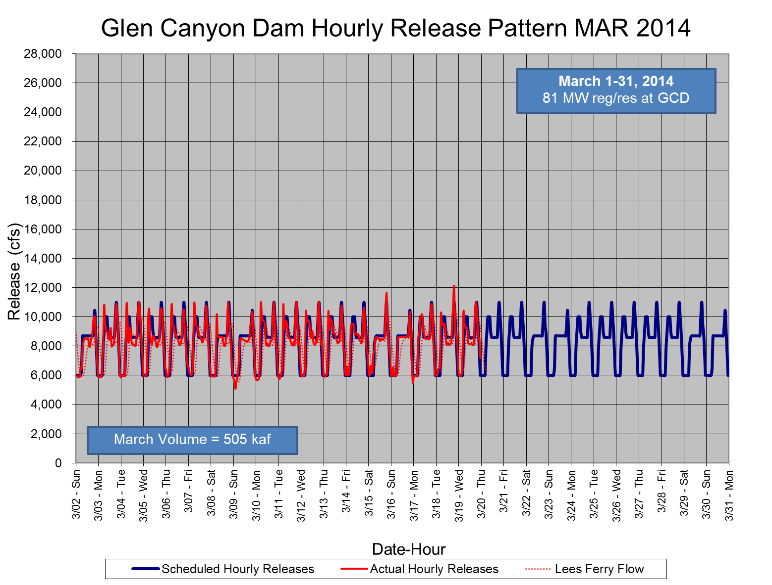

Slide 10
