Slide 1
USBR Updates:
Green River
CRFS Meeting March 26, 2015

Slide 2
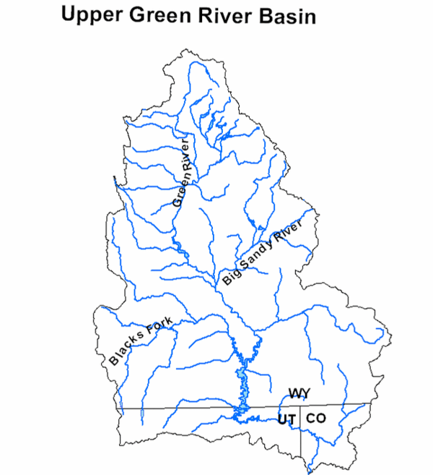
Green River Operations
Fontenelle
Flaming Gorge

Slide 3
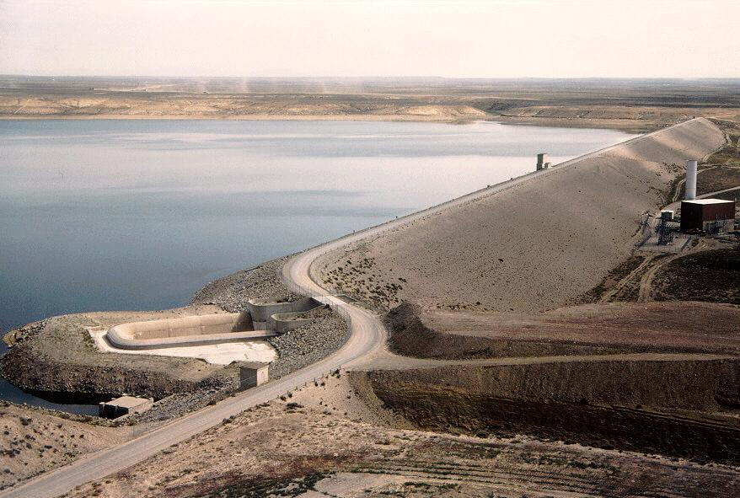
Fontenelle Operations

Slide 4
Fontenelle
Storage
Live Capacity 345,000 AF
Capacity on 3/25/15 199,063 AF
(58% full) high for March
Pool Elevation
Reservoir Elev. (Min) 6463.00 feet
Elevation on 3/25/15 6485.66 feet
Elevation above (Min) 22.70 feet
Inflow and Release
Average Inflow 1,437 cfs
Average Release 1,250 cfs

Slide 5
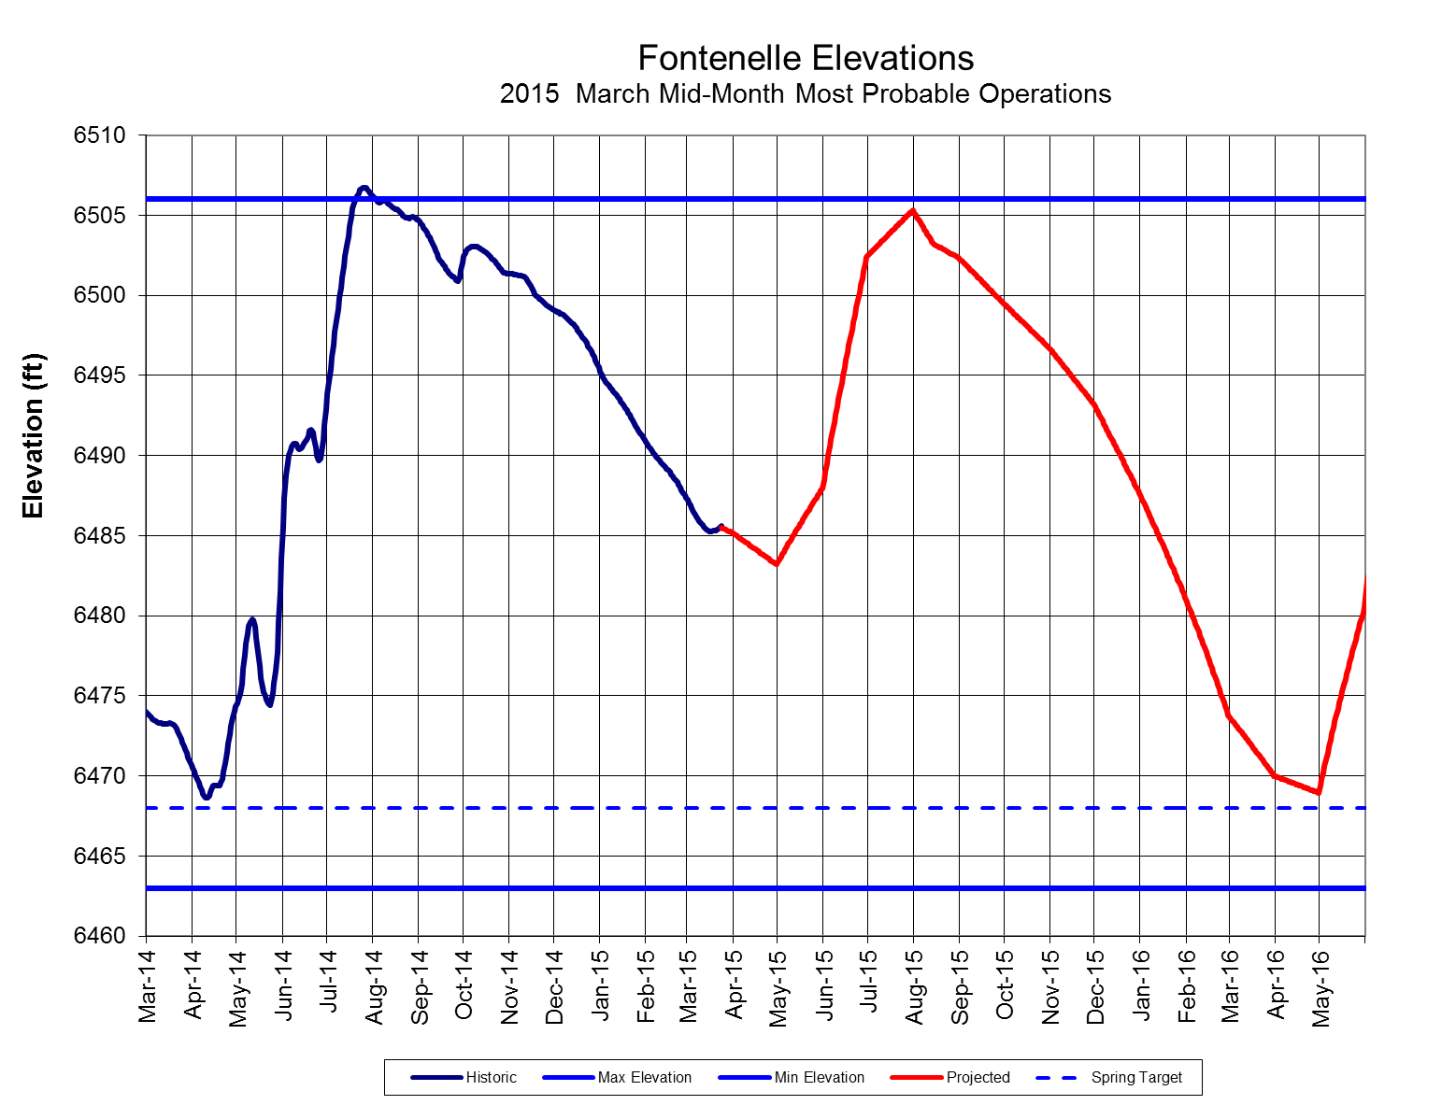
Fontenelle Reservoir Elevation
Notes:
Go to P:\FontenelleOps\FontenelleDailyOps.xls to get most recent plot

Slide 6
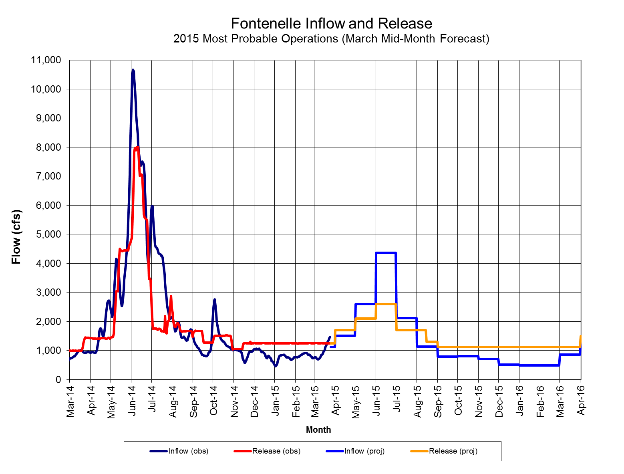
Fontenelle Inflow and Release
2014 Apr – Jul Inflow
1,020 KAF (141%)
2015 Apr – Jul Inflow
640 KAF (88%)
2015 Projected releases between 1,700-2,600 cfs over summer
Notes:
Go to P:\FontenelleOps\FontenelleDailyOps.xls to get most recent plot

Slide 7
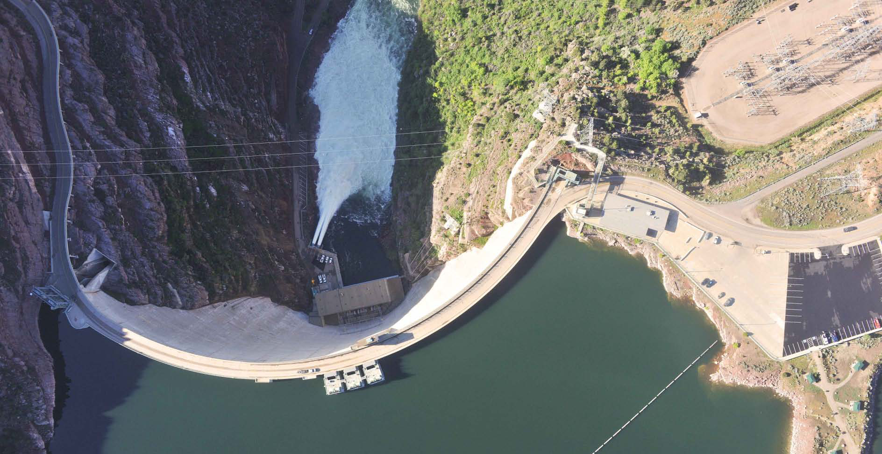
Flaming Gorge Operations

Slide 8
Flaming Gorge
Live Capacity 3.752 MAF
Capacity on 3/25/15 3.180 MAF
Available Space .572 MAF
(85% full)
Reservoir Elev. 6040.00 feet
Elevation on 3/25/15 6025.51 feet
Elevation below (Full) 14.49 feet
Average Inflow 1,290 cfs
Average Release 2,000 cfs

Slide 9
Upper Green Classifications

Slide 10
Yampa River Classifications

Slide 11
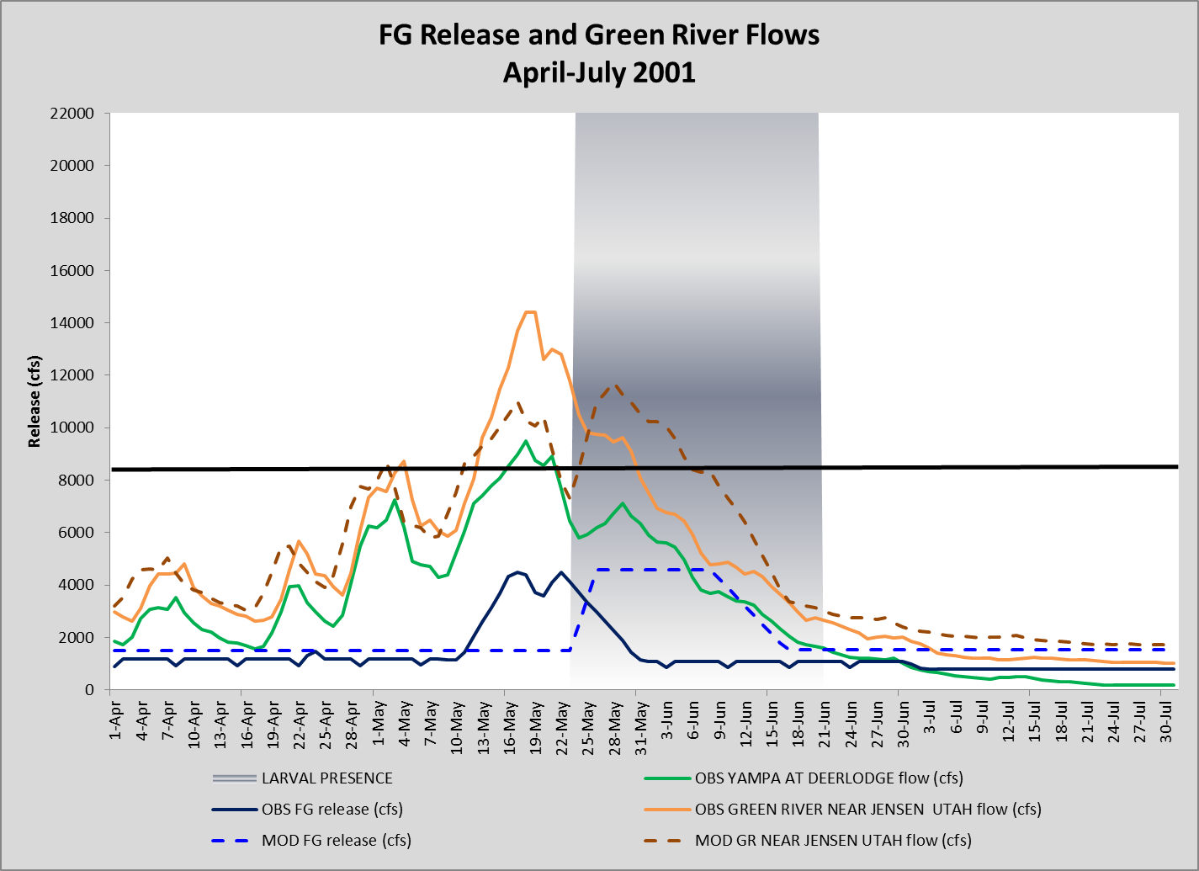
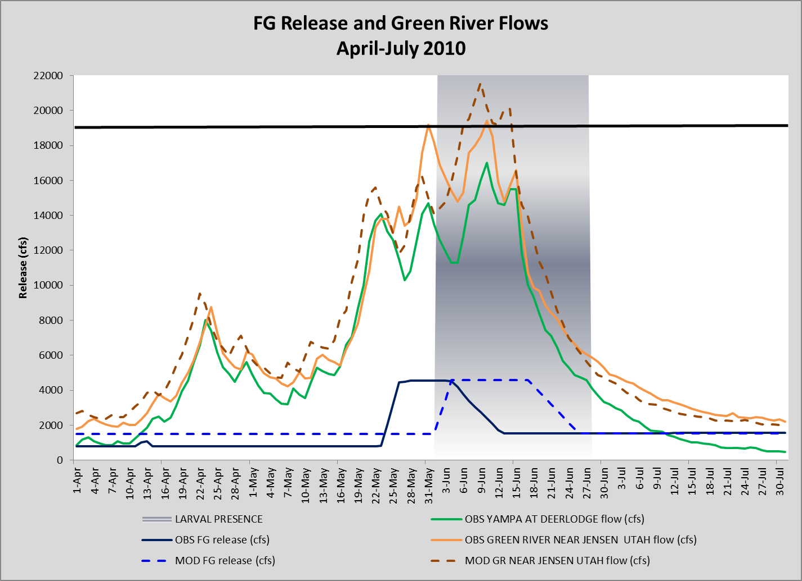
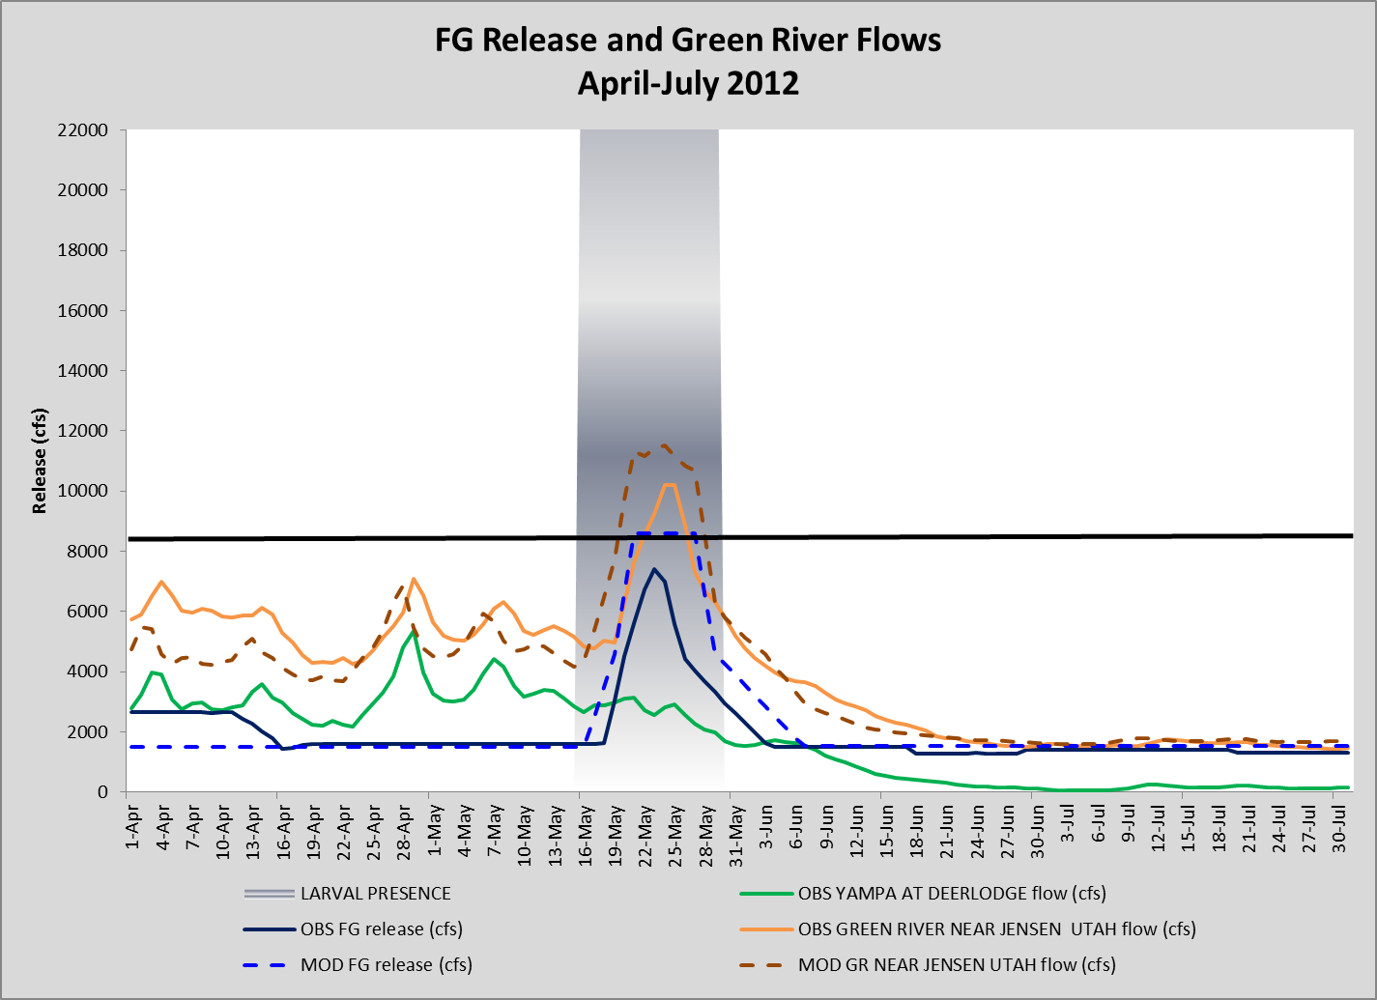
Spring 2015 Hydrograph

