Slide 1
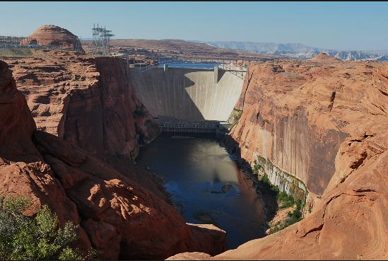
Lake Powell Operations
CRFS Spring 2015 March 25, 2015

Slide 2
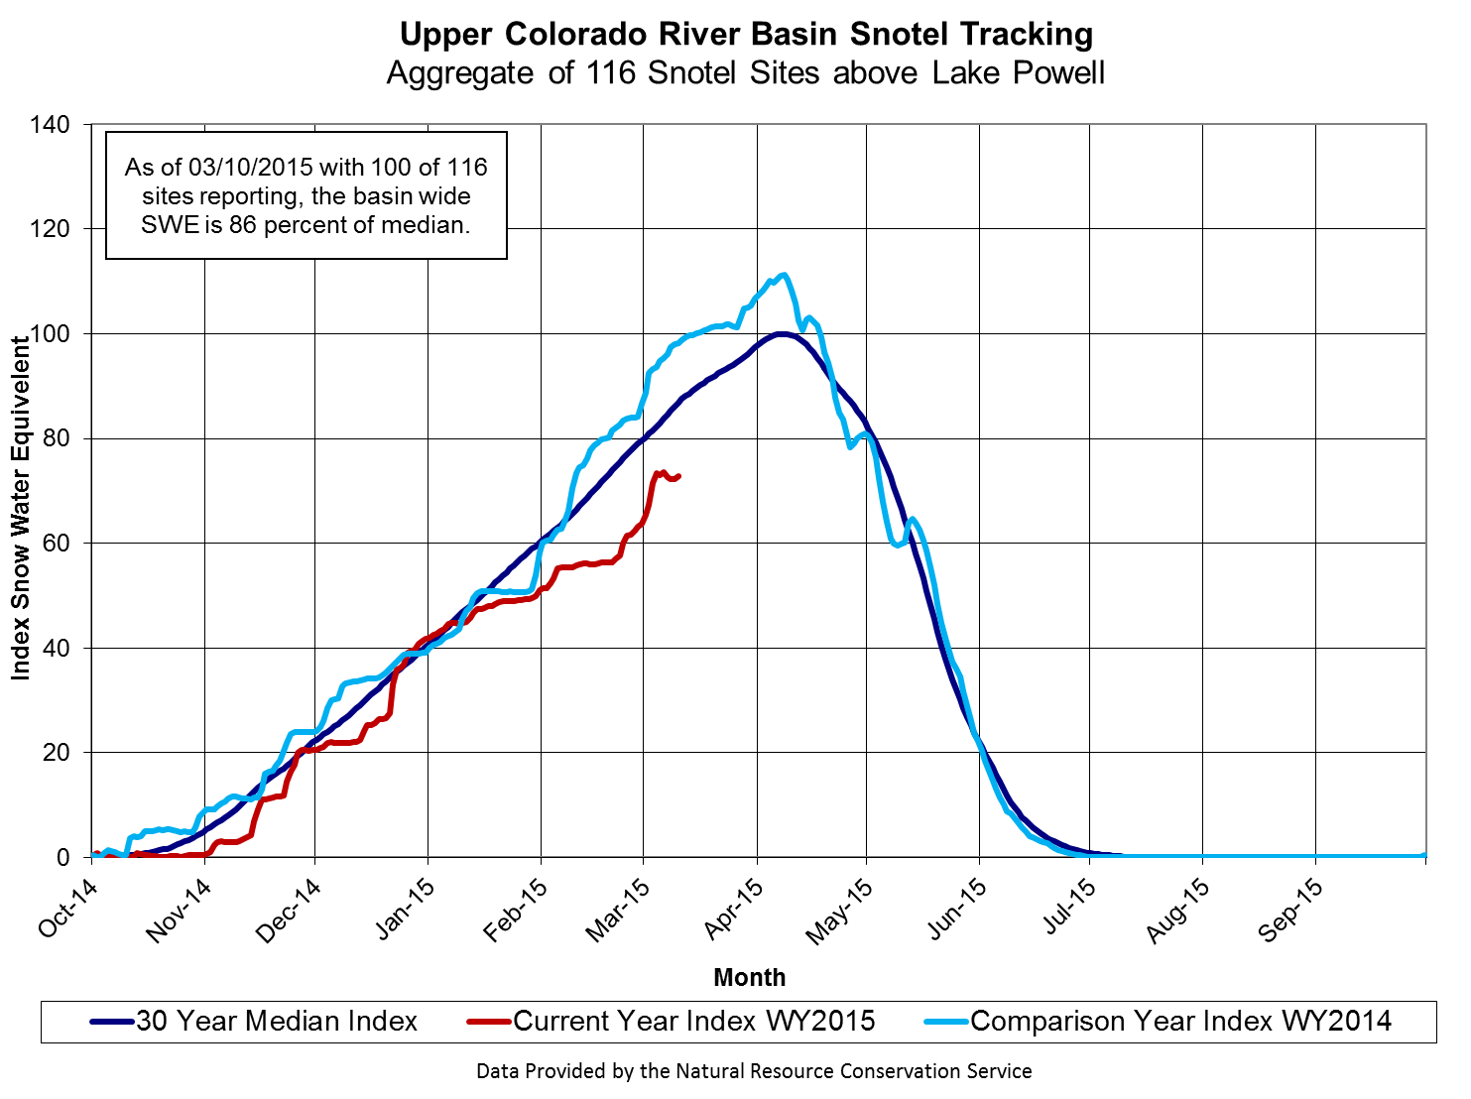
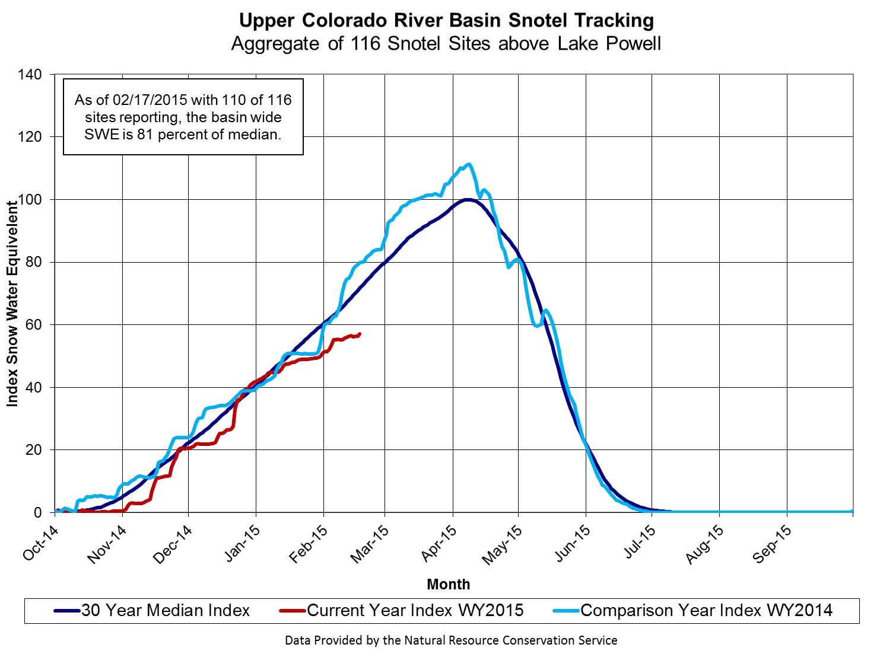
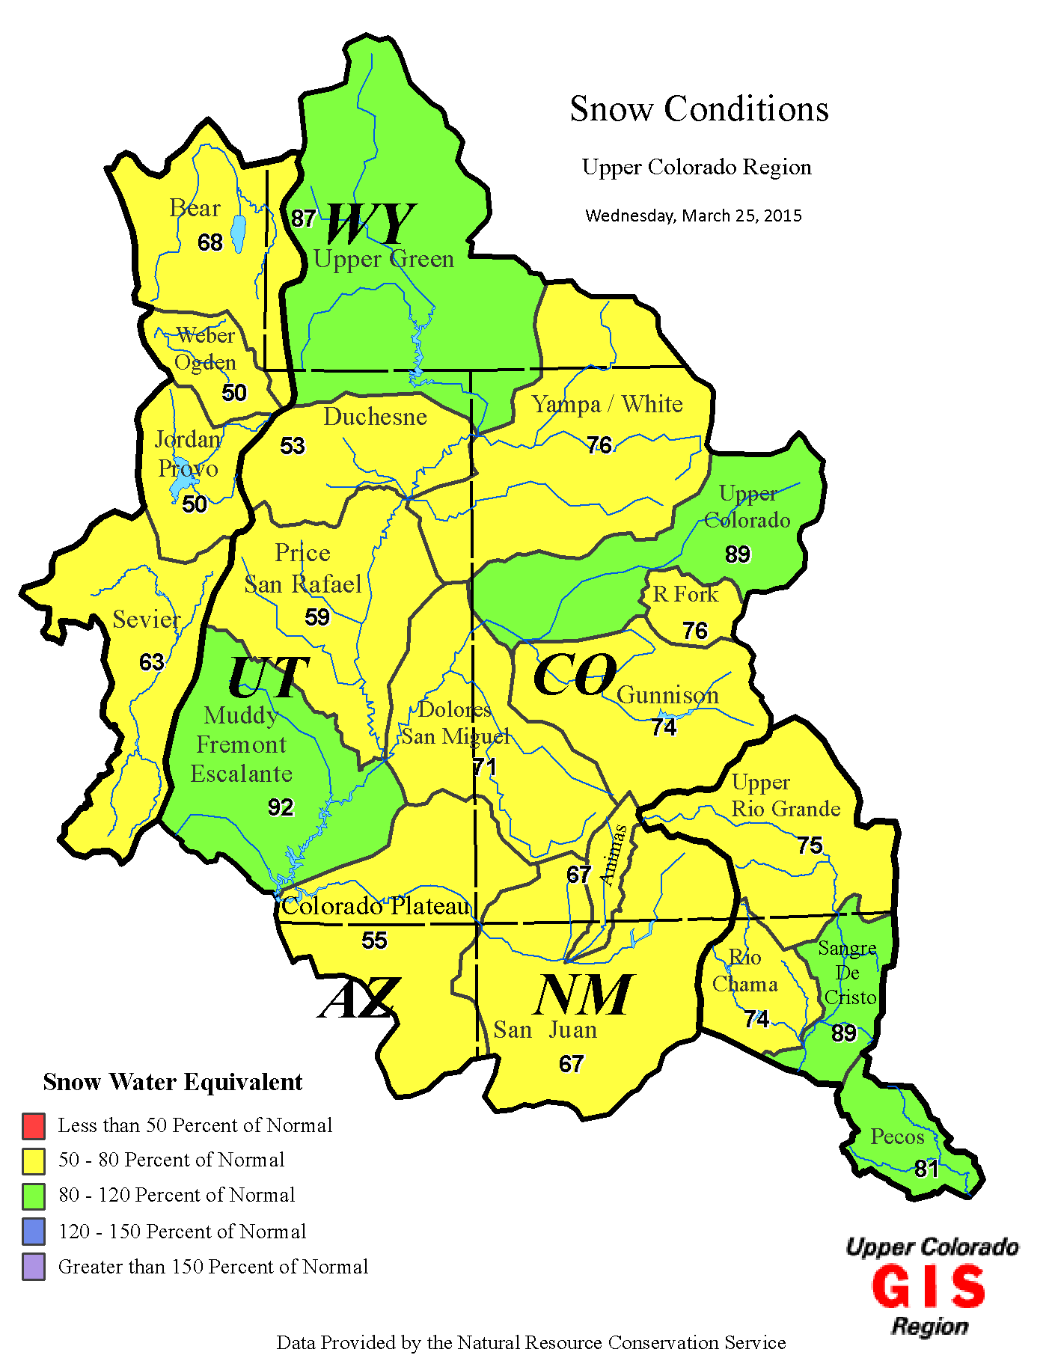
Snow Conditions

Slide 3
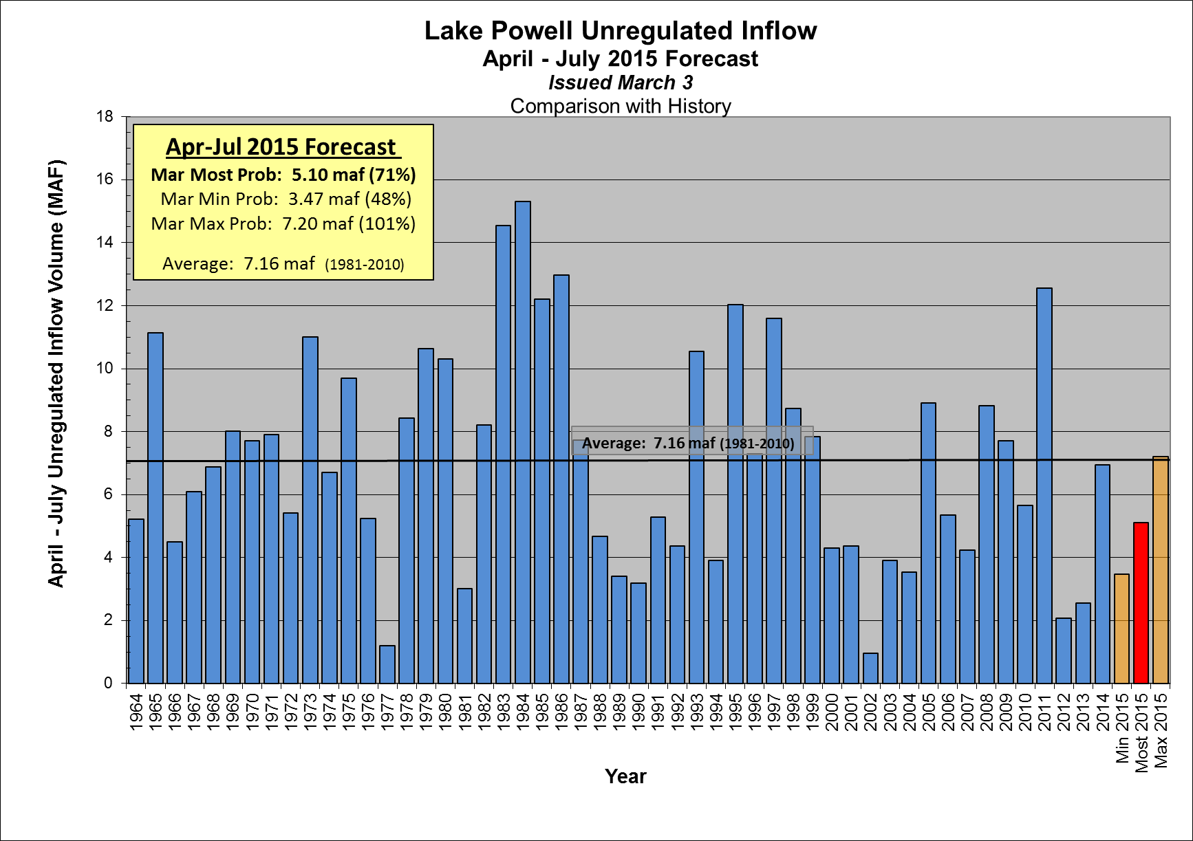
Mar Mid-Month: 4.85 maf (68%)

Slide 4
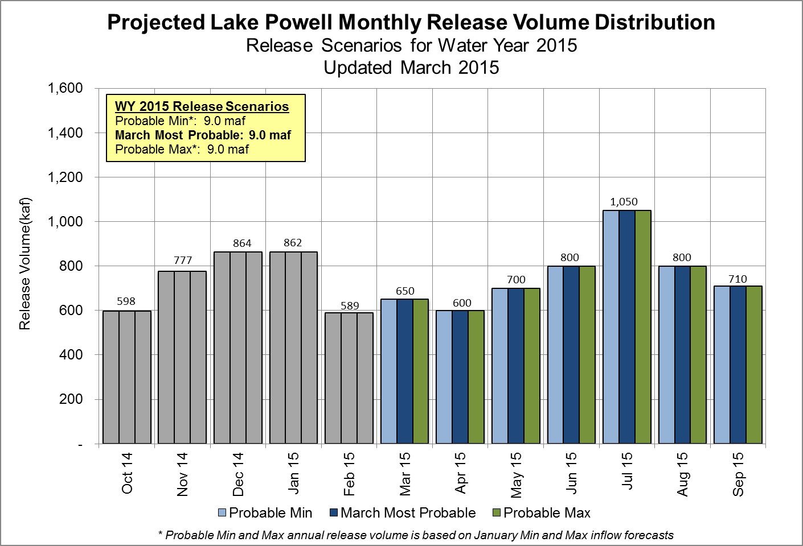

Slide 5
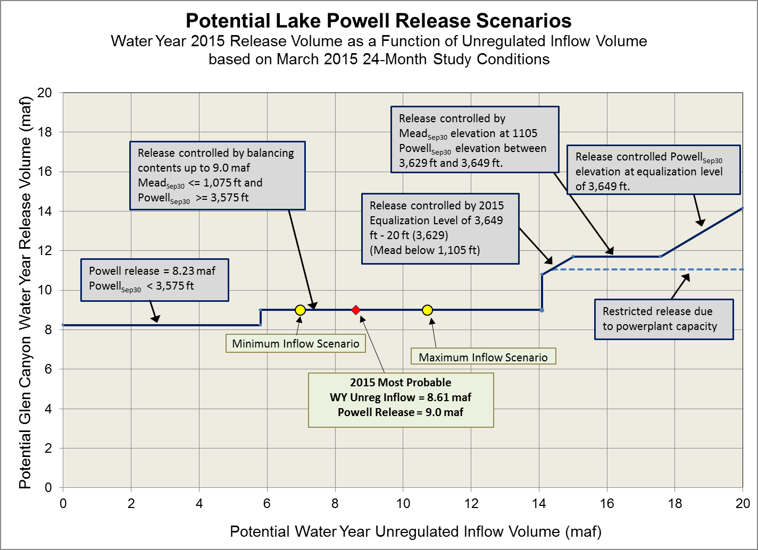
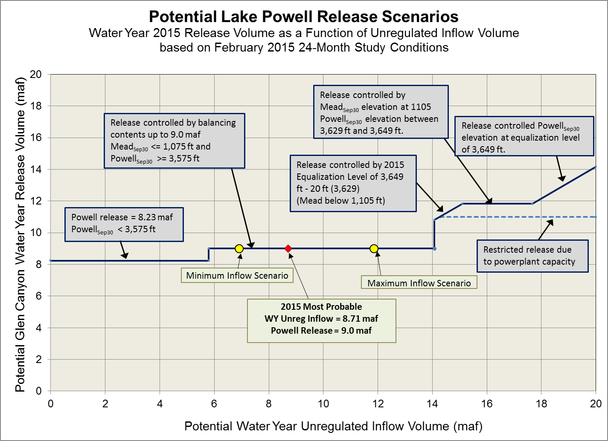

Slide 6
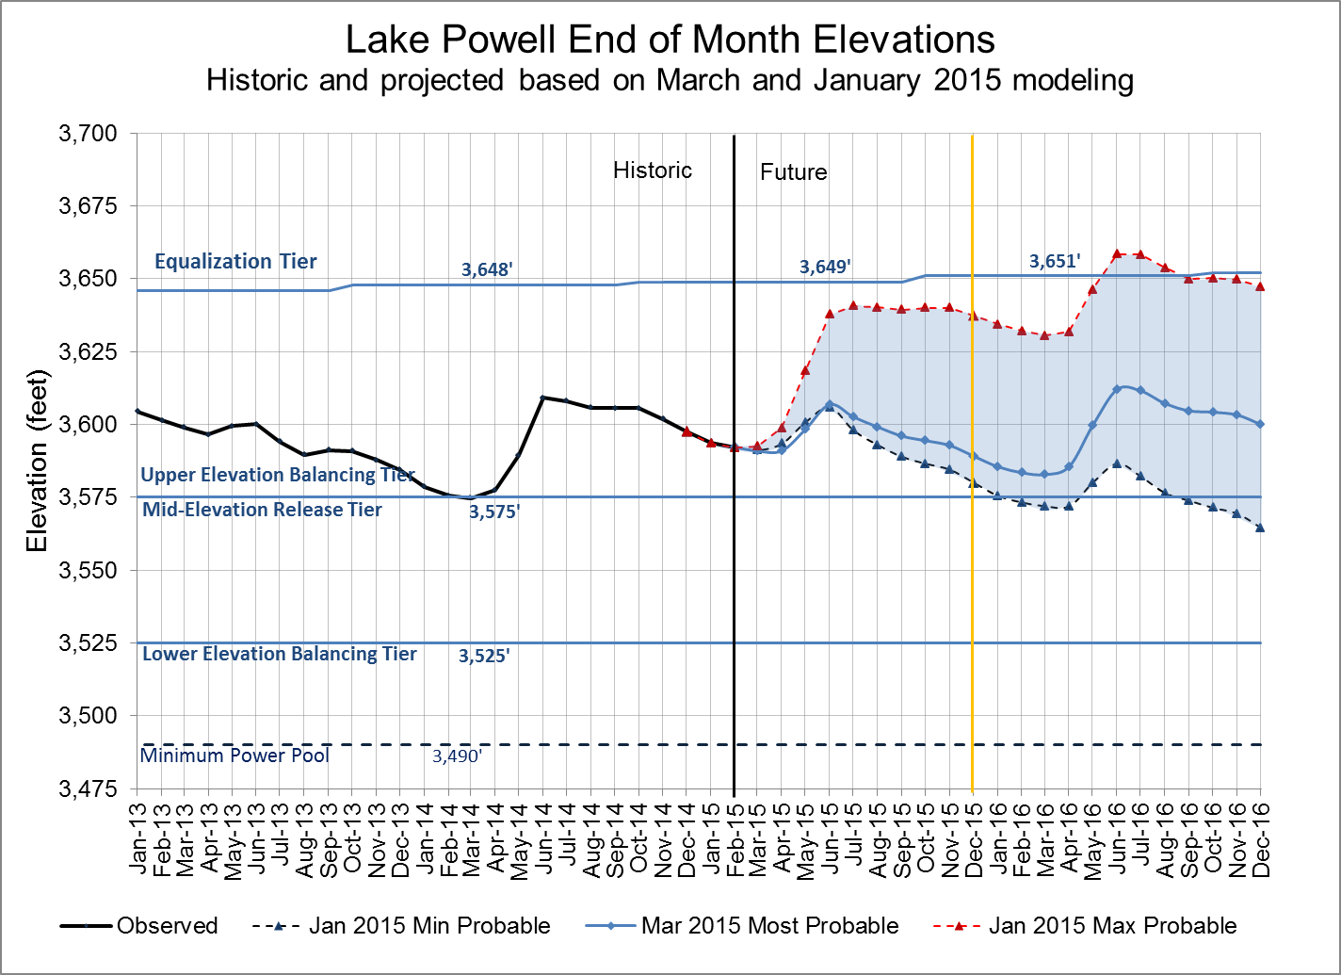
Water Year 2015 projections
Most: 9.0 maf release
Max: 9.0 maf release
Min: 9.0 maf release
Notes:
Excel file: U:\1_Powell Ops\5_Spreadsheets\24 Month Study Data\Powell_Projected_Ele_Nov2012.xlsx

Slide 7
Glen Canyon Power Plant Provisional Unit Outage Schedule for Water Year 2015
Unit Number | Oct 2014 | Nov 2014 | Dec 2014 | Jan 2015 | Feb 2015 | Mar 2015 | Apr 2015 | May 2015 | Jun 2015 | Jul 2015 | Aug 2015 | Sep 2015
1
2
3
4
5
6
7
8
Units Available | 5 | 7 | 6 | 6 |  |  | 6 |  | 6 | 7 | 6 | 6
Capacity (cfs) | 14,400 | 21,500 | 18,000 | 18,000 |  |  | 18,000 |  | 18,000 | 21,400 | 17,700 | 17,700
Capacity (kaf/month) | 910 | 1,280 | 1,110 | 1,110 | 690 | 750 | 1,070 | 980 | 1,070 | 1,320 | 1,110 | 1,060
Max (kaf) ¹ | -- | -- | -- | -- | -- | 650 | 600 | 700 | 800 | 1,050 | 800 | 710
Most (kaf) ² | 598 | 776 | 864 | 862 | 589 | 650 | 600 | 700 | 800 | 1,050 | 800 | 710
Min (kaf) ¹ | -- | -- | -- | -- | -- | 650 | 600 | 700 | 800 | 1,050 | 800 | 710
4
4
6
6
6
5
11,400
11,300
18,000
18,000
18,000
14,500
9.0
9.0
9.0
Projected release, based on January 2015 Min and Max Probable Inflow Projections and 24-Month Study model runs
Projected release, based on March 2015 Most Probable Inflow Projections and 24-Month Study model runs
(updated 3-17-2015)
Notes:
Annuals 2014
Annual 5-6 start 10/14/2013 finish 11/01/2013
Annual 7-8 start 02/03/2014 finish 02/21/2014 Includes Digital Governor Replacement
Annual 3-4 start 02/24/2014 finish 03/14/2014 Includes Digital Governor Replacement
Annual 4 start 04/28/2014 finish 05/15/2014 Fixed Wheel Gate 8 Year
Annual 1-2 start 09/01/2014 finish 09/19/2014 Includes Digital Governor Replacement
Annual 5-6 start 09/22/2013 finish 10/10/2013 Includes Digital Governor Replacement
Replacements 2014
Unit 3 start 09/23/2013 finish 06/27/2014 Turbine Runner Replacement
Unit 6 start 04/01/2014 finish 04/03/2015 Generator Rebuild
Unit 2 start 07/01/2014 finish 04/06/2015 Turbine Runner Replacement

Slide 8
Glen Canyon Power Plant Provisional Unit Outage Schedule for Water Year 2016
Unit Number | Oct 2015 | Nov 2015 | Dec 2015 | Jan 2016 | Feb 2016 | Mar 2016 | Apr 2016 | May 2016 | Jun 2016 | Jul 2016 | Aug 2016 | Sep 2016
1
2
3
4
5
6
7
8
Units Available | 5 | 7 | 7 | 7 | 5 | 5 | 7 | 7 | 7 | 7 | 7 | 5
Capacity (cfs) | 14,500 | 21,200 | 21,200 | 21,200 | 14,900 | 14,500 | 21,500 | 21,500 | 21,500 | 21,400 | 21,400 | 14,300
Capacity (kaf/month) | 900 | 1,260 | 1,260 | 1,250 | 880 | 940 | 1,280 | 1,280 | 1,290 | 1,270 | 1,270 | 940
Max (kaf) ¹ | 600 | 600 | 850 | 950 | 800 | 900 | 1,000 | 1,100 | 1,200 | 1,300 | 1,300 | 1,061
Most (kaf) ² | 600 | 600 | 800 | 800 | 650 | 650 | 600 | 650 | 800 | 1,000 | 1,050 | 800
Min (kaf) ¹ | 600 | 600 | 800 | 800 | 600 | 600 | 600 | 600 | 650 | 850 | 900 | 630
11.7
9.0
8.23
Projected release, based on January 2015 Min and Max Probable Inflow Projections and 24-Month Study model runs
Projected release, based on March 2015 Most Probable Inflow Projections and 24-Month Study model runs
(updated 3-17-2015)
Notes:
Annuals 2014
Annual 5-6 start 10/14/2013 finish 11/01/2013
Annual 7-8 start 02/03/2014 finish 02/21/2014 Includes Digital Governor Replacement
Annual 3-4 start 02/24/2014 finish 03/14/2014 Includes Digital Governor Replacement
Annual 4 start 04/28/2014 finish 05/15/2014 Fixed Wheel Gate 8 Year
Annual 1-2 start 09/01/2014 finish 09/19/2014 Includes Digital Governor Replacement
Annual 5-6 start 09/22/2013 finish 10/10/2013 Includes Digital Governor Replacement
Replacements 2014
Unit 3 start 09/23/2013 finish 06/27/2014 Turbine Runner Replacement
Unit 6 start 04/01/2014 finish 04/03/2015 Generator Rebuild
Unit 2 start 07/01/2014 finish 04/06/2015 Turbine Runner Replacement

Slide 10
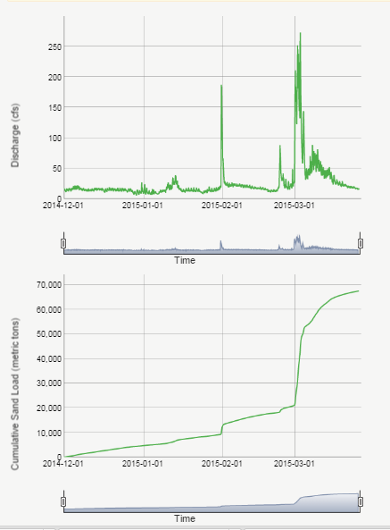
Sediment Conditions As of 3-35-2015
Paria River Discharge Dec 1 though Mar 25
HFE Protocol allows for spring HFEs (March / April) starting in 2015, if sediment inputs are adequate.
Logistics require planning / coordination start 30-days prior to HFE implementation
Currently not enough sediment to support a spring 2015 HFE– highly unlikely to occur.
Paria River Sand Input Dec 1 though Mar 25
Sediment Model Results
Run on 3-17-2015
Have: ~68 ktons (as of 3-25-15)
Need: ~235 ktons (for the smallest HFE)

