Slide 1
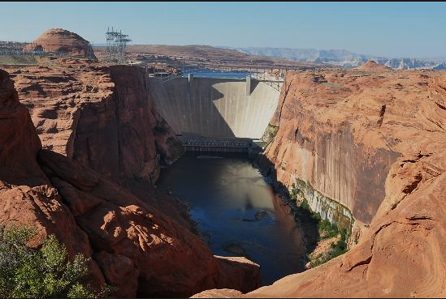
Lake Powell Operations
CRFS Spring 2016 March 15, 2016

Slide 2
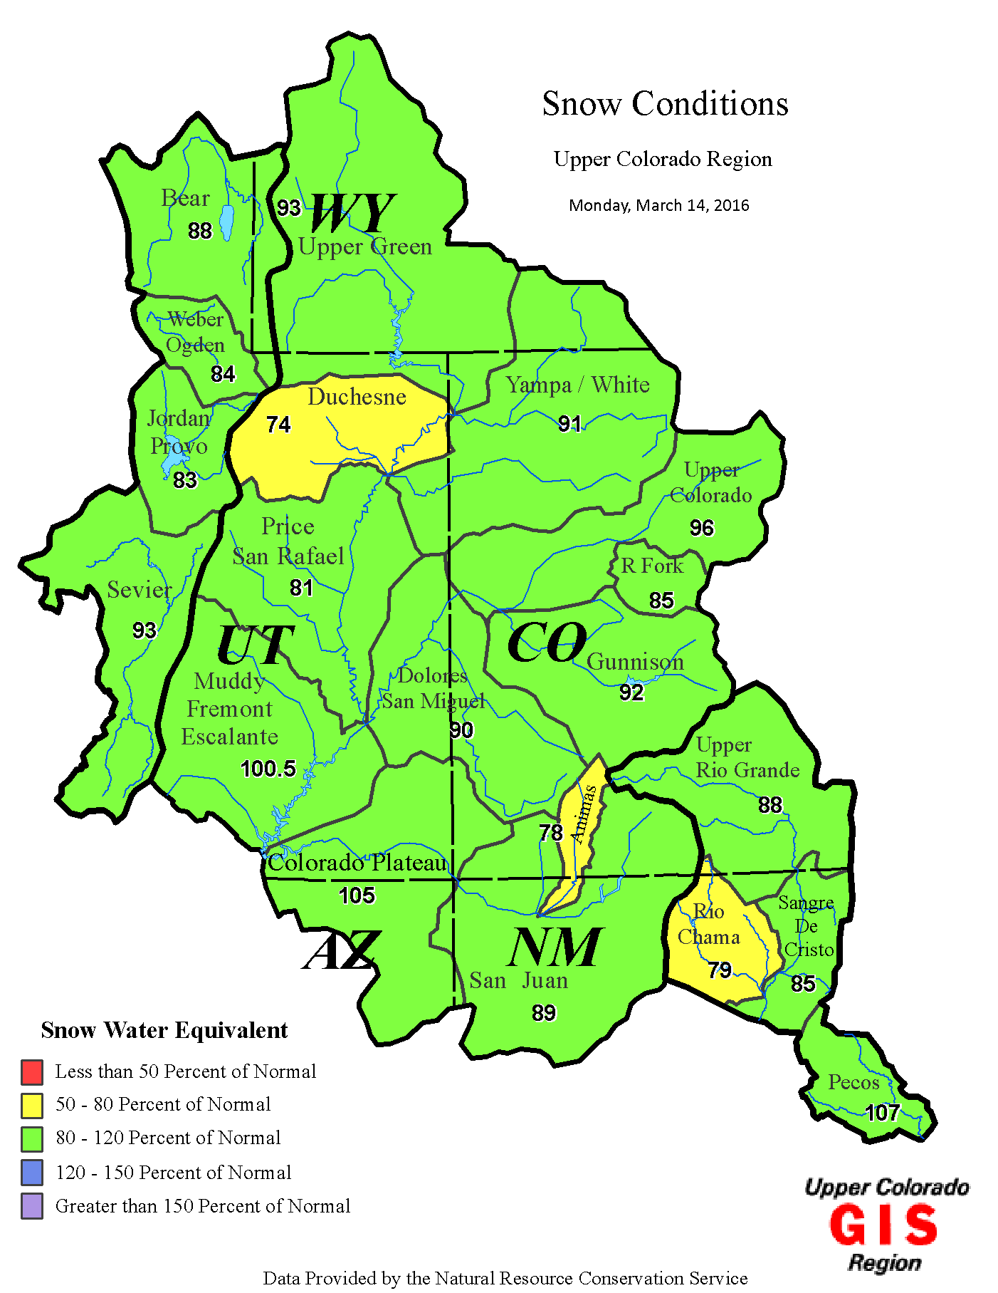
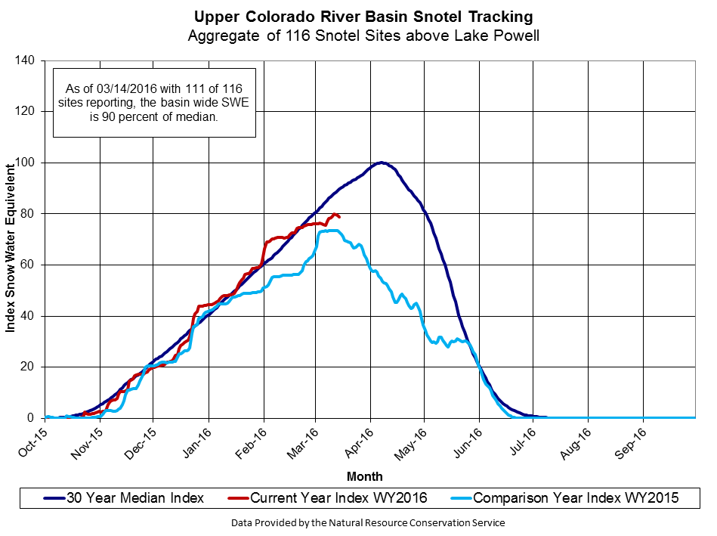
As of 3-14-2016 SWE is 90% of median
79% of total average seasonal accumulation
Notes:
For chart image go to:
T:\WRG\Reservoir Operations\HDB Reports\Basin SnowPack and Precip\Snotel\Snowmap Charts\Upper_Colorado.png

Slide 3
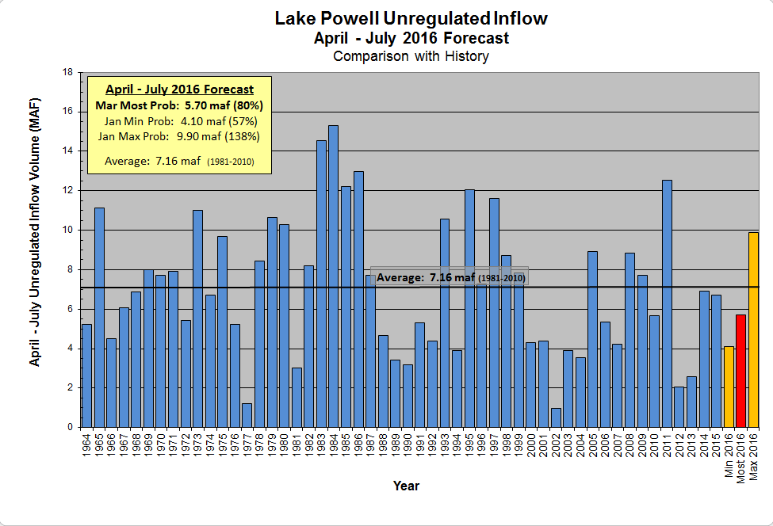
Mid-month: 6.50 maf (91%)
* Water Year 2016 forecast: 9.02 maf (83%)
Notes:
Excel file: T:\WRG\Reservoir Operations\Katrina\1_Powell Ops\3_Ops Spreadsheets\4_Inflow Forecast Graphs\Feb2016-HistoricInflow_forecast.xlsx
*Need to update the mid-month forecast

Slide 4
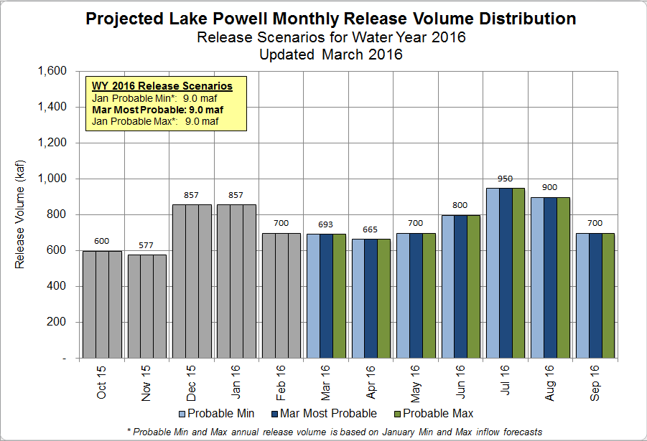
Notes:
Excel file: T:\WRG\Reservoir Operations\Katrina\1_Powell Ops\3_Ops Spreadsheets\3_24 Month Study Data\24MonthStudyDataTool_January2016.xlsx

Slide 5
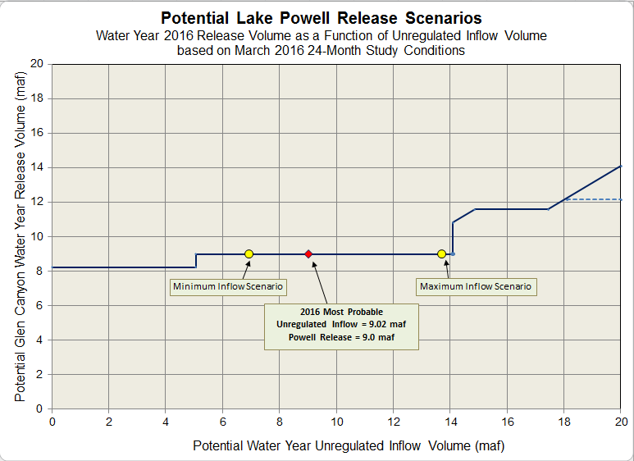
Water Year 2016
Upper Elevation Balancing Tier
Initial release of 8.23 maf
Potential April adjustment to Equalization or Balancing
April adjustment to Equalization releases
April adjustment to Balancing releases
No April Adjustment
Notes:
T:\WRG\Reservoir Operations\Katrina\1_Powell Ops\3_Ops Spreadsheets\3_24 Month Study Data\AOPDistribution_of_Potential_Releases_WY2016_1-19-16.xlsx
Graphic showing what WATER YEAR 2015 total release may be.
This graphic is based on the May min, most, max forecast and the release associated with that APPROXIMATE unregulated inflow volume. This graphic is to help us relate the current forecast to a projected annual release. In reality, it is the observed inflow and the resulting volume in Lake Powell and Lake Mead at the end of the water year that will determine the final total release from Lake Powell.

Slide 6
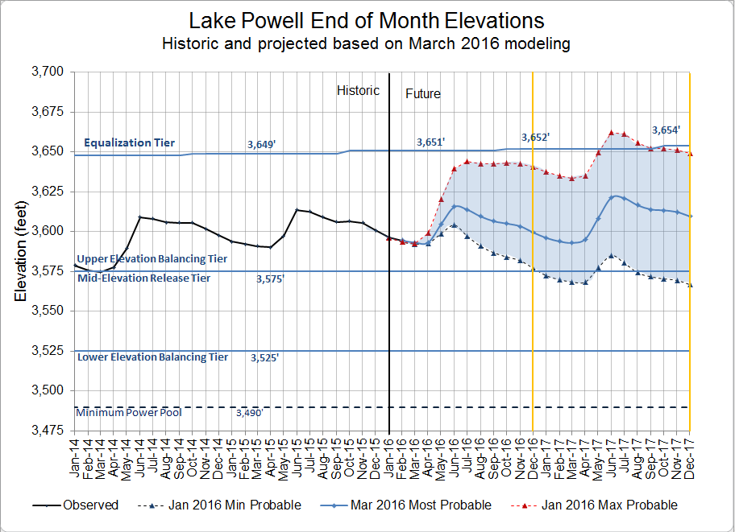
End of CY 2016 Projection:
3,599.51 feet
(Range 3,577 to 3,640 feet)
End of CY 2017 Projection:
3609.50 feet
(Range 3,567 to 3,649 feet)
WY 2016 release projections
Most: 9.0 maf release
Max: 9.0 maf release
Min: 9.0 maf release
Notes:
Excel file: T:\WRG\Reservoir Operations\Katrina\1_Powell Ops\3_Ops Spreadsheets\3_24 Month Study Data\Powell_Projected_Ele_Feb2016.xlsx
End of calendar year 2016 projection for MOST- 3599.51 feet, down from last month’s projection of 3606.66 feet.
MIN/MAX range 3577-3640
End of Calendar year 2017 projection for MOST – 3609.50 feet, down from last month’s projection of 3617.40 feet.
MIN/MAX range 3567-3649
WY 2017 release projections
Most: 9.0 maf release
Max: 11.95 maf release
Min: 8.23 maf release

Slide 7
Glen Canyon Power Plant Provisional Unit Outage Schedule for Water Year 2016
Unit Number | Oct 2015 | Nov 2015 | Dec 2015 | Jan 2016 | Feb 2016 | Mar 2016 | Apr 2016 | May 2016 | Jun 2016 | Jul 2016 | Aug 2016 | Sep 2016
1
2
3
4
5
6
7
8
Units Available | 5 | 7 | 7 | 7 | 5 | 6 | 5 | 6 | 7/5 | 7 | 7 | 5
Capacity (cfs) | 18,400 | 22,100 | 22,100 | 22.100 | 15,500 | 15,300 | 15,300 | 18,800 | 22,10015,300 | 22,100 | 22,100 | 14,900
Capacity (kaf/month) | 1,150 | 1,130 | 1,280 | 1,300 | 950 | 1090 | 970 | 1,140 | 1,140 | 1,310 | 1,310 | 930
Max (kaf) ¹ | -- | -- | -- | -- | 700 | 700 | 658 | 700 | 800 | 950 | 900 | 700
Most (kaf) ² | 600 | 577 | 857 | 857 | 700 | 700 | 658 | 700 | 800 | 950 | 900 | 700
Min (kaf) ¹ | -- | -- | -- | -- | 700 | 700 | 658 | 700 | 800 | 950 | 900 | 700
9.0
9.0
9.0
Projected release, based on January 2016 Min and Max Probable Inflow Projections and 24-Month Study model runs
Projected release, based on March 2016 Most Probable Inflow Projections and 24-Month Study model runs
(updated 3-10-2016)
Notes:
T:\WRG\Reservoir Operations\Katrina\1_Powell Ops\3_Ops Spreadsheets\2_Glen Canyon Maintainance\WY2015-2016_GCD_maintainance_1-19-2016_kag.xlsx
-- Ask Roger to update this about a week before the DOI-DOE Fed Family Call. He puts in the 0’s and 1’s It’s best to send him your most up to date spreadsheet and ask him to update that (otherwise he’ll just use the one he had last month which might not have any changes you made)
-- Also need to update this spreadsheet with the latest Unit Load Test (90% gate opening) – spreadsheet that GCD operators send each month:
T:\WRG\Reservoir Operations\Katrina\1_Powell Ops\3_Ops Spreadsheets\2_Glen Canyon Maintainance\Full Load Capacity 01-2016.xlsx
(also, can use : T:\WRG\Reservoir Operations\Katrina\1_Powell Ops\3_Ops Spreadsheets\2_Glen Canyon Maintainance\CRSP Outage Schedule_01.04.2016 LB.xlsx if Roger isn’t around to update the 0’s and 1’s.)

Slide 8
Glen Canyon Power Plant Provisional Unit Outage Schedule for Water Year 2017
Unit Number | Oct 2016 | Nov 2016 | Dec 2016 | Jan 2017 | Feb 2017 | Mar 2017 | Apr 2017 | May 2017 | Jun 2017 | Jul 2017 | Aug 2017 | Sep 2017
1
2
3
4
5
6
7
8
Units Available | 5 | 7 | 7 | 7 | 5 | 5 | 7 | 7 | 7 | 7 | 8 | 6
Capacity (cfs) | 15,100 | 22,000 | 22,000 | 22,000 | 15,100 | 15,100 | 22,000 | 22,000 | 22,000 | 22,000 | 25,600 | 18,500
Capacity (kaf/month) | 928 | 1,309 | 1,352 | 1,352 | 838 | 928 | 1,309 | 1,353 | 1,309 | 1,353 | 1,574 | 1,100
Max (kaf) ¹ | 600 | 600 | 850 | 950 | 800 | 900 | 1000 | 1100 | 1200 | 1400 | 1500 | 1049
Most (kaf) ² | 600 | 600 | 800 | 800 | 650 | 650 | 600 | 650 | 800 | 1000 | 1050 | 800
Min (kaf) ¹ | 600 | 600 | 800 | 800 | 600 | 600 | 600 | 600 | 650 | 850 | 900 | 630
11.95
9.0
8.23
Projected release, based on January 2016 Min and Max Probable Inflow Projections and 24-Month Study model runs
Projected release, based on March 2016 Most Probable Inflow Projections and 24-Month Study model runs
(updated 3-10-2016)

Slide 10
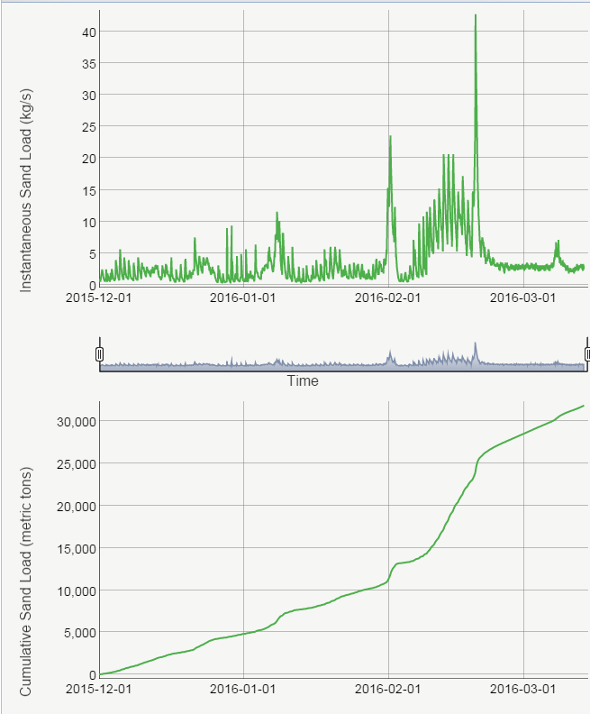
Sediment Conditions As of 3-35-2015
Paria River Discharge Dec 1 though Mar 14
HFE Protocol allows for spring HFEs (March / April) starting in 2015, if sediment inputs are adequate.
Logistics require planning / coordination start 30-days prior to HFE implementation
Currently not enough sediment to support a spring 2015 HFE– highly unlikely to occur.
Paria River Sand Input Dec 1 though Mar 14
Sediment Model Results
Run on 3-14-2016
Have: ~32 ktons (as of 3-25-15)
Need: ~270 ktons (for the smallest HFE)
Notes:
http://www.gcmrc.gov/discharge_qw_sediment/station/GCDAMP/09382000
Open in Chrome:
-Select "Instantaneous Sand Load" and "Cumulative Sand Load" (near the bototm on left
-Date range shoudl be from start of accounting period to today (Dec 1 - today for spring) OR (July 1 to today for fall)
-Build Graph
Copy paste into presentaiton

