Slide 1
CBRFC Postmortem Analysis on June 2010 flooding in UT and CO

Slide 2
Post-Mortem for June 6-10 flooding
Forecasts generally poor and under simulated for peak flows that occurred June 6-10, 2010 in northern Utah and western Colorado
General conditions leading into event:
Near normal/below normal snowpack and precipitation on June 1
Very cool May
Warm (but not record), moist air mass beginning June 5
Temperature forecasts generally good
SNOTEL sites in flooding catchments near average for this time of year
Streamflow forecasts were almost uniformly too low
What happened in the real world?
What happened in the model world?

Slide 3
Temperature

Slide 4
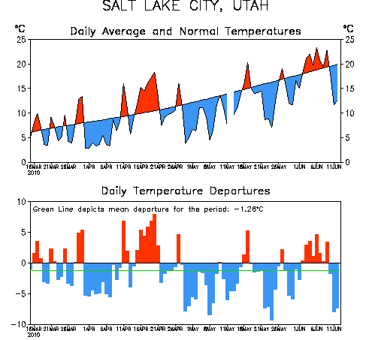
Recent local Temperatures
May was generally cool, delayed melt
First week in June was warm
From
NOAA CPC
A cool May
A warm week

Slide 5
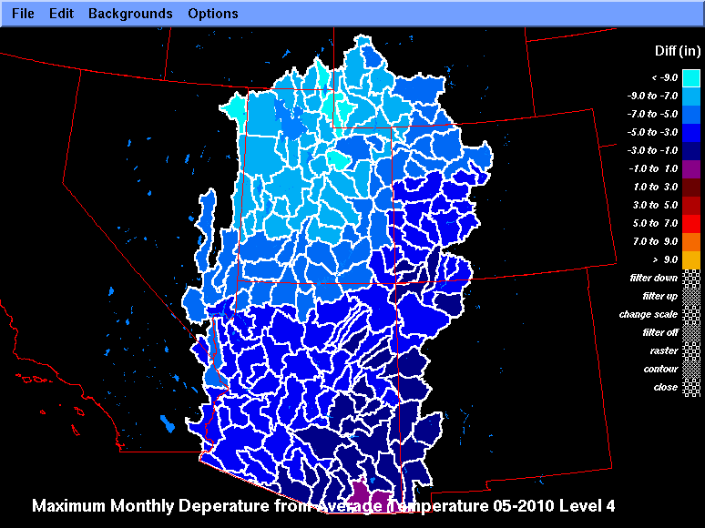

Slide 6
Snow

Slide 7
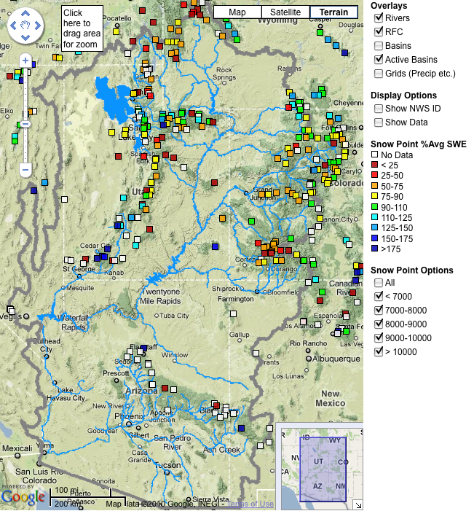
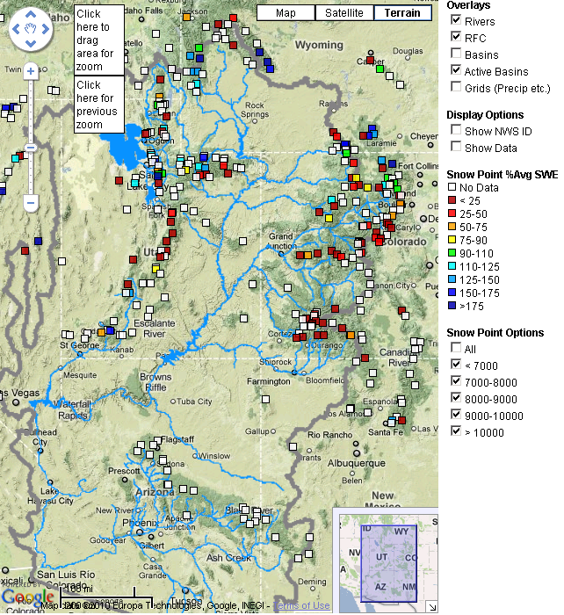
Snow:
May 6 (above)
June 4 (right)

Slide 8
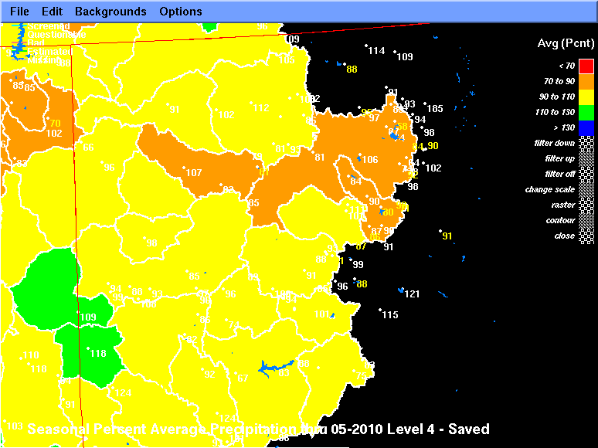

Slide 9
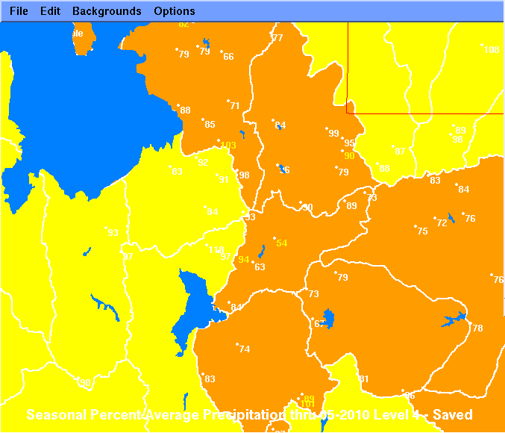

Slide 10
Streamflow Forecasts

Slide 11
Observations
Assumption that Peaks=f(snow volume)
Season volumes affected somewhat
Seen on:
Roaring Fork
Eagle
Uncompahgre (a little)
Granby (a little)
Yampa
Big/Little Cottonwood
Headwaters of Provo/Weber/Bear/Uinta streams
Did not affect
Gunnison/San Juan Rivers
Blue
Upper Green

Slide 12
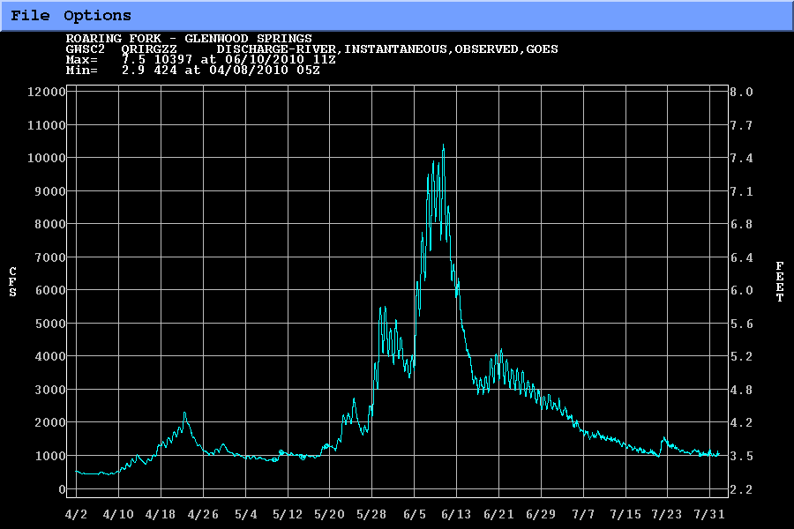

Slide 13
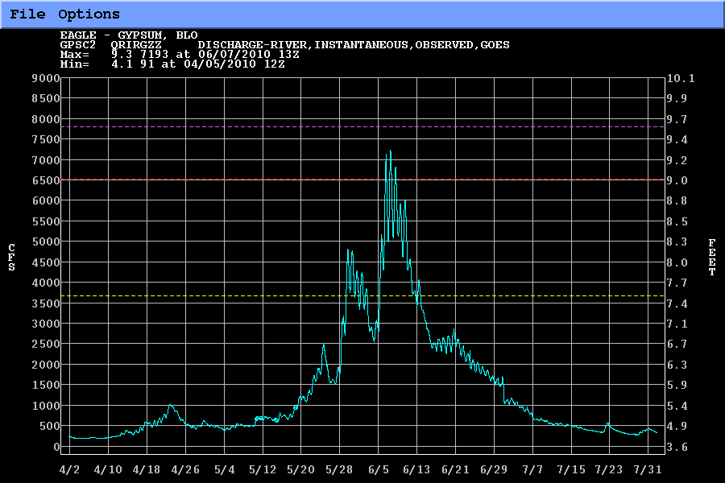

Slide 14
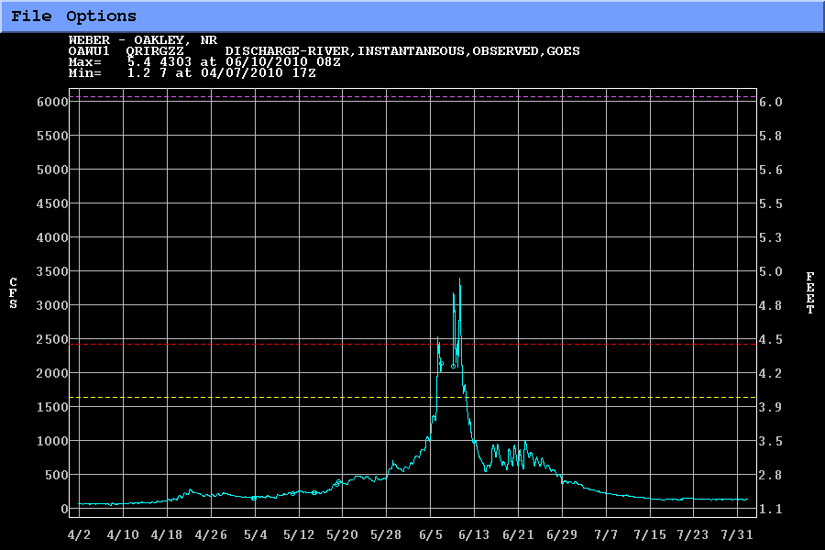

Slide 15
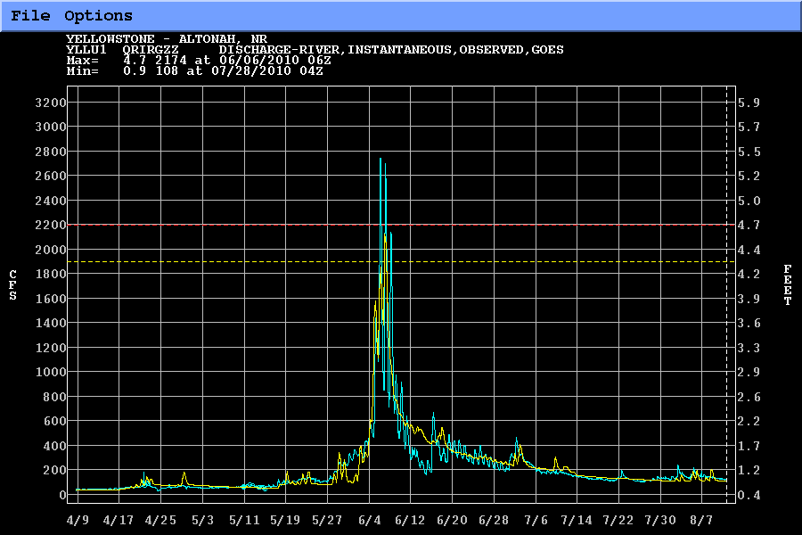

Slide 16
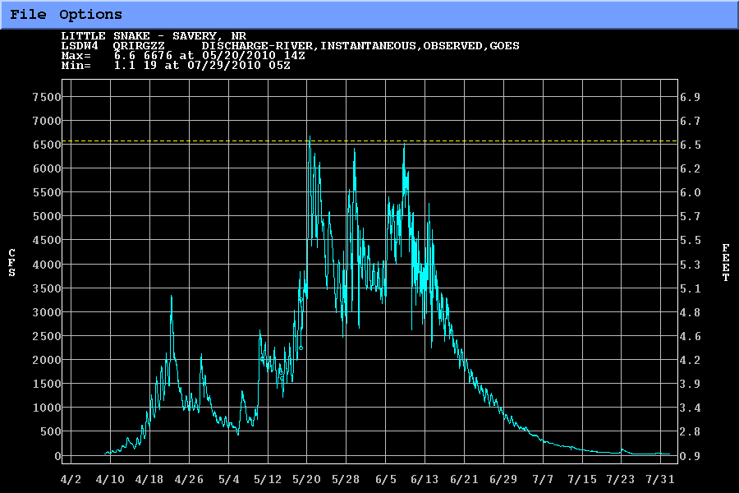

Slide 17
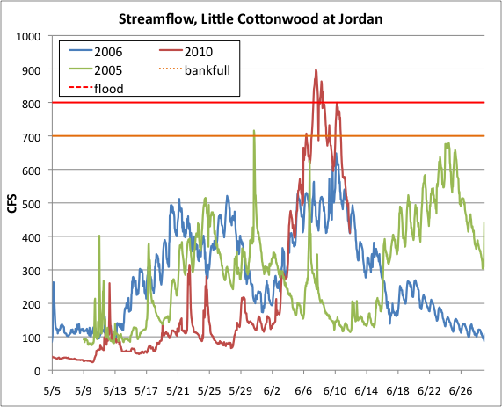
Streamflow Year Comparisons
Both 2005 and 2006 had bigger snowpacks
Flow peaks in prior years occurred after lower snow was gone
In 2005 and 2006, imagine combining the two melt pulses into one – you’d get a flood!
2010
Rainfall
2005
2006

Slide 18
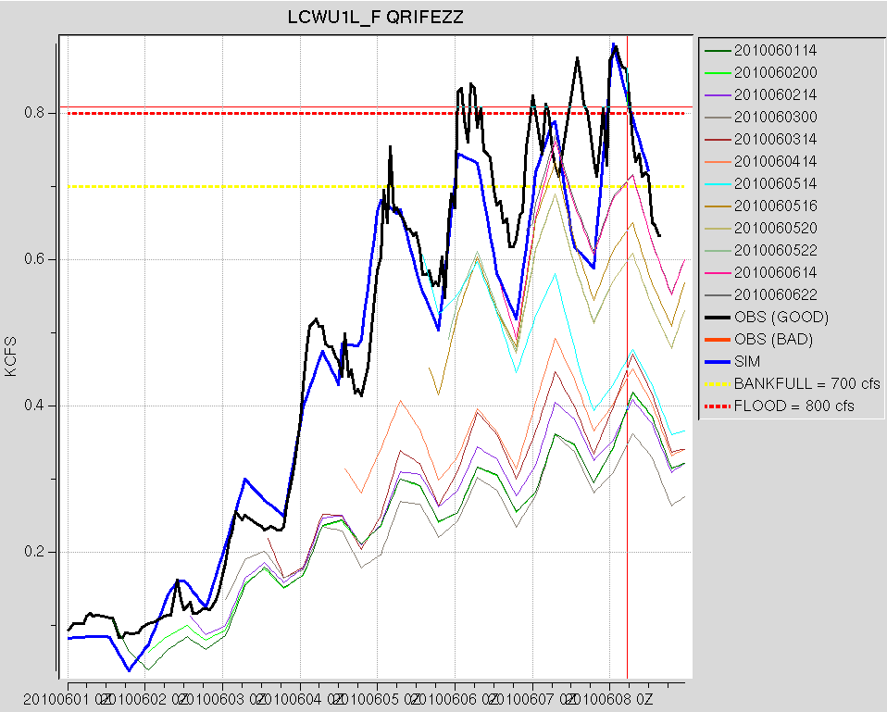
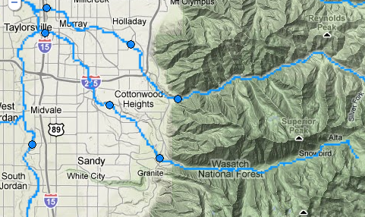
Little Cottonwood at Crestwood Park flow forecasts under-simulated
flood
bankfull
observed
forecasts
simulated
weekend

Slide 19
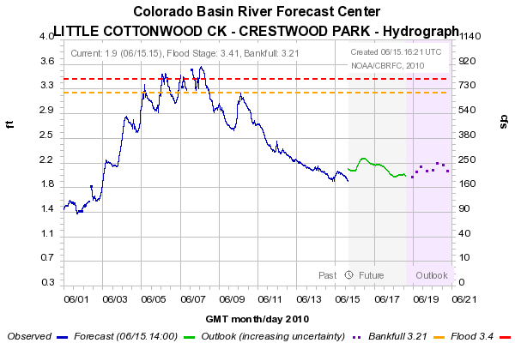
WFO Watches and warnings for Little Cottonwood (Cottonwood, Crestwood Park hydrograph shown)
Flood Warning
543 PM MDT SUN JUN 6
Flood Watch
1132 AM MDT SUN JUN 6
Hydrologic Outlook (ESF)
330 PM MST SAT JUN 5
“FLOODING IS NOT ANTICIPATED”
weekend

Slide 20
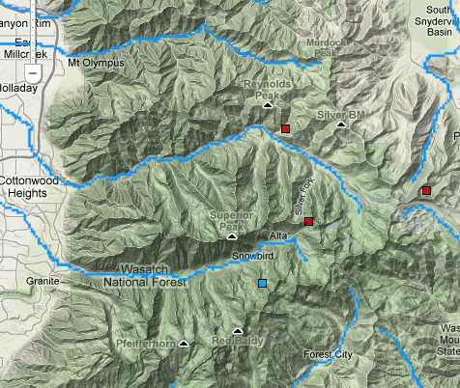
Snotels in Cottonwoods
Mill-D North (8960’, southwest face)
“middle”
Brighton (8750’, southeast face)
“middle”
Snowbird (9640’, northeast face)
“high”
Mill-D North
Brighton
Snowbird

Slide 21
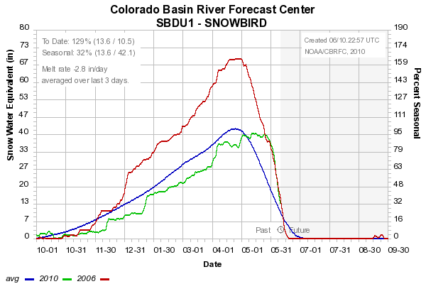
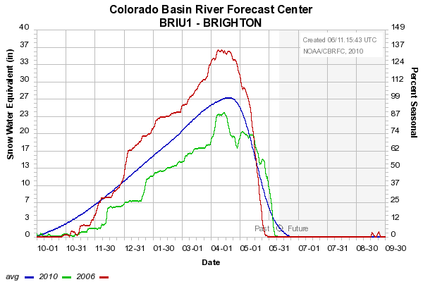
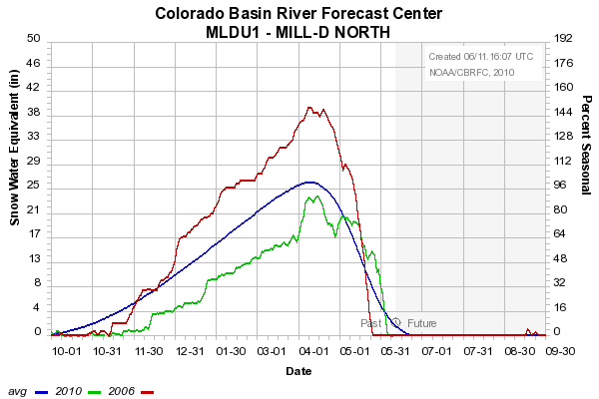
SWE in Cottonwoods
2006
Nearly identical melt!
Snowmelt rate extraordinarily large? (no)
Snowmelt extraordinarily late? (no)
2010

Slide 22
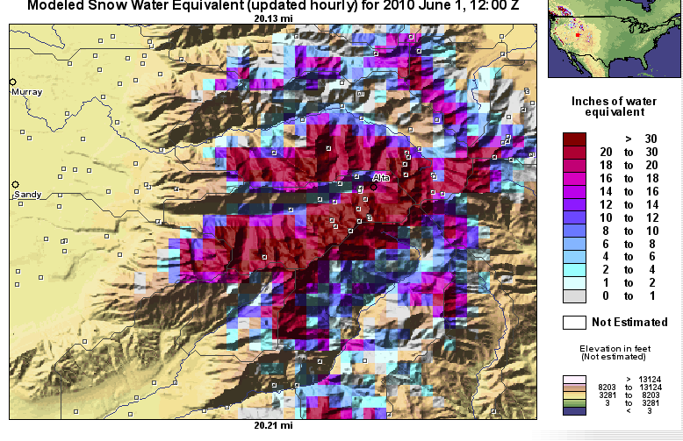
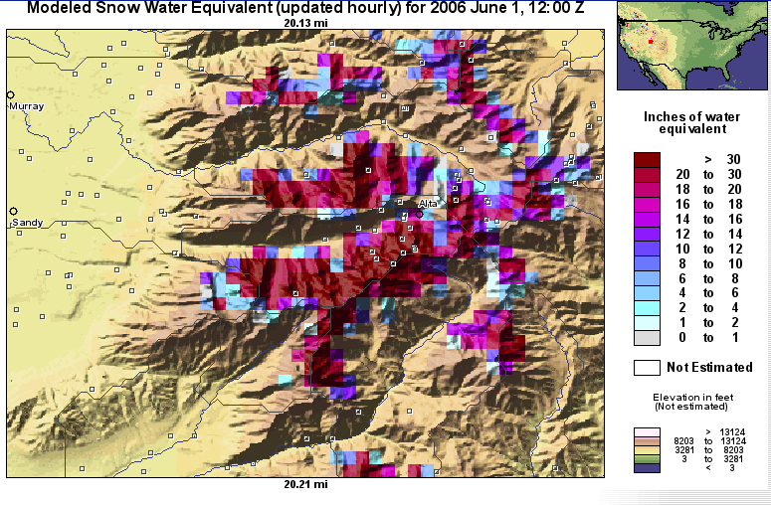
Snow Distribution – corroborates presence of lower elevation snow in 2010 at start of event
2010 June 1
2006 Snowbird SNOTEL trace almost identical to 2010 trace from June 1-10
However, NOHRSC indicates south facing slopes had already melted out in 2006
2006 June 1, for comparison

Slide 23
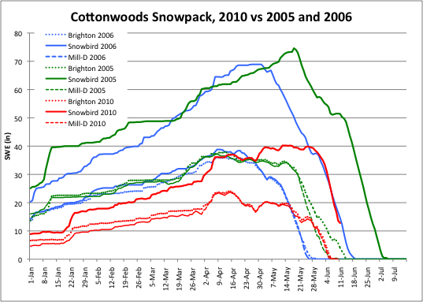
SWE melt comparison
Compared to 2005 and 2006: 2010 had less SWE, but melt was more synchronized
2006
2005
2010
Lower vs upper meltout
30 days
20 days
5 days

Slide 24
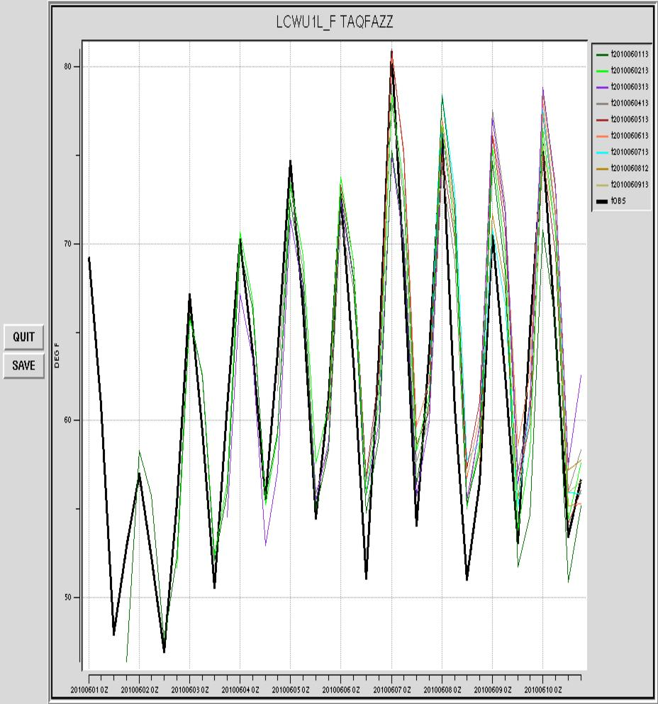
Little Cottonwood at Crestwood Park: Temp. forecasts
Averaged over all elevation zones: not bad!
observed
forecasts
weekend

Slide 25
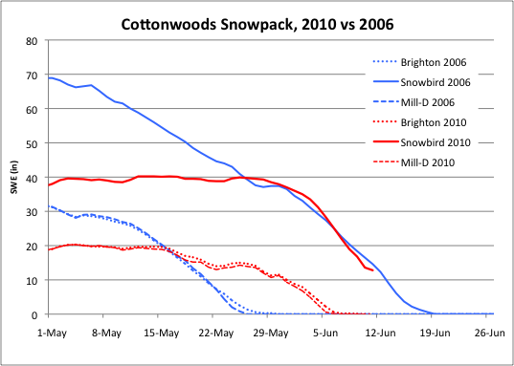
SWE/Snotel Comparison
June Snowmelt at Snowbird in 2006 & 2010 were similar, but in 2006, snow at lower elevations was gone – in 2010 there was synchronized, rapid melt at both elevations.
What about May 2006, when both zones were also melting? Melt rates were lower, particularly in upper zone (and flow response was smaller).
2006
2010
~1.5 in/day
2.5 to 3 in/day
~1.8 in/day
~2 in/day

Slide 26
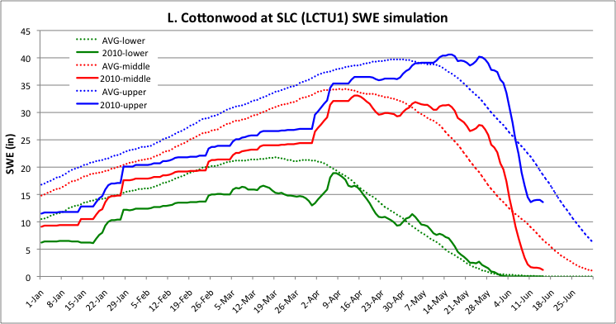
What did the model think?
Model SWE at time of runoff was sufficient, and melt rates were close to observed rates
Overall shape of seasonal snowpack was good (compare to ~38’ peak at Snowbird)
Jun 3-8
2.8 in/day
2.6 in/day

Slide 27
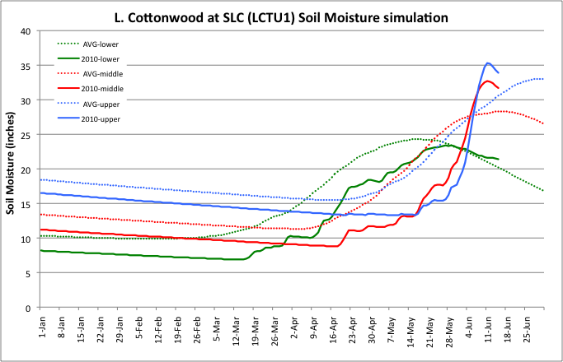
What did the model think?
Model soil was on pretty dry in upper and middle levels entering event, and stored water
Jun 3-8
3-4 days melt
soaked up
lower
upper
Deficits in model soil filling
middle

Slide 28
Was the model right about soil moisture?
Partly right – 2010 was relatively dry
Partly wrong – throughout winter, SM steadily moved upward toward normal levels
In model, this recovery started late and didn’t get as far
3-4 days of melt went by before model really started generating runoff

Slide 29
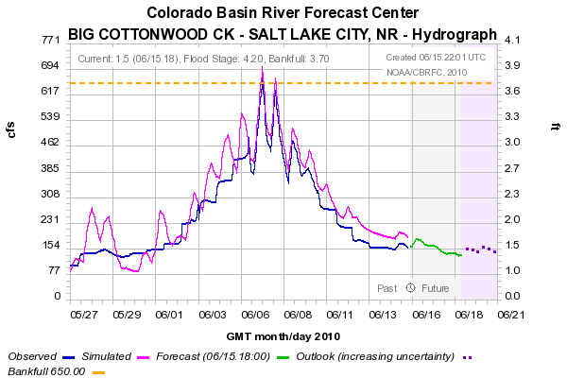
SWE related mods? LCTU1 (Cottonwood @ SLC) only melt factor was used
MFC 0.69
CFS
MFC 1.70
MFC 1.80 – deleted 6/7
MFC 2.35 – deleted 6/8, 6/10
MFC 1.47 – deleted 6/9
Note, appears we did only one soil water mod during May-June

Slide 30
Preliminary Thoughts (circa June 2010)
The snowmelt that drove the flooding was …
More rapid than normal
From more area than normal (both middle and high elevations; also south facing and north facing at the same time)
The cool May 2010 …
Delayed the melt of snow into June, holding lower elevation snow
Atmospheric moisture effects contributed little during the event, but prior month of cool, relatively moist conditions may have helped it ripen
CBRFC models under-simulated the streamflow response

Slide 31
Questions
Hypothesis #1: Existing model infrastructure not sufficient to capture this event.
H1A: Mismatch between real time and calibration precipitation and temperature input?
H1B: Insufficient model spatial distribution? E.g. Model differentiates elevation but not aspect.
H1C: Insufficient physics in (temperature index) snow model?
Hypothesis #2: Existing observational infrastructure not sufficiently distributed in space to capture this event.
Tested by extending calibration dataset for Weber Basin through 2010 (Craig)
Result: did not significantly alter streamflow simuation
Tested by expanding number of “zones” in Weber Basin model to reflect aspect (Craig)
Result: Improved simulation somewhat but not dramatically

Slide 32
Possible Reasons
Possible Input errors
Precipitation
Temperature
Fixes for the future
However, running model in calibration mode showed similar errors
Show results
Known Snow-17 errors in anomalous situations
Temperature index model
Melt of snow probably was atypical
Diurnal amplitude/SCE tells us something
Model is split by elevation zones not aspect
Significant melt in May in exposed areas
Delay of melt in colder, less exposed areas
North facing lower level melted at same time as south facing high level?
Preliminary re-calibration results not much help
Added more zones
Made sac-sma more responsive
Similar errors in other years

Slide 33
Areas of Study
Areal Extent updates
Incorporate Snow Cover Extent into model
Improvements to the Snow model
Pursue alternatives to SNOW-17
Distributed models
Finer scale modeling may be the only answer
Late melt = flooding potential

