Slide 1
CBRFC Water Supply Webinar November 9, 2010

Slide 2
Outline
2010 Year in review
2011 Look ahead
Climate forecasts
CBRFC update

Slide 3
2010 Year in Review
Precipitation, Temperature, and Snowfall Review
Climate forecast verification
Water Supply and Peak Flow Forecast Verification

Slide 4
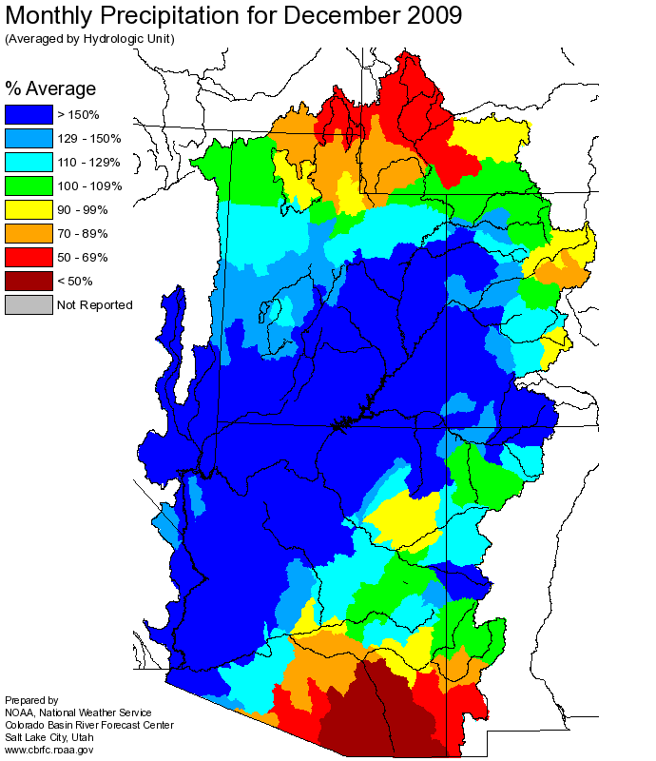
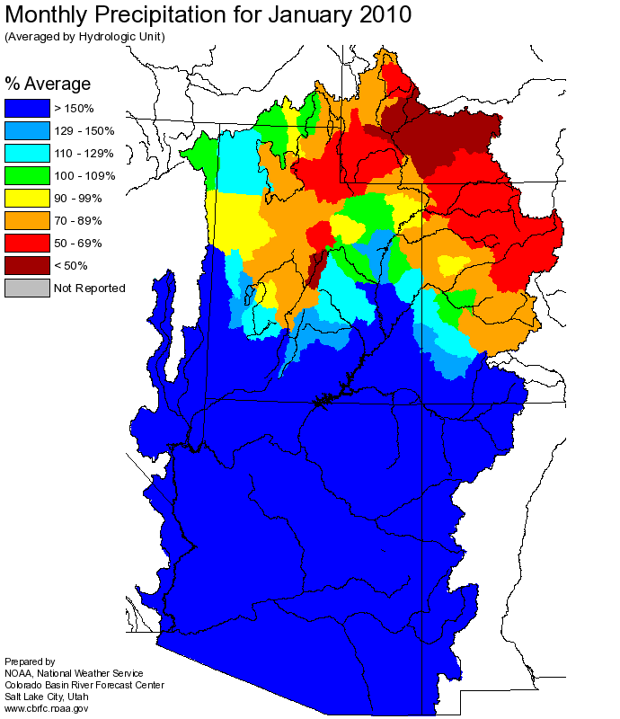
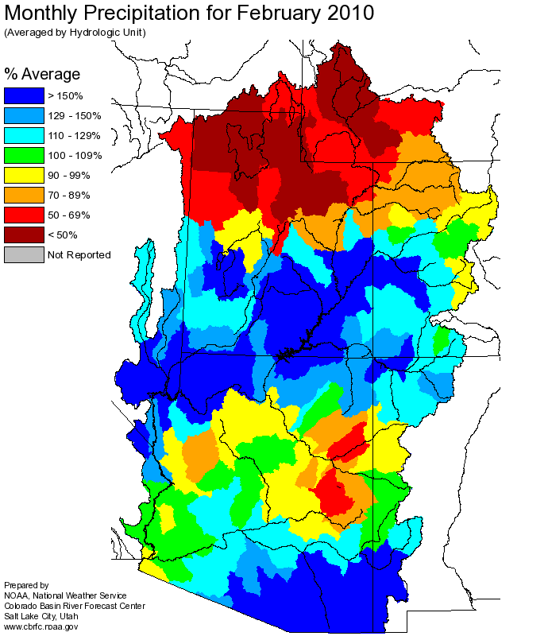
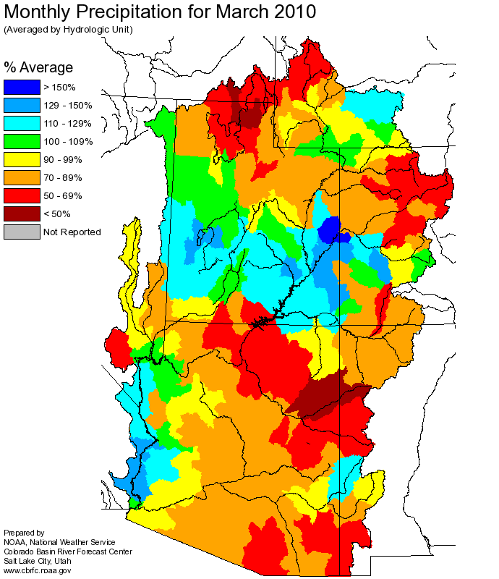
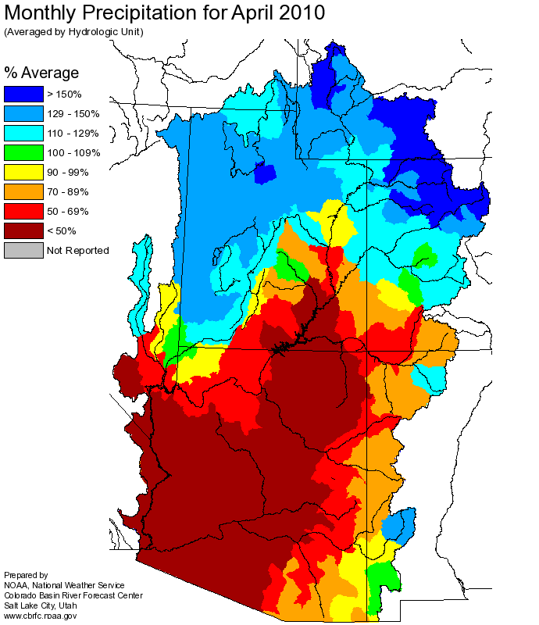
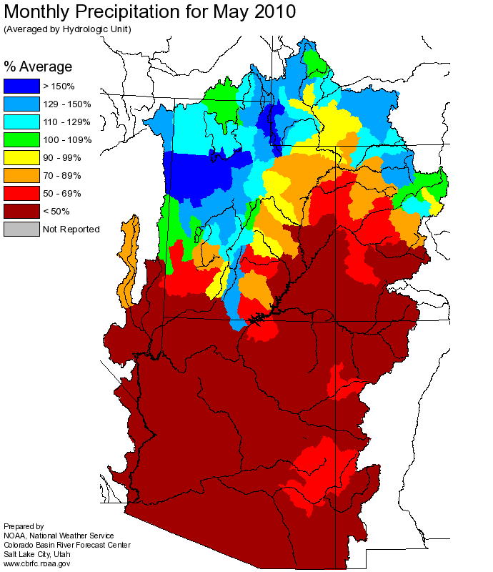

Slide 5
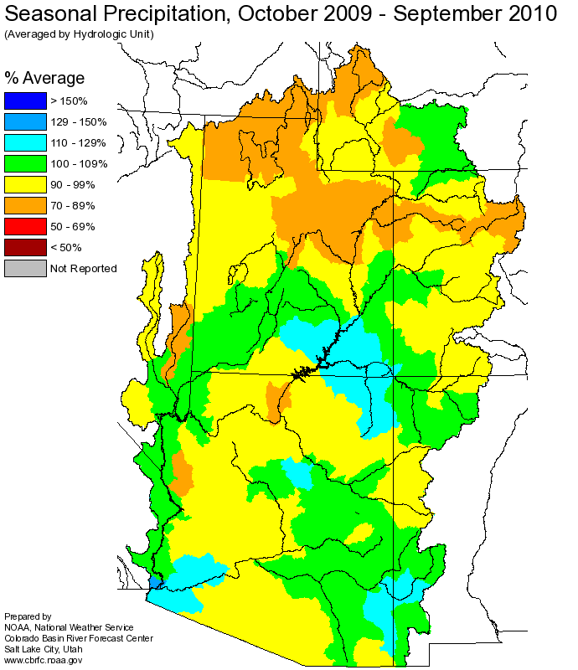

Slide 6
CPC Precipitation Outlooks from November 2009

Slide 7
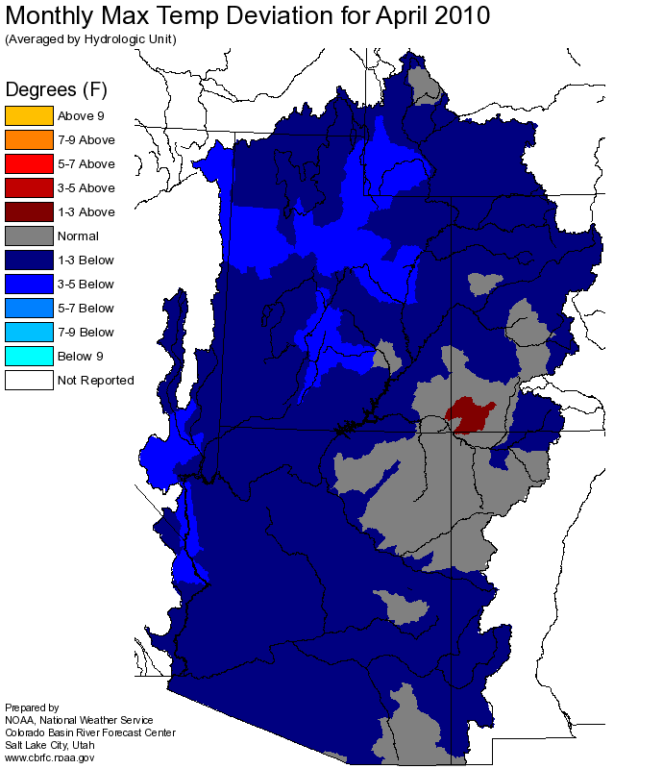
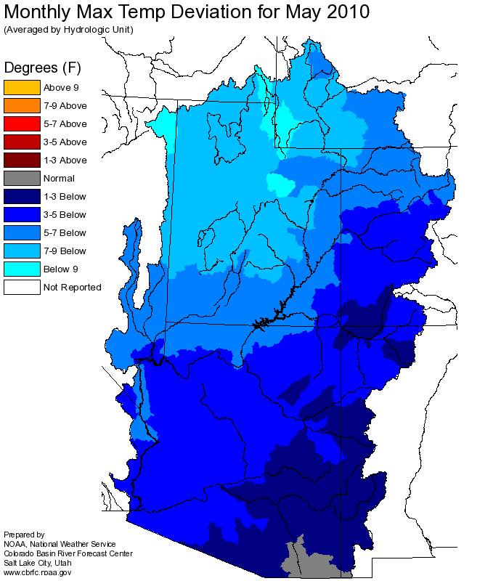
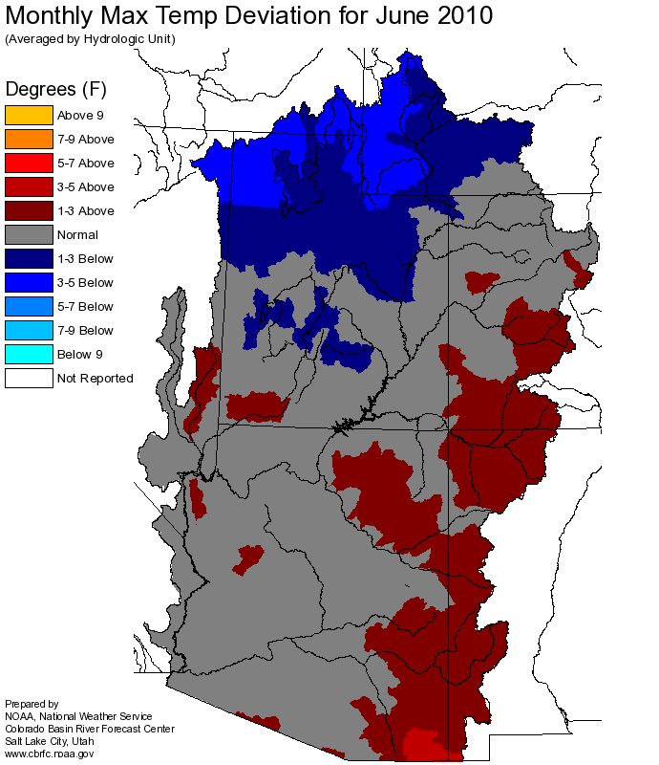
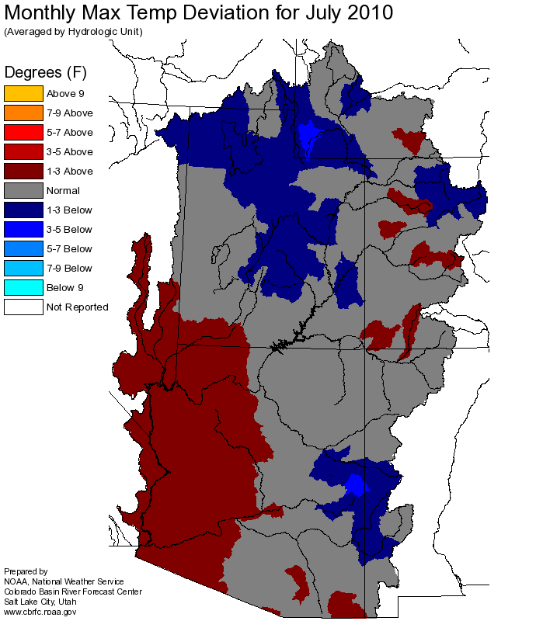
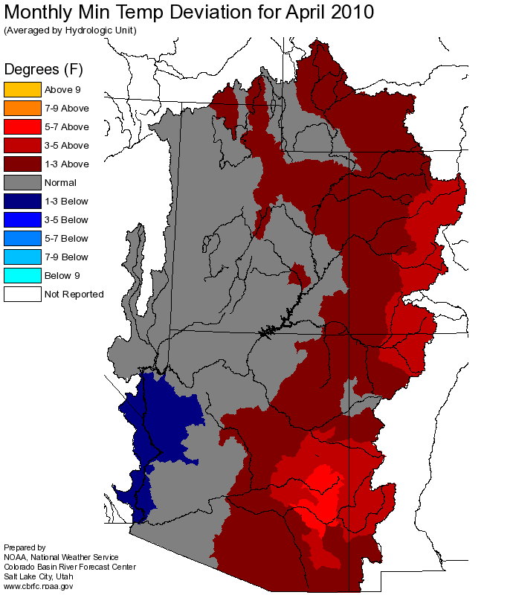
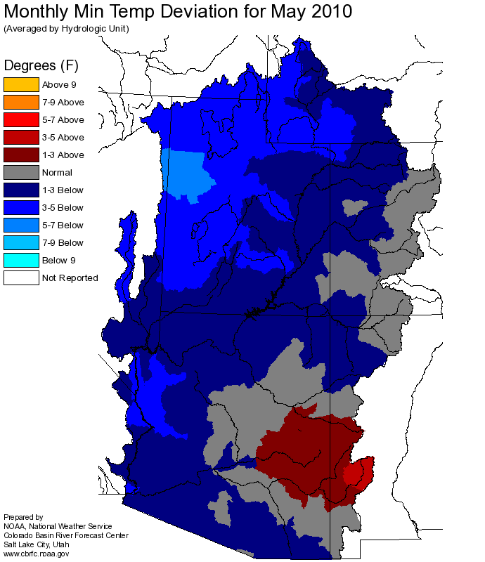
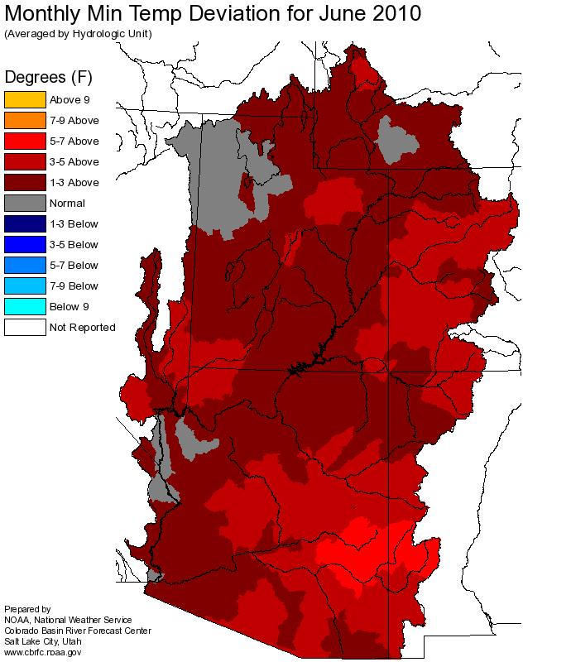
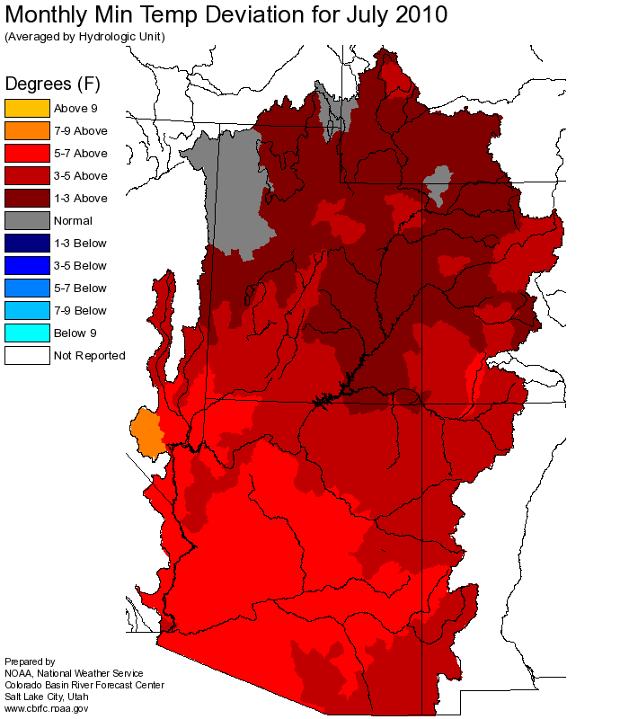
Spring Temperatures Deviations
Maximum Temps
April
May
June
July
Minimum Temps
Temperature Deviation Source - http://www.cbrfc.noaa.gov/product/mapsum/mapsum.cgi?temp?cbrfc????2010

Slide 8
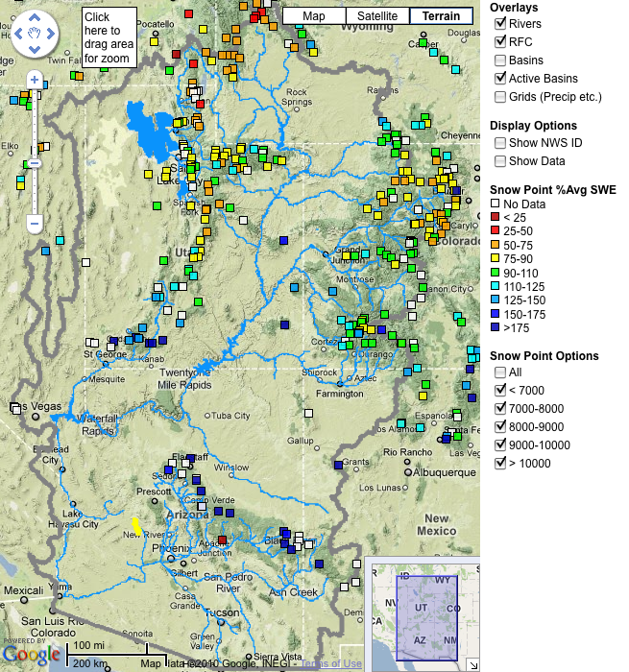
Snow:
Apr 6 (right)
Web Reference: http://www.cbrfc.noaa.gov/gmap/gmapm.php?scon=checked

Slide 9
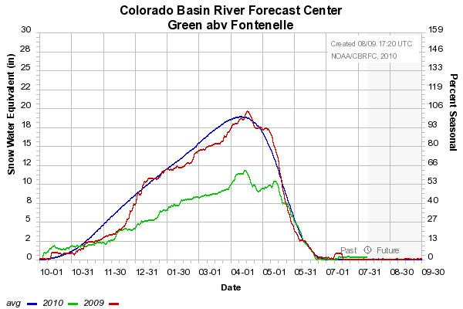
Snow Accumulation In May

Slide 10
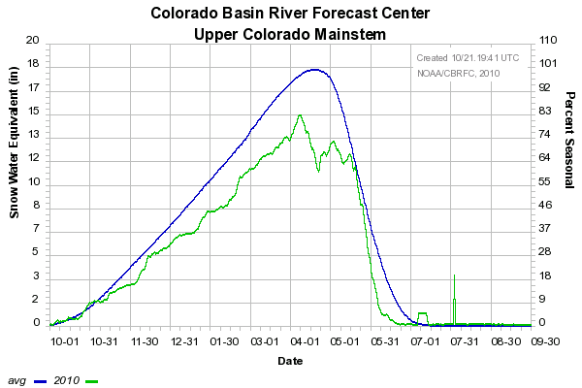
77%
73%
5/20
97%
81%
57%

Slide 11
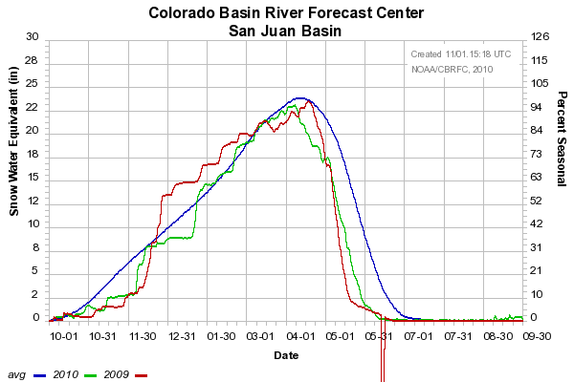

Slide 12
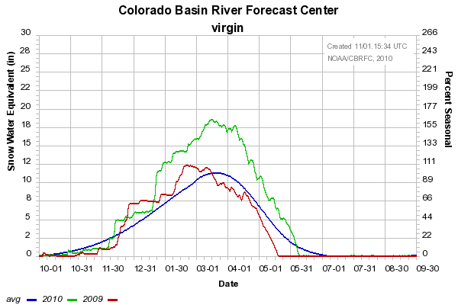

Slide 13
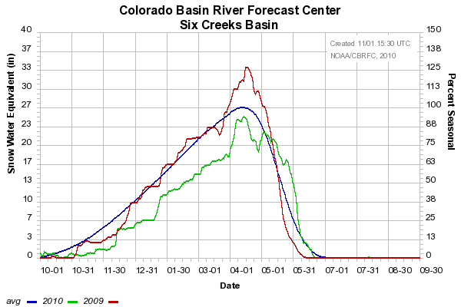

Slide 14
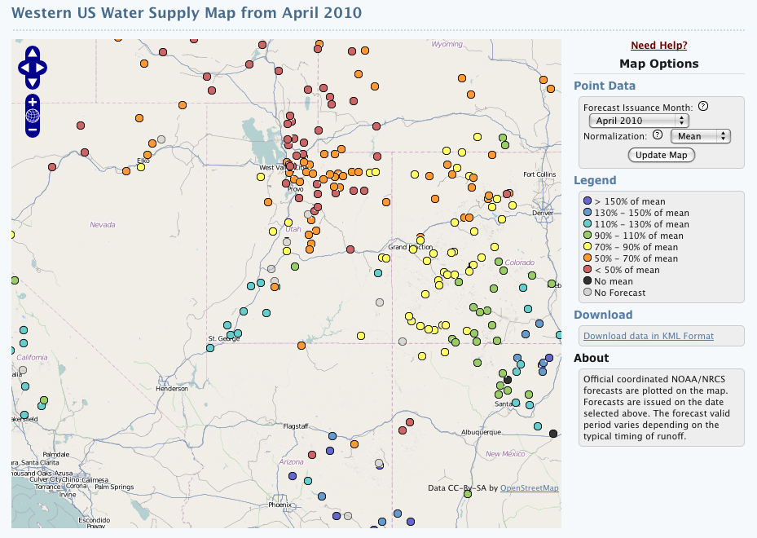
2010 Water Supply Forecasts

Slide 15
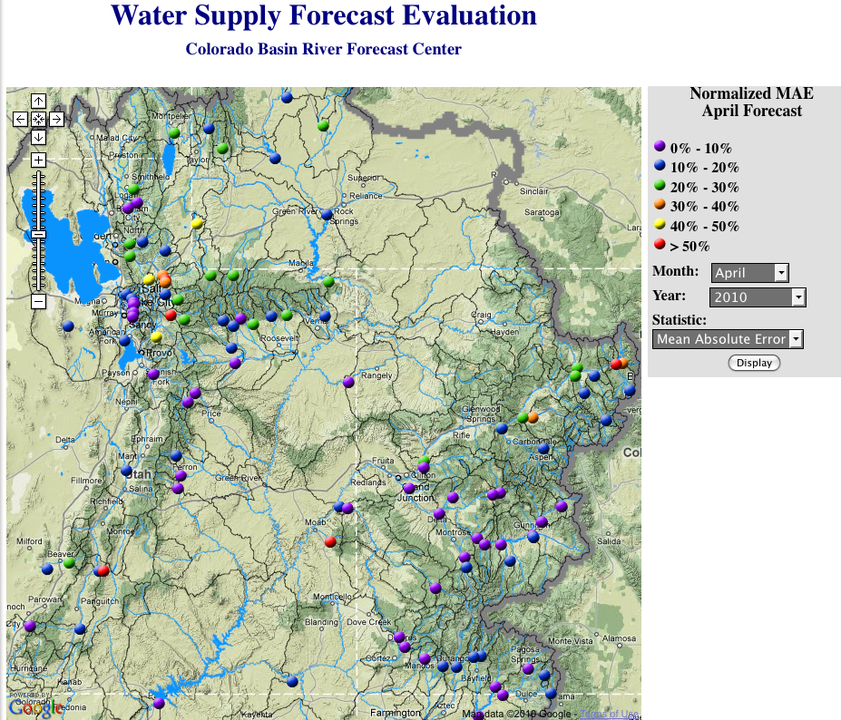
2010 Water Supply Forecasts
April 2010 Forecast Error
|(Forecast – Observed)/Observed |
Lower is better
www.cbrfc.noaa.gov -> Water Supply -> Verification

Slide 16
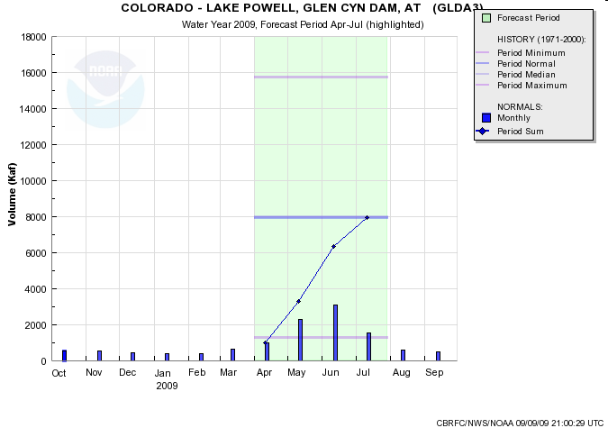
2010 Water Supply Forecasts:
Lake Powell Inflow
1971-2000 History and Normals
Forecast Period Normal
Forecast Period Accumulation – Monthly Normals
www.nwrfc.noaa.gov/westernwater

Slide 17
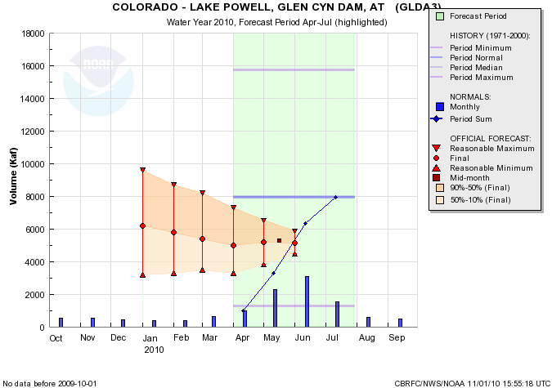
2010 Water Supply Forecasts
2010 Beginning Of Month
Exceedence Forecasts
For April-July Runoff Volume
1 0%
50%
90%
wateroutlook.nwrfc.noaa.gov

Slide 18
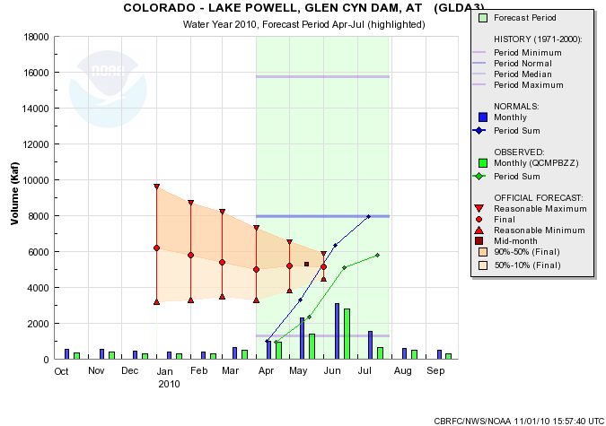
2010 Water Supply Forecasts
2010 Observed Values:
2010 Observed (5795 KAF) Slightly Above June 1st 50% Exceedence Forecast
5795 KAF
73% avg
Forecast Period Accumulation – Monthly Observed
May runoff was less than normal.
Wateroutlook.nwrfc.noaa.gov

Slide 19
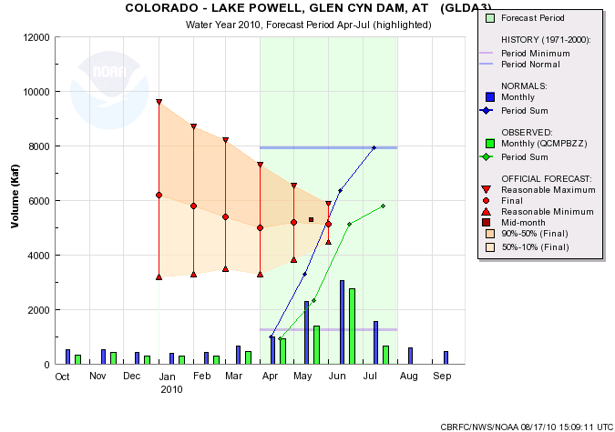
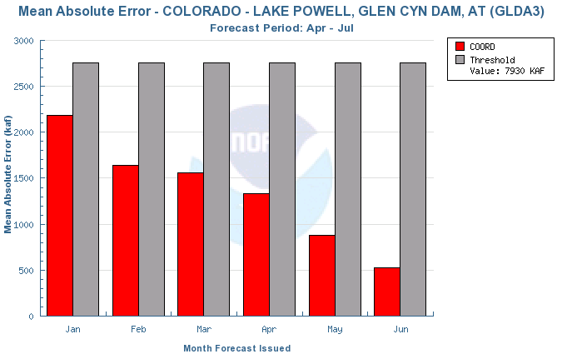
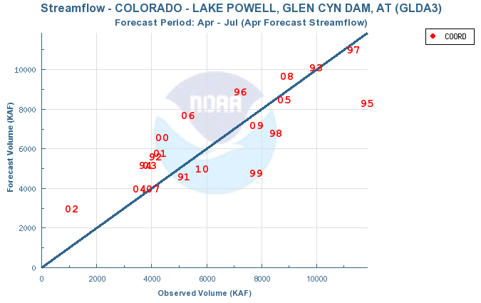
5795 KAF
73% avg

Slide 20
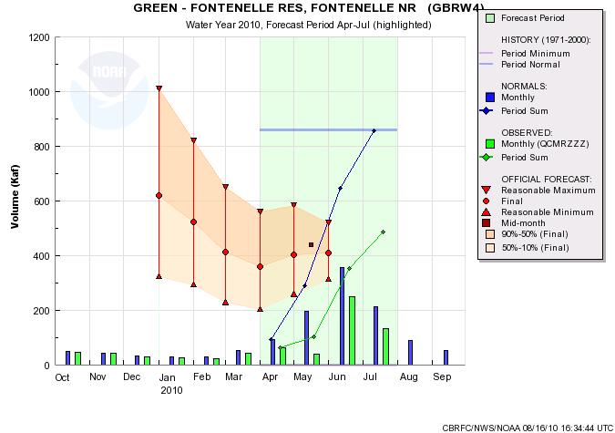
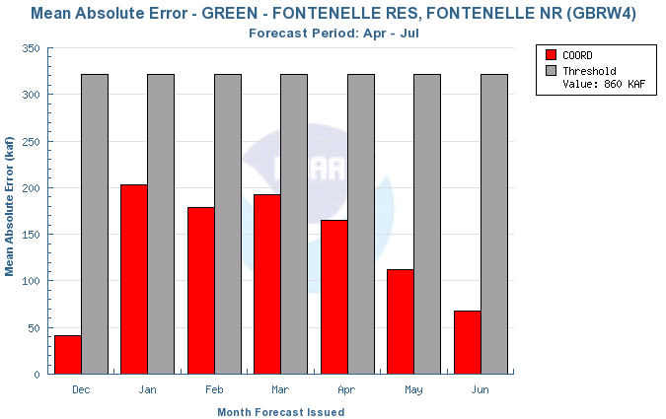
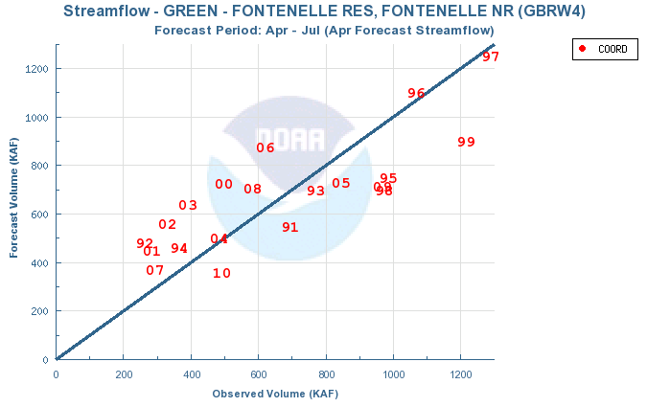
488 KAF
57% avg

Slide 21
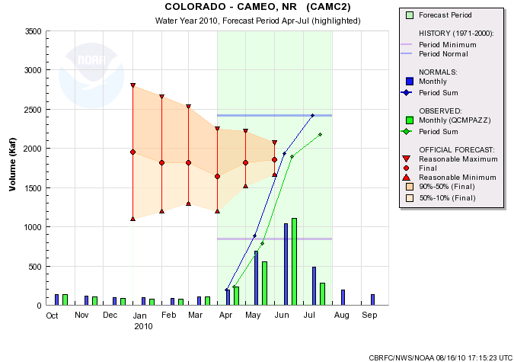
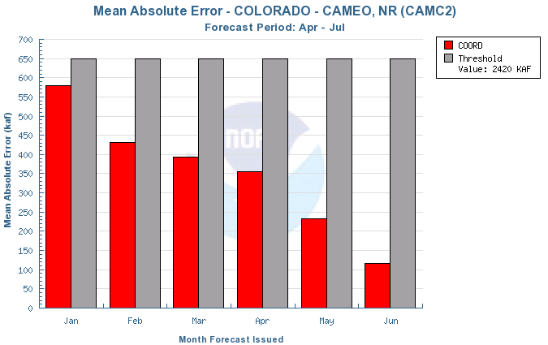
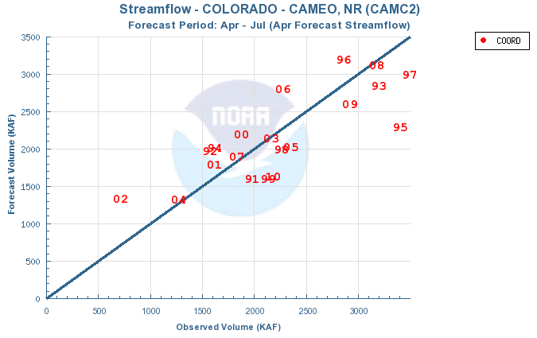
2175 KAF
90% avg

Slide 22
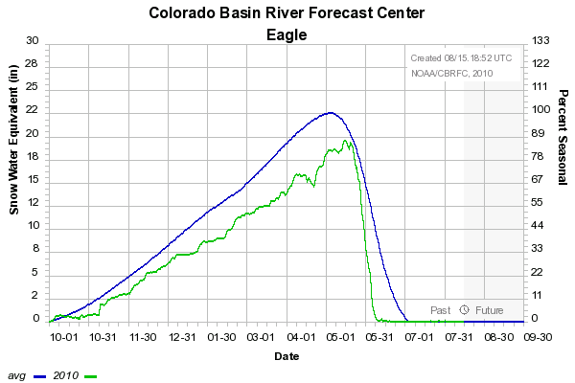
Vail (10300 ft) + Fremont Pass (11400 ft) SNOTELS
5/20
96% avg
87% seasonal peak
80%
72%
Near normal temperatures followed by period of above to much above average temps
79%
55%
6/10
Warm temperatures in mid-April
Cool, wet period end of April through mid-May

Slide 23
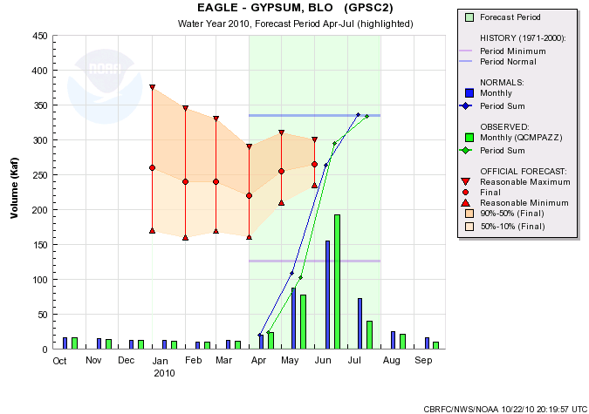
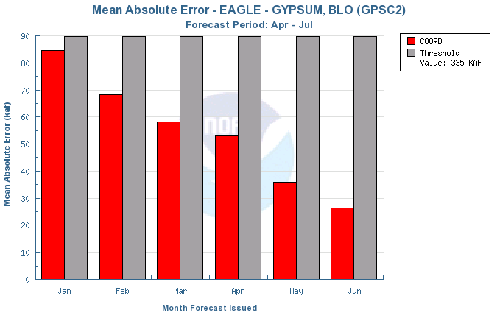
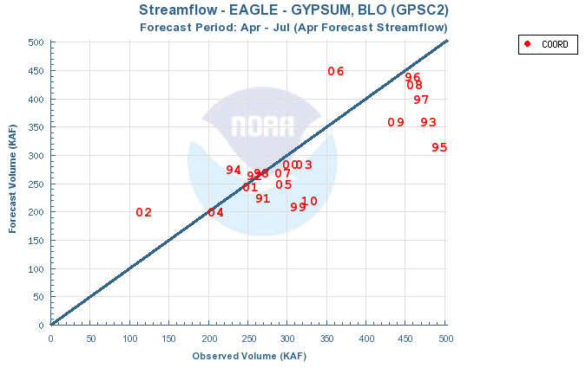
334 KAF
100% avg
Forecast points with similar results
SITE | 4/1 FCST (% avg) | OBS (% avg)
Eagle-Gypsum | 66% | 100%
Granby | 67% | 100%
Willow Ck | 45% | 102%
Wolford | 52% | 79%

Slide 24
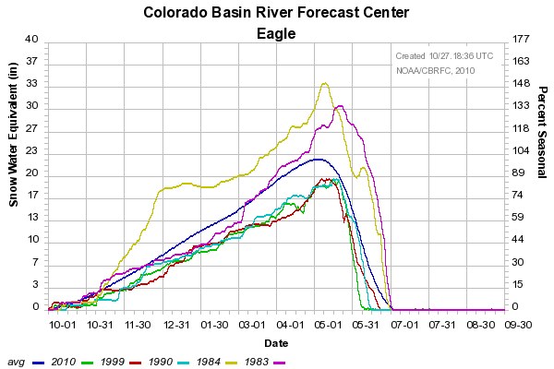
YEAR | APR-JUL VOLUME (KAF) | VOL / PEAK RANK (1947-2010) | PEAK FLOW (CFS)
1990 | 219 | 55 / 40 | 2850
1999 | 314 | 32 / 43 | 2640
2010 | 334 | 27 / 2 | 6070
1983 | 447 | 9 / 3 | 6060
1984 | 608 | 1 / 1 | 6580

Slide 25
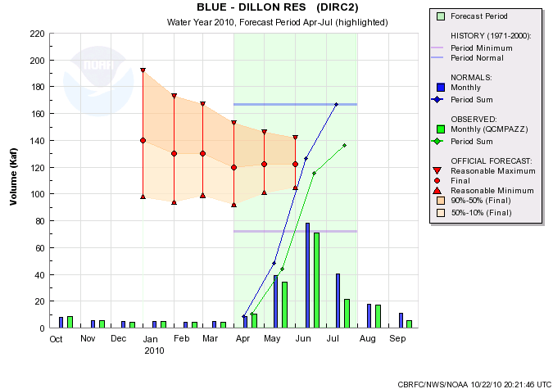
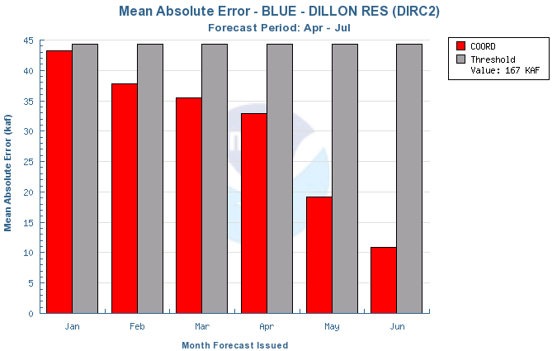
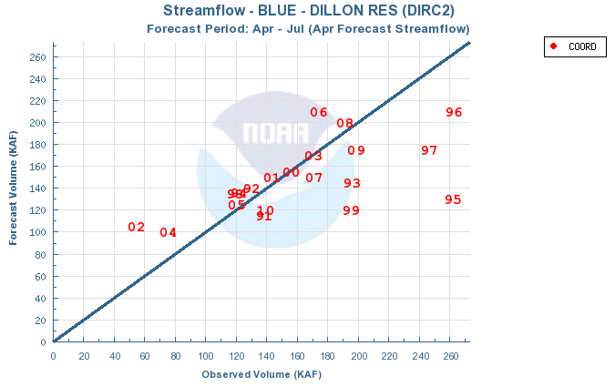
Forecast points with similar results
137 KAF
82% avg
SITE | 4/1 FCST (% avg) | OBS (% avg)
Dillon | 72% | 82%
Fraser | 80% | 94%
Williams Fk | 68% | 87%
Ruedi | 72% | 90%
Roaring Fk – Glenwood | 80% | 90%

Slide 26
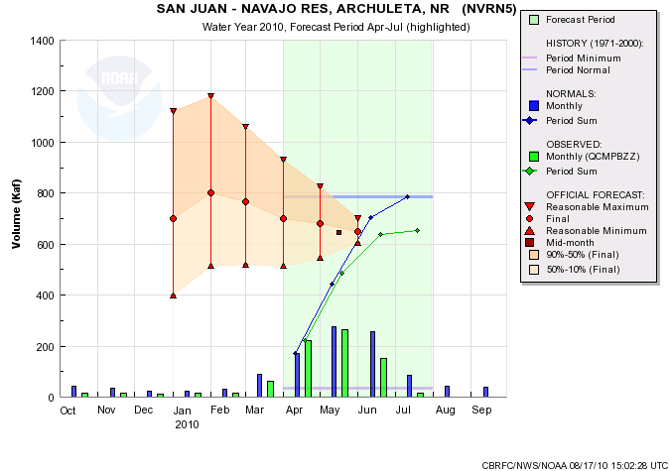
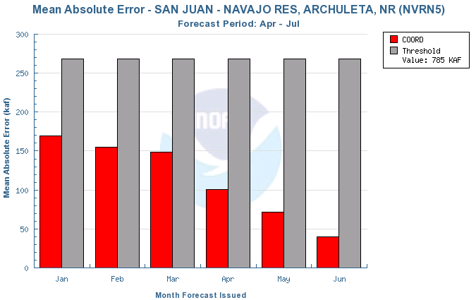
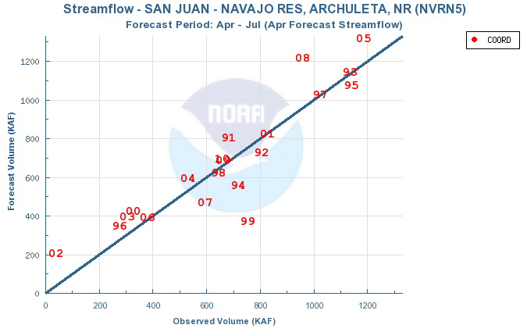
654 KAF
83% avg

Slide 27
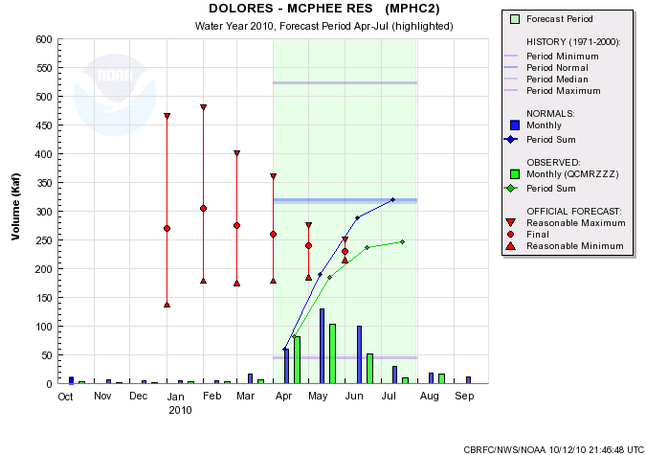
Observed 2010 April-July (kAF)
246.99 = 245 rounded
Which is 77% of average

Slide 28
McPhee WY2010
 | 1-Jan | 15-Jan | 1-Feb | 15-Feb | 1-Mar | 15-Mar | 1-Apr | 15-Apr | 1-May | 15-May | 1-Jun | 15-Jun | 1-Jul | obs
jan | 3 | 3 |  |  |  |  |  |  |  |  |  |  |  | 3.1
feb | 3.5 | 3.5 | 3 | 3 |  |  |  |  |  |  |  |  |  | 2.9
mar | 15 | 15 | 15 | 15 | 10 | 10 |  |  |  |  |  |  |  | 6.3
apr |  |  | 60 | 60 | 50 | 50 | 47 | 53 |  |  |  |  |  | 82
may |  |  |  |  | 115 | 115 | 107 | 92 | 83 | 83 |  |  |  | 104
jun |  |  |  |  |  |  | 86 | 73 | 61 | 45 | 33 | 56 |  | 51
jul |  |  |  |  |  |  |  |  | 16 | 12 | 11 | 11 | 10.5 | 10.4
apr-jul | 270 | 270 | 305 | 305 | 275 | 275 | 260 | 230 | 240 | 220 | 230 | 250 | 245 | 245

Slide 29
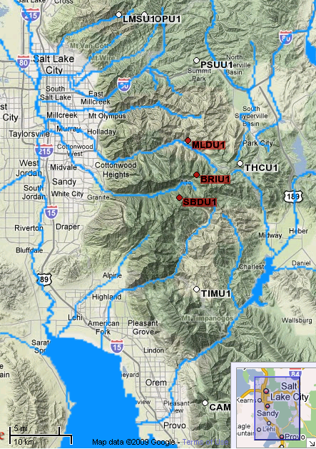
Great Basin: Six Creeks Area and Big Cottonwood Creek nr SLC
SNOTEL
SLC Public Utilities Gage
Big Cottonwood Creek

Slide 30
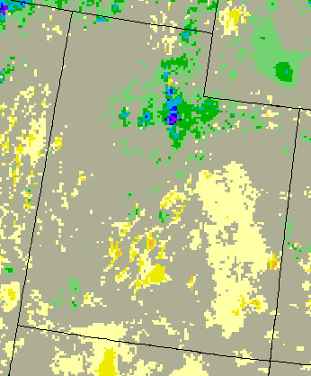
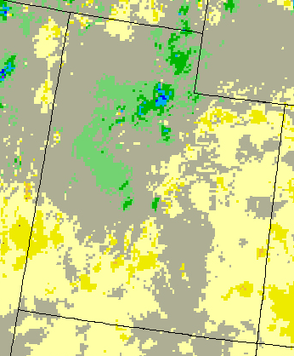
Six Creeks HUC, April – July Departure from Normal Precipitation
Apr Departure
Much Above Avg.
May Departure
Much Above Avg.
June Departure
Above Avg.
July Departure
Much Below Avg.
CBRFC Precipitation Calculations
HUC 161%
HUC 159%
HUC 116%
HUC 35%
The above graphics are from http://water.weather.gov

Slide 31
2010 Snow Melt Pattern – Six Creeks
May 108%
March 65%
April 70%
9640 ft.
Near Seasonal Peak value in
Late May, normally Apr 15.
June 136%
8967 ft.
8750 ft.
May 1st

Slide 33
Arizona / New Mexico Basins – Impacts to Forecasts and Runoff Volumes
All areas:
Dry late summer and fall, initially dry soil conditions in model.
El Nino conditions suggested wetter than average conditions.
Dry soil conditions persisted under high elevation snowpack.
Significant rain event in January set the stage for large volumes
Frequent cold storms & below average temps.
Heavy, record snowpack persisted throughout the winter
Good snowmelt contribution in March-April.
Gila Basins
Driest area early on as December was also dry.
Salt River Basin (Verde & Tonto)
January event had the most significant impact in this area.

Slide 34
January Precipitation Event:
Jan 18-22 Precipitation Event

Slide 35
Snow Maps: www.nohrsc.noaa.gov
Arizona/New Mexico Basins – 2010 Snow Impacts
February 1 2010 – Snow Water Equivalent
April 1 2010 – Snow Water Equivalent
Verde basin 7200 feet
Little Colorado 7600 feet
Salt Basin 9100 feet
2010 observed
Average

Slide 36
SALT – ROOSEVELT:
2010 CBRFC-NRCS COORDINATED FORECASTS
Progressive Forecast Period (Forecast Issue Date through May)
Volume in acre-feet

Slide 37
SALT – ROOSEVELT:
2010 CBRFC-NRCS COORDINATED FORECASTS
Progressive Forecast Period (Forecast Issue Date through May)
QPF Driven ESP Guidance
+ 58.6%
+ 54.1%
-51.8%
+ 6.6%
-30.6%
+ 16.5%
-3.6%
Volume in acre-feet

Slide 38
VERDE-HORSHOE:
CBRFC-NRCS COORDINATED FORECASTS
Progressive Forecast Period (Forecast Issue Date through May)
+57.9%
+ 57.9%
-4.8%
+ 18%
-62.8%
+ 47.6%
+ 42.9%
Volume in acre-feet

Slide 39
GILA – SOLOMON:
CBRFC-NRCS COORDINATED FORECASTS
Progressive Forecast Period (Forecast Issue Date through May)
+1.4%
-59%
-32.4%
-15.4%
Volume in thousands of acre-feet

Slide 40
2010 Water Supply Forecast Verification Lower Colorado Basin Summary
What was observed ?
Significantly above median volumes – all areas.
Primary impacts to the forecasts and ensuing runoff ?
Wet December through February.
Precipitation event the 3rd week of January.
Below average temps – cold storms – built / maintained heavy snowpack.
El Nino conditions were present – gave greater weight to El Nino years in forecast development.
How did we do compared to ‘usual’ (over the last 20 yrs)
Jan 1st forecast error exceeded the statistical mean average error (AZ & NM).
Jan 15th forecast (good Precipitation Forecast) – was a vast improvement.
Beyond January, over forecast some on the Verde/Salt, and under on the Gila.
Virgin River Forecasts were better than mean absolute error – and pretty good Feb forward.
Geographically - where is the best / worst skill?
It’s kind of a wash in January
Much greater skill exists in the snow runoff basins (Virgin) at onset of runoff
Other factors (were we biased by particular events?)
Perhaps too much emphasis on the snow contribution in Salt/Verde, not enough in Gila
ESP performed well on the Salt system beyond Jan 1st.
Snow updating planned for this year in Arizona (however, it’s La Nina).

Slide 41
Daily forecasts for peak flow
Very significant forecast problems on Roaring Fork, Eagle, Uncompahgre, Grandby, Yampa, Big/Little Cottonwood, Uinta streams (e.g. Provo, Weber, Bear) with very high peak flows in early June with rapid rises (and declines) and streamflow
Below average snow in all basins and similar melt out patterns at SNOTEL sites to previous years
Very cold May (up to -10 F for monthly mean)
CBRFC tested extended calibration time series and increased spatial distribution of model
Hypothesis: Improvements to snow covered area observations and snow models may yield improvements.

Slide 42
Verification Conclusions
2010 had several important anomalies that were important for water supply:
Major January precipitation event for lower 2/3 of basin
Cold May
Rapid melt out in northern 1/3 of basin in early June
Climate forecasts were “equal chances” except in AZ, NM
Individual storms were important drivers in the lower basin and in the SLC area
Results vary sometimes dramatically between basins depending on physical characteristics including elevation and location among others
Forecasts for seasons were better than forecasts for individual months
Forecast range (10 and 90% values in published forecasts) are generally reliable and more representative than the single 50% number.
“There are known knowns; there are things we know that we know. There are known unknowns; that is to say, there are things that we now know we don’t know. But there are also unknown unknowns; there are things we do not know we don’t know.” –Don Rumsfeld

Slide 43
2011 Look Ahead
Outlook and current situation:
Summer / Fall Precip
Soil Moisture States
Snow States
Climate Forecasts and ENSO
CBRFC updates
Weekly ESP
Lake Powell Probability of Exceedence
Webinars
30 year average change

Slide 44
Summer / Fall 2010 Precipitation

Slide 46
Soil Moisture

Slide 48
La Nina
Sources: cpc.ncep.noaa.gov and iri.columbia.edu/climate/ENSO

Slide 49
ONI is three month mean of nino3.4
Current ONI value is -1.0

Slide 51
Objective Consolidation of Tools
CFS
FINAL FORECAST
OBJECTIVE CONSOLIDATION
fore-
caster
SKILL & SPREAD wts
ECCA
TOOLS
SKILL & SPREAD wts
TOOLS
CPC’s Objective
Consolidation
Scheme for 3-
Month Outlook
Models (tools)
Unger et al, 2009, O’Lenic et al, 2008)
O’Lenic Oct 26, 2010

Slide 52
Source: www.cpc.ncep.noaa.gov

Slide 53
Source: www.cpc.ncep.noaa.gov

Slide 54
Source: www.cpc.ncep.noaa.gov

Slide 55
Source: www.cpc.ncep.noaa.gov

Slide 56
CPC Temperature Outlooks
Source: www.cpc.ncep.noaa.gov

Slide 57
La Nina and the Upper Colorado
Some analyses (e.g. Klaus Wolter, right) have shown seasonal teleconnections to precipitation in the Upper Colorado basin
Possible tendency toward drier fall and spring and wetter winters in La Nina
Credit: Klaus Wolter http://wwa.colorado.edu/IWCS/2010_October.html

Slide 58
La Nina and Streamflow
Very low correlations in most of upper basin (right: Lake Powell)
La Nina correlated with low streamflow in lower basin at around 0.2 – 0.3
Weaker correlations for San Juan Basin with low streamflow and Upper Green with high streamflow
2011 forecast
Average = 7.9 maf

Slide 60
CBRFC Projects
CBRFC is a SERVICE oriented center. This means your input is critical to driving the development activities undertaken
2010 Stakeholder Forum identified key work areas. Report available online
Key projects going forward:
NWSRFS to CHPS migration
30 Year average update
WY11 will continue using 71-00 averages and datasets
WY12 will start using the 81-10 averages and datasets
More information available upon request
Integration of climate (CFS) and weather (GFS) forecasts into ESP
Forecasts supporting decision making on equalizing Lake Powell releases
Revamping weekly ESP forecasts for more rapid forecast updates
Continue webinars

Slide 61
CBRFC Staff
Basin focal points / forecasters:
Brenda Alcorn (Upper Colorado)
Ashley Nielson (Green + Yampa / White)
Tracy Cox (San Juan + Gunnison)
Brent Bernard (Great Basin)
Greg Smith (Lower Colorado)
Other key staff members:
Michelle Schmidt (Hydrologist In Charge)
Kevin Werner (Service Coordination Hydrologist)
Craig Peterson (Calibrations, Operations lead, etc)
Cass Goodman (IT Support, web development, etc)
John Lhotak (New model development focal point)
Bill Reed (dam break)
Kristen Yeager (student)
Mike Hobbins (post-doc)
Stacie Bender (New hydrologist starting in January 2011)

Slide 62
CBRFC Forecast Schedule
Water supply forecasts
Monthly January through June
Final forecasts published by 5th working day of the month
Webinar follows shortly afterwards
Preliminary schedule:
January 7 @1pm MT
February 7 @1pm
March 7 @1pm
April 7 @1pm
May 6 @1pm
Peak flow forecasts
Monthly or as needed March through June
Webinars as needed

Slide 63
More Resources
www.cbrfc.noaa.gov
Forecasts
Verification
Soil moisture maps
Precipitation maps
Temperature maps
Presentations
NWS Water Supply Website
These slides:
www.cbrfc.noaa.gov -> presentations

Slide 64
Questions

Slide 65
30 year average
30 year averages are updated once every 10 years
Currently using 1971-2000 averages
Update for WY2012 will be based on 1981-2010 averages
Update will affect both water supply reference (e.g. percent of normal… normal will change) and forecast numbers (e.g. data input to tools will change)

Slide 66
Preliminary Data
18% reduction in mean

Slide 67
Preliminary Data
4% reduction in mean

Slide 68
Preliminary Data
6% reduction in mean

Slide 69
Preliminary Data
6% reduction in mean

Slide 70
Preliminary Data
11% reduction in mean

Slide 71
Preliminary Data
All 30 year means since 1911-1940

Slide 72
1981-2010 is the driest 30 year period on record

Slide 73
Affect on Forecasts
WY2011 forecasts will continue to use 1971-2000 means:
Statistical models (SWS and NRCS) will use 1971-2000
Simulation model (ESP) will use 1976-2005
WY2012 forecasts will be based on 1981-2010 inputs in both forecast models
ESP and SWS will both use the same period
SNOTEL network much stronger for 1981-2010 period than in 1970s. This network is critical for forecast skill.
All things equal, these forecasts will be lower since input data sets are drier in the 30 year average
Especially true in early season forecasts
Later season forecasts more controlled by observed snowpack
Percent of normal forecast values should remain largely unchanged (since normals AND forecasts will be lower)

