Slide 1
Overview of CBRFC Flood Operations Arizona WFOs – May 19, 2011
Kevin Werner, SCH

Slide 2
Outline
Basics of RFC hydrologic model
Model inputs
Challenges during events
Examples during the December 2010 event
Dam Failures
How RFC and WFO work together
In the Future

Slide 3
Forecast Process
Hydrologic Model Analysis
hydrologic
expertise &
judgment
model
guidance
Weather and Climate Forecasts
River
Forecast
System
Forecast
precip / temp
Outputs
Graphics
River Forecasts
Analysis &
Quality Control
Rules, values, other factors, politics
parameters
Observed
Data
Calibration
Decisions

Slide 4
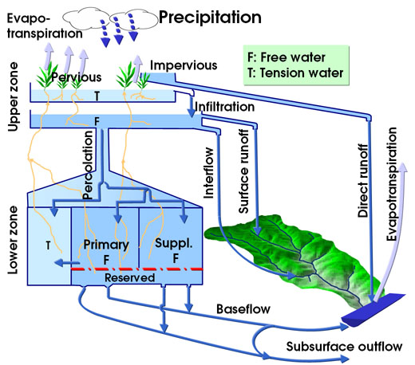
RFC Forecast System
RFC forecast uses a snow model and a rainfall-runoff model:
SNOW-17: Temperature index model for simulating snowpack accumulation and melt
Sacramento Soil Moisture Accounting Model: Conceptual hydrologic model used to generate runoff
Snow Model: SNOW-17 Temperature Index Snow model

Slide 5
RFC Model Inputs
Observed
Precipitation (radar and gages)
Streamflow
Temperatures
Freezing levels
Forecast
Precipitation (5 days, from HPC or WFOs)
Temperatures (10 days – MOS)
Freezing levels (RUC)

Slide 6
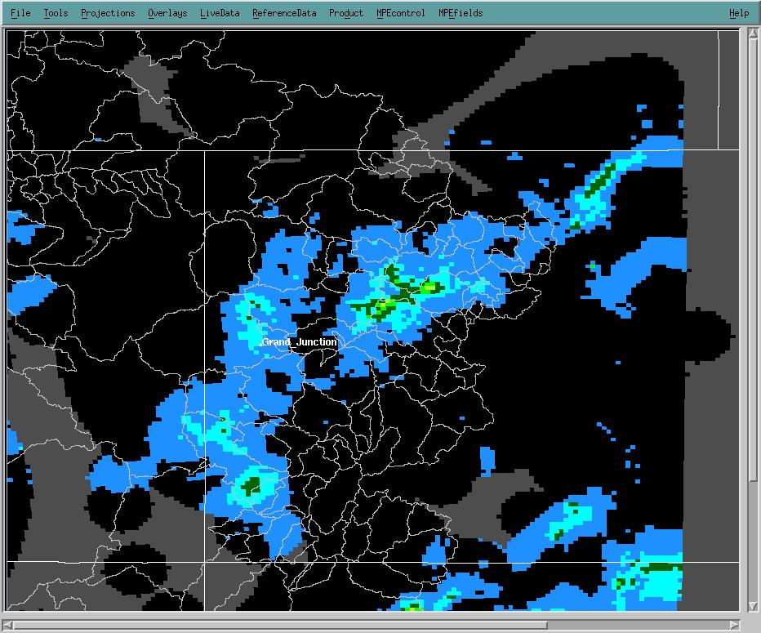
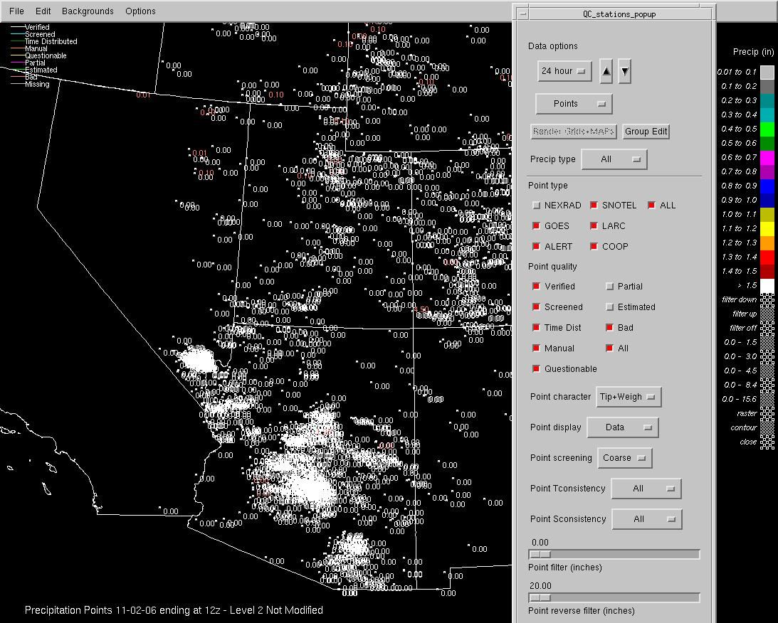
QC Observed Precip/Temp
Mountain Mapper (MM) for 24 hour and 6 hourly amounts (point data), and min/max temp
Multi-sensor Precipitation Estimator (MPE) for hourly (incorporates gage data from MM and radar)
→ feeds hydrologic model

Slide 7
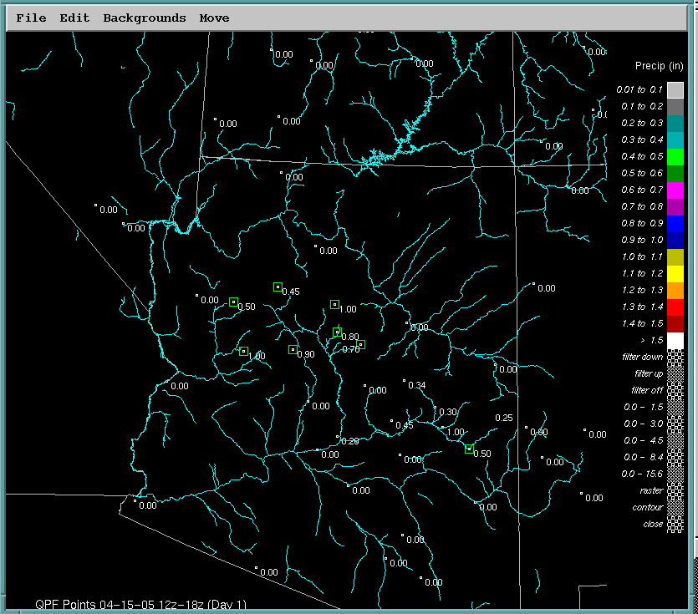
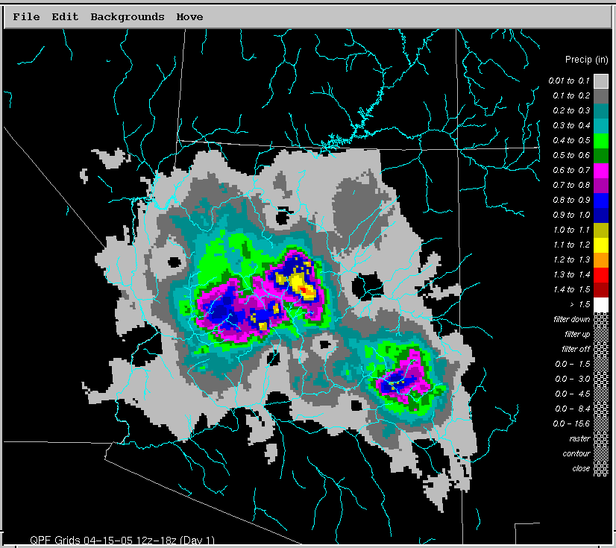
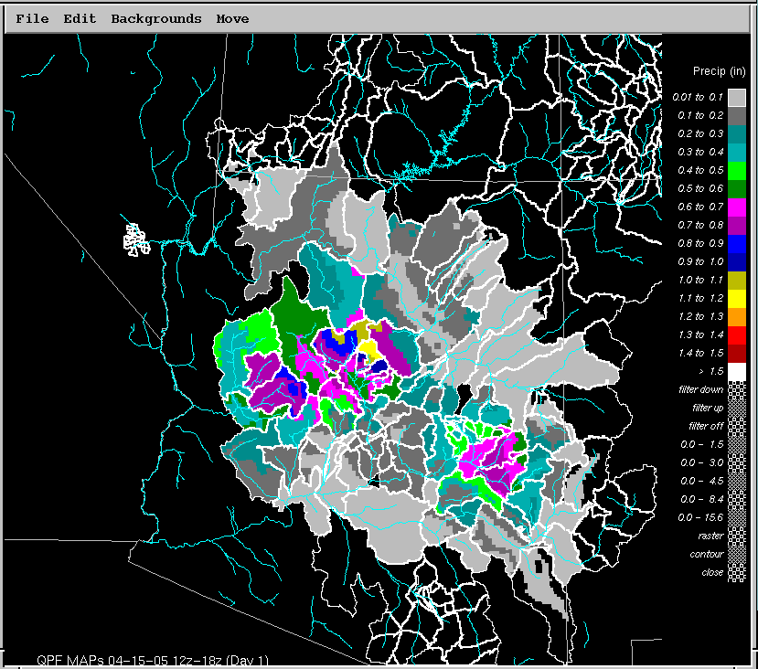
QPF
CBRFC relies on WFO
QPF expertise during
Hydrologic events
Point Values
(HPC)
Basin Values
Grid Values
(Prism
Scaling)
Use GFE to view WFO QPF
→ Will very soon feed hydro model

Slide 8
Influence of Inputs on River Forecast
QPF!!
Amount, timing, distribution and location all affect the streamflow forecast GREATLY
Freezing levels for some storms
Dictates snow or rain
Data availability during an event
Forecast temperature for snow melt

Slide 9
Challenges during events
DATA!!
Streamgages malfunction or get washed away during high water events
Precip data not always representative
ALERT data was an issue in December

Slide 10
Challenges during events - cont
Rating tables shift
Scouring
Debris
Updated daily
Updated during events

Slide 11
Issues during events – cont
Rating tables shift, especially during events
Model uses flow derived from stage, and then converts back to stage for the forecast

Slide 12
Contingency Runs
Phone call to discuss potential QPF or freezing level scenarios
RFC provide contingency runs, accessible though hydrograph on web site

Slide 13
Working together
RFC → WFO
WFO → RFC
Bad streamflow data
Currently weekly notification
Program to alert during event
Rating table changes
Daily program
Need to figure out what to do during events
Quality of simulation
Reports on the ground impacts
Significant changes to QPF
Confidence in QPF/forecast freezing levels/temps
Contingency runs
Extended staffing – CBRFC will extend hours for events as needed and upon request from WFO management
Call us if you have questions

Slide 14
In the future…
CHPS – Community Hydrologic Prediction System: Parallel Operations now; Operational by Oct 1, 2011
Distributed modeling – better representation of areal distribution of precipitation
Ensemble forecasts – HEFS being run experimentally now

Slide 15
CHPS
CHPS – Community Hydrologic Prediction System
The whole system, ie data collection, quality control, future forcing creation
Includes FEWS
FEWS – Flood Early Warning System
The hydrologic modelling software
Within CHPS
Replaces NWSRFS

Slide 16
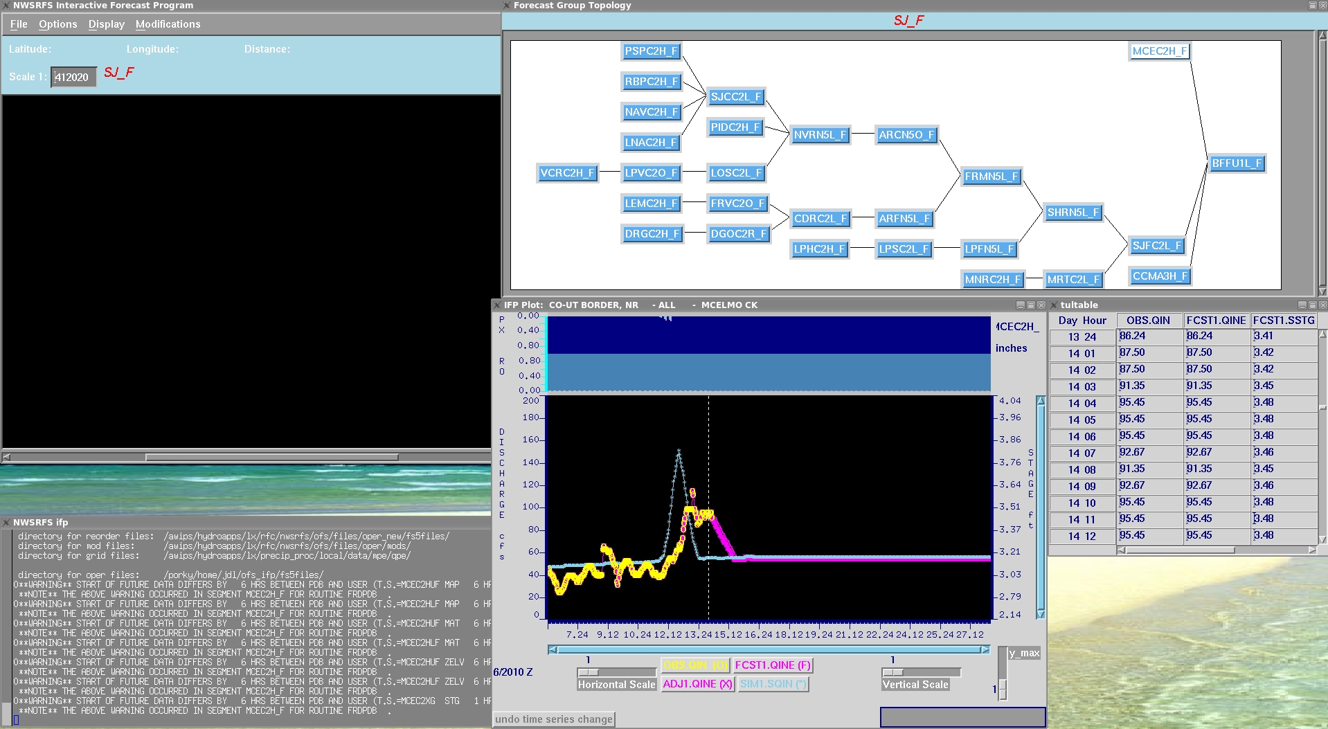
Current IFP interface with NWSRFS

Slide 17
New IFD interface for FEWS
Highlights of new features
More logging of system
Easier navigation of model plots
Better integration of segment information
Ability to view all data in system

Slide 18
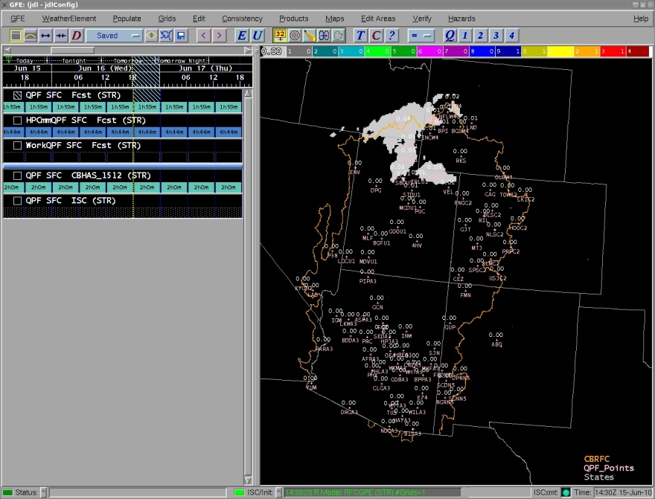
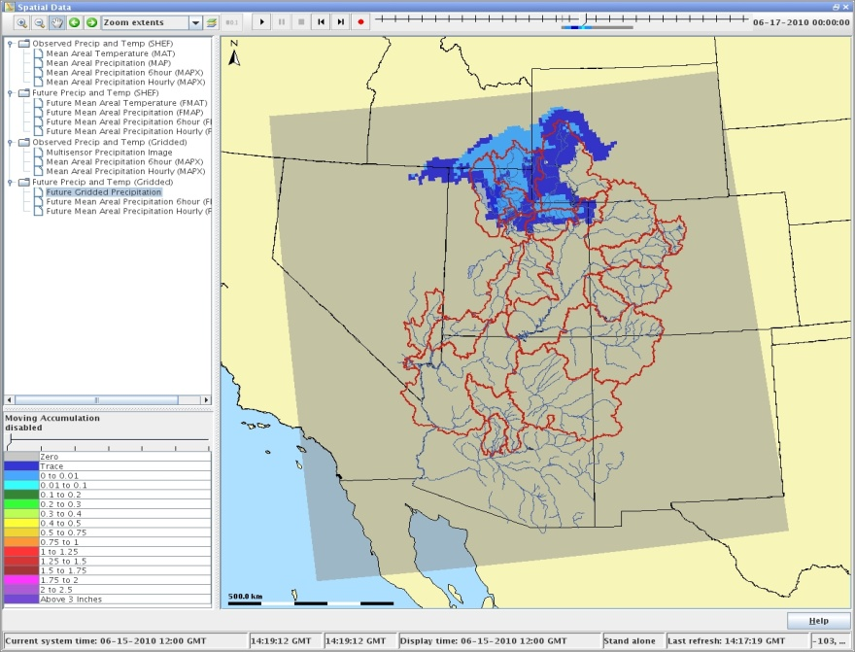
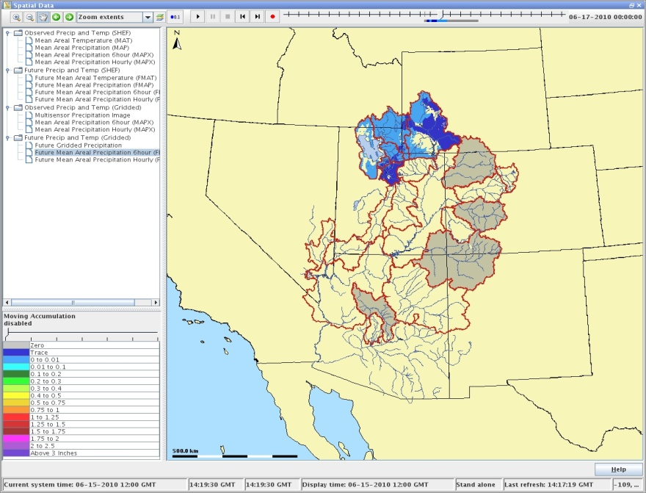
Gridded data into FEWS QPF example

Slide 19
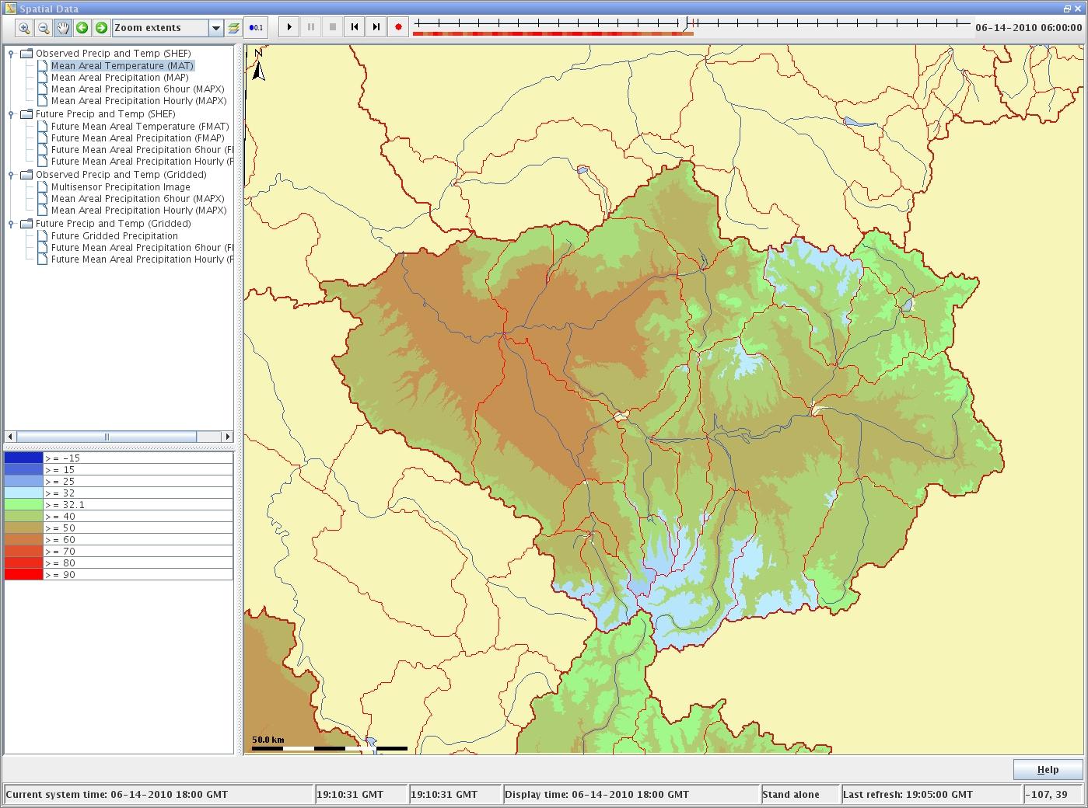
Gridded Temperatures and Freezing Levels will be imported too

Slide 20
Example Short Range Ensemble Products
7 of 13 RFCs are now producing an operational short range ensemble forecast product
Example -- Russian River – Guerneville, CA (GUEC1), December 24-29, 2010
2 upstream reservoirs,
5 locals
5 routing reaches
Following slides from Rob Hartman, Hydrologist in Charge
California-Nevada River Forecast Center (CNRFC)

Slide 21
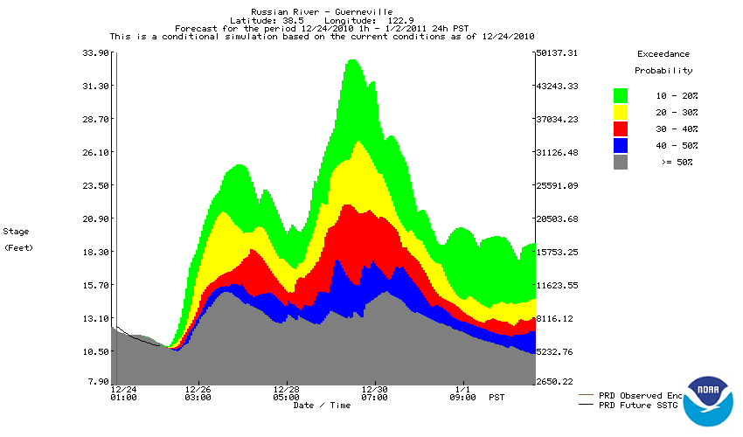
GUEC1 – 12/24/2010
X
X

Slide 22
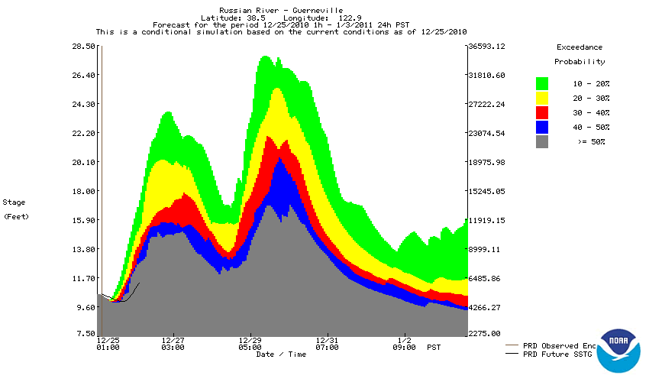
GUEC1 – 12/25/2010
X
X

Slide 23
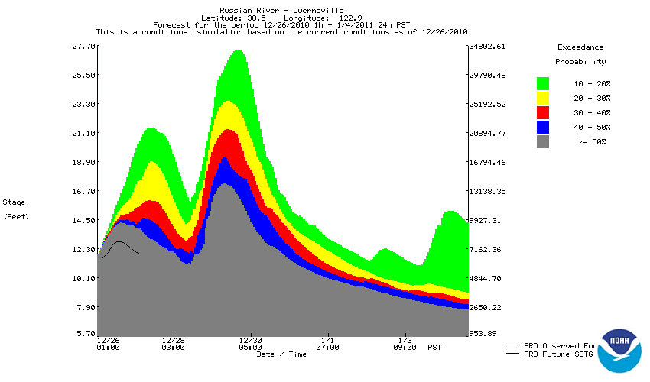
GUEC1 – 12/26/2010
X
X

Slide 24
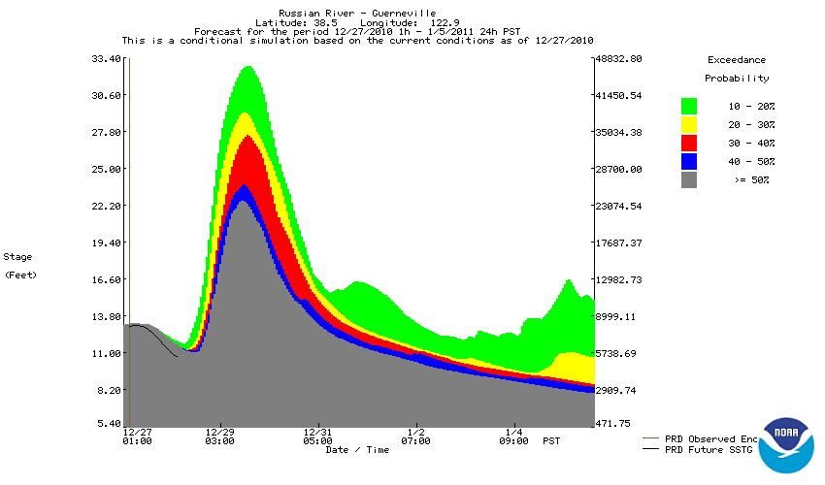
GUEC1 – 12/27/2010
X
X

Slide 25
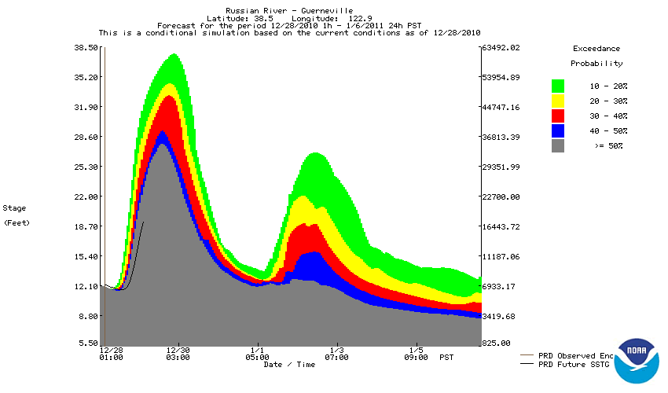
GUEC1 – 12/28/2010
X
X

Slide 26
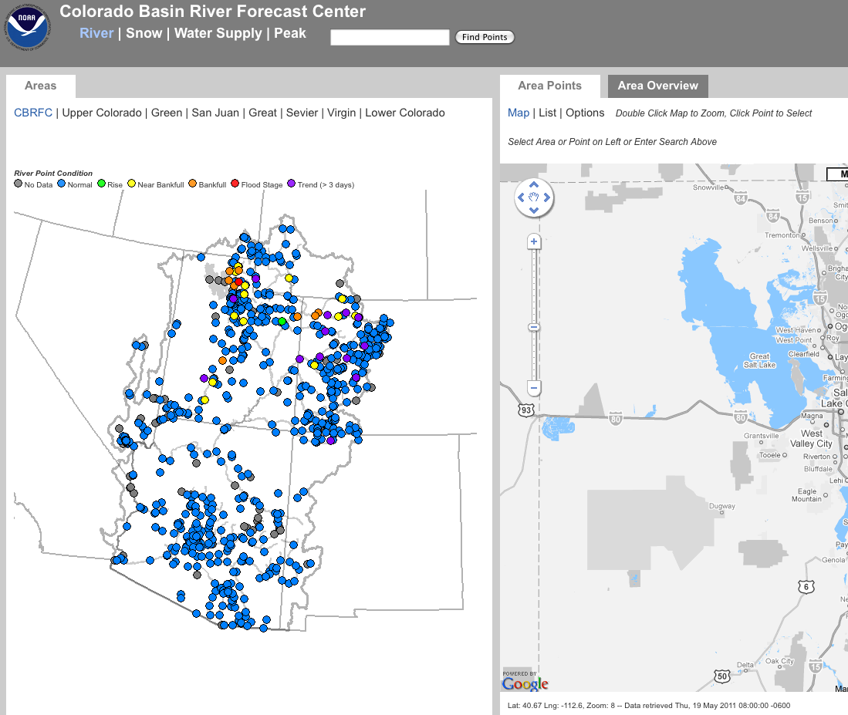
Beta CBRFC Website
Main page -> beta map
Seeking input

Slide 27
Discussion
Current and future RFC modeling and forecasting capabilities – Are you using these effectively?
CBRFC website retooling – Any input?
How can new services / tools be applied in the WFO and to stakeholders?

Slide 28
Feedback, Questions, Concerns always welcome….
Kevin Werner
CBRFC Service Coordination Hydrologist
Phone: 801.524.5130
Email: michelle.schmidt@noaa.gov
www.cbrfc.noaa.gov

