Slide 1
CBRFC Forecasts and Updates
Kevin Werner
NWS Colorado Basin River Forecast Center

Slide 2
Outline
Current Forecast / Conditions
Ensemble Streamflow Prediction (ESP) Primer
30 year average period update

Slide 3
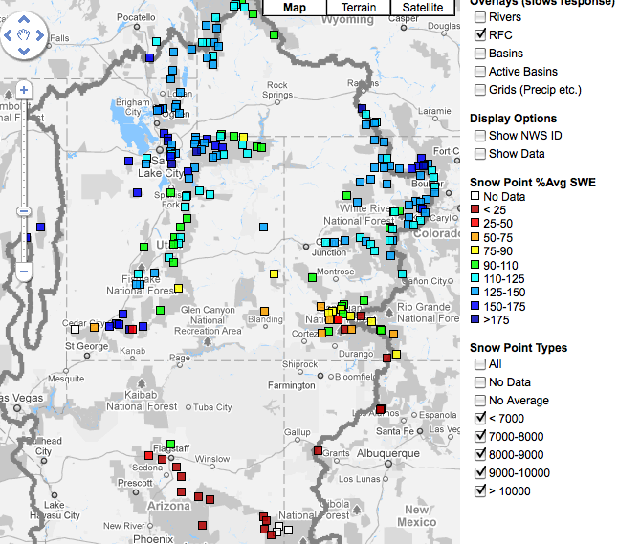
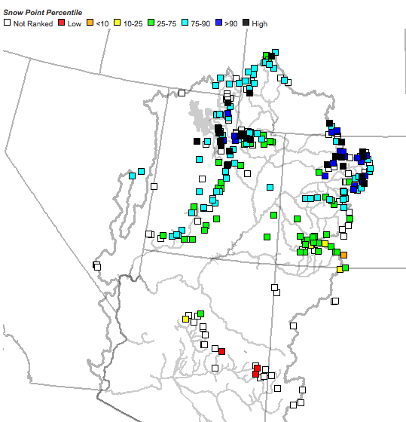
Snow
April 7 as a percent of average (above)
April 7 as a percentile (right)
Web Reference: http://www.cbrfc.noaa.gov/gmap/gmapm.php?scon=checked

Slide 4
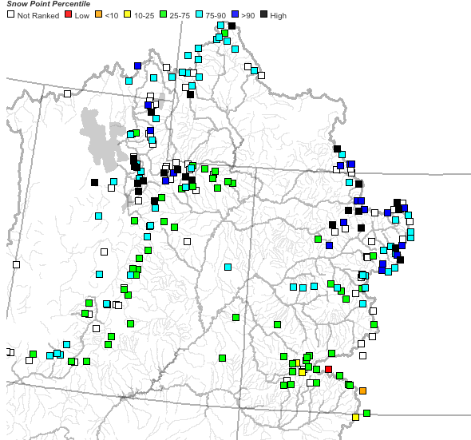
~25 sites showing highest value ever for today!!

Slide 5
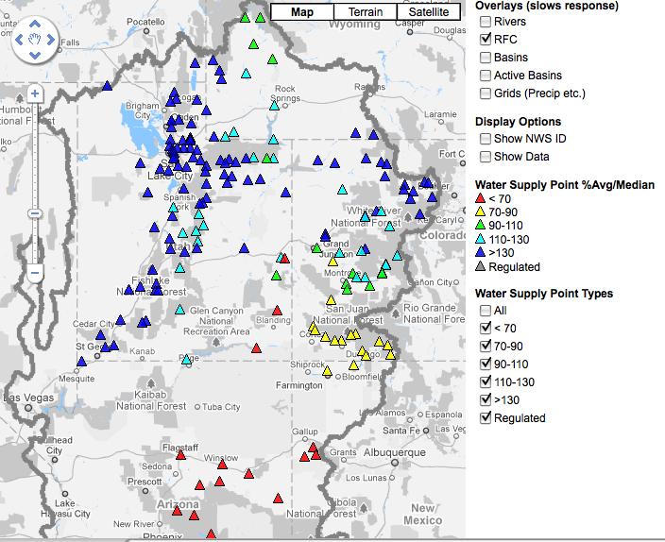
April 1, 2011
Water Supply Forecasts
Highlights:
Wet winter continues for much of the basin with many forecasts higher than any year since 1997
Some northern basins predicting flows near the top 10%
Forecasts slightly higher across northern basins since Feb 1 and Mar 1
San Juan and lower basin somewhat lower since Feb 1 and Mar 1
Web Reference: www.cbrfc.noaa.gov/gmap/gmapm.php?wcon=checked

Slide 6
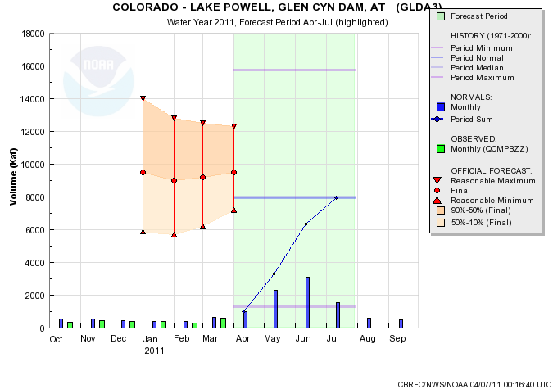
Web Reference: www.cbrfc.noaa.gov/gmap/gmapm.php?wcon=checked

Slide 7
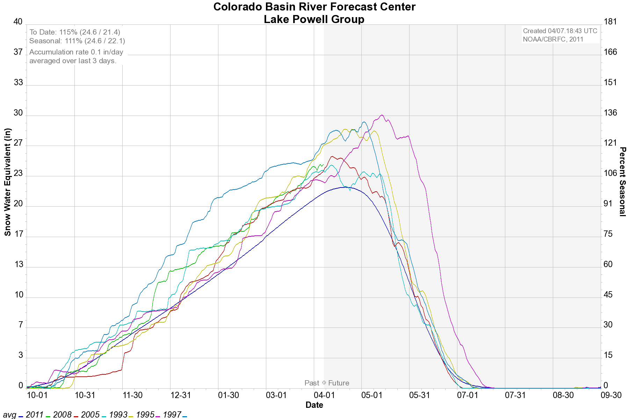
YEAR | OBS VOL (KAF) / %AVG | RANK (101 YRS)
2005 | 8844 / 112% | 39
2008 | 8909 / 112% | 38
1993 | 9984 / 126% | 29
Lake Powell historical inflows

Slide 8
Water Supply Forecast Methods
Statistical Forecasting
Statistical Regression Equations
Primary NOAA/RFC forecast method from 1940’s to mid 1990’s.
Primary NRCS/NWCC forecast method
Historical Relationships between flow, snow, & precipitation (1971-2000)
Tied to a fixed runoff period (inflexible)
Ensemble Simulation Model Forecasting
A component of a continuous conceptual model (NWSRFS)
Continuous real time inputs (temperature, precipitation, forecasts)
Accounts for soil moisture states (SAC-SMA) - drives runoff efficiency
Builds and melts snowpack (Snow-17) – output feeds SAC-SMA
Flexible run date, forecast period, forecast parameters.
Evolving toward ESP as primary forecast tool at NOAA/RFCs
Current Calibration period: 1976-2005
Notes:
8
The NWS started making water supply forecasts in the 1940s for the Colorado basin. Eventually these forecasts were expanded to cover most western snow melt dominated basins through cooperation with the NRCS. Seasonal streamflow forecasts tradionally derive nearly all of their skill from current snowpack conditions in the basin. In fact, the NRCS SNOTEL network was deployed beginning in the late 1970s explicitly to improve seasonal streamflow prediction.
Bullets on left give background information on water supply forecasts.
The upper right figure is hyperlinked to “live” website (www.cbrfc.noaa.gov/westernwater). - Suggest clicking on website and giving a brief synopsis of current forecasts for western US. Note that most areas are extremely dry this year – particularly most all of California and the Colorado Basin. The Washington Cascades and the upper Arkansas River Basin are the only areas with above normal forecasts this year.

Slide 9
ESP Technique
Now
Low chance of this level flow or higher
Past
Future
Medium chance of this level flow or higher
Flow
High chance of this level flow or higher
Time
©The COMET Program
Notes:
In another example, past observations are use to adjust the hydrologic model. The current time is when model states are saved. The future will use forecast or historic data as input to the model to produce possible hydrographs. Here, a series of hydrograph traces are generated, each based on a particular set of input values. The resulting traces give an idea of the range of possible flows.
For this case, because all of the traces are above this point, the probability that this flow will occur is very high. For the this second case, there is a medium chance flows at this level will occur since some of the traces were above and below this point. For the third case, chances of this flow are low, since all of the trances are lower than this particular value.

Slide 10
ESP for Water Supply
ESP forecasts based on
(1) initial conditions (e.g. snow pack, base flow, etc)
(2) future scenarios
Early in the season, future scenarios contribute more to forecast
As snow accumulates, dry/wet years begin to define themselves in the initial conditions

Slide 11
Feb 1 forecast
Feb 1
Low chance of this level snow or higher
Past
Future
Medium chance of this level snow or higher
Snow
High chance of this level snow or higher
Time
©The COMET Program
Notes:
In another example, past observations are use to adjust the hydrologic model. The current time is when model states are saved. The future will use forecast or historic data as input to the model to produce possible hydrographs. Here, a series of hydrograph traces are generated, each based on a particular set of input values. The resulting traces give an idea of the range of possible flows.
For this case, because all of the traces are above this point, the probability that this flow will occur is very high. For the this second case, there is a medium chance flows at this level will occur since some of the traces were above and below this point. For the third case, chances of this flow are low, since all of the trances are lower than this particular value.

Slide 12
Mar 1 forecast
Low chance of this level flow or higher
Mar 1
Past
Future
Medium chance of this level flow or higher
Snow
High chance of this level flow or higher
Time
©The COMET Program
Notes:
In another example, past observations are use to adjust the hydrologic model. The current time is when model states are saved. The future will use forecast or historic data as input to the model to produce possible hydrographs. Here, a series of hydrograph traces are generated, each based on a particular set of input values. The resulting traces give an idea of the range of possible flows.
For this case, because all of the traces are above this point, the probability that this flow will occur is very high. For the this second case, there is a medium chance flows at this level will occur since some of the traces were above and below this point. For the third case, chances of this flow are low, since all of the trances are lower than this particular value.

Slide 13
Apr 1 forecast
Low chance of this level snow or higher
Apr 1
Future
Past
Medium chance of this level snow or higher
Snow
High chance of this level snow or higher
Time
©The COMET Program
Notes:
In another example, past observations are use to adjust the hydrologic model. The current time is when model states are saved. The future will use forecast or historic data as input to the model to produce possible hydrographs. Here, a series of hydrograph traces are generated, each based on a particular set of input values. The resulting traces give an idea of the range of possible flows.
For this case, because all of the traces are above this point, the probability that this flow will occur is very high. For the this second case, there is a medium chance flows at this level will occur since some of the traces were above and below this point. For the third case, chances of this flow are low, since all of the trances are lower than this particular value.

Slide 14
30 year average
30 year averages are updated once every 10 years
Currently using
1971-2000 for averages
1971-2000 for statistical prediction
1976-2005 for ESP
Update for WY2012 will be based on 1981-2010 averages
Trends in monthly precipitation are important for ESP

Slide 15
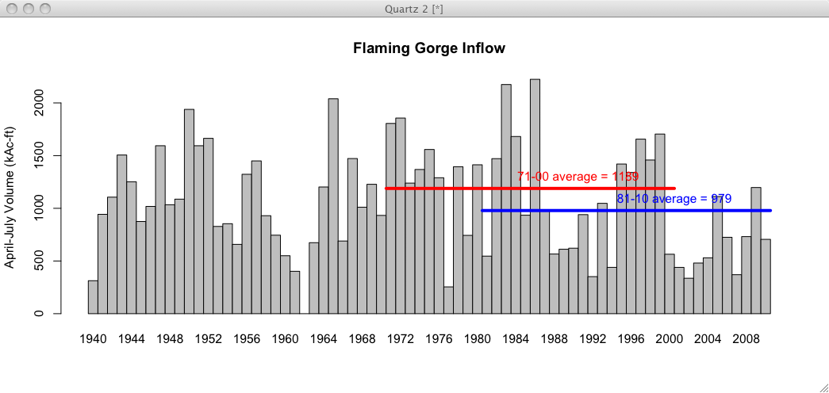
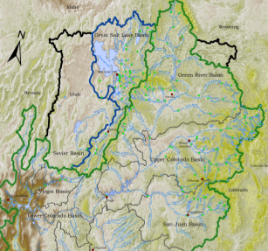
Preliminary Data
18% reduction in mean

Slide 16
Upper Green (at Warren Bridge) Precipitation Trends by Month

Slide 17
Upper Green (at Warren Bridge) Precipitation Trends by Month

Slide 18
Yampa / White Rivers (updated through 2010)

Slide 19
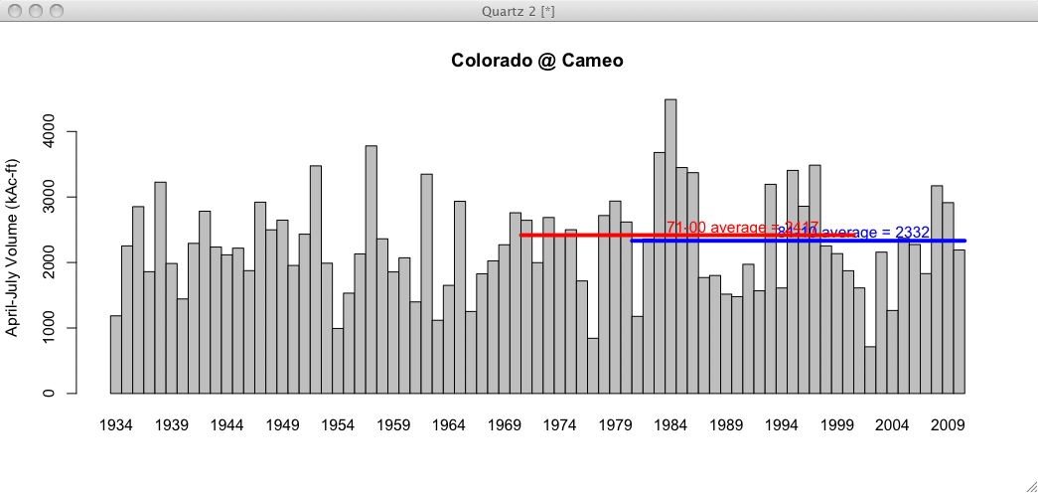
Preliminary Data
4% reduction in mean

Slide 20
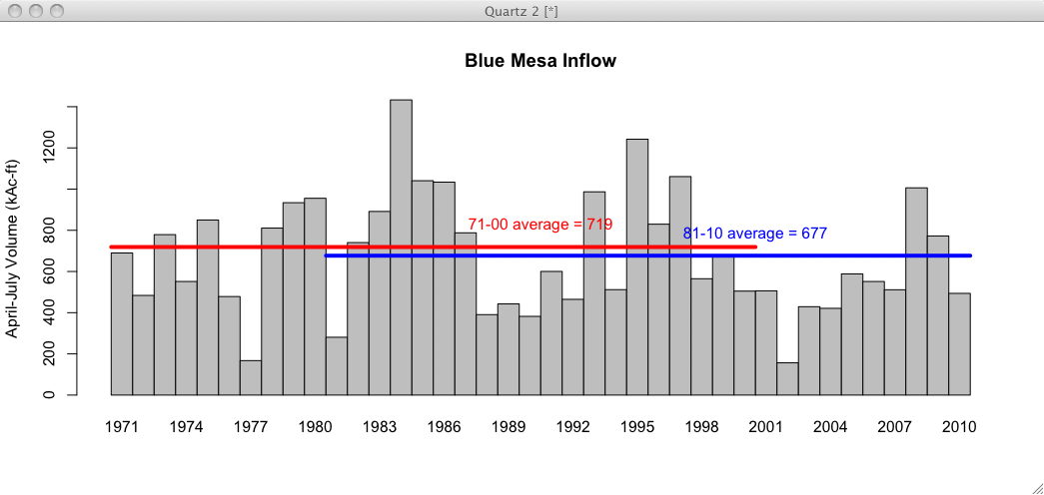
Preliminary Data
6% reduction in mean

Slide 21
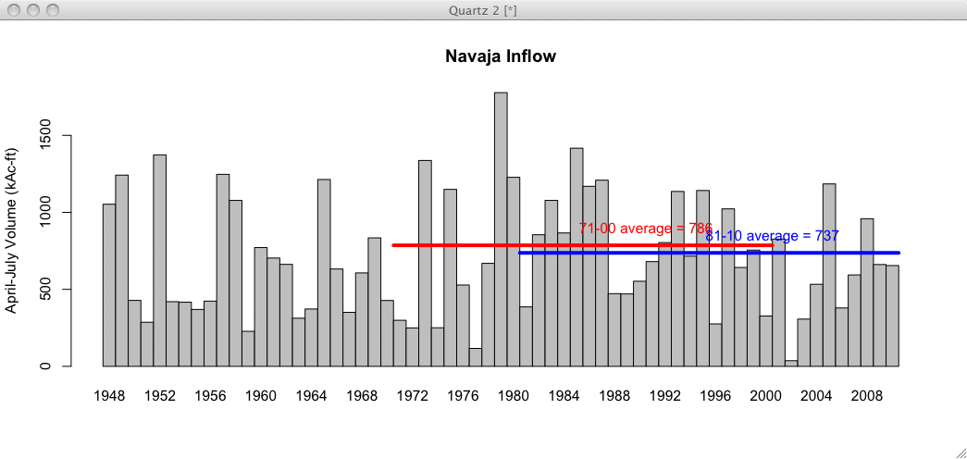
Preliminary Data
6% reduction in mean

Slide 22
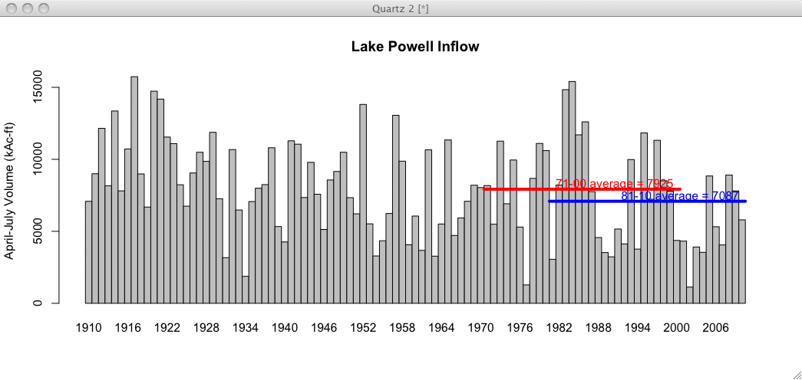
Preliminary Data
11% reduction in mean

Slide 23
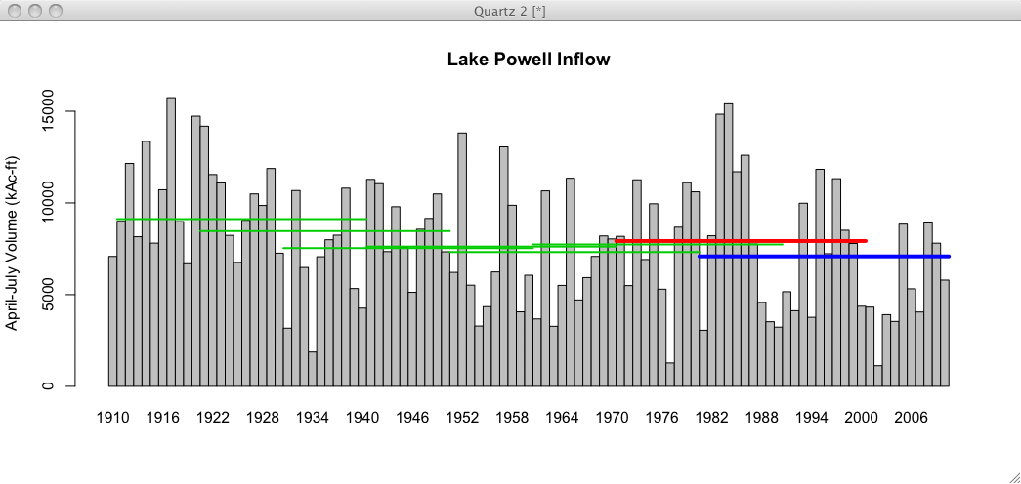
Preliminary Data
All 30 year means since 1911-1940

Slide 24
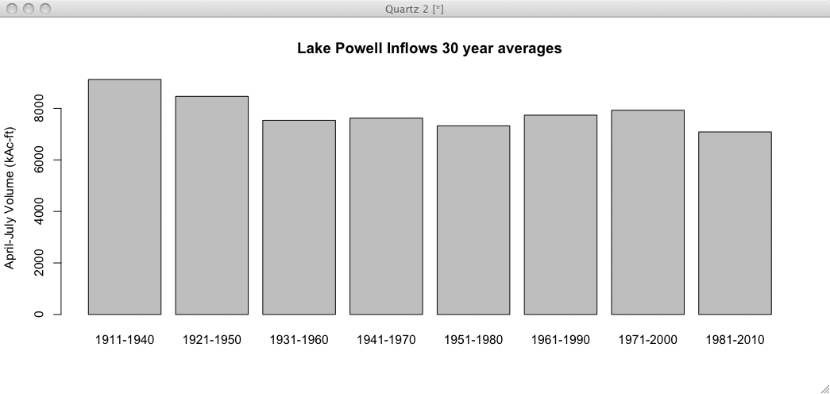
1981-2010 is the driest 30 year period on record

Slide 25
Affect on Forecasts
WY2011 forecasts continue to use 1971-2000 means:
Statistical models (SWS and NRCS) will use 1971-2000
Simulation model (ESP) will use 1976-2005
WY2012 forecasts will be based on 1981-2010 inputs in both forecast models
ESP and SWS will both use the same period
SNOTEL network much stronger for 1981-2010 period than in 1970s. This network is critical for forecast skill.
All things equal, these forecasts will be lower since input data sets are drier in the 30 year average
Especially true in early season forecasts
Later season forecasts more controlled by observed snowpack
Percent of normal forecast values should remain largely unchanged (since normals AND forecasts will be lower)

Slide 26
CBRFC Updates
Anticipating significant spring flooding May-June
Migration to new CHPS (Community Hydrologic Prediction Services) software complete late summer / early fall
Experimental hydrologic ensemble services running – incorporates ensemble weather and climate forecasts
Seasonal / 2 year prediction workshop (March 2011) and testbed activity – possible fall workshop to include stakeholders
Evapotranspiration work ongoing – testing application to drought and water demand forecast / analysis

Slide 27
Discussion
CBRFC will shortly develop plan for implementation of new normal period (bulk of work to occur over summer)
USBR requested update occur on August 1 or on January 1 but not in between
Comments / Questions?

Slide 28
Kevin Werner
CBRFC Service Coordination Hydrologist
Phone: 801.524.5130
Email: kevin.werner@noaa.gov
www.cbrfc.noaa.gov

