Slide 1
Forecasting Evaporative Demand across the Conterminous US
Michael Hobbins
Dave Streubel
Kevin Werner

Slide 2
Outline and Background
ET_{rc} forecasts
Improving streamflow forecasts
Evaporative demand: Upper constraint on actual evapotranspiration (ET). Numerous metrics, either physically based or more simple temperature-only based including:
  Reference crop ET (ET_{rc})
  Pan Evaporation (E_{pan})
  Potential ET

Slide 3
1. Forecasting ET_{rc} across NWS Western Region
provide forecasts of ET_{rc} that are scientifically sound, web-disseminated, fine-resolution, accurate, and daily-to-weekly;
develop a 30-year climatology to add context to these forecasts.

Slide 4

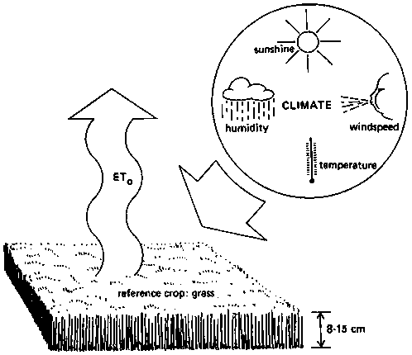
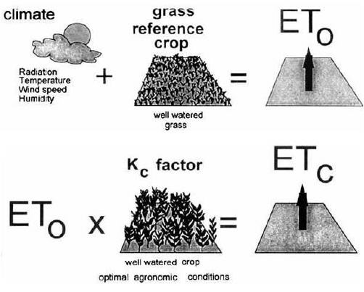
1. Forecasting ET_{rc} across NWS Western Region
Penman-Monteith ET_{rc} (standard FAO-56 formulation)
ET_{rc} = reference crop ET
λ = latent heat of vaporization
T = 2-m air temperature
Δ = de_{sat}/dT at T
γ = psychrometric constant
Q_{n} = net available energy for ET
e_{sat} = saturated vapor pressure
e_{a} = actual vapor pressure
U₂ = 2-m wind speed
Weighted combination of radiative and advective drivers.
reference crop is specified:
  well-watered grass,
  actively growing,
  0.12 m in height,
  completely shading the ground,
  albedo of 0.23.
ET_{rc} then multiplied by factors describing soil moisture, stress, and phenology, to yield an actual ET estimate, e.g.:

Slide 5
1. Forecasting ET_{rc} across NWS Western Region
Two set of model drivers
1. North American Land Data Assimilation System (NLDAS)
  Air temperature at 2-m elevation
  Specific humidity at 2-m
  Down-welling short-wave radiation
  Down-welling long-wave radiation
  Station pressure
  Wind speed at 10-m
  Hourly time-step
  0.125-deg (~12 km) resolution
  1980 through present
2. National Digital Forecast Database (NDFD)
  Air temperature at 2-m
  Dewpoint temperature at 2-m
  Wind speed at 2-m
  Areal extent of cloud cover
  Hourly, 3-hourly, or 6-hourly time-steps
  2.5-km / 5-km resolution HRAP grid
Reanalysis data for climatology
Forecast data

Slide 6
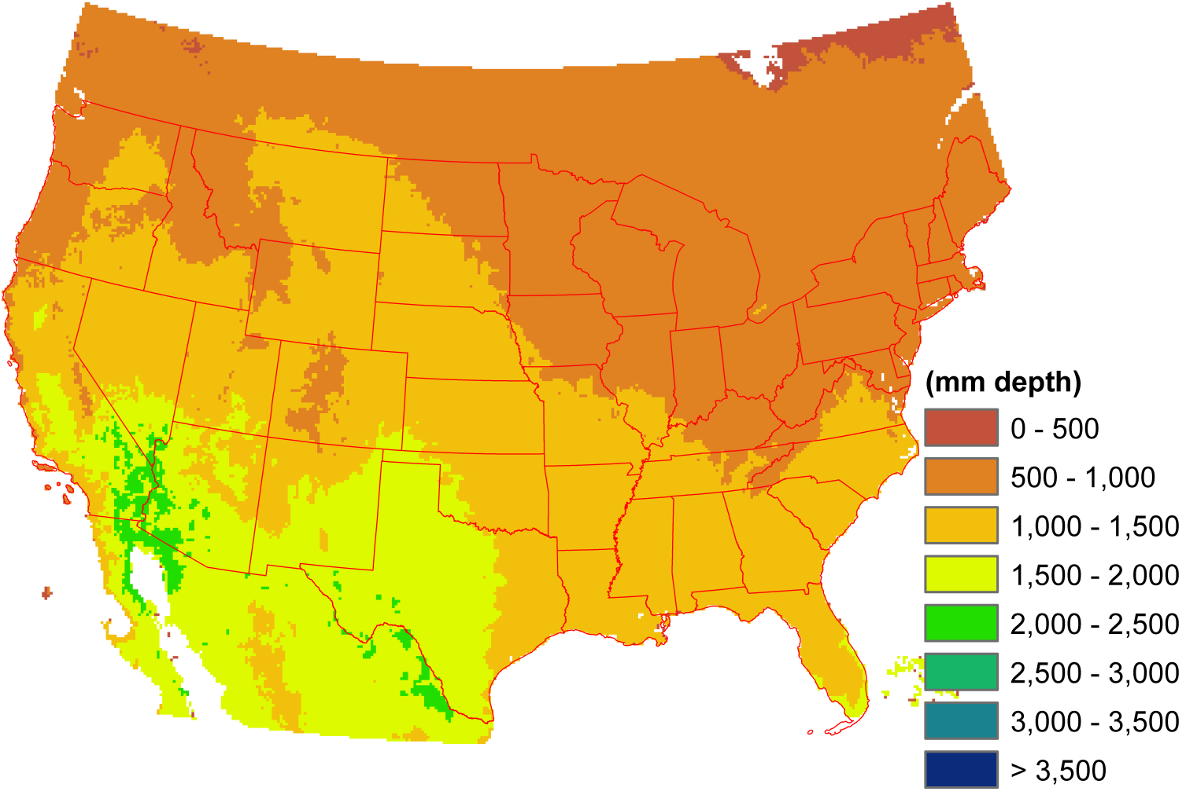
1. Forecasting ET_{rc} across NWS Western Region
Mean annual Penman-Monteith ET_{rc}

Slide 7
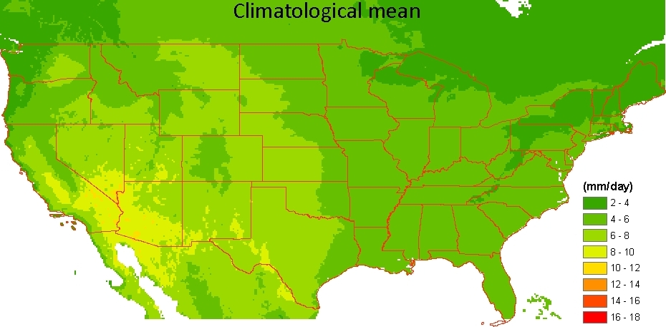
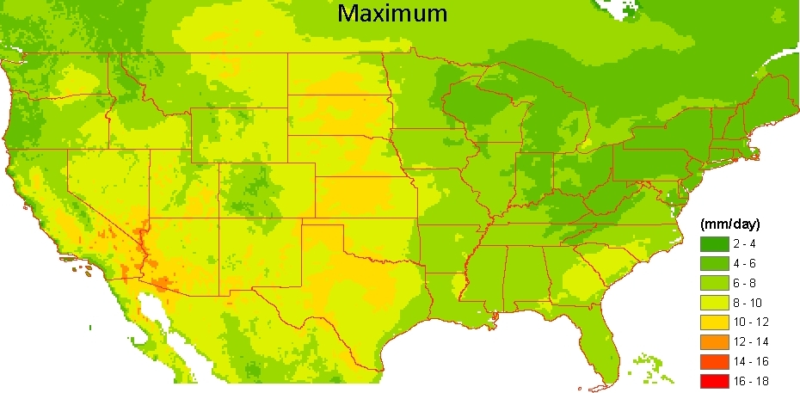
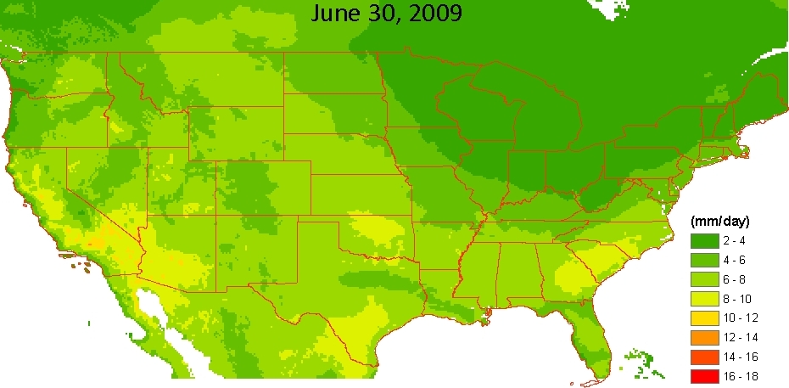
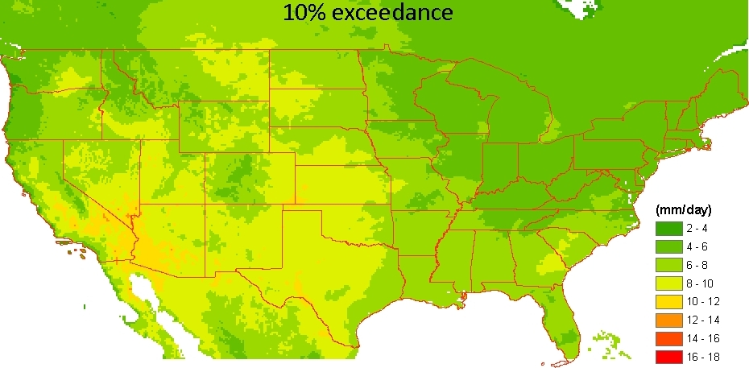
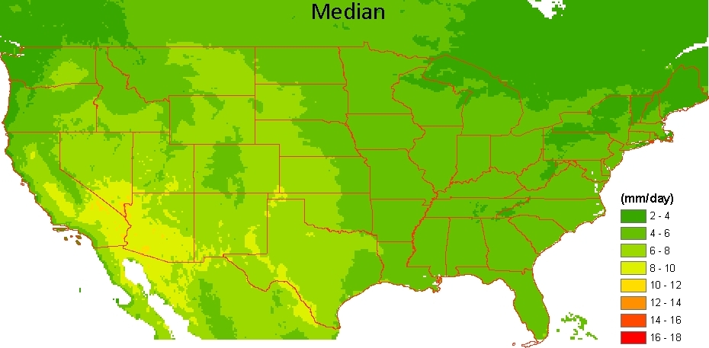
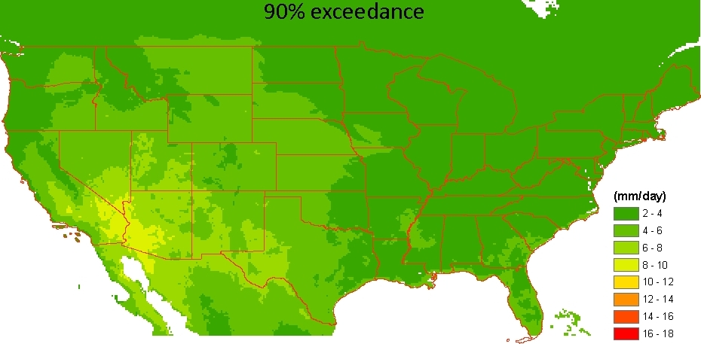
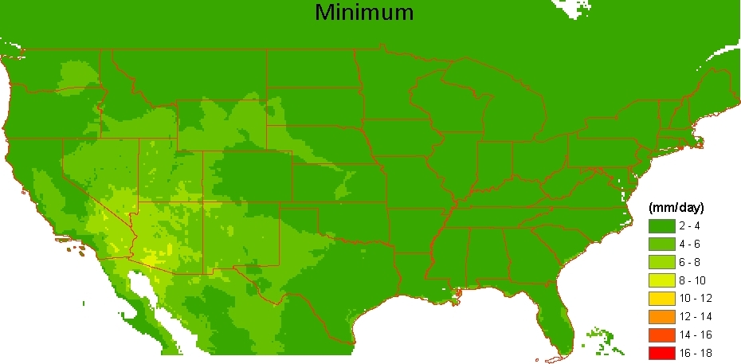
1. Forecasting ET_{rc} across NWS Western Region
NLDAS-forced climatologies of ET_{rc}
Computed for each day (1980 – present)
Also available at multi-day time-steps.
NLDAS = North American Land Data Assimilation System

Slide 8
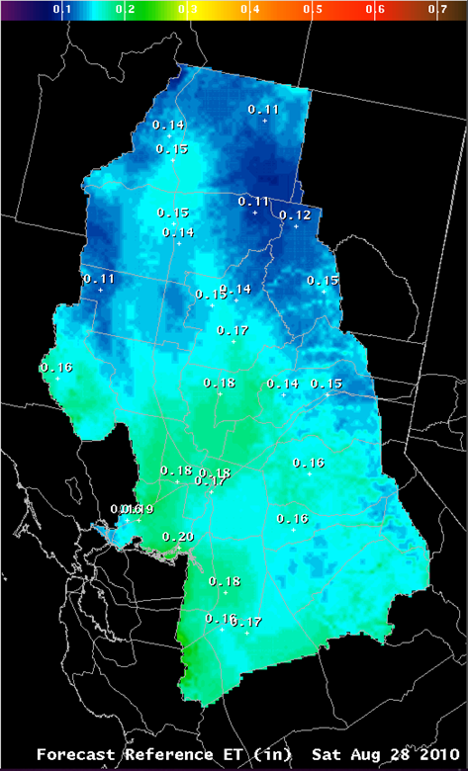
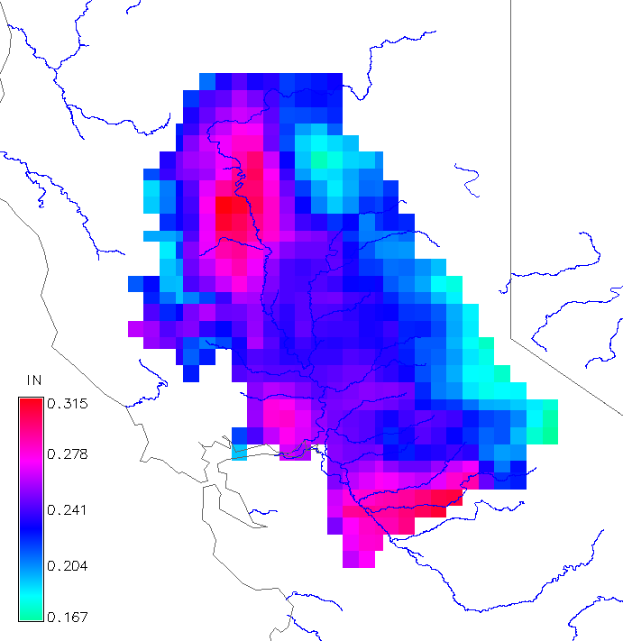
1. Forecasting ET_{rc} across NWS Western Region
NLDAS-driven climatology and NDFD-driven forecasts
Forecast surface, generated at Weather Forecast Office
Climatology surface, specific to date and tailored to local area
+

Slide 9

1. Forecasting ET_{rc} across NWS Western Region
Product delivery
Wind
Temperature
Dewpoint
Sky cover
Input forecast grids
NDFD-derived
2.5-km resolution
hourly
WFO FORECAST
+ + +
ET_{rc} climatology grids
NLDAS-derived
0.125º resolution
CONUS-wide
daily / weekly
moving window / static weeks
CBRFC & WR-SSD
mean
GFE
script
variance
minimum
90% exceedance
median (50%)
10% exceedance
maximum
ET_{rc} forecast grid
2.5-km resolution
daily/weekly outlook
ET_{rc} point forecast
value-added
historical context
spatial context
WFO PRODUCT
e.g., http://www.wrh.noaa.gov/sto/et

Slide 10
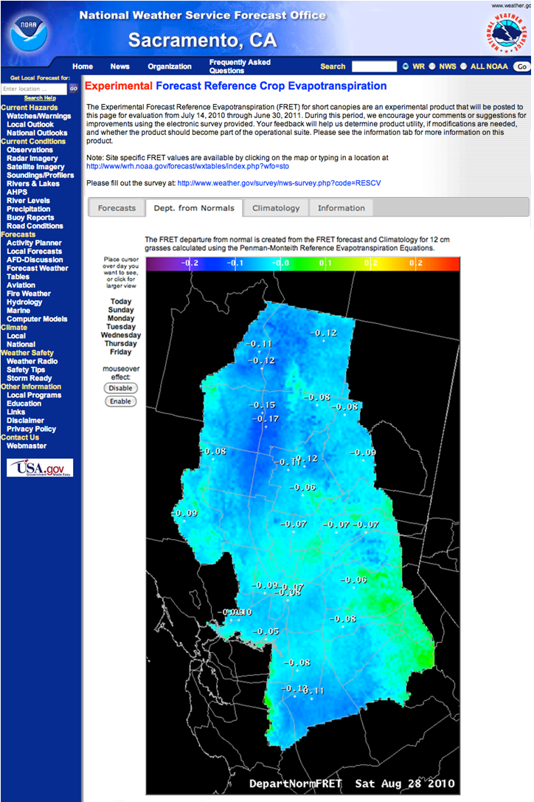
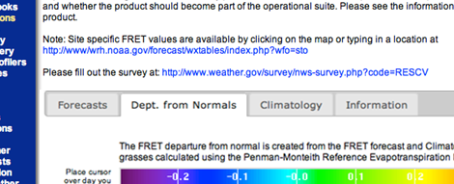
1. Forecasting ET_{rc} across NWS Western Region
Product delivery: Forecast ET_{rc} (FRET) webpage
Operational status:
  running at 12 NWS-WR WFOs:
  soon at rest of NWS Western Region,
  eventually CONUS-wide (in line with NWS 2020 Goal #2),
  experimental period ends 06/30/2011.
FRET website for Sacramento, CA
http://www.wrh.noaa.gov/forecast/evap/FRET/FRET.php?wfo=sto

Slide 11
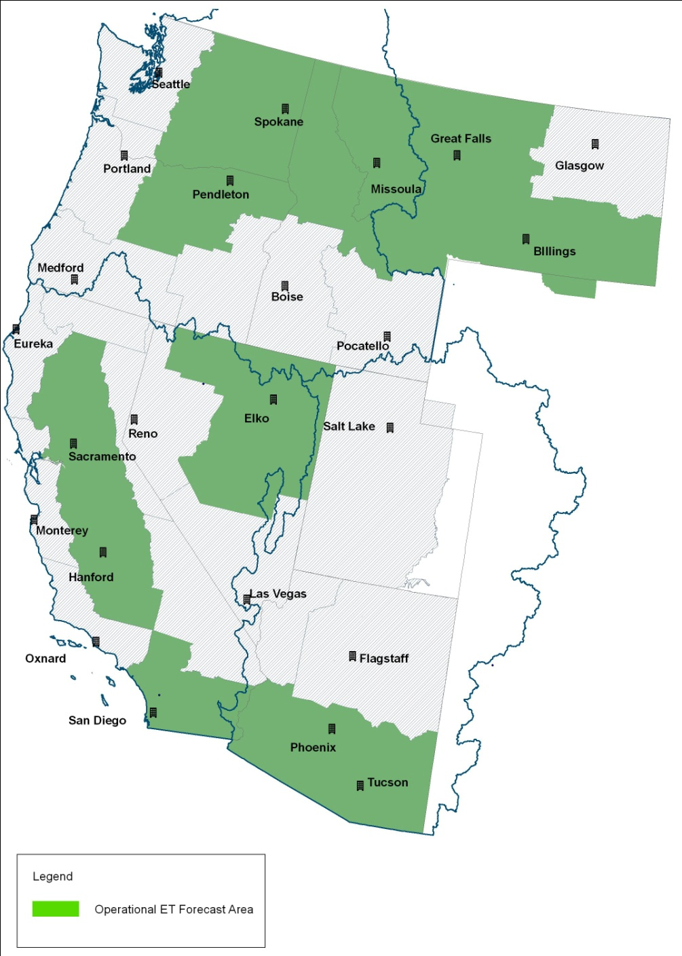
1. Forecasting ET_{rc} across NWS Western Region
Project status: 12 Weather Forecast Offices
Notes:
11 WFOs in NWS Western Region, 12th is Grand Forks WFO in ND.

Slide 12
1. Forecasting ET_{rc} across NWS Western Region
Project status
Climatology
Jan 1980 – Dec 2009
high resolution
unbiased wrt forecasts
Forecast
operations
real-time
daily/weekly
ET_{rc}(t)
verification
ET_{rc}(forecast)
statistical analysis
ET_{rc}(climo)
Value-added ET_{rc}(forecast)
experimental www publication
feedback from users
www publication
system spread
Notes:
Black rounded box represents current project status

Slide 13
1. Forecasting ET_{rc} across NWS Western Region
Uses of ET-related reanalyses, real time analyses, and forecasts
    Reanalysis
    Daily gridded time series
    Multi-decadal analysis
    Trend analysis
    Real time analysis
    Daily updating gridded time series
    Consistent with reanalysis
    Anomaly calculation
    Forecasts
    Days 1-5 based on NDFD
    Seasonal forecasts
Drought analyses, reanalyses:
  ongoing drought monitoring
  forecast drought development
  historical drought trends
  (e.g., improved PDSI-analyses in Hobbins et al., [2008])
  US Drought Monitor
    No explicit ET related input
Demand-planning and management for:
  Agriculture – irrigation scheduling
  Municipal utilities – water management
  Trans-mountain diversions
  Reservoir operations
Hydrologic science community
Private industry – e.g., recreation, estimating water needed to support proposed developments
Notes:
Many uses at different time-scales:
Climate change analyses: Treating the final piece of the hydrologic cycle in a temporally dynamic, physically rigorous manner will allow climate change analyses across the Colorado River basin within the RFC model infrastructure.

Slide 14
2. Dynamic Evaporative Demand in the Sac-SMA model at CBRFC
Goals
Improve streamflow forecast skill at daily operational and seasonal time-scales;
By improving ET-treatment in river forecast operations;
By replacing the current, static evaporative driver of the Sac-SMA model with a physically based, accurate, and temporally dynamic driver.

Slide 15
2. Dynamic Evaporative Demand in the Sac-SMA model at CBRFC
Drivers
1. North American Land Data Assimilation System (NLDAS)
  Air temperature at 2-m elevation
  Specific humidity at 2-m
  Down-welling short-wave radiation
  Down-welling long-wave radiation
  Station pressure
  Wind speed at 10-m
  Hourly time-step
  0.125-deg (~12 km) resolution
2. National Digital Forecast Database (NDFD)
  Air temperature at 2-m
  Dewpoint temperature at 2-m
  Wind speed at 2-m
  Areal extent of cloud cover
  Hourly, 3-hourly, or 6-hourly time-steps
  2.5-km / 5-km resolution HRAP grid
Data for reanalyses of E_{pan}, streamflow
Forecast data

Slide 16
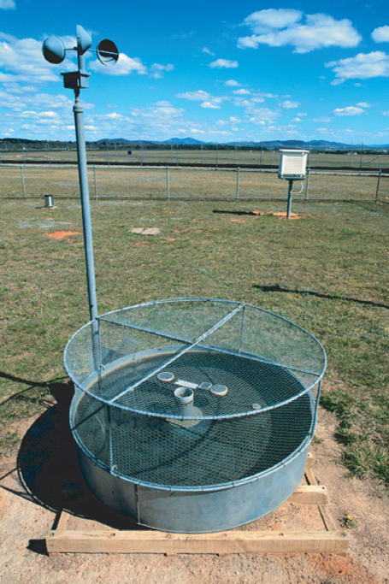

2. Dynamic Evaporative Demand in the Sac-SMA model at CBRFC
PenPan equation
Modifies Penman equation to replicate the enhanced characterization of radiative and advective dynamics of evaporation pans.
weighted combination of radiative and advective drivers.
synthesizes monthly E_{pan} observations well.
E_{pan} = synthetic pan evaporation
λ = latent heat of vaporization
U₂ = 2-m wind speed
f_{q}(U₂) = vapor transfer function or “wind function”
e_{sat} = saturated vapor pressure
e_{a} = actual vapor pressure
Δ = de_{sat}/dT at air temperature
a_{P} = ratio of effective surface areas for heat and water-vapor transfer in a pan
γ = psychrometric constant
Q_{n} = net available energy for E_{pan}

Slide 17
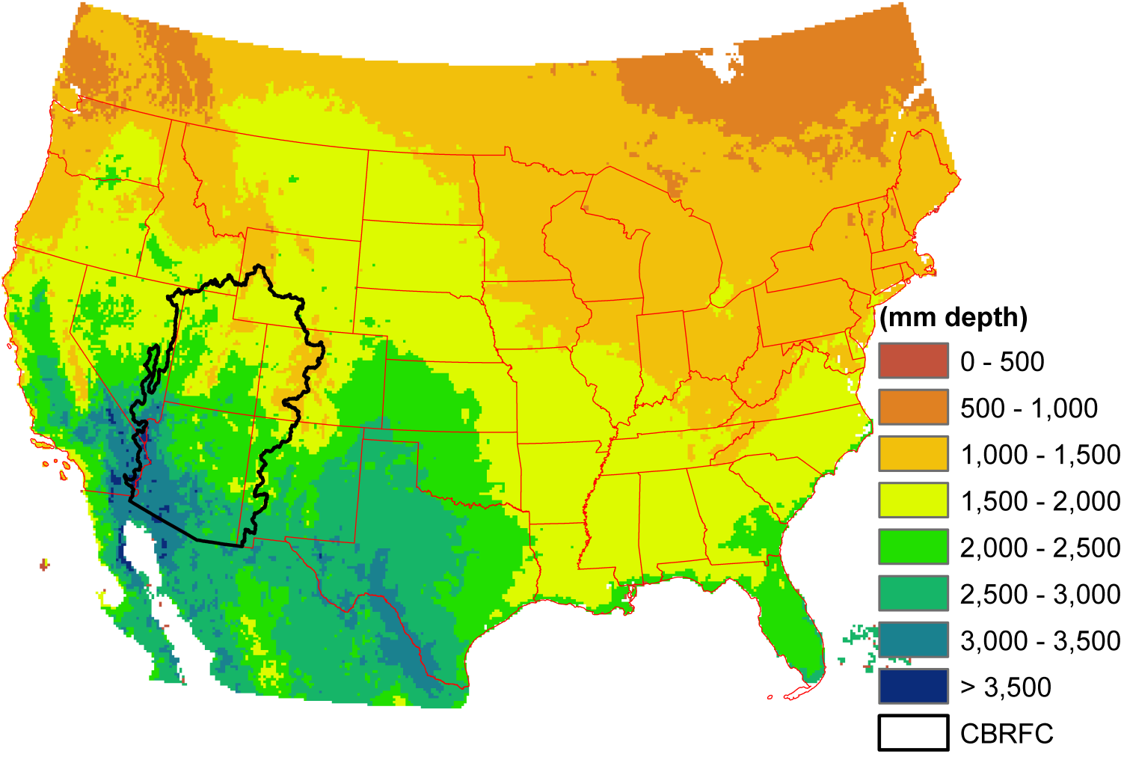
2. Dynamic Evaporative Demand in the Sac-SMA model at CBRFC
Mean annual PenPan, 1980-2009

Slide 18
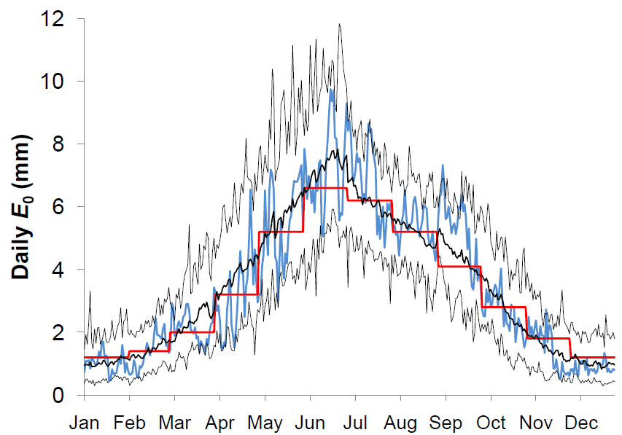
2. Dynamic Evaporative Demand in the Sac-SMA model at CBRFC
PenPan for Animas River at Durango, CO, 1980-2009
Daily E_{pan} (mm)
max, min daily E_{pan} (1980-2009)
mean daily E_{pan} (1980-2009)
1983 daily E_{pan}
current, static evaporative demand

Slide 19
2. Dynamic Evaporative Demand in the Sac-SMA model at CBRFC
Streamflow for Animas River at Durango, CO, 1983

Slide 20
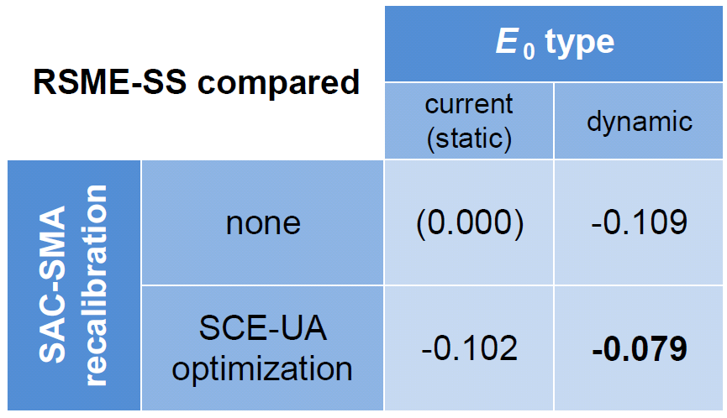
2. Dynamic Evaporative Demand in the Sac-SMA model at CBRFC
Aggregate results for Animas River at Durango, CO: simulation error
reference = current operational simulation

Slide 21
Future Work
Address CBRFC operational issues (e.g., calibration, forecast mechanics)
Temporal / spatial variability and trends (e.g., what drivers are dominating?)
Apply evaporative demand forecasting methods to seasonal forecasts
Real time ET_{rc} accumulated anomalies as applied to drought
Application to water management, drought monitor, etc.

Slide 22
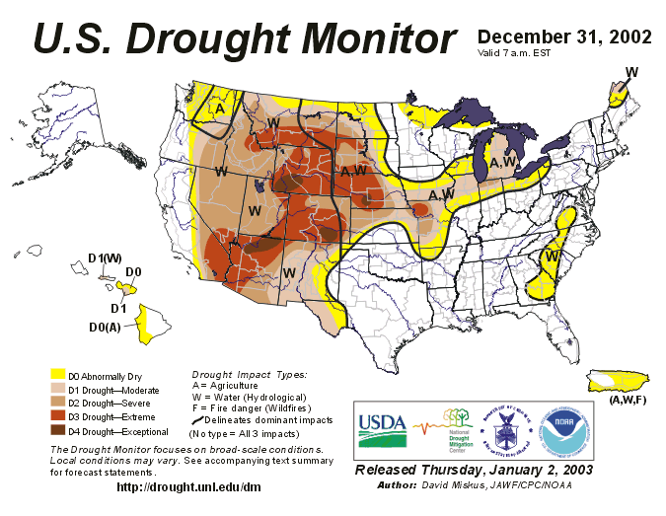
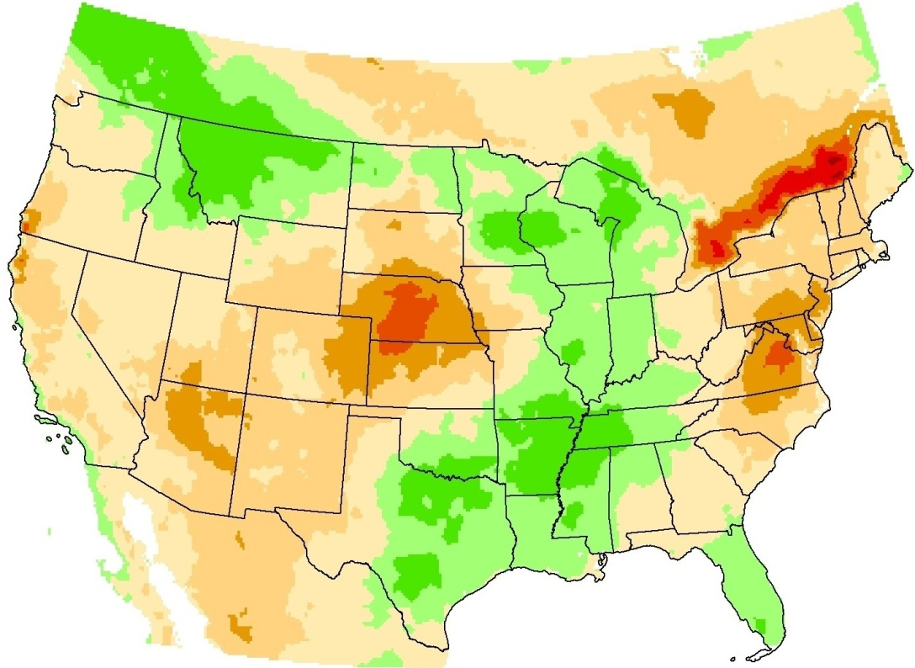
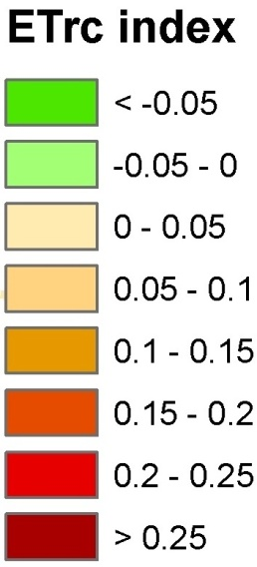
Evaporative Demand as a metric of drought
2002 drought examined across CONUS
Notes:
The ETrc drought index for the period April 1 – September 30, 2002 looks very similar, at least qualitatively, to the US US Drought Monitor for December 31, 2002.

Slide 23
Evaporative Demand as a metric of drought
2002 drought examined at Lakewood, CO
> 0 positive anomaly in evaporative demand, DROUGHT
X = 0 expected evaporative demand
< 0 negative anomaly in evaporative demand
Notes:
Kevin,
Here, ETrc(t) is the time-series of daily ETrc (Penman-Monteith) for 2002, April 1- Sept 30,
E[ETrc](t) is the daily climatology of ETrc for the same period,
the summed E[ETrc] is the sum of the climatology accumulated across the drought.
So the X(t) is just a dimensionless measure: like a normalised anomaly, but actually divided by the mean, not the standard deviation.
The red line is the accumulated

Slide 24
Evaporative Demand as a metric of drought
2002 drought examined at Lakewood, CO
Double-mass curve: accumulating ET_{rc}, Apr 1 – Sep 30, 2002

Slide 26
Further work
Temporal variability drivers in E_{pan}
Uncertainty concept
contribution to the variability in E_{pan} of uncertainties in individual drivers varying independently
sensitivities are derived analytically from model formulation
contribution from the interdependence of all possible pairs of drivers
variances and covariances are derived empirically

Slide 27
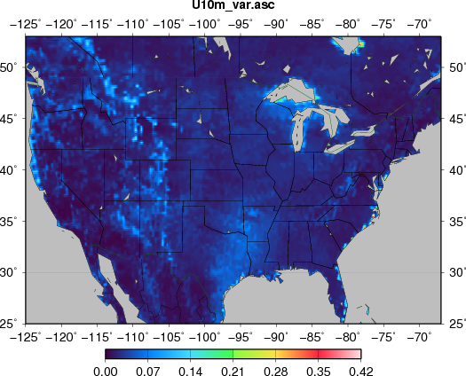
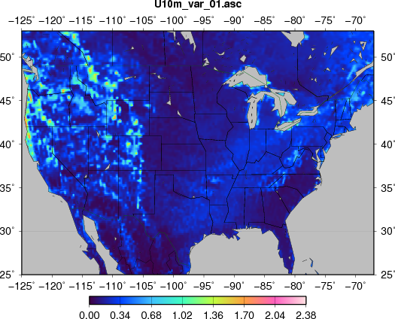
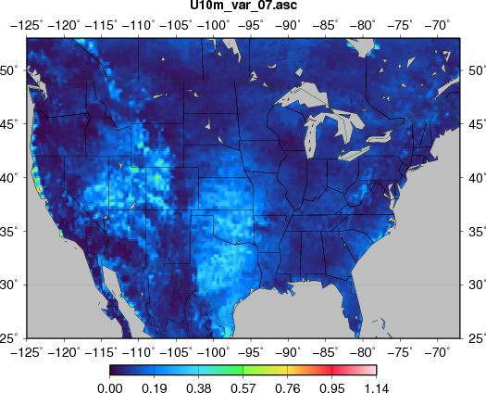
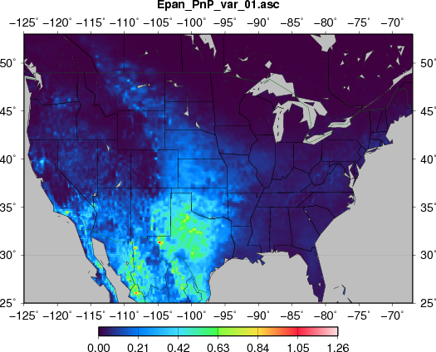
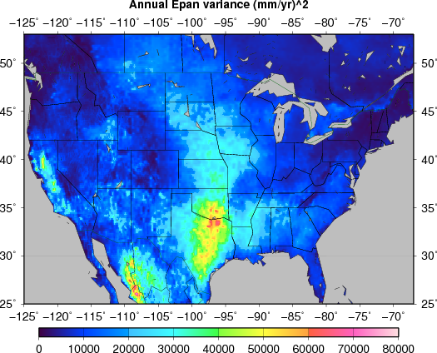
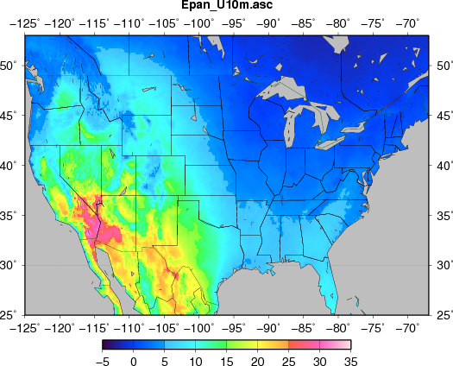
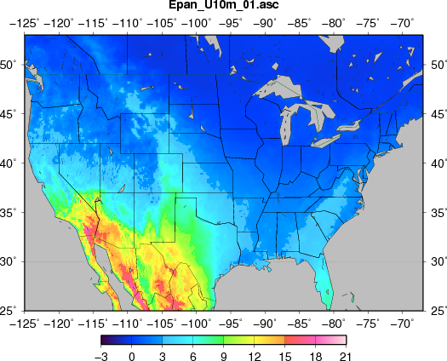
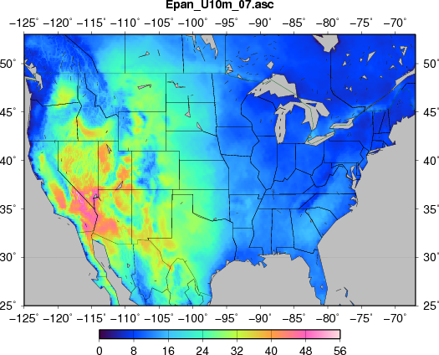
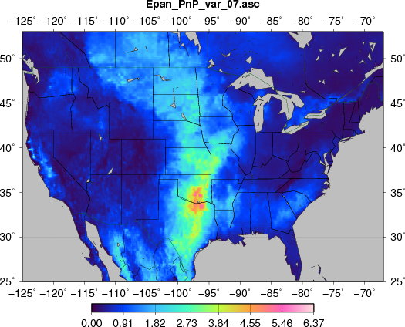
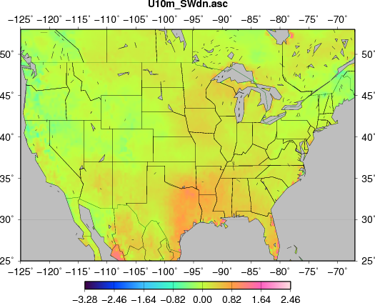
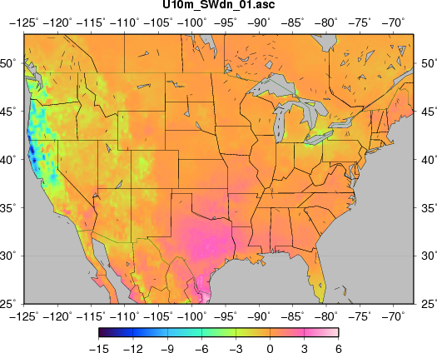
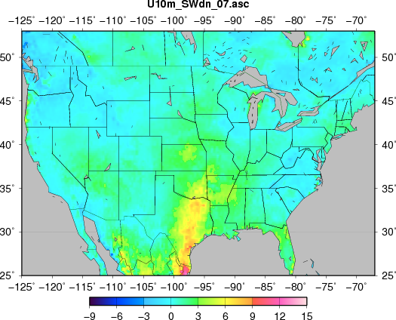
Further work
Temporal variability drivers in E_{pan}, 1980 - 2009
Decomposing variability in E_{pan} – e.g., U₂ and U₂-SW_{dn}
Annual
January
July
January
Variance
Annual
Sensitivity
July
Covariance

Slide 28
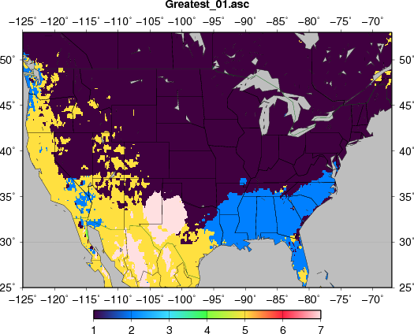
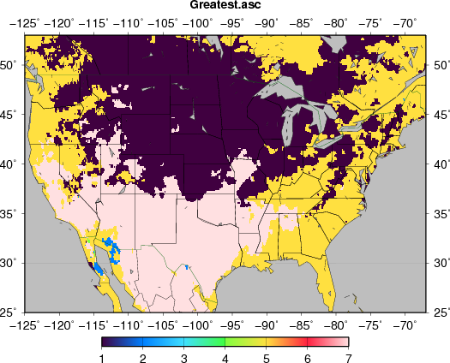
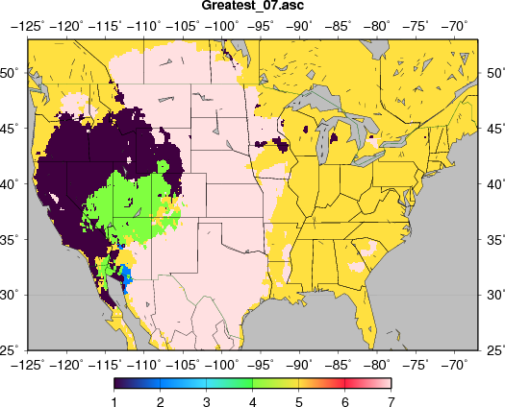
Further work
Most significant drivers of E_{pan} variability, 1980 - 2009
January
Annual
T
q
T
SW_{dn}
covs
July
covs
SW_{dn}
T
U₁₀
SW_{dn}
q
covs
q

Slide 29
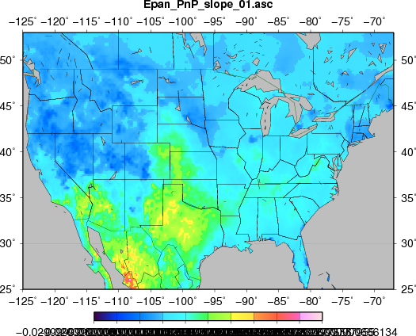
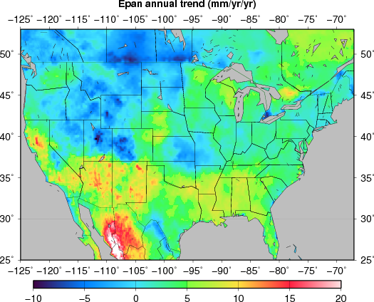
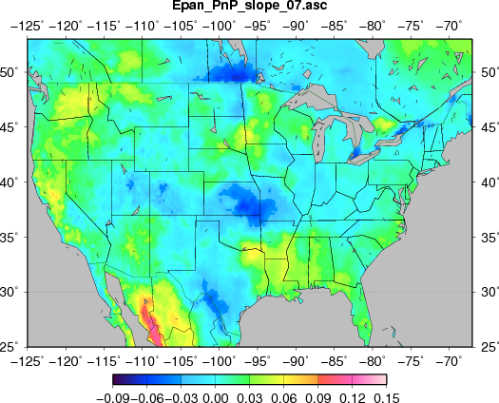
Further work
Trends in E_{pan}, 1980 - 2009
January
Annual
July

Slide 30
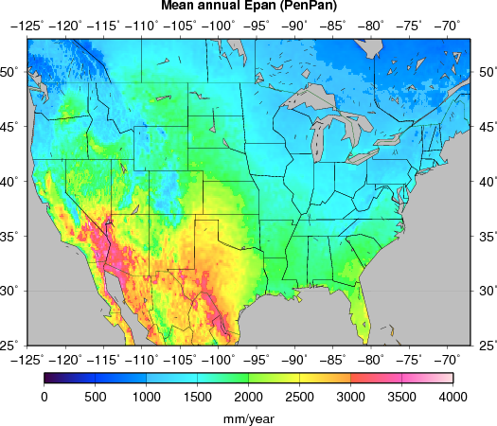
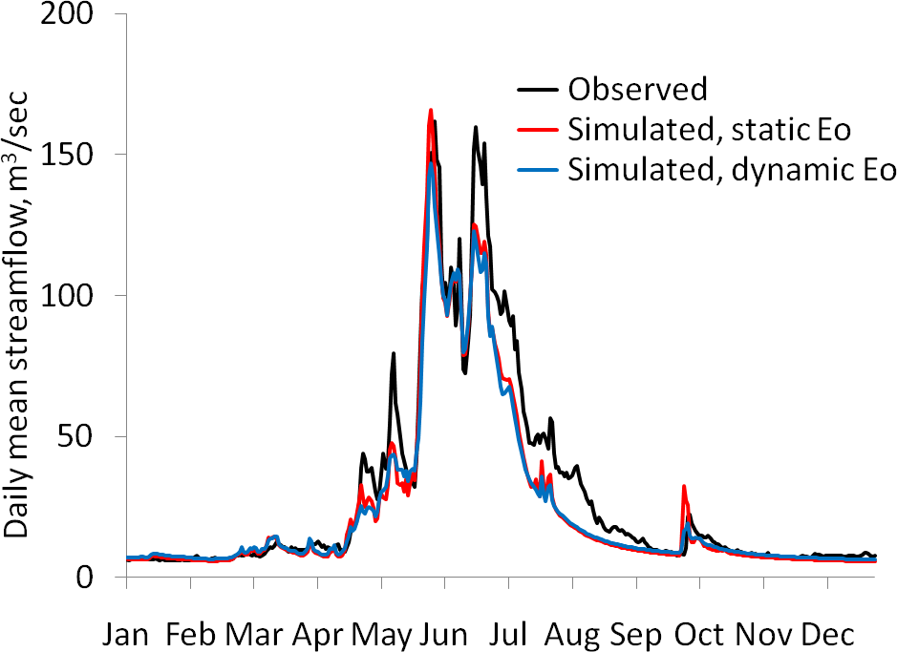


Dynamic evaporative demand across CBFC: DRGC2H test-basin
Mean annual E_{pan}, 1980 - 2009
E_{pan} across DRGC2H, 1980 - 2009 (& 1983)
mean, max, min daily E_{pan} (1980-2009)
1983 daily E_{pan}
current, static E₀
PenPan equation of synthetic pan evaporation
Modifies Penman equation to replicate the enhanced characterization of radiative and advective dynamics of evaporation pans.
Streamflow at DRGC2H, 1983
Skill-test of simulation at DRGC2H, 1980 - 2009
weighted combination of radiative and advective drivers.
synthesizes monthly E_{pan} observations well.

