Slide 1
A Toolkit for User Engagement
AMS Annual Meeting
Kevin Werner, CBRFC
Kristen Averyt, WWA
Gigi Owen, CLIMAS
January 27, 2011

Slide 2
Outline
  Motivation and Background
  Grand Junction workshop
  Results
Notes:
2

Slide 3
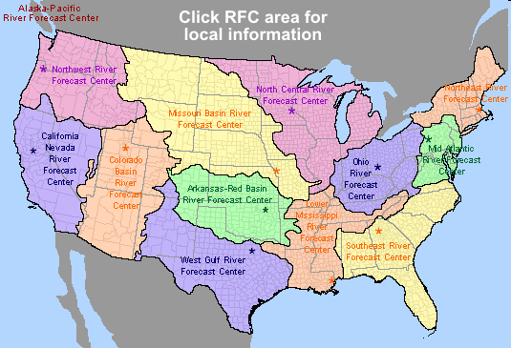
Background:
NOAA River Forecast Centers
River Forecasts
  Support flood warnings (hours to days)
  Support water management (days to months/years)
  Support flash flood warnings (hours)
Decision Support
  NOAA mission: “to understand and predict changes in Earth’s environment … to meet our Nation’s economic, social, and environmental needs”
  New focus for RFCs with the Service Coordination Hydrologist program (2008)

Slide 4
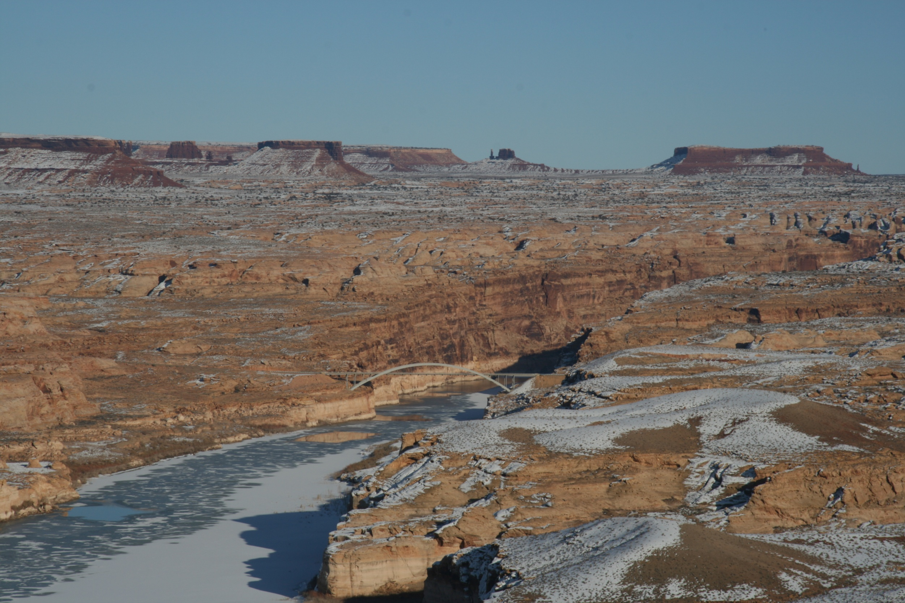

Motivation
Water Management: agencies responsible for delivering, allocating, or treating fresh water. Examples:
-USBR
-Metropolitan Water District
-Colorado River Commission
Forecasts:
-Weather
-Climate
-Water
Photo: Lake Powell, January 2010

Slide 5
Previous Research
Study | Method(s) | Geographic Area(s)
(Rayner et al., 2005) | Field Research: Semi-structured Interviews | USA: Pacific Northwest, Southern California, and Washington, DC
(O'Connor et al., 2005) | Survey | USA: South Carolina and Susquehanna River Basin of Pennsylvania
(Lemos, 2008) | Field Research: Observation of Meetings | USA and Brazil
(Dow et al., 2007) | Survey (building on earlier work (O'Connor et al., 2005)) | USA: South Carolina and Susquehanna River Basin of Pennsylvania
(Callahan & Miles, 1999) | Field Research: Semi-structured interviews | USA: Pacific Northwest
(Ziervogel et al., 2010) | Case Study | South Africa
(Pulwarty & Redmond, 1997) | Field Research: Semi-structured interviews | USA: Pacific Northwest
Forecasts generally not used. Water management agencies value reliability and quality above all else. Unless those are threatened, agencies have little incentive to use forecasts.
Forecast use correlates with perceived risk. Forecast usage not dependent on agency size or on understanding of forecast skill and reliability.
Policy and infrastructure in USA limit use of forecasts. Many operating decisions are tied to observed data and do not allow flexibility.
Hopeless?
No! Long term drought, increasing demands, and climate change projections for less water each present opportunities for increasing forecast usage.
5

Slide 6
Colorado River Supply and Demand
Credit: USBR
Notes:
6
6

Slide 7
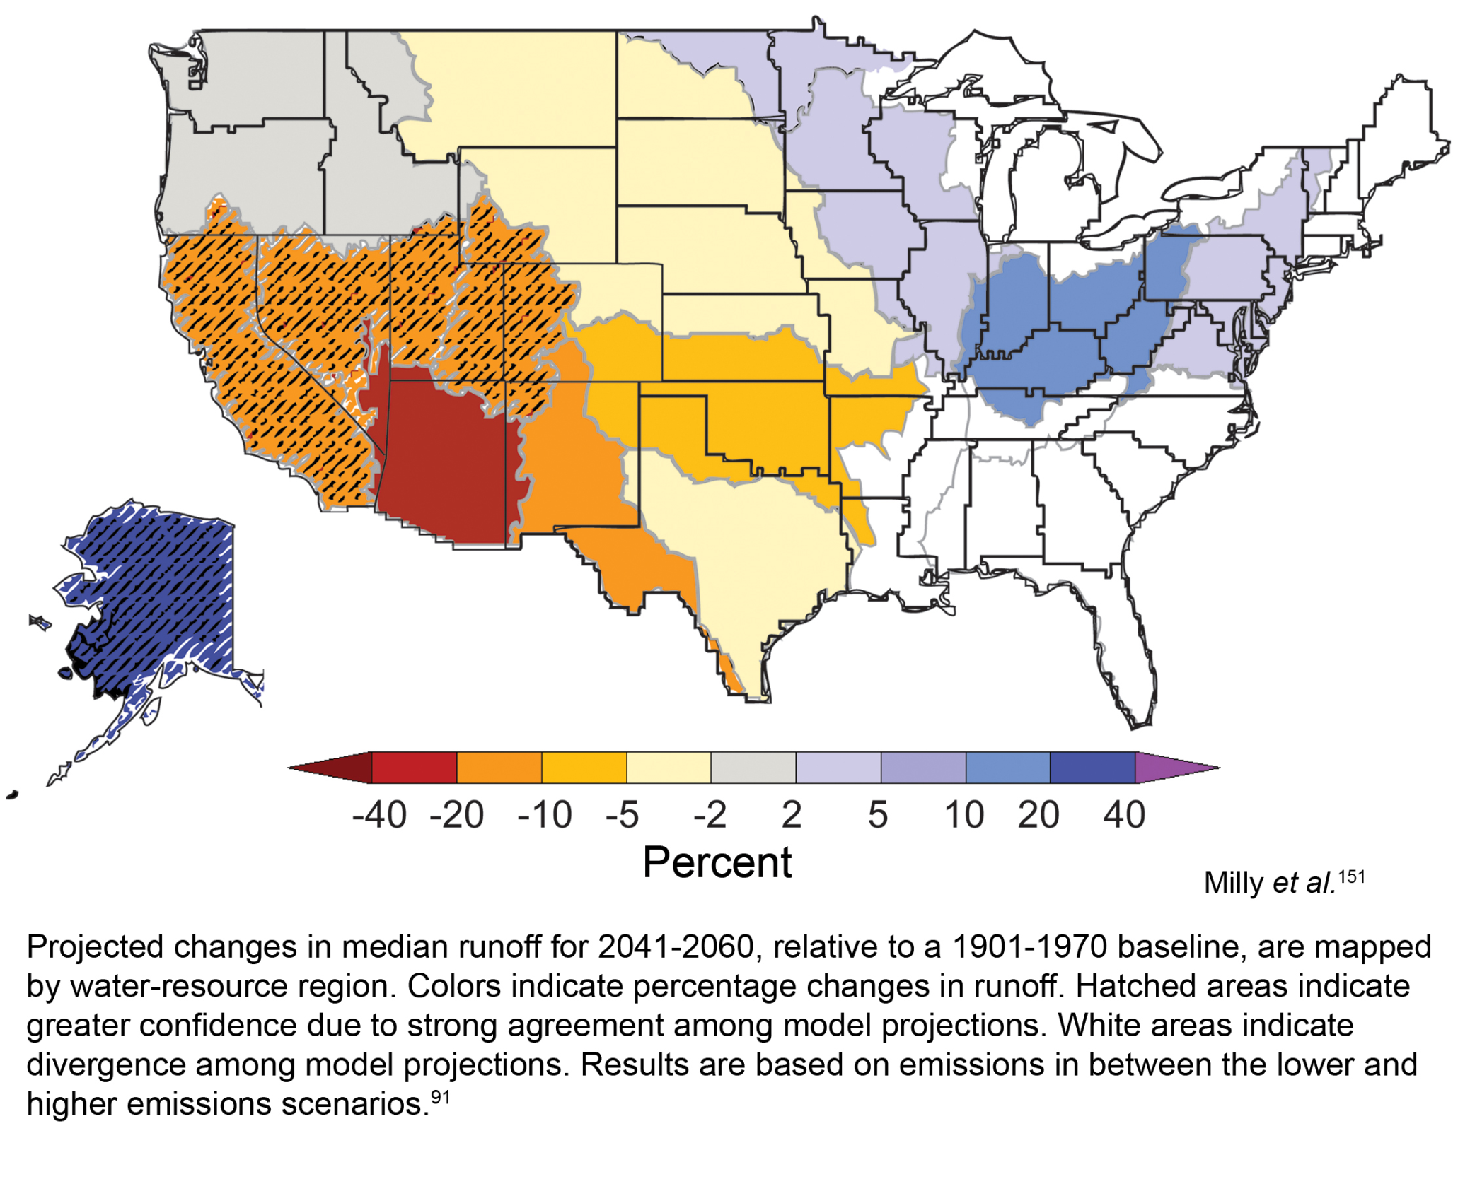

Slide 8
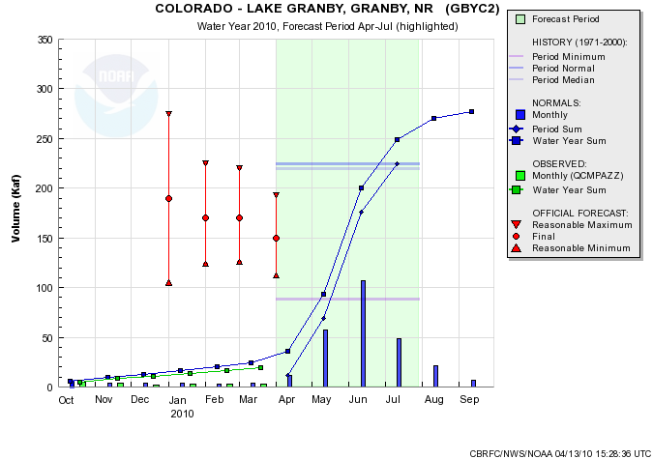

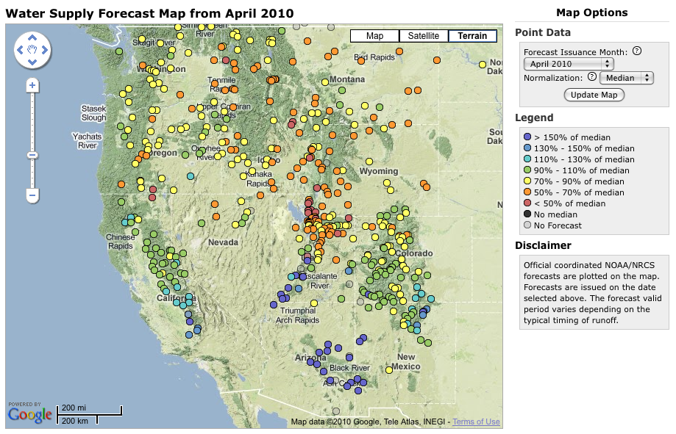


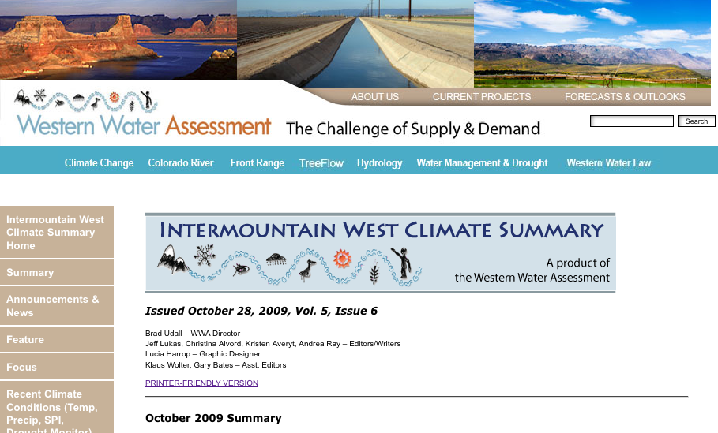

Strategy: Integrated and Iterative
Climate and Water Forecast and Information Machine
START
Research & Science
Better Climate and Water Information
Users + Existing
Information
Product Developers
Information Providers
(RFCs)
Information Providers
(RFCs)
More Informed Stakeholders
Workshops
Education
Notes:
This diagram represents the RISA concept of climate services– emphasize that RISA do not deliver climate services, but prototype and document processes– they are research entities
It is neither top down or bottom up, but is best described as integrated and iterative
And the emphasis here is on process over product
First start with available climate information and those interested in using that information
Information and the users enter into the climate services machine
Machine represents the interactions that occur among the users, scientists, researchers, developers of climate information
The challenge is to build the most efficient machine that will result in more informed users and more useful information
But this doesn’t end here; users continue to be entrained as part of the system, and they have to be
as users understanding of climate evolves, so do their needs for climate information
Consequently, the climate machine can’t be static, but rather dynamic and adaptable
So as people and information change as they move through the cycle, the machine can also change

Slide 9
Methods
Improving Forecasts and Information
  Implementing new modeling software
  Enhancing ensemble forecast capabilities
  Web tool development
  Evapotranspiration
  Distributed modeling
  Etc.
Connecting with Stakeholders
  Annual stakeholder forum
  Monthly water supply and peak flow forecast webinars
  Forecast verification workshop
  Soil moisture workshop
  User engagement workshop and toolset

Slide 10
Workshops to date
April 23, 2010: Grand Junction, CO
30 outside stakeholders with interests in water
May 2010: NWS SAFER Workshop
40 mostly NWS meteorologists
January 2011: AMS Short Course
30 outside stakeholders
Climate Literacy and Information Use Survey
  (Pre- and Post-Workshop)
Computer-based usability evaluation
Scenario Exercises
  Used to evaluate how the tool might be used & what information people use to make decisions
Notes:
A few weeks ago, workshop working with water resource managers on the West Slope:
Introduced participants to new Water Resources Outlook tool
Used climate literacy survey, computer-based usability survey and new iteration of the scenarios.

Slide 11
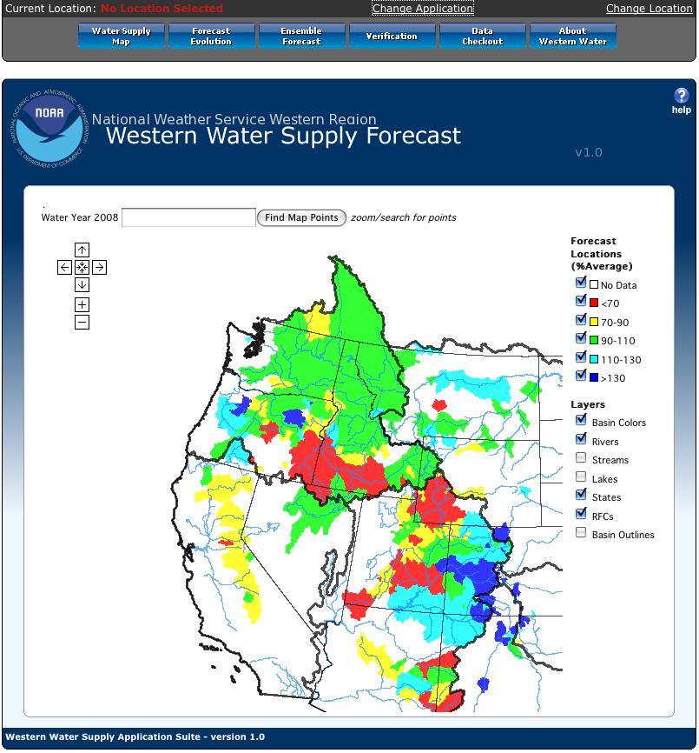
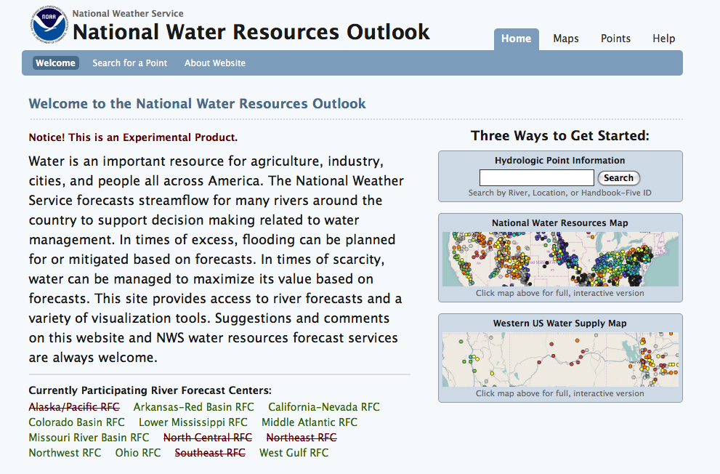
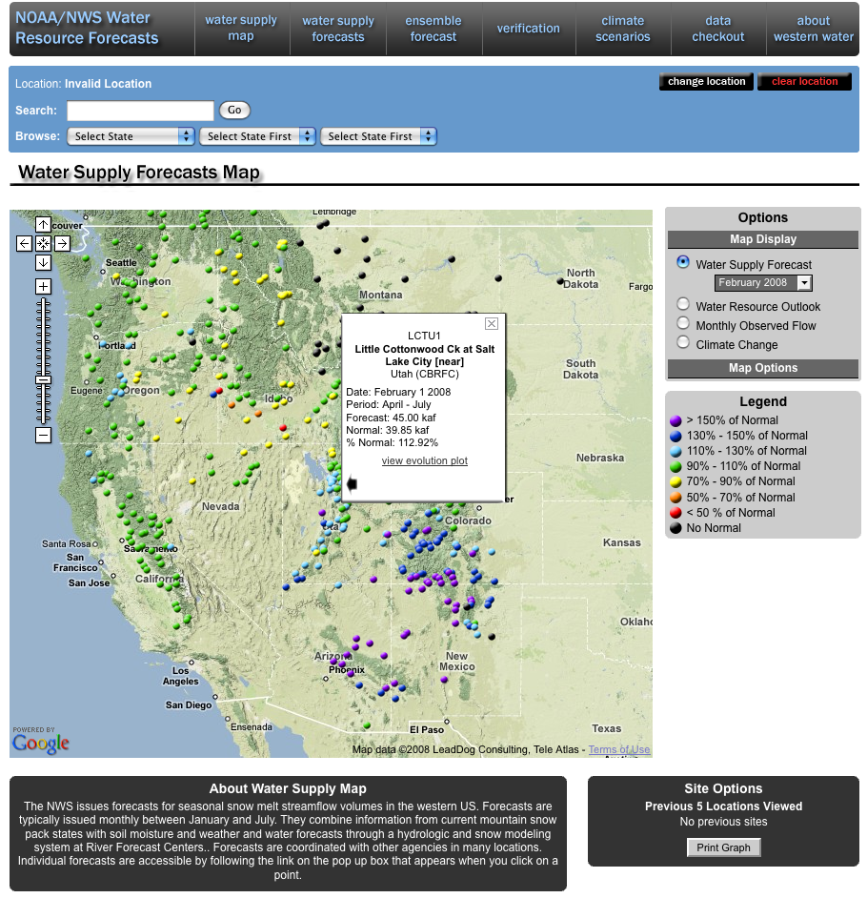
NWS Western Water Supply /
Water Resources Outlook
2008 (version 2)
2009 (version 3)
2010 (version 4): wateroutlook.nwrfc.noaa.gov

Slide 12
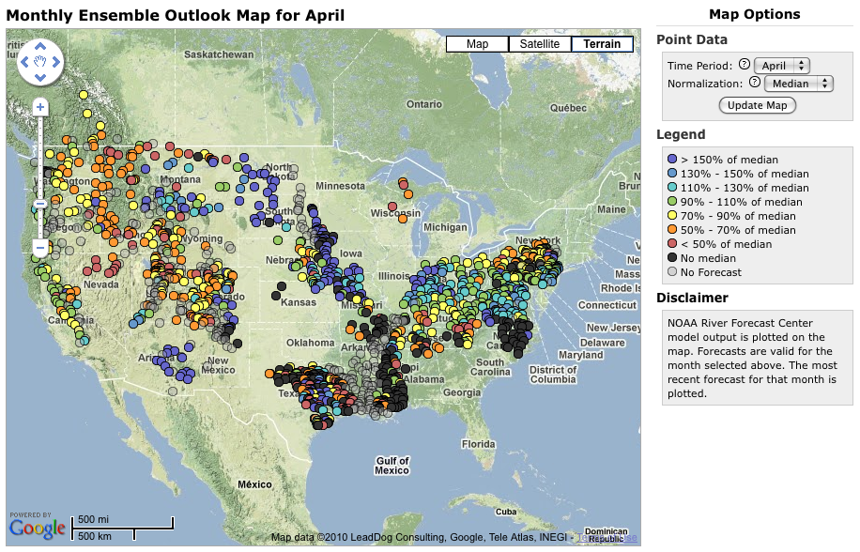
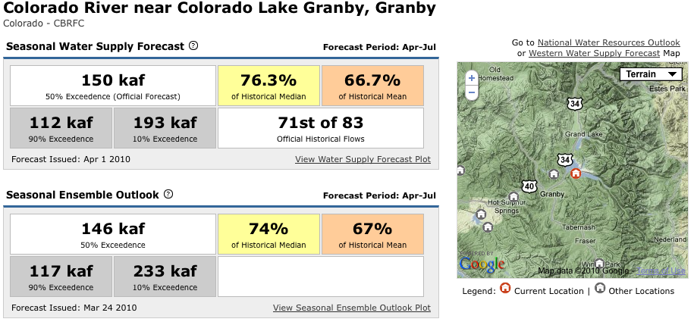
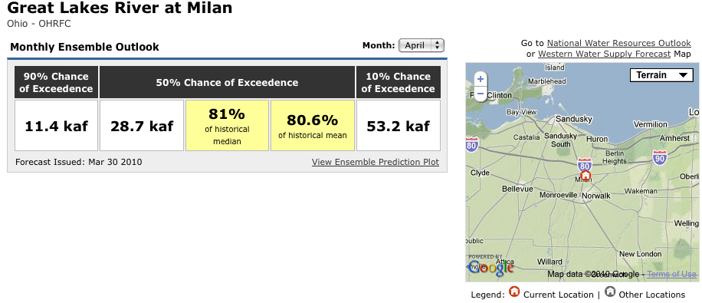
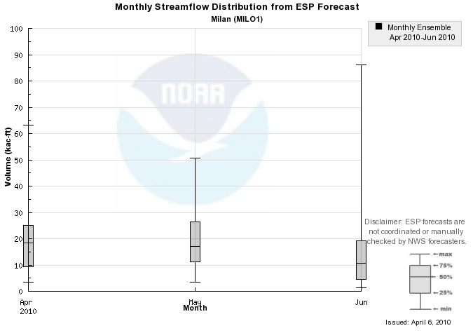
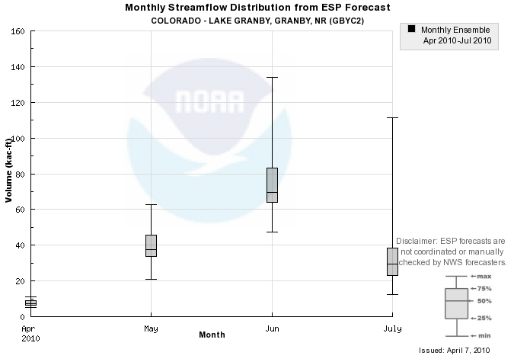
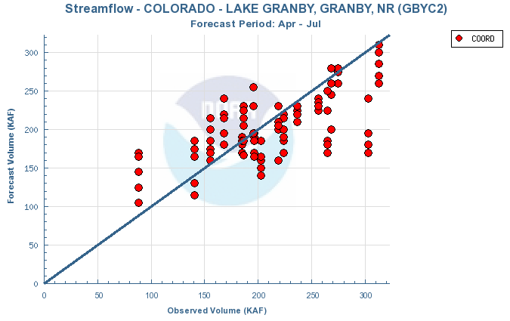
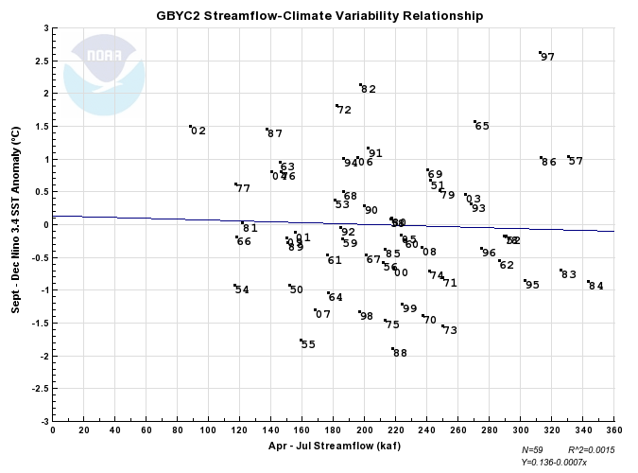
Water Supply Forecasts in Western USA
National Water Resources Outlook
Map
Map
Forecast Overview
Forecast Overview
Forecast Evolution – display of forecast and observed streamflow progression
Ensemble Forecast – display tool for monthly ESP forecasts
Ensemble Forecast – display tool for monthly ESP forecasts
Verification – Many, many verification plots and graphics
Climate variability – Streamflow / climate index relationship plot

Slide 13

Climate Literacy Survey
35+ Questions
  Demographics
  Familiarity about sources of climate information
  Perceptions about Climate Forecasts (based on “Feeling at Risk Matters: Water Managers and the Decision to Use Forecasts,” O’Connor et al, 2005)
  Test of Climate Concepts (based on booklet from U.S. Global Change Research Program)
Notes:
Climate Literacy Survey: Generate a database of various users and potential users of climate information in the region, to better understand how they use/interpret/perceive climate information)

Slide 14
Survey Results

Slide 15
Survey Results

Slide 16
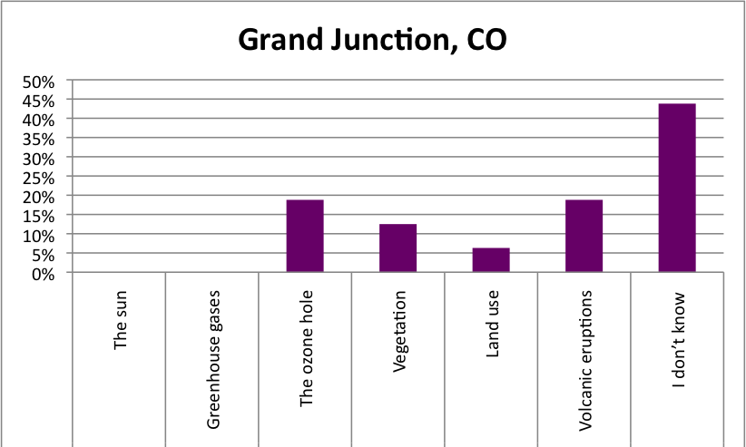
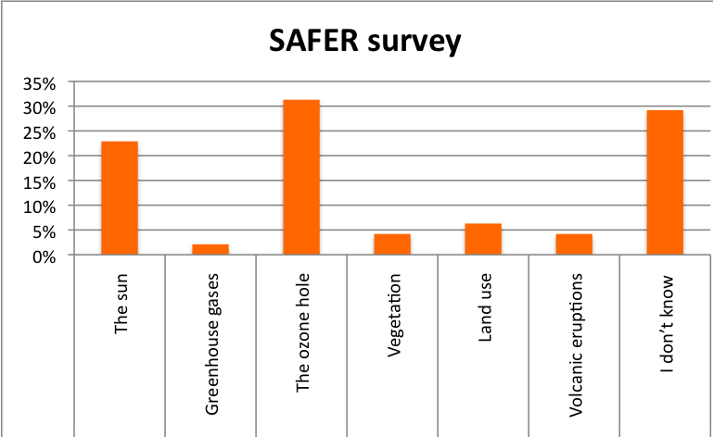
Survey Results
Which of the following has had the least influence on large-scale global climate over the last 30 years?

Slide 17
Usability Survey
37+ Questions
  Complete a series of tasks using all different aspects of the Water Resources Outlook
  Feedback on how to improve the tool
    How it looks and ease of use
    Practical applications to different lines of work
“What additional climate information do you need to make a well-informed decision or plan?”
“What level of skill would make a forecast good enough? How would you know?”
Notes:
Usability Survey: Tied to a specific product – Water Resources Outlook
Information gathered includes:
Getting to know how someone would use the tools and information available in the Outlook.
Gathering feedback on how to improve the tool – visually and usability wise, but also in terms of practical applications to different types of work.
This was the most popular portion of the workshop in Grand Junction. It gave people hands-on experience with the product and allowed them to play with different aspects. Allowed them to see uses in their own jobs.
When asking people what their needs are, I’ve found it’s easiest to have something for people to respond to. An open-ended question about what products you need doesn’t get you very far (SURVEY)?
14. What additional climate information do you need to make a well-informed decision or plan? But answers were not really informative…
Better if they have something, a product, or information to respond to…

Slide 18
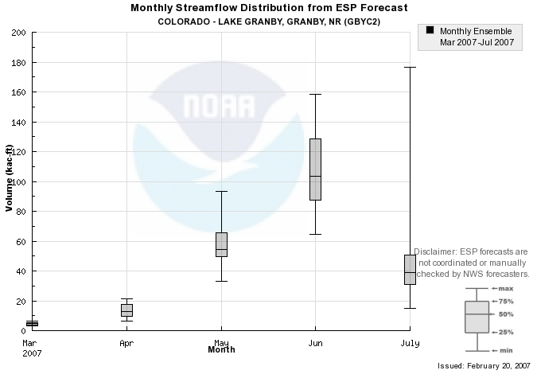
Scenarios
Simulate decision making based on forecasts
  Decision making using probabilistic forecasts
  Participants given a single forecast and asked to make a single decision
  Participants given a series of forecasts and asked to make decisions from each
Notes:
Idea behind the scenarios was to create an activity in which we could understand individual decision-making processes given a controlled scenario, a particular piece of information and individual background knowledge.
Three scenarios tied to recreation, and three tied to water managers…
One in each set was tied to a decision a month out, one to seasonal (3-month) decisions, and one to 50 year planning decisions….
Also tied to a specific product BUT more about how people process visual representations of streamflow data and forecasts AND how they use it to make a decision.

Slide 19
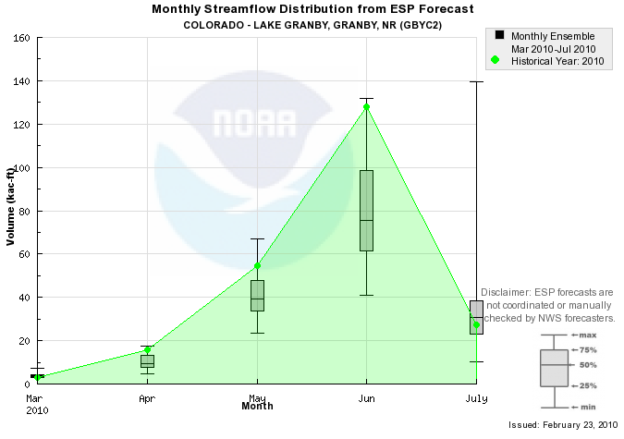
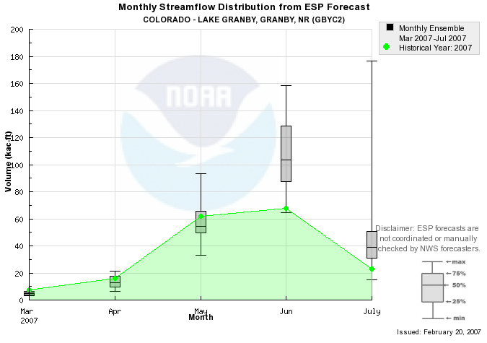
AMS Short Course Scenarios
Group 1a:
Actual forecasts for Lake Granby 2010
Underforecast peak flow (June)
Group 1b:
Actual forecasts for Lake Granby 2007
Overforecast June and July volumes

Slide 20
AMS Short Course Scenario Results
Underforecast scenario
9 of 11 overtopped reservoir
Participant who drew down reservoir early was not familiar with water management or probabilistic forecasts
Overforecast scenario
No one overtopped
Participants most familiar with water management drew down reservoir early

Slide 21
Findings So Far
Meteorologists more confident in weather forecasts and less confident in climate forecasts than outside stakeholders (literacy survey)
Stakeholders typically rely on forecast agencies to tell them when forecast skill is sufficient (usability survey)
Stakeholders interested in flooding and high flows are interested in “worst” case scenarios (scenarios)
Water management stakeholders tend to plan to median forecast (scenarios)
People – regardless of background – have difficulties applying probabilistic forecasts to deterministic decisions (scenarios)

Slide 22
Next Steps
Process of creating workshops is continually evolving
Continually tweaking the techniques used, questions asked – especially important as we talk to different populations – general public vs. more specialized users
Learning process – we learn from our participants just as much as we hope they learn from us about using climate information
NEXT STEPS: Workshops in Utah (Spring and Summer), Workshop in AZ or NM (Fall), Workshop in Southeast (TBD)

Slide 23





Kevin Werner
CBRFC Service Coordination Hydrologist
Phone: 801.524.5130
Email: kevin.werner@noaa.gov
Gigi Owen
Staff Social Scientist, Univ. of Arizona
Phone: 520.621.9001
Email: gigi@email.arizona.edu
Kristen Averyt
Deputy Director, Western Water Assessment
Phone: 520.621.9001
Email: kristen.averyt@noaa.gov

