Slide 1
Peak Flow Forecasts
Methods and Evaluation
AMS Annual Meeting
January 26, 2011
Ashley Nielson
Hydrologist, NOAA/CBRFC
Kevin Werner
Service Coordination Hydrologist, NOAA/CBRFC

Slide 2
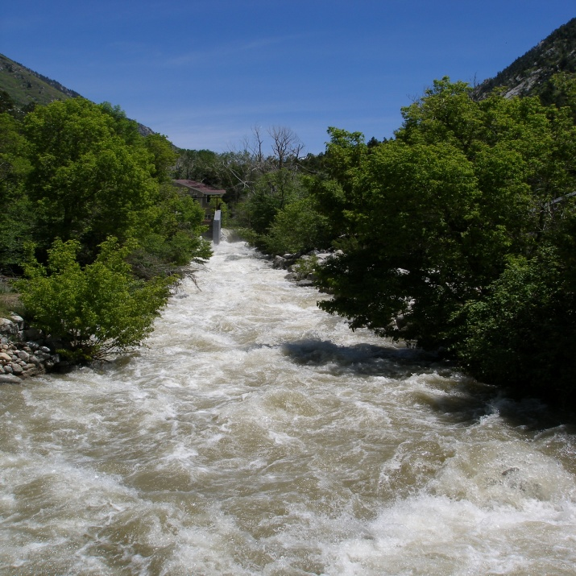
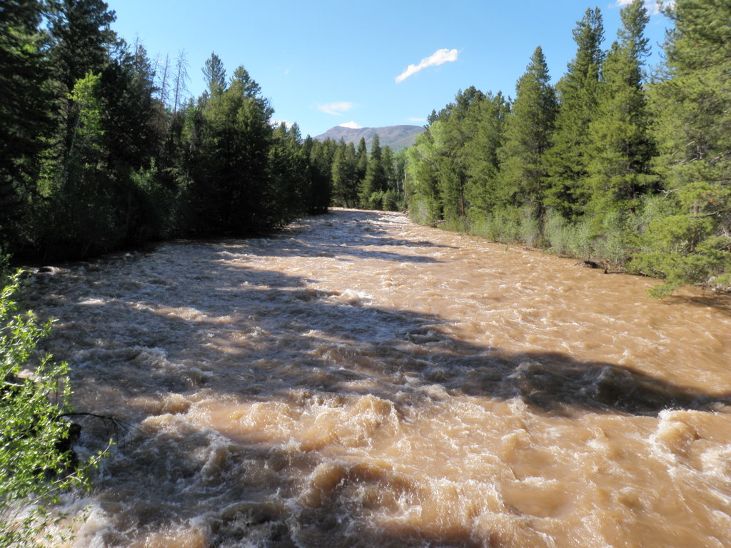
Outline
What is a peak flow forecast?
How do we make a peak flow forecast?
Forecast Evaluation
Conclusions
Questions/Discussion

Slide 3
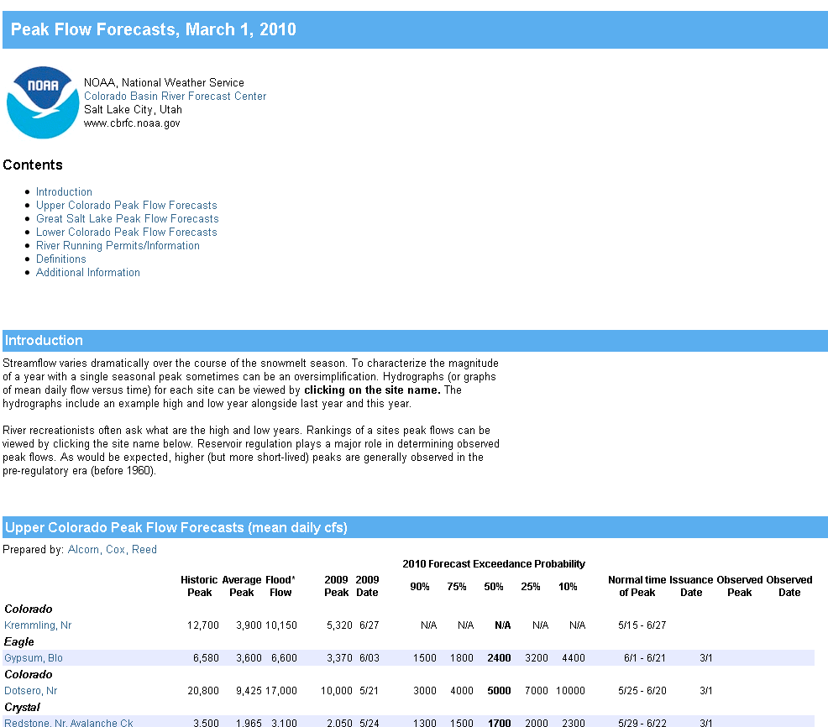
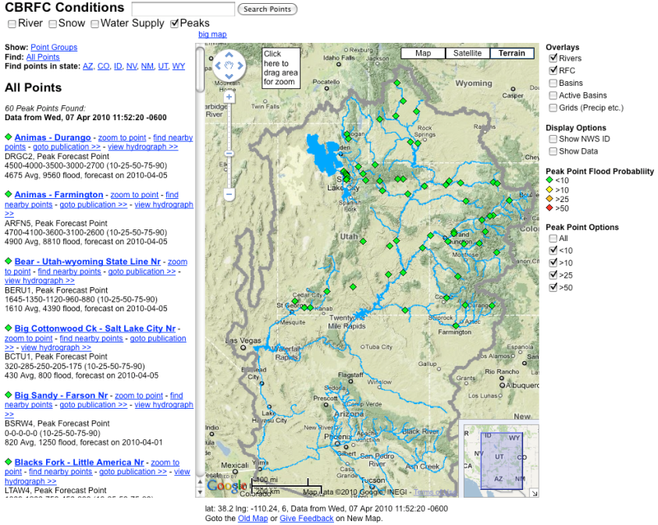
What is a Peak Flow Forecast?
Snowmelt Mean Daily Maximum Flow (April-July)
Probabilistic Forecasts
Exceedence Probabilities -10%,25%,50%, 75%, 90%
Issued (at least) monthly from March-June
~60 forecast points – some unregulated, some regulated
Updated as needed
Forecast Users include:
Emergency Managers
USGS hydrologists
Water Managers
River Recreation

Slide 4
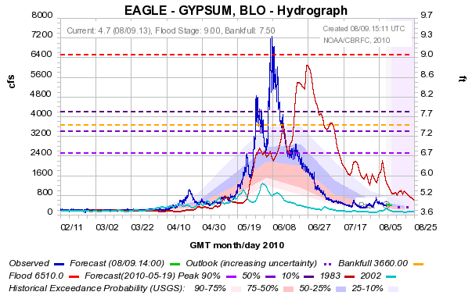
10%
50%
90%

Slide 5
How do we make a Peak Flow Forecast?
Main Variables:
1. Current Soil Moisture States
2. Snowpack Conditions
3. Current Base Flow
4. Reservoir Regulation Plans
5. Future Precipitation Events
6. Future Temperature
Methods:
1. ESP
(Max mean daily flow April-July)
2. Regression Equations
(Historical Peaks vs Historical Volumes)
3. Hybrid method of ESP + Regressions

Slide 6
Forecast Evaluation
Why peak flow forecast verification?
No previous verification information -Unlike water supply and flood event forecasts
Large uncertainty in forecasts - Heavily dependent on weather conditions during the snowmelt period
Forecast process is difficult - Verification studies should help drive decisions about changes to peak flow forecast program:
When to start making forecasts?
When to update?
Where to make forecasts?
Forecasting tools (ESP) – How are the current tools performing? How the skill/error change over the current and historical forecast period?

Slide 7
Verification Methods
Selected 8 sites- 4 unregulated, 4 regulated
Collected monthly peak flow forecasts from March-May for 1997-2010
Constructed daily ESP reforecasts of peak flow 1976-2005
Calculated error/skill of forecasts and reforecasts
Compared error/skill of forecasts and reforecasts
Verification done with spreadsheet software and with NWS/OHD EVS (Ensemble Verification System) software
Limitations
-Small sample size
-No future QPF or temperature forecasts included in reforecasts (coming soon)
-Reforecasts currently only available to 2005
-Observed peaks may be rain enhanced
-No archived documentation on past forecast methodology

Slide 8
Little Snake nr Lily (LILC2)
FORECASTS (1997-2009)
March r²=0.37, MAE=1161cfs
April r²=0.62, MAE=913cfs
May r²=0.82, MAE=572cfs
10 %
Forecasts improve with decreasing lead time for this site (not true for other sites
Forecasts generally better than climatology
25%
50 %
75 %
90 %

Slide 9
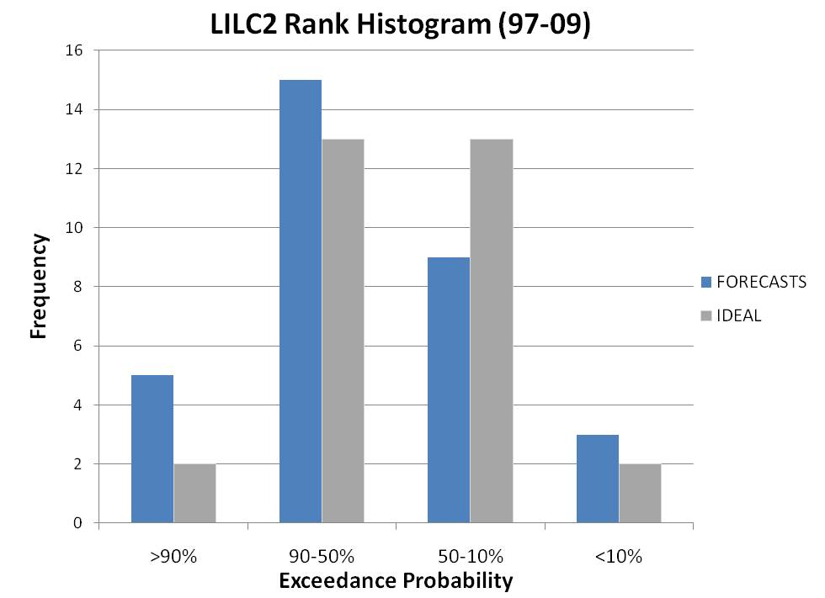
Little Snake nr Lily (LILC2)
FORECASTS (1997-2009)
Forecast spread too small
* Includes first of month forecasts from March, April, and May*

Slide 10
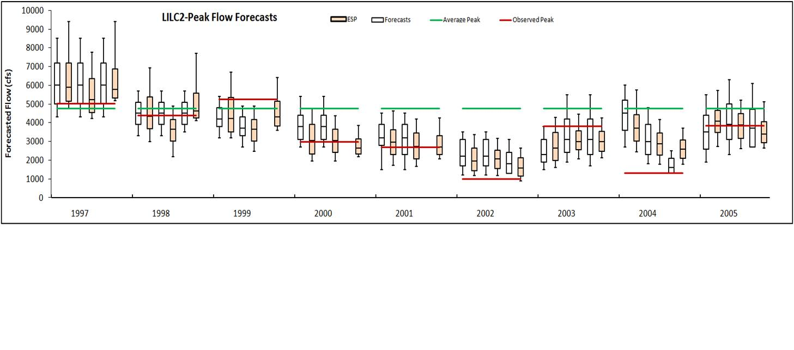
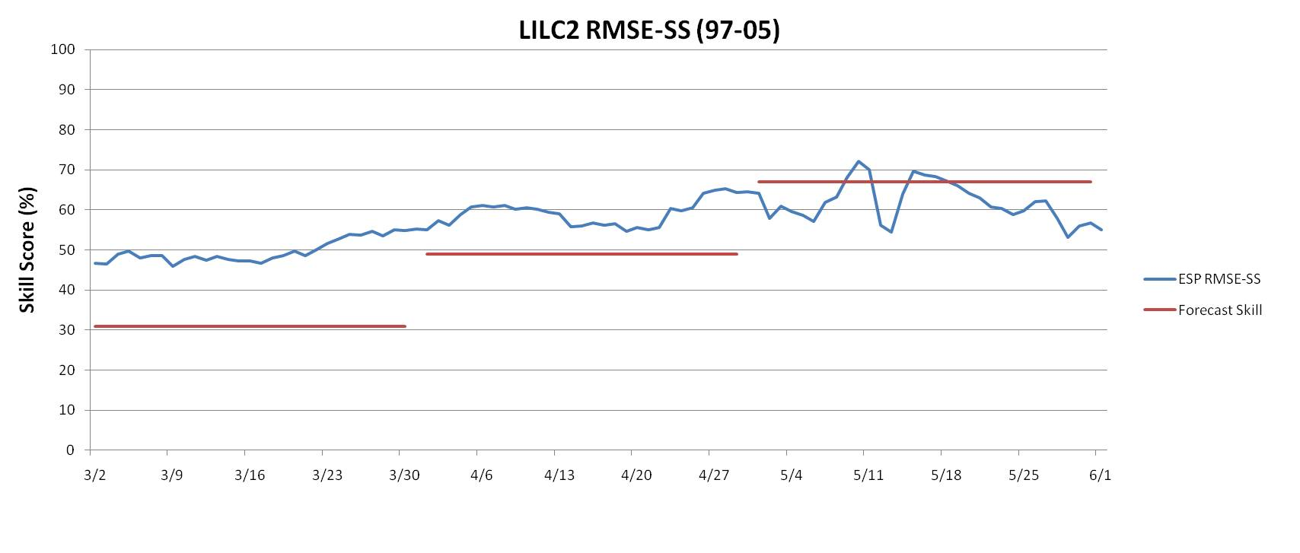
Little Snake nr Lily (LILC2)
10 %
25%
ESP REFORECASTS and actual FORECASTS(1997-2005)
50 %
75 %
90 %
ESP Reforecasts more skillful than March and April forecasts
Caveats: Small sample size and one point

Slide 11
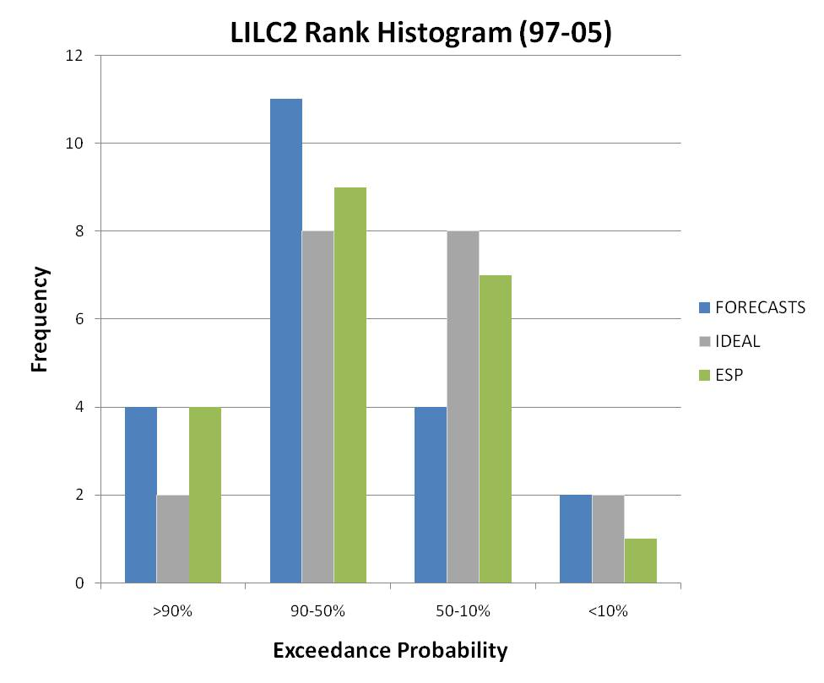
Little Snake nr Lily (LILC2)
ESP REFORECASTS (1997-2005)
ESP reforecast distribution better than actual forecasts
Caveats: Small sample size and only one point
* Includes first of month forecasts from March, April, and May*

Slide 12
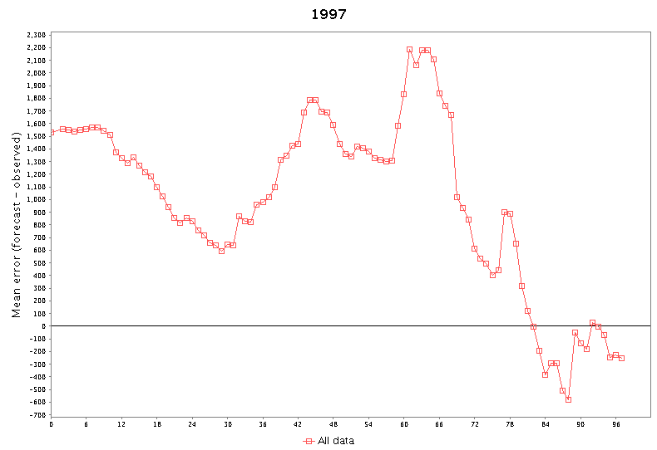
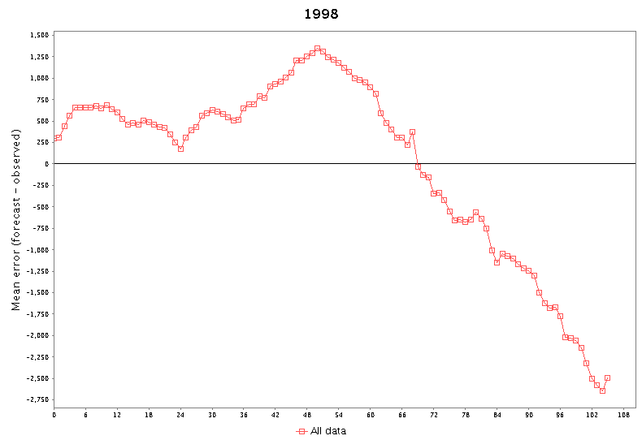
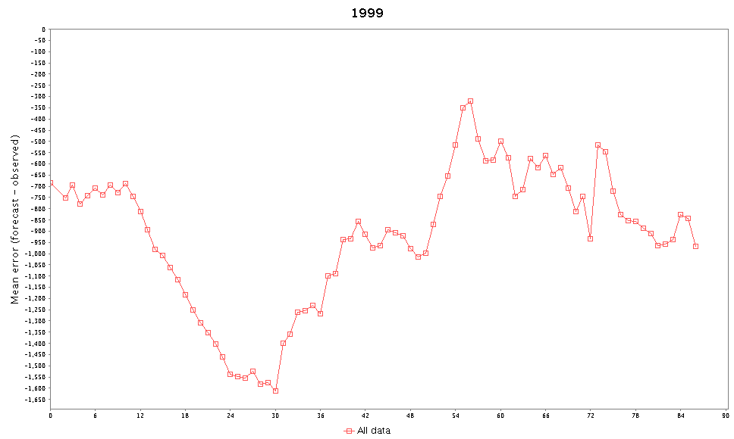
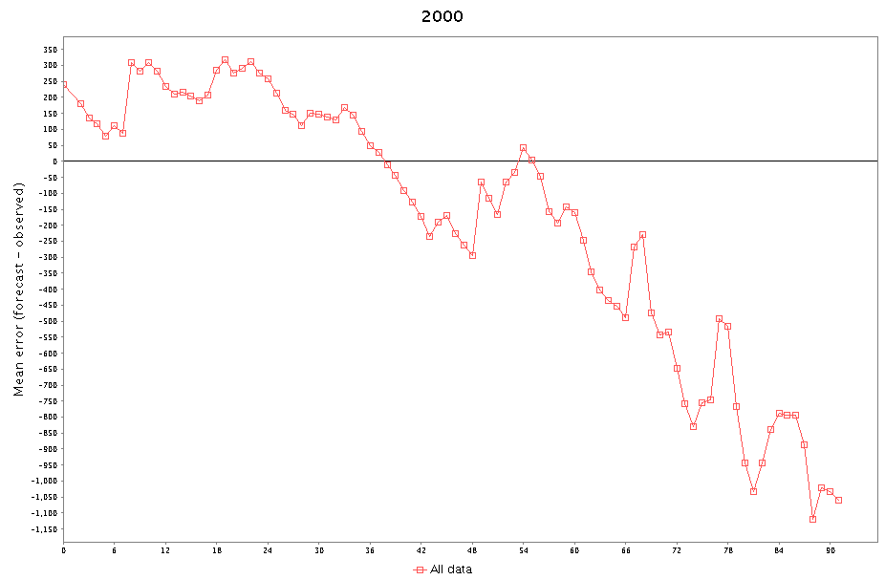
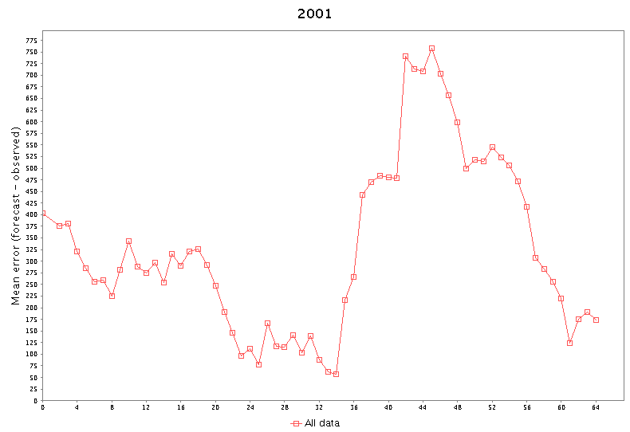
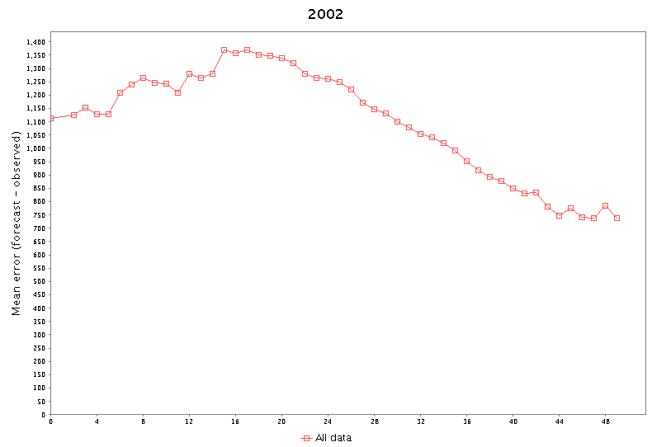
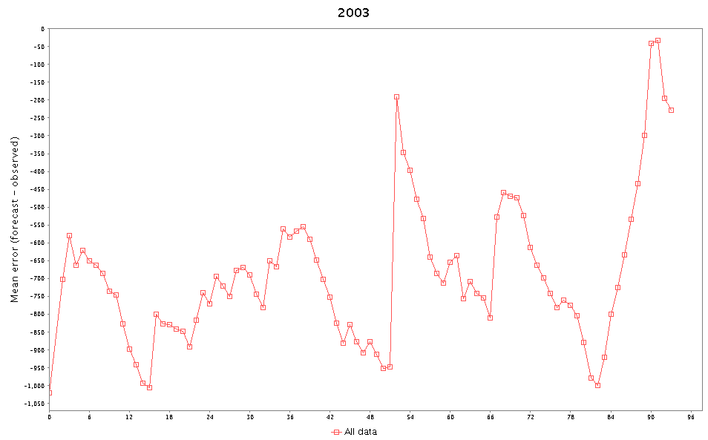
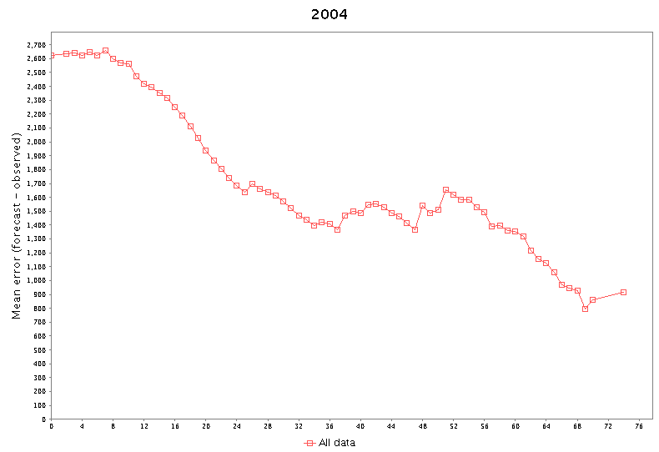
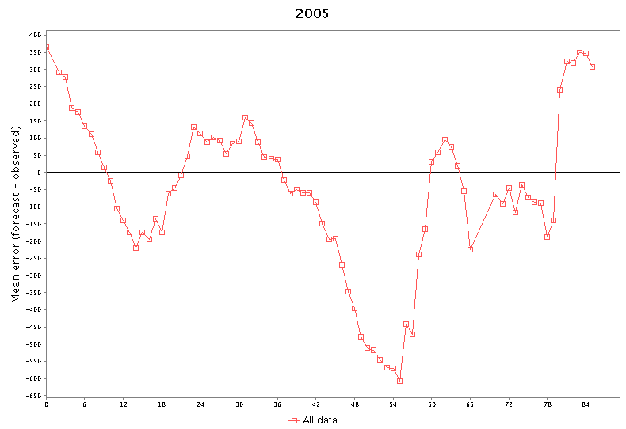
3/1
5/26
6/5
6/19
4/19
5/4
6/1
5/25
6/2
5/14
Mean Error of Ensemble Mean: March 1 –Peak Date

Slide 13
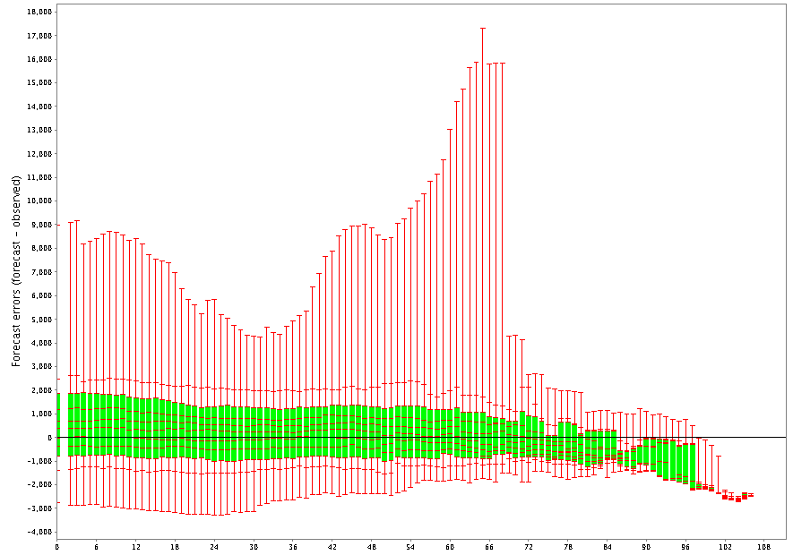
Little Snake nr Lilly ESP Reforecasts (97-05)-Daily
Mean forecast error improves with lead time (e.g. green boxes)
Outliers determined by single year (e.g. 2001 here)
3/1 4/1 5/1 6/1

Slide 14
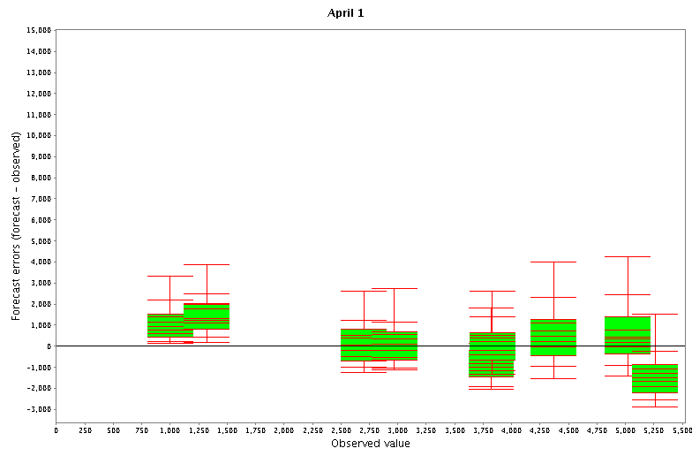
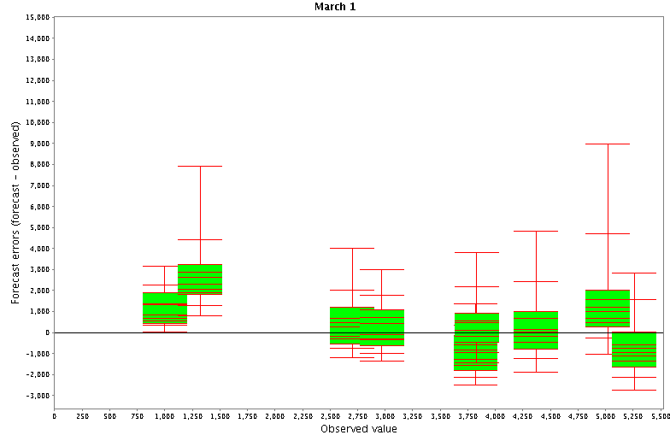
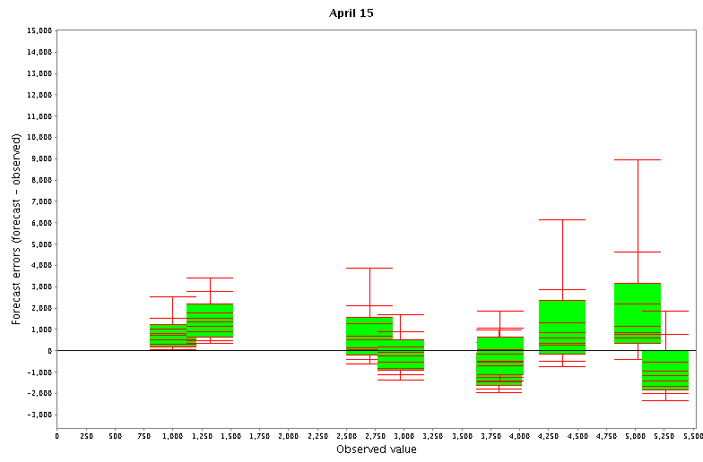
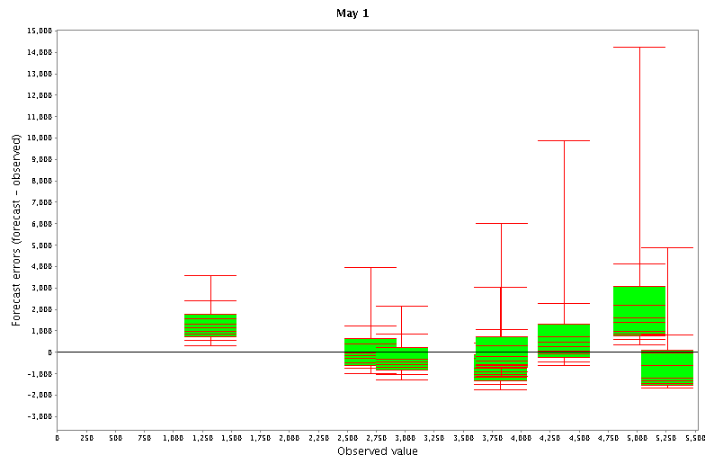
04
02
02
04
01
00
97
00
01
98
97
03/05
98
99
03/05
99
04
04
97
02
01
98
01
00
97
00
03/05
99
03/05
98
99

Slide 15
Conclusions
Forecasts and ESP Reforecasts compared at 4 unregulated sites:
Forecast and reforecast skill generally better than climatology
Forecast and reforecast skill generally improves with lead time
Reforecasts had greater skill in March (3 of 4 sites) and April (all 4 sites) but at only one site in May
Forecasts and reforecasts are generally reliable (except reforecasts at one site)
Future Plans:
Extend reforecasts through 2010
Reforecast for additional points
Determine when and where forecast skill exists
Engage with stakeholders to appropriately modify forecast locations, issuance dates, etc
Questions / Comments?

