Slide 1
CBRFC Support for Dam Breaks
DamBreak and EAPs
Arizona 2011 Spring Hydrology Seminar (May 19, 2011)
William B. Reed
Senior Hydrologist
Colorado Basin River Forecast Center

Slide 2
Overview of CBRFC Dam Break Services
Pre-computed model runs (High Fast | High Normal | High Slow | Low Fast | Low Normal | Low Slow | Middle Fast | Middle Normal | Middle Slow)
Run Simplified DamBreak Model Using Prismatic Cross Section at the DAM and Downstream Points
Consulting role (e.g. help with EAPs, rules of thumb, etc)
Bottom line: Dam Breaks are primarily a WFO Service

Slide 3
Information needed for CBRFC to provide services.
Primary Information:
Name of Dam
Name of River
County
State
Secondary Information:
Water Surface elevation or depth (feet)
Height of Dam (feet)
Structure Type (Earth, Concrete)
Crest Length of Dam (feet)
Volume (acre feet)
Information Needed To Identify Dam And Make Accurate Forecast

Slide 4
Example Product (HF)
SLCRVFSTR
COLORADO BASIN RIVER FORECAST CENTER
NATIONAL WEATHER SERVICE, SALT LAKE CITY, UTAH
0024 UTC Tue May 17, 2011
** INTERNAL NATIONAL WEATHER SERVICE PRODUCT FOR GUIDANCE PURPOSES ONLY **
FORECASTS BASED ON LATEST SIMPLIFIED DAMBREAK PROG ISSUED BY HRL
*** TWC HSA
. . . D A M B R E A K F O R E C A S T . . .
TUFA STONE on TUFA STONE CREEK
Time and Flood Wave Forecast:
Forecast Distance Time Est Time Depth Peak
Point From to Flood to of Flow
Dam Flood Stage Peak Peak
(mi) (min) (ft) (min) (ft) (cfs)
-----------------------------------------------------------------------------------------------------------------------------------------
DAMSITE 0.00 0 3 7 9 155609
SAN CARLOS 2.00 23 3 30 6 71955
Comments:
Tufa Stone Dam on Tufa Stone Creek

Slide 5
Inputs for This Forecast:
Source: STR
Scenario: HF
Starting Water Surface: 2794.76
Bottom of Breach Width: 2763.41
Starting Volume: 850
Starting Surface Area: 0
Time of Failure: 6.6
Additional Flow to Add: 10
Final Breach Width: 2376
Dam Type Code: 0
Comments: 'Used dambatch.tcl'
Dam Information:
NID ID: AZ10407
Dam Name: TUFA STONE
State ID: 0
River: TUFA STONE CREEK
County: GILA
Latitude: 33.375 (33 22 30)
Longitude: -110.46944 (110 28 10)
Elevation: 2761.76
Topo Map: GLOBE
Return Flow Region: 12
Drainage Area: 16
Emergency Action Plan: 0 (None)
Comments: 'Used dambatch.tcl'
Updated: 07/03/2002
HSA: TWC
RFC: CBRFC
Dam Type: RE
Dam Height: 33
Structural Height: 35
Hydraulic Height: 34
NID Height: -9
NID Storage: -9
Max Storage: 850
Normal Storage: 380
Dam Length: 2640
Surface Area: 0
Max Discharge: 6100
Volume Material: 109000
Core: BLANK
Foundation: BLANK
Spillway Type: U
Spillway Width: 370
Owner Name: SAN CARLOS APACHE TRIBE
Owner Type: P
Year Completed: 1944
Purposes: I
Private on Federal Land: N
Downstream Hazard: H
Inspection Date: 11/16/1992
State Regulated: N
Source Agency: DOI BIA
Included In Product Sent From CBRFC (should match dam info)

Slide 6
Example Product (LS)
SLCRVFSTR
COLORADO BASIN RIVER FORECAST CENTER
NATIONAL WEATHER SERVICE, SALT LAKE CITY, UTAH
0024 UTC Tue May 17, 2011
** INTERNAL NATIONAL WEATHER SERVICE PRODUCT FOR GUIDANCE PURPOSES ONLY **
FORECASTS BASED ON LATEST SIMPLIFIED DAMBREAK PROG ISSUED BY HRL
*** TWC HSA
. . . D A M B R E A K F O R E C A S T . . .
TUFA STONE on TUFA STONE CREEK
Time and Flood Wave Forecast:
Forecast Distance Time Est Time Depth Peak
Point From to Flood to of Flow
Dam Flood Stage Peak Peak
(mi) (min) (ft) (min) (ft) (cfs)
-----------------------------------------------------------------------------------------------------------------------------------------
DAMSITE 0.00 2 3 13 4 16104
SAN CARLOS 2.00 38 3 49 3 11645
Comments:
Tufa Stone Dam on Tufa Stone Creek

Slide 7
Inputs for This Forecast:
Source: STR
Scenario: LS
Starting Water Surface: 2778.26
Bottom of Breach Width: 2763.41
Starting Volume: 425
Starting Surface Area: 0
Time of Failure: 13.2
Additional Flow to Add: 10
Final Breach Width: 2376
Dam Type Code: 0
Comments: 'Used dambatch.tcl'
Dam Information:
NID ID: AZ10407
Dam Name: TUFA STONE
State ID: 0
River: TUFA STONE CREEK
County: GILA
Latitude: 33.375 (33 22 30)
Longitude: -110.46944 (110 28 10)
Elevation: 2761.76
Topo Map: GLOBE
Return Flow Region: 12
Drainage Area: 16
Emergency Action Plan: 0 (None)
Comments: 'Used dambatch.tcl'
Updated: 07/03/2002
HSA: TWC
RFC: CBRFC
Dam Type: RE
Dam Height: 33
Structural Height: 35
Hydraulic Height: 34
NID Height: -9
NID Storage: -9
Max Storage: 850
Normal Storage: 380
Dam Length: 2640
Surface Area: 0
Max Discharge: 6100
Volume Material: 109000
Core: BLANK
Foundation: BLANK
Spillway Type: U
Spillway Width: 370
Owner Name: SAN CARLOS APACHE TRIBE
Owner Type: P
Year Completed: 1944
Purposes: I
Private on Federal Land: N
Downstream Hazard: H
Inspection Date: 11/16/1992
State Regulated: N
Source Agency: DOI BIA
This changes
Included In Product Sent From CBRFC (should match dam info)

Slide 8
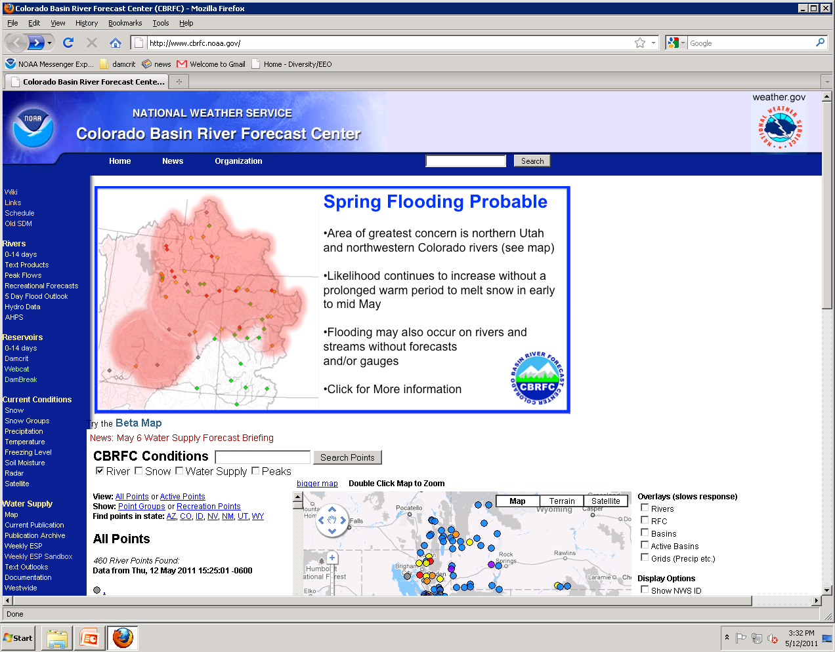
DamBreak
If you don’t see DamBreak
send us IP addresses for the PC's
in operations area
Start with DamBreak on Webpage

Slide 9
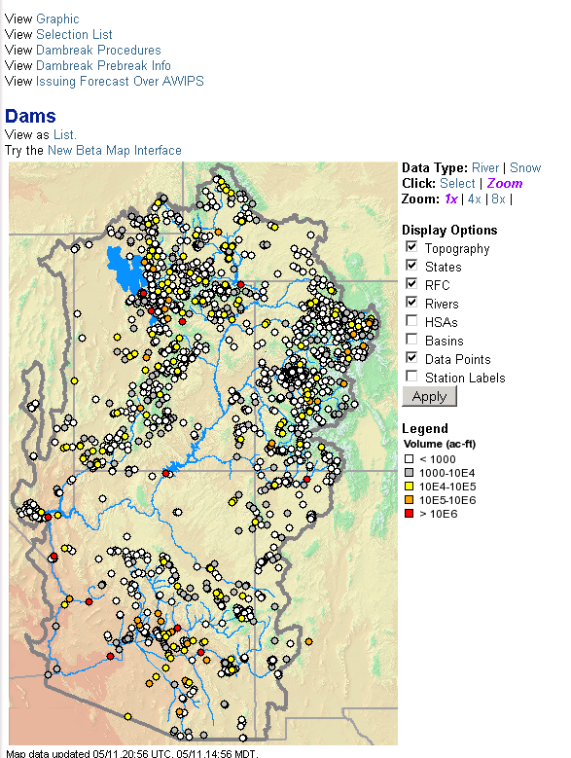
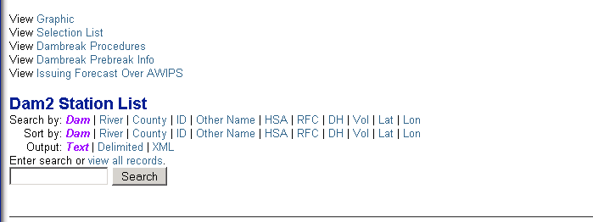
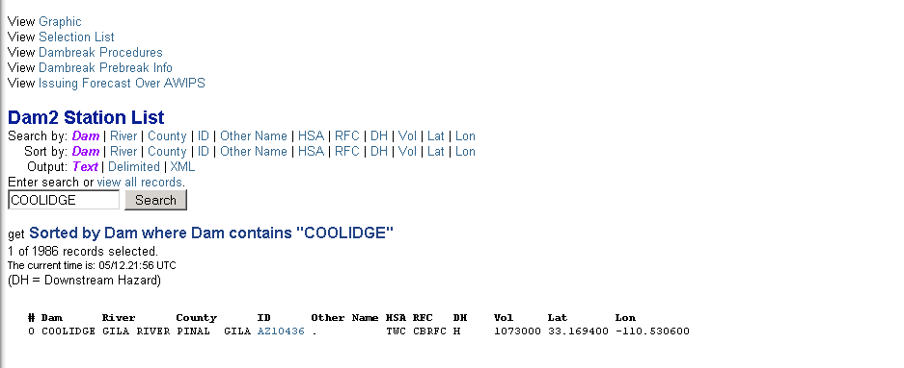
Selection List
Type Name
COOLIDGE
Click Dam ID

Slide 10
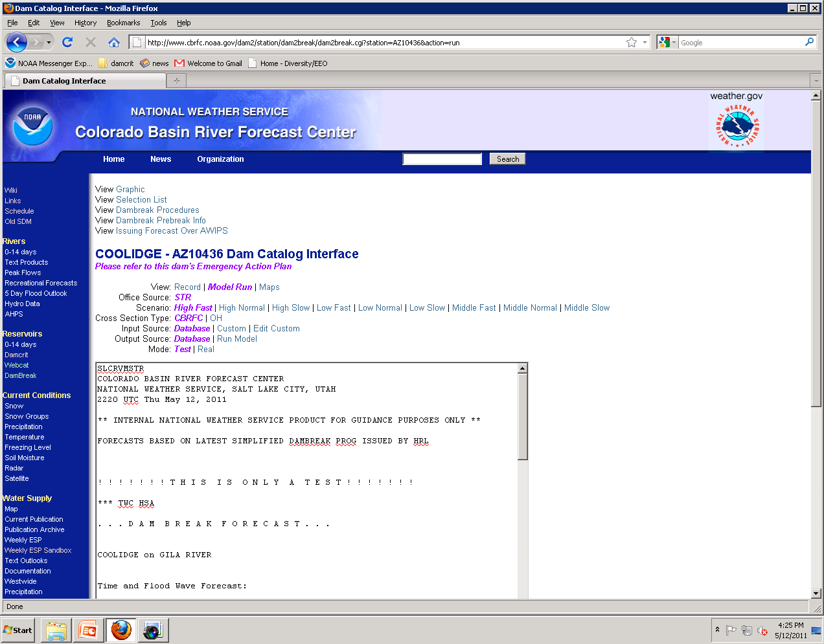
New , (use EAP for Forecast if EAP is available)
New DamBreak Notice on Webpage for sites with EAPs

Slide 11
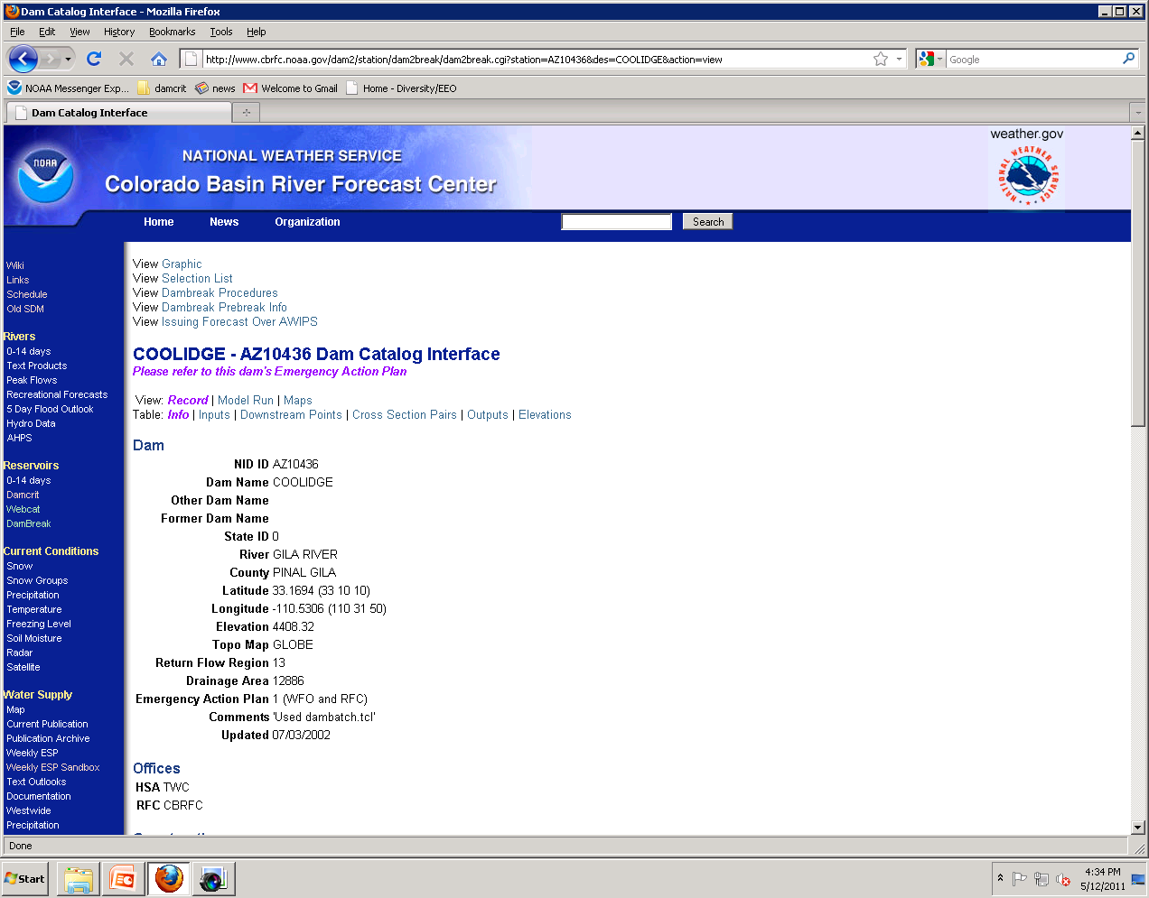
New, (tells us where EAP is, at CBRFC we would like to have copies of all EAPs)
New EAP Code In View: Record, Table: Info

Slide 12
DAMBREAK PROCEDURES
COORDINATION
FIRST ACTION:
Broken: WFO issue a generic Warning.
Not Broken: WFO issue a generic Watch.
SECOND ACTION: DETERMINE IF THE WFO HAS AN EMERGENCY ACTION PLAN (EAP) AVAILABLE BY CHECKING DAM CATALOG FOR A 1 OR 2 IN EMERGENCY ACTION BOX
1=EAP AT WFO AND CBRFC, 2=EAP AT WFO ONLY, 0=NO EAP
***STOP! REFER TO EAP FOR ALL INFORMATION, DO NOT USE SIMPLIFIED DAM BREAK FORECASTS
New DamBreak Procedure: Code Defined

Slide 13
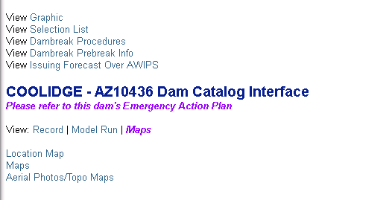
LOCATE DAM
Go to: Water -> Dambreak -> List
Using the primary information collected in step 2, and the station list, attempt to locate the dam information.
Topographic maps, aerial photos, soils, etc., are available for most dams on the web.
Locate Identified Dam

Slide 14
Rules of Thumb
At the Dam:
(Depth of Water ) If the height of the water is known behind the dam, estimate the depth of the water at the breach to be ½ the depth of the water. If the water is near the top, or overtopping, estimate the height of the water at the breach to be ½ the height of the dam.
Downstream of the Dam at Forecast Point:
(Travel Time)
Steep slopes: 8-10 mph
Medium slopes: 5-7 mph
Shallow Channels: 2-4 mph
(Depth of Water) There is no easy rule of thumb in estimating depth at some distance X from the dam.
Rules of Thumb can be applied quickly

Slide 15
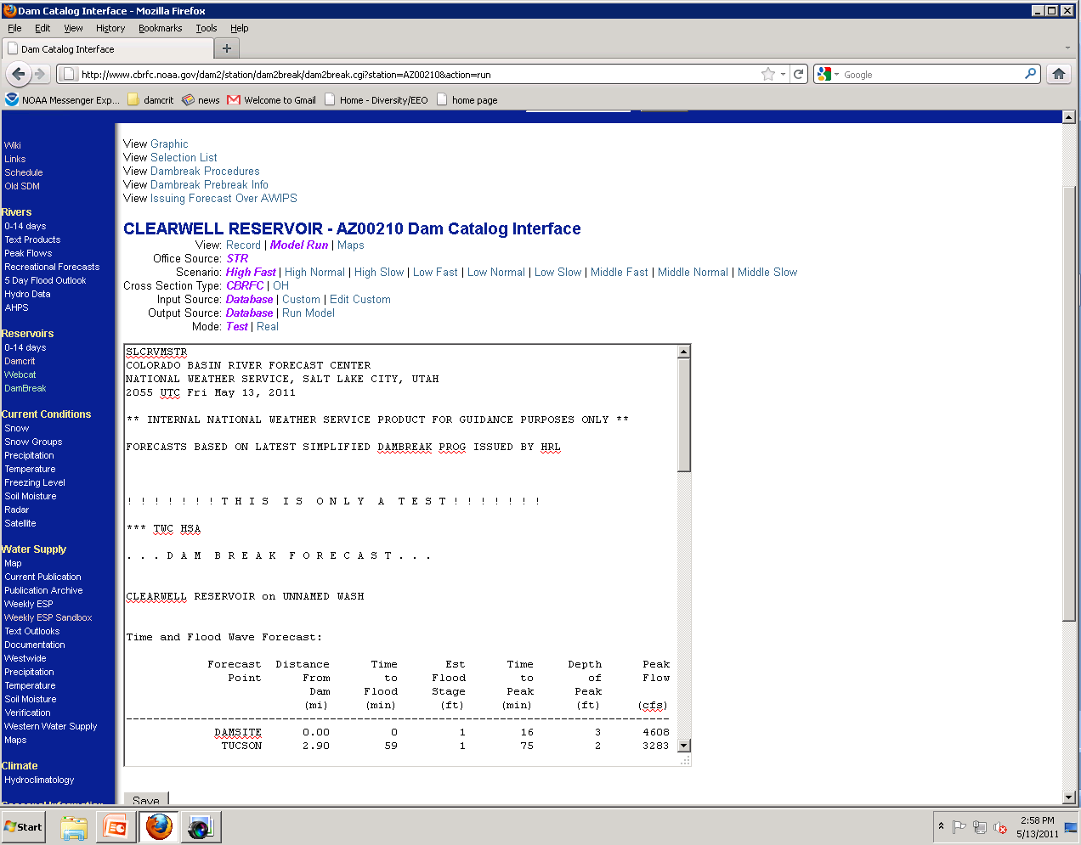
High Fast
CBRFC
Database
Database
Test
[ This Color shows what has been selected…Change Mode to Real (Test is the default) ]

Slide 16
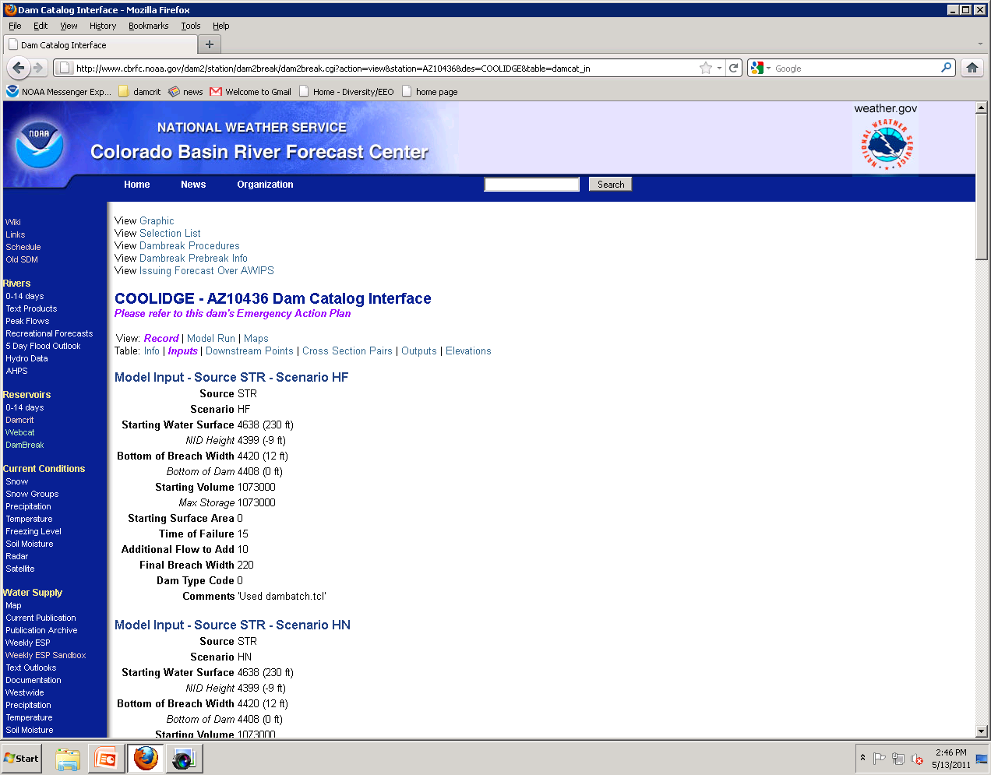
[ For more detailed information ….check the inputs table (Click on: Table -> Inputs) ]

Slide 17
SUMMARY OF WHAT IS AT CBRFC
Totals | # of Dams in CBRFC | # 0f EAPs with “2” or NIS | # of EAPs with “1” or NIS
 | damcat_dam | Copy at WFO only | Copy at CBRFC & WFO
ABQ | 80 | 7 | 2
FGZ | 149 | 21 | 1
GJT | 663 | 17 | 31
PSR | 83 | 27 | 3
SLC | 610 | 0 | 94
TWC | 69 | 3 | 2
VEF | 106 | 40 | 2
BOU | 65 | 5 | 5
EPZ | 19 | 0 | 1
CYS | 10 | 0 | 0
LKZ | 0 | 0 | 0
PIH | 14 | 0 | 3
PUB | 6 | 0 | 0
RIW | 106 | 2 | 0
CBRFC | 1980 | 130 (16 NOT IN SYSTEM) | 144
Current spreadsheet has 276 EAPs listed.

Slide 18
Do we have all EAPs for your HSA at CBRFC? (check DamBreak)
Please obtain copy for CBRFC of any EAPs we do not have.
Do we have the right HSA defined? (View: Record, Table: Info)

