Slide 1
CBRFC April 2011 Peak Flow Forecast Webinar
1pm, April 7, 2011
Kevin Werner
These slides: www.cbrfc.noaa.gov/present/present.php

Slide 2
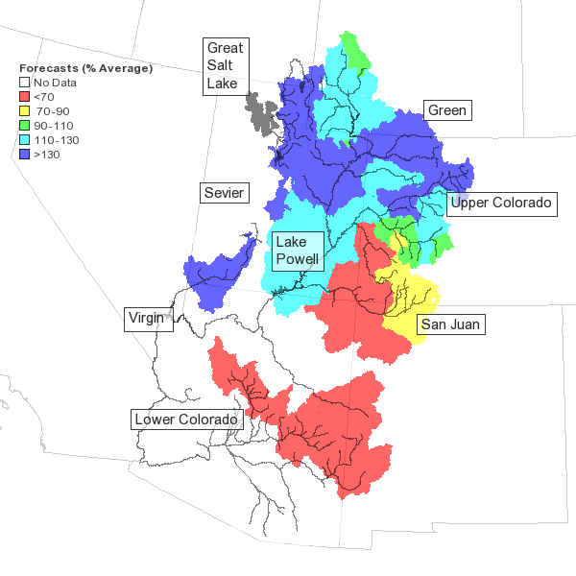
Outline
March Weather Review
Snow States
Water Supply Forecasts
Web Reference: www.cbrfc.noaa.gov/wsup/pub2/map/html/cbrfc.1.2011.html

Slide 3
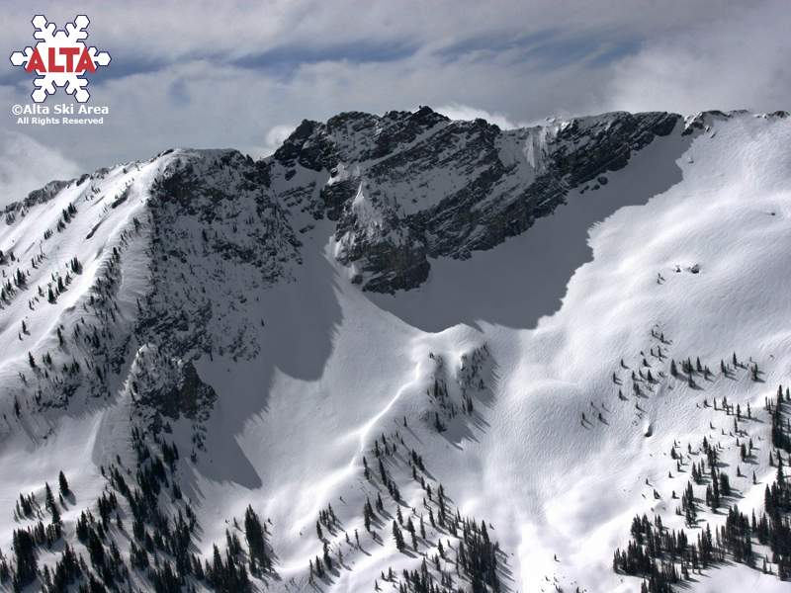

Slide 4
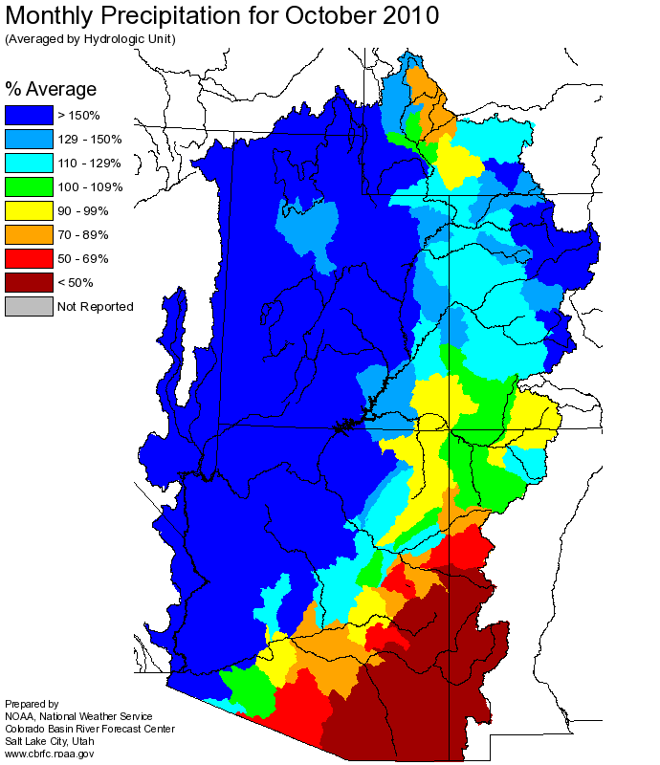
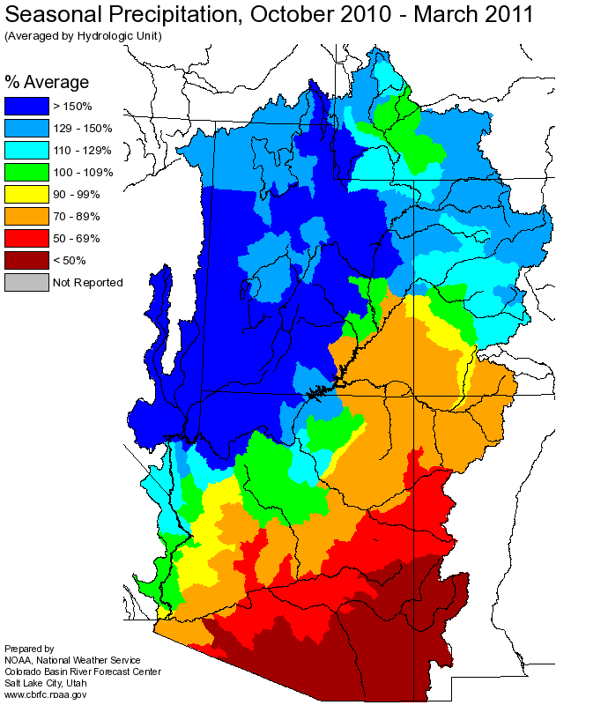
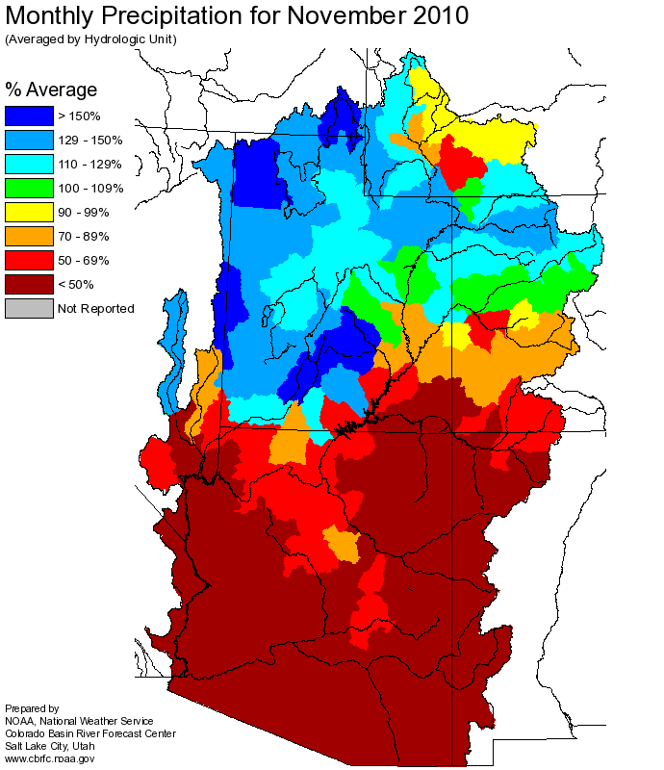
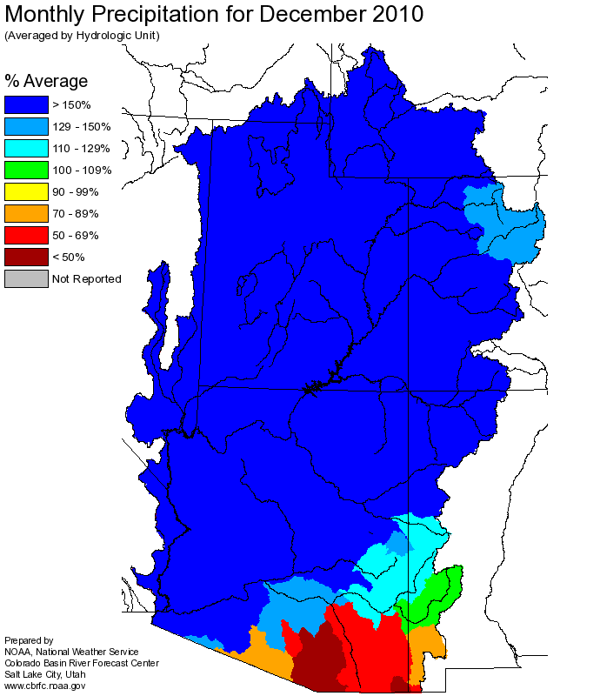
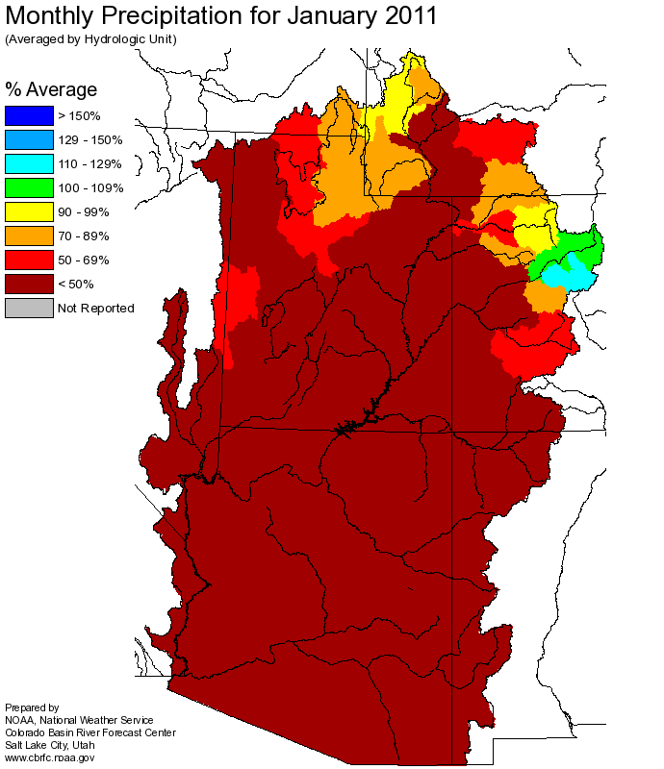
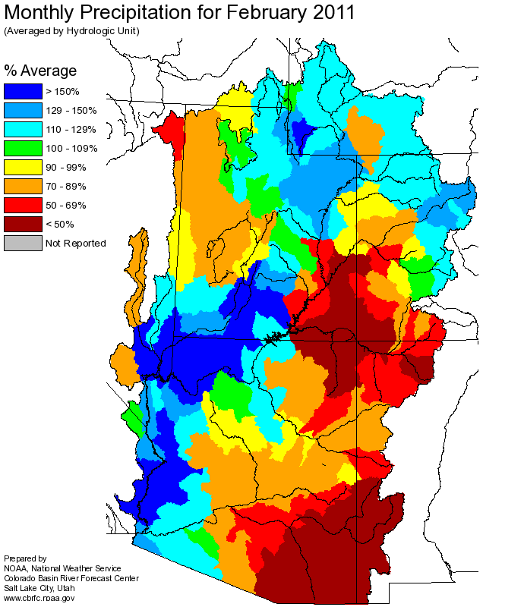
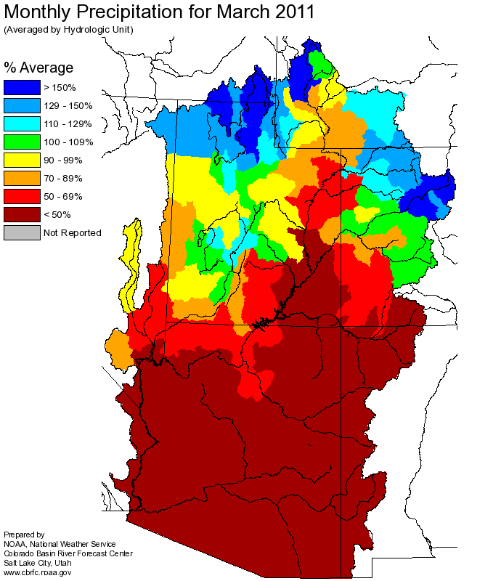
Web Reference: http://www.cbrfc.noaa.gov

Slide 5
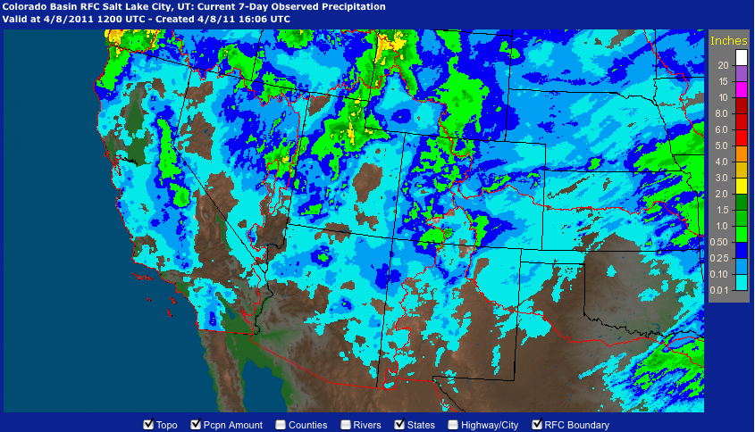
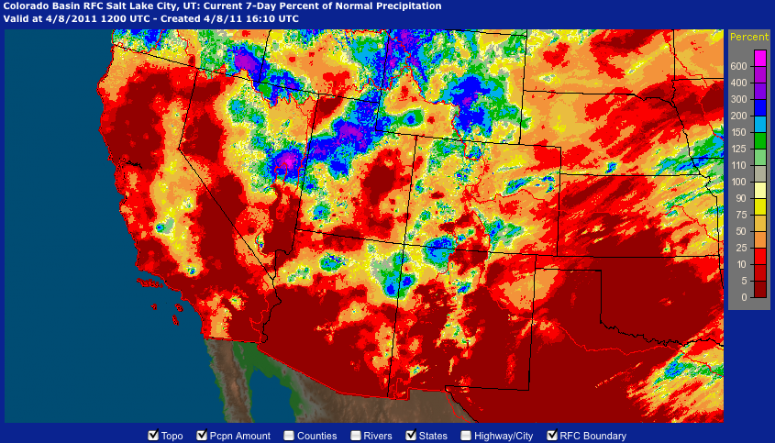
Web Reference: http://water.weather.gov/precip

Slide 6
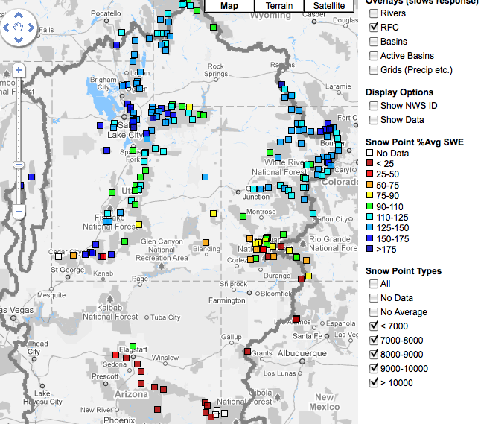
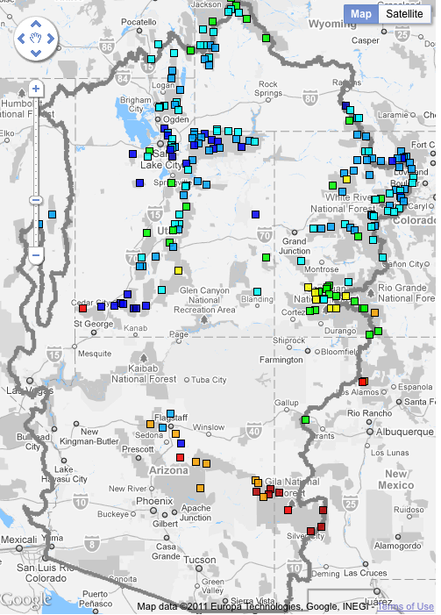
Snow
March 7 (above)
April 7 (right)
Web Reference: http://www.cbrfc.noaa.gov/gmap/gmapm.php?scon=checked

Slide 7
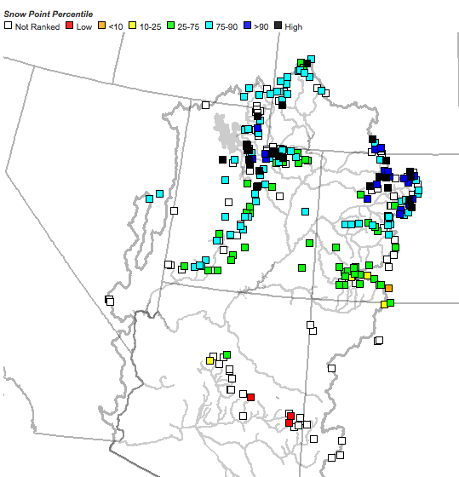
Snow
April 7 as a percent of average (above)
April 7 as a percentile (right)
Web Reference: http://www.cbrfc.noaa.gov/gmap/gmapm.php?scon=checked

Slide 8
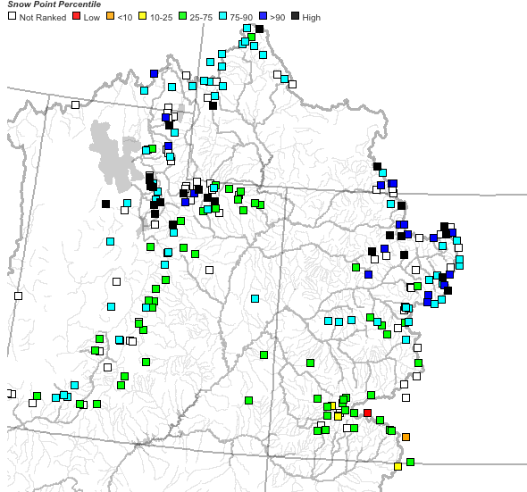
~25 sites showing highest value ever for today!!

Slide 9
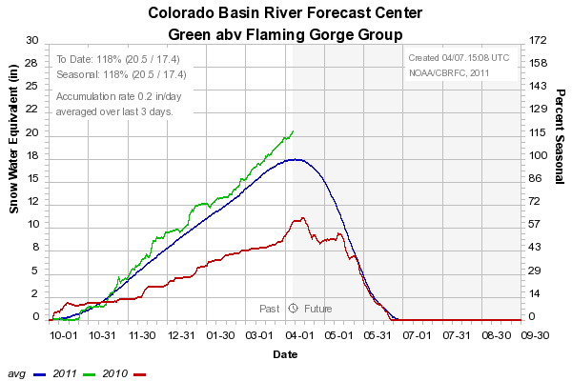
Snow: Upper Green Basin (above Flaming Gorge)
Web Reference: http://www.cbrfc.noaa.gov/station/sweplot/sweplot.cgi???open

Slide 10
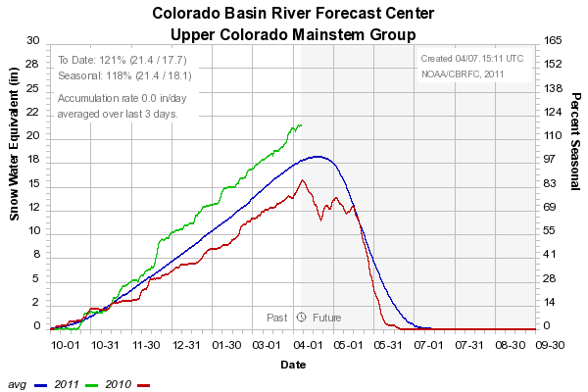
Snow: Colorado Mainstem (above Cameo)
Web Reference: http://www.cbrfc.noaa.gov/station/sweplot/sweplot.cgi???open

Slide 11
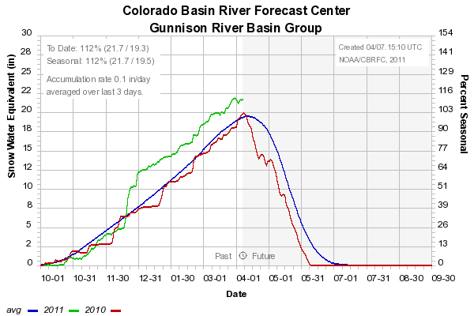
Snow: Gunnison Basin
Web Reference: http://www.cbrfc.noaa.gov/station/sweplot/sweplot.cgi???open

Slide 12
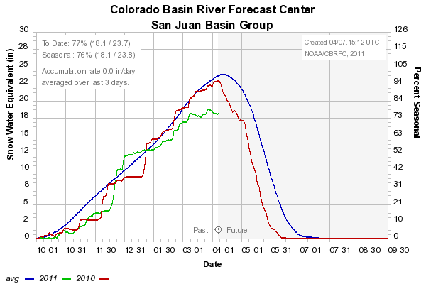
Snow: San Juan Basin
Web Reference: http://www.cbrfc.noaa.gov/station/sweplot/sweplot.cgi???open

Slide 13
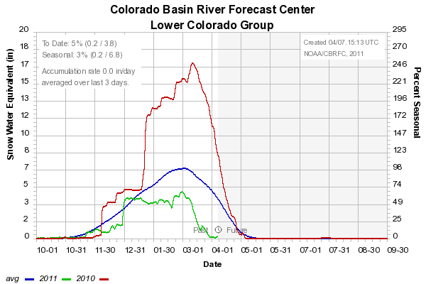
Snow: Lower Colorado
Web Reference: http://www.cbrfc.noaa.gov/station/sweplot/sweplot.cgi???open

Slide 14
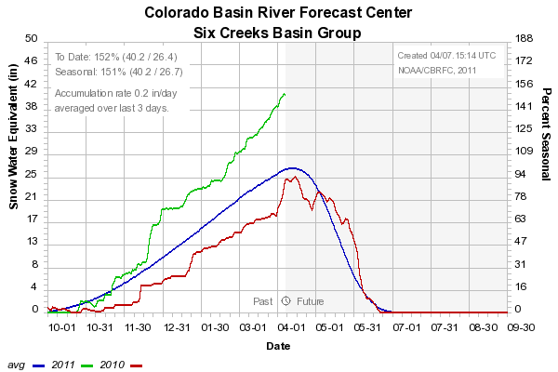
Snow: Six Creeks in Salt Lake County
Web Reference: http://www.cbrfc.noaa.gov/station/sweplot/sweplot.cgi???open

Slide 15
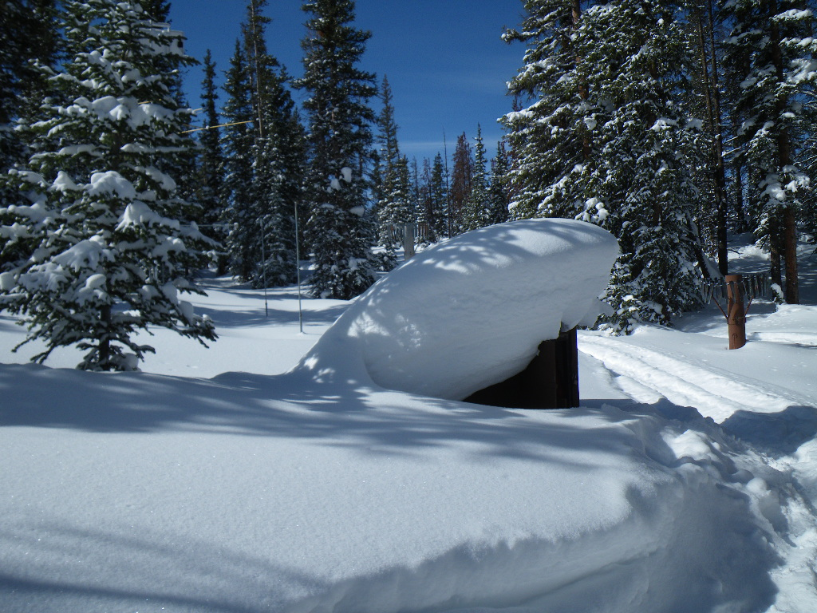
NRCS SNOTEL pictures:
Garden Summit (Right)
Trial Lake (Bottom)

Slide 16
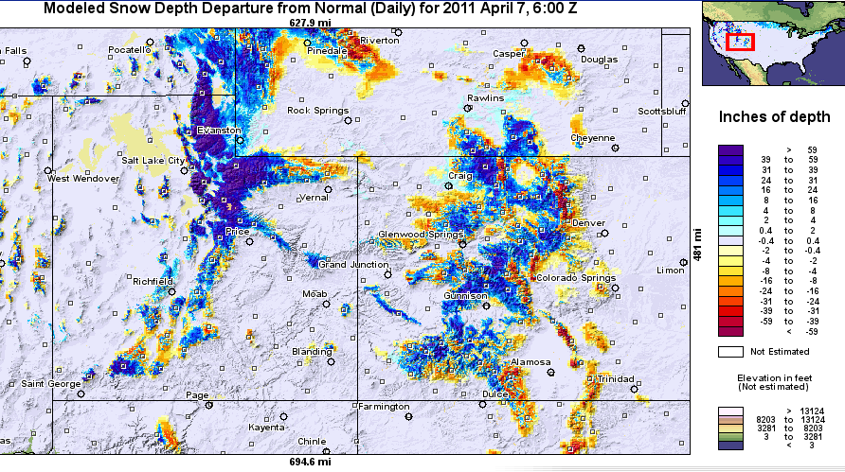
Snow Maps
Web Reference: http://www.nohrsc.nws.gov

Slide 17
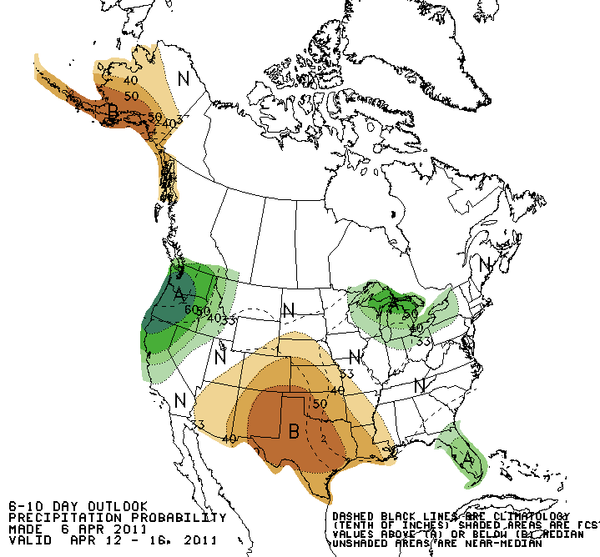
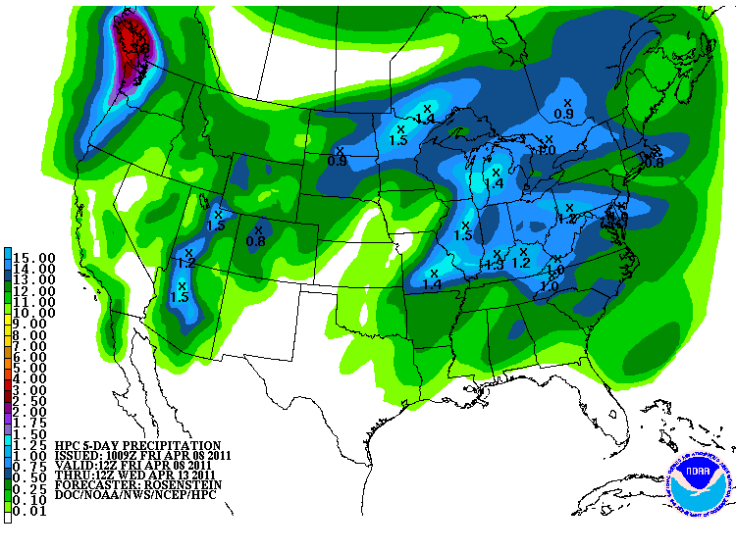
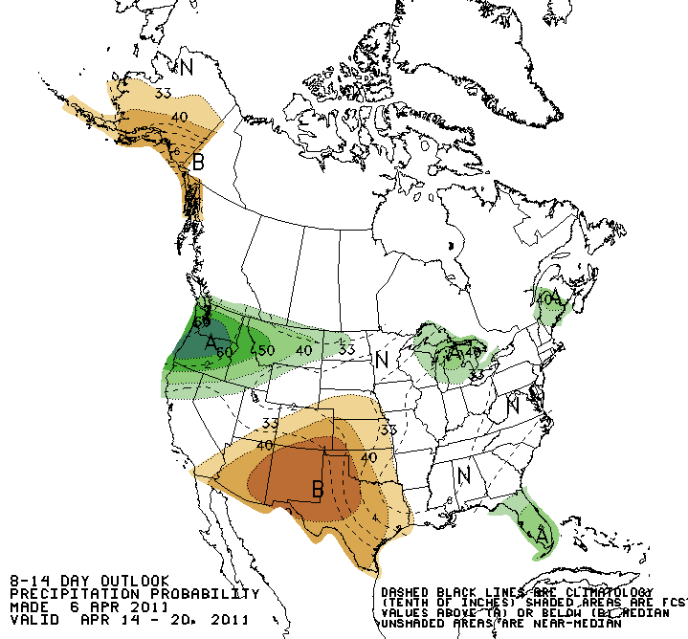
Forecast Precipitation
Active weather period continues!!
Weak storm today/tomorrow
Cold, more powerful storm for the weekend affecting entire basin
Another weaker storm for the middle of next week
Web Reference: www.hpc.noaa.gov

Slide 18
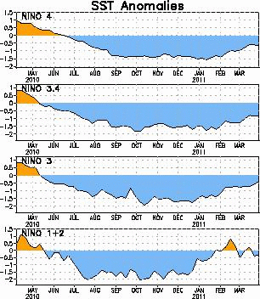
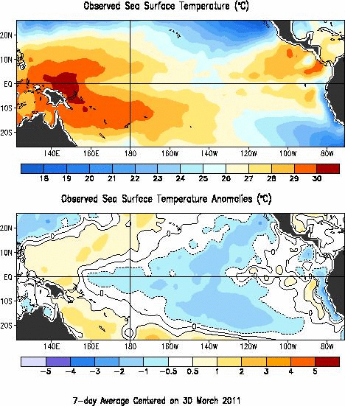
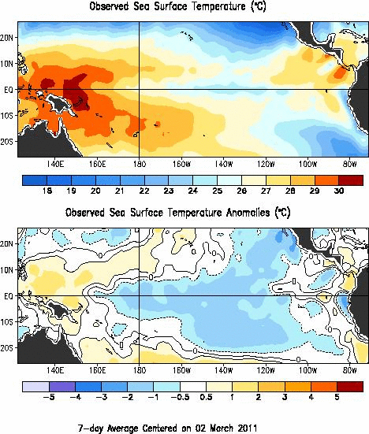
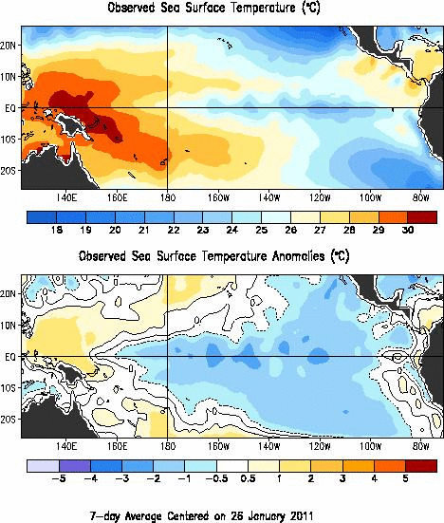
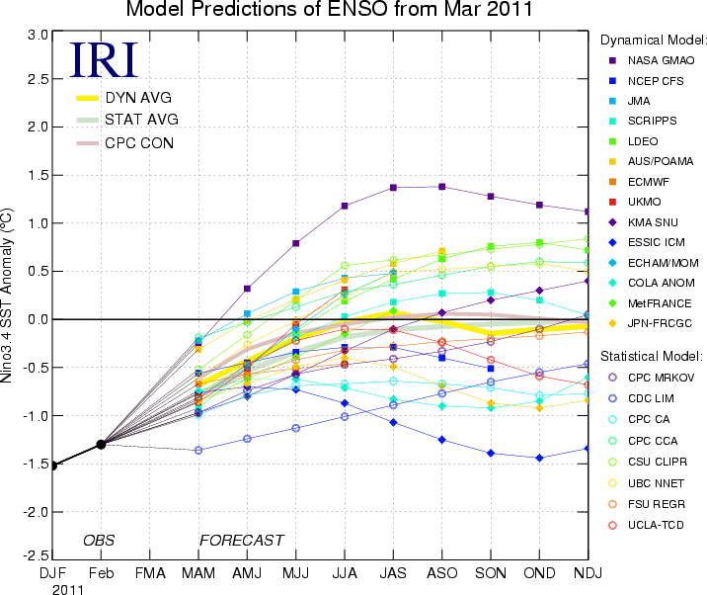
La Nina Update
Web Reference: http://www.cpc.noaa.gov and iri.columbia.edu/climate/ENSO

Slide 19
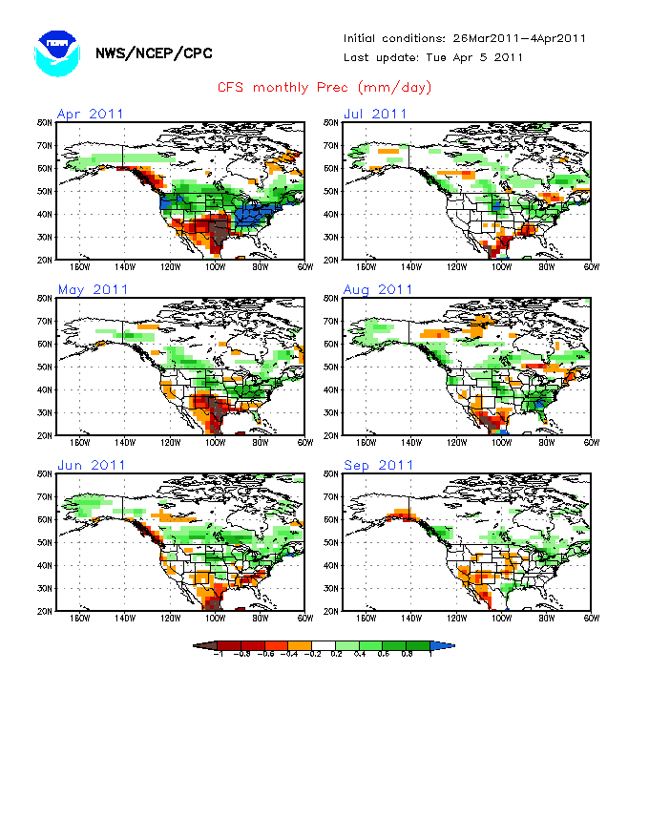
Web Reference: http://www.cbrfc.noaa.gov/climate/climoForecasts.cgi

Slide 20
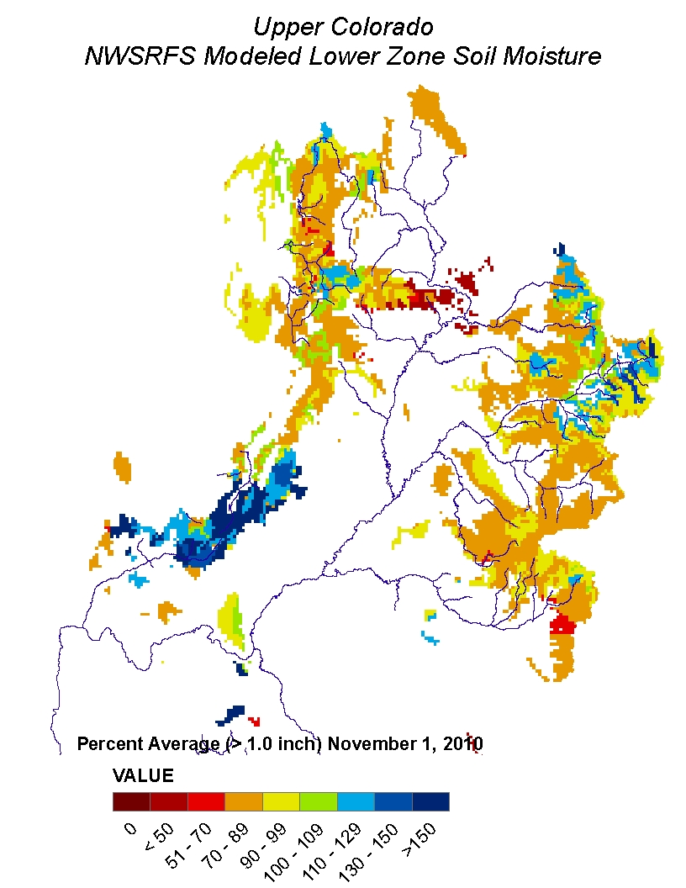
Soil Moisture

Slide 21
What is a Peak Flow Forecast?
Snowmelt Mean Daily Maximum Flow (April-July)
Probabilistic Forecasts
Exceedence Probabilities -10%,25%,50%, 75%, 90%
Issued (at least) monthly from March-June (this year weekly starting April 19)
~60 forecast points – some unregulated, some regulated
Updated as needed
Forecast Users include:
Emergency Managers
USGS hydrologists
Water Managers
River Recreation

Slide 22
Spring Weather Really Matters
Runoff characteristics are largely determined by the day-to-day spring weather.
While large snow pack years increase chances for flooding, it is not an inevitability
Small snow pack years (like last year) can flood with the right sequence of spring temperatures

Slide 23
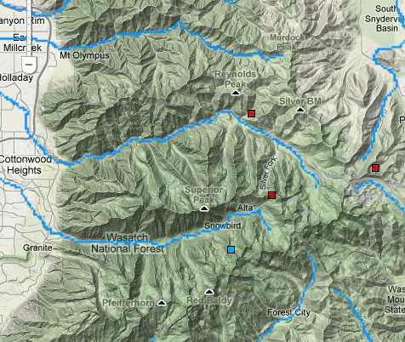
Snotels in Cottonwoods
Mill-D North (8960’, southwest face)
“middle”
Brighton (8750’, southeast face)
“middle”
Snowbird (9640’, northeast face)
“high”
Mill-D North
Brighton
Snowbird

Slide 24
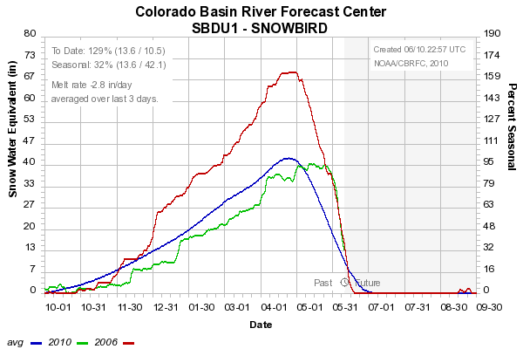
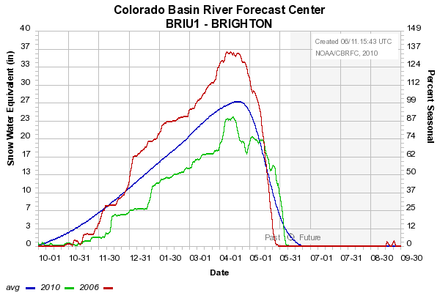
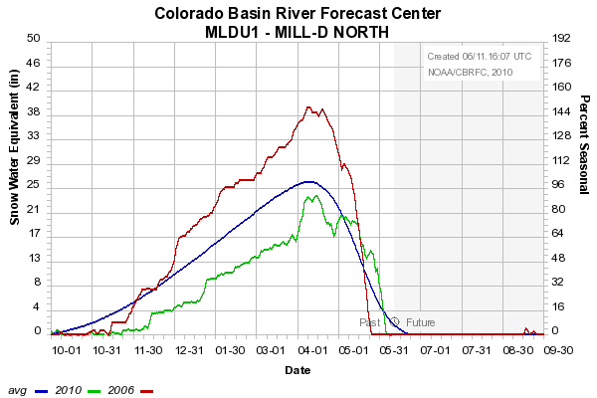
SWE in Cottonwoods
2006
Nearly identical melt!
Large snow year (2006) compared to small snow year (2010)
2010

Slide 25
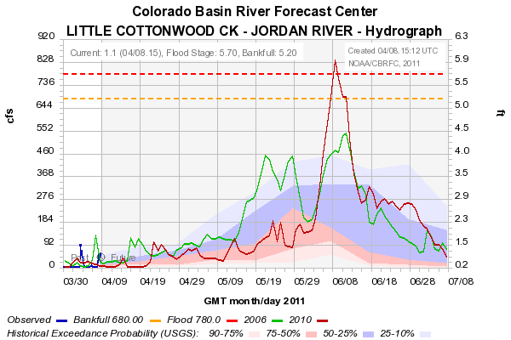

Slide 26
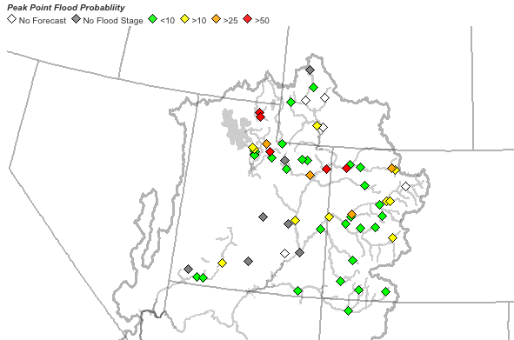
April 5 Peak Flow Forecasts

Slide 27
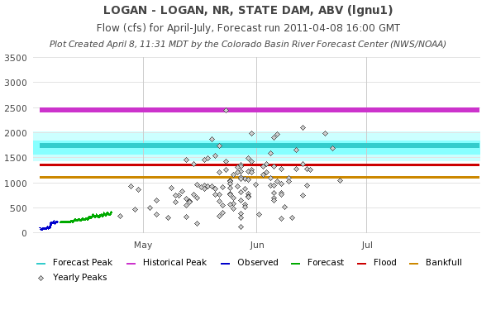
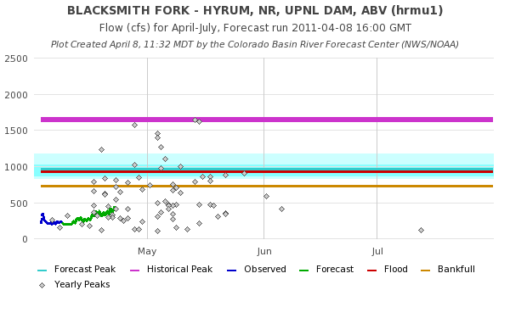

Slide 28
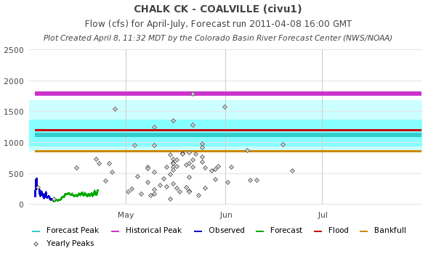
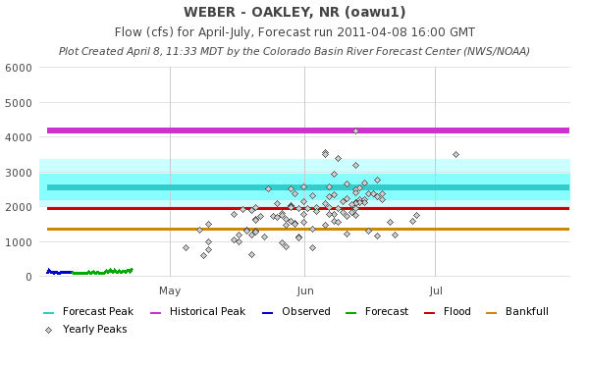

Slide 29
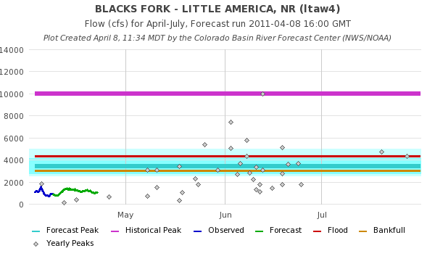

Slide 31
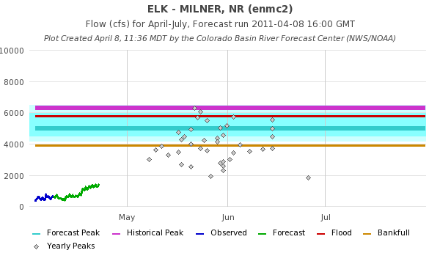
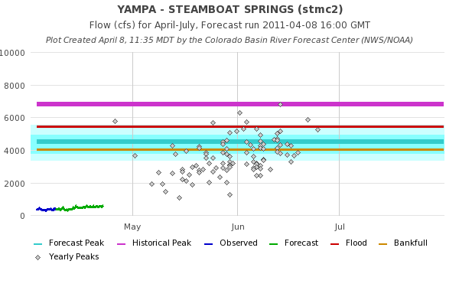

Slide 32
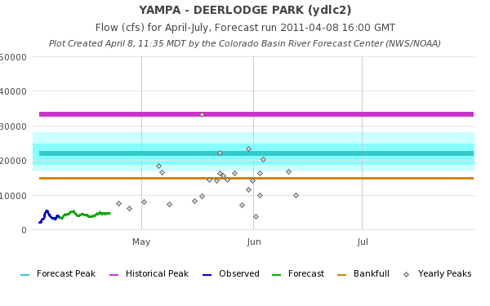
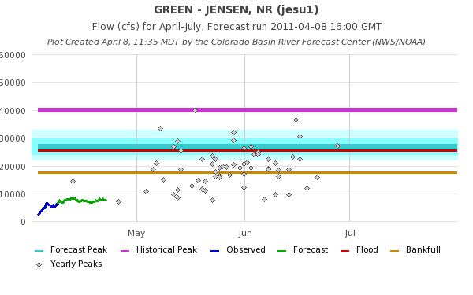

Slide 33
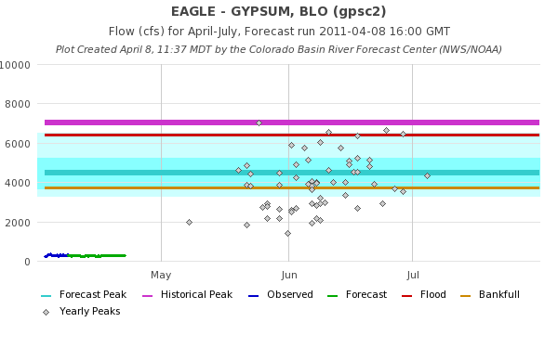
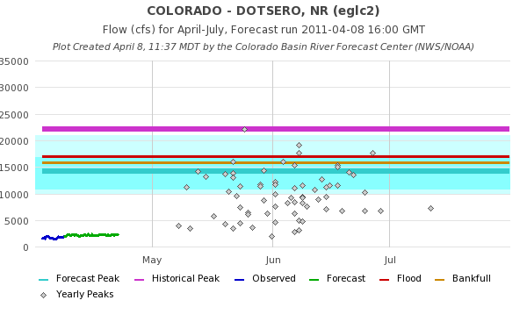

Slide 36
Peak Flow Publication

Slide 37
April 1, 2011
Water Supply Forecasts
Highlights:
Wet winter continues for much of the basin with many forecasts higher than any year since 1997
Some northern basins predicting flows near the top 10%
Most northern basins higher than Mar 1
San Juan and lower basin somewhat lower since Feb 1 and again Mar 1
Web Reference: www.cbrfc.noaa.gov/gmap/gmapm.php?wcon=checked

Slide 38
Peak Flow Forecasts
Forecast updates planned for:
4/5 (done), 4/19, 4/26, 5/5, 5/10, 5/17, 5/24
Webinars: Bi-weekly on Wednesdays starting April 20??
“beta” website developments:
SNOTEL percentiles
Simplified peak flow chart
In progress: instantaneous peaks (vs mean daily)
Discussion:
How do you use peak flow forecasts?
Does the above meet your needs? (If not, why not?)

Slide 39
CBRFC News
Basin Focal Points (Available to discuss forecasts: 801.524.5130)
Upper Colorado: Brenda Alcorn
Green: Ashley Nielson
San Juan / Gunnison: Tracy Cox
Great Basin: Brent Bernard
Lower Colorado (below Lake Powell): Greg Smith
Upcoming:
Weekly ESP model guidance
Email product updates via govdelivery (can add more products / webpages upon request)
Changes to CBRFC webpage: www.cbrfc.noaa.gov/gmap/gmap3.php
Blog (blog.citizen.apps.gov/cbrfc)

Slide 40
Feedback, Questions, Concerns always welcome….
Kevin Werner
CBRFC Service Coordination Hydrologist
Phone: 801.524.5130
Email: kevin.werner@noaa.gov

