Slide 1
CBRFC April 2011 mid-month Peak Flow Forecast Webinar
11am, April 20, 2011
Kevin Werner
These slides: www.cbrfc.noaa.gov/present/present.php

Slide 2
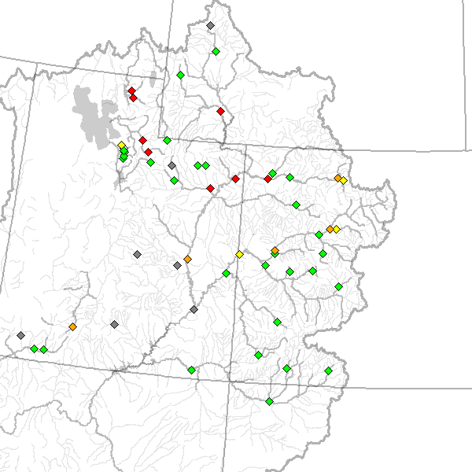
Outline
Recent and Upcoming Weather Review
Snow States
Peak Flow Forecasts
Web Reference: www.cbrfc.noaa.gov/wsup/pub2/map/html/cbrfc.1.2011.html

Slide 3
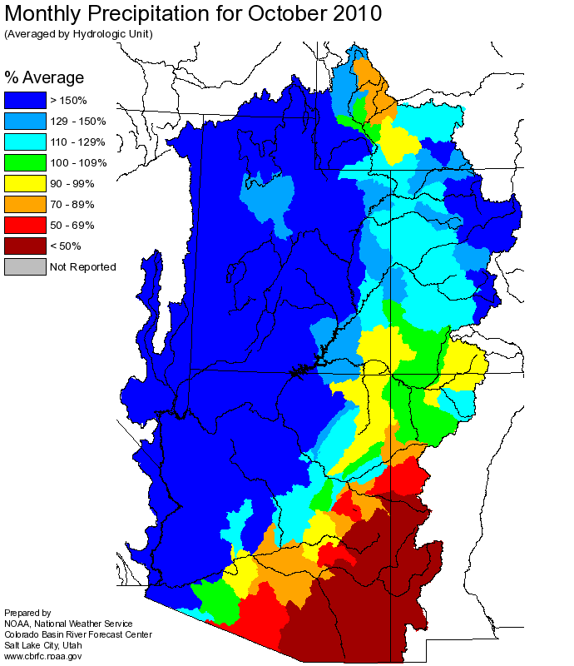
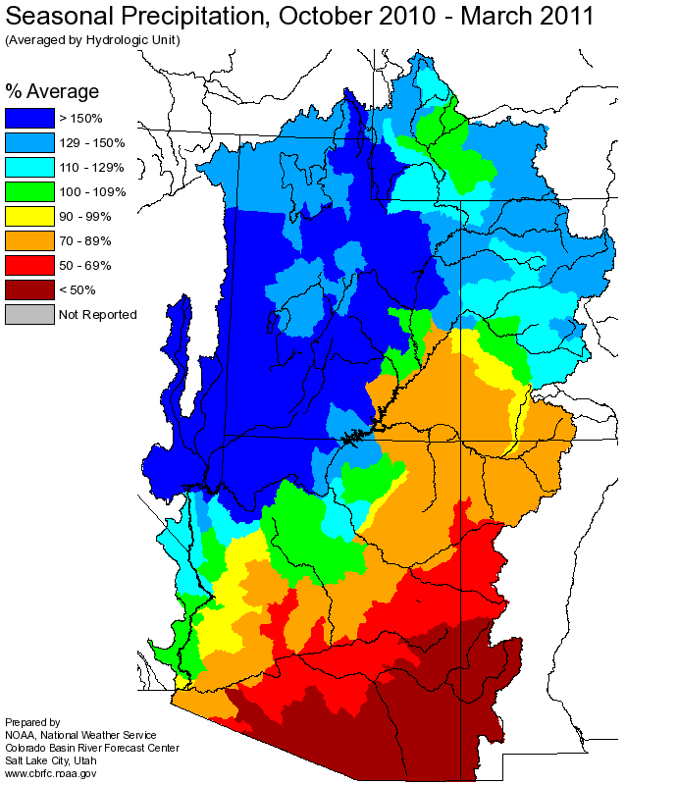
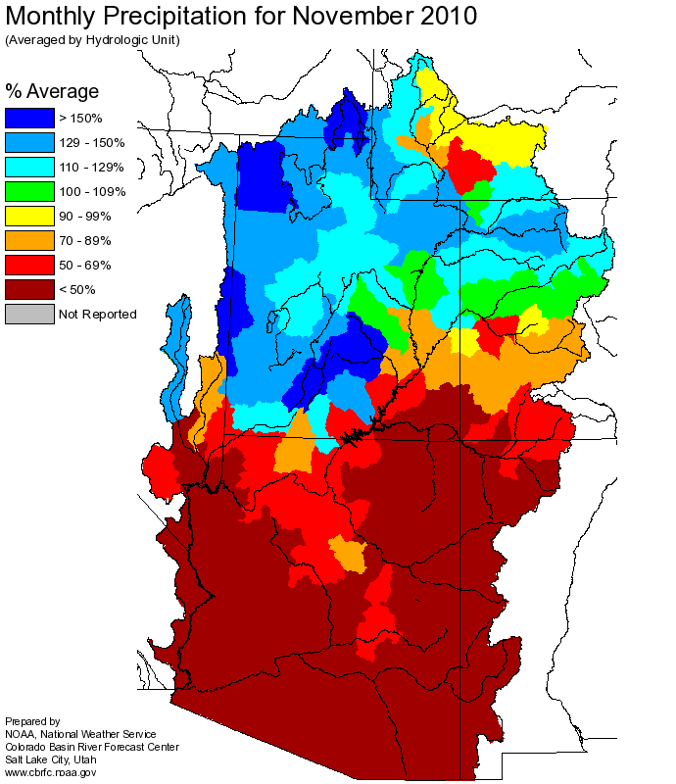
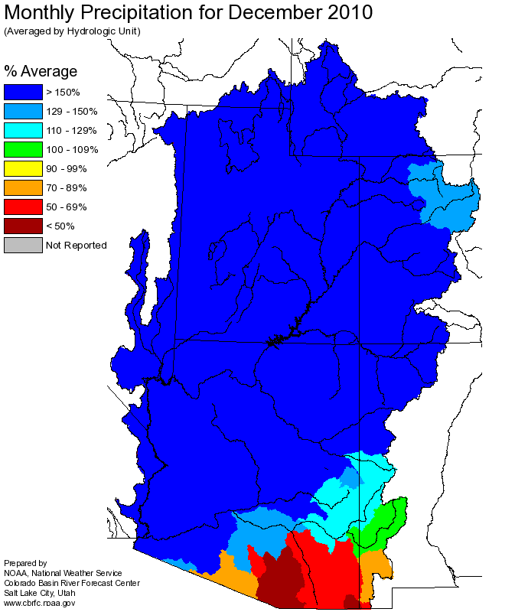
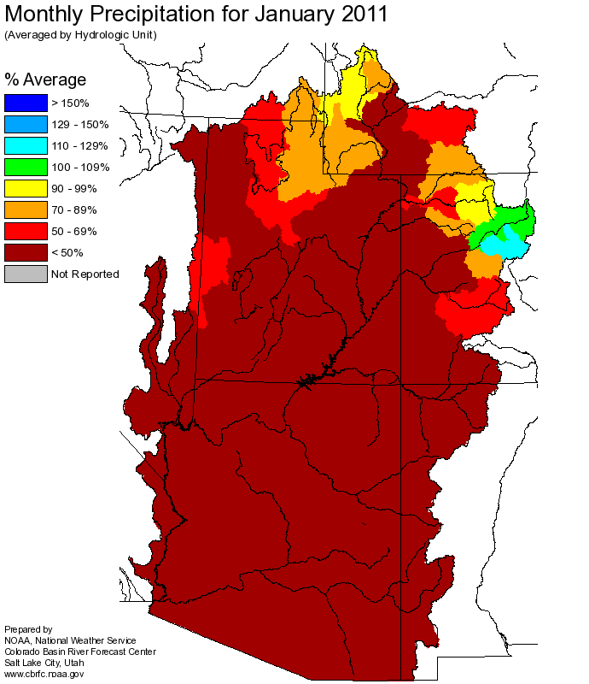
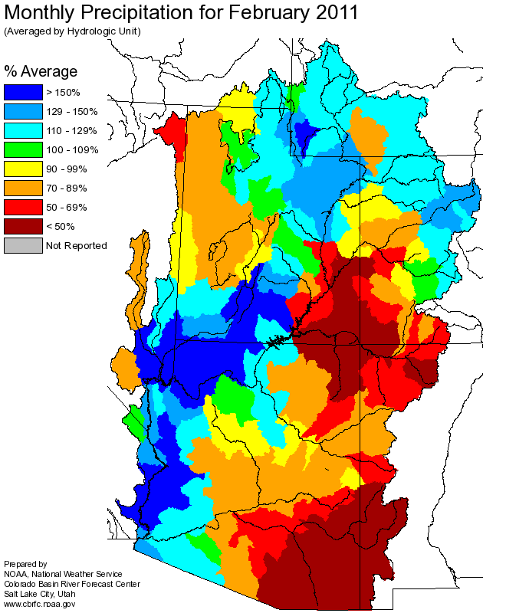
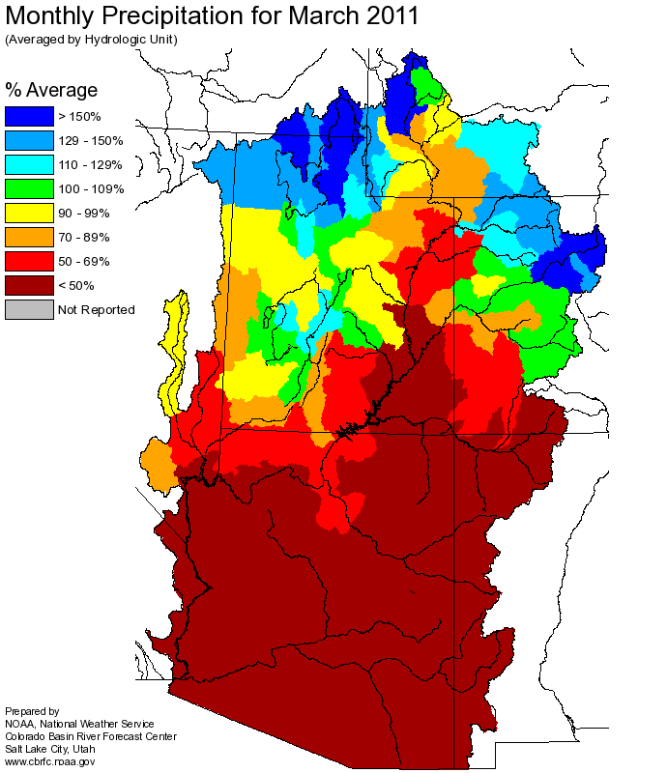
Web Reference: http://www.cbrfc.noaa.gov

Slide 4
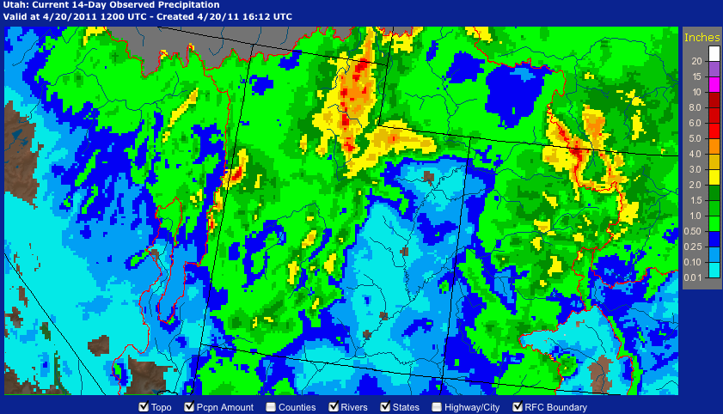
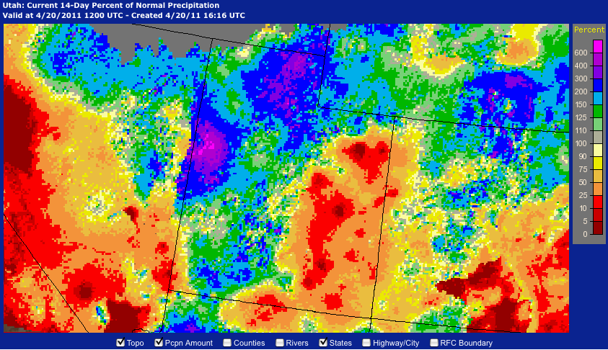
Web Reference: http://water.weather.gov/precip

Slide 5
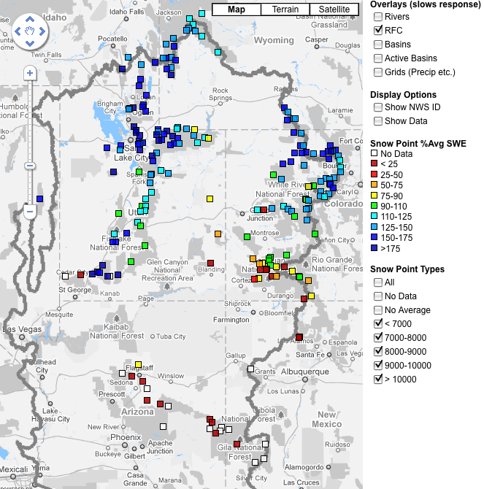
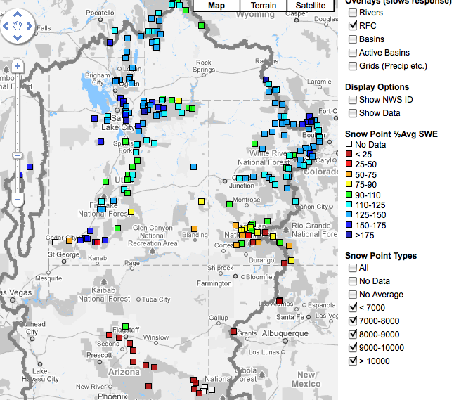
Snow
April 7 (above)
April 20 (right)
Web Reference: http://www.cbrfc.noaa.gov/gmap/gmapm.php?scon=checked

Slide 6
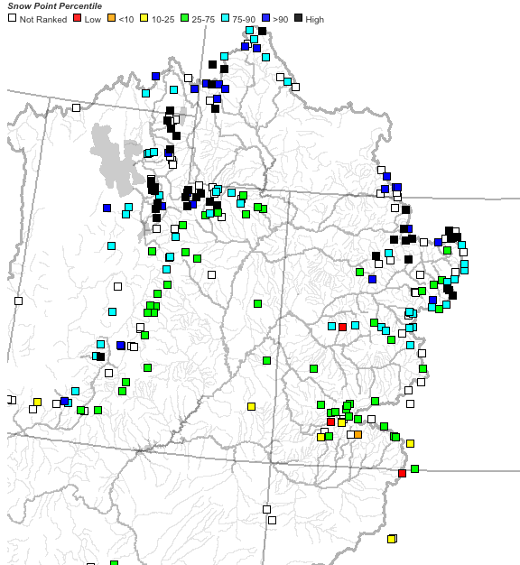
Snow
April 7 as a percent of average (above)
April 7 as a percentile (right)
Web Reference: http://www.cbrfc.noaa.gov/gmap/gmapm.php?scon=checked

Slide 7
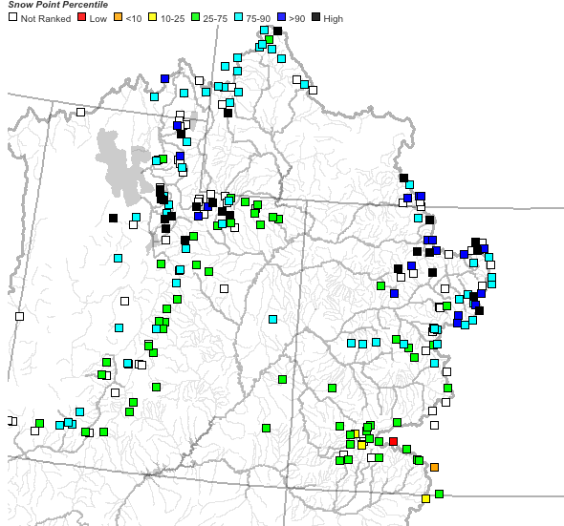
April 7 (left); April 20 (right)
~40 sites showing highest value ever for today!!

Slide 8
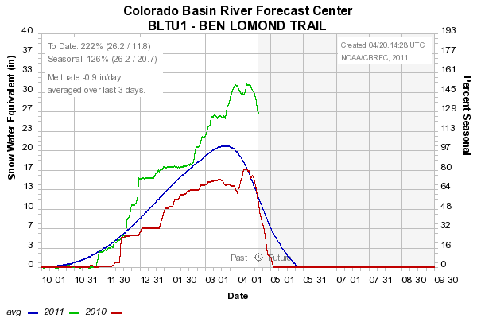
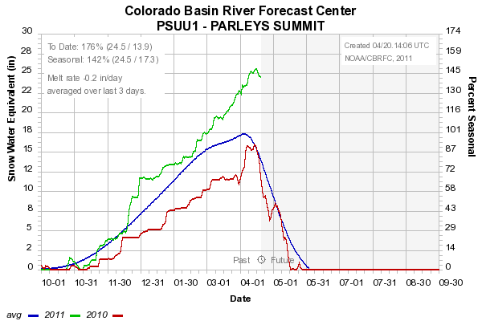
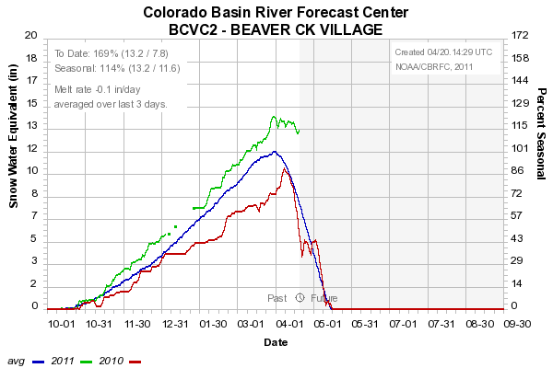
Sites below ~8500’
starting to melt
8000’
7500’
8400’

Slide 9
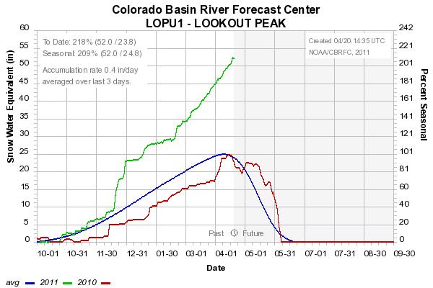
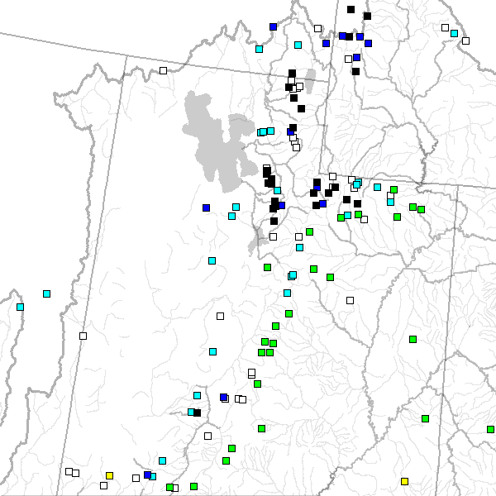
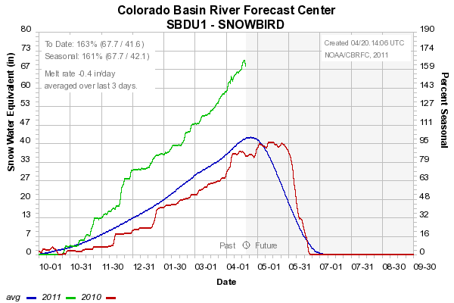
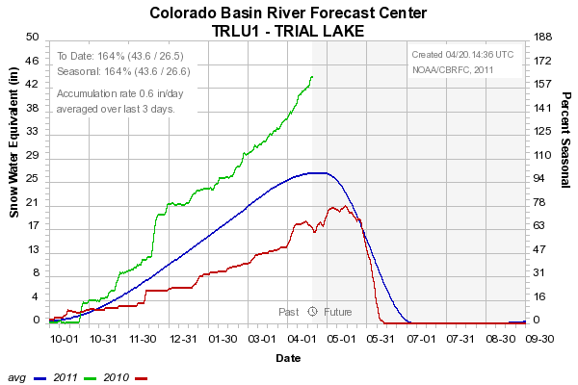
Sites above 8500’
Still accumulating snow
8200’
9600’
8400’

Slide 10
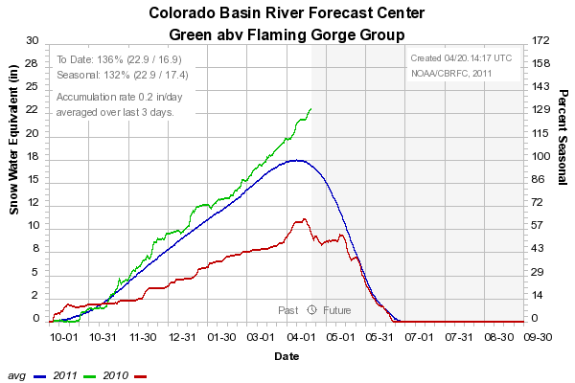
Snow: Upper Green Basin (above Flaming Gorge)
Web Reference: http://www.cbrfc.noaa.gov/station/sweplot/sweplot.cgi???open

Slide 11
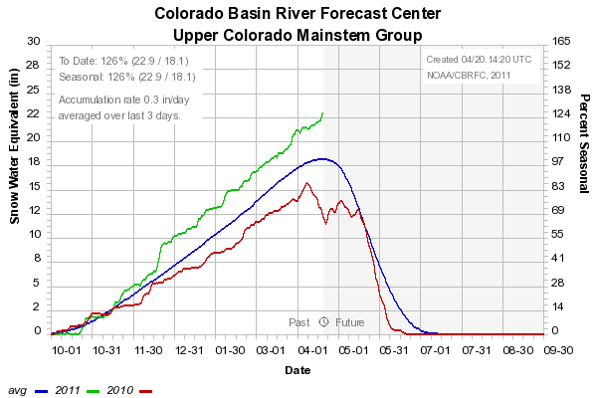
Snow: Colorado Mainstem (above Cameo)
Web Reference: http://www.cbrfc.noaa.gov/station/sweplot/sweplot.cgi???open

Slide 12
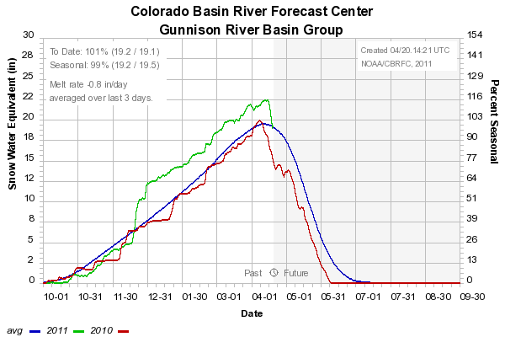
Snow: Gunnison Basin
Web Reference: http://www.cbrfc.noaa.gov/station/sweplot/sweplot.cgi???open

Slide 13
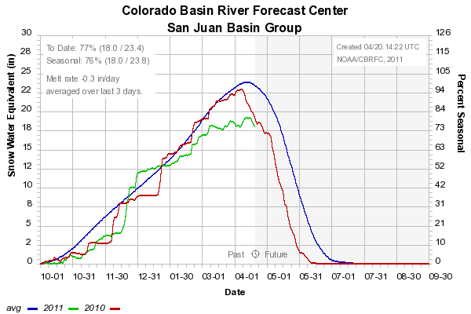
Snow: San Juan Basin
Web Reference: http://www.cbrfc.noaa.gov/station/sweplot/sweplot.cgi???open

Slide 14
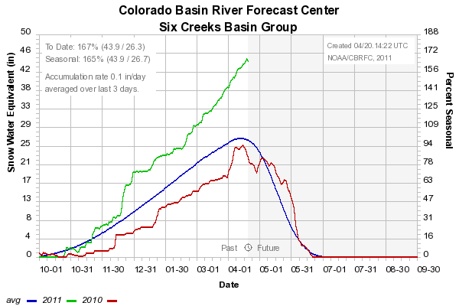
Snow: Six Creeks in Salt Lake County
Web Reference: http://www.cbrfc.noaa.gov/station/sweplot/sweplot.cgi???open

Slide 15
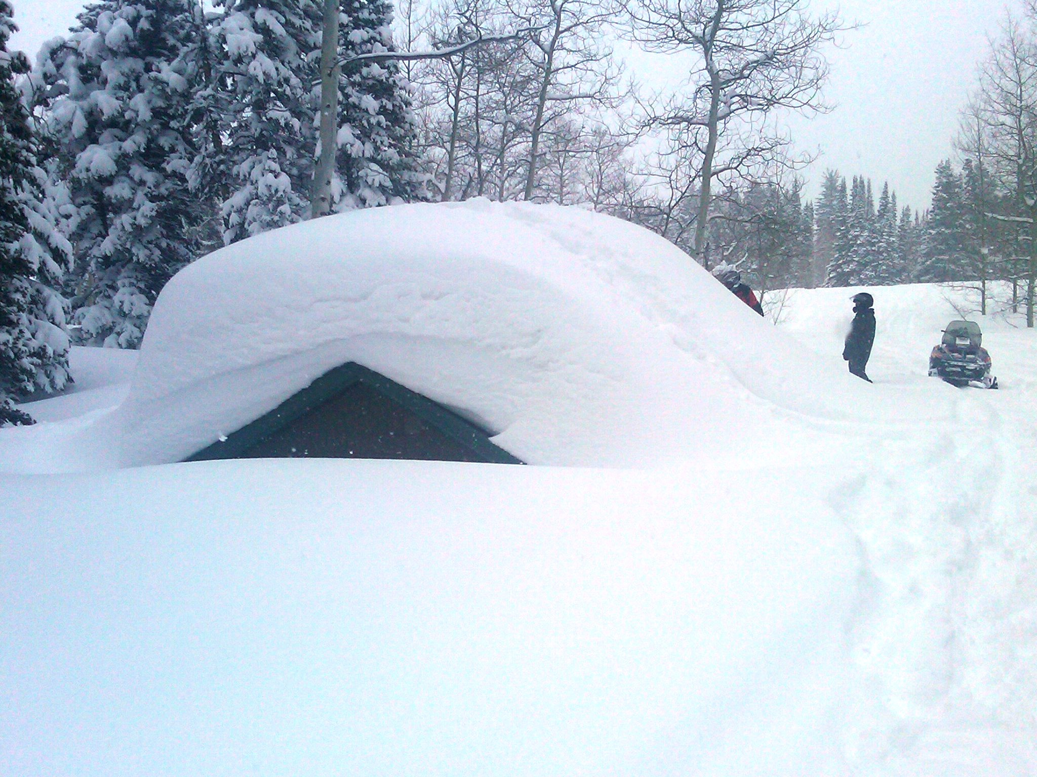
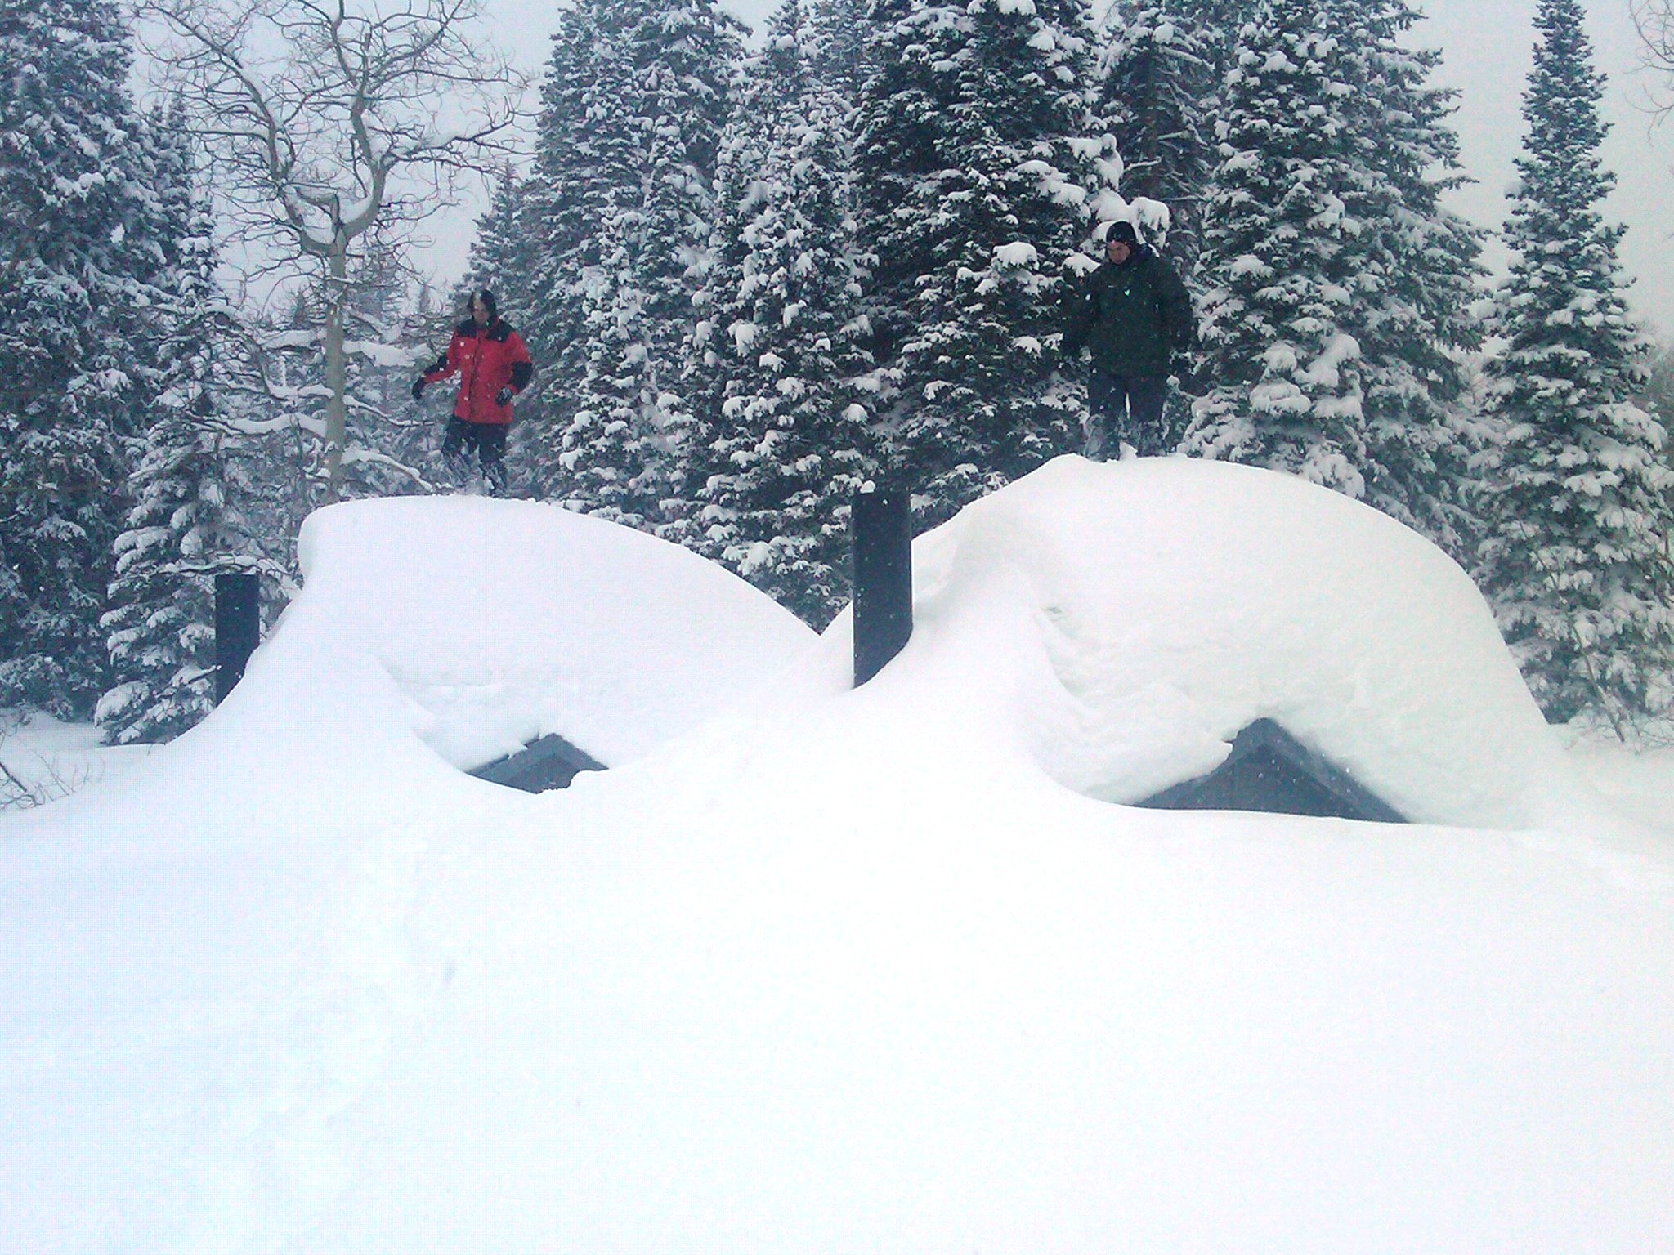
NRCS Snow Survey pictures:
Monte Cristo Campground, UT

Slide 16
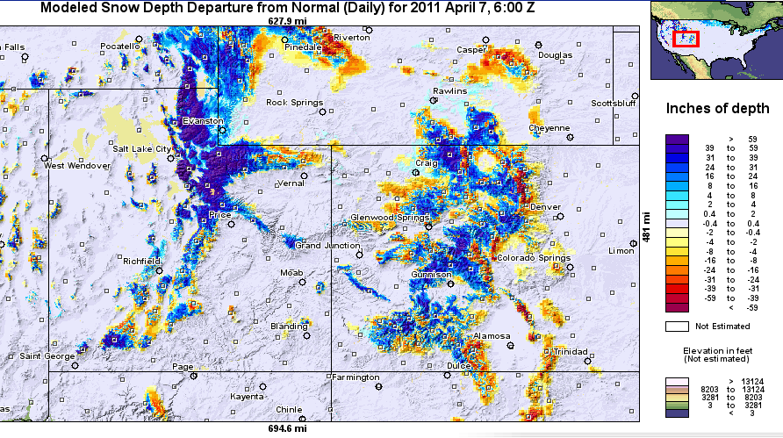
Snow Maps
Web Reference: http://www.nohrsc.nws.gov

Slide 17
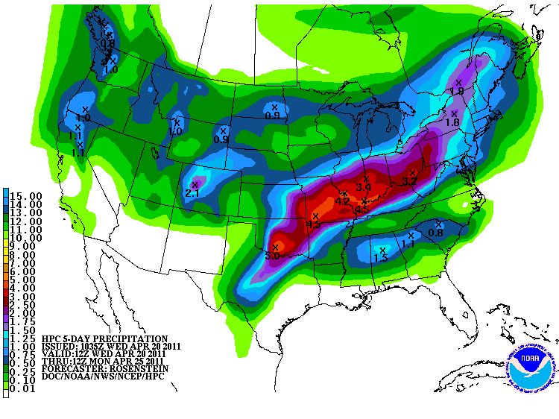
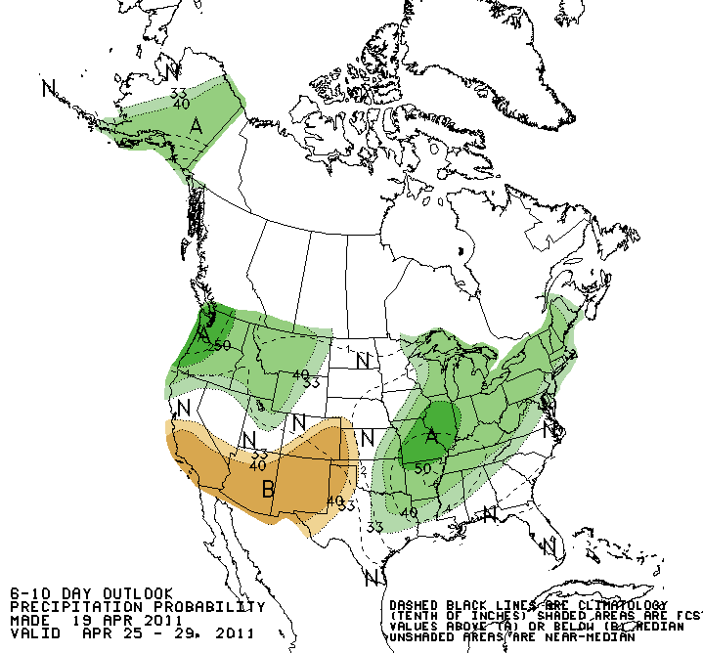
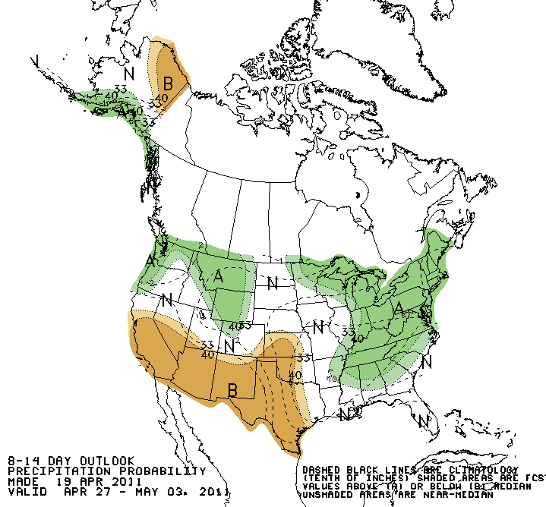
Forecast Precipitation
Active weather period continues!!
Weak storm today/tomorrow (< 1” SWE)
Second, weak storm for Sunday/Monday
Web Reference: www.hpc.noaa.gov

Slide 18
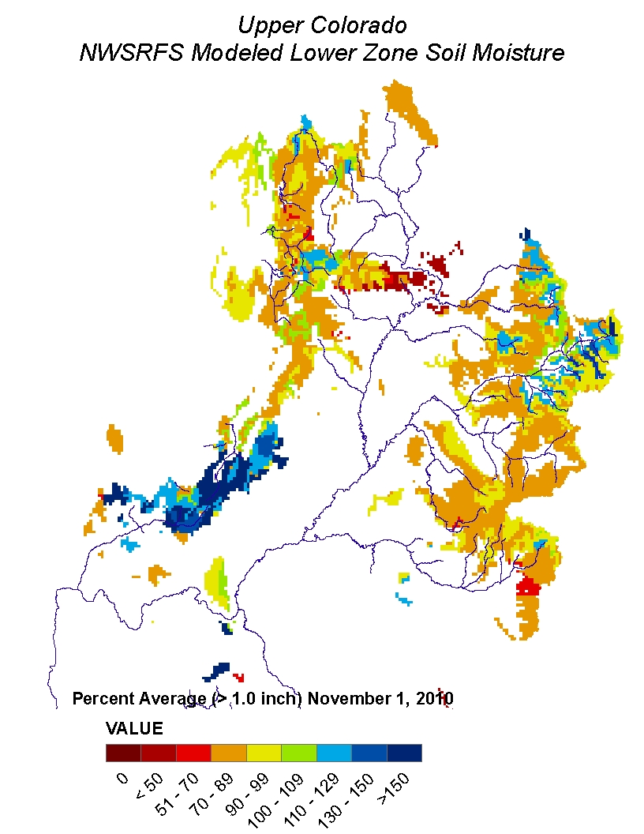
Soil Moisture

Slide 19
What is a Peak Flow Forecast?
Snowmelt Mean Daily Maximum Flow (April-July)
Probabilistic Forecasts
Exceedence Probabilities -10%,25%,50%, 75%, 90%
Issued (at least) monthly from March-June (this year weekly starting April 19)
~60 forecast points – some unregulated, some regulated
Updated as needed
Forecast Users include:
Emergency Managers
USGS hydrologists
Water Managers
River Recreation

Slide 20
Spring Weather Really Matters
Runoff characteristics are largely determined by the day-to-day spring weather.
While large snow pack years increase chances for flooding, it is not an inevitability
Small snow pack years (like last year) can flood with the right sequence of spring temperatures

Slide 21
April 19 Peak Flow Forecasts
April 5 Forecasts
April 19 Forecasts

Slide 22
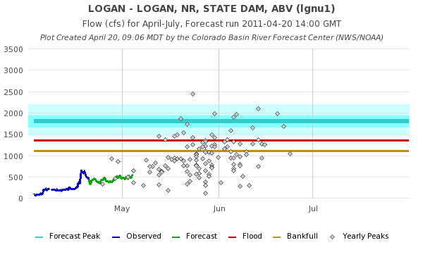
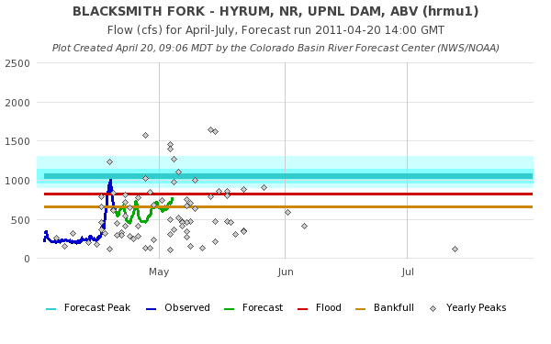

Slide 23
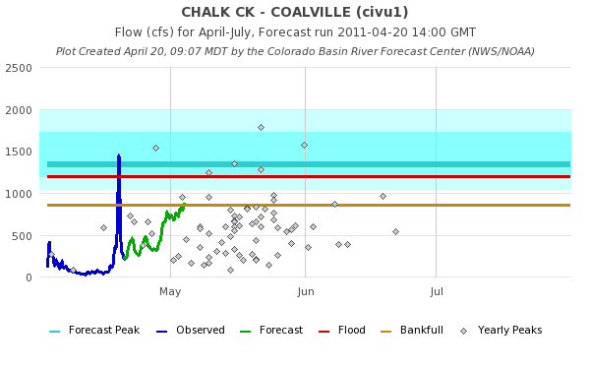
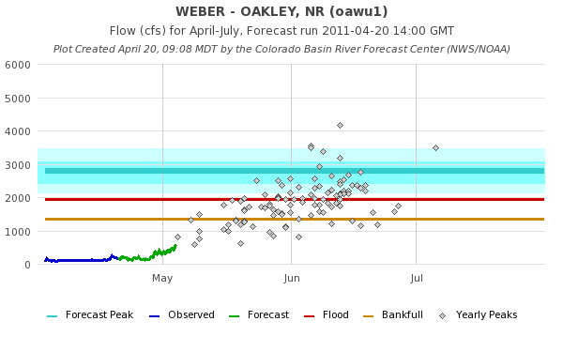

Slide 24
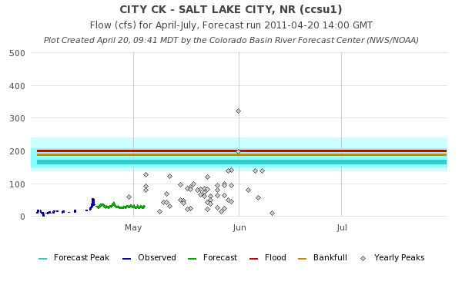
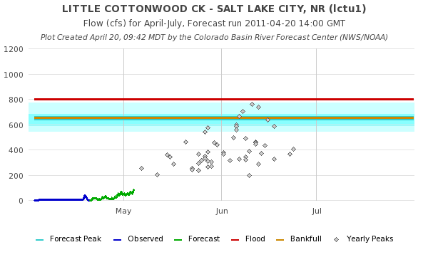

Slide 25
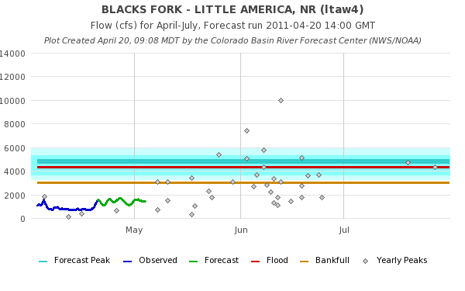

Slide 26
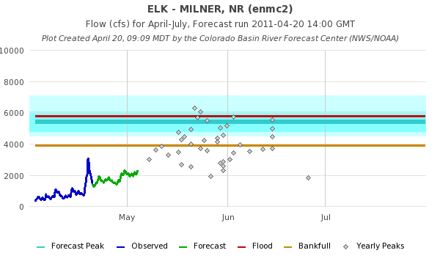
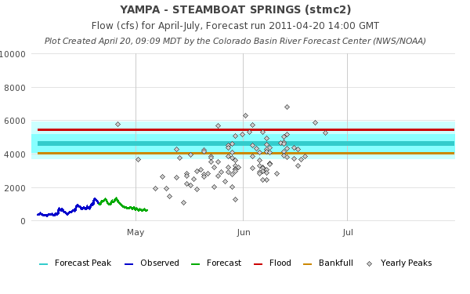

Slide 27
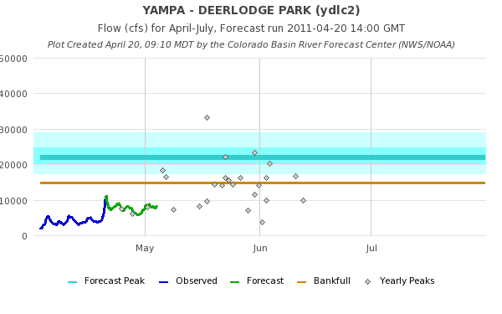
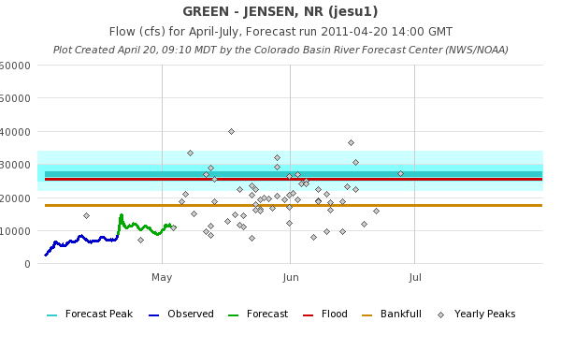

Slide 28
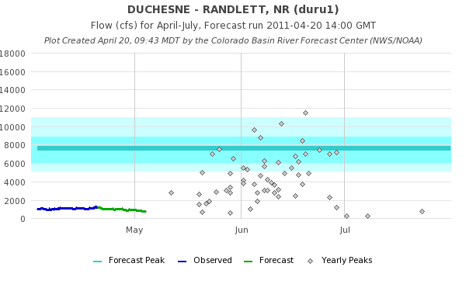
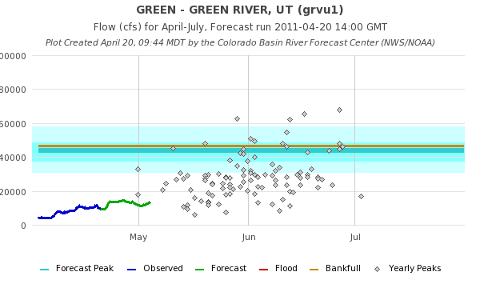

Slide 29
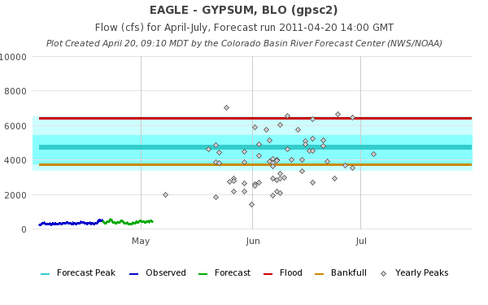
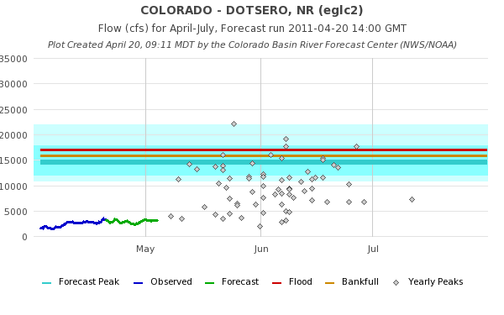

Slide 30
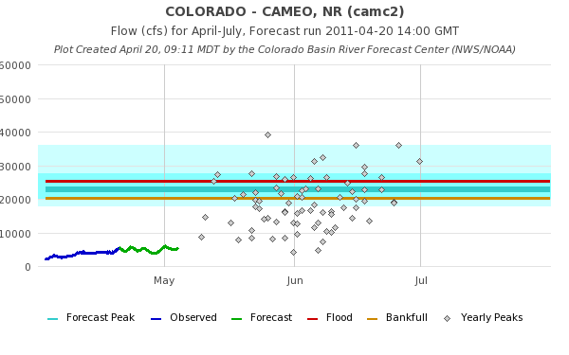
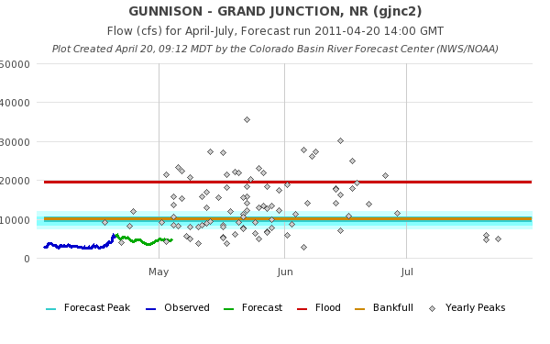

Slide 32
Peak Flow Publication

Slide 33
April 1, 2011
Water Supply Forecasts
Highlights:
Wet winter continues for much of the basin with many forecasts higher than any year since 1997
Some northern basins predicting flows near the top 10%
Most northern basins higher than Mar 1
San Juan and lower basin somewhat lower since Feb 1 and again Mar 1
Web Reference: www.cbrfc.noaa.gov/gmap/gmapm.php?wcon=checked

Slide 34
Peak Flow Forecasts
Forecast updates planned for:
4/5, 4/19 (done), 4/26, 5/5, 5/10, 5/17, 5/24
Webinars: 4/20,4/27,5/11
“beta” website developments:
SNOTEL percentiles
Simplified peak flow chart
In progress: instantaneous peaks (vs mean daily)
Discussion:
How do you use peak flow forecasts?
Does the above meet your needs? (If not, why not?)

Slide 35
CBRFC News
Basin Focal Points (Available to discuss forecasts: 801.524.5130)
Upper Colorado: Brenda Alcorn
Green: Ashley Nielson
San Juan / Gunnison: Tracy Cox
Great Basin: Brent Bernard
Lower Colorado (below Lake Powell): Greg Smith
Upcoming:
Weekly ESP model guidance
Email product updates via govdelivery (can add more products / webpages upon request)
Changes to CBRFC webpage: www.cbrfc.noaa.gov/gmap/gmap3.php
Blog (blog.citizen.apps.gov/cbrfc)

Slide 36
Feedback, Questions, Concerns always welcome….
Kevin Werner
CBRFC Service Coordination Hydrologist
Phone: 801.524.5130
Email: kevin.werner@noaa.gov

