Slide 1
CBRFC
June 2
Peak Flow and Water Supply Forecast Webinar
1pm, June 2, 2011
Kevin Werner
These slides: www.cbrfc.noaa.gov/present/present.php

Slide 2
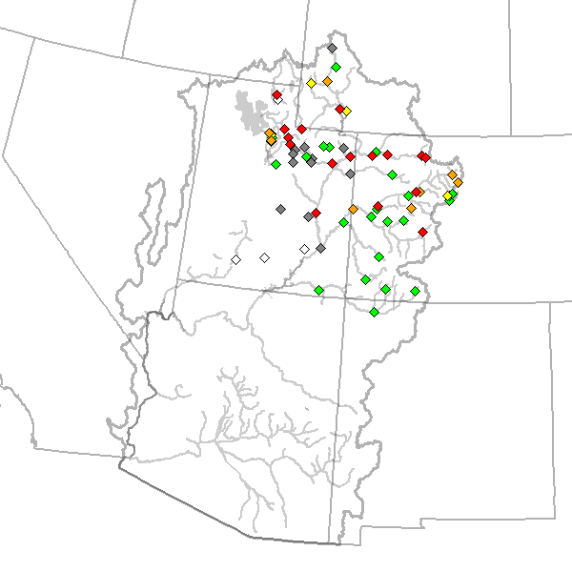
Outline
Recent and Upcoming Weather Review
Snow States
Streamflow forecasts:
  Long Lead Peak
  Daily
  Water Supply
Web Reference: www.cbrfc.noaa.gov/wsup/pub2/map/html/cbrfc.1.2011.html

Slide 3
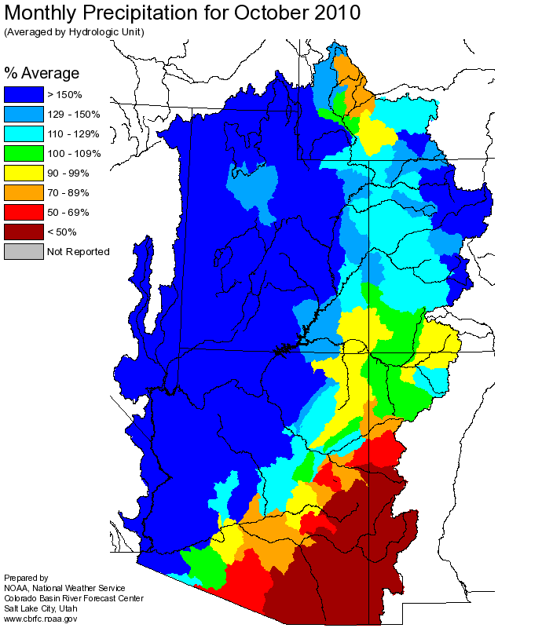
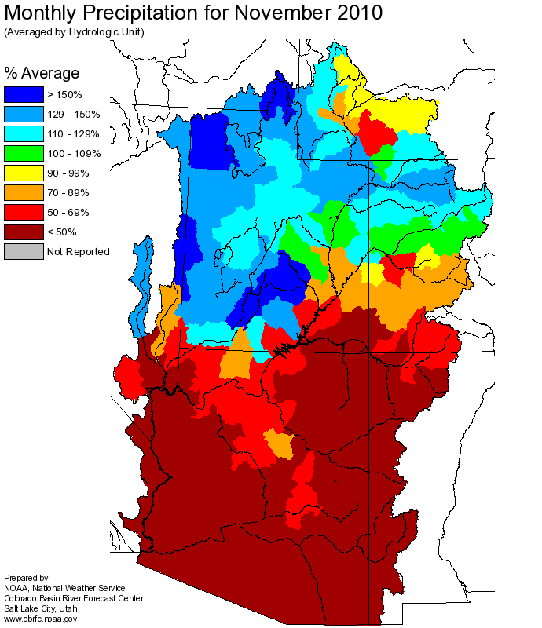
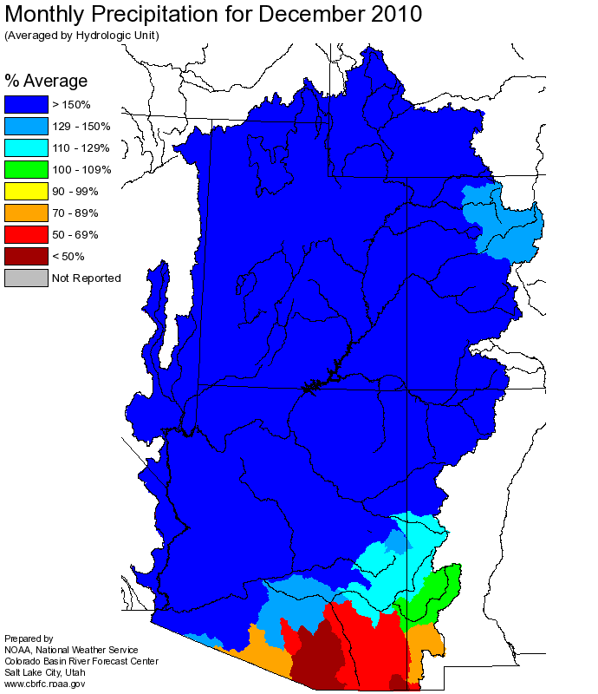
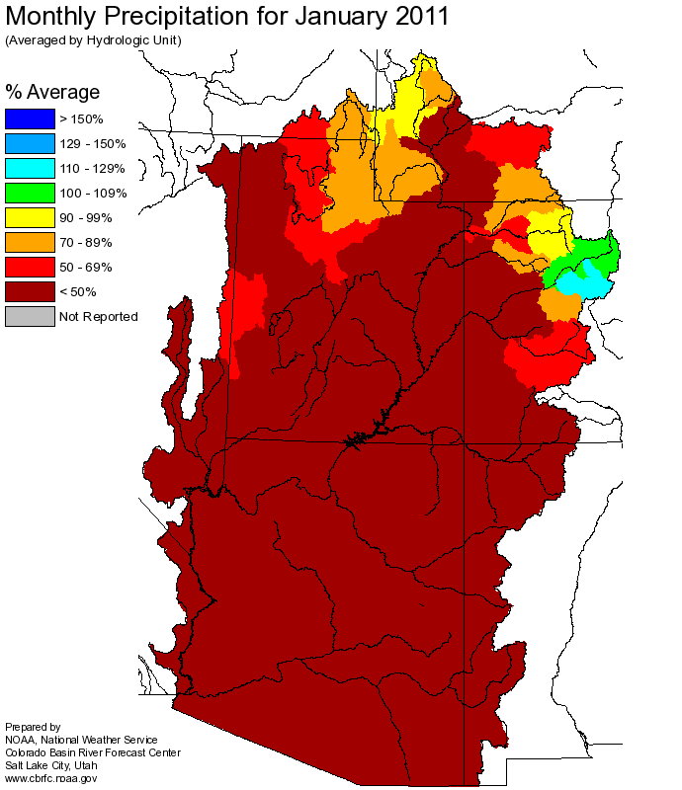
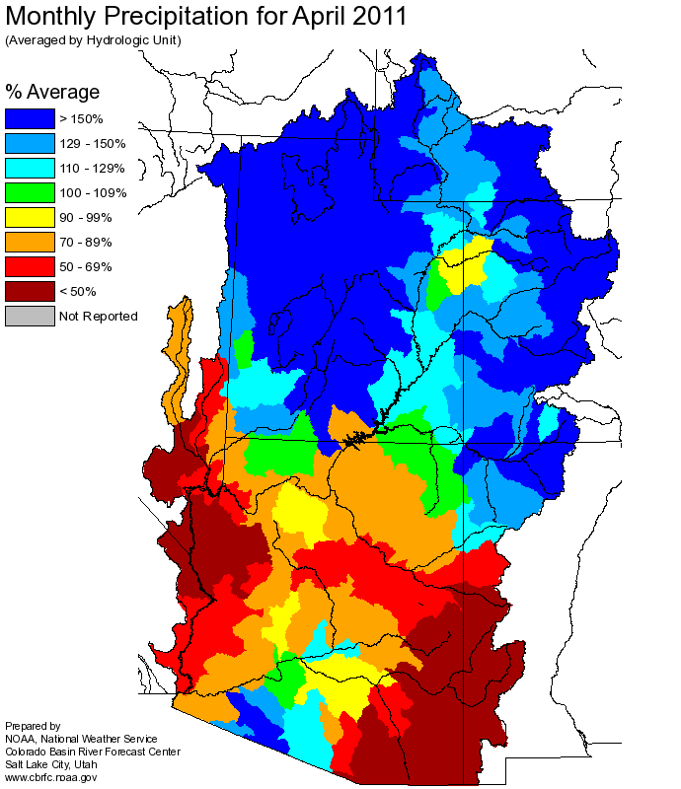
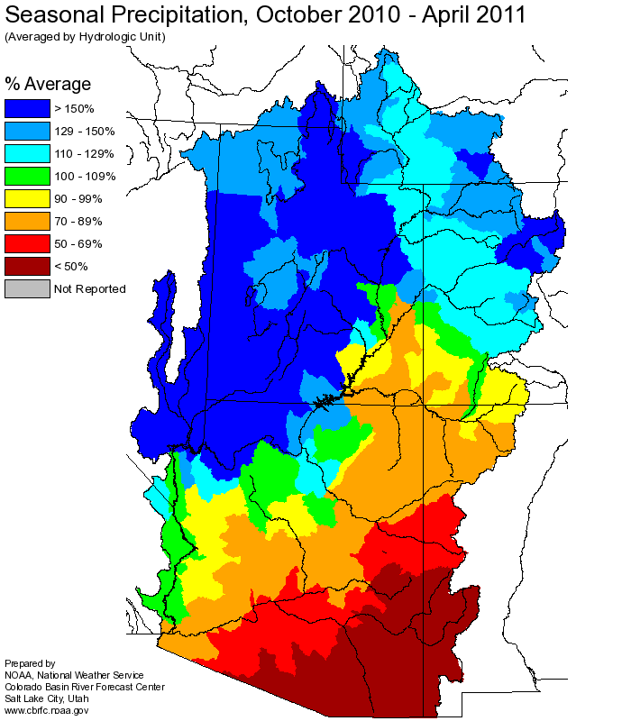
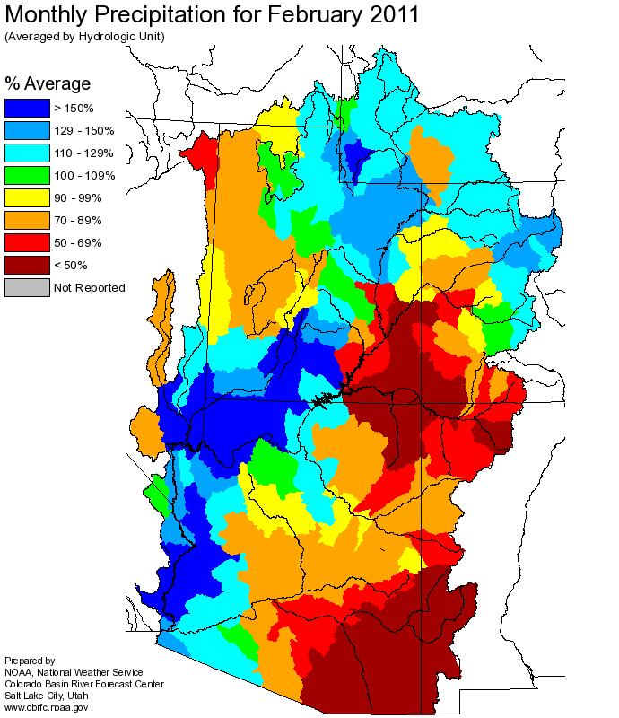
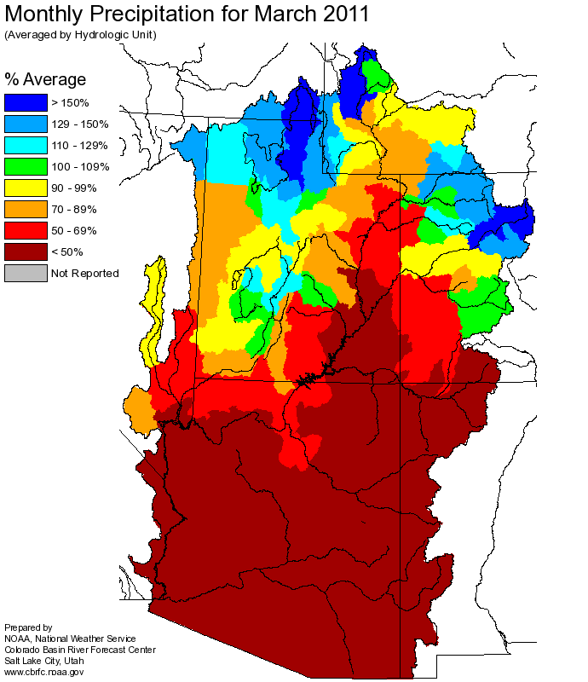
Web Reference: http://www.cbrfc.noaa.gov

Slide 4
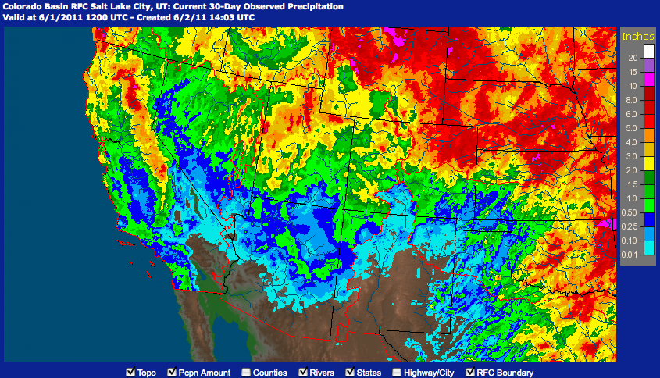
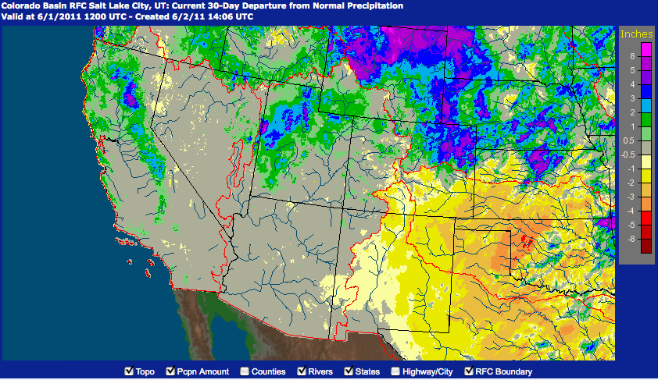
Precipitation
May
Web Reference: http://water.weather.gov/precip

Slide 5
Temperature

Slide 6
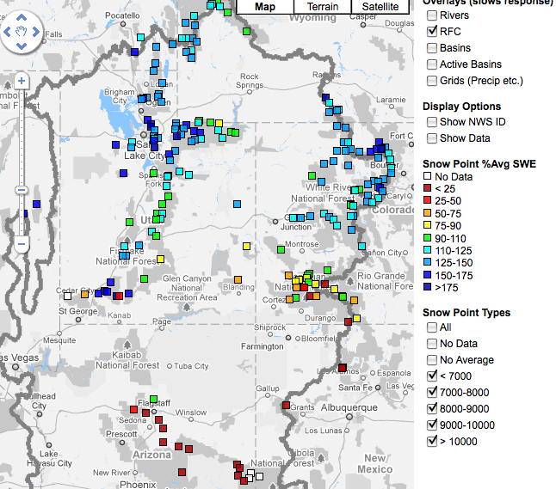
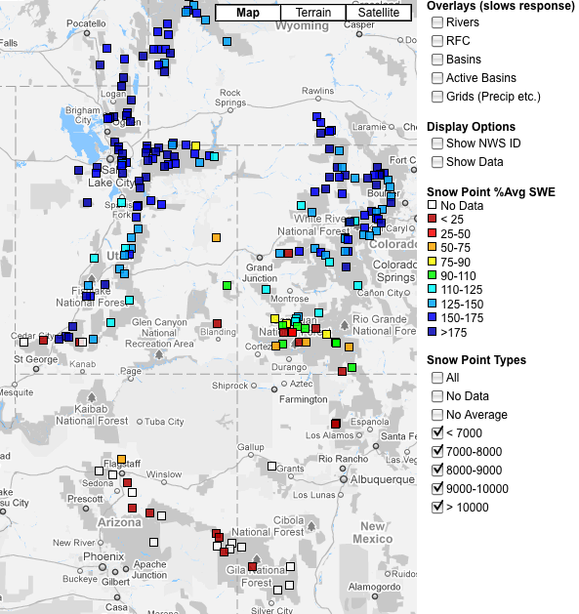
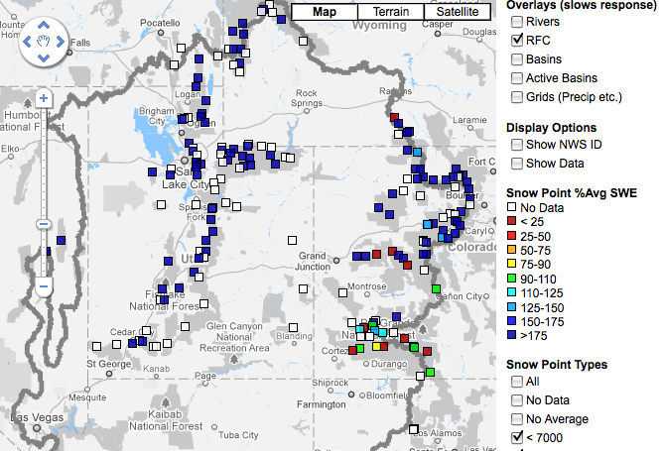
Snow
April 7 April 27 June 2
Web Reference: http://www.cbrfc.noaa.gov/gmap/gmapm.php?scon=checked

Slide 7
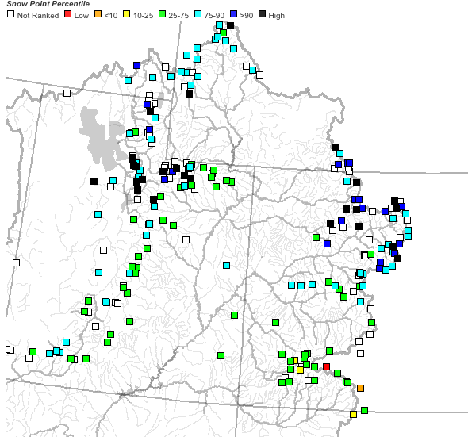
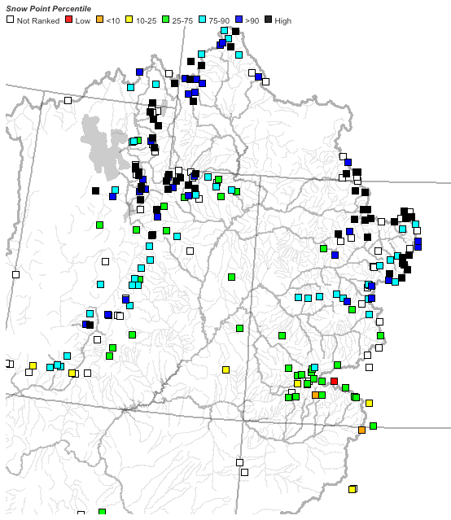
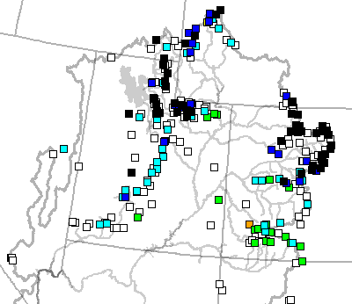
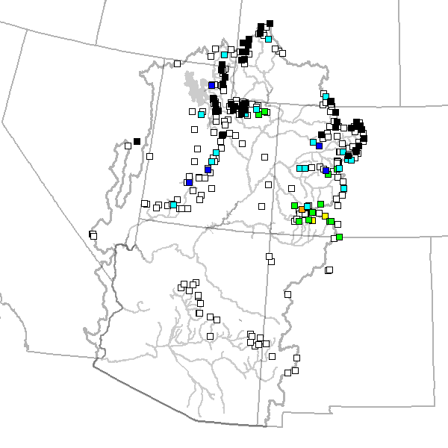
April 7 April 27 May 24 June 2

Slide 8
123 sites showing highest value for today!!

Slide 9
229 sites with 10+ years of record; 127/229 or 55% of sites with daily record as of 5/31

Slide 10
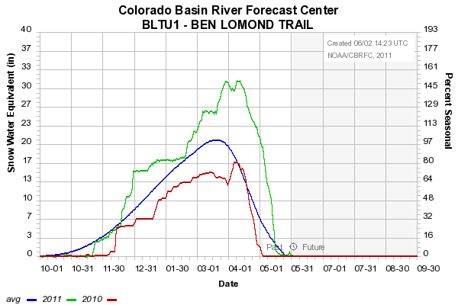
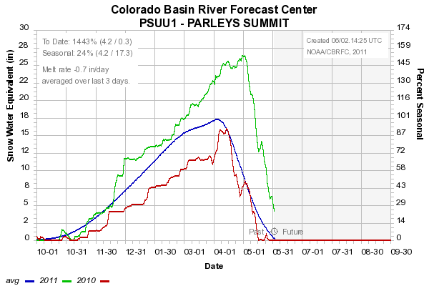
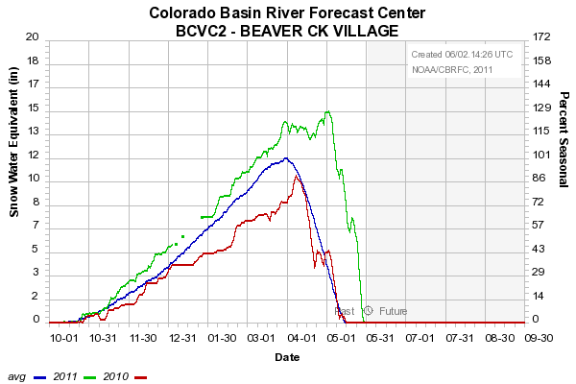
Sites below ~8500’
Very significant melt
8000’
7500’
8400’

Slide 11
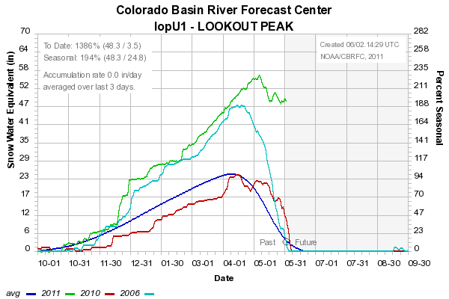
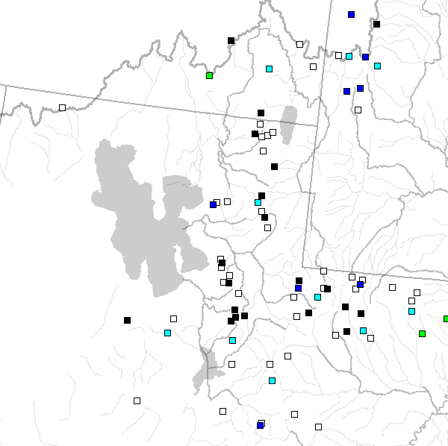
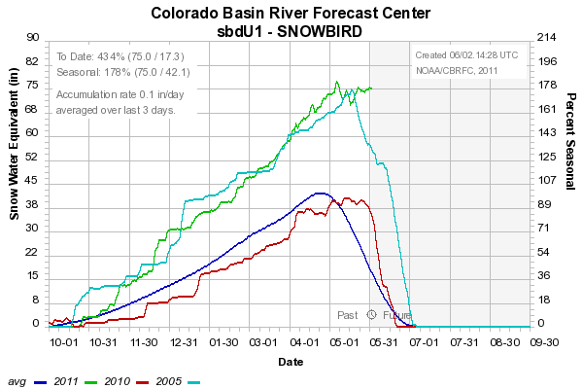
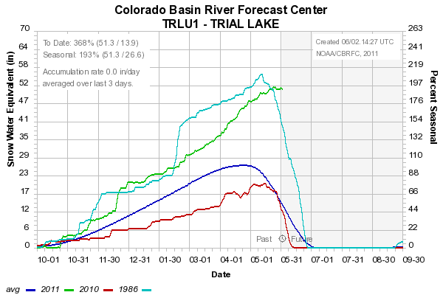
8200’
9600’
8400’
Sites above 8000’: Peaking? Starting to melt?

Slide 12
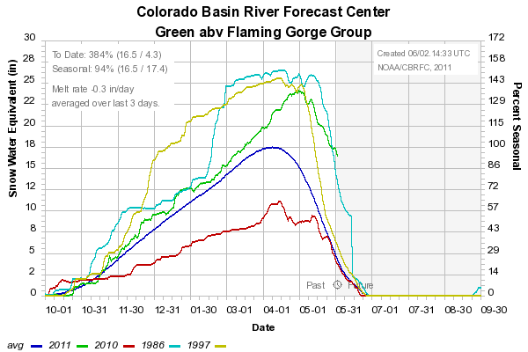
Snow:
Upper Green Basin (above Flaming Gorge)
Web Reference: http://www.cbrfc.noaa.gov/station/sweplot/sweplot.cgi???open

Slide 13
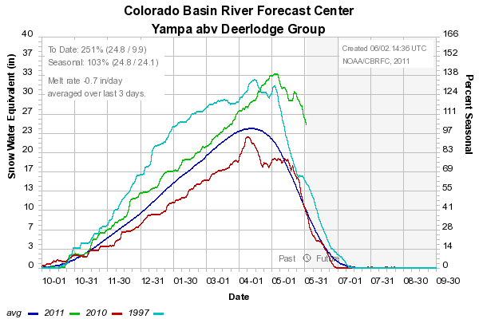
Snow:
Yampa
Web Reference: http://www.cbrfc.noaa.gov/station/sweplot/sweplot.cgi???open

Slide 14
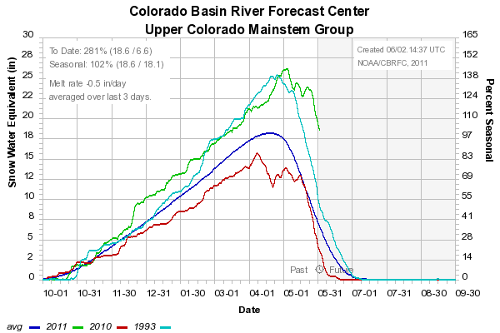
Snow:
Colorado Mainstem (above Cameo)
Web Reference: http://www.cbrfc.noaa.gov/station/sweplot/sweplot.cgi???open

Slide 15
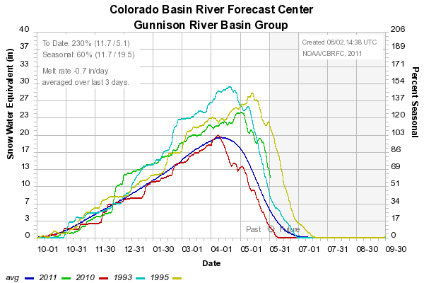
Snow:
Gunnison Basin
Web Reference: http://www.cbrfc.noaa.gov/station/sweplot/sweplot.cgi???open

Slide 16
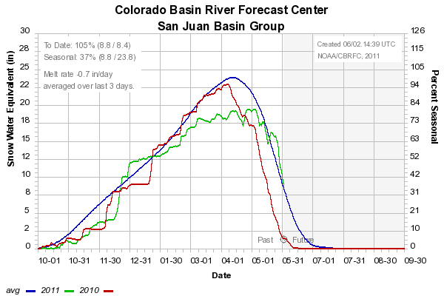
Snow:
San Juan Basin
Web Reference: http://www.cbrfc.noaa.gov/station/sweplot/sweplot.cgi???open

Slide 17
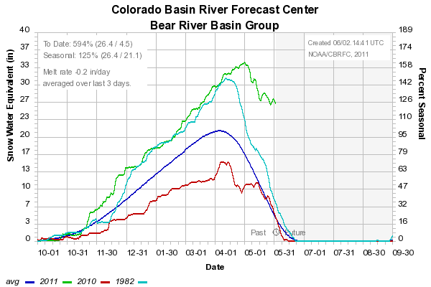
Snow:
Bear River Basin
Web Reference: http://www.cbrfc.noaa.gov/station/sweplot/sweplot.cgi???open

Slide 18
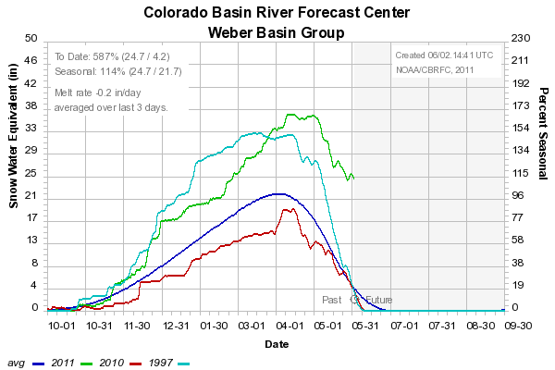
Snow:
Weber River Basin
Web Reference: http://www.cbrfc.noaa.gov/station/sweplot/sweplot.cgi???open

Slide 19
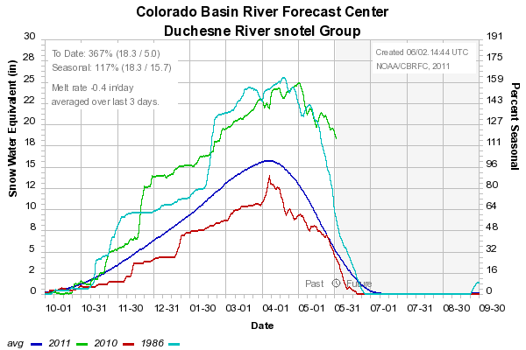
Snow:
Duchesne River Basin
Web Reference: http://www.cbrfc.noaa.gov/station/sweplot/sweplot.cgi???open

Slide 20
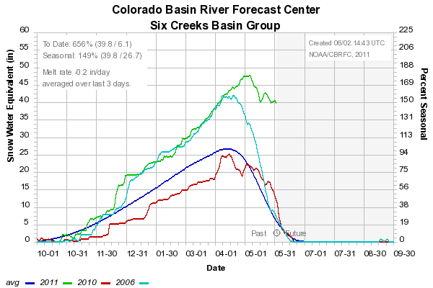
Snow:
Six Creeks in Salt Lake County
Web Reference: http://www.cbrfc.noaa.gov/station/sweplot/sweplot.cgi???open

Slide 21
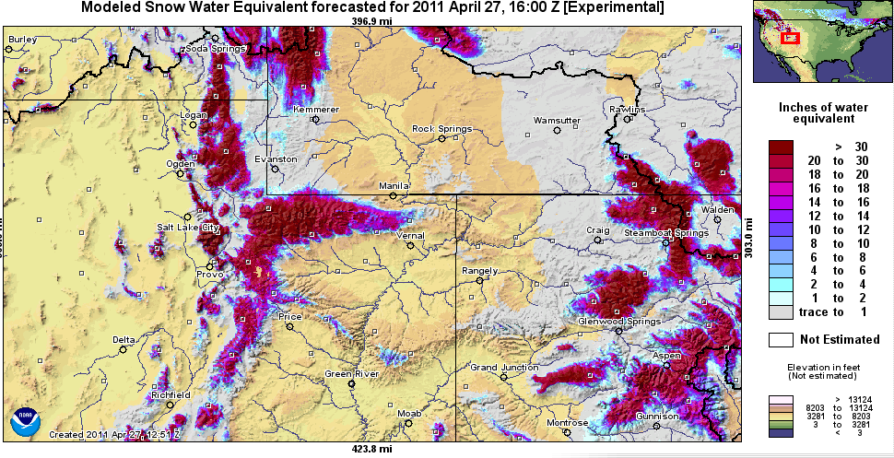
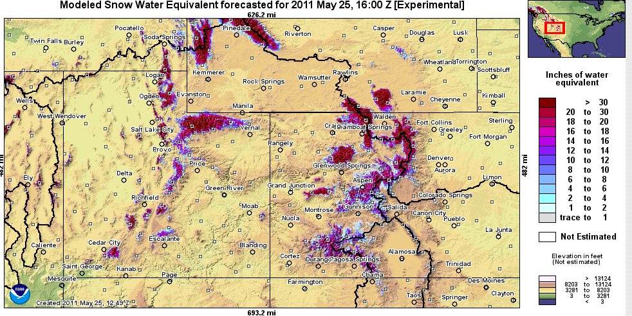
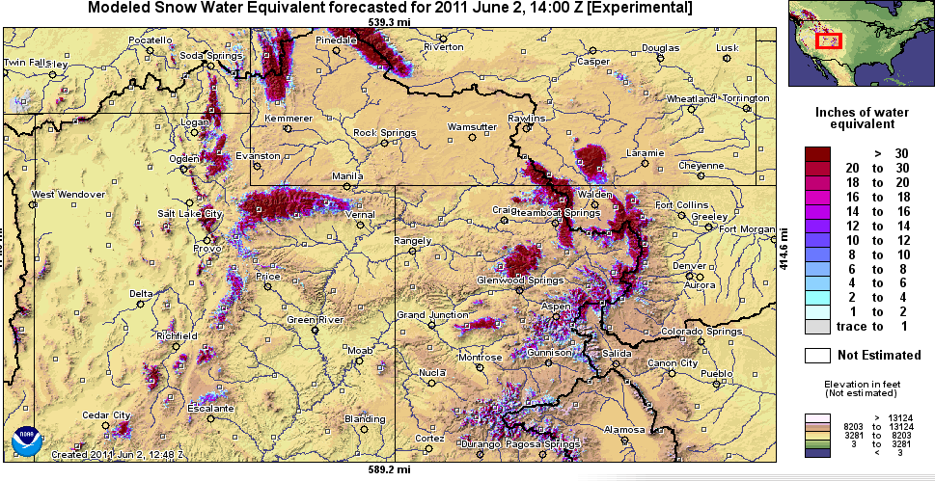
Snow Maps
Web Reference: http://www.nohrsc.nws.gov

Slide 22
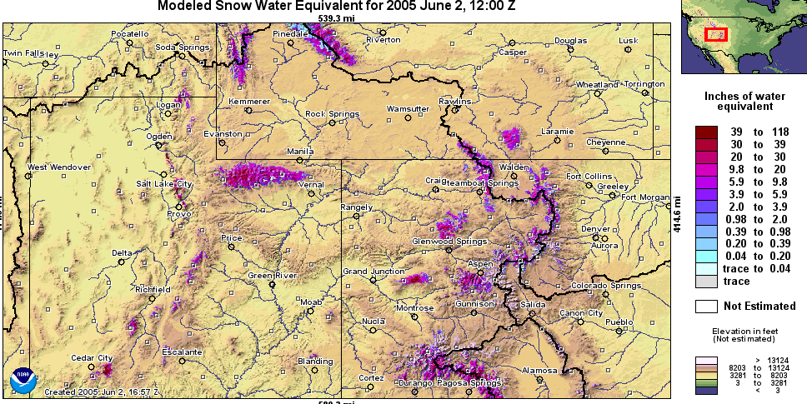
Snow Maps
Web Reference: http://www.nohrsc.nws.gov

Slide 23
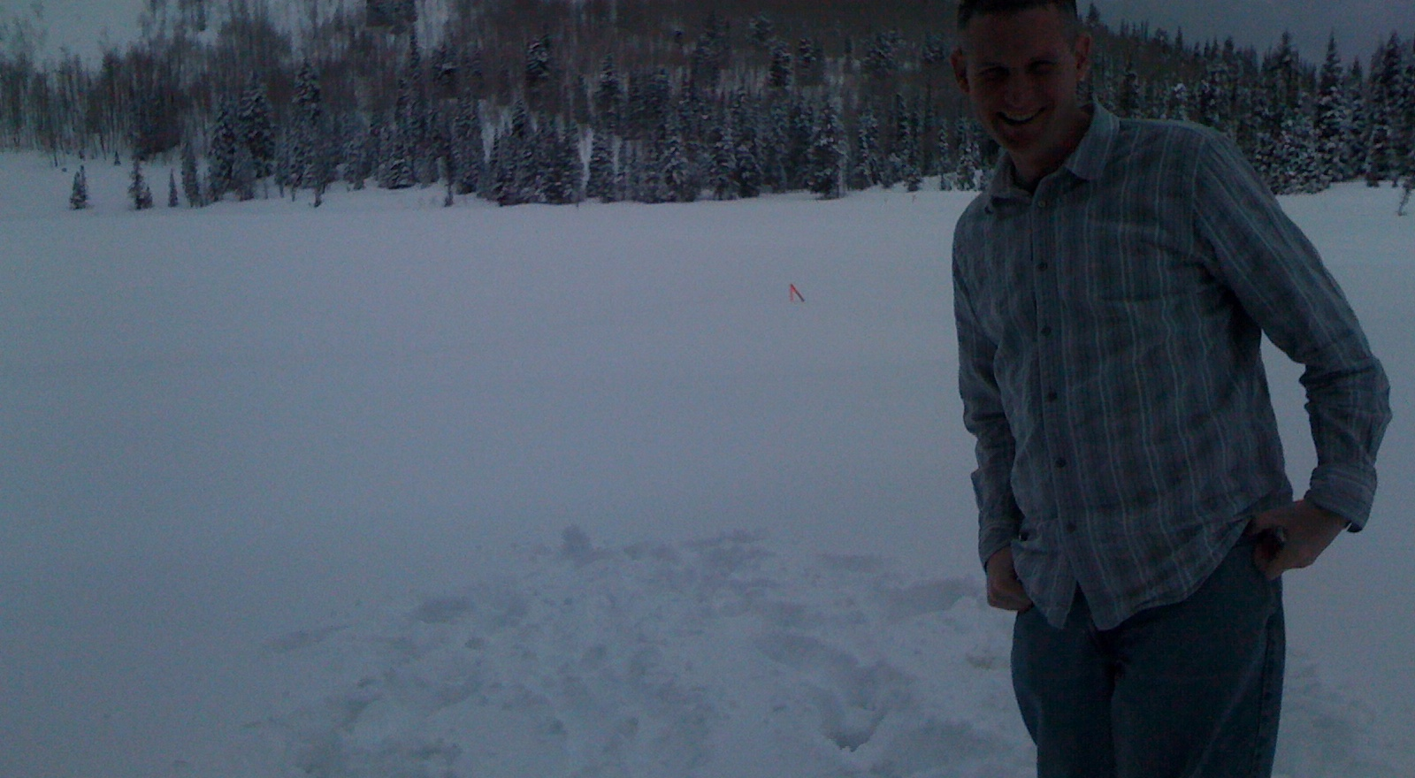
Monday near Brighton, UT

Slide 24
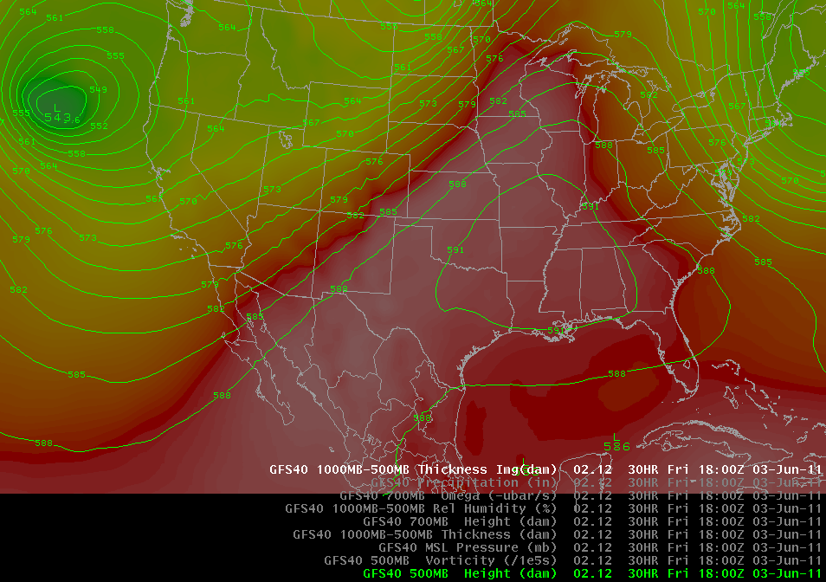
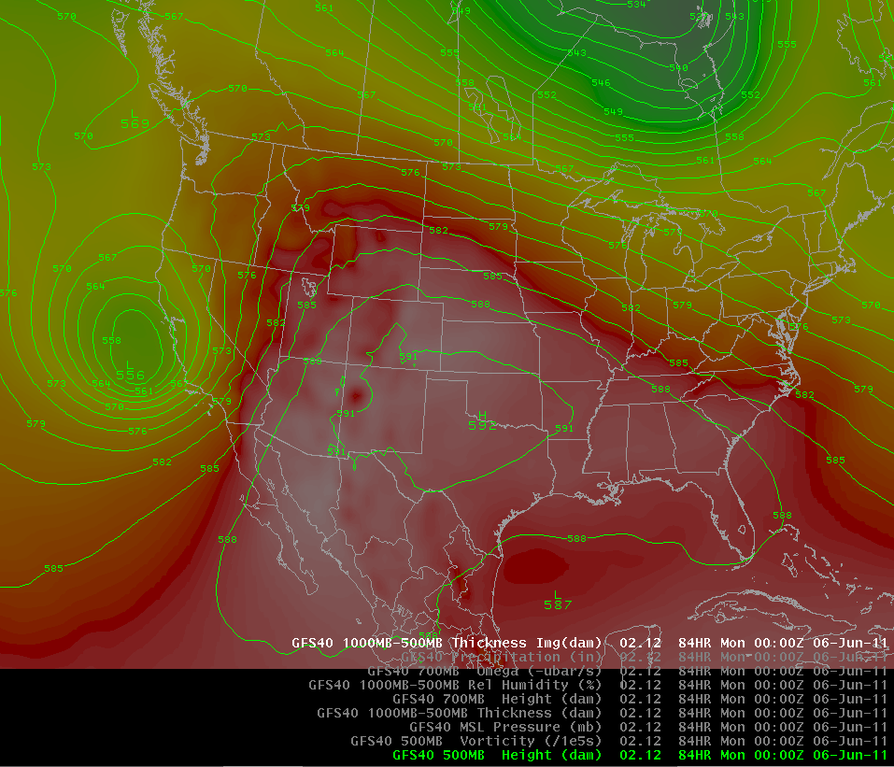
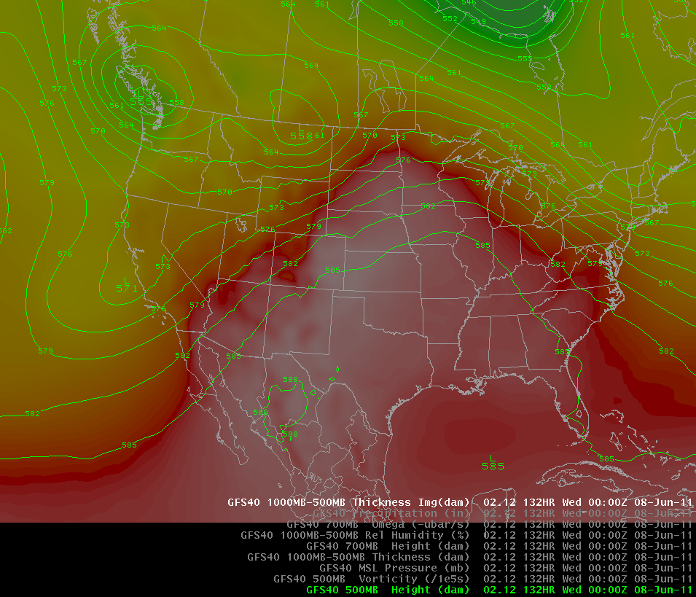
Weather Forecast
<- Friday AM
Sunday PM
Tuesday PM
Low pressure center off west coast will gradually move east. Temperatures will warm ahead of its arrival (~Tuesday next week) before cooling again

Slide 25
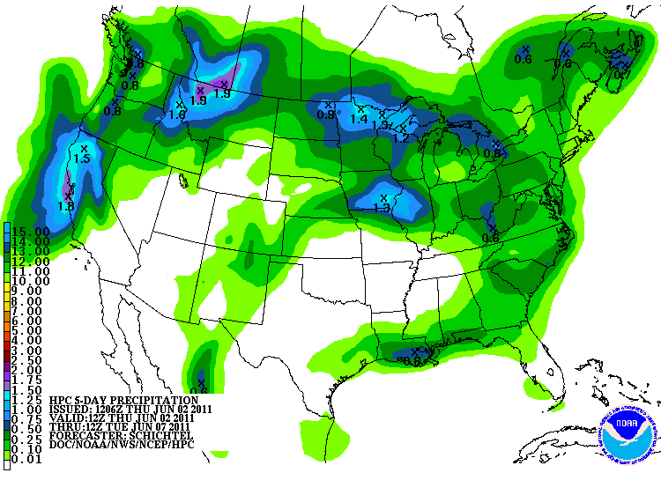
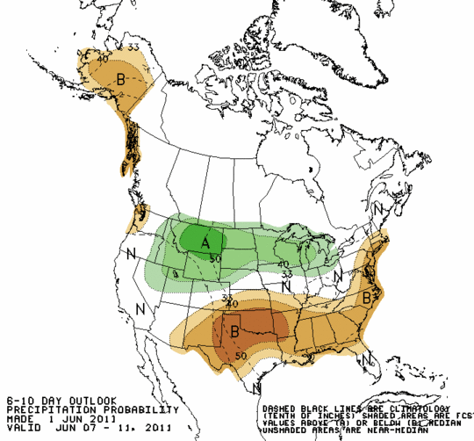
Forecast Precipitation
Dry weather pattern
Web Reference: www.hpc.noaa.gov

Slide 26
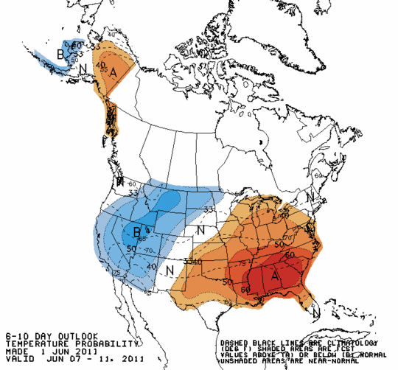
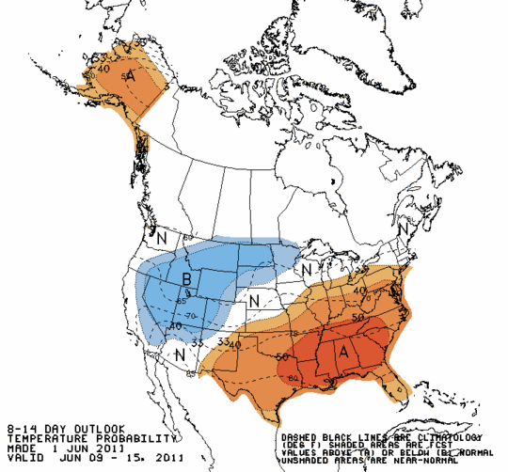
Forecast Temperature

Slide 27
Soil Moisture

Slide 28
Peak Flow Forecasts
Long Lead Peak Flow Forecasts
Snowmelt Mean Daily Maximum Flow (April-July)
Probabilistic Forecasts
  Exceedence Probabilities -10%,25%,50%, 75%, 90%
Issued (at least) monthly from March-June (this year weekly starting April 19)
~60 forecast points – some unregulated, some regulated
Daily Forecasts
Full Hydrograph out 14 days
  Includes temperature (10 days) and precipitation (5 days) forecast
  Includes any knowledge of future regulation (e.g. reservoir release)
Single value forecast
Issued daily by 10am MDT and updated throughout day
~450 forecast points

Slide 29
Spring Weather Really Matters
Runoff characteristics are largely determined by the day-to-day spring weather.
  While large snow pack years increase chances for flooding, it is not an inevitability
  Small snow pack years (like last year) can flood with the right sequence of spring temperatures

Slide 30

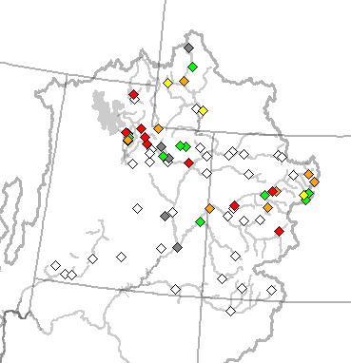
May 24 Peak Flow Forecasts
May 24 Forecasts
June 1 Forecasts

Slide 31
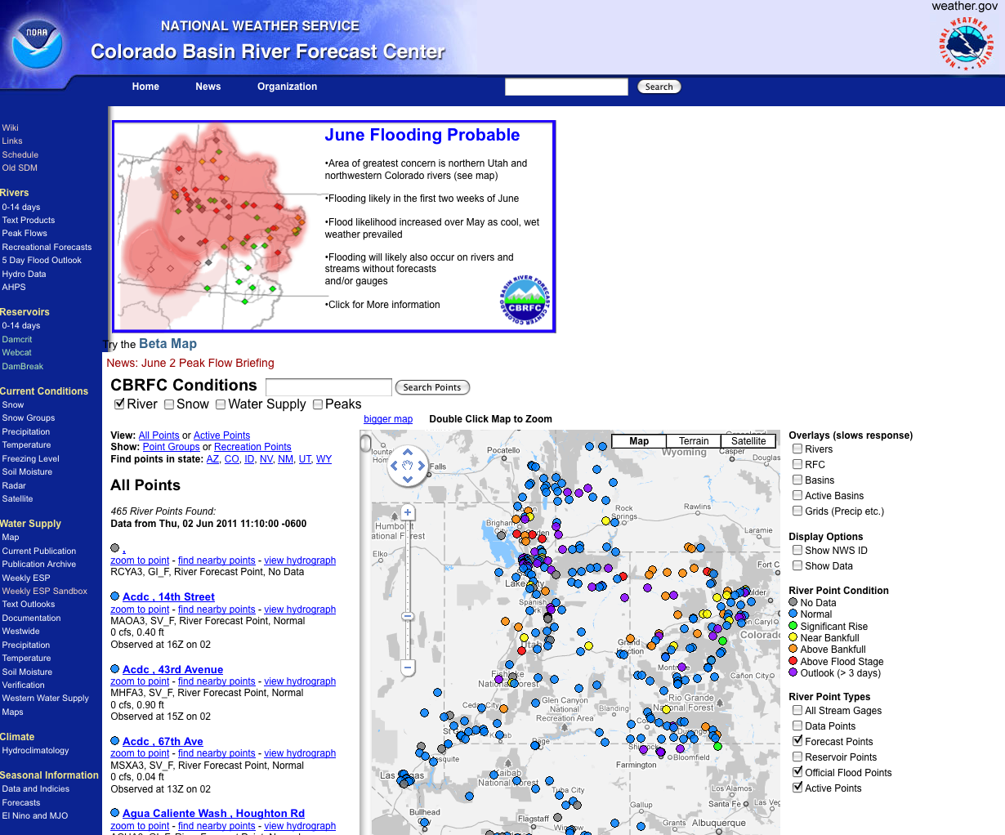
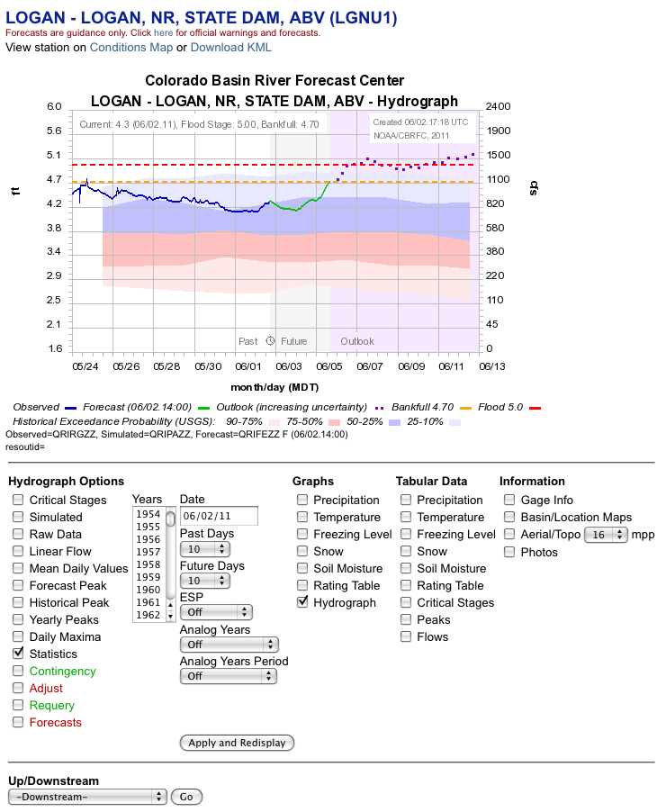
CBRFC Website Mini Tutorial
Current website
  Extensive in scope
  Slower, cumbersome
www.cbrfc.noaa.gov

Slide 32
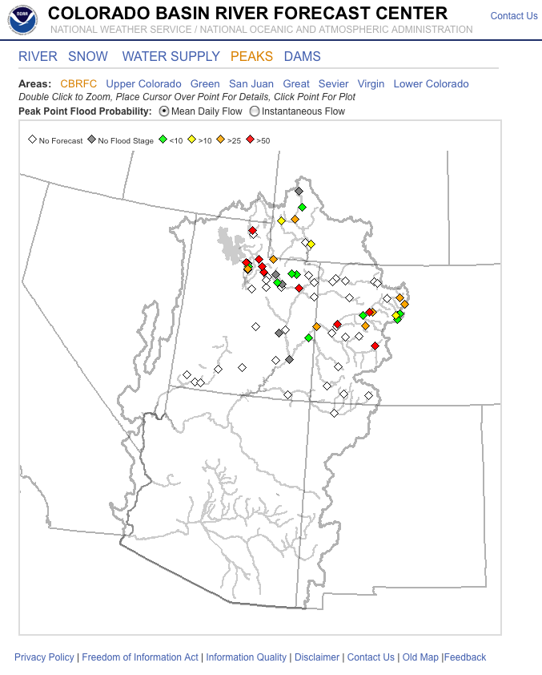

CBRFC Website Mini Tutorial
“Beta” website
  Faster
  Easier access to key information
  Actively being developed
www.cbrfc.noaa.gov/gmap/cmap.php

Slide 33
Peak Flow Charts
Flood Stage
Forecast Creation Time
Long lead peak forecast
Observed streamflow since April 1
Daily forecast
Bankfull
web reference: www.cbrfc.noaa.gov/gmap/cmap.php

Slide 34


Slide 35



Slide 36



Slide 37



Slide 38



Slide 39



Slide 40



Slide 41



Slide 42



Slide 43



Slide 44



Slide 45



Slide 46



Slide 47


Experimental:
Peak Flow Forecast Evolution
Daily long lead peak forecasts from ESP reflect changing weather forecasts and hydrology.
Started in late May and comparing to official forecasts
Yampa at Deerlodge (top)
City Creek near Salt Lake City (bottom)
Comments welcome
Web reference: http://www.cbrfc.noaa.gov/devel/dly_peak/

Slide 48



“AHPS” long lead forecasts:
Last week (top)
This week (bottom)
Web reference: water.weather.gov

Slide 49


Streamflow Ensemble Forecast
Temperature Ensemble Forcing

Slide 50

Peak Flow Publication
New: Instantaneous Flow Forecasts!

Slide 51
June Flooding Probable
Area of greatest concern is northern Utah and northwestern Colorado rivers (see map)
First two weeks of June are critical
Flood likelihood increased over May as cool, wet weather prevailed
Flooding will likely also occur on rivers and streams without forecasts
and/or gauges
Click for More information

Slide 52


NWS Flood Warnings, Watches
NWS Weather Offices are responsible for setting flood stage and issuing flood warnings and watches based on CBRFC forecasts. Key personnel for snow melt floods:
  Salt Lake City – Brian McInerney
  Grand Junction – Aldis Strautins
  Riverton – Jim Fahey
  Boulder – Treste Huse

Slide 53

May 1, 2011
Water Supply Forecasts
Highlights:
Wet winter + April has led to significant rises in most forecasts
Web Reference: www.cbrfc.noaa.gov/gmap/gmapm.php?wcon=checked

Slide 54

June 1, 2011
Water Supply Forecasts
Preliminary reservoir forecasts issued June 1
Green, Upper Colorado higher (5-10%), Gunnison lower (-5%), San Juan same as May 1
Highlights:
Lake Powell: 11.5 maf -> 12.0 maf
Flaming Gorge: 1.66 maf -> 1.98 maf
Blue Mesa: 945 maf -> 895 maf
Web Reference: www.cbrfc.noaa.gov/gmap/gmapm.php?wcon=checked

Slide 55
Peak Flow Decision Support
Peaks are coming soon!!
Long lead peak forecasts will no longer be updated this year because most rivers are peaking within the 14-day daily forecast windwo
Daily forecasts posted by ~10am MDT each (and updated later during the day). When temperatures are forecast to warm, please check here for the latest peak flow forecasts.
“beta” website developments:
  SNOTEL percentiles
  Simplified peak flow chart
  Publication referencing forecasts above historic peaks
  New peak flow forecast points added
Webinars: Weekly until peak flows are passed? Thursday, June 9 at 1pm?
Discussion:
  Anything else you need??

Slide 56

CBRFC Contacts
Basin Focal Points (Available to discuss forecasts: 801.524.5130)
  Upper Colorado: Brenda Alcorn
  Green: Ashley Nielson
  San Juan / Gunnison: Tracy Cox
  Great Basin: Brent Bernard
  Lower Colorado (below Lake Powell): Greg Smith

Slide 57


Feedback, Questions, Concerns always welcome….
Kevin Werner
CBRFC Service Coordination Hydrologist
Phone: 801.524.5130
Email: kevin.werner@noaa.gov

