Slide 1
CBRF June 9
Peak Flow and Water Supply Forecast Webinar
Please Mute Your Phones: *6
1pm, June 9, 2011
Kevin Werner
These slides: www.cbrfc.noaa.gov/present/present.php

Slide 2
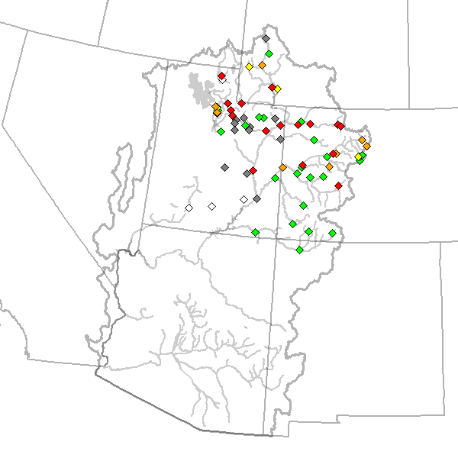
Outline
Recent and Upcoming Weather Review
Snow States
Streamflow forecasts:
  Long Lead Peak
  Daily
  Water Supply
Web Reference: www.cbrfc.noaa.gov/wsup/pub2/map/html/cbrfc.1.2011.html

Slide 3
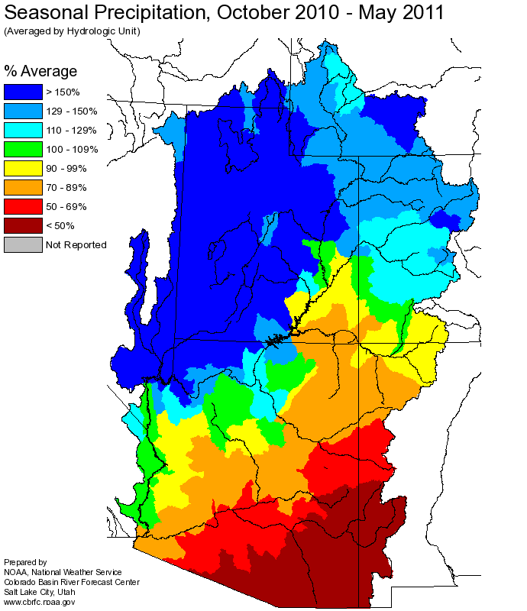
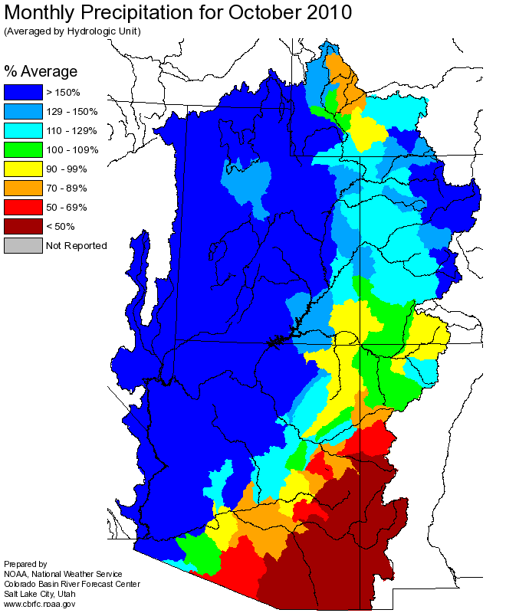
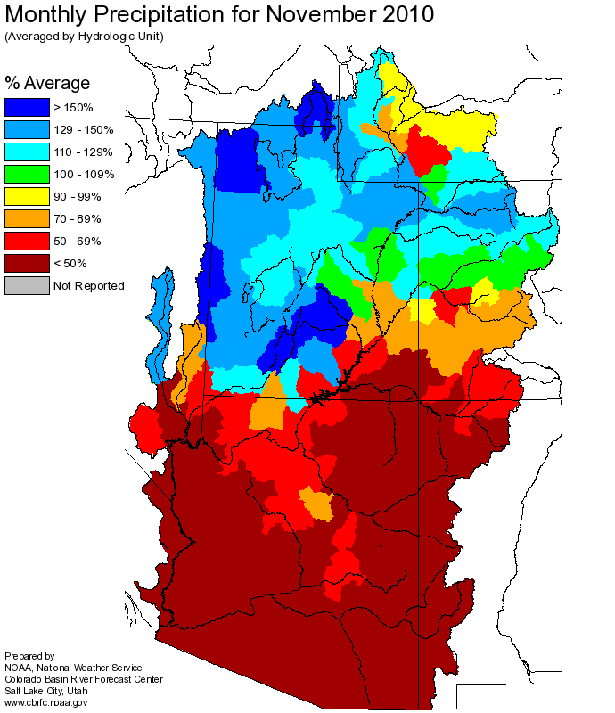
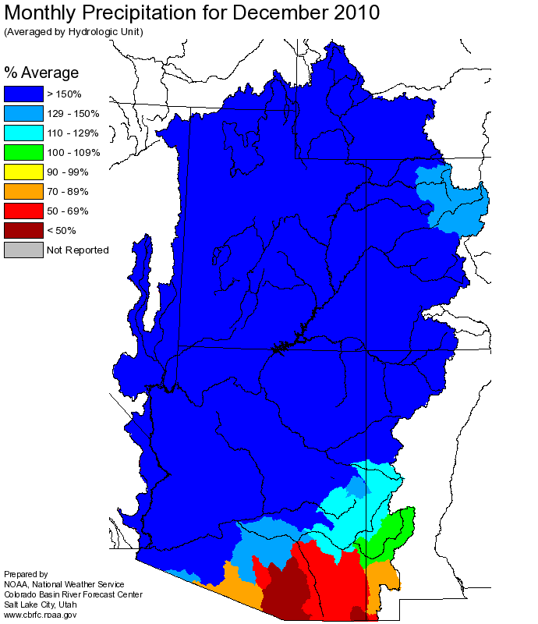
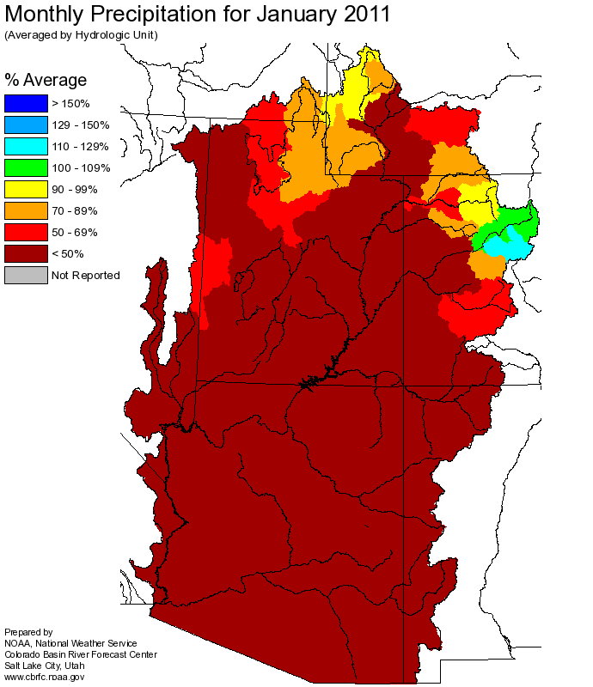
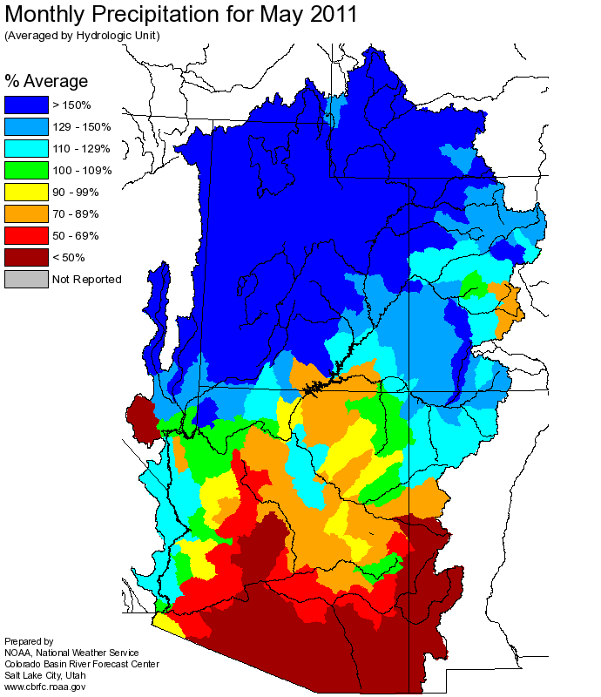
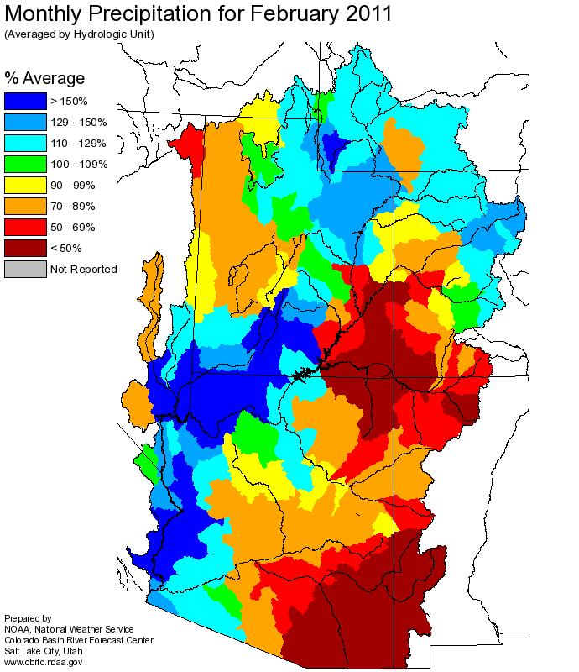
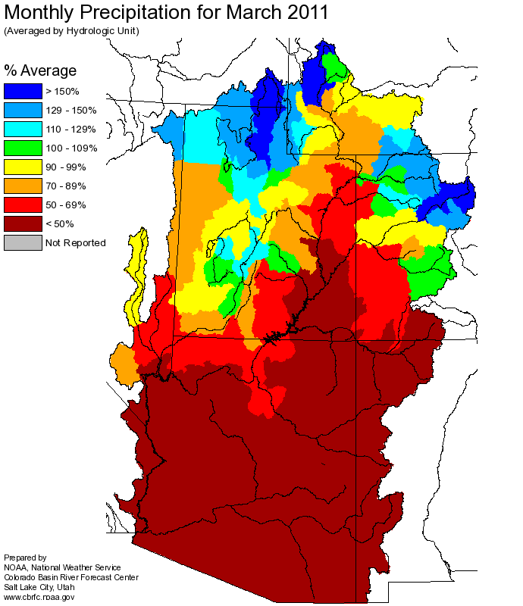
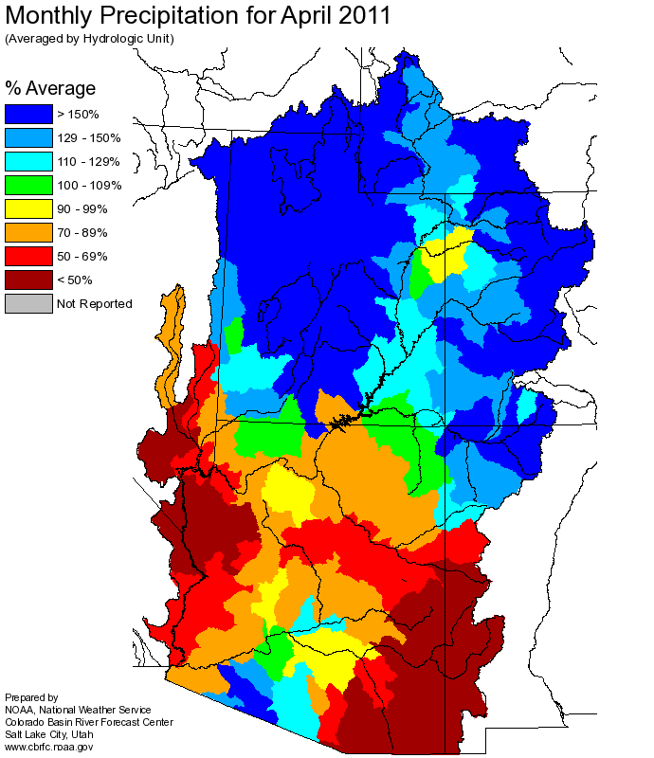
Web Reference: http://www.cbrfc.noaa.gov

Slide 4
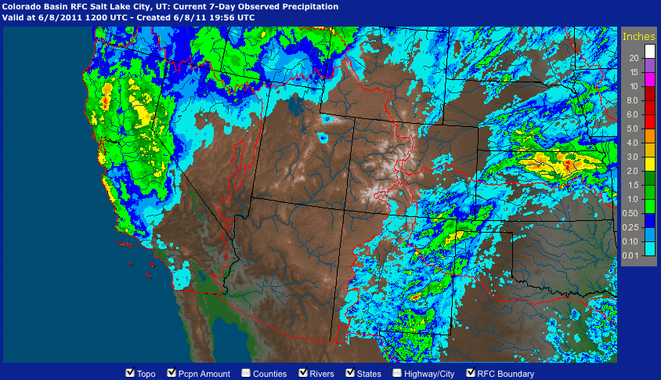
June 1-8 Precipitation
Web Reference: http://water.weather.gov/precip

Slide 5
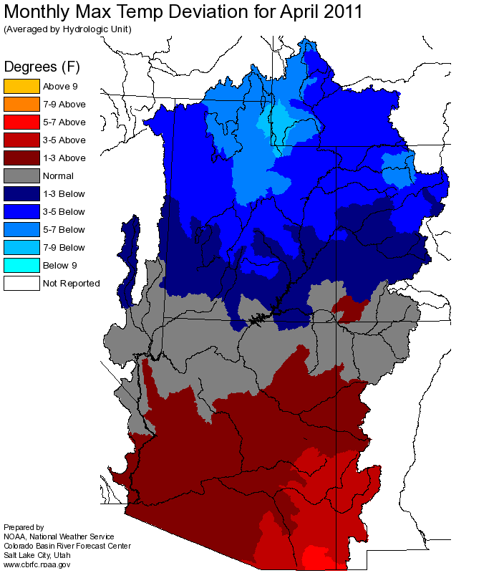
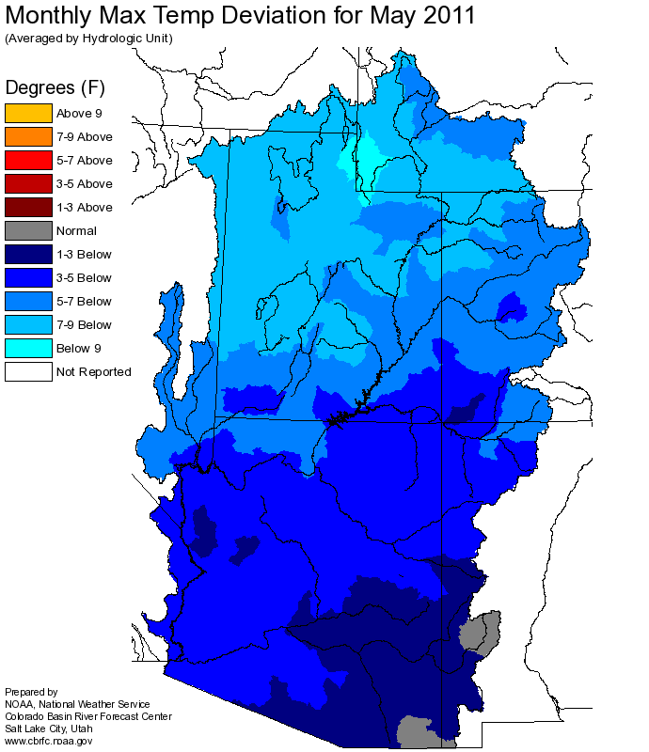
Temperature

Slide 6
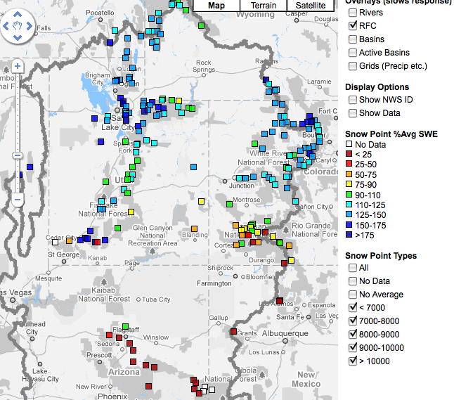
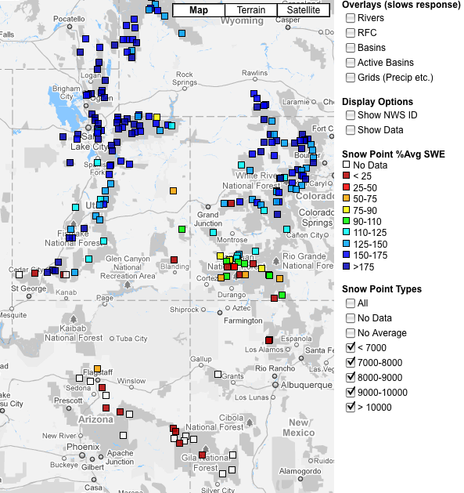
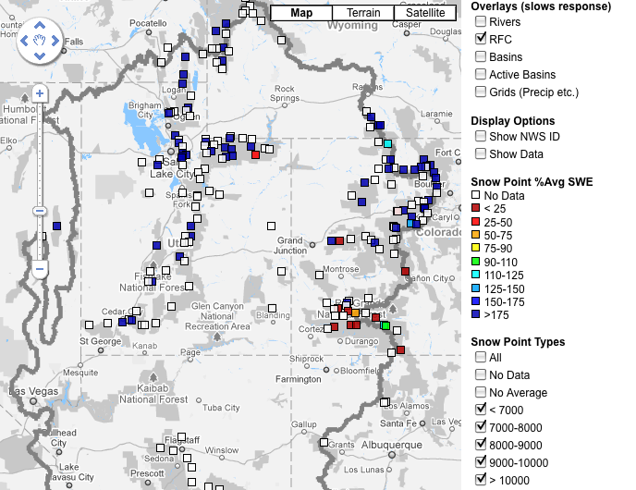
Snow
April 7 April 27 June 9
Web Reference: http://www.cbrfc.noaa.gov/gmap/gmapm.php?scon=checked

Slide 7
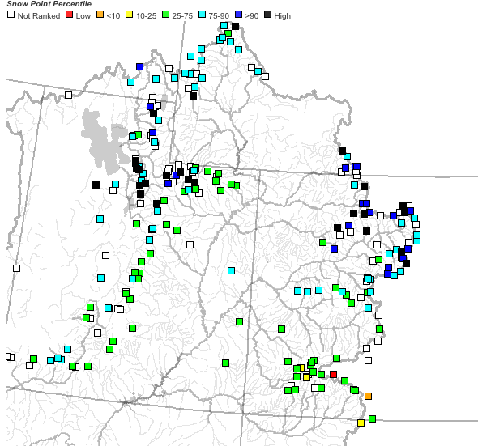
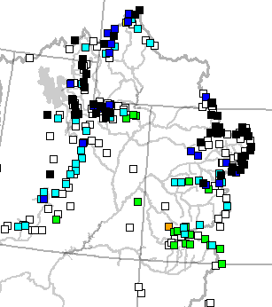
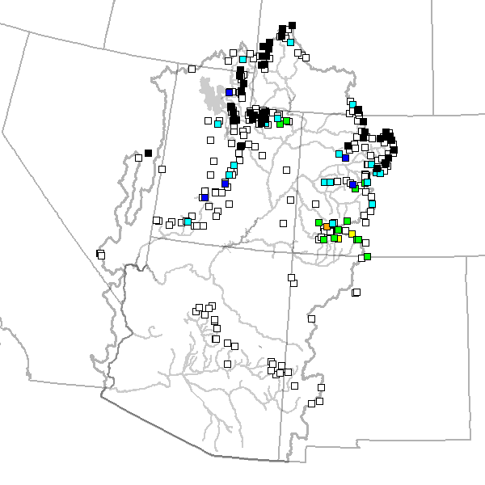
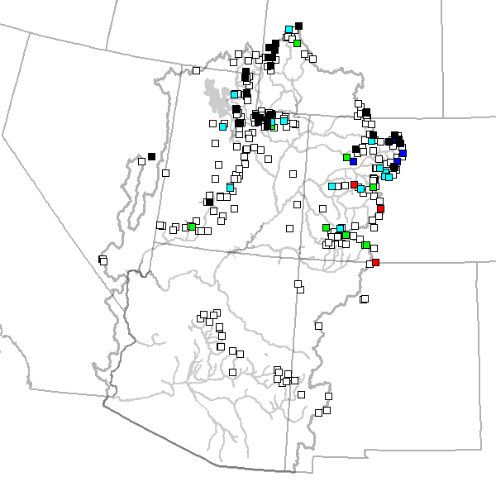
April 7 May 24 June 2 June 9

Slide 8
103 sites showing highest value for today!!

Slide 9
229 sites with 10+ years of record; 127/229 or 55% of sites with daily record as of 5/31

Slide 10
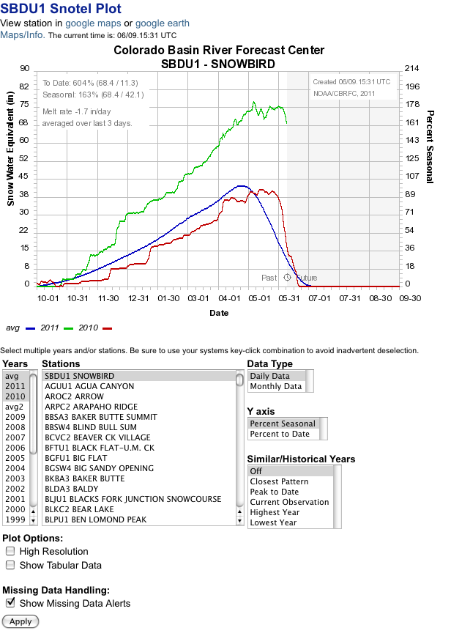
% average daily
% average seasonal peak
Melt or accumulation rate
Historical years
Analogue years

Slide 11
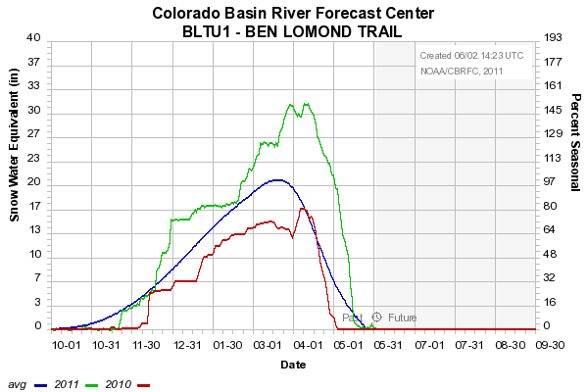
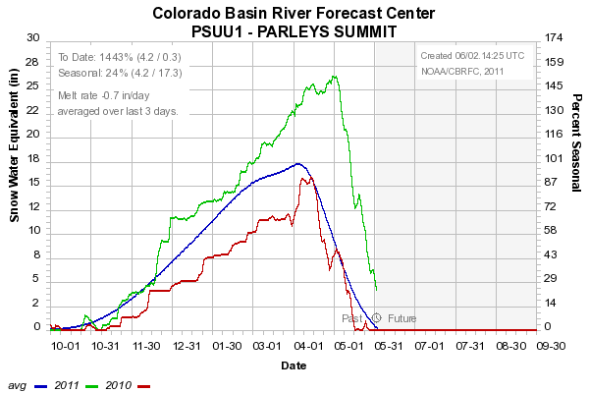
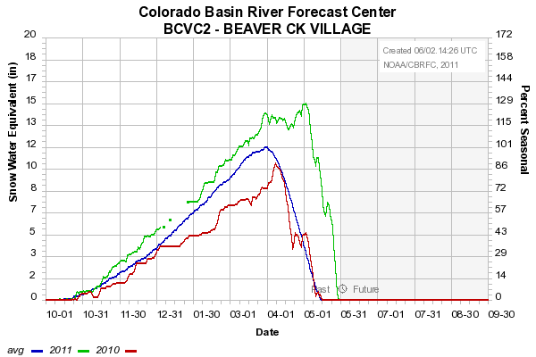
Sites below ~8500’
Snow mostly gone
8000’
7500’
8400’

Slide 12
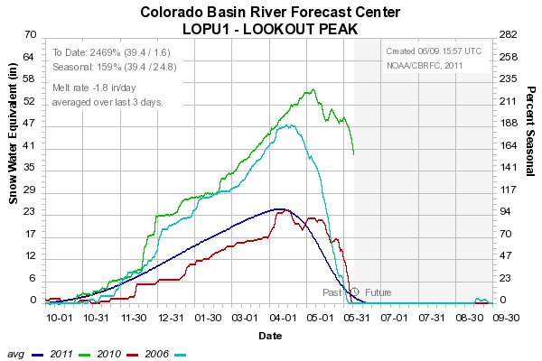
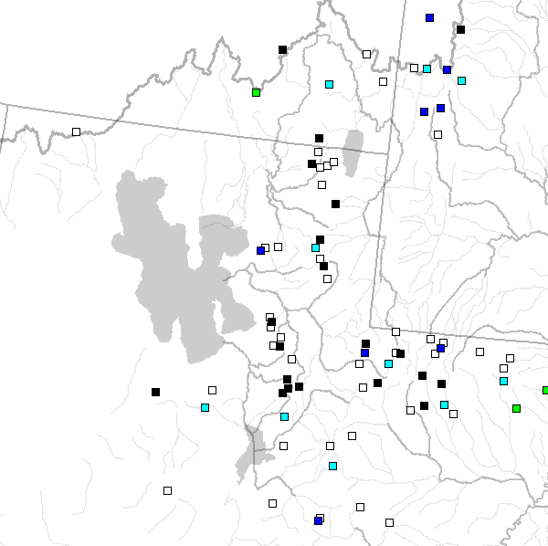
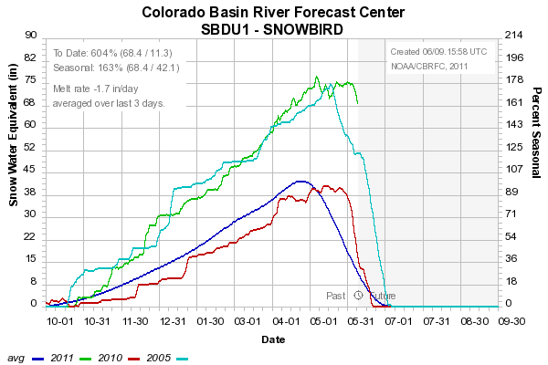
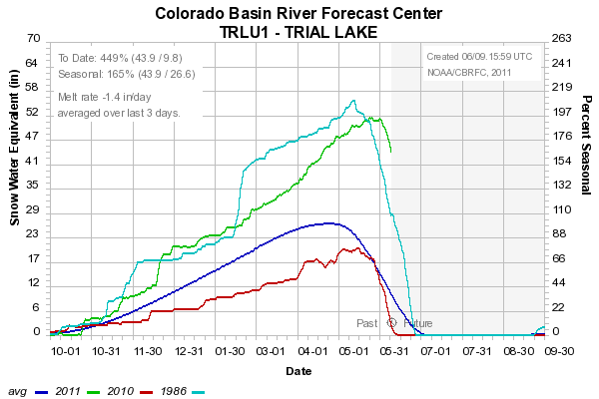
8200’
9600’
8400’
Sites above 8000’: Starting to melt: 0-2”/day

Slide 13
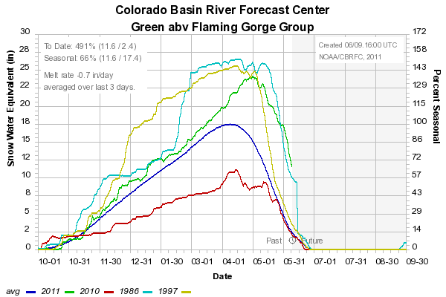
Snow:
Upper Green Basin (above Flaming Gorge)
Web Reference: http://www.cbrfc.noaa.gov/station/sweplot/sweplot.cgi???open

Slide 14
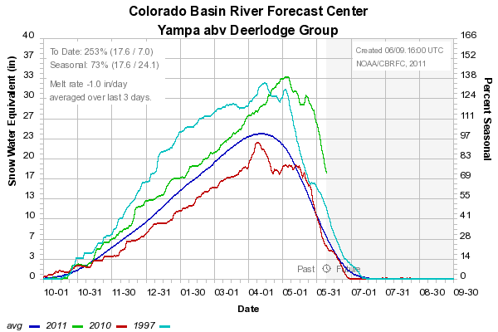
Snow:
Yampa
Web Reference: http://www.cbrfc.noaa.gov/station/sweplot/sweplot.cgi???open

Slide 15
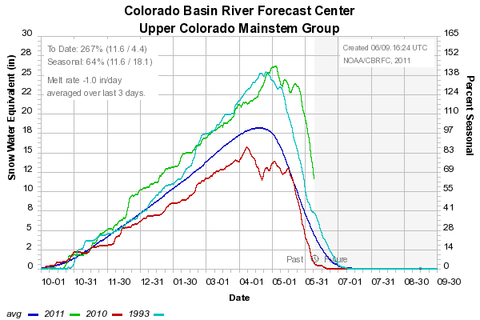
Snow:
Colorado Mainstem (above Cameo)
Web Reference: http://www.cbrfc.noaa.gov/station/sweplot/sweplot.cgi???open

Slide 16
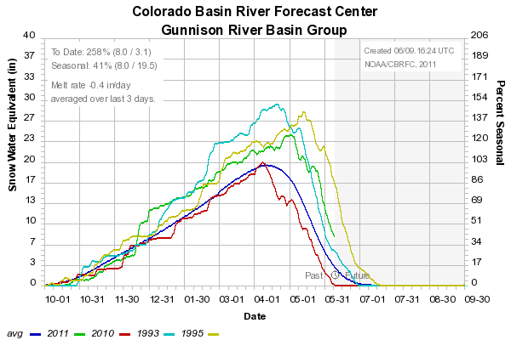
Snow:
Gunnison Basin
Web Reference: http://www.cbrfc.noaa.gov/station/sweplot/sweplot.cgi???open

Slide 17
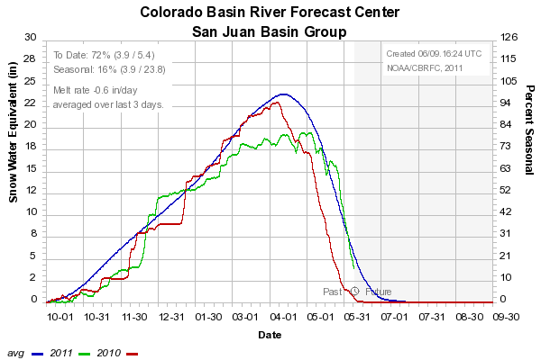
Snow:
San Juan Basin
Web Reference: http://www.cbrfc.noaa.gov/station/sweplot/sweplot.cgi???open

Slide 18
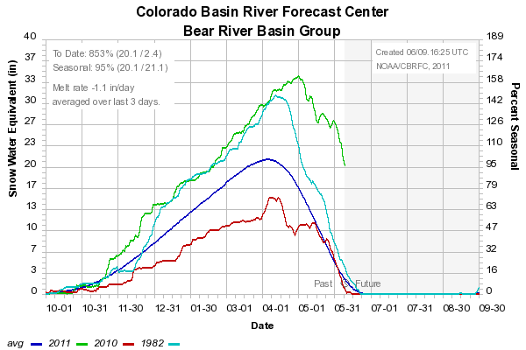
Snow:
Bear River Basin
Web Reference: http://www.cbrfc.noaa.gov/station/sweplot/sweplot.cgi???open

Slide 19
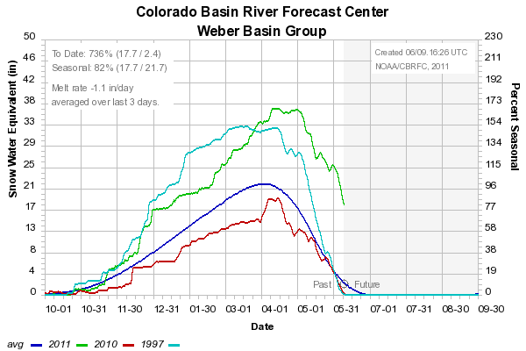
Snow:
Weber River Basin
Web Reference: http://www.cbrfc.noaa.gov/station/sweplot/sweplot.cgi???open

Slide 20
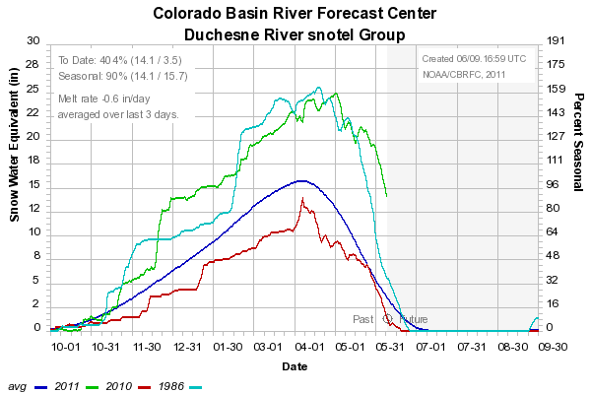
Snow:
Duchesne River Basin
Web Reference: http://www.cbrfc.noaa.gov/station/sweplot/sweplot.cgi???open

Slide 21

Snow:
Six Creeks in Salt Lake County
Web Reference: http://www.cbrfc.noaa.gov/station/sweplot/sweplot.cgi???open

Slide 22
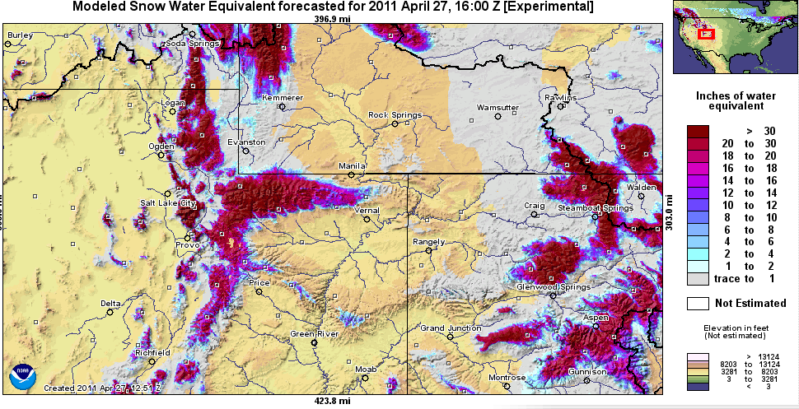
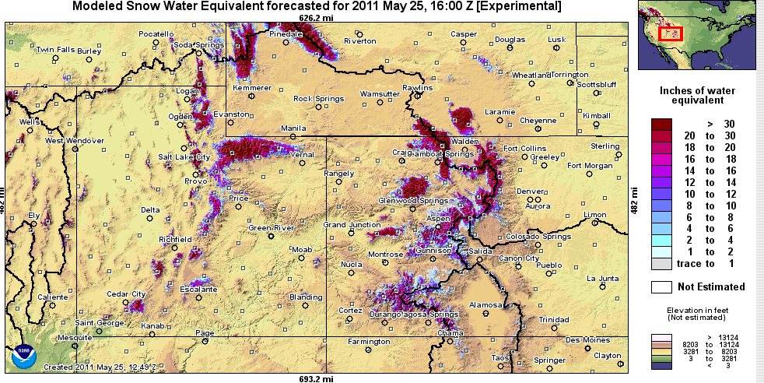
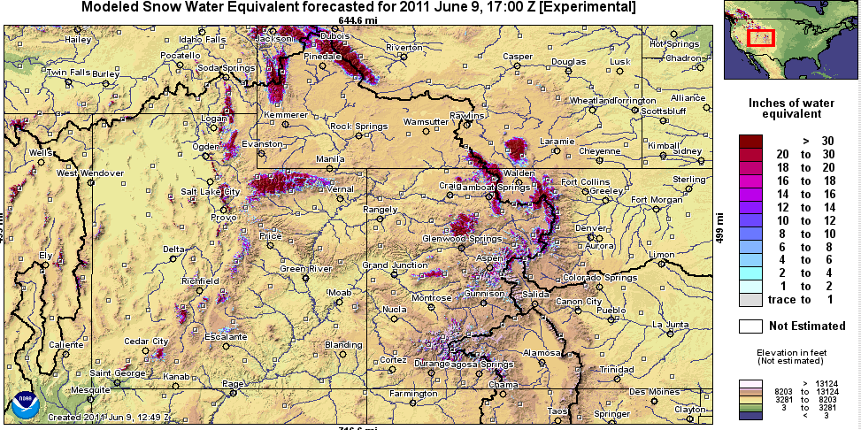
Snow Maps
Web Reference: http://www.nohrsc.nws.gov

Slide 23
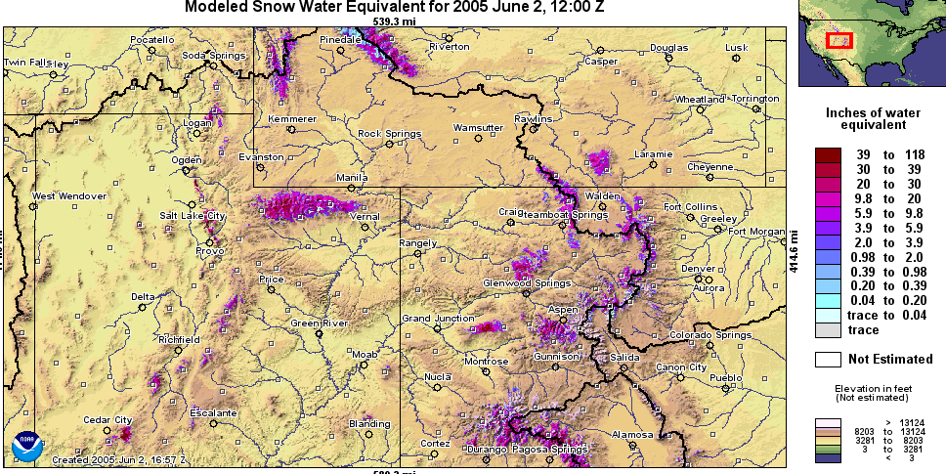
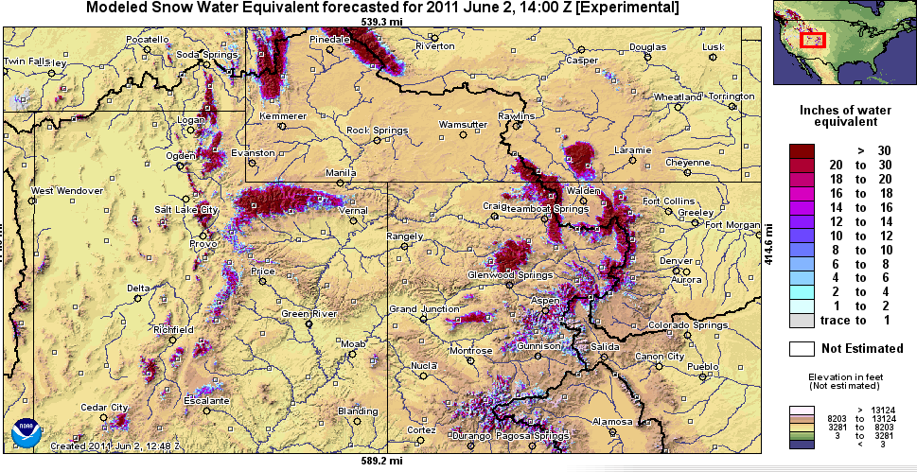
Snow Maps
Web Reference: http://www.nohrsc.nws.gov

Slide 24
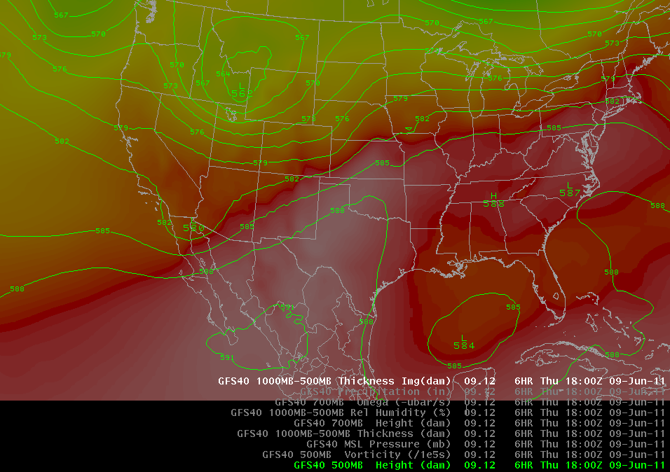
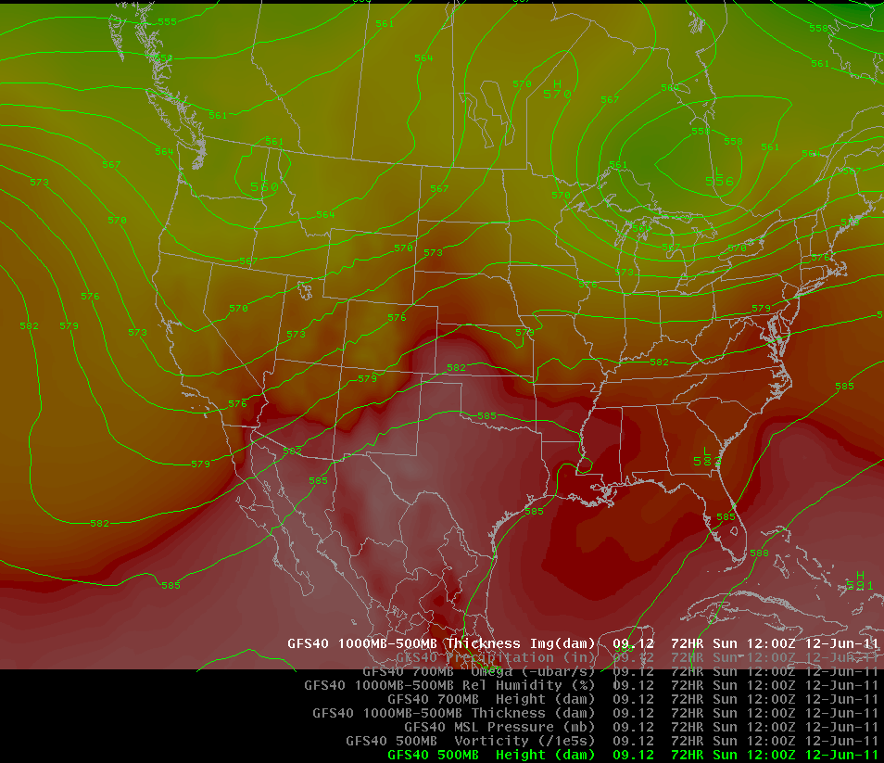
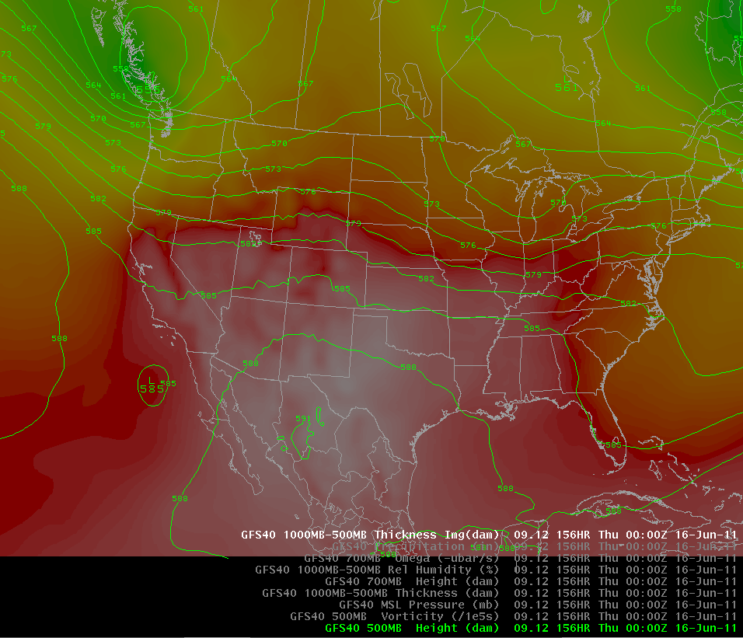
Weather Forecast
<- Today (Thursday)
Sunday AM
Wednesday PM
Low Pressure bringing cooling today and tomorrow
Gradual warming to near normal temperature this weekend

Slide 25
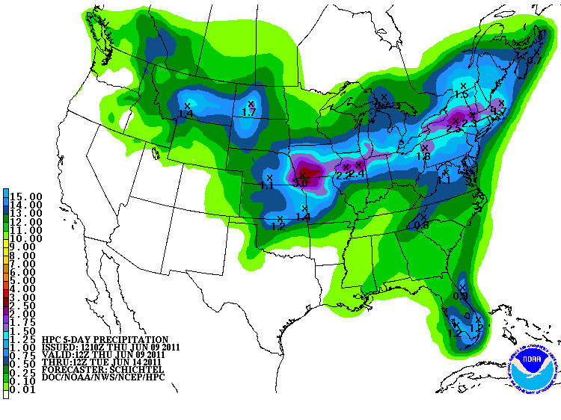
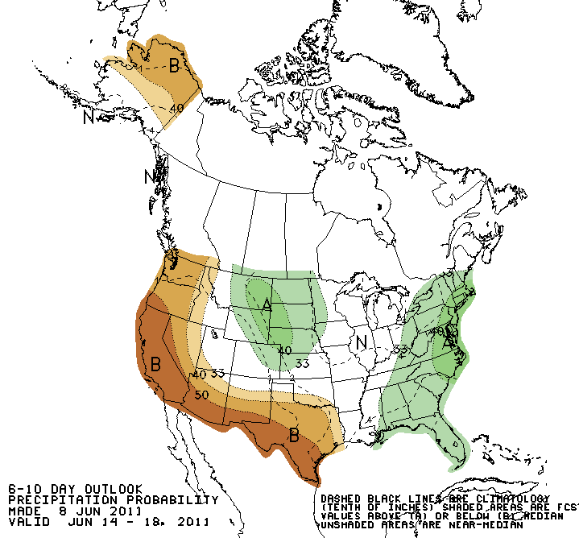
Forecast Precipitation
Dry weather pattern
Web Reference: www.hpc.noaa.gov

Slide 26
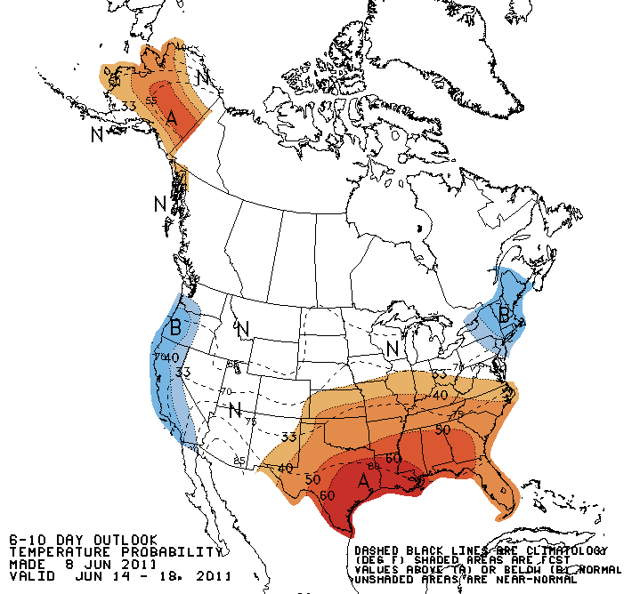
Forecast Temperature

Slide 27
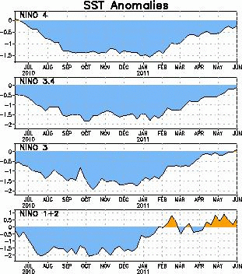
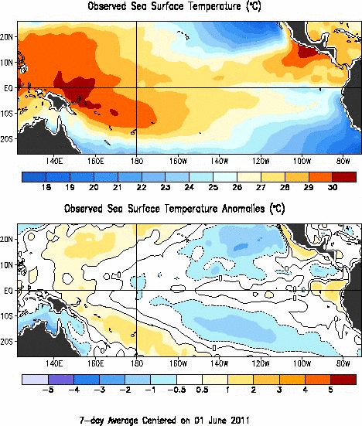
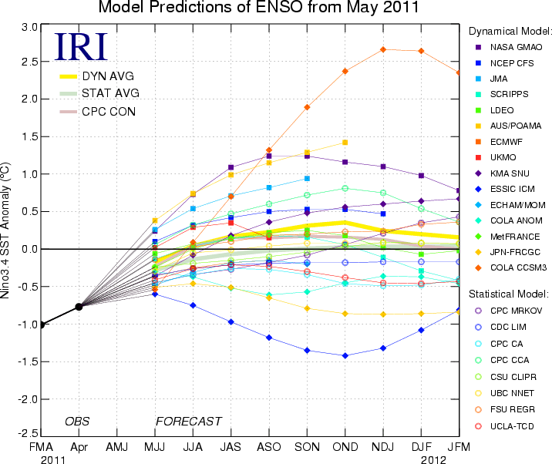
La Nina
Web Reference: http://www.cpc.noaa.gov and iri.columbia.edu/climate/ENSO

Slide 28


Slide 29

Soil Moisture

Slide 30
Peak Flow Forecasts
Long Lead Peak Flow Forecasts
Snowmelt Mean Daily Maximum Flow (April-July)
Probabilistic Forecasts
  Exceedence Probabilities -10%,25%,50%, 75%, 90%
Issued (at least) monthly from March-June (this year weekly starting April 19)
~60 forecast points – some unregulated, some regulated
Daily Forecasts
Full Hydrograph out 14 days
  Includes temperature (10 days) and precipitation (5 days) forecast
  Includes any knowledge of future regulation (e.g. reservoir release)
Single value forecast
Issued daily by 10am MDT and updated throughout day
~450 forecast points

Slide 31
Spring Weather Really Matters
Runoff characteristics are largely determined by the day-to-day spring weather.
  While large snow pack years increase chances for flooding, it is not an inevitability
  Small snow pack years (like last year) can flood with the right sequence of spring temperatures

Slide 32


CBRFC Website Mini Tutorial
Current website
  Extensive in scope
  Slower, cumbersome
www.cbrfc.noaa.gov

Slide 33


CBRFC Website Mini Tutorial
“Beta” website
  Faster
  Easier access to key information
  Actively being developed
www.cbrfc.noaa.gov/gmap/cmap.php

Slide 34
Peak Flow Charts
Flood Stage
Forecast Creation Time
Long lead peak forecast
Observed streamflow since April 1
Daily forecast
Bankfull
web reference: www.cbrfc.noaa.gov/gmap/cmap.php

Slide 35


Current Forecasts
May 24 Forecasts
June 9 daily Forecasts

Slide 36


Snowpack (and elevation) really matter
Ensemble forecasts for:
Yampa River
  Middle elevation
  Significant melt already occurred
Little Cottonwood Creek
  Higher elevation
  Most melt forthcoming

Slide 37




Slide 38



Slide 39



Slide 40



Slide 41



Slide 42



Slide 43



Slide 44



Slide 45



Slide 46



Slide 47



Slide 48



Slide 49



Slide 50


Experimental:
Peak Flow Forecast Evolution
Daily long lead peak forecasts from ESP reflect changing weather forecasts and hydrology.
Started in late May and comparing to official forecasts
Little Cottonwood Creek (top)
Yamap near Deerlodge (bottom)
Comments welcome
Web reference: http://www.cbrfc.noaa.gov/devel/dly_peak/

Slide 51

Experimental Daily Ensembles
Ensemble forecasts that incorporate weather forecasts are run daily for Upper Colorado Basin forecast points
Prototype web tool available
Does NOT work correctly downstream of reservoirs yet
NOT available for the Great Basin yet
URL: www.cbrfc.noaa.gov/devel/hefs

Slide 52
June Flooding Probable
Area of greatest concern is northern Utah and northwestern Colorado rivers (see map)
First two weeks of June are critical
Flood likelihood increased over May as cool, wet weather prevailed
Flooding will likely also occur on rivers and streams without forecasts
and/or gauges
Click for More information

Slide 53


NWS Flood Warnings, Watches
NWS Weather Offices are responsible for setting flood stage and issuing flood warnings and watches based on CBRFC forecasts. Key personnel for snow melt floods:
  Salt Lake City – Brian McInerney
  Grand Junction – Aldis Strautins
  Riverton – Jim Fahey
  Boulder – Treste Huse

Slide 54

June 1, 2011
Water Supply Forecasts
Highlights:
Wet winter + April + May led to significant rises in most forecasts.
Web Reference: www.cbrfc.noaa.gov/gmap/gmapm.php?wcon=checked

Slide 55


Web Reference: www.cbrfc.noaa.gov/gmap/gmapm.php?wcon=checked

Slide 56


Web Reference: www.cbrfc.noaa.gov/gmap/gmapm.php?wcon=checked

Slide 57


Web Reference: www.cbrfc.noaa.gov/gmap/gmapm.php?wcon=checked

Slide 58


Web Reference: www.cbrfc.noaa.gov/gmap/gmapm.php?wcon=checked

Slide 59


Web Reference: www.cbrfc.noaa.gov/gmap/gmapm.php?wcon=checked

Slide 60


Web Reference: www.cbrfc.noaa.gov/gmap/gmapm.php?wcon=checked

Slide 61


Web Reference: www.cbrfc.noaa.gov/gmap/gmapm.php?wcon=checked

Slide 62


Web Reference: www.cbrfc.noaa.gov/gmap/gmapm.php?wcon=checked

Slide 63
Peak Flow Decision Support
Peaks are coming soon!!
Long lead peak forecasts will no longer be updated this year because most rivers are peaking within the 14-day daily forecast window
Daily forecasts posted by ~10am MDT each (and updated later during the day). When temperatures are forecast to warm, please check here for the latest peak flow forecasts.
“beta” website developments:
  SNOTEL percentiles
  Simplified peak flow chart
  Publication referencing forecasts above historic peaks
  New peak flow forecast points added
Webinars: Weekly until peak flows are passed. Thursday, June 16 at 1pm
Discussion:
  Anything else you need??

Slide 64

CBRFC Blog
Blog.citizen.apps.gov/cbrfc

Slide 65

CBRFC Contacts
Basin Focal Points (Available to discuss forecasts: 801.524.5130)
  Upper Colorado: Brenda Alcorn
  Green: Ashley Nielson
  San Juan / Gunnison: Tracy Cox
  Great Basin: Brent Bernard
  Lower Colorado (below Lake Powell): Greg Smith

Slide 66


Feedback, Questions, Concerns always welcome….
Kevin Werner
CBRFC Service Coordination Hydrologist
Phone: 801.524.5130
Email: kevin.werner@noaa.gov

