Slide 1
CBRFC May 11 2011 Peak Flow Forecast Webinar
Greg Smith
These slides: www.cbrfc.noaa.gov/present/present.php

Slide 2
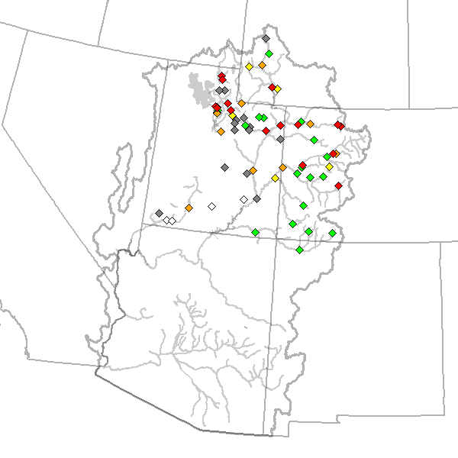
Outline
Recent Weather
Current Snow States
Upcoming Weather
Peak Flow Forecasts
Web Reference: www.cbrfc.noaa.gov/wsup/pub2/map/html/cbrfc.1.2011.html

Slide 3
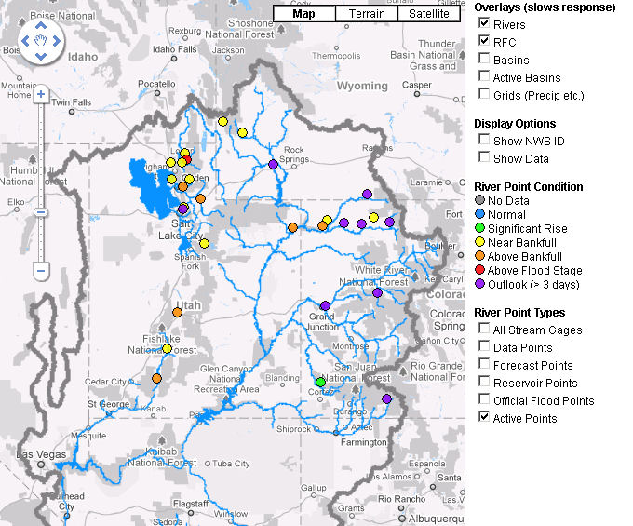
Snow Melt Runoff is Here – peaks to occur in the next 1-6 weeks.
Most Active Areas as of Today May 11th
Web Reference: http://www.cbrfc.noaa.gov

Slide 4
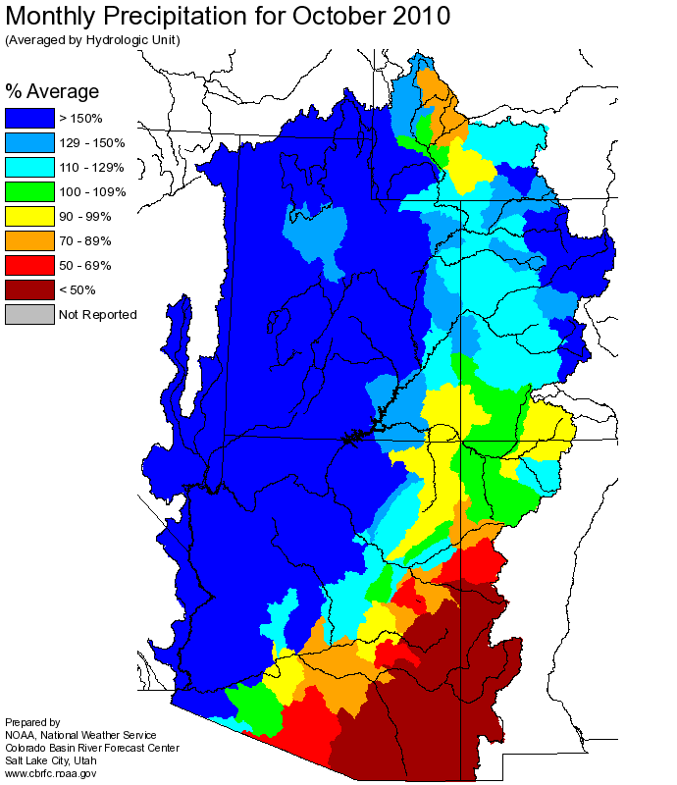
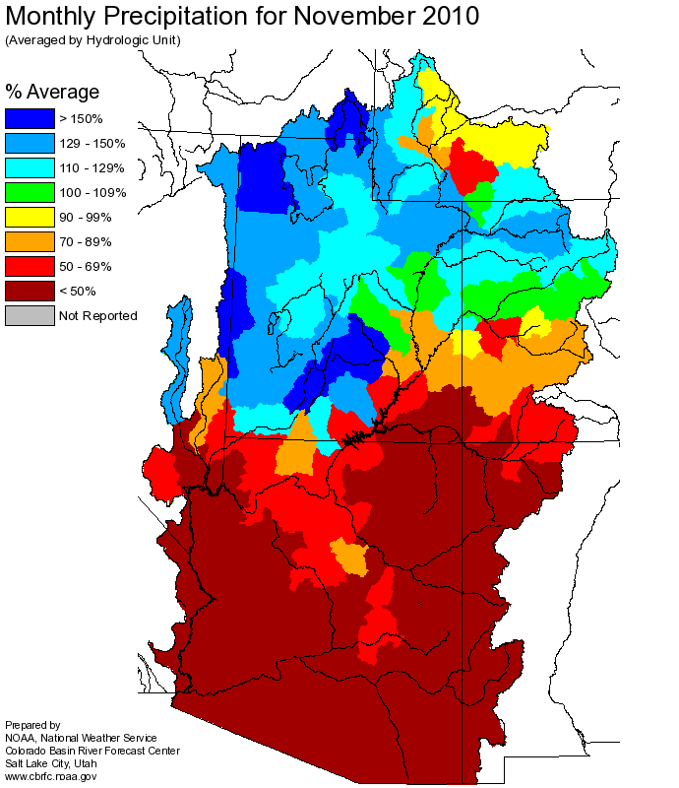
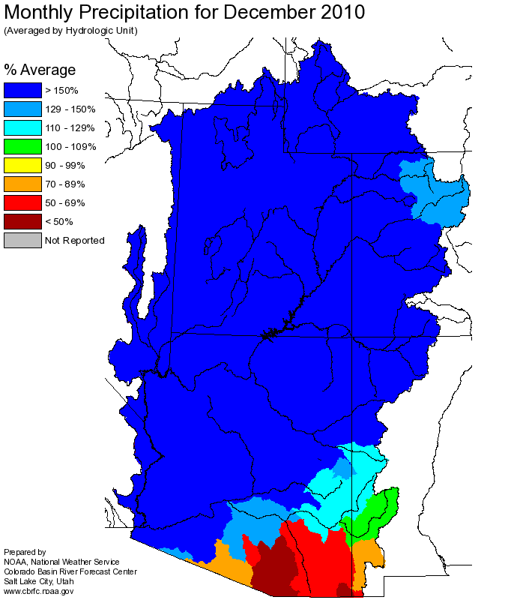
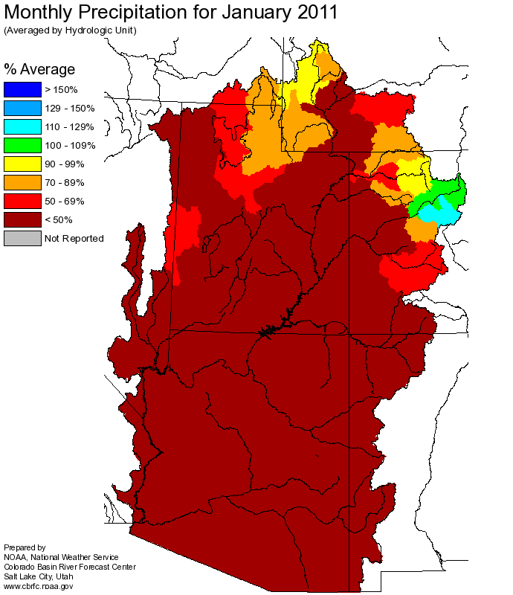
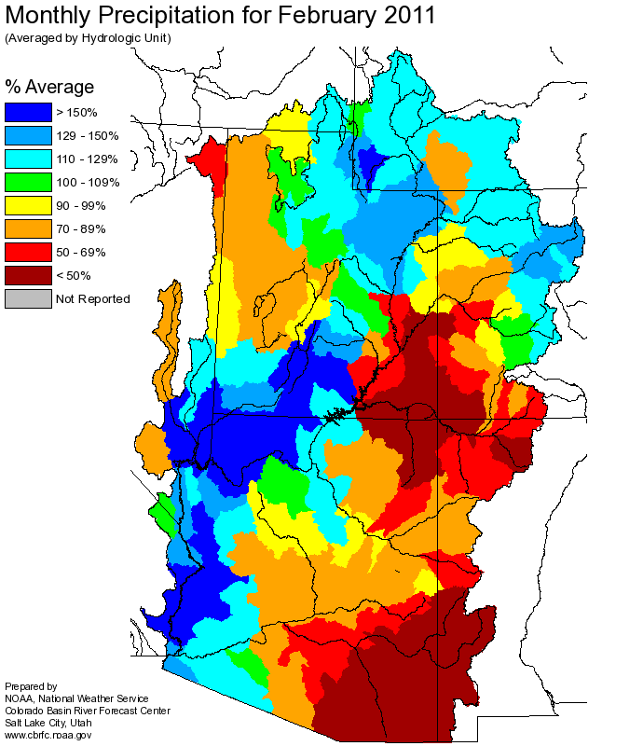
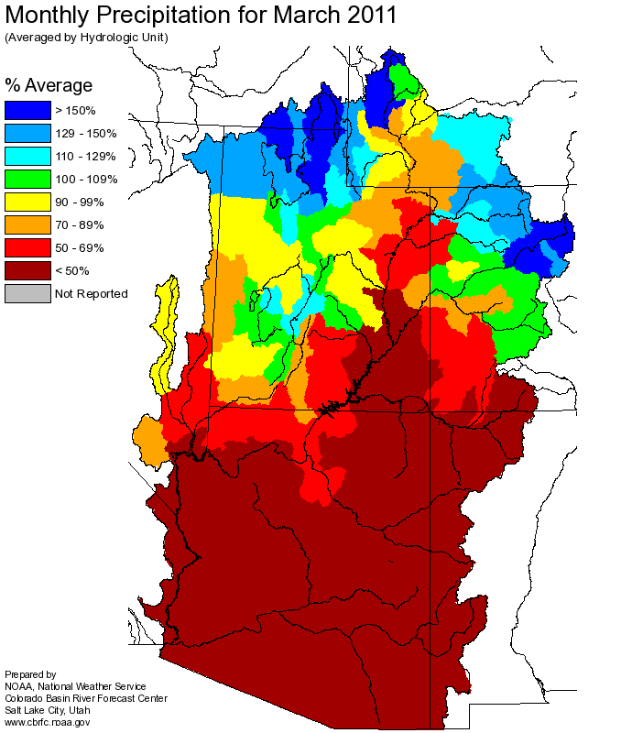
Web Reference: http://www.cbrfc.noaa.gov

Slide 5
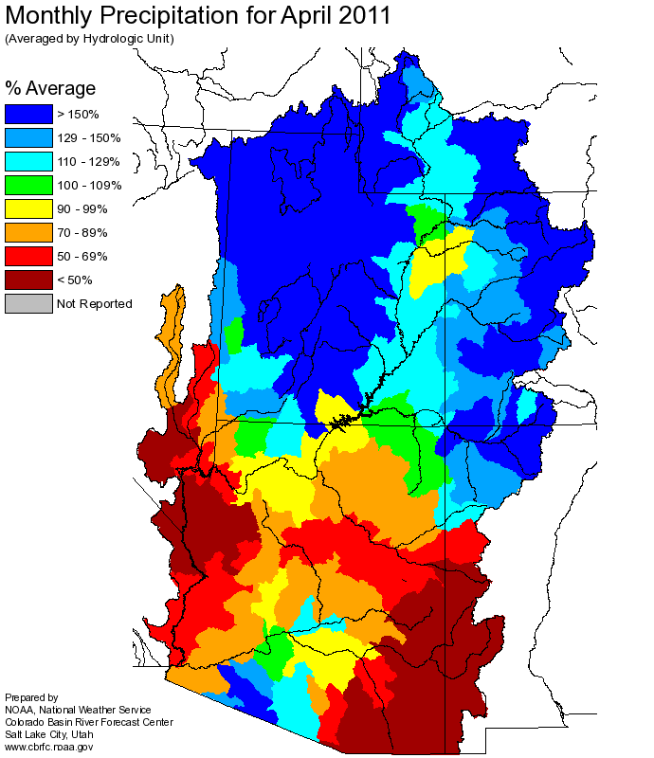
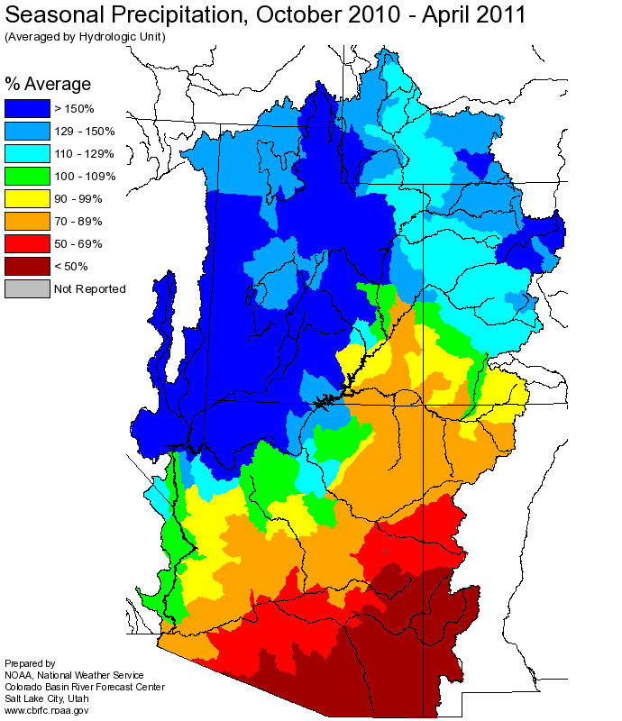

Slide 6
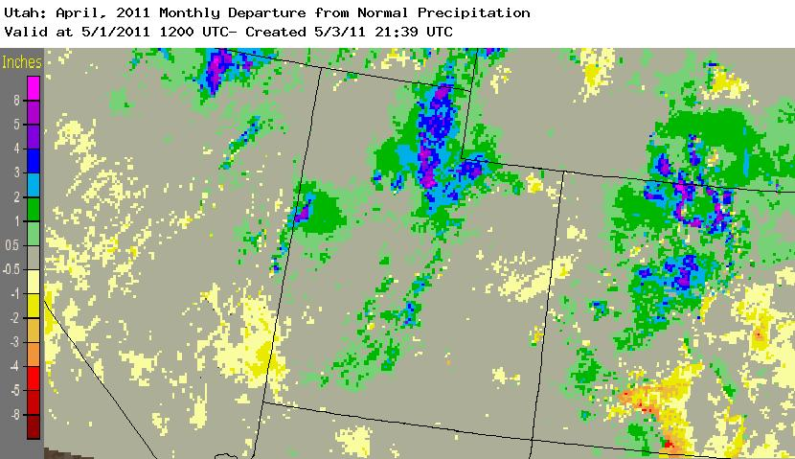
Web Reference: http://water.weather.gov/precip

Slide 7
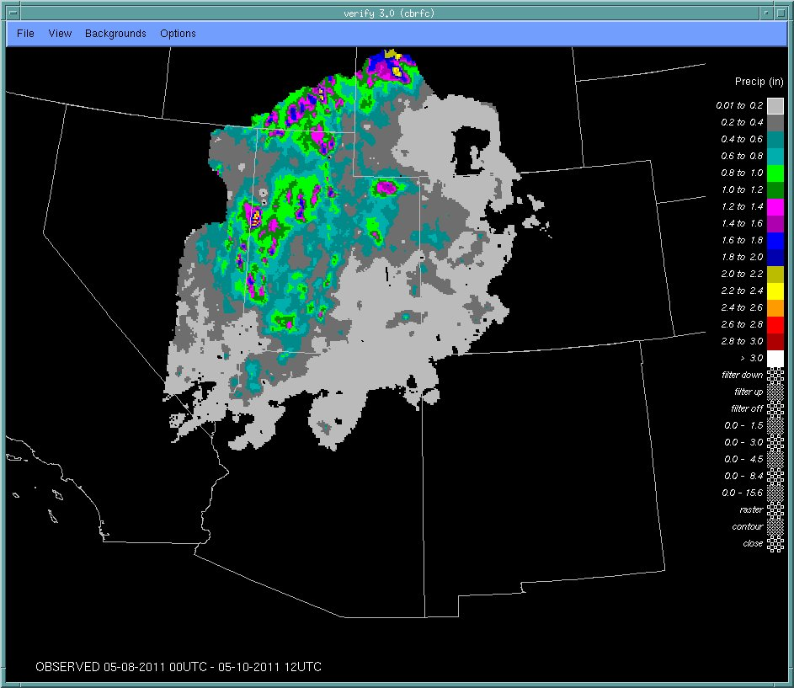
Precipitation: Two day storm total May 8-9

Slide 8
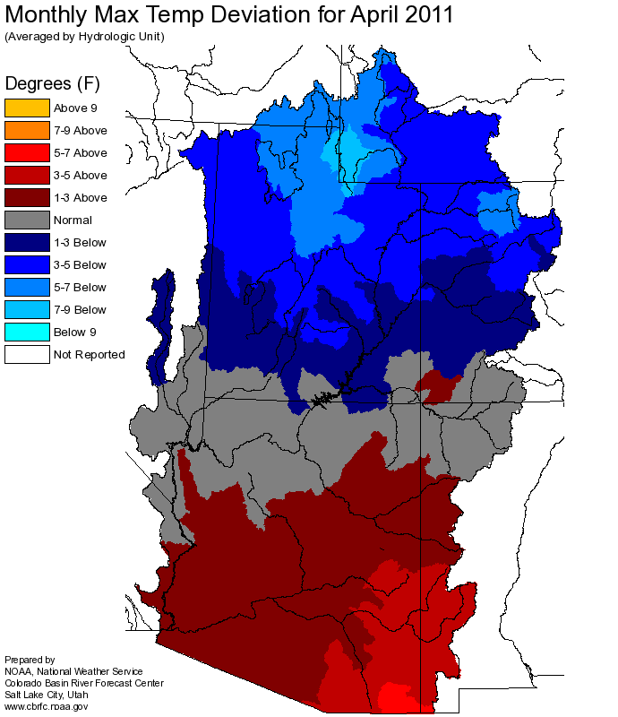

Slide 9
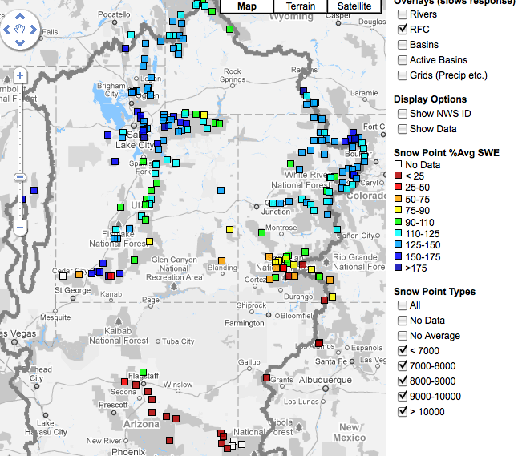
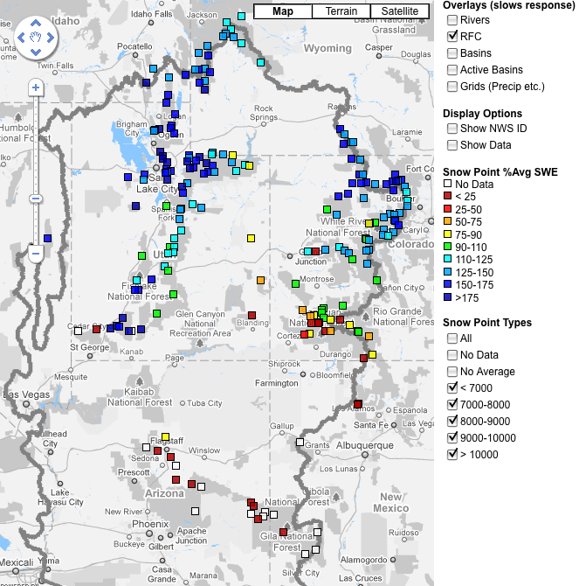
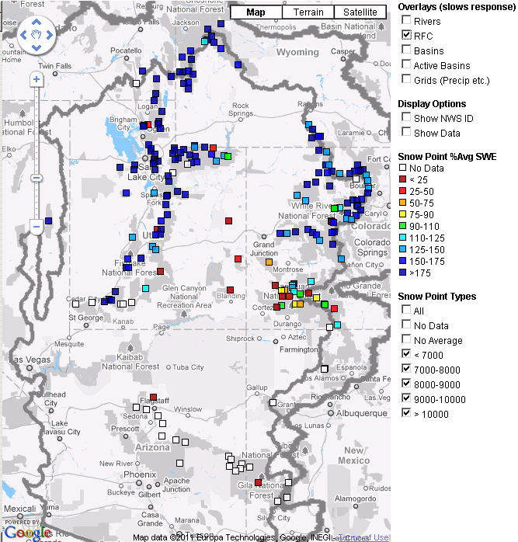
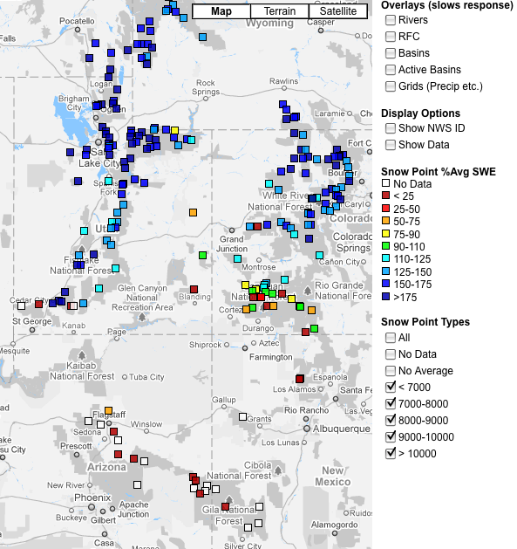
Snow
April 20
April 7
April 27
May 10
Web Reference: http://www.cbrfc.noaa.gov/gmap/gmapm.php?scon=checked

Slide 10
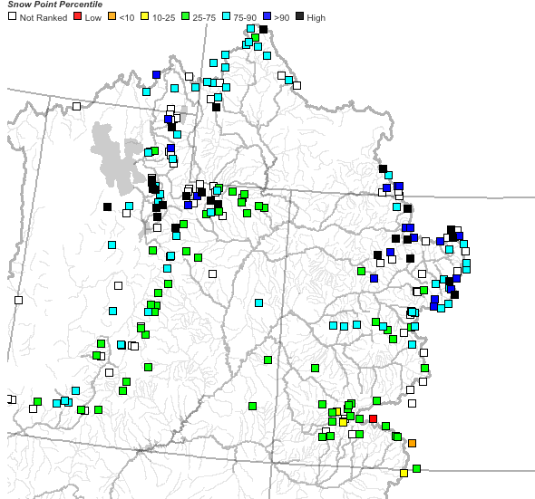
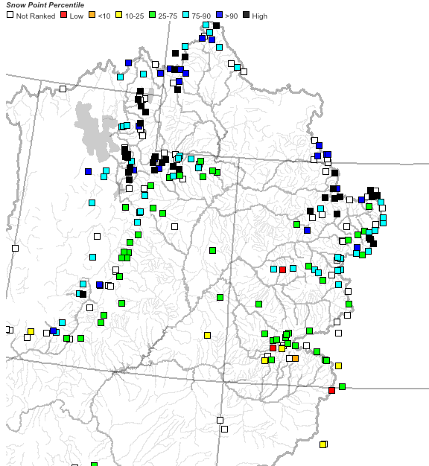
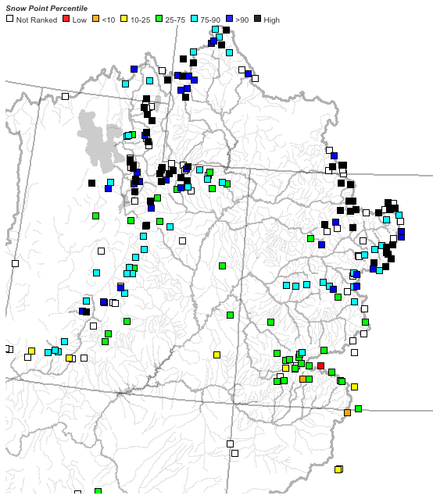
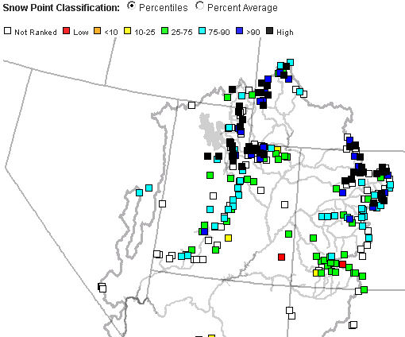
April 7
April 20
April 27
May 10

Slide 11
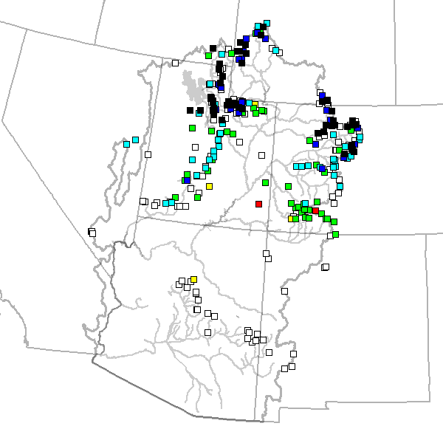
72 sites showing highest value for May 10th (31% of SNOTEL Sites)

Slide 12
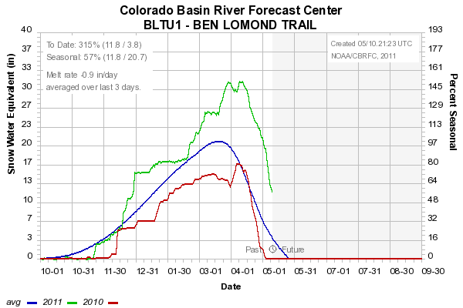
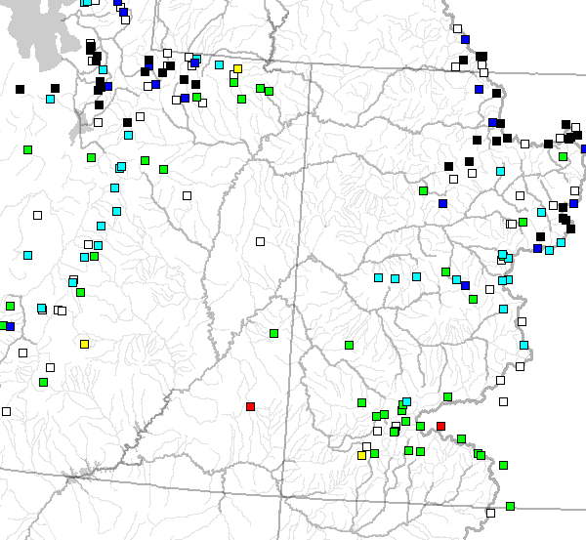
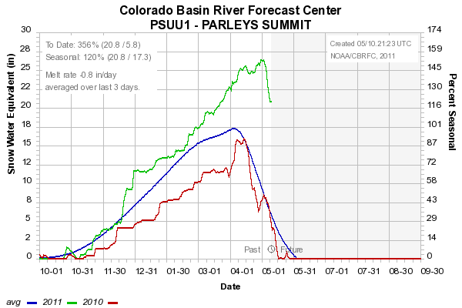
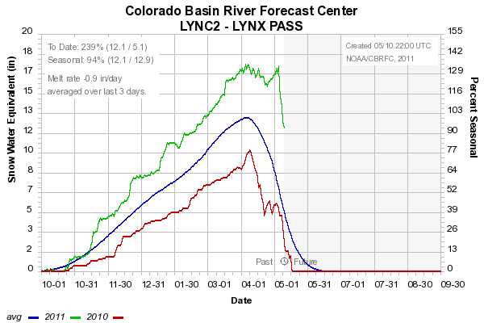
Lower Elevations (~8000’ and below)
Melt is underway
8000’
7500’
8800’

Slide 13
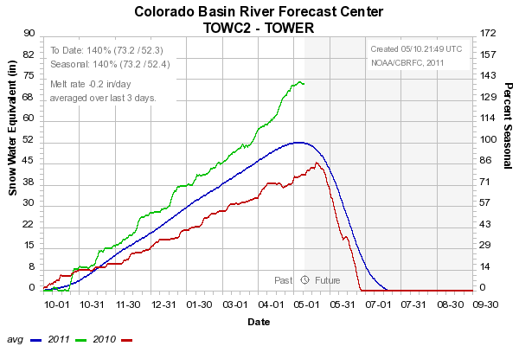
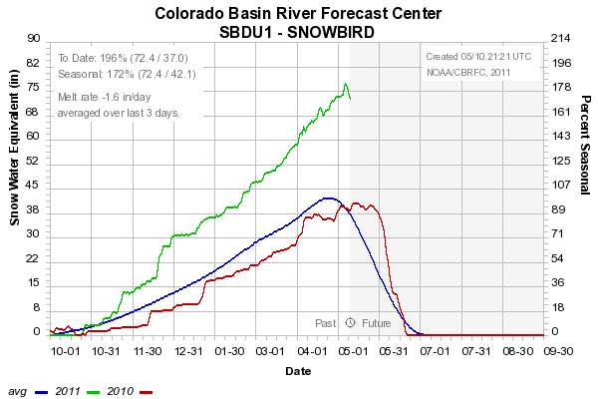
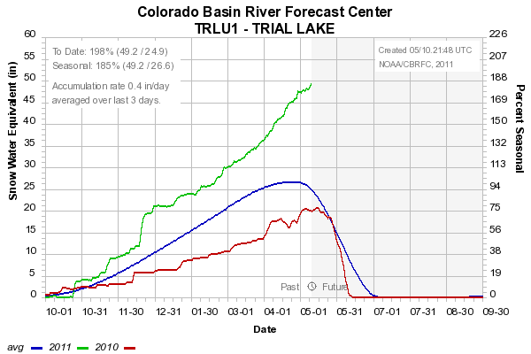
High Elevation Sites (~9000’ +)
Maintaining / Accumulating Snow
10500’
9640’
9960’

Slide 14
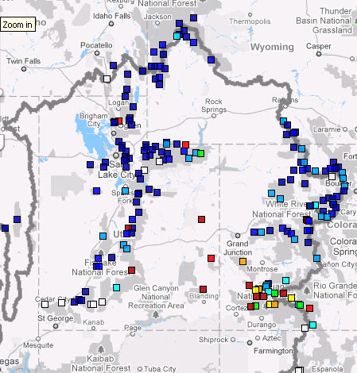
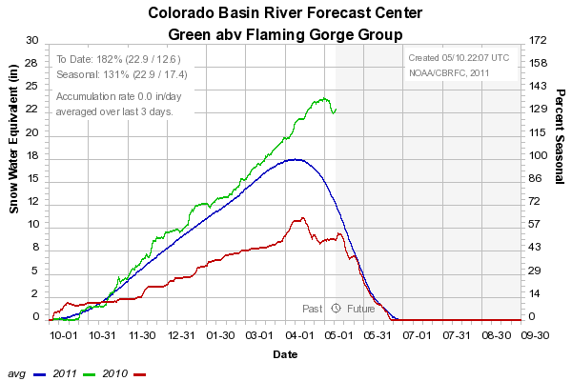
Snow: Upper Green Basin (above Flaming Gorge)
Web Reference: http://www.cbrfc.noaa.gov/station/sweplot/sweplot.cgi???open

Slide 15
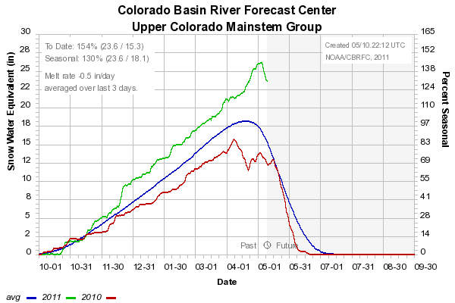
Snow: Colorado Mainstem (above Cameo)
Web Reference: http://www.cbrfc.noaa.gov/station/sweplot/sweplot.cgi???open

Slide 16
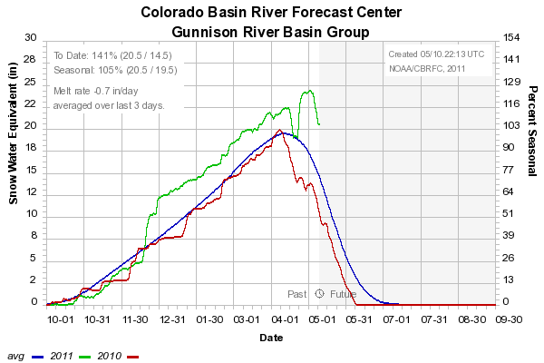
Snow: Gunnison Basin
Web Reference: http://www.cbrfc.noaa.gov/station/sweplot/sweplot.cgi???open

Slide 17
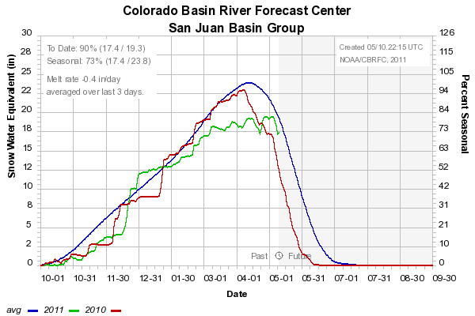
Snow: San Juan Basin
Web Reference: http://www.cbrfc.noaa.gov/station/sweplot/sweplot.cgi???open

Slide 18
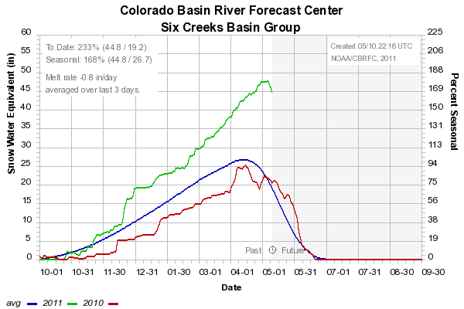
Snow: Six Creeks in Salt Lake County
Web Reference: http://www.cbrfc.noaa.gov/station/sweplot/sweplot.cgi???open

Slide 19
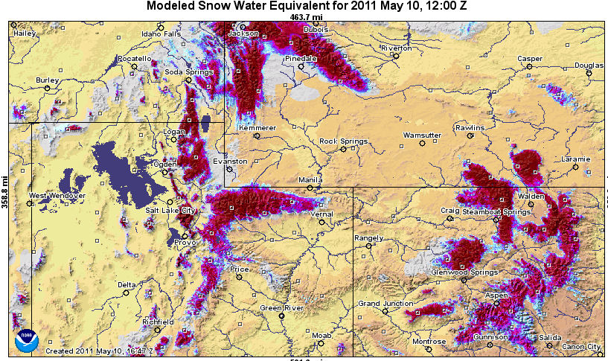
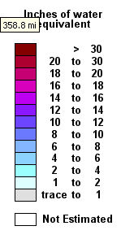
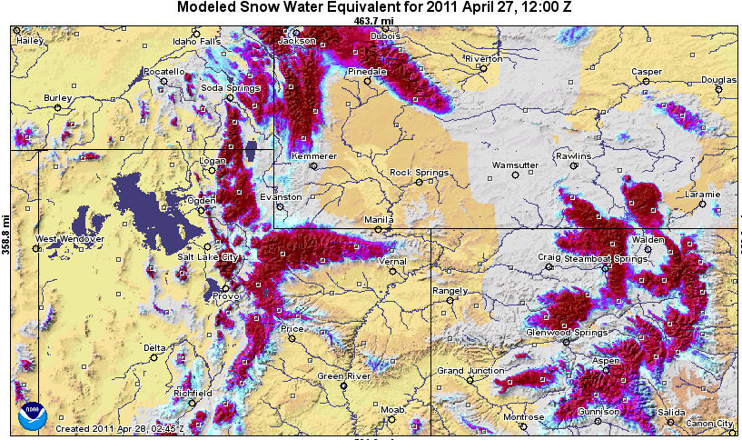
Model generated Snow Maps:
Current compared to Apr 27 (last peak flow discussion)
Web Reference: http://www.nohrsc.nws.gov

Slide 20
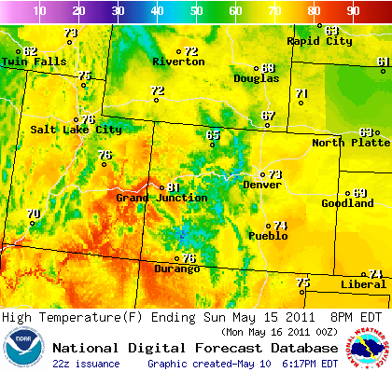
Upcoming Weather:
This Week: Temperatures 5-10 degrees above average by the weekend.
Next Week: Another storm system possible mid week. Cooler
Web Reference: http://www.weather.gov/forecasts/graphical/sectors/centrockiesWeek.php#tabs

Slide 21
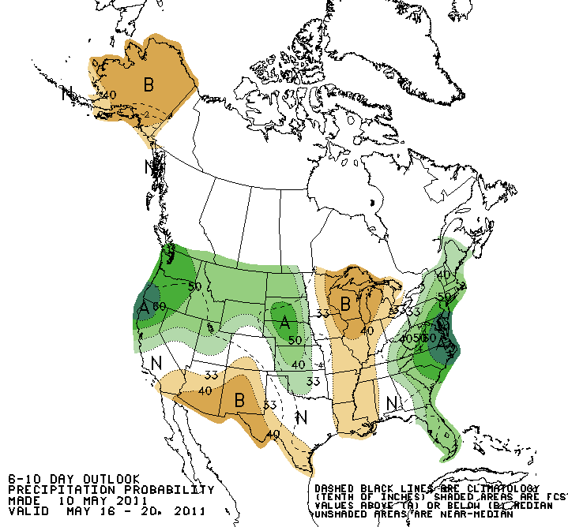
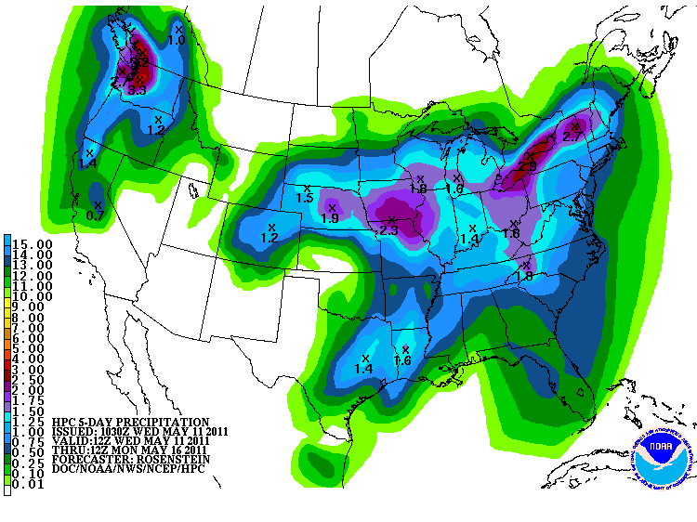
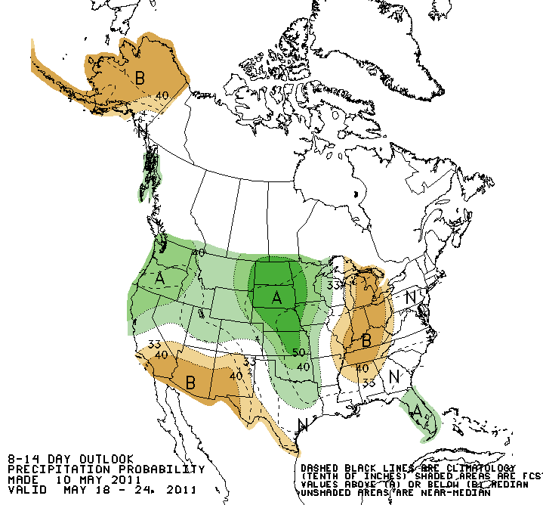
Forecast Precipitation
This Week: Dry. Colorado precipitation is from exiting storm.
6-14 day period suggests increased chance of precipitation
Web Reference: www.hpc.ncep.noaa.gov & www.cpc.ncep.noaa.gov

Slide 22
What is a Peak Flow Forecast?
Snowmelt Mean Daily Maximum Flow (April-July)
Instantaneous Forecasts where relationships/data exist
New Information (applicable to flooding concerns)
Mean Daily Peak – Instantaneous peak relationship washes out if heavy rain occurs during the peak.
Probabilistic Forecasts
Exceedence Probabilities -10%,25%,50%, 75%, 90%
Issued (at least) monthly from March-June (this year weekly starting April 19)
~60 forecast points – some unregulated, some regulated
Updated as needed

Slide 23
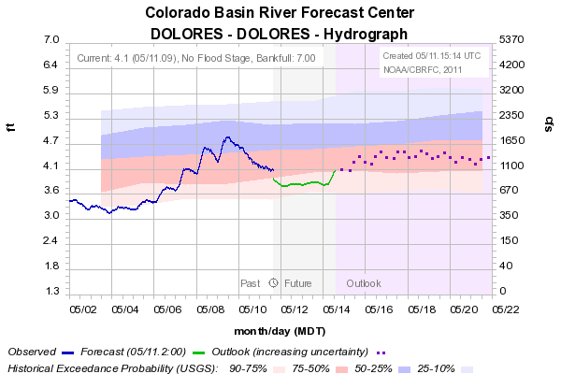
Accounting for diurnal variation daily mean to instantaneous peak adjustment
some rivers have predictable diurnal melt variations
instantaneous peak exceeds daily mean
RFC ESP forecasts simulate the daily mean (from 6 hr models)
we now use the observed relationship between daily mean and instantaneous peak to relate our daily mean peak forecast percentiles to instantaneous peaks

Slide 24
Spring Weather Really Matters
Runoff characteristics are largely determined by the day-to-day spring weather.
While large snow pack years increase chances for flooding, it is not an inevitability
Small snow pack years (like last year) can flood with the right sequence of spring temperatures

Slide 25
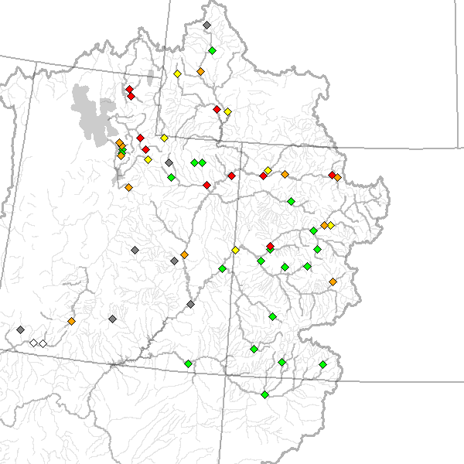
May 10 Peak Flow Forecasts
April 26 Forecasts
May 10 Forecasts

Slide 26
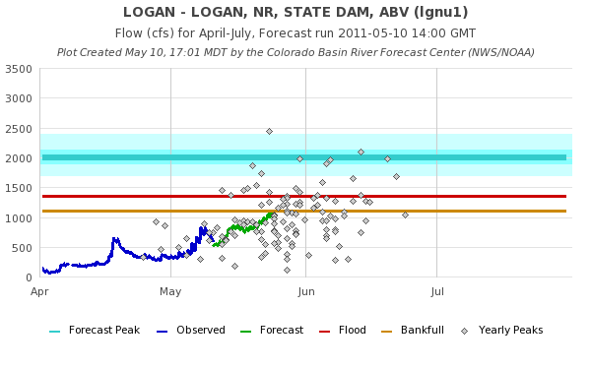
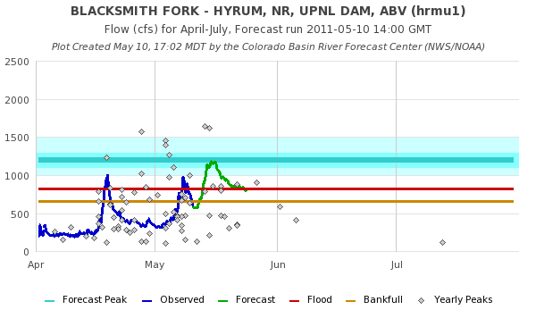

Slide 27
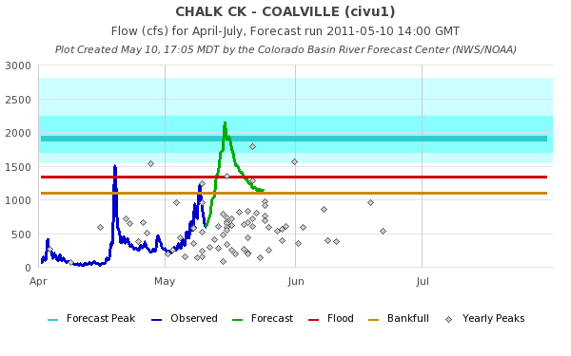
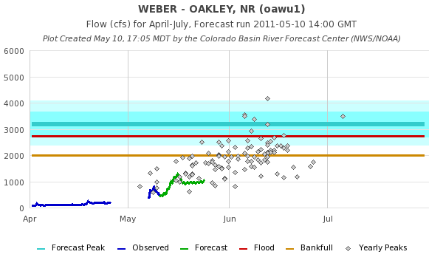

Slide 28
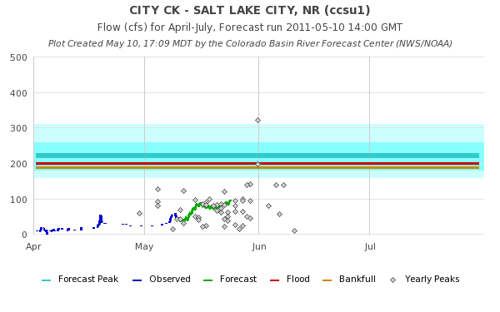
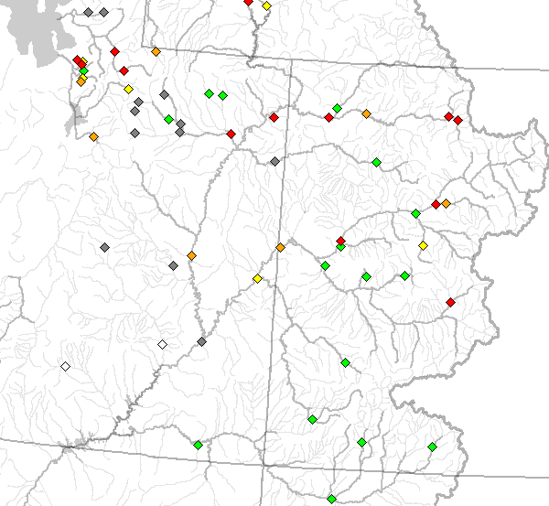

Slide 36
Peak Flow Publication

Slide 37
Transition from peak flow publication to our active conditions main web page:
Start looking at both at this time – focus on our active conditions map as the peak nears (not always obvious)
Frequent updates using recent observations and short term meteorological forecasts (active quality control)
Multiple peaks that exceed critical levels may occur (not represented in mean daily forecast)
Known regulation changes will be accounted for on active web page hydrographs
Planning vs real time
Active Conditions Web Page: www.cbrfc.noaa.gov

Slide 38
Basin Focal Points (Available to discuss forecasts: 801.524.5130)
Upper Colorado: Brenda Alcorn
Green: Ashley Nielson
San Juan / Gunnison: Tracy Cox
Great Basin: Brent Bernard
Lower Colorado (Virgin/Below Powell): Greg Smith

Slide 39
Peak Flow Forecasts
Forecast updates planned for:
- 5/17, 5/24
Additional webinars can be arranged if needed
Discussion:
Anything else you need??

Slide 40
Feedback, Questions, Concerns always welcome….
Kevin Werner
CBRFC Service Coordination Hydrologist
Phone: 801.524.5130
Email: kevin.werner@noaa.gov

