Slide 1
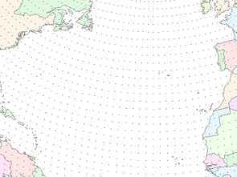



Southwest Hydrometeorology Symposium
Tempe, AZ
September 28, 2011
2011: A Year of Extremes
Kevin Werner
NWS Colorado Basin River Forecast Center

Slide 2
Outline
River Forecast Center overview
2011 runoff review
  Colorado River
  Salt/Verde Rivers
Forecast verification

Slide 3

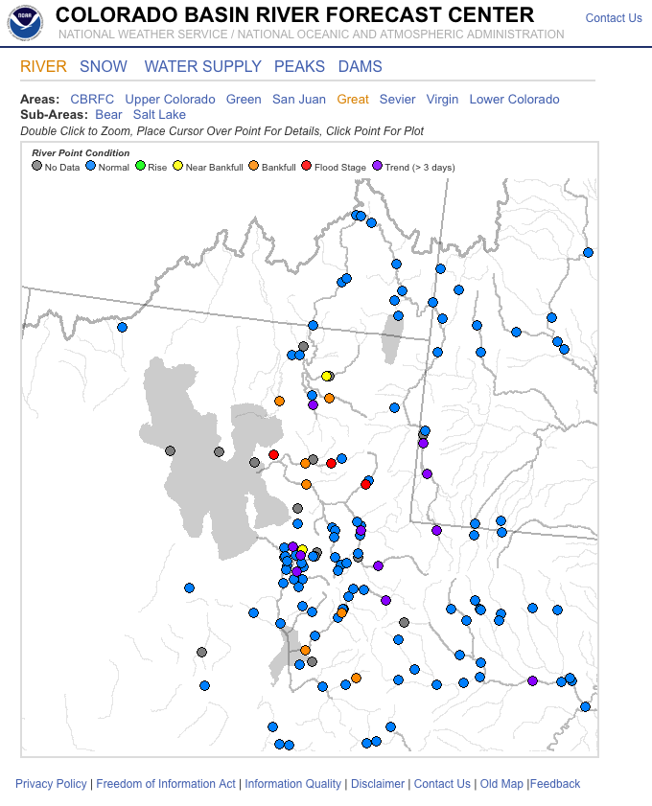
Colorado Basin
River Forecast Center
The Colorado Basin River Forecast Center (CBRFC) generates streamflow forecasts across the Colorado and Utah. The latest forecasts, data, and more are available online:
  Daily streamflow forecasts
  Long lead peak flow forecasts
  Water supply forecasts
  Webinar briefings
  Email updates
  And More….
www.cbrfc.noaa.gov

Slide 4
Arizona Water Supply
Arizona’s water surface water supply:
1.5 MAF/year from Colorado R
~800 MAF/year from Salt Verde
~250 MAF/year from other rivers

Slide 5
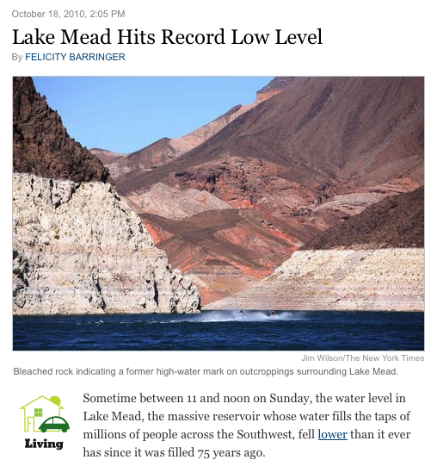

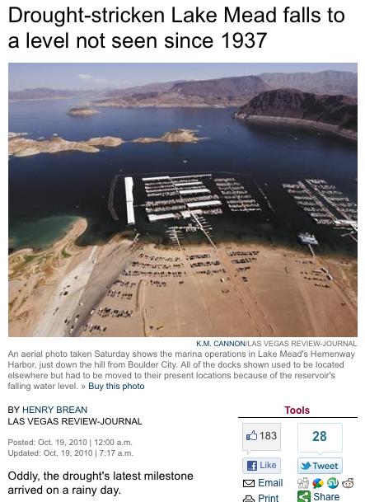
Late 2010

Slide 6
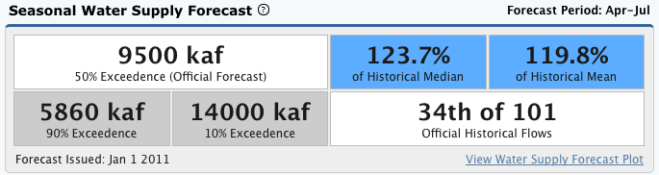
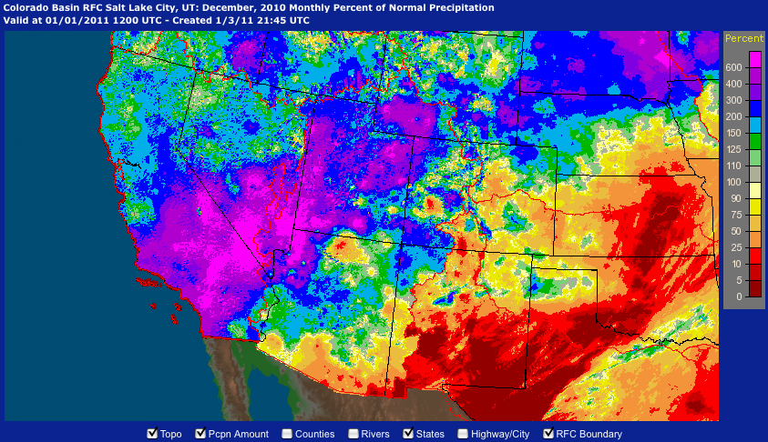
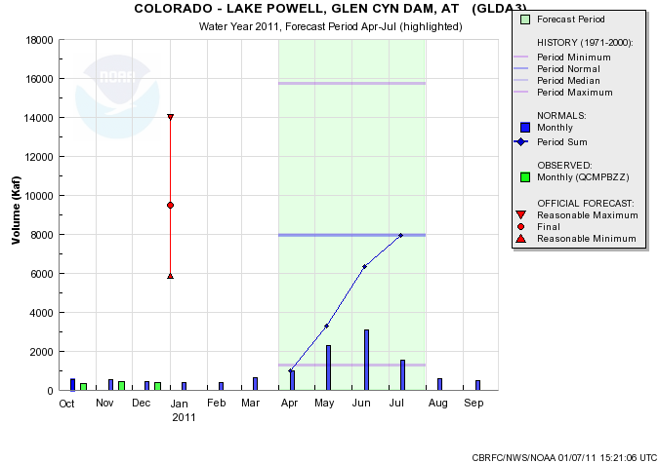
Early 2011
Pre Holiday Storm:
Lake Mead up ~2 feet from local runoff
Large snow accumulation
Forecasts reflected that….
Irrational Exuberance?

Slide 7
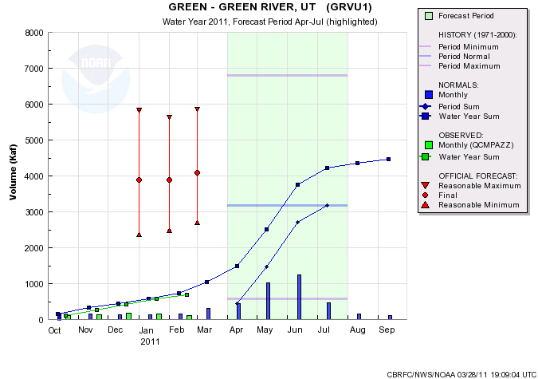
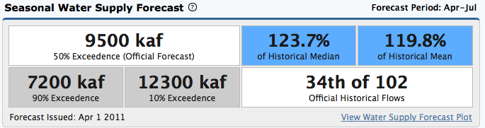
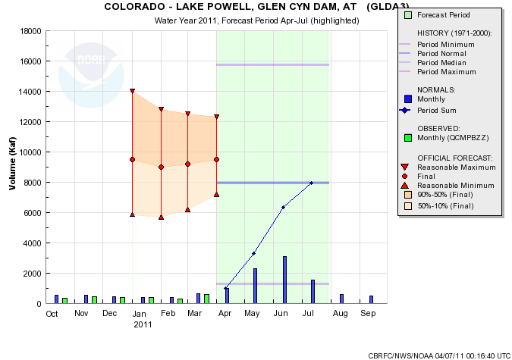
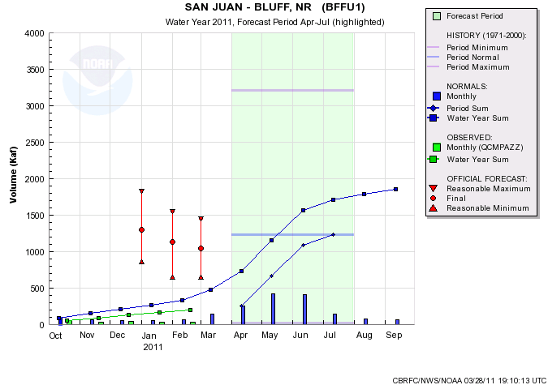
4090/129%
1040/85%
Web Reference: www.cbrfc.noaa.gov/gmap/gmapm.php?wcon=checked

Slide 8
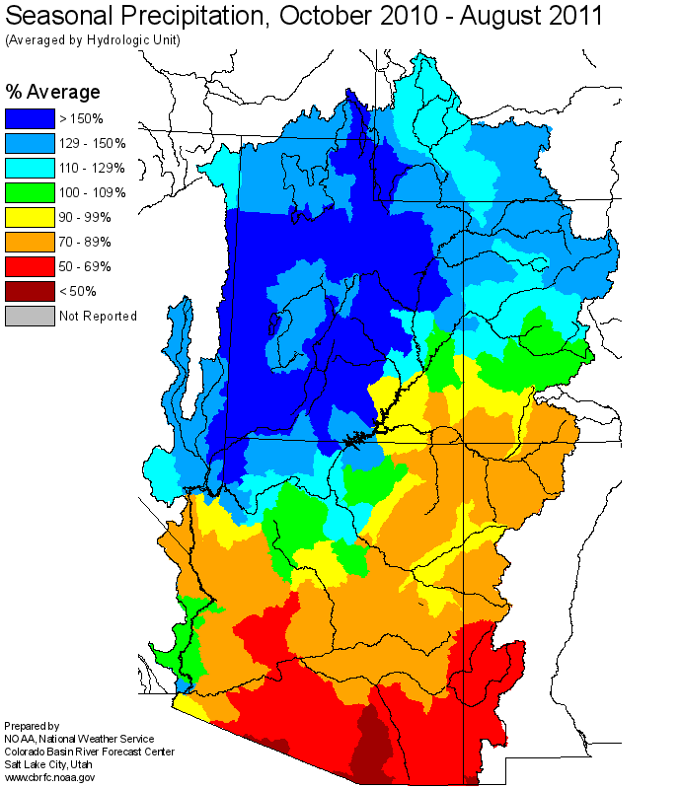

Spring 2011
  Winter and Spring 2011 were much wetter than normal for most of the northern basin while much drier than normal for the southern basin
  Spring was very cold across northern basin
  Snowpack accumulated to record or near record amounts at most SNOTEL sites in the north
  Snow melt was delayed – and largely tempered by cool May/June weather
  Flood did occur in low elevation basins (May/June) and high elevation basins (late June/July)

Slide 9
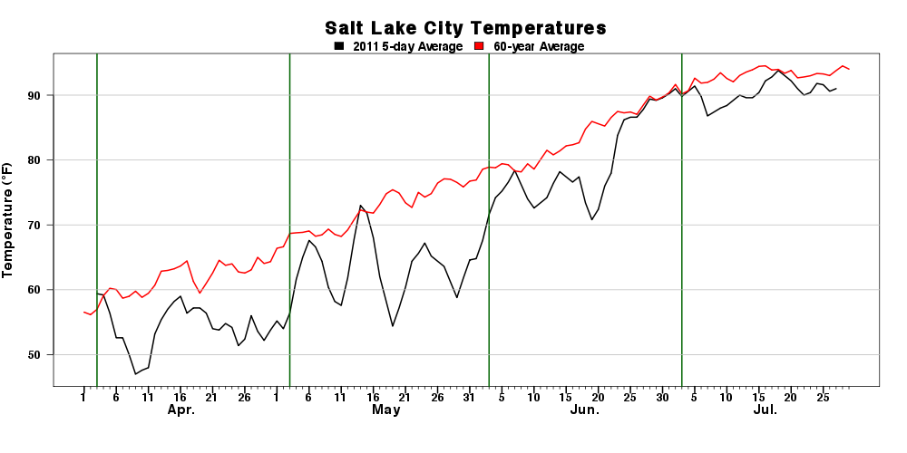
Spring 2011
  Winter and Spring 2011 were much wetter than normal for most of the northern basin while much drier than normal for the southern basin
  Spring was very cold across northern basin
  Snowpack accumulated to record or near record amounts at most SNOTEL sites in the north
  Snow melt was delayed – and largely tempered by cool May/June weather
  Flood did occur in low elevation basins (May/June) and high elevation basins (late June/July)

Slide 10
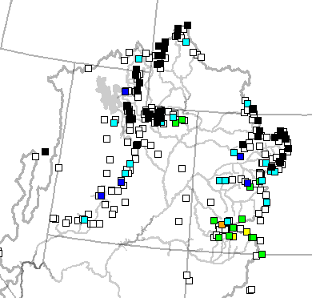
Spring 2011
  Winter and Spring 2011 were much wetter than normal for most of the northern basin while much drier than normal for the southern basin
  Spring was very cold across northern basin
  Snowpack accumulated to record or near record amounts at most SNOTEL sites in the north
  Snow melt was delayed – and largely tempered by cool May/June weather
  Flood did occur in low elevation basins (May/June) and high elevation basins (late June/July)
May 31 SNOTEL rankings

Slide 11
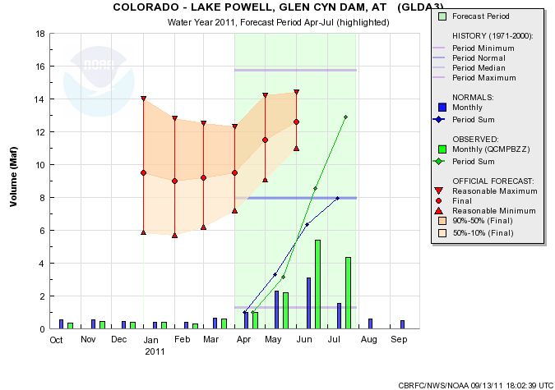
Spring 2011
2011 Inflow = 12.9 MAF
163% of normal
  Winter and Spring 2011 were much wetter than normal for most of Utah – especially the months of March/April/May
  Spring was very cold across Utah
  Snowpack accumulated to record or near record amounts at most SNOTEL sites
  Snow melt was delayed – and largely tempered by cool May/June weather
  Flood did occur in low elevation basins (May/June) and high elevation basins (late June/July)

Slide 12


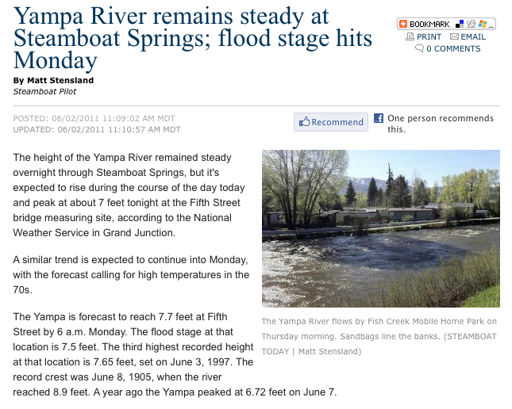
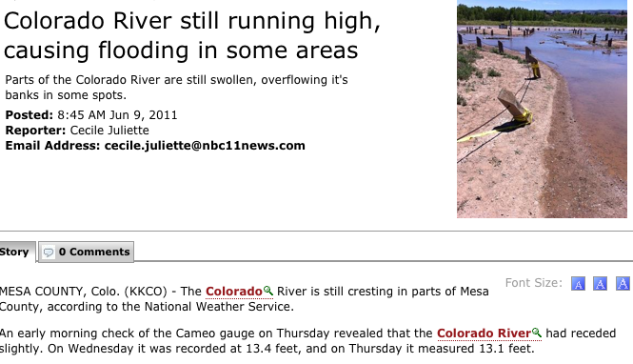
Flooding and High Flows

Slide 13
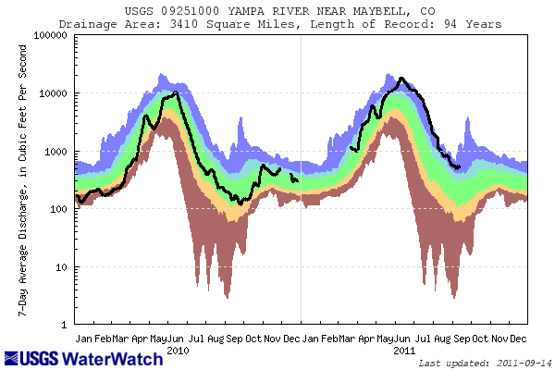
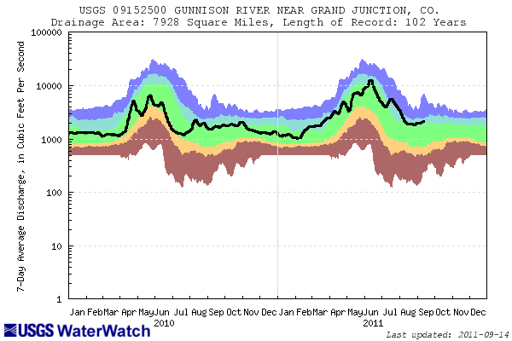
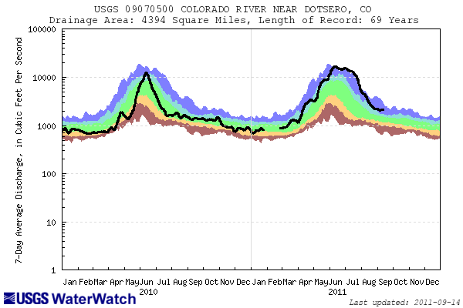
Flooding and High Flows
Wettest area was northern Colorado
Upper Colorado also quite wet
Gunnison divided web from normal
Dolores, San Juan basins nearer normal
Yampa River
Gunnison River
Upper Colorado River

Slide 14
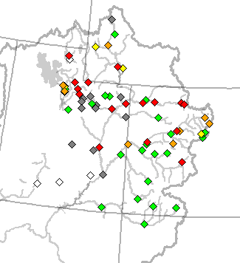
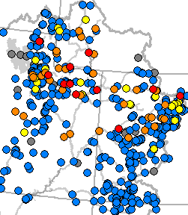
Peak Flow Forecasts
Long Lead Peak Flow Forecasts
Snowmelt maximum mean daily flow (April-July)
Probabilistic Forecasts
  Exceedence Probabilities -10%,25%,50%, 75%, 90%
Issued (at least) monthly from March-June (this year weekly starting April 19)
~60 forecast points – some unregulated, some regulated
Daily Forecasts
Full Hydrograph out 14 days
  Includes temperature (10 days) and precipitation (5 days) forecast
  Includes any knowledge of future regulation (e.g. reservoir release)
Single value forecast
Issued daily by 10am MDT and updated throughout day
~450 forecast points

Slide 15
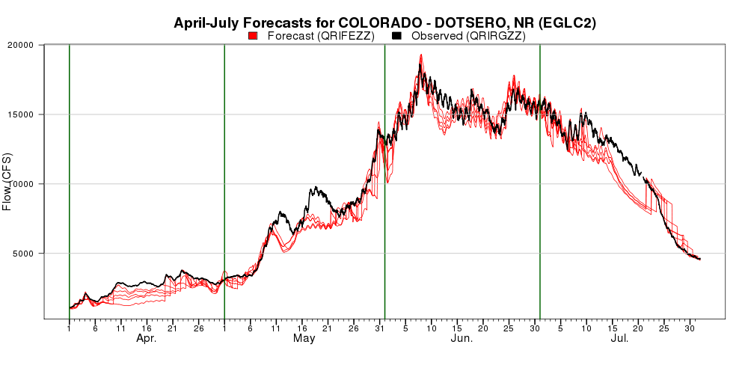
Upper Colorado
Upper Colorado includes many high elevation basins that peaked late into June or early July
Near record snowpack caused high flows
High flows were mitigated by cool June temperatures

Slide 16
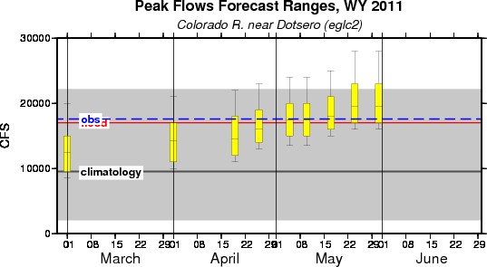
Upper Colorado: Long Lead Peak Forecasts

Slide 17

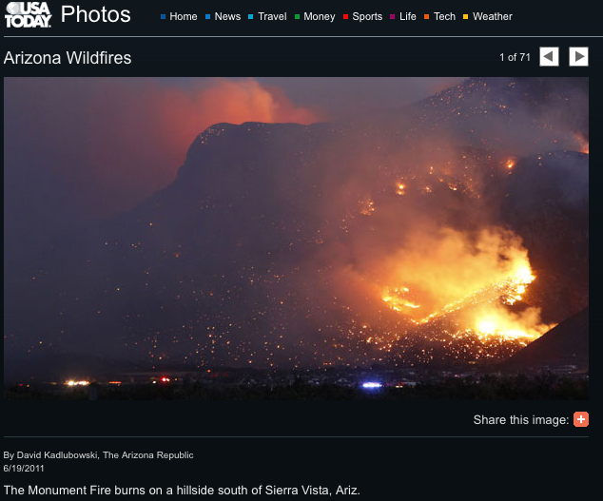
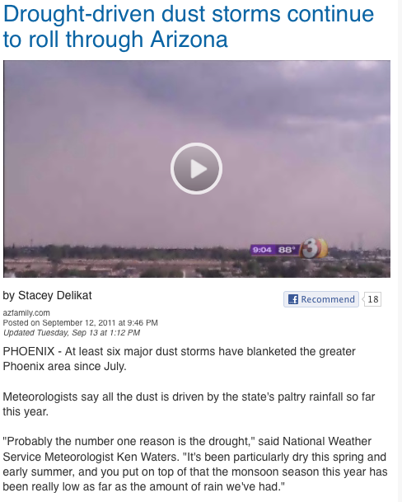
Drought and Low Flows

Slide 18
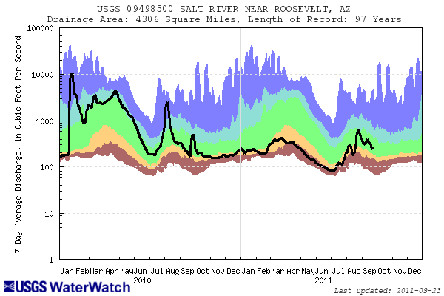
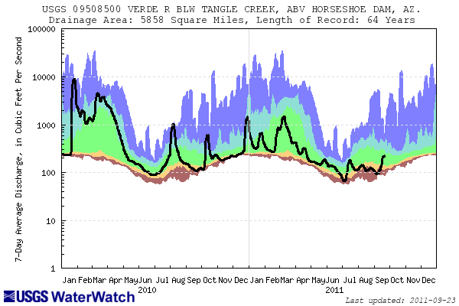
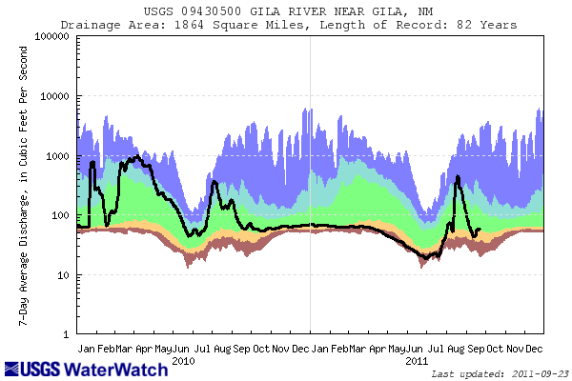
Drought and Low Flows
Dry conditions throughout AZ
Salt, upper Gila at or near record low volumes (right)
Verde somewhat better (below)
Salt River
Verde River
Gila River

Slide 19
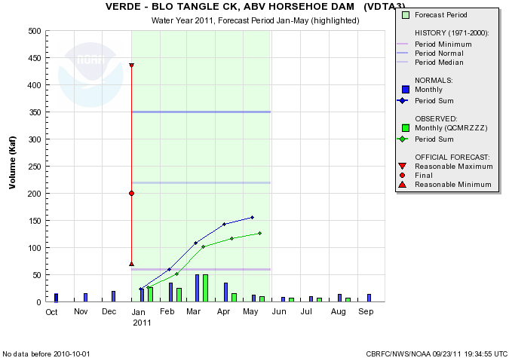
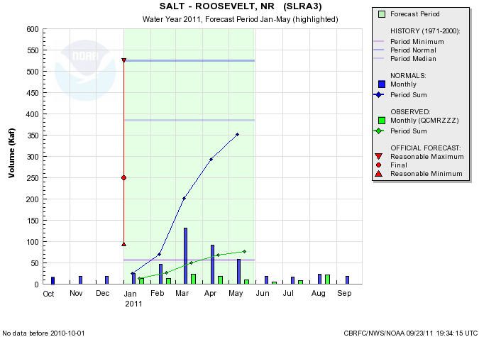
Salt / Verde
Salt River:
78 KAF for Jan-May
20% median
15% average
89th of 98 years
Verde River:
126 KAF for Jan-May
57% median
36% average
42nd of 73 years

Slide 20
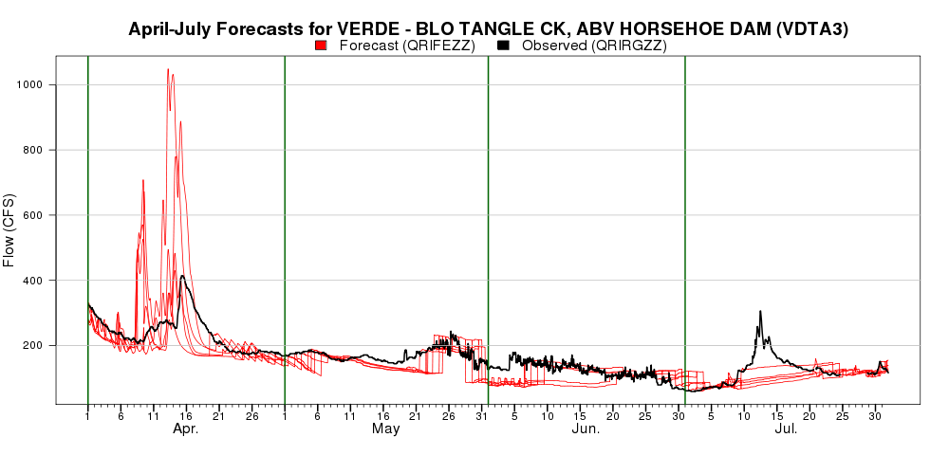
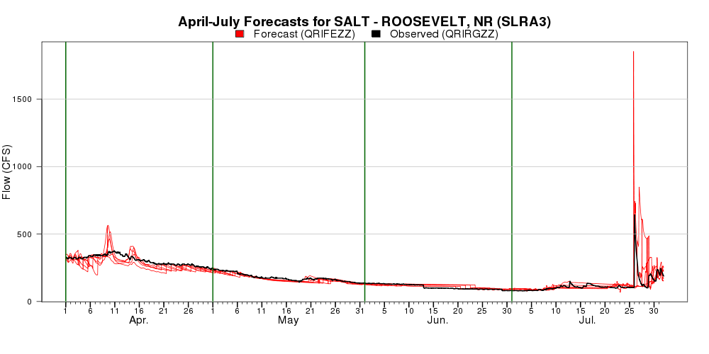

Slide 21
2011 Summary
  2011: extremes:
    High flows and flooding in northern basin
    Low flows and drought in southern basin
  Forecasts generally quite skillful
  Forecast Verification: Now Online!!
  Forecast Issues
    Struggled with some reservoir release plans in some cases
    Temperature forecasts in late May / early June were much too high causing streamflow forecasts to be too high
  Upcoming CBRFC activities
    November 3 stakeholder forum – Denver, CO
    Annual recap and outlook webinar – Oct/Nov
    Individual meetings with water managers

Slide 22
30 year average update
30 year averages are updated once every 10 years
Currently using
  1971-2000 for averages
  1971-2000 for statistical prediction
  1976-2005 for ESP
Update for WY2012 will be based on 1981-2010 averages
Trends in monthly precipitation are important for ESP

Slide 23
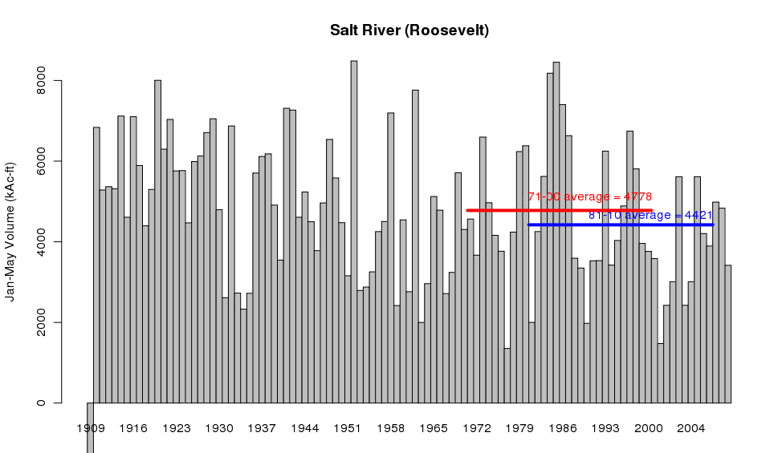
Preliminary Data
8% reduction in mean

Slide 24
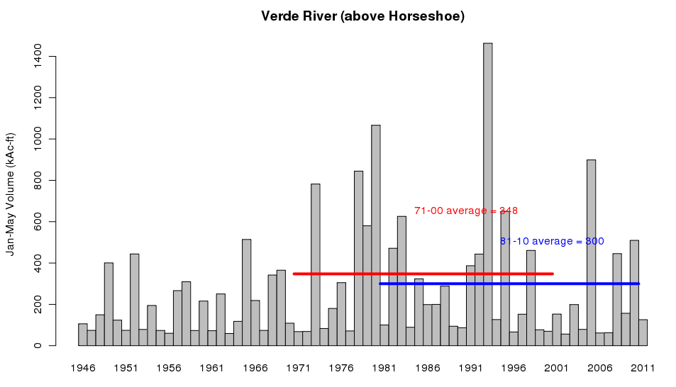
Preliminary Data
14% reduction in mean

Slide 25
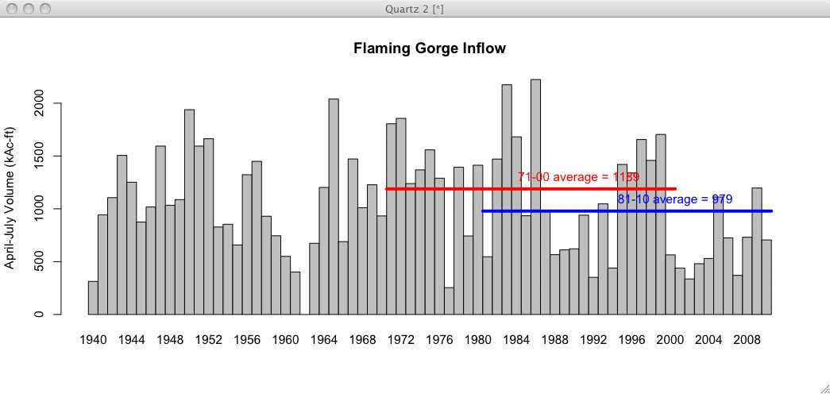
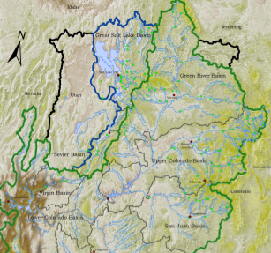
Preliminary Data
18% reduction in mean

Slide 26
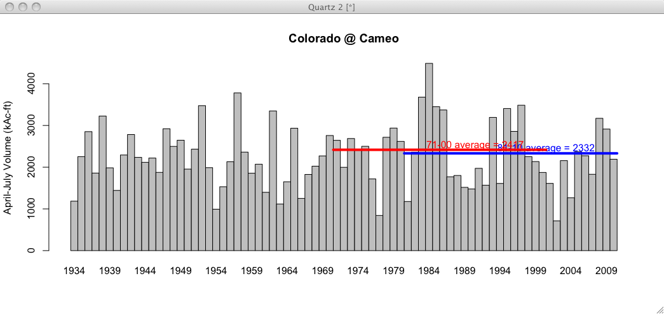
Preliminary Data
4% reduction in mean

Slide 27
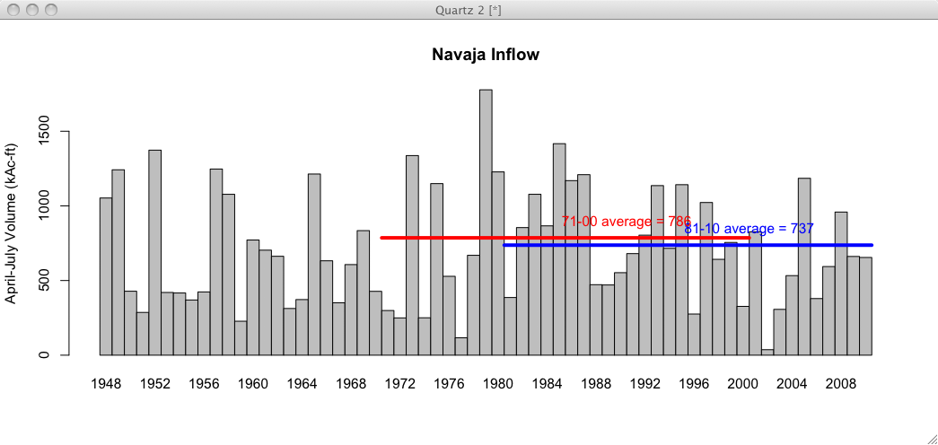
Preliminary Data
6% reduction in mean

Slide 28
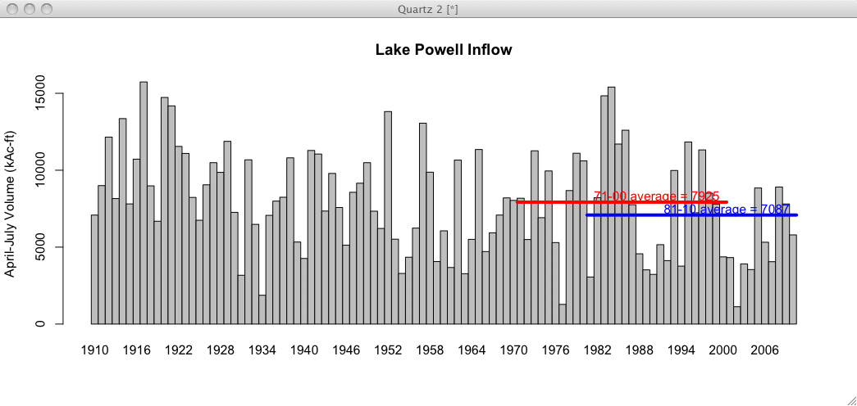
Preliminary Data
11% reduction in mean

Slide 29
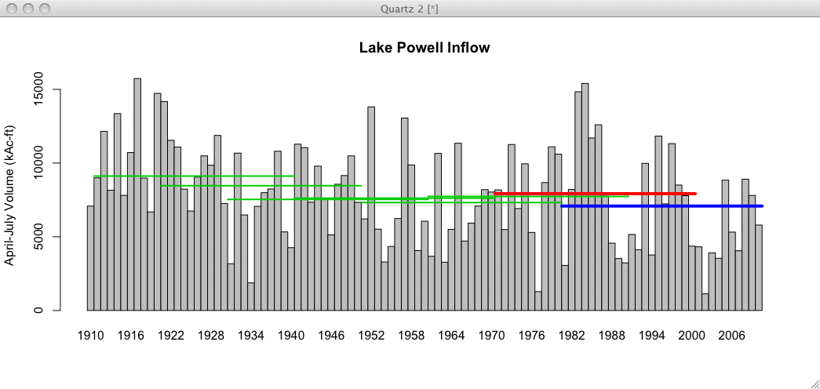
Preliminary Data
All 30 year means since 1911-1940

Slide 30
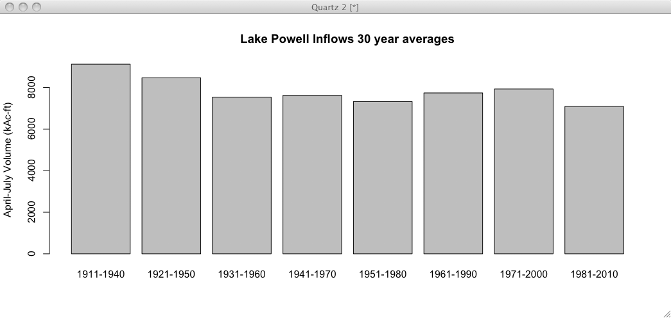
1981-2010 is the driest 30 year period on record

Slide 31
Effect on Forecasts
WY2011 forecasts continue to use 1971-2000 means:
  Statistical models (SWS and NRCS) will use 1971-2000
  Simulation model (ESP) will use 1976-2005
WY2012 forecasts will be based on 1981-2010 inputs in both forecast models
  ESP and SWS will both use the same period
SNOTEL network much stronger for 1981-2010 period than in 1970s. This network is critical for forecast skill.
All things equal, these forecasts will be lower since input data sets are drier in the 30 year average
  Especially true in early season forecasts
  Later season forecasts more controlled by observed snowpack
Percent of normal forecast values should remain largely unchanged (since normals AND forecasts will be lower)

Slide 32


Feedback, Questions, Concerns always welcome….
Kevin Werner
CBRFC Service Coordination Hydrologist
Phone: 801.524.5130
Email: kevin.werner@noaa.gov

