Slide 1
CBRFC March 2011 Water Supply Webinar
1pm, March 7, 2011
Kevin Werner
These slides: www.cbrfc.noaa.gov/present/present.php

Slide 2
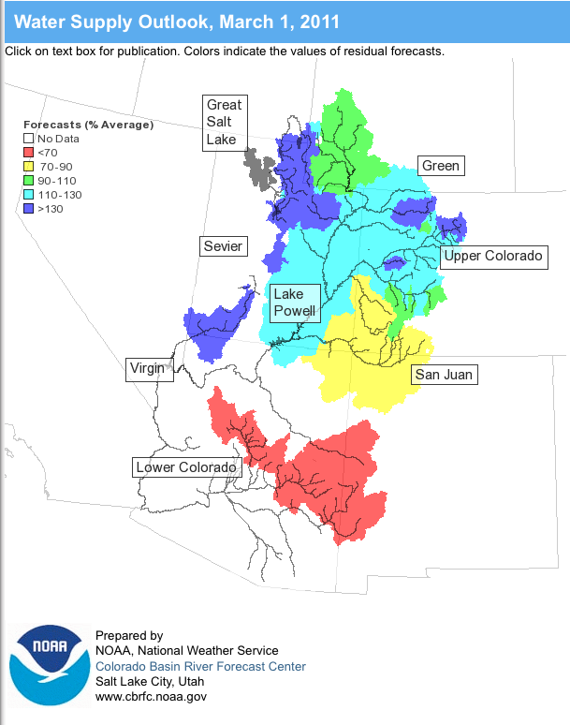
Outline
February Weather Review
Snow States
Water Supply Forecasts
Web Reference: www.cbrfc.noaa.gov/wsup/pub2/map/html/cbrfc.1.2011.html

Slide 3
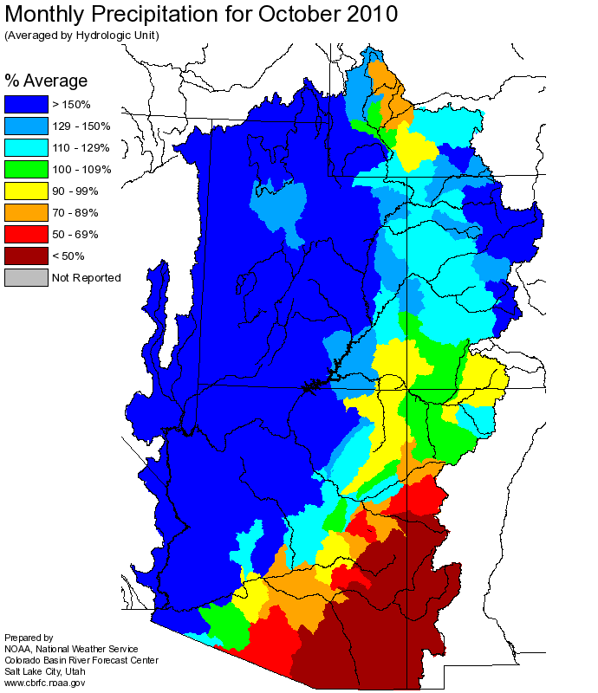
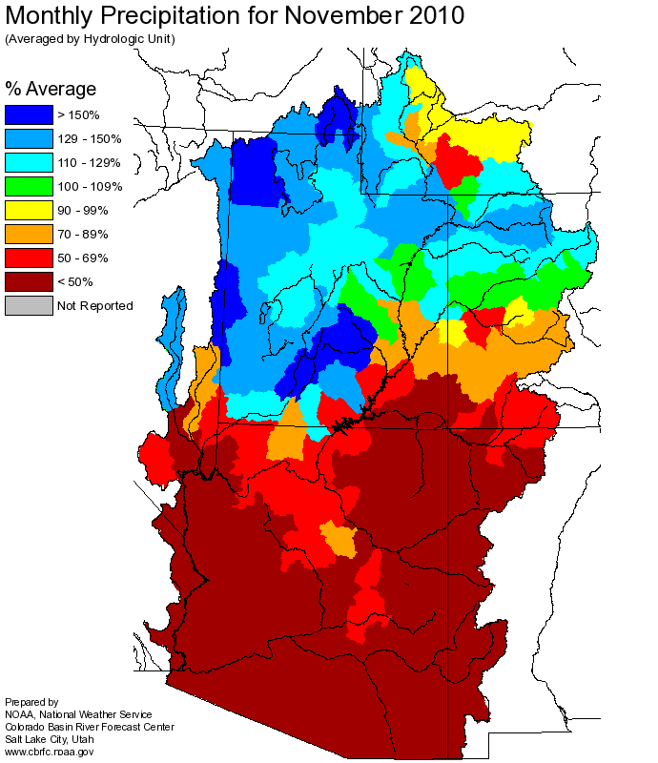
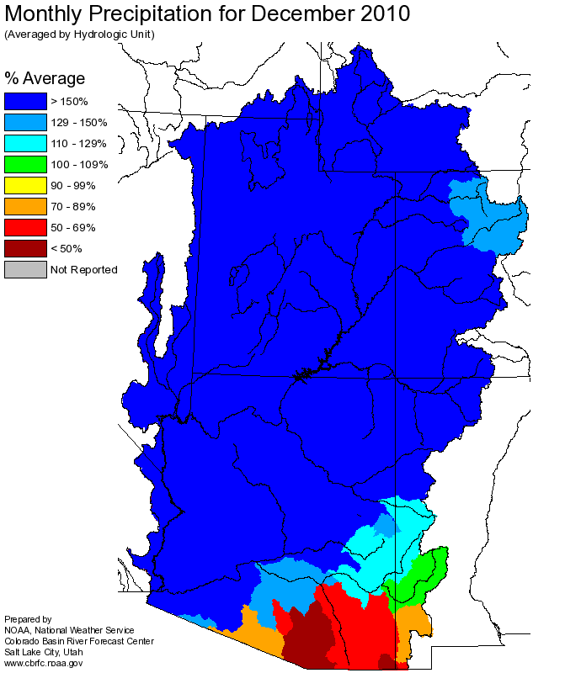
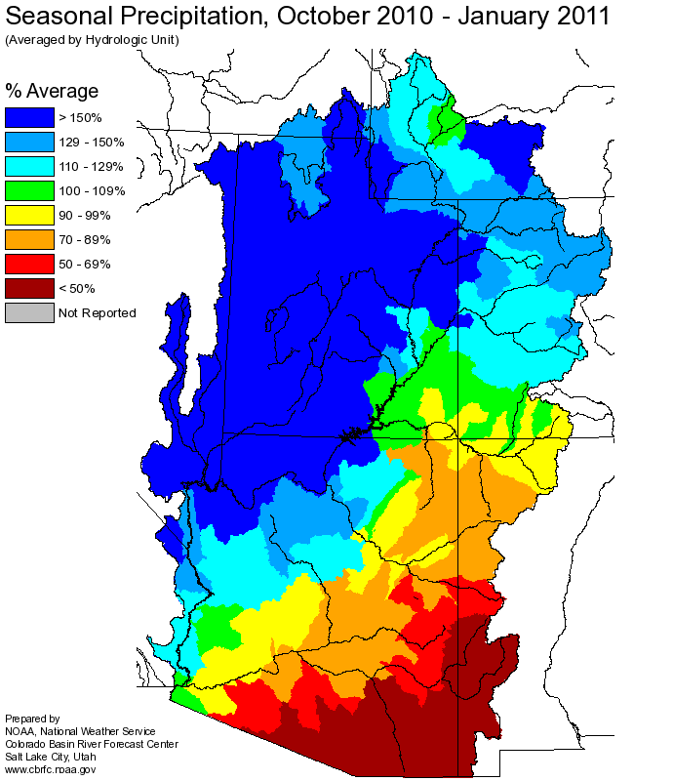
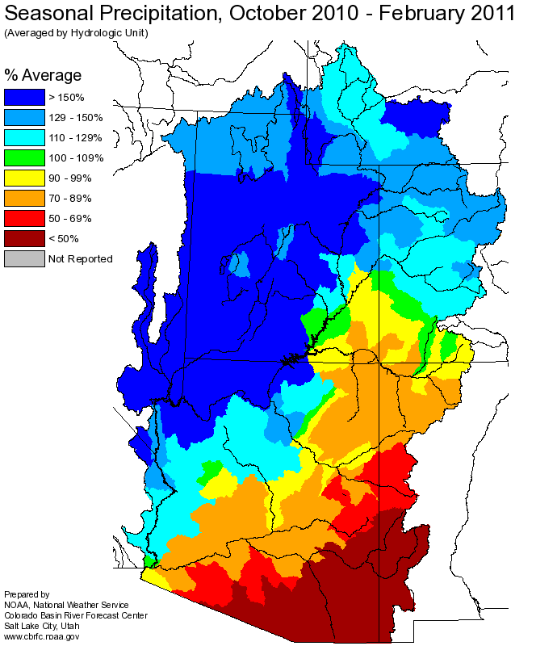
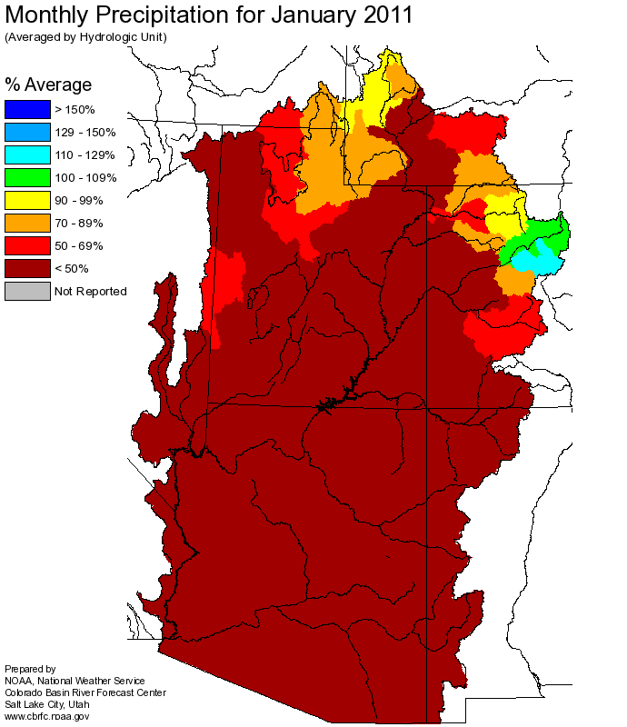
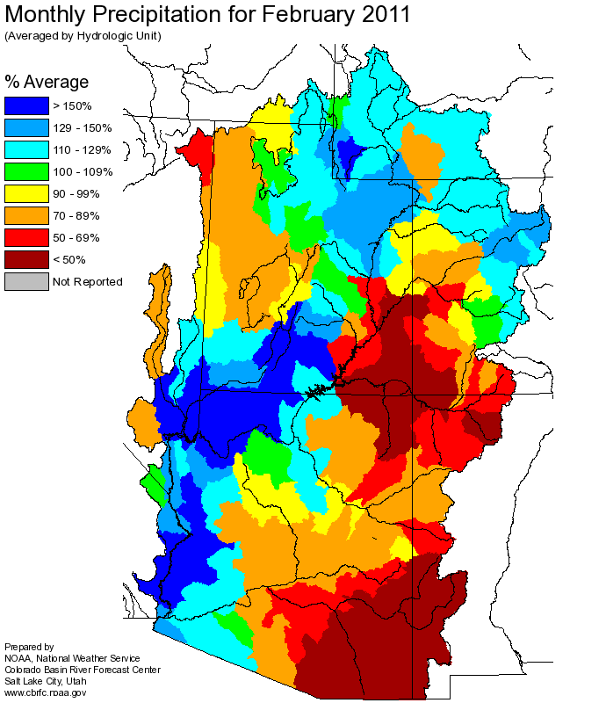
Web Reference: http://www.cbrfc.noaa.gov

Slide 4
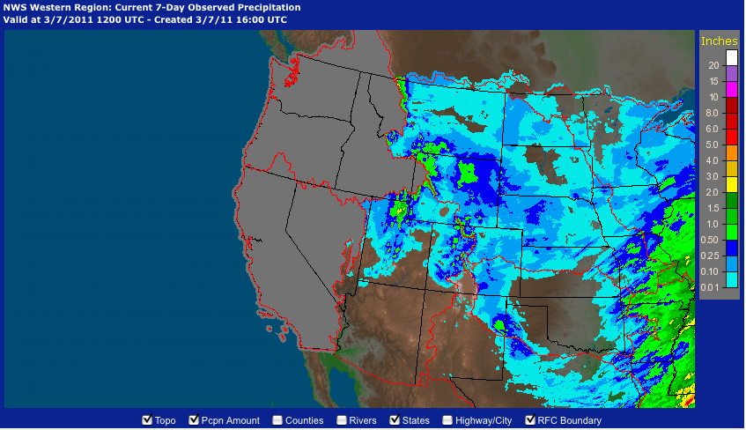

Slide 5
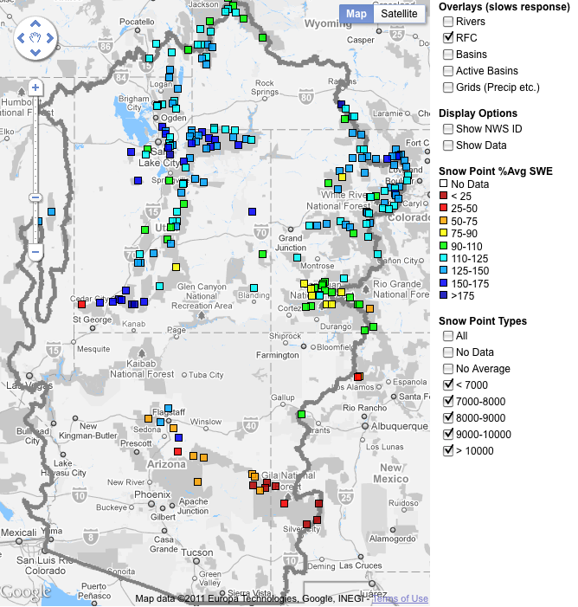
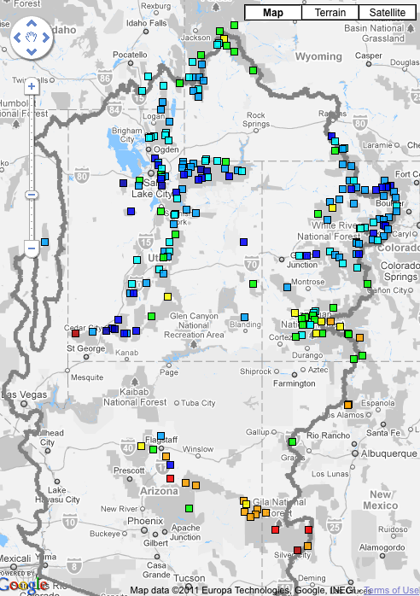
Snow
February 7 (above)
March 7 (right)
Web Reference: http://www.cbrfc.noaa.gov/gmap/gmapm.php?scon=checked

Slide 6
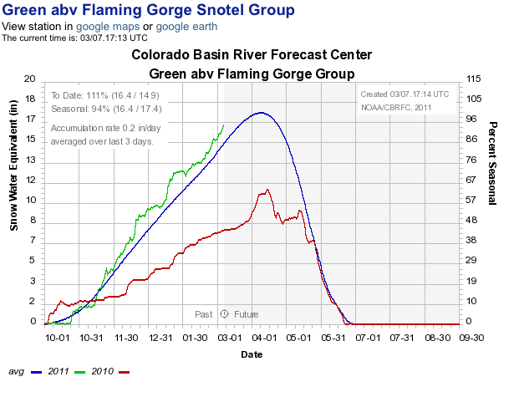
Snow: Upper Green Basin (above Flaming Gorge)
Web Reference: http://www.cbrfc.noaa.gov/station/sweplot/sweplot.cgi???open

Slide 7
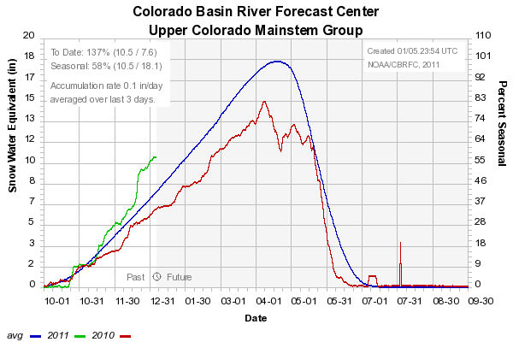
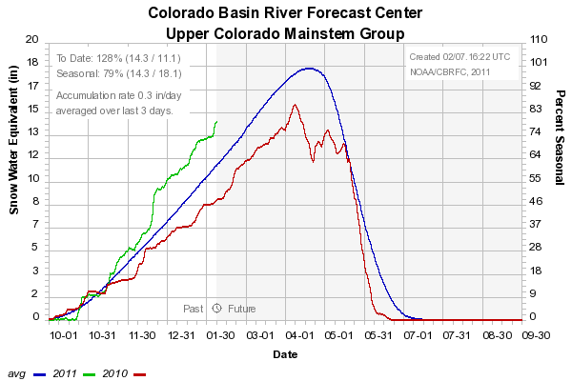
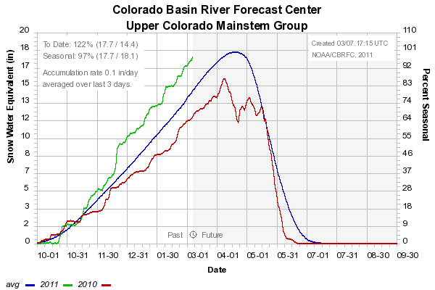
Snow: Colorado Mainstem (above Cameo)
Web Reference: http://www.cbrfc.noaa.gov/station/sweplot/sweplot.cgi???open

Slide 8
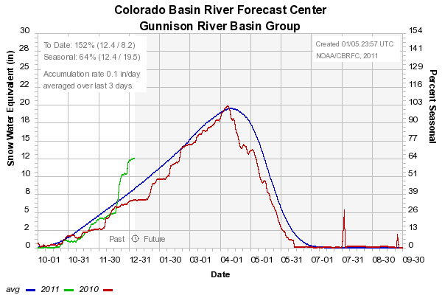
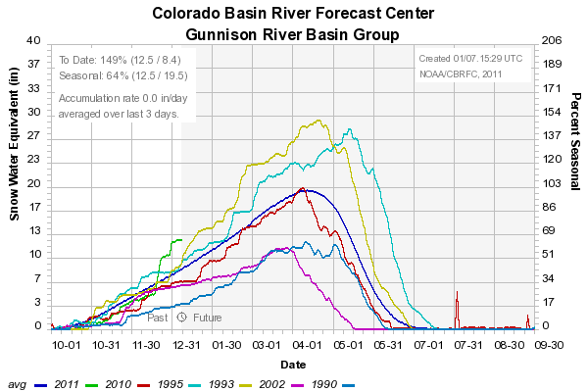
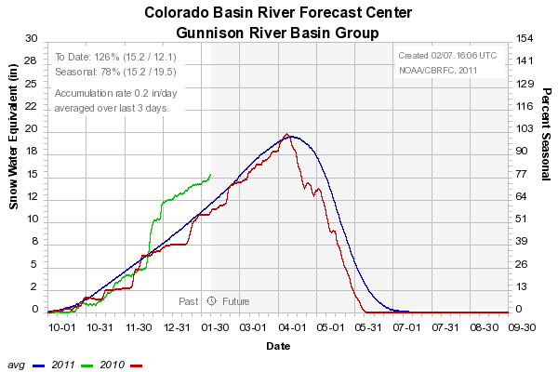
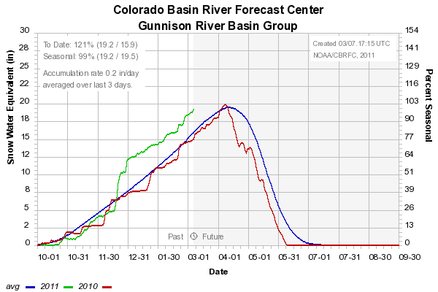
Snow: Gunnison Basin
Web Reference: http://www.cbrfc.noaa.gov/station/sweplot/sweplot.cgi???open

Slide 9
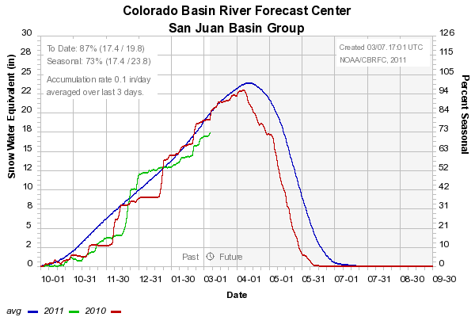
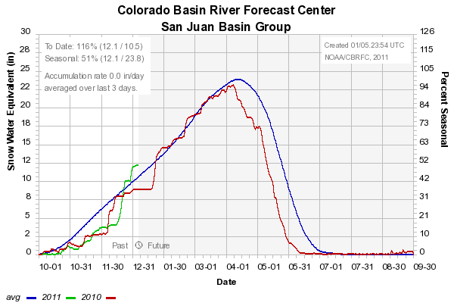
Snow: San Juan Basin
Web Reference: http://www.cbrfc.noaa.gov/station/sweplot/sweplot.cgi???open

Slide 10
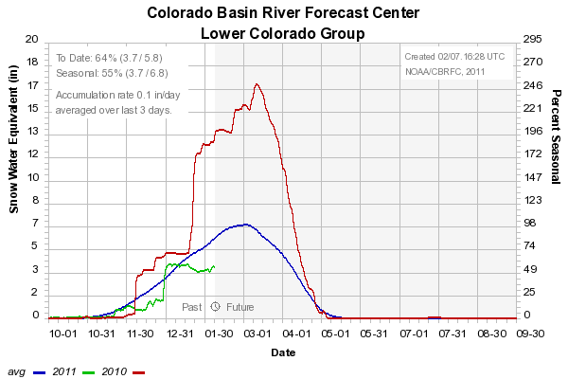
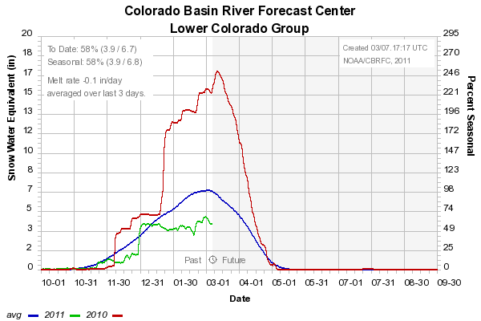
Snow: Lower Colorado
Web Reference: http://www.cbrfc.noaa.gov/station/sweplot/sweplot.cgi???open

Slide 11
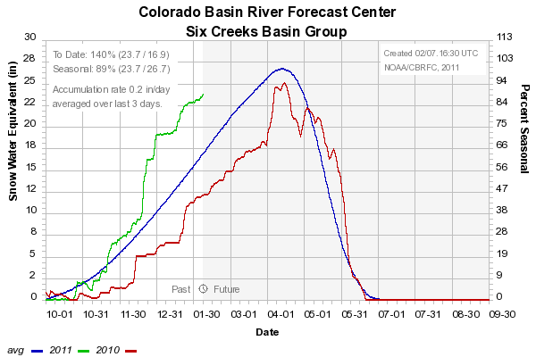
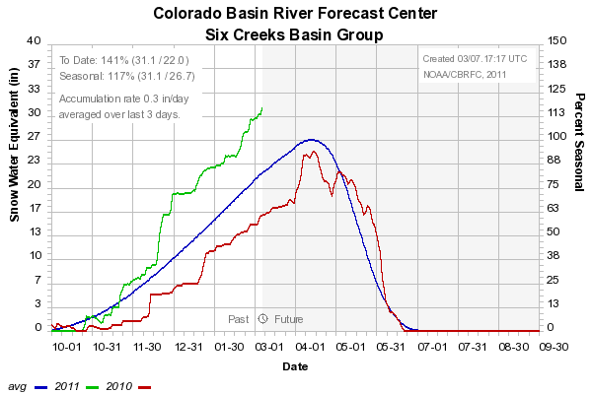
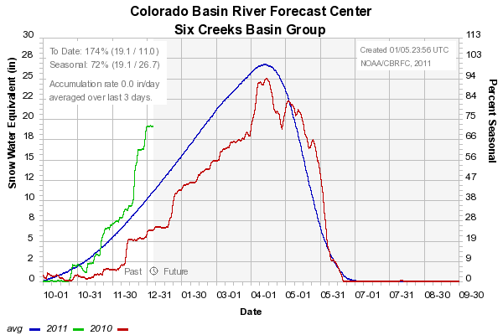
Snow: Six Creeks in Salt Lake County
Web Reference: http://www.cbrfc.noaa.gov/station/sweplot/sweplot.cgi???open

Slide 12
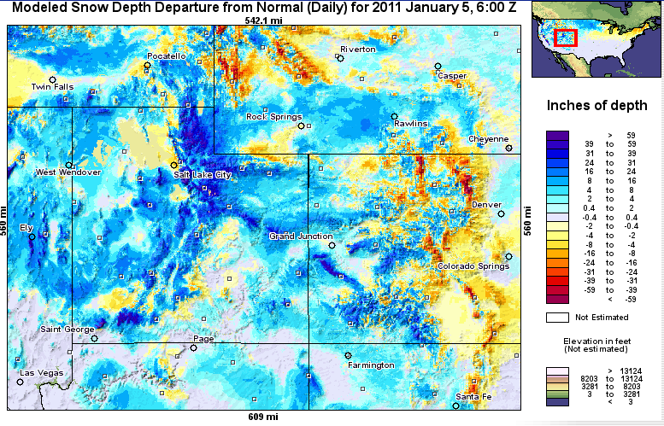
Snow Maps
Web Reference: http://www.nohrsc.nws.gov

Slide 13
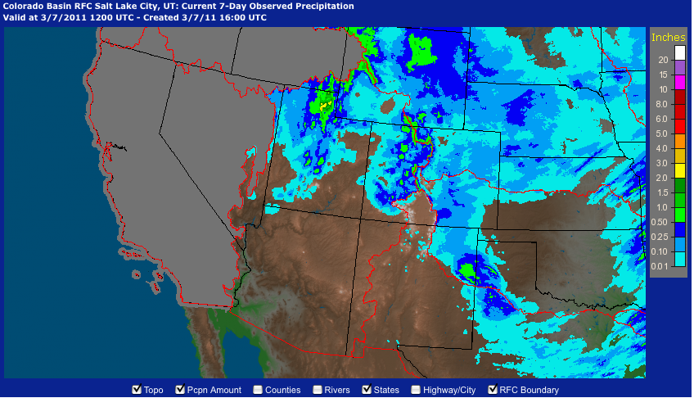
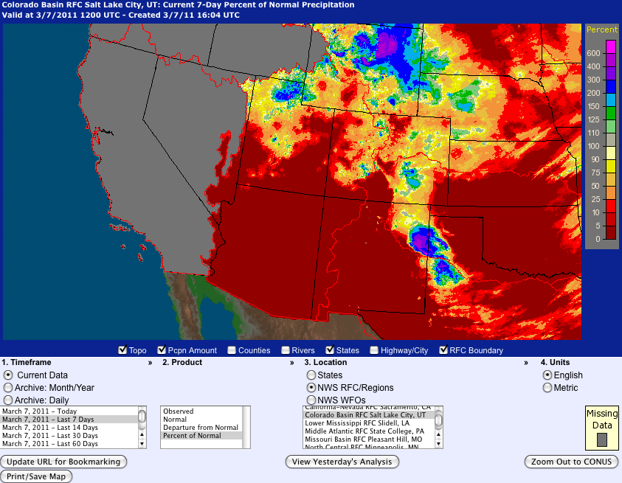
Last 7 days…
Web Reference: http://water.weather.gov

Slide 14
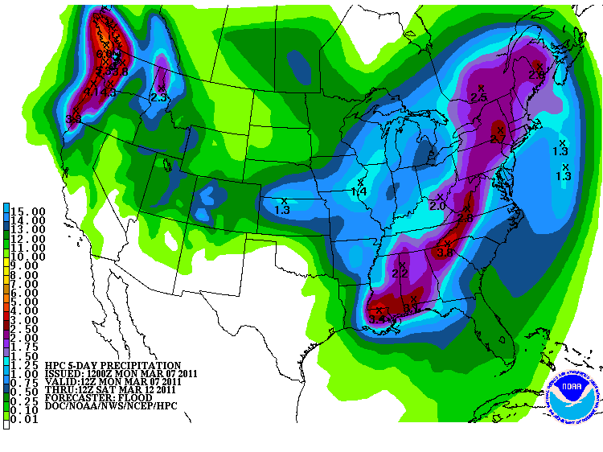
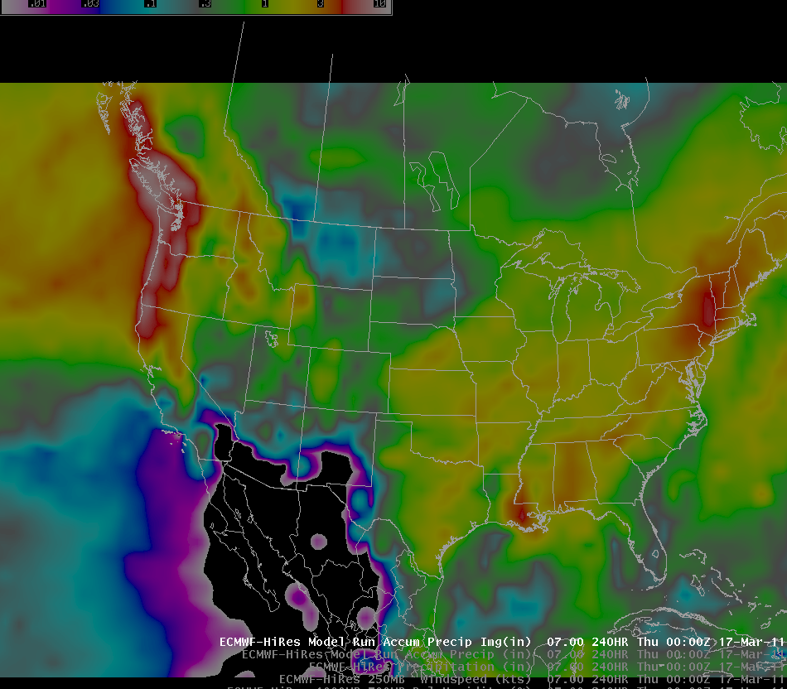
Forecast Precipitation
Active weather period continues!!
Storm #1 passing through today/tomorrow
Storm #2 Friday/Saturday (mostly north)
Storm #3 Sunday/Monday
Total accumulations around 2” of water in northern basins
Web Reference: www.hpc.noaa.gov

Slide 15
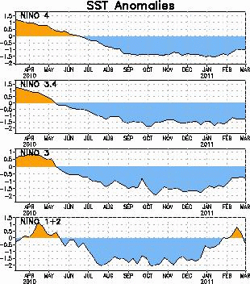
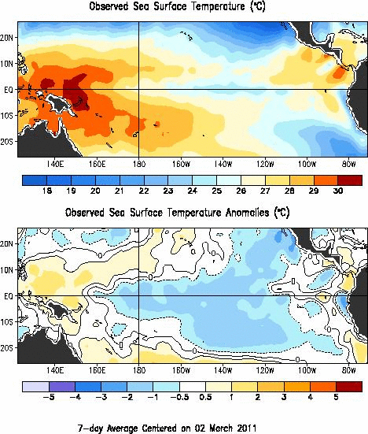
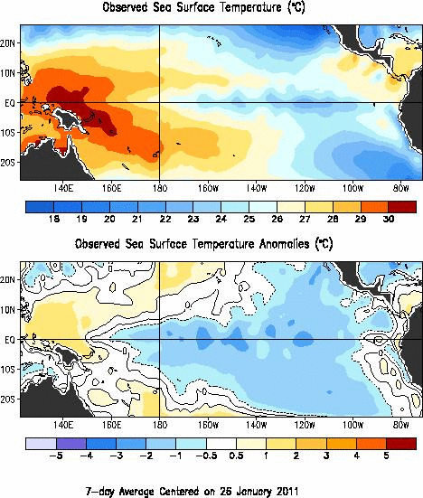
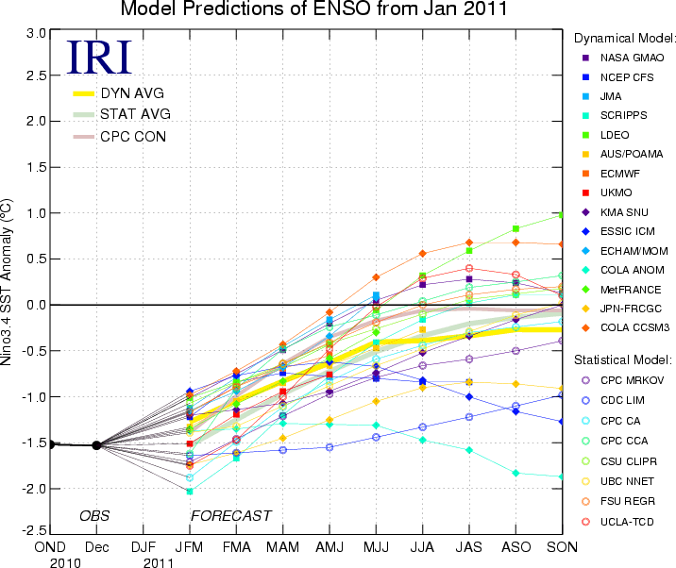
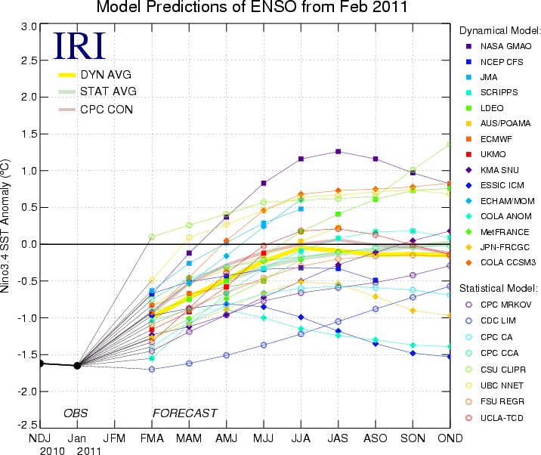
La Nina Update
Web Reference: http://www.cpc.noaa.gov and iri.columbia.edu/climate/ENSO

Slide 16
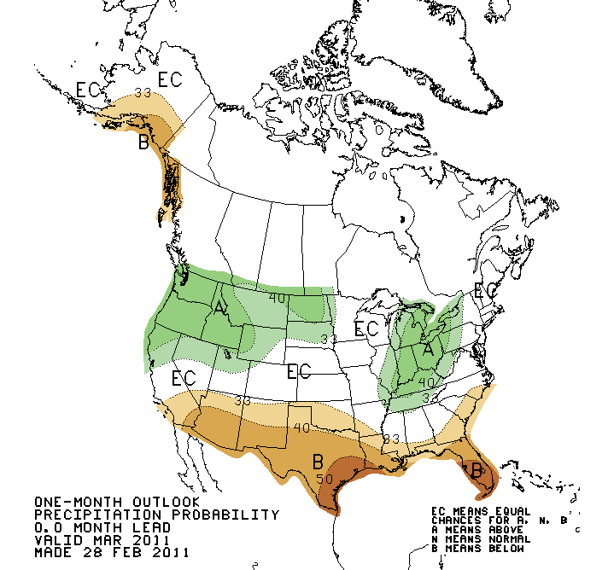
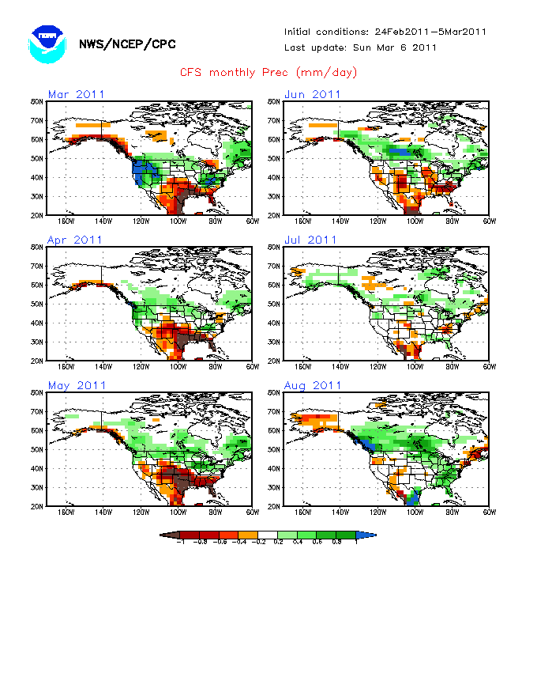
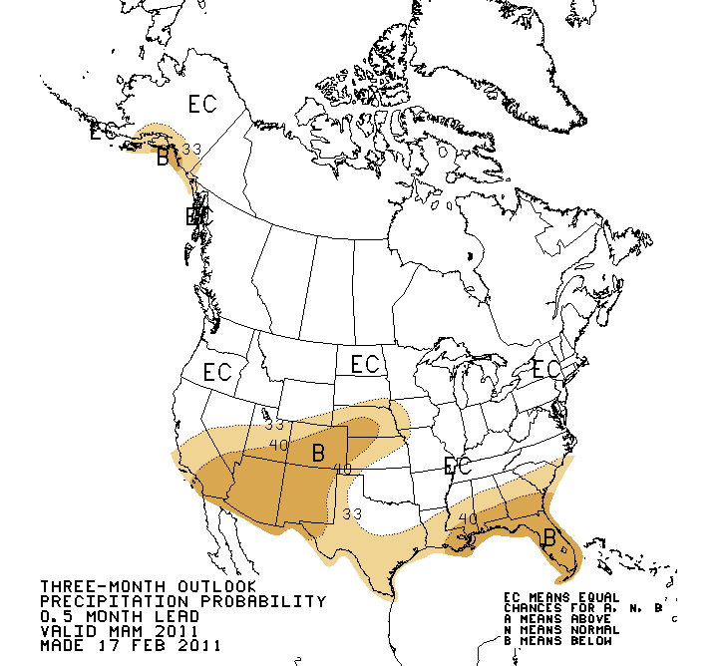
Web Reference: http://www.cbrfc.noaa.gov/climate/climoForecasts.cgi

Slide 17
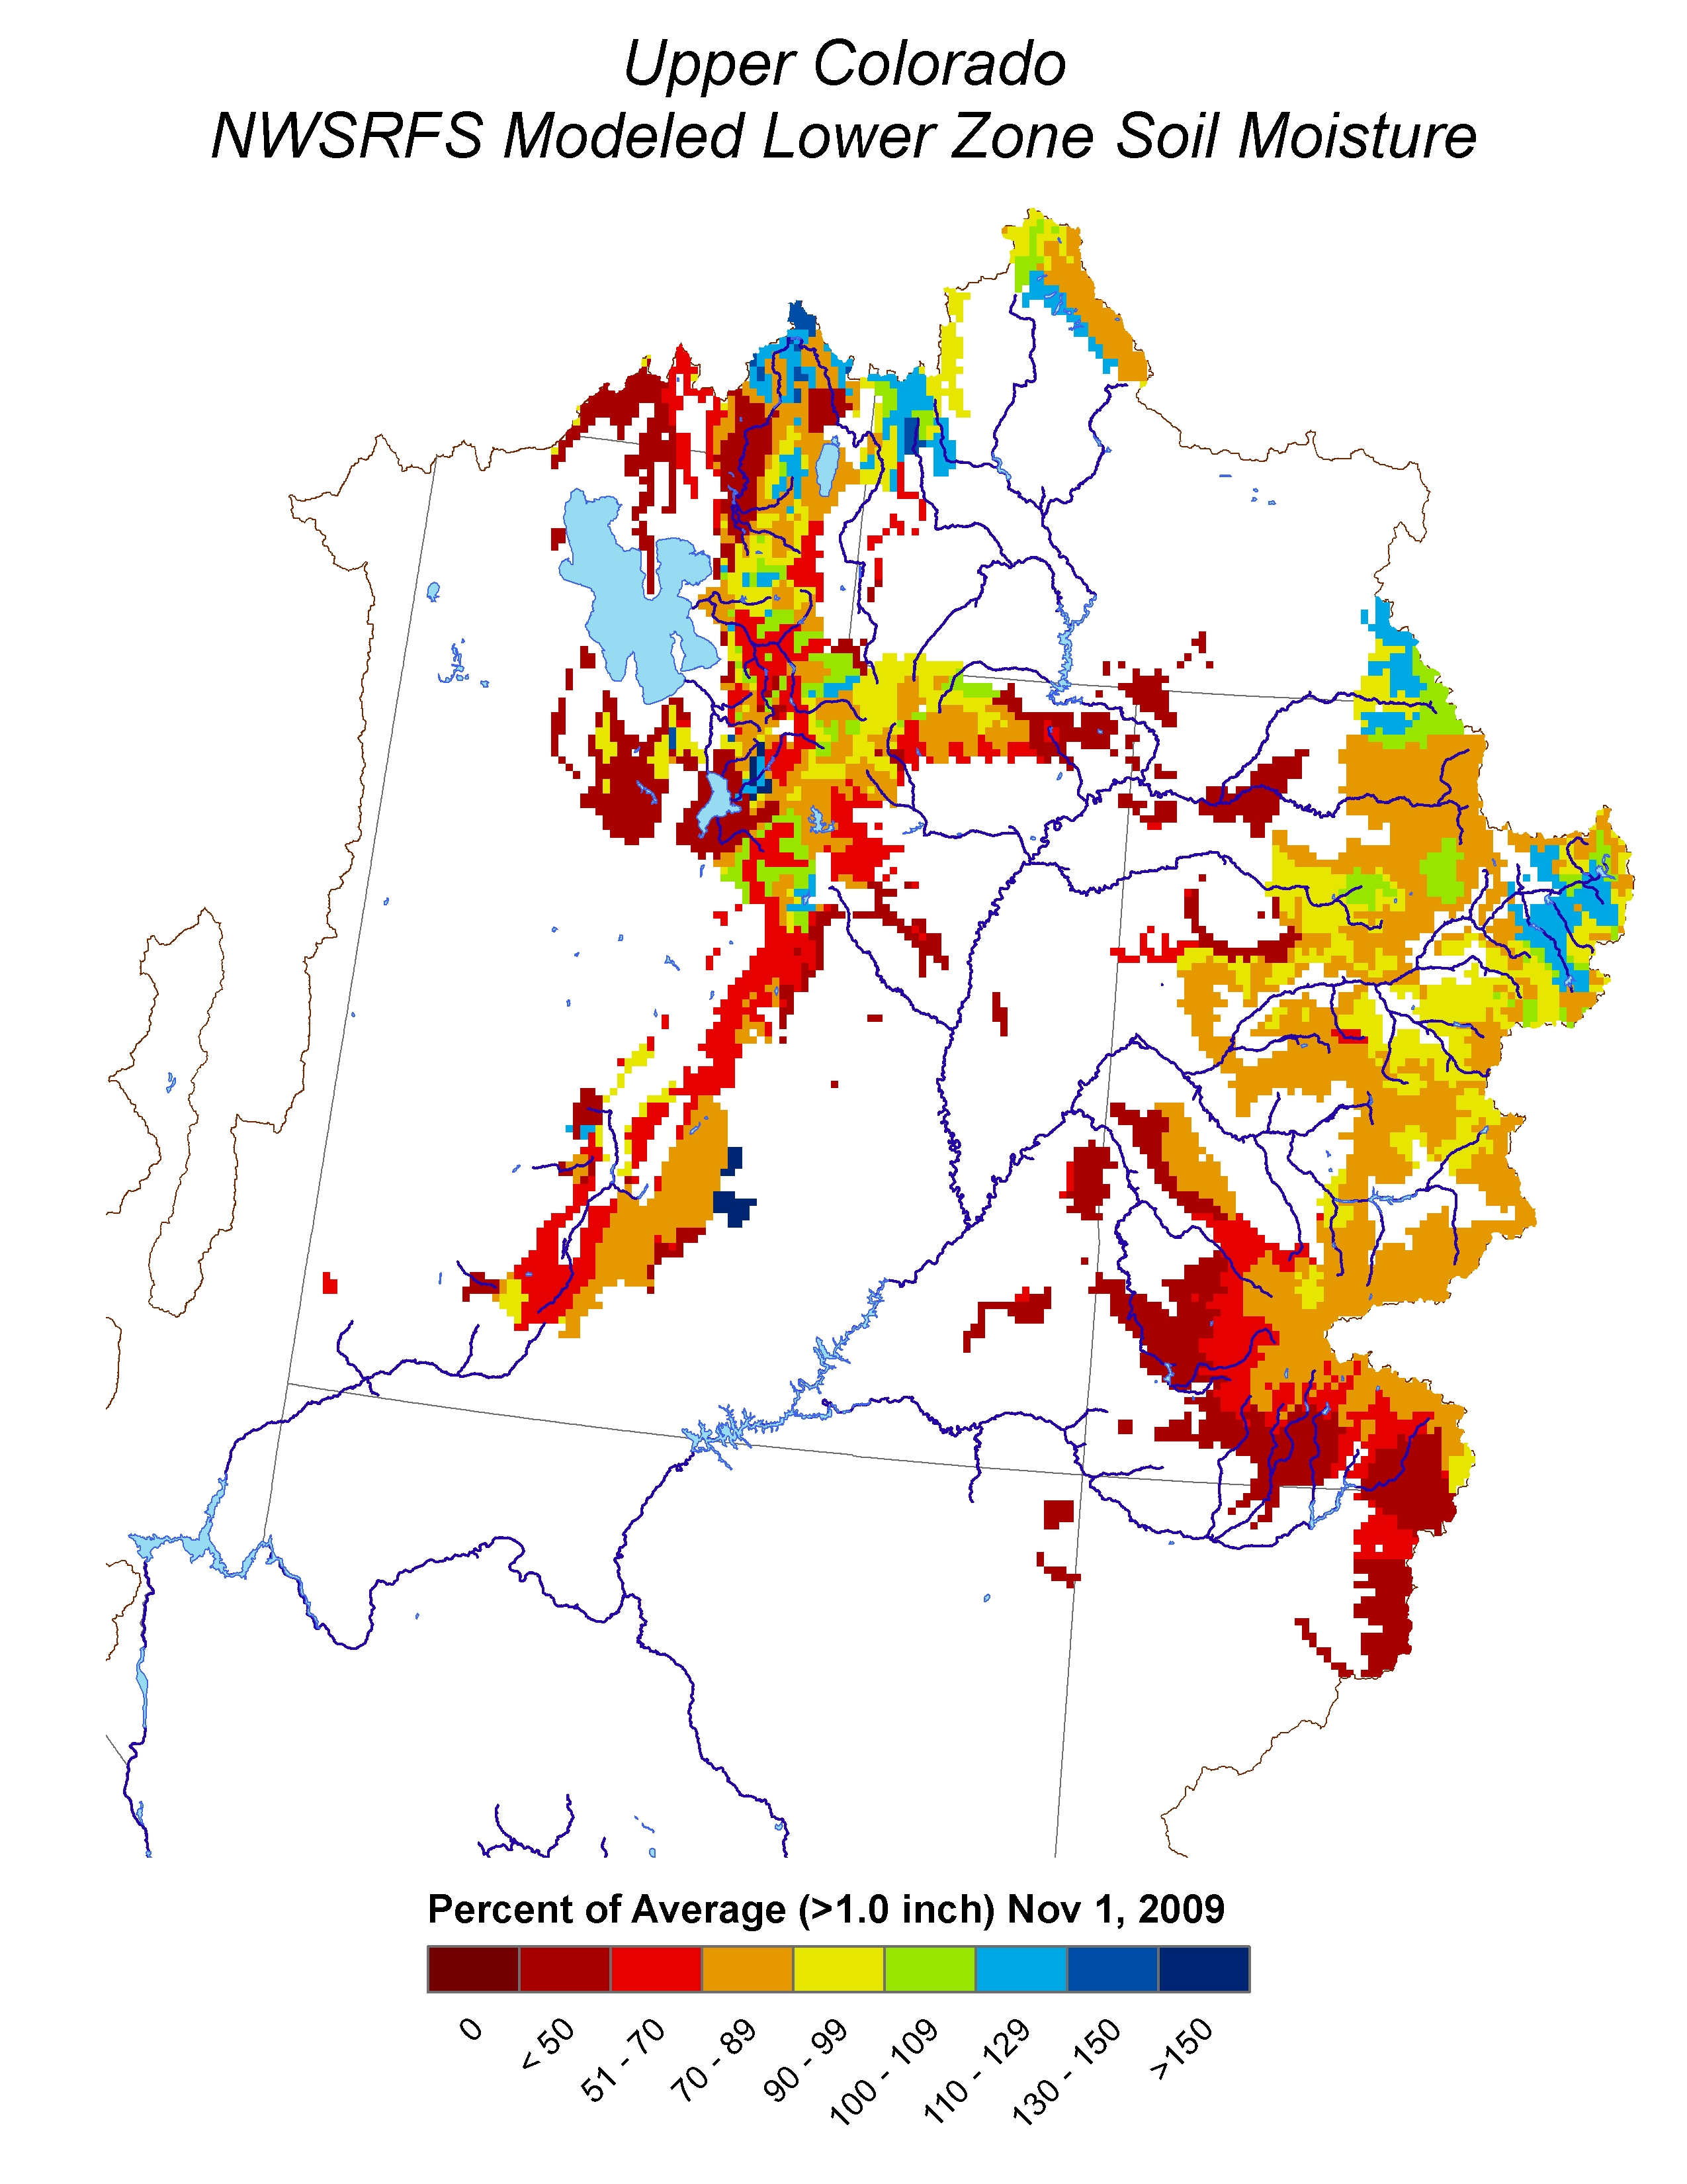
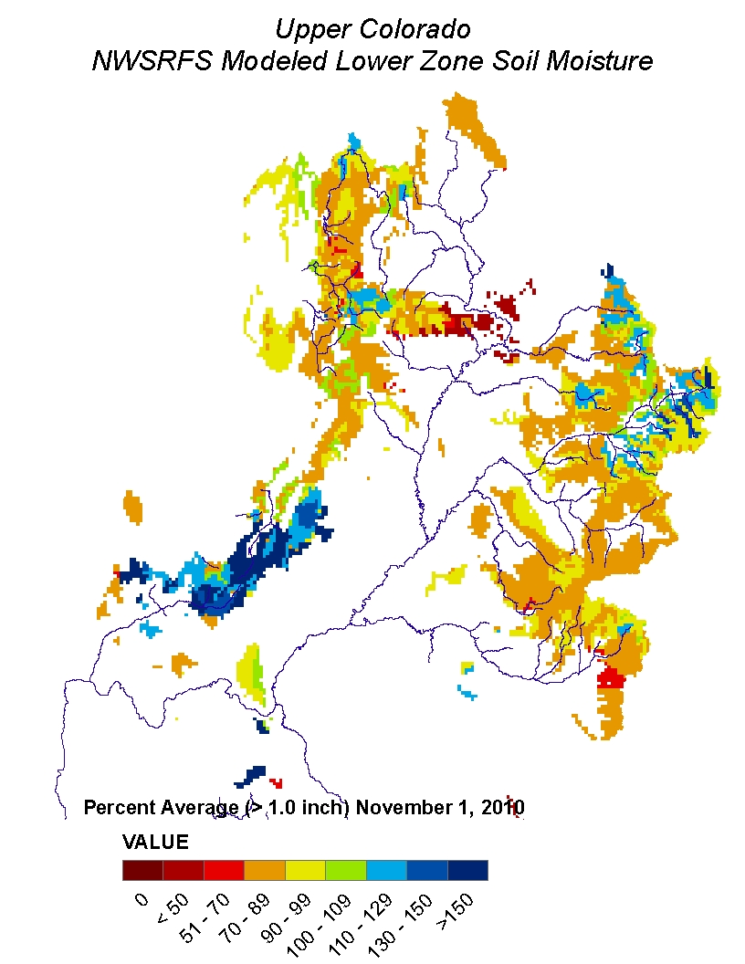
Soil Moisture

Slide 18
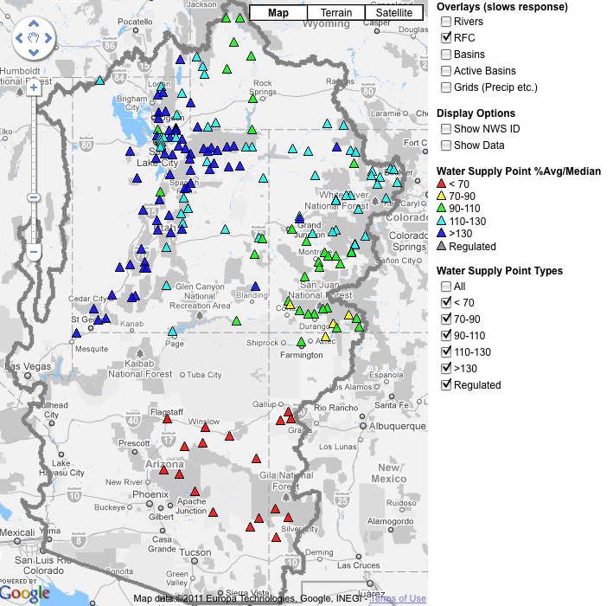
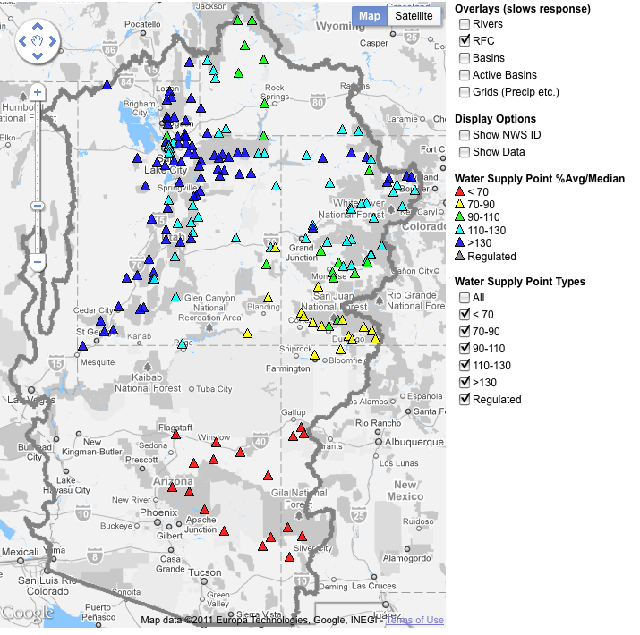
March 1, 2011
Water Supply Forecasts
Highlights:
Wet winter continues for much of the basin with many forecasts higher than any year since 1997
Some northern basins predicting flows near the top 10%
Forecasts slightly higher across northern basins since Feb 1
San Juan and lower basin somewhat lower since Feb 1
Web Reference: www.cbrfc.noaa.gov/gmap/gmapm.php?wcon=checked

Slide 19
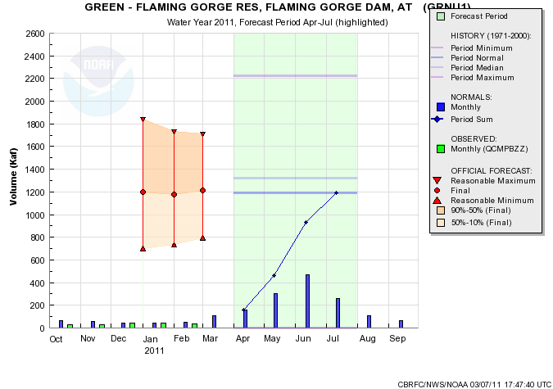
Web Reference: www.cbrfc.noaa.gov/gmap/gmapm.php?wcon=checked

Slide 20
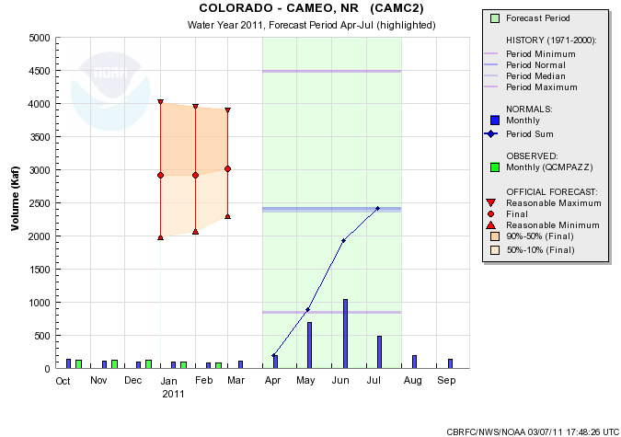
Web Reference: www.cbrfc.noaa.gov/gmap/gmapm.php?wcon=checked

Slide 21
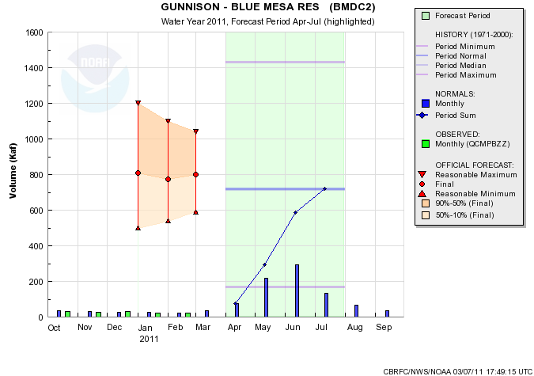
Web Reference: www.cbrfc.noaa.gov/gmap/gmapm.php?wcon=checked

Slide 22
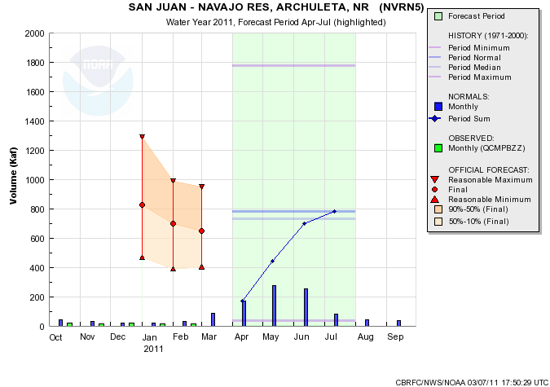
Web Reference: www.cbrfc.noaa.gov/gmap/gmapm.php?wcon=checked

Slide 23
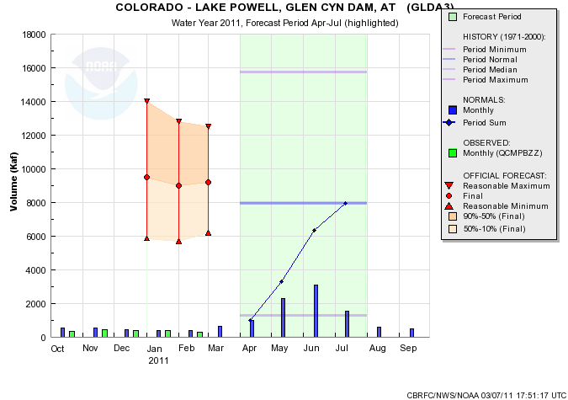
Web Reference: www.cbrfc.noaa.gov/gmap/gmapm.php?wcon=checked

Slide 24
Lake Powell Forecast
Equalization determined (in part) on April 1 forecast:
For 2011, April 1 median forecast would need to be about 7.0 maf or lower to avoid equalizing releases from Lake Powell
March 1 median forecast is 9.2 maf
Forecast would need to drop 2.2 maf or more
Historical forecasts dropping 1.5 maf or more in last 30 years:
2004: 6.5 to 4.0 (-2.5)
1999: 6.5 to 4.8 (-1.7)
2007: 5.6 to 4.0 (-1.6)
1997: 12.5 to 11.0 (-1.5)
Therefore forecast probability of April 1 forecast dropping below 7.0 maf is 1/30 or about 3%
However….

Slide 25
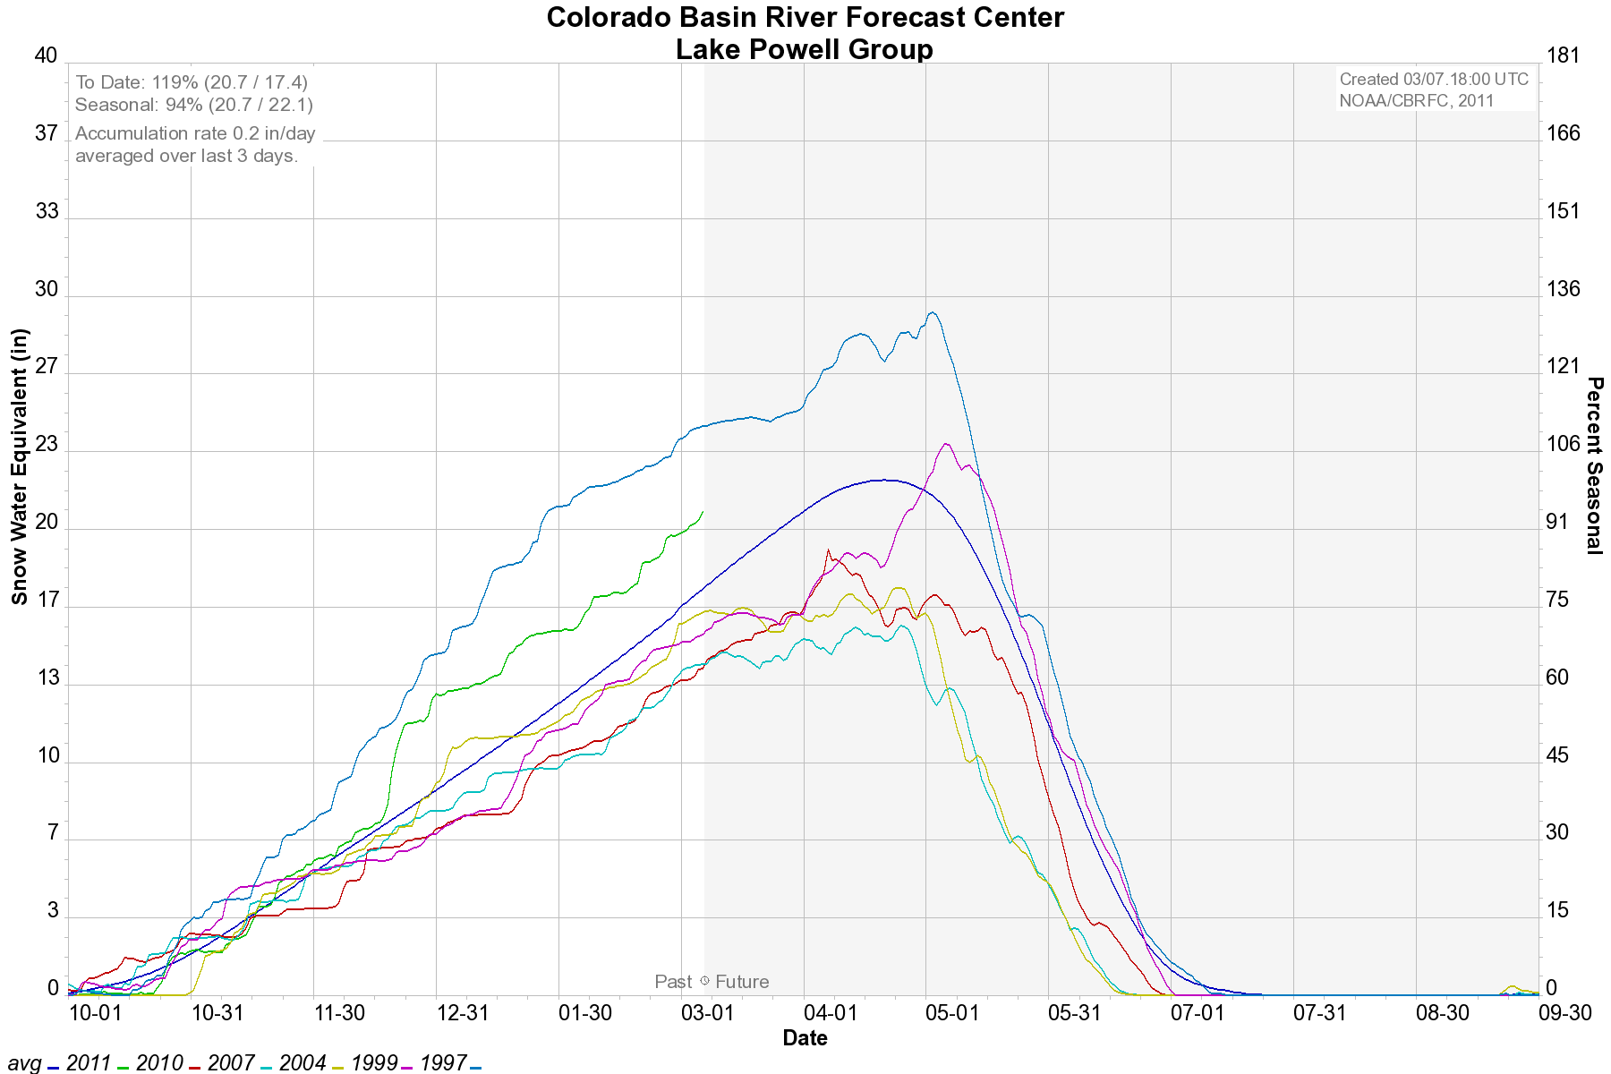

Slide 26
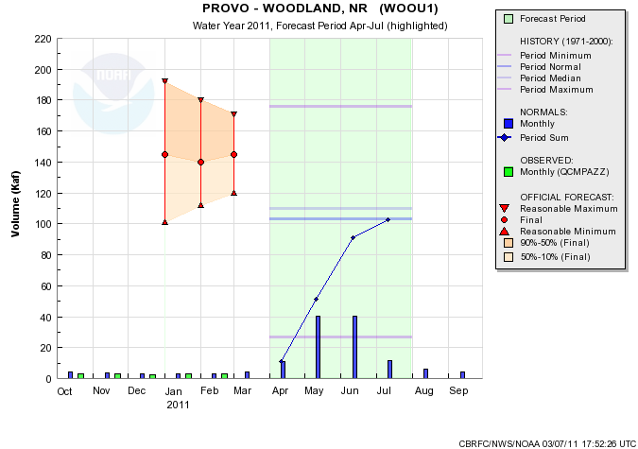
Web Reference: www.cbrfc.noaa.gov/gmap/gmapm.php?wcon=checked

Slide 27
Web Reference: www.cbrfc.noaa.gov/gmap/gmapm.php?wcon=checked

Slide 28
Web Reference: www.cbrfc.noaa.gov/gmap/gmapm.php?wcon=checked

Slide 29
Online Publication
Web Reference: www.cbrfc.noaa.gov/wsup/pub2/map/html/cpub.php

Slide 30
Web Reference: www.cbrfc.noaa.gov/wsup/pub2/map/html/cpub.php

Slide 31
Peak Flow Forecast
March 1 Peak flow forecasts highlights:

Slide 38
Peak Flow Publication

Slide 39
CBRFC News
Basin Focal Points (Available to discuss forecasts: 801.524.5130)
Upper Colorado: Brenda Alcorn
Green: Ashley Nielson
San Juan / Gunnison: Tracy Cox
Great Basin: Brent Bernard
Lower Colorado (below Lake Powell): Greg Smith
Here now:
Sign up for all webinars through May 2011
Weekly ESP model guidance
Email product updates via govdelivery (can add more products / webpages upon request)
Changes to CBRFC webpage
Blog (blog.citizen.apps.gov/cbrfc)
Coming soon:
New water supply publication – example

Slide 40
Mockups for WS “pub” Pages
Objectives
easily navigable to content
pages focused on water supply areas (powell, great basin, etc.)
high level “scoreboard” gives overview – can drill elsewhere for details
updating throughout season

Slide 41
Mockup WS “pub” Pages
tabs for various info types
Basin
Overview
Basin Forecasts
Weather & Climate
Snow & Precip
Soil Moisture
Analysis Tools
Forecast Point: Flaming Gorge (Only Major basin outlets)
Official Coordinated Seasonal Water Supply Forecast (Help?)
Issued: February 1, 2011 Forecast period: Apr-Jul
[click here to expand]
Latest ESP Guidance Forecast:
Issued: February 10, 2011 Forecast period: Apr-Jul
[click here to expand]
Snowpack: Current Basin Average Snowpack (as of 2/1):
Precipitation: Current Basin Average Precipitation (as of Feb 10, 2011):
Soil Moisture: Nov 1 basin average soil moisture:
Forecast points within basin:
Better Map showing:
Major sub-basins (TBD)
NOT color coded by forecast
Individual forecast points available through point selection
370 kaf
10% Exceedence
280 kaf
50% Exceedence
150 kaf
90% Exceedence
370 kaf
10% Exceedence
280 kaf
50% Exceedence
150 kaf
90% Exceedence
34” SWE
120%
Of daily average
89%
Of average peak
34” SWE
120%
Of daily average
89%
Of average peak
various search options

Slide 42
Mockup WS “pub” Pages
tabs for various info types
Basin
Overview
Basin Forecasts
Weather & Climate
Snow & Precip
Soil Moisture
Analysis Tools
Official Coordinated Seasonal Water Supply Forecast (Help?)
Forecast Point: Flaming Gorge (Only Major points
Issued: February 1, 2011 Forecast period: Apr-Jul
Latest ESP Guidance Forecast:
Issued: February 10, 2011 Forecast period: Apr-Jul
Better Map showing:
Major sub-basins (TBD)
NOT color coded by forecast
Individual forecast points available through point selection
370 kaf
10% Exceedence
180 %
Of historical median
160 %
Of historical mean
1st of 80
Of historical flows
-10%
From previous month
280 kaf
50% Exceedence
140 %
Of historical median
110 %
Of historical mean
10th of 80
Of historical flows
-1%
From previous month
150 kaf
90% Exceedence
90 %
Of historical median
80 %
Of historical mean
70th of 80
Of historical median
+15%
From previous month
370 kaf
10% Exceedence
180 %
Of historical median
160 %
Of historical mean
1st of 80
Of historical flows
-10%
From previous month
Current Snowpack: xx% of average
Current Precip: xx% of average
Fall Soil Moisture: xx% of average
Listing of all forecast points with current forecasts (clickable)
280 kaf
50% Exceedence
140 %
Of historical median
110 %
Of historical mean
10th of 80
Of historical flows
-1%
From previous month
150 kaf
90% Exceedence
90 %
Of historical median
80 %
Of historical mean
70th of 80
Of historical median
+15%
From previous month
various search options

Slide 43
Mockup WS “pub” Pages
tabs for various info types
Basin
Overview
Basin Forecasts
Weather & Climate
Snow and Precip
Soil Moisture
Analysis Tools
Current official forecast:
Change from previous month:
Current ESP guidance (options: with QPF, with GFS, with CFS):
Change from previous (week, month, year):
Forecast discussion (e.g. ~2 paragraphs a la current publication)
Distinguish forecaster “looked at” forecasts from those that are not
various search options

Slide 44
Mockup WS “pub” Pages
tabs for various info types
Basin
Overview
Basin Forecasts
Weather & Climate
Snow and Precip
Soil Moisture
Analysis Tools
Time series plots: Forecasts and climatology
QPF (time options): XX in or % average
Climate outlook (time options): % average
various search options

Slide 45
Mockup WS “pub” Pages
tabs for various info types
Basin
Overview
Basin Forecasts
Weather & Climate
Snow & Precip
Soil Moisture
Analysis Tools
Percent of average precip (area weight / runoff weight):
Percent of average snow
Percent snow required for average runoff
Map with current observed conditions
various search options

Slide 46
More Resources
www.cbrfc.noaa.gov
Wateroutlook.nwrfc.noaa.gov
Tentative April webinar: 1pm April 7
April peak flow webinar: TBD (contact me if you’d like to participate)

Slide 47
Feedback, Questions, Concerns always welcome….
Kevin Werner
CBRFC Service Coordination Hydrologist
Phone: 801.524.5130
Email: kevin.werner@noaa.gov

