Slide 1
Recent Forecasts, Updates, and the Path Ahead
NOAA’s National Weather Service
Colorado Basin River Forecast Center
W. Paul Miller
Senior Hydrologist
Colorado Basin River Forecast Center
April 17th, 2013
NOAA’s National Weather Service
Notes:
Hi everyone,
Michelle is sorry she couldn’t make it today, but the sequester has really limited our ability to travel, as I’m sure you are all well aware.

Slide 2
Overview
The Bottom Line
Current Water Year Forecasts and Conditions
New ESP Products Available
Current Efforts and Engagements Moving Forward
Notes:
Just a quick overview of this presentation. I’ll let you know the take-away points from this talk, and then go into more detail regarding our current water year hydrologic conditions, our new ESP products that are now available, and other current efforts in our office that you may be interested in.

Slide 3
The Bottom Line
Precipitation over WY 2013 has been dry, resulting in low water supply forecasts
April through July forecast for Lake Powell is 2.7 MAF (38% of average)
Dry antecedent soil moisture conditions have contributed to low streamflow forecasts
New ESP products are now available from the CBRFC
Daily ESP results are posted daily to our website
Click on “Water Supply” and then “Daily ESP” from our homepage
Notes:
If there are only two things you take away from this presentation, it’s that we are experiencing, and expecting, a dry 2013 water year and low inflow over the Colorado River Basin. Also, we have new ESP products available that are updated daily and posted to our website. When you have a moment, check them out and let us know what you think.

Slide 4
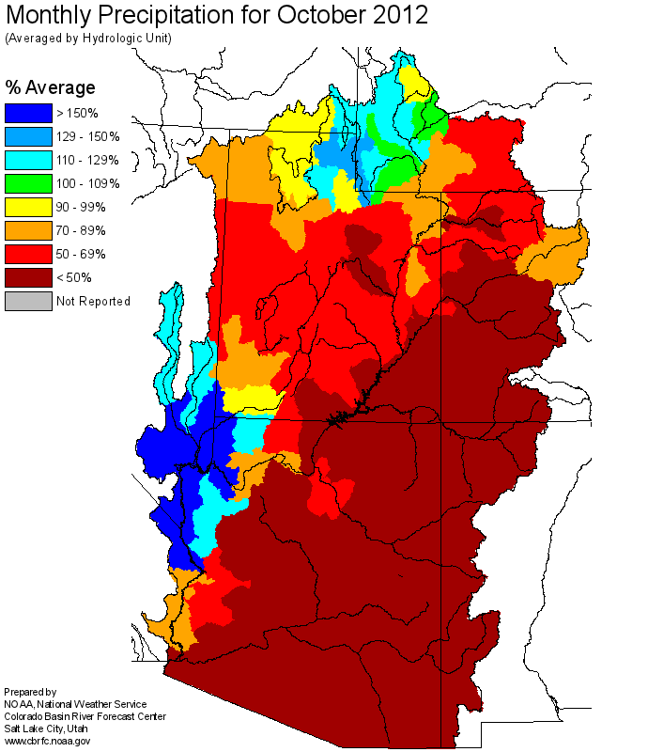
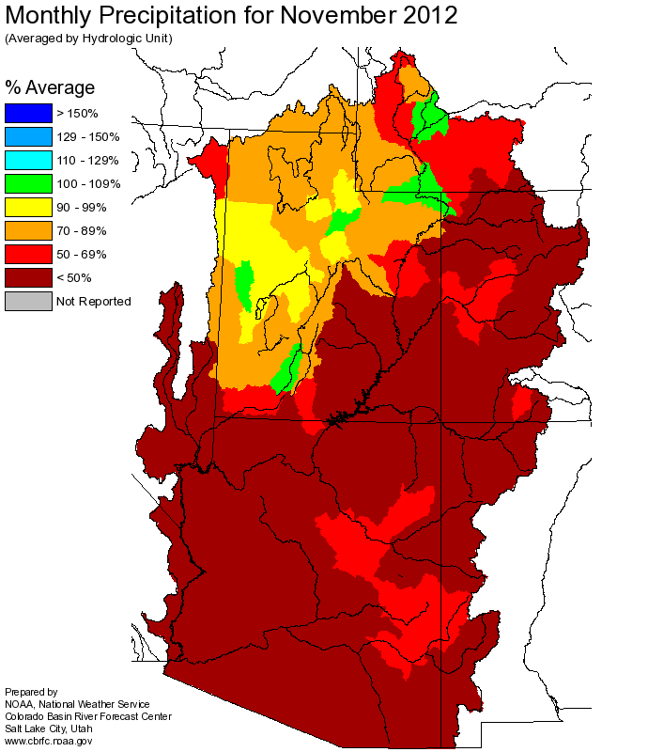
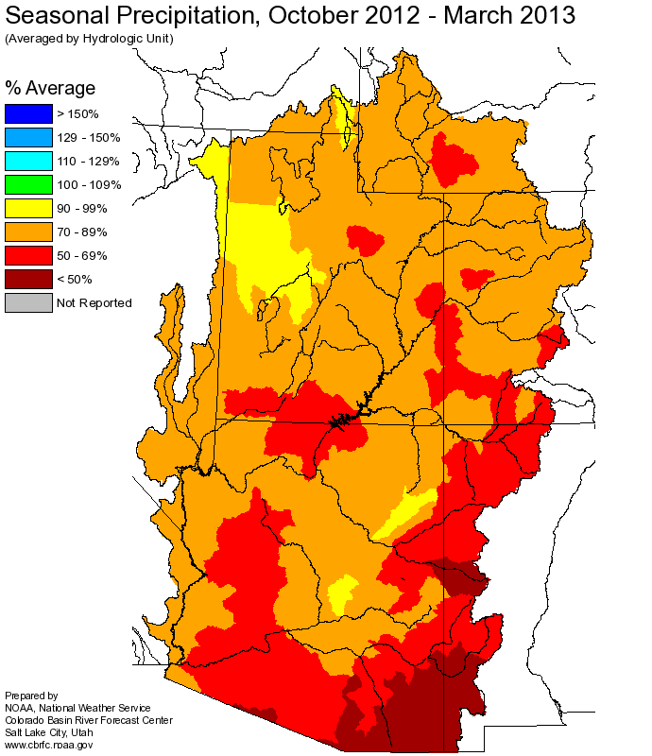
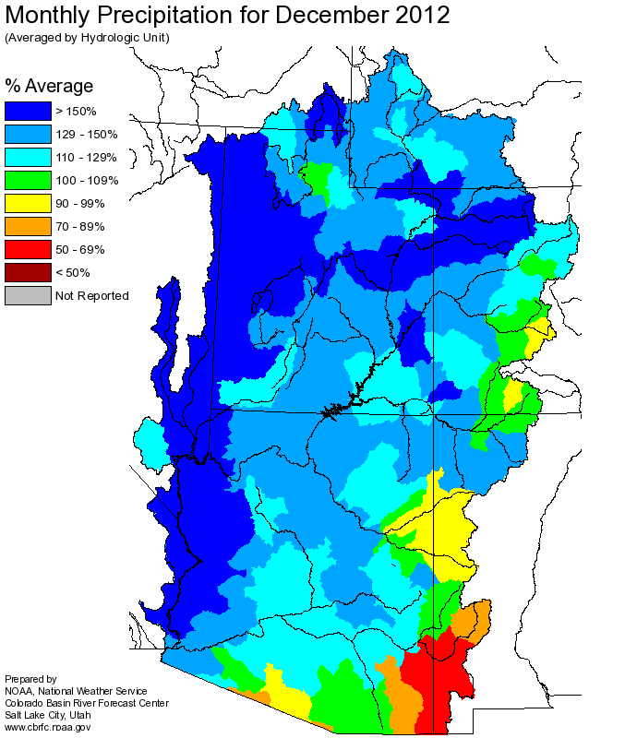
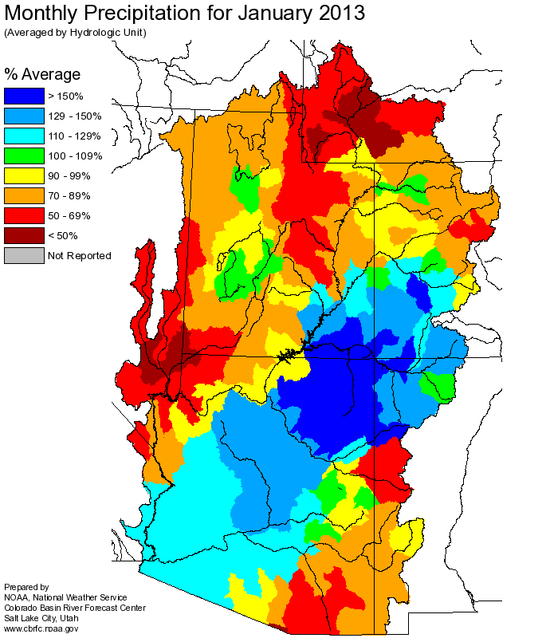
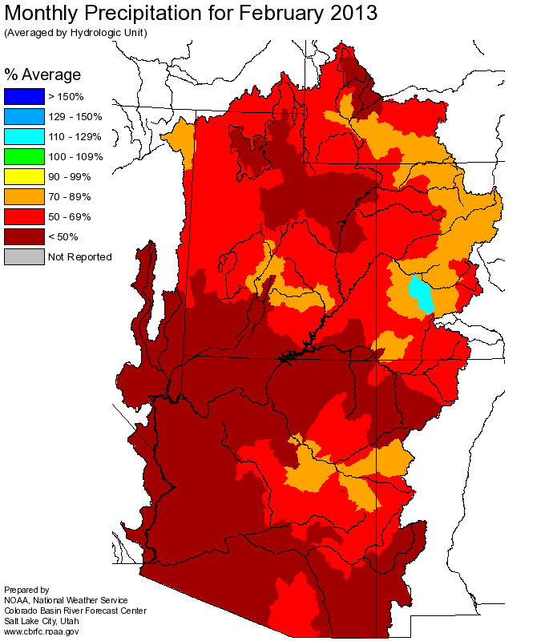
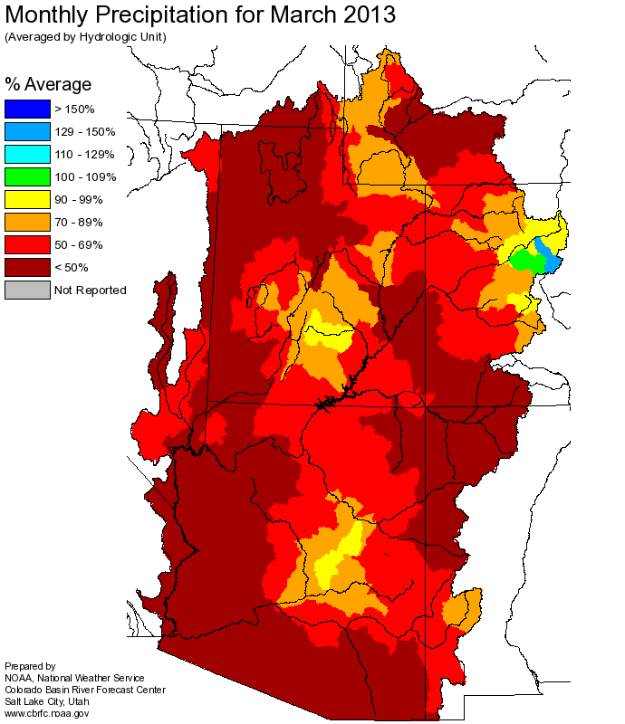
Current WY Conditions
Notes:
Okay, as we’ve probably all noticed, we have not had a particularly wet water year. October and November were dry almost throughout the entire basin. Conditions slightly improved in December and the San Juan region had a relatively good January, but overall, precip hovered around 65% for much of the basin.

Slide 5
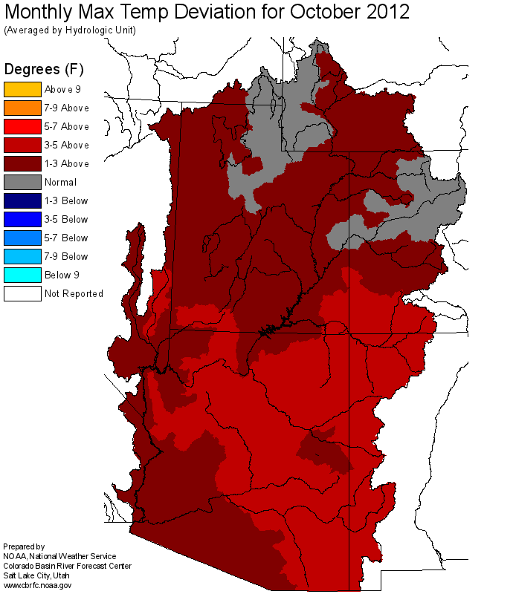
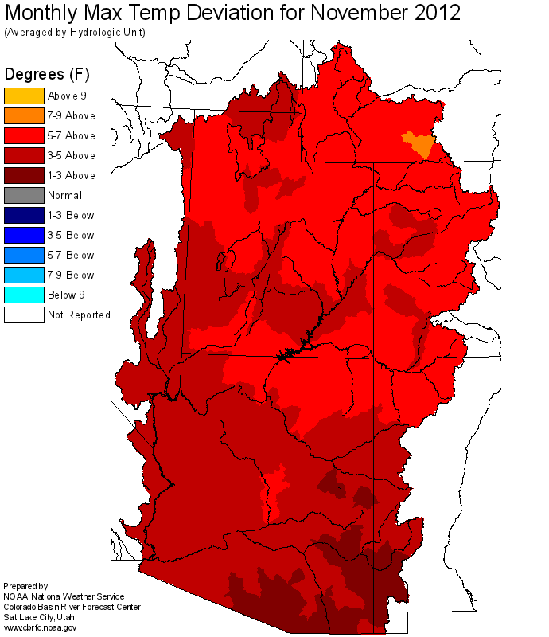
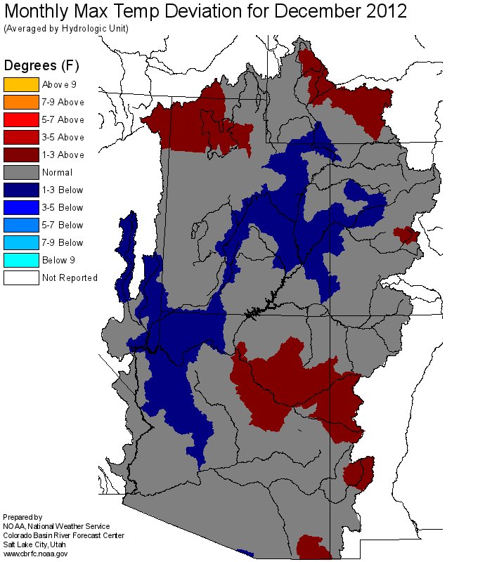
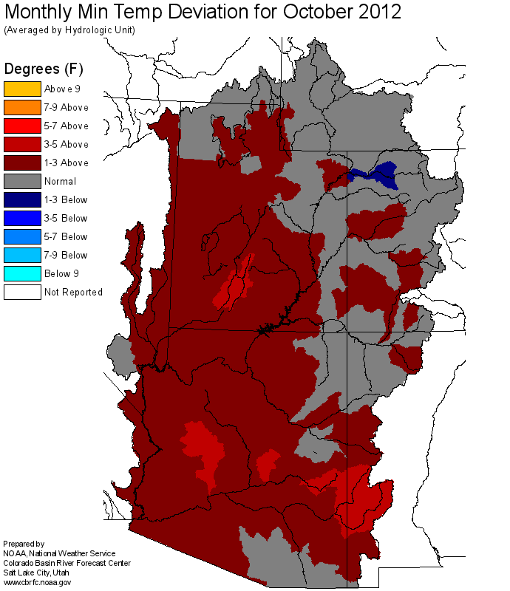
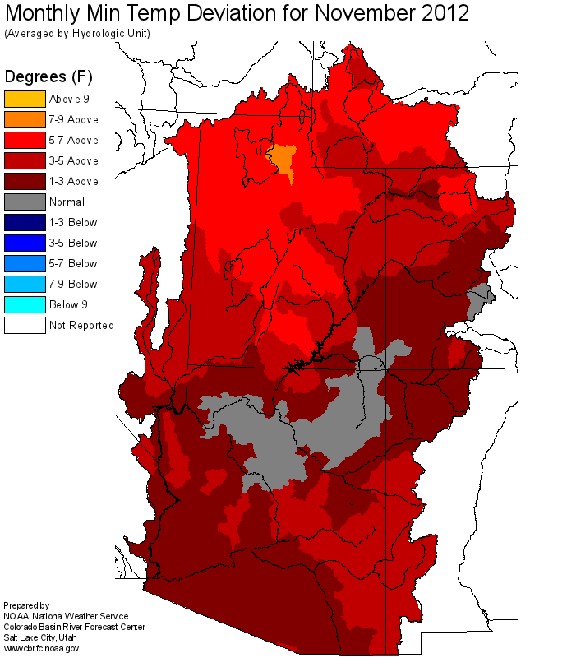
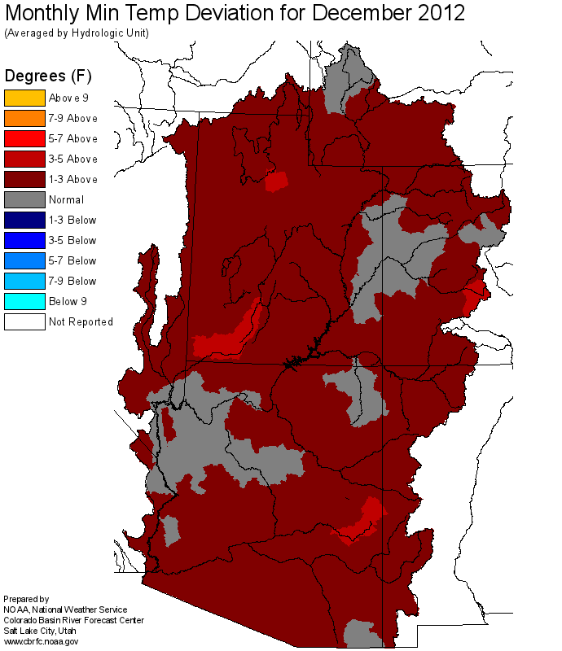
Current WY Conditions
OCT
NOV
DEC
Max Temp Deviation
Min Temp Deviation
Notes:
In addition to dry conditions, the first quarter of the water year was much warmer than average for the most part.

Slide 6
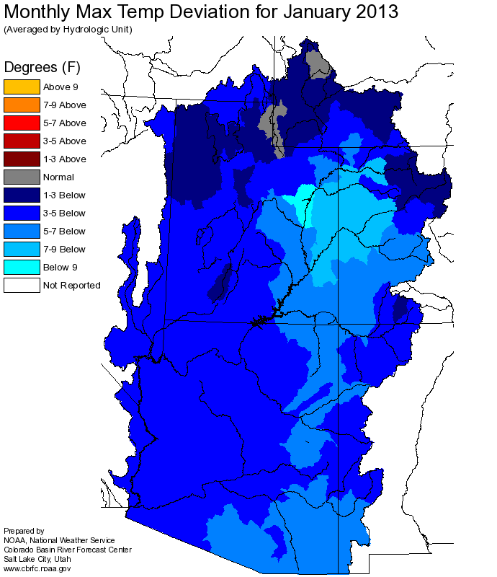
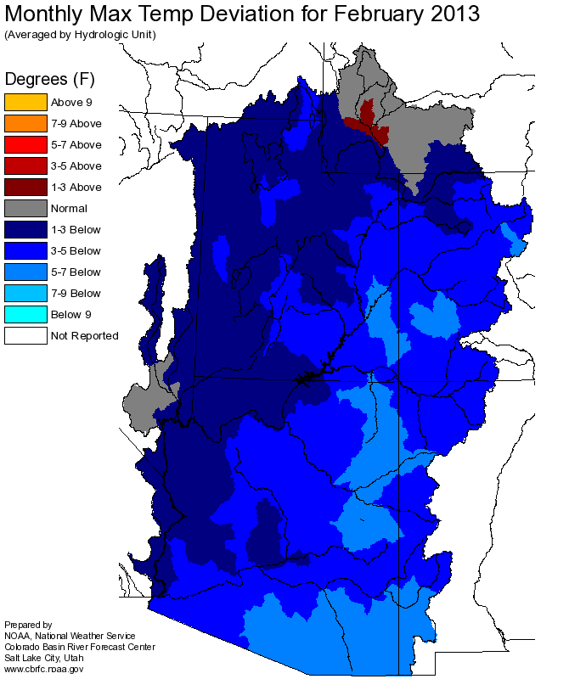
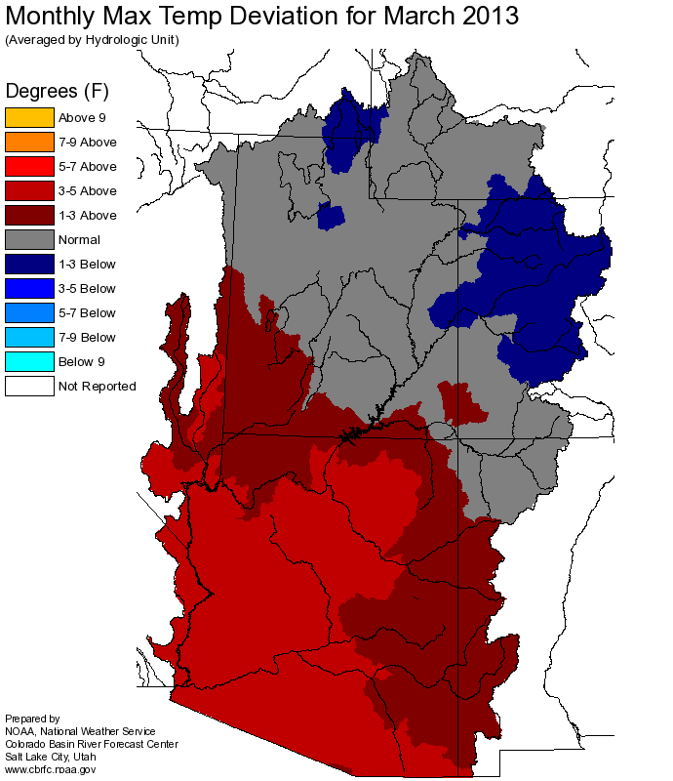
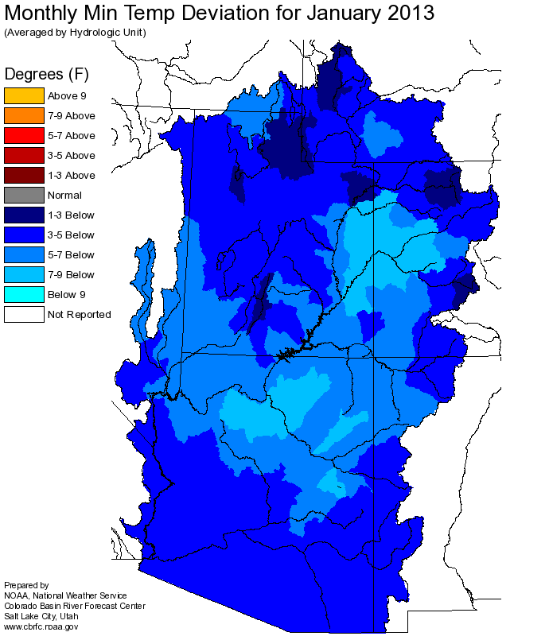
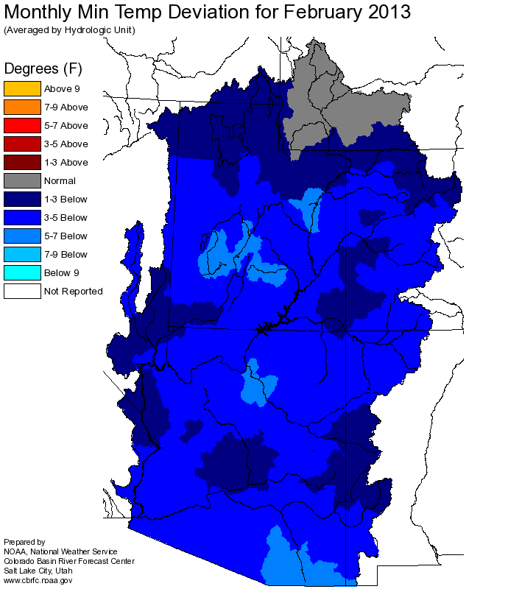
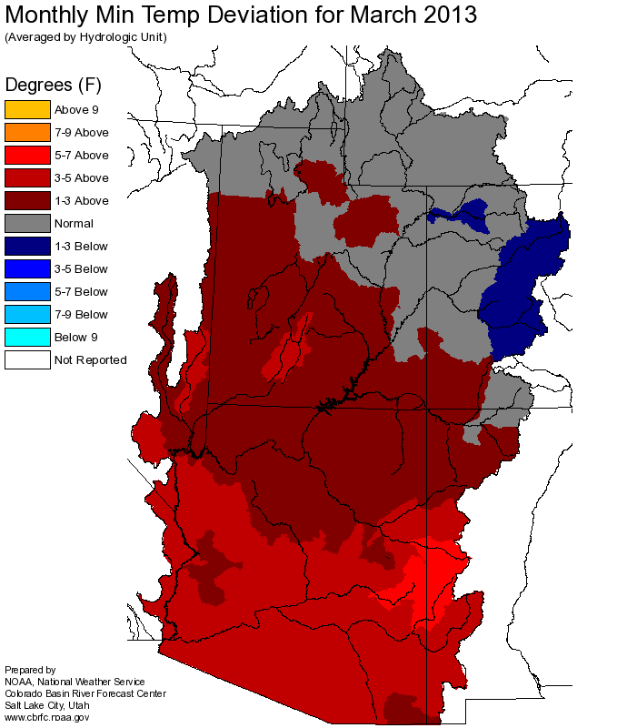
Current WY Conditions
JAN
FEB
MAR
Max Temp Deviation
Min Temp Deviation
Notes:
We experienced a pretty cold January and February, but did not have the precipitation that is normally associated with it. It was particularly odd in the Great Basin region, where SLC received snow in the valley, but higher elevation areas saw little precipitation. SLC also had freezing rain for only the 9th time since 1940.

Slide 7
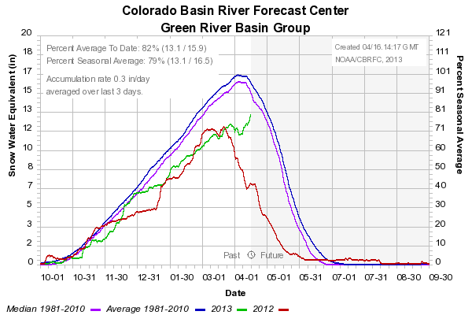
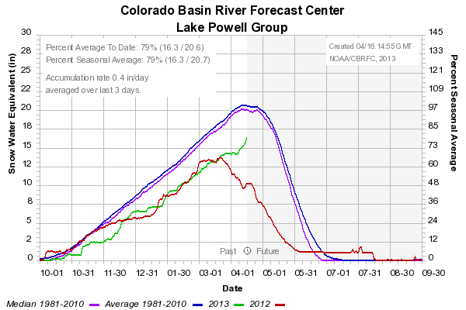
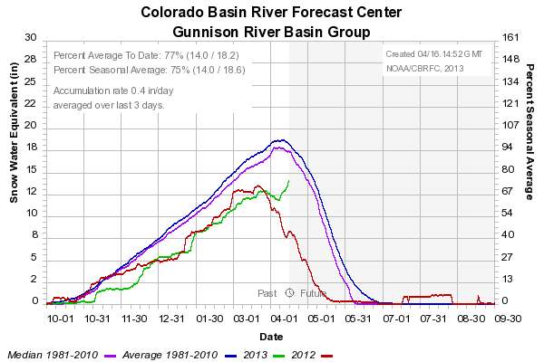
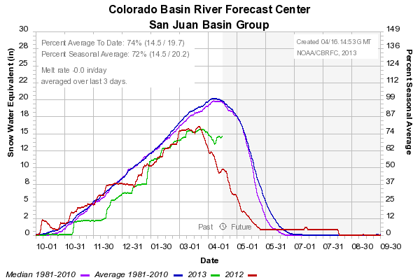
WY Snow Conditions
Notes:
Show snow accumulation here. Point out difference between median and average and how it is available on our website.

Slide 8
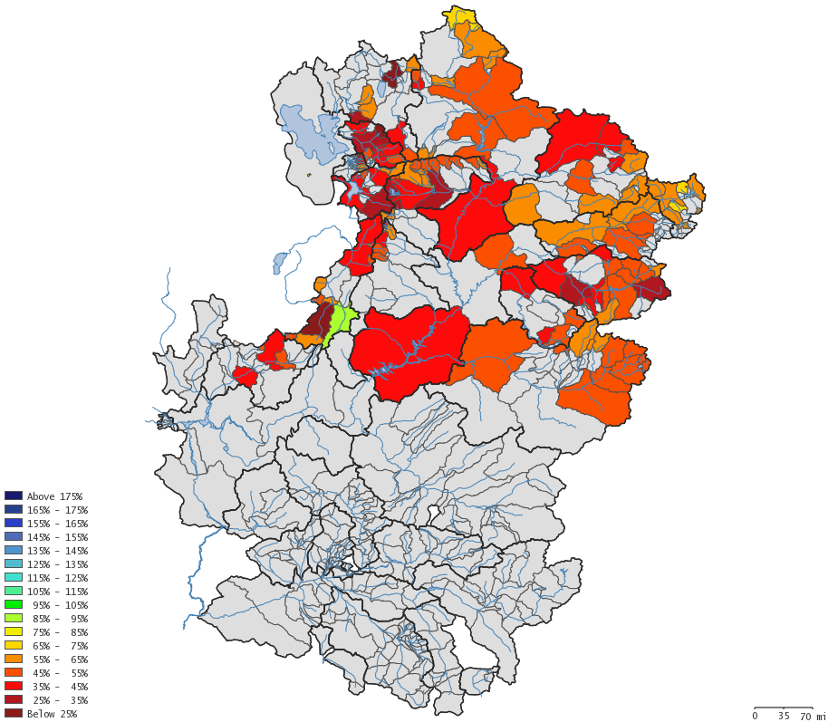
Current Unregulated Forecast
Lake Powell April-July Unregulated Forecast (MAF) (% of Average)
Month | Max | Most | Min
Oct. | 11.2 (157%) | 5.2 (73%) | 2.8 (39%)
Jan. | 7.7 (108%) | 4.4 (61%) | 1.8 (25%)
Apr. | 4.65 (65%) | 2.7 (38%) | 1.5 (21%)
Notes:
Show how the unregulated inflow forecast has evolved since October and display our new water supply approval tool here.

Slide 9
Why is our forecast so low?
Poor precipitation conditions
With the exception of December, the basin has been dry
This may be potentially the driest consecutive 2 years on record
Poor antecedent soil moisture conditions
Dry antecedent years have the potential to contribute to significantly reduced flows
Notes:
What contributed to such a low forecast? Dry precipitation combined with poor antecedent soil moisture conditions.
VERIFY with Brenda: Driest 2-year stretch?
Apr-Jul would be driest consecutive 2-years, but not WY, but it’s close. 2002-2003

Slide 10
A word about soil moisture
We recently conducted a sensitivity analysis of our hydrologic model to soil moisture within the CHPS framework
Soil moisture has the potential to significantly impact runoff within the Colorado River Basin
Poor initial soil moisture states disproportionately impact the peak runoff period (April through May)
Notes:
Just to show a bit as to how our streamflow forecast can be negatively impacted by dry antecedent soil moisture conditions.

Slide 11
Notes:
This plot shows streamflow response at Lake Powell under various soil moisture conditions. Red indicates the driest conditions over our calibrated record, and blue indicates the wettest conditions over our calibration record. You can see that the difference in April through July runoff between the driest conditions and the wettest conditions is approximately 3.3 MAF.

Slide 12
ESP Update
We now have daily ESP results available on our website
Is meant to show results from our daily ESP run, and general trend in the hydrologic conditions at a particular forecast point
Statistical Water Supply (SWS) and Official CBRFC forecasts are also provided for reference
Notes:
You may recall some plots that Michelle showed at the previous BSTC meeting. Since then, the plots have evolved quite a bit, and are now available online daily.

Slide 13
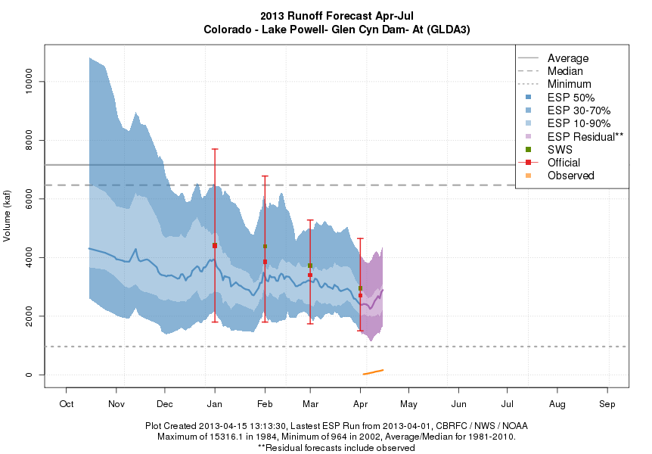
ESP Update
Notes:
Here are our new daily ESP plots. Point out:
Evolution of the ESP run since the beginning of the water year.
Comparison with our official water supply forecasts and SWS.
Show mean and median thresholds, minimum threshold, and explain why the max isn’t on there because someone ALWAYS asks.
Explain what the “ESP residual” is.
Highlight information in the text at the bottom of the chart.

Slide 14
Other Ongoing Efforts
Continue providing ESP traces to Reclamation for use in their MTOM
Investigate lengthening the forecast period
Incorporate climate information
Development of Stochastic Weather Generator tool in conjunction with the University of Colorado
Incorporation of remotely-sensed snow data into our operations
Improving intervening flow forecasts in the Lower Colorado River Basin
Notes:
Other ongoing projects:
We’re looking into expanding our capabilities with the ESP traces that we currently provide to Reclamation, by looking into lengthening the forecast period and incorporating climate information.
We’re working with the University of Colorado on a SWG project to better assess forecasts based on additional information, like the ENSO signal.
We’re looking into incorporating remotely-sensed snow information from MODIS
We’re also looking into improving our intereveing flow forecast product.

Slide 15
Questions?

