Slide 1
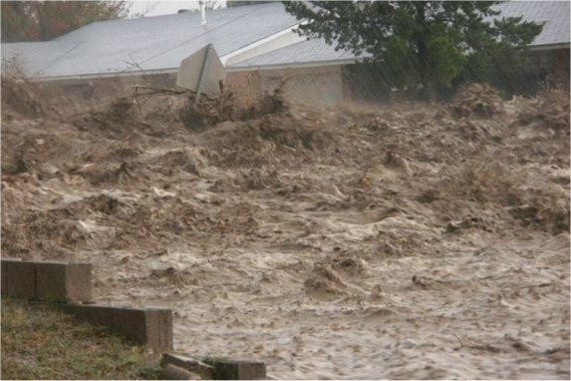
Flash Flood
A rapid and extreme flow of high water into a normally dry area, or a rapid water
level rise in a stream or creek above a predetermined flood level, beginning within six hours of the causative event (e.g., intense rainfall, dam failure, ice jam).
However, the actual time threshold may vary in different parts of the country. Ongoing flooding can intensify to flash flooding in cases where intense rainfall results in a rapid surge of rising flood waters.
NWS Manual 10-950, Dec 4, 2012 – Hydrologic Services Program
What support we can & do provide
Our FFG Method / RFC Methods
WFO Tools
Future Support (CBRFC & National)

Slide 2
CBRFC Flash Flood Support
Gridded Flash Food Guidance (feeds WFO FFMP program)
1, 3, 6 hour precipitation threshold
Static Value, Empirical Rule of Thumb, Varies based on terrain characteristics
RFC Short-Term Forecasts: Limited modeling capabilities for rain driven flash floods
Routing of observed rises downstream
Organized Convection (well defined disturbance)
Evolve from convective to longer duration stratiform rainfall situation

Slide 3
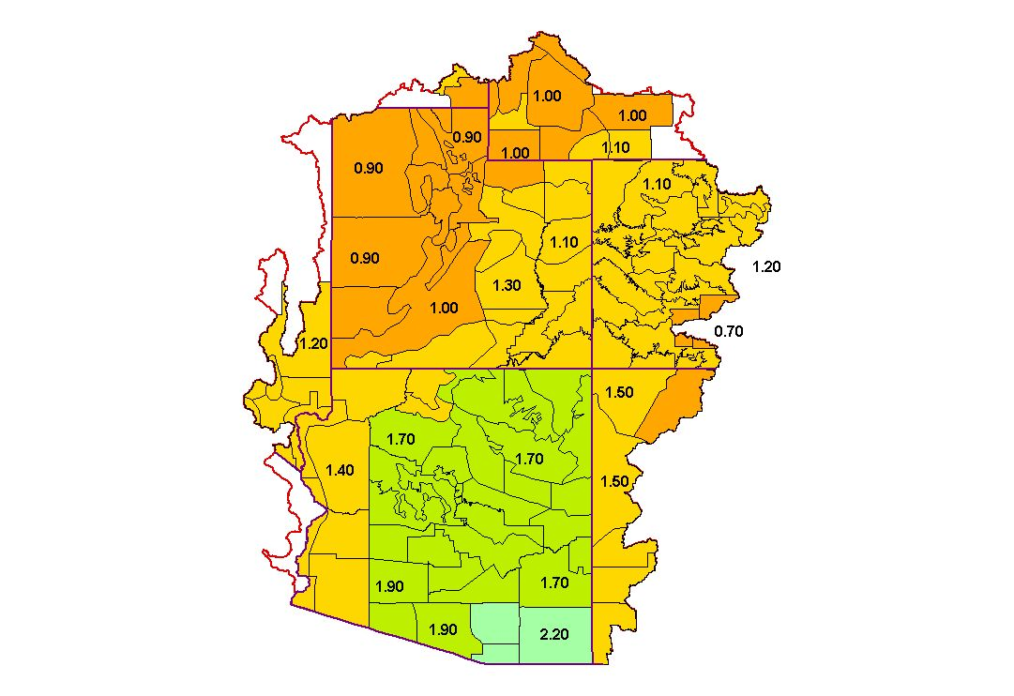
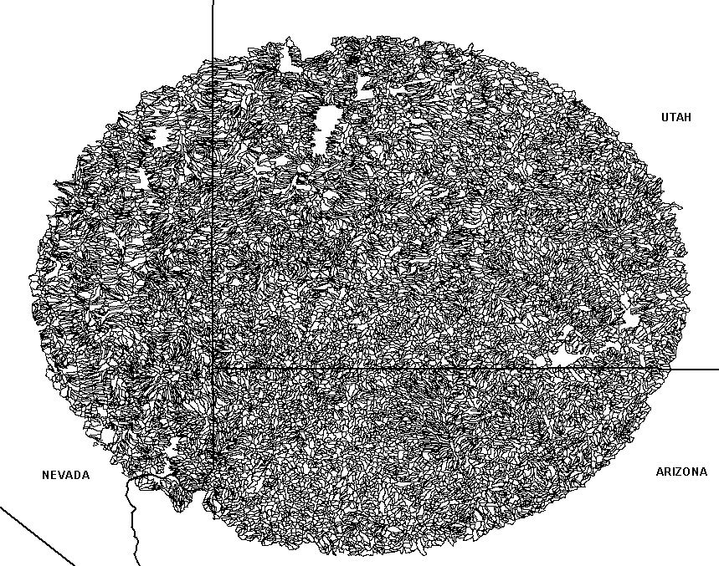
Flash Flood Guidance: Legacy Local and ‘Rule-of-Thumb” procedures lack spatial resolution
Implication: All basins have the same hydrologic response
Flash Flood Precipitation Thresholds
Observed Precipitation
Pre-defined Climate Zones
FFMP Flash Flood Basins
Largest exceeds 13,000 KM²
Areas range from 15-130 KM²

Slide 4
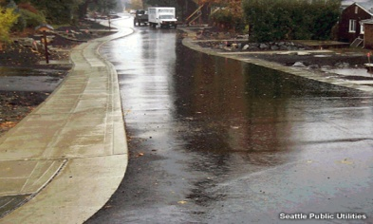
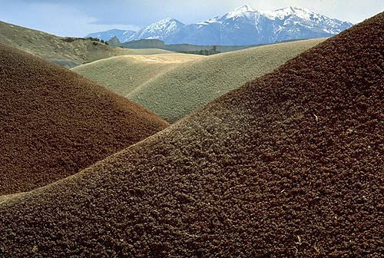
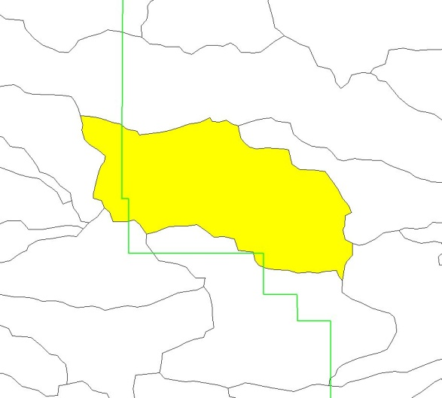
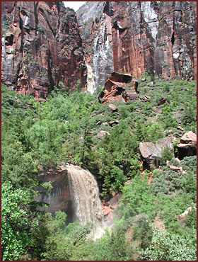
The Flash Flood Potential Index uses information such as land-use, forest density, slope, and soil type to characterize an areas potential response to heavy rainfall
Land Use
?
Soil type
Vegetation type and density
Cedar City, UT
FFMP Radar Basins
Slopes
Notes:
The Flash Flood Potential Index or FFPI was originally developed by Greg Smith at the CBRFC to assess relative flash flood potentials of the land surface. All three RFCs utilize geographic information to determine relative flash flood potentials. CBRFC and CNRFC use the FFPI directly in their FFG calculations. NWRFC does not use the FFPI directly, but it leans on its concepts.
The FFPI is a novel method for combining geographic information sources including infiltration characteristics due to soil texture, forest cover, slope, and land use data sets using GIS software. The end result is a single value gridded index that represents the potential for flash flooding. The specific steps for creating the FFPI grid will be described in the following slides.

Slide 5
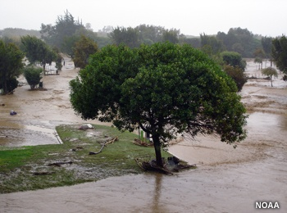
FFPI Method
Creating a single FFPI layer
Hydrologic response
7
3
Slope
Greater response and potential
7
1
10
3
8
Forest Density
Lesser response and potential
8
6
4
Land Use
8
9
6
Soil
9
6
5
Flash Flood Potential Index
8
Notes:
Attributes associated with these datasets, such as the percent slope of an area, the density of the forest, and the percent of clay content within the soil are ranked based on their infiltration capabilities and runoff response potential. A scale of 1-10, defined as the Flash Flood Potential Index, is used where higher values indicate a higher runoff response and lower values are indicative of a lower runoff response. This is repeated for each data layer. A mean of all the data layers is computed

Slide 6
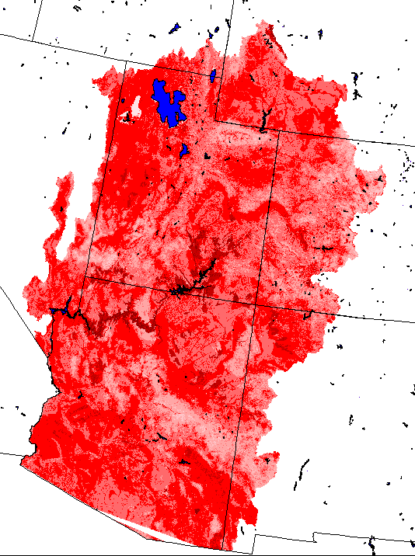
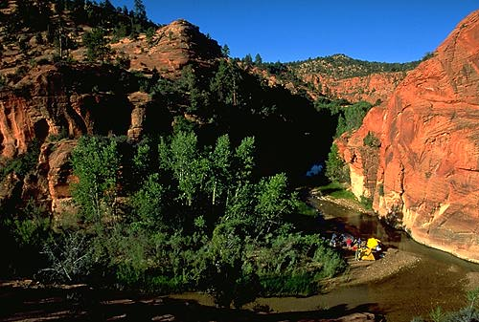
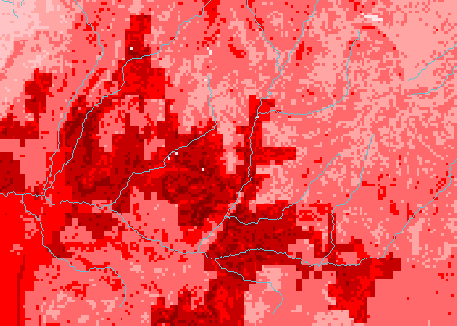
FFPI in a Gridded Format
East Fork of the Virgin River
Southwest Utah
FFPI
1
Decreasing Potential
10
Increasing Potential
Notes:
The resulting FFPI is shown here for the Colorado Basin RFC domain. This example also shows the FFPI highlighting the flash flood prone Virgin River in southwest Utah.

Slide 7
FFG Grid Modified by FFPI
FFPI Grid
Gridded FFG product for FFMP
Initialize FFG Grid Cell
7
0.7
1
3
2.3
1.5
1.0 per 1 hour
4
4
8
1.0
1.0
0.6
5
6
7
0.9
0.8
0.7
If the mean FFPI value for the entire RFC area is 4 thus all FFPI grid boxes of “4” will get assigned the value for the pertinent time period. Other values are scaled up or down by a selected range.

Slide 8
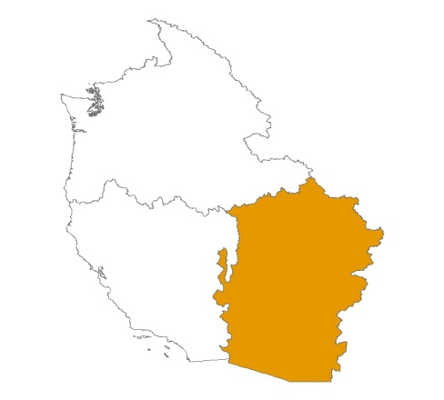
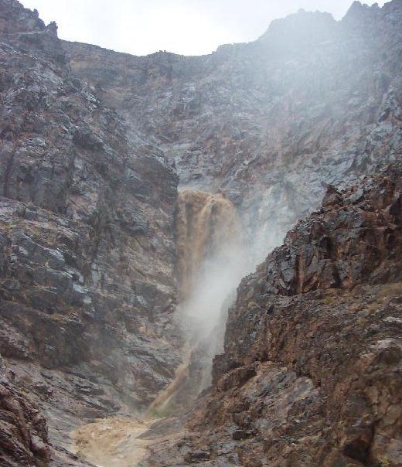
CBRFC Gridded FFG Relationship:
Start with reasonable average FFG values of
1 inch in 1 hour (empirically derived)
Assign these values to grid cells with the mean FFPI value of 4
Incrementally adjust the FFG values up or down as FFPI varies
Limit the range of FFG values to climatologically reasonable values
Verify results by comparing to archived flash flood events & modify
The FFPI values range from 1 to 9 with a mean value for the CBRFC near 4
If FFPI = 4: FFG is 1.00
If FFPI = 5: FFG is .90
If FFPI = 6: FFG is . 80
If FFPI = 7: FFG is .70
if FFPI = 8: FFG is .60
if FFPI = 9: FFG is .55
if FFPI = 3: FFG is 1.45
if FFPI = 2: FFG is 2.00
if FFPI = 1: FFG is 2.25

Slide 9
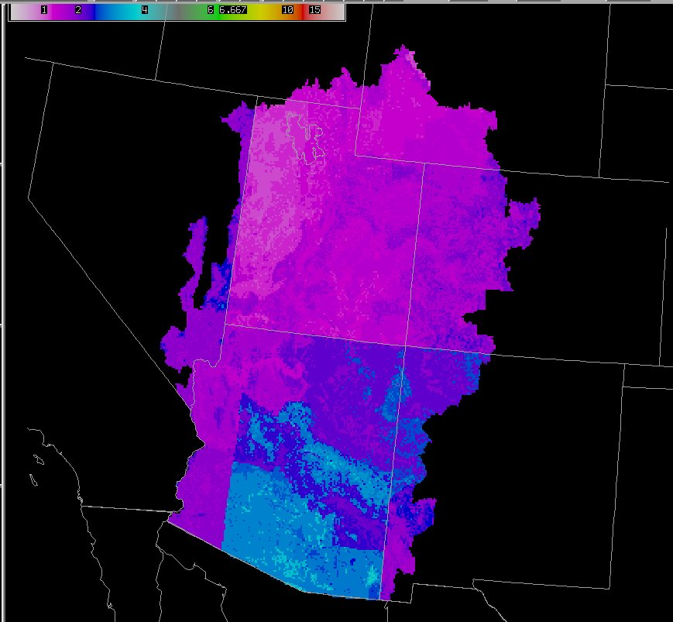
CBRFC Flash Flood Guidance Influenced by the Flash Flood Potential Index
Notes:
The CBRFC gridded FFG as displayed on D2D is shown here.

Slide 10
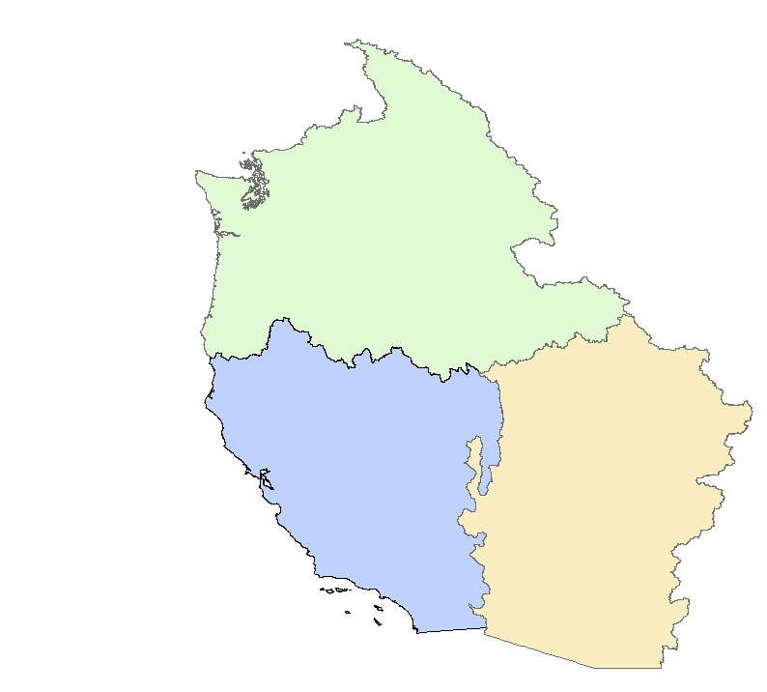
RFC gridded FFG Generation Methods:
Geospatial analysis of known flash flood events used to create a GIS model for computing FFG
Rules of thumb – skewed and given spatial variability based on the GIS generated flash flood potential index (FFPI).
Northwest
California - Nevada
Colorado Basin
Rules of thumb – skewed and given spatial variability based on the GIS generated flash flood potential index (FFPI)
Notes:
This slide highlights methods used by the 3 Western Region RFCs. More detailed descriptions will follow on subsequent slides.
The Colorado Basin RFC utilizes an existing empirically based method that relates historical event data to precipitation return frequency values. These values are skewed and given greater spatial variability based on the Flash Flood Potential Index (to be discussed shortly).
The California-Nevada River Forecast Center also utilizes the Flash Flood Potential Index but it is applied to “rule-of-thumb” flash flood guidance values.
The Northwest River Forecast Center performed a geospatial analysis of known flash flood events to create a GIS model for computing FFG.

Slide 11
RFC gridded FFG Generation Methods:

Slide 12
WFO Tools/Procedures
Pattern Recognition / Atmospheric Triggers
Local flash flood knowledge (prone areas)
Flash Flood Monitoring & Prediction (FFMP)
Recent Burn Scares – Rule of thumb thresholds adjusted
annually
Storm Frequency – Rules of thumb adjusted
Local FFG methods – Return interval information

Slide 13
WFO Tools:
Guidelines For Flash Flood Index
500 MB
WIND SPEED
CAP
TRIGGER
PRECIPITABLE WATER
> 1.00
>.90-1.00
.50-.80
<.50
< 15 KTS
NO
YES
Very High
High
Mod-High
Low
NO
High
Mod-High
Moderate
Low
YES
YES
Mod-High
Low-Mod
Moderate
Low
NO
Low-Mod
Low
Low
Low
15<25 KTS
NO
YES
High
Mod-High
Moderate
Low
NO
Mod-High
Moderate
Low-Mod
Low
YES
YES
Mod-High
Low-Mod
Low
Low
NO
Low-Mod
Low
Low
Low
< =25 KTS
NO
YES
Mod-High
Moderate
Low-Mod
Low
NO
Moderate
Low-Mod
Low
Low
YES
YES
Low-Mod
Low
Low
Low
NO
Low
Low
Low
Low

Slide 14
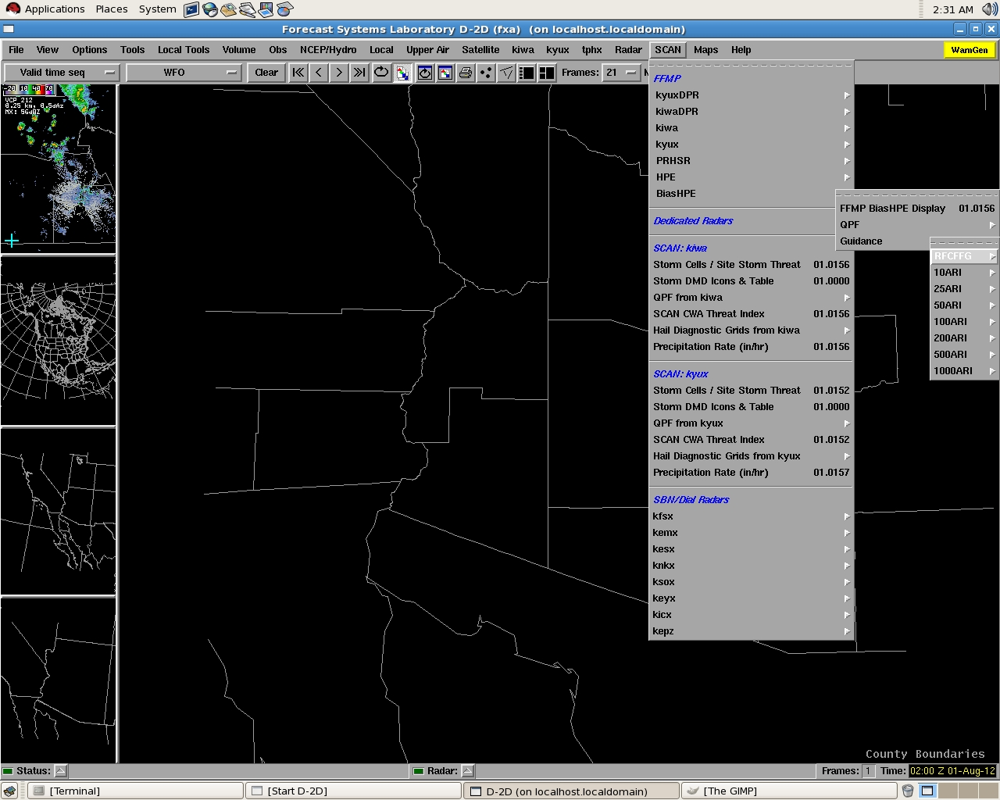
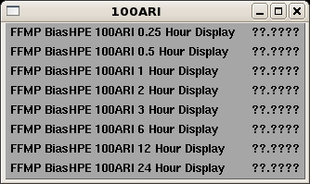
Displaying ARI Guidance in D2D
Notes:
After precipitation frequency data is in AWIPS in can be accessed several ways. In D2D basin averaged guidance can be accessed from the SCAN menu in similar fashion to RFC guidance. The selection GUI for 100-year Average Recurrence Interval (ARI) data is shown here.

Slide 15
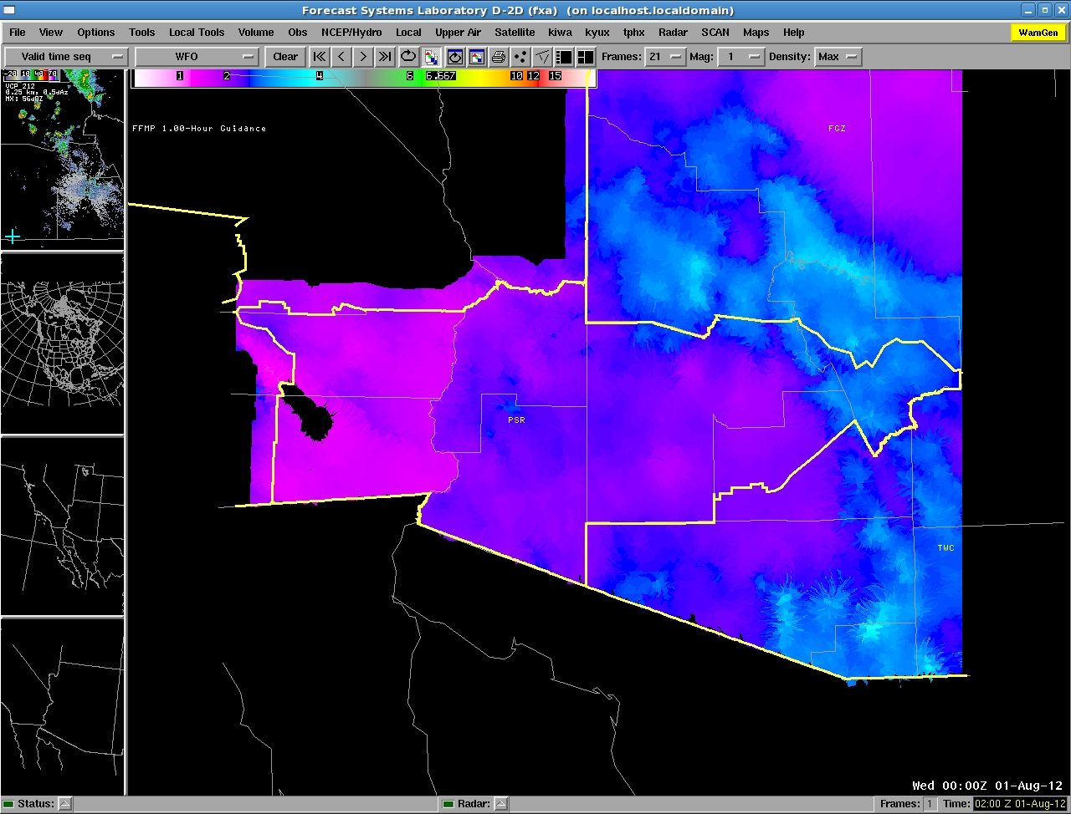
1-Hour / 100 Year Guidance
Notes:
Basin averaged guidance will display in the D2D pane after selecting one of the ARI / event duration combinations. The 1-hour / 100-year ARI guidance is shown here. You will notice there is a discontinuity in the data as you cross the Colorado River. This artifact exists in the original data and is the result of the original analysis being done individually by state.

Slide 16
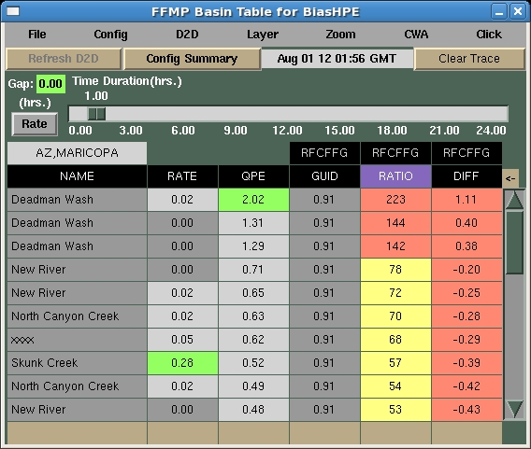
Displaying ARI in FFMP Basin Table
Notes:
To use ARI data in FFMP, we use the D2D SCAN menu to load the desired QPE data source normally. ARI guidance is added by selecting the “arrow” on the upper right side of the FFMP basin table (shown here by the red oval).

Slide 17
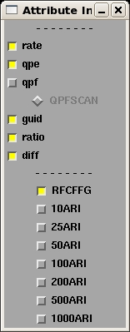
Selecting Attributes to Display
Notes:
This will bring up the Attribute Inclusion GUI, where you can select guidance sources for display in the basin table. 100 year Average Recurrence Interval (ARI) guidance has been selected in the graphic shown here.

Slide 18
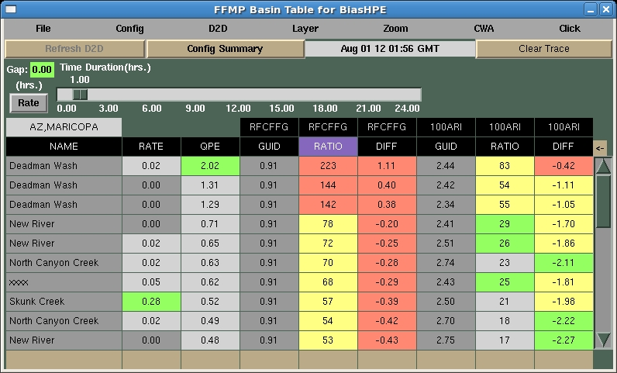
100 Year Guidance in FFMP Table
Notes:
This will add the applicable ARI guidance into the basin table. Multiple recurrence intervals can be added if desired. ARI ratio and difference can be displayed in the table just like the RFC Flash Flood Guidance.

Slide 19
FUTURE:
CBRFC:
Provide Radar Coverage limitation information
Provide Radar Bias Information
Additional GIS-Based Basin Information (impervious areas)
Facilitate flow of procedures & methods between WFO’s
Possibly Re-visit FFPI analysis (improved methodology, datasets)
NATIONAL:
Improved precipitation and precipitation rate products (near-term)
National high resolution distributed modeling patflorm (long term)
Develop a national consistent FFG approach (long-term)

