Slide 1
CBRFC April 2013 Peak Flow Forecast Webinar
11 am, April 18, 2013
Greg Smith & Ashley Nielson
These slides: www.cbrfc.noaa.gov/present/present.php

Slide 2
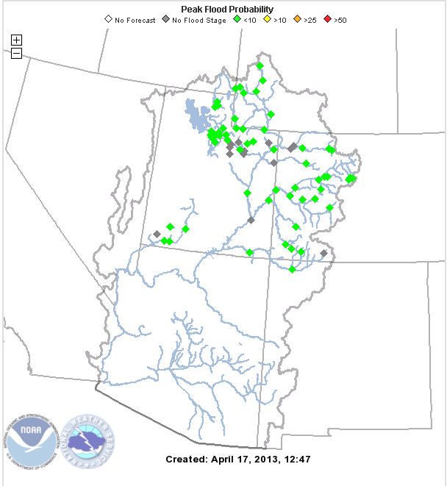
Today’s Presentation
Brief Precipitation Review
Current Snow Situation
Short term weather outlook
Peak Flow Forecasts
Mid April water supply update
Web Reference: www.cbrfc.noaa.gov click on peak map

Slide 3
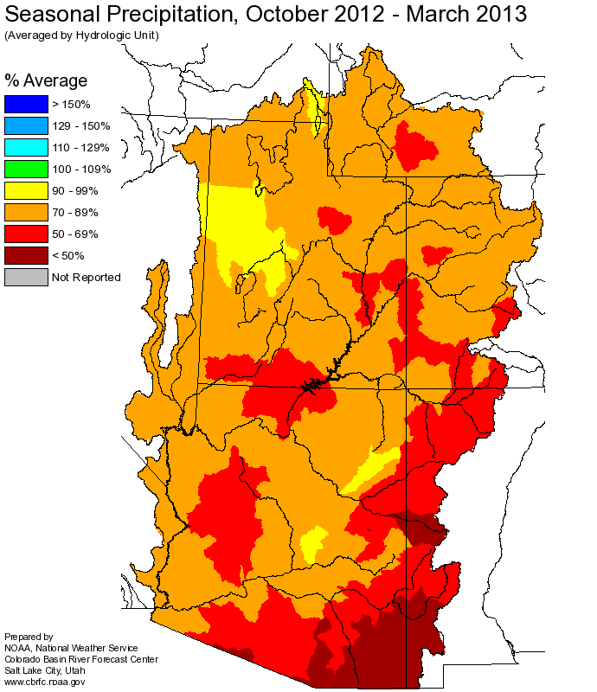
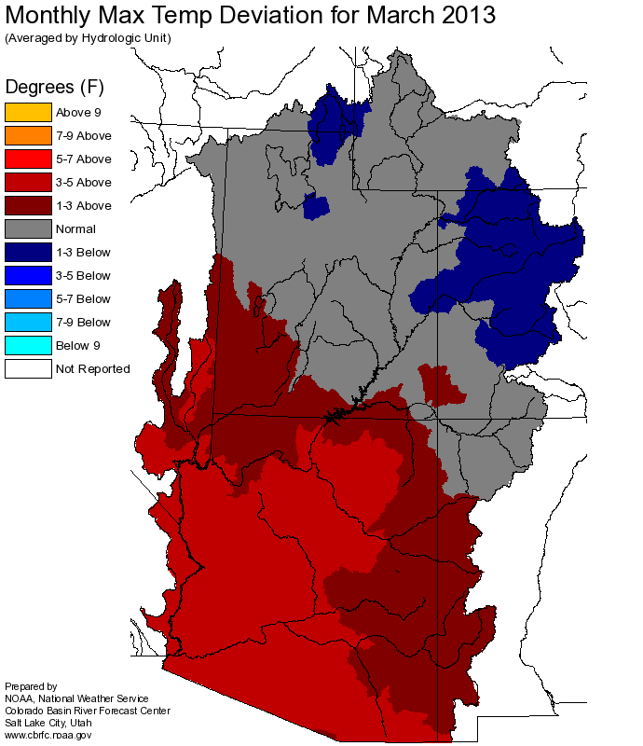
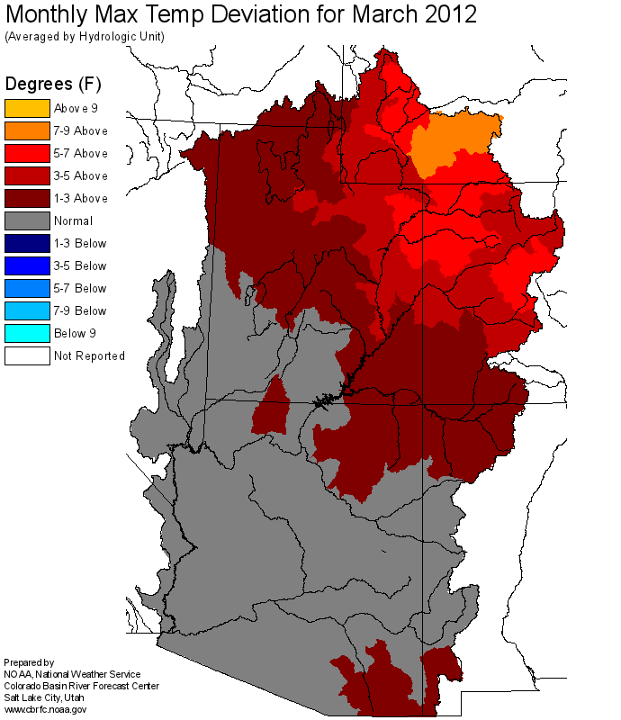
Very Warm &
Very Dry
March

Slide 4
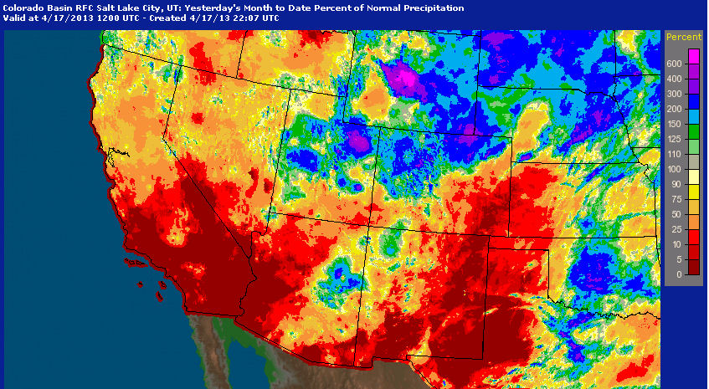
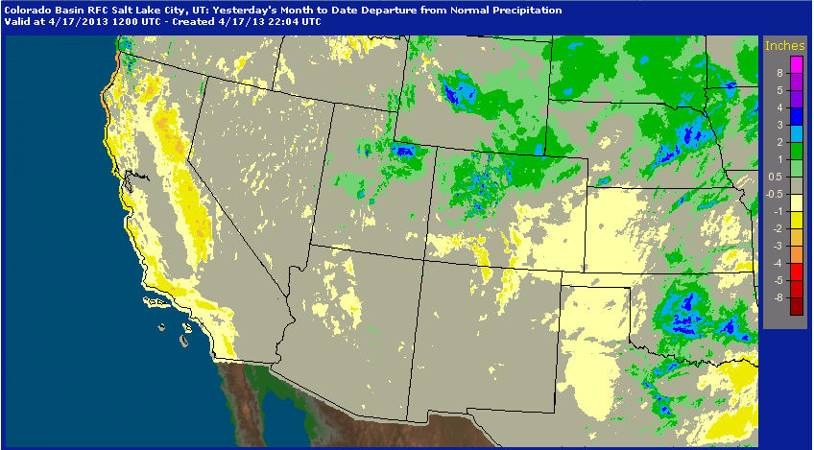
First Half of April Precipitation
Percent of Average
Departure from Average
Web Reference: http://water.weather.gov/precip

Slide 5
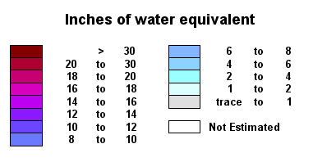
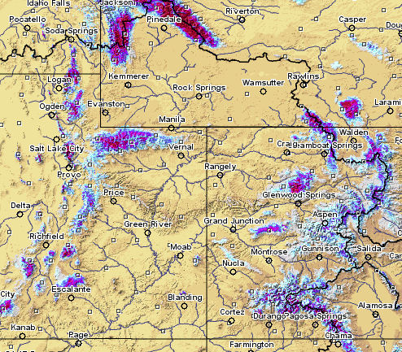
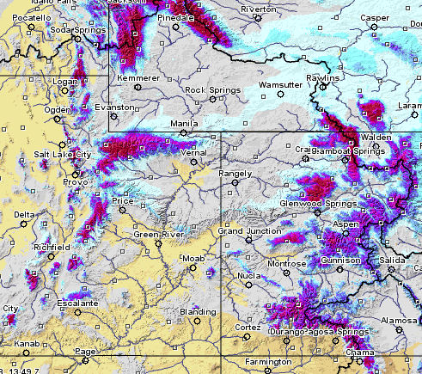
Snow: The impact of spring weather
Retained and added to the snowpack compared to 2012
April 18 2012
April 18 2013
Web Reference: http://www.nohrsc.nws.gov

Slide 6
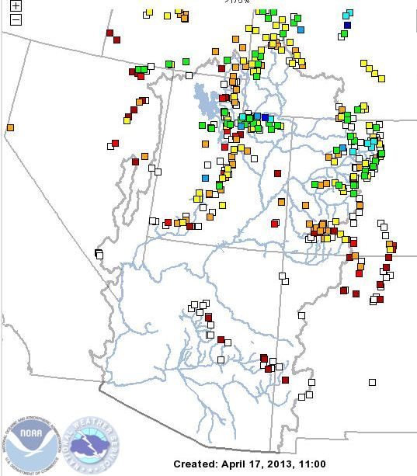
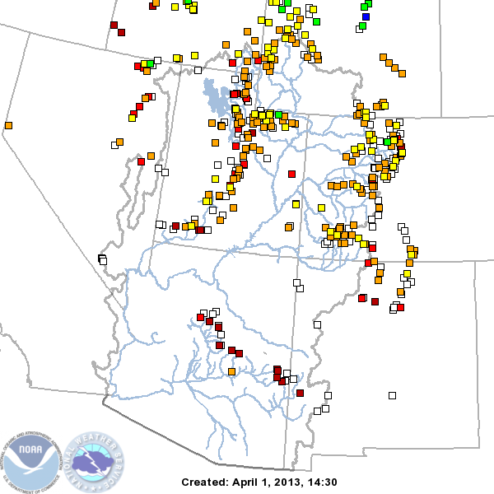
Snow: April Retention and Building of Snowpack
April 1st 2013
April 17th 2013

Slide 7
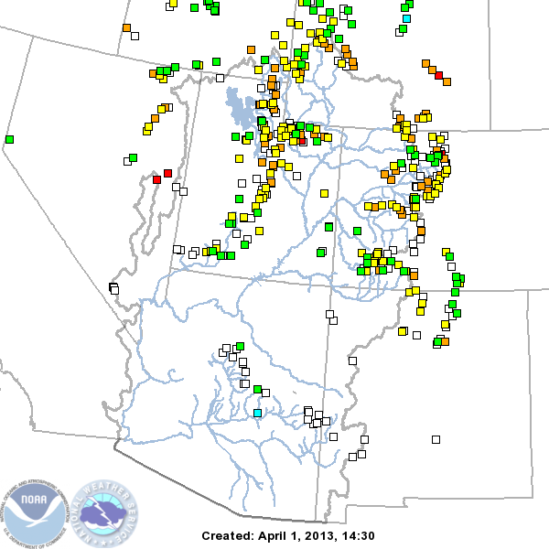
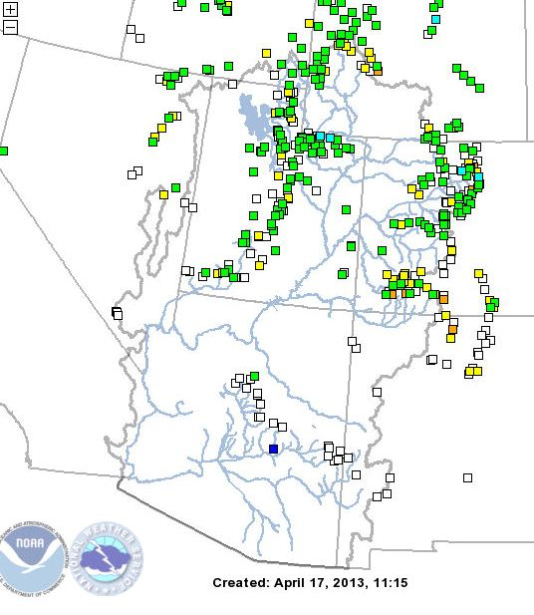
Snow: April Retention and Building of Snowpack
April 1st 2013
April 17th 2013

Slide 8
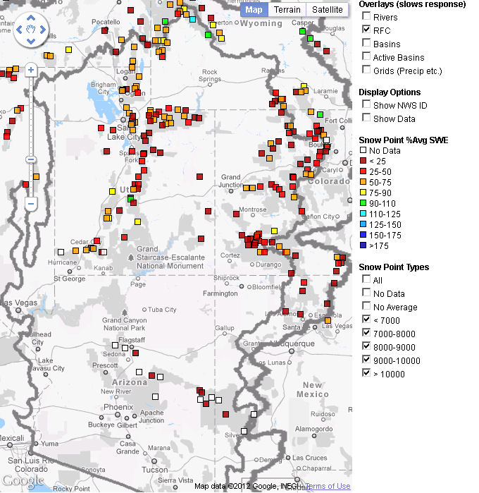
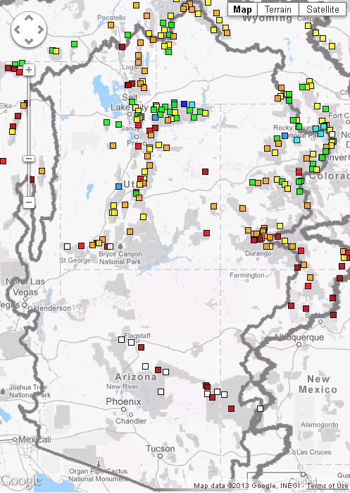
Snow
2012 Melt Underway / 2013 Building Snowpack
April 17 2012
April 17 2013

Slide 9
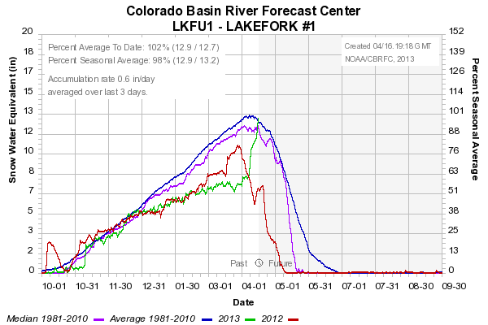
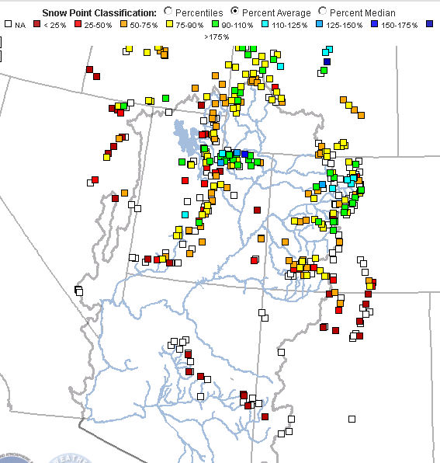
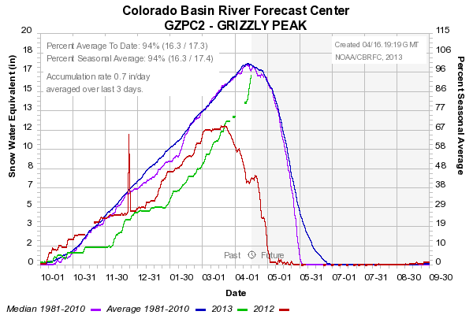
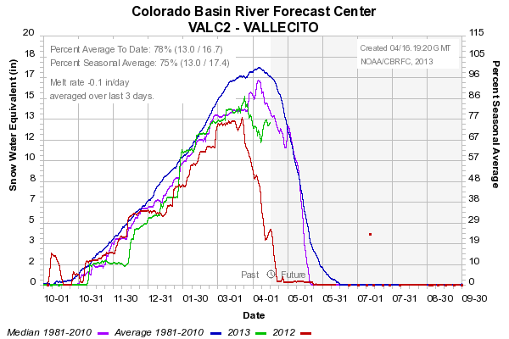
Big difference from 2012
10100 FT
11100 FT
10800 FT

Slide 10
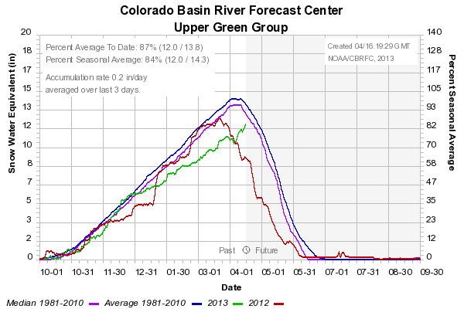
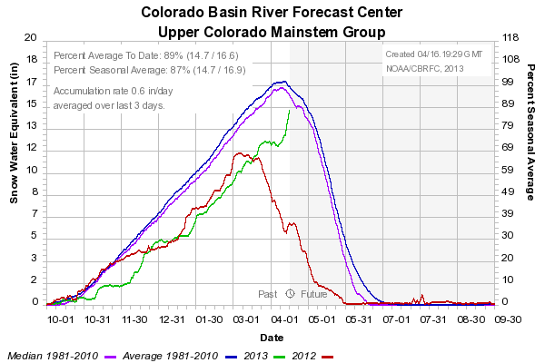
SNOW: Upper Green Basin (above Flaming Gorge)
SNOW: Colorado Mainstem (above Cameo)

Slide 11
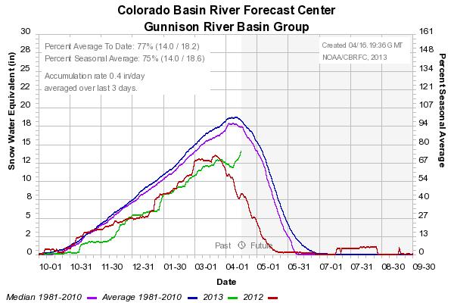
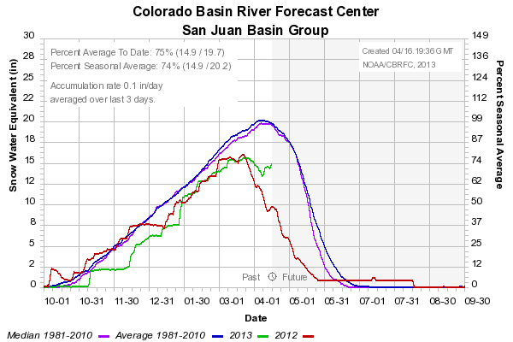
SNOW: Gunnison Basin
SNOW: San Juan Basin

Slide 12
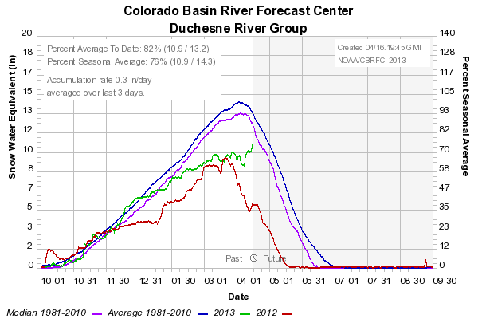
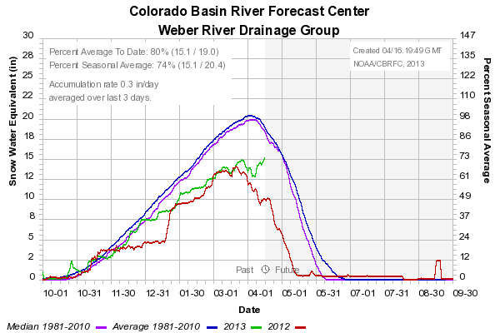
SNOW: Duchesne River Basin
SNOW: Weber River

Slide 13
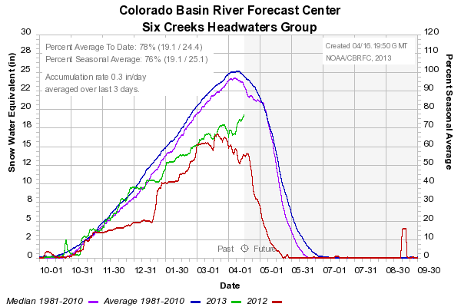
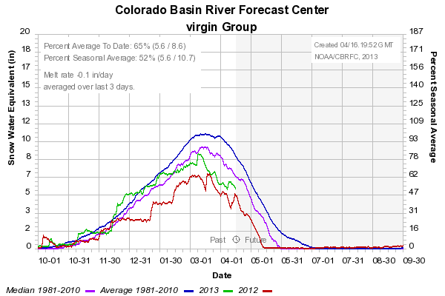
SNOW: Six Creeks (S.L. County)
SNOW: Virgin River
Web Reference: http://www.cbrfc.noaa.gov/station/sweplot/sweplot.cgi???open

Slide 14
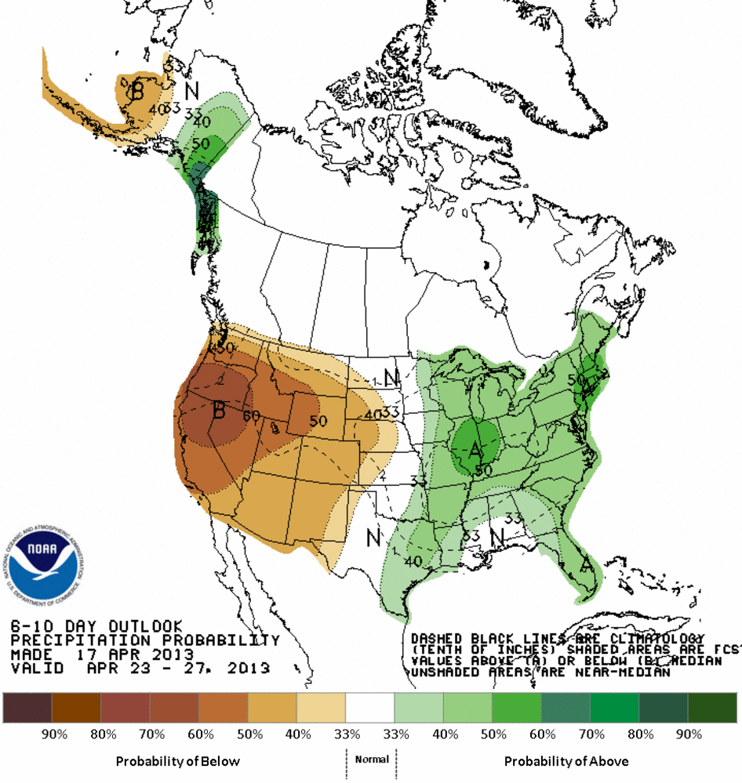
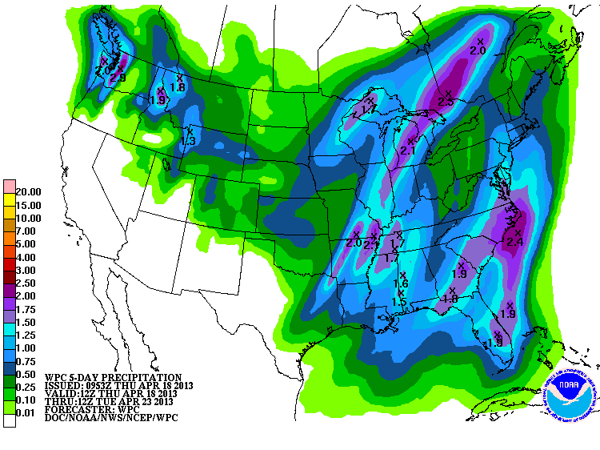
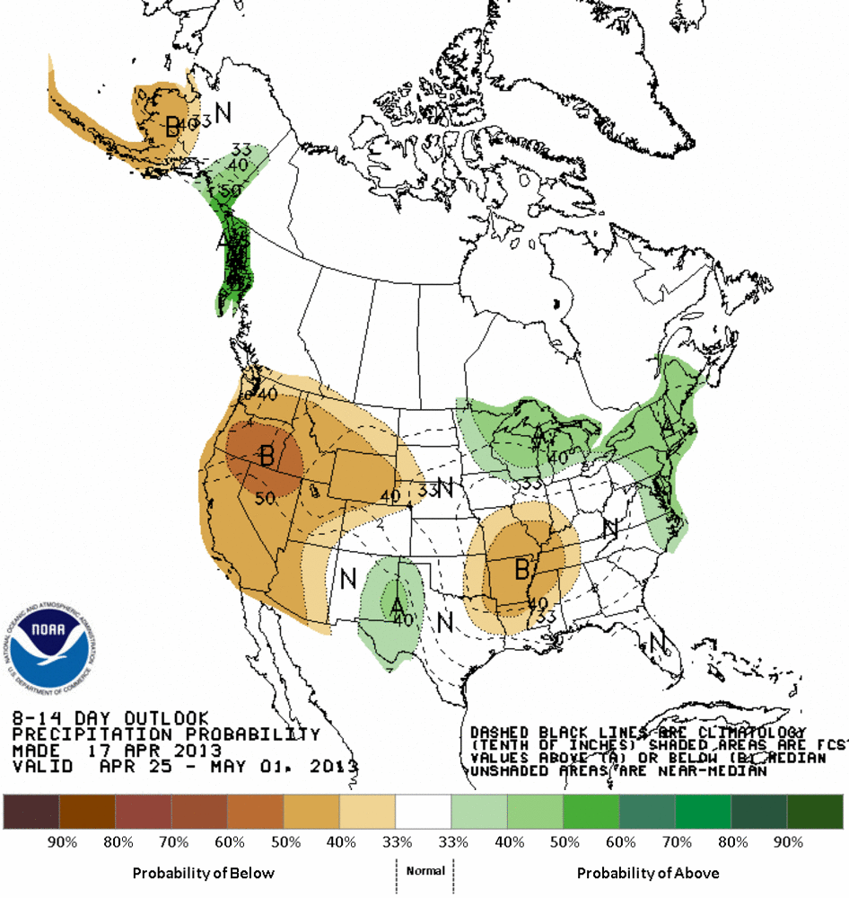
Forecast Precipitation
6-10 day 4/23 – 4/27
5 day total 4/18 – 4/23
8-14 day
4/25 – 5/1
Additional Storminess Sat through Tue/Wed
High pressure / warmer temperatures follow later next week
Less confidence beyond, but maybe trend toward normal
Web Reference: www.hpc.ncep.noaa.gov

Slide 15
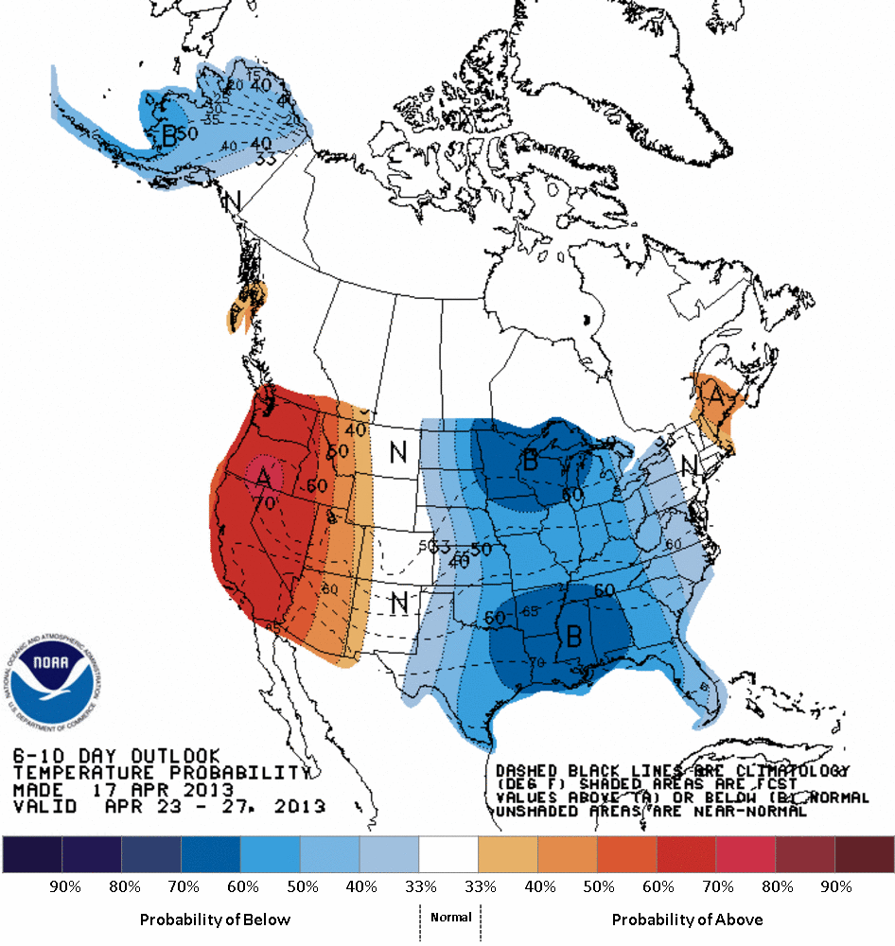
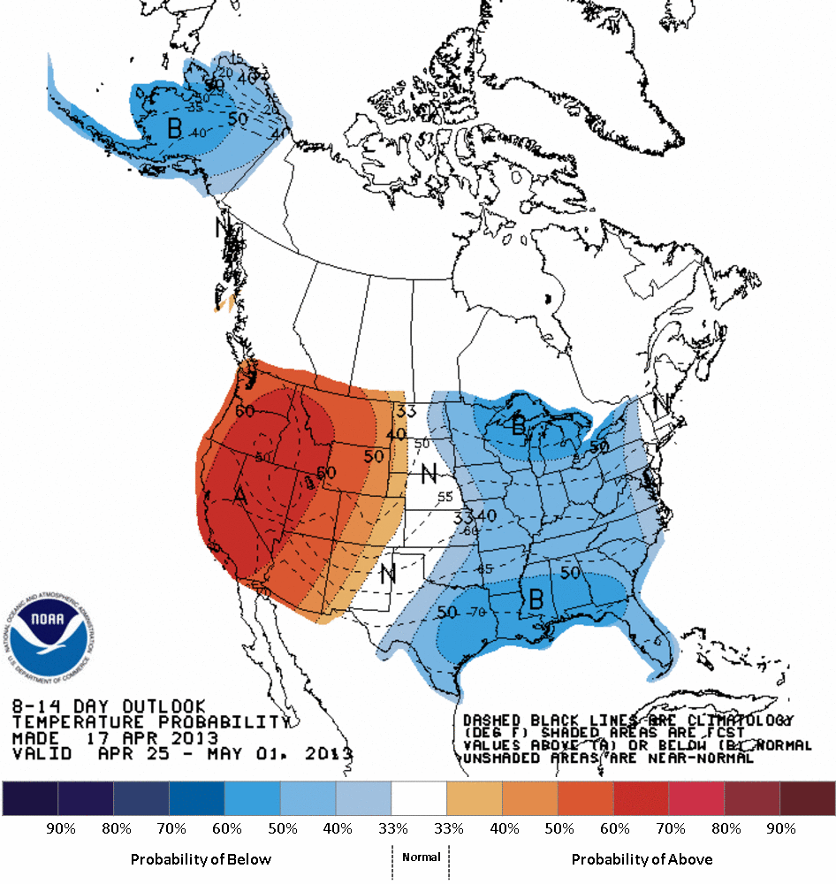
Forecast Temperature
6-10 day 4/23 – 4/27
8-14 day
4/25 – 5/1

Slide 16
What is a Peak Flow Forecast?
Snowmelt Mean Daily Maximum Flow (April-July)
Probabilistic Forecasts
Exceedence Probabilities -10%,25%,50%, 75%, 90%
Issued (at least) monthly from March-June (April 16th, May 1st, May 16th depending upon runoff scenario)
~60 forecast points – some unregulated, some regulated
Updated as needed
Forecast Users include:
Emergency Managers
USGS hydrologists
Water Managers
River Recreation

Slide 17
Spring Weather Really Matters
Runoff characteristics are largely determined by the day-to-day spring weather.
While large snow pack years increase chances for flooding, it is not an inevitability (dodged a bullet at many sites in 2011)
Small snow pack years can flood with the right sequence of spring temperatures and with flows enhanced by precipitation.
Rain events may play a larger role in the magnitude of the peak flow during very low snow years.
Keep an eye on our web page / daily forecasts

Slide 18
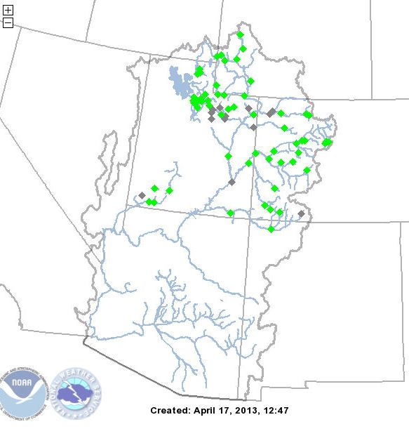
April 17 Peak Flow Forecasts

Slide 19
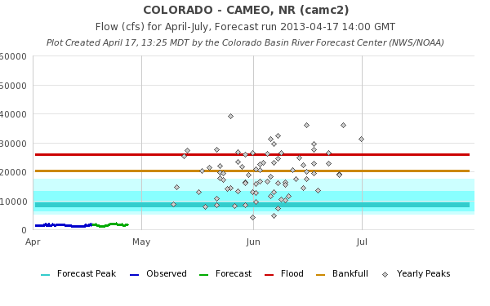
Peak Flow Forecast Graphic
Accessible from peak flow map, list and CBRFC main web page
Exceedance
Probability
10%
25%
50%
75%
90%
Historical yearly peaks are instantaneous , forecasts are mean daily peaks (CFS)

Slide 20
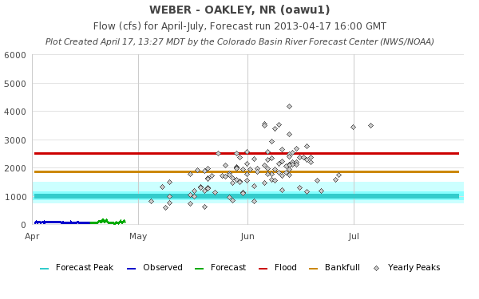
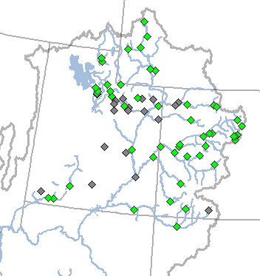
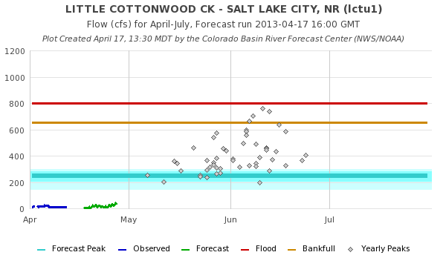
Great Basin

Slide 21
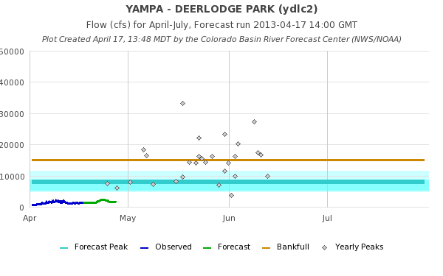
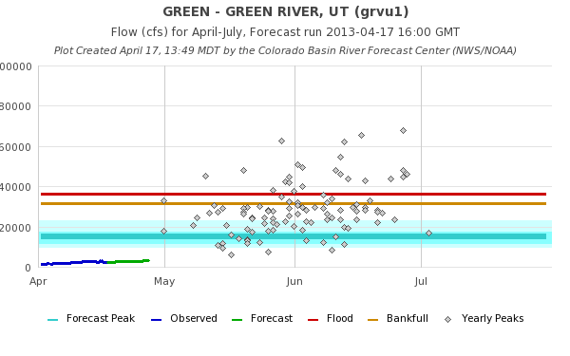
Green River

Slide 22
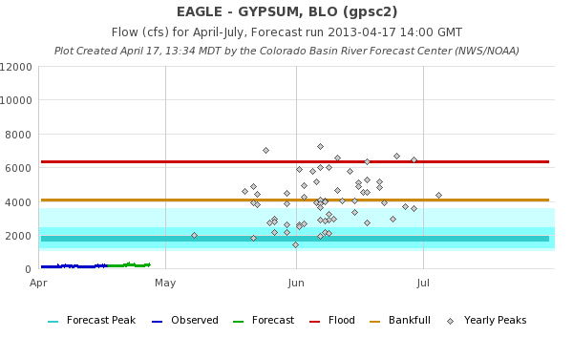
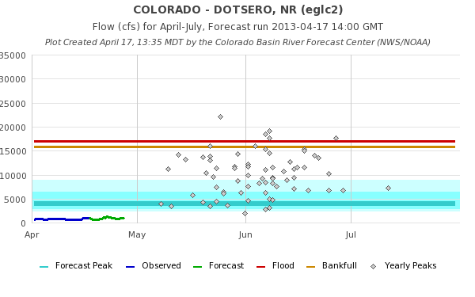
Upper Colorado

Slide 23
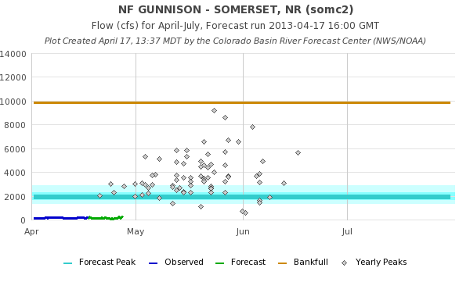
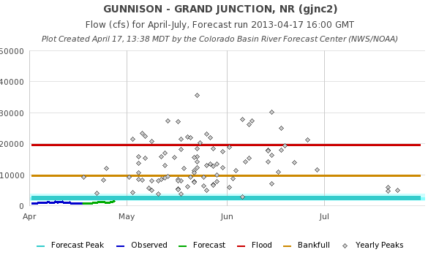
Gunnison

Slide 24
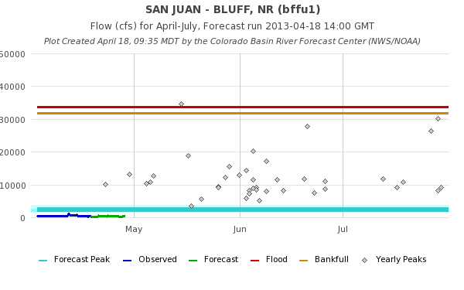
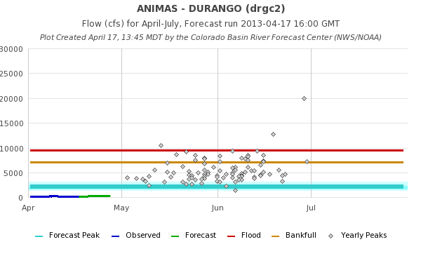
San Juan

Slide 25
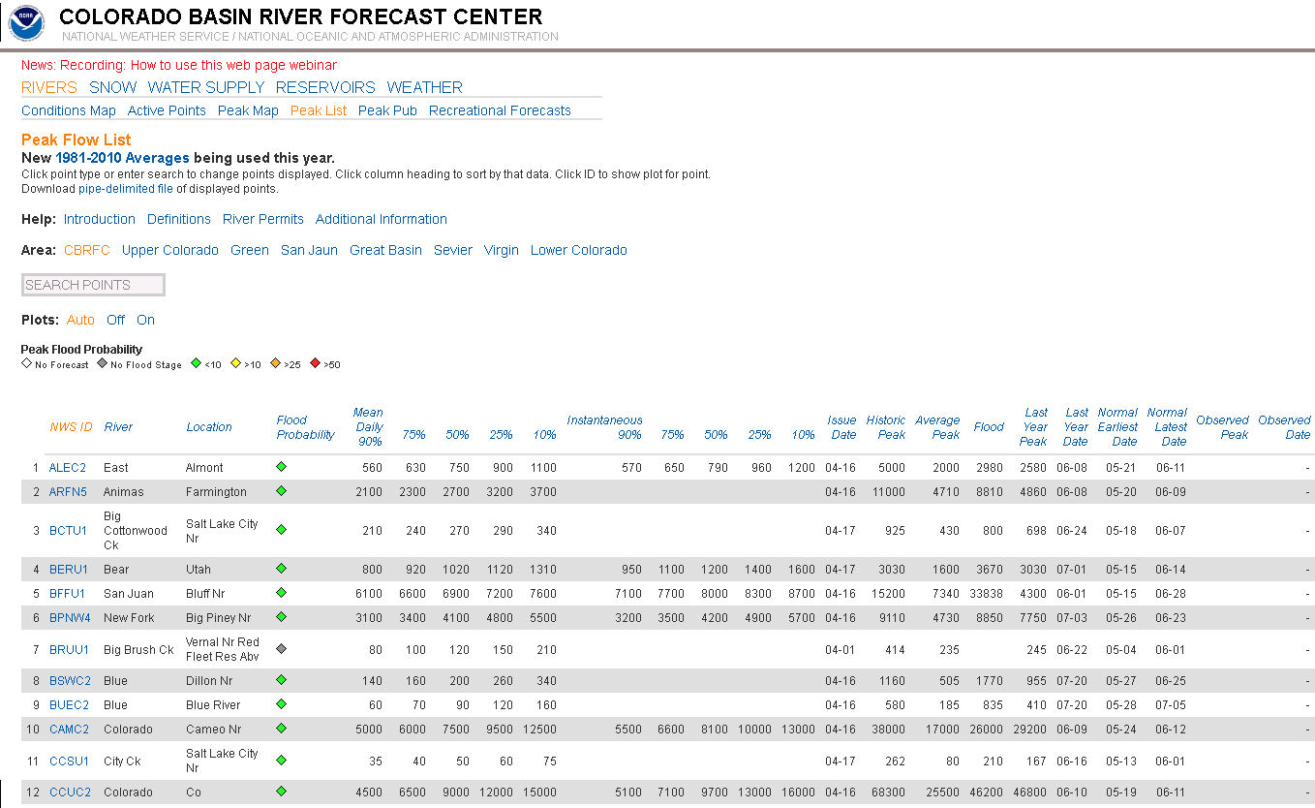
Peak Flow List at www.cbrfc.noaa.gov

Slide 26
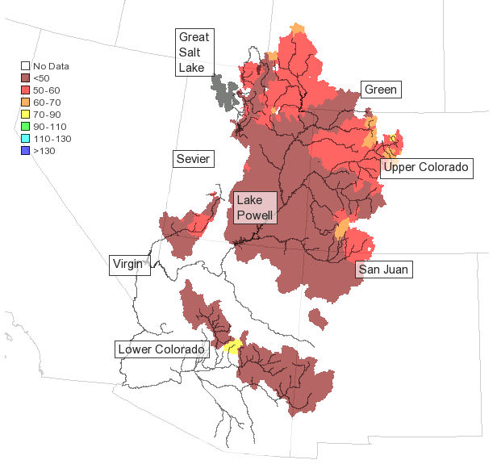
April 16th Water Supply Forecast Update (Major Reservoirs)
Change in April-July forecast volumes as a percent of average
5 % Increase Upper Green
3 % Increase Lake Powell
0-10% Increase Gunnison
No Change San Juan

Slide 27
Peak Flow Forecasts
Forecast updates planned for:
5/1, 5/17,6/1? (depending on evolution of the runoff)
Webinars: 5/6, 6/6 – all at 11 am
water supply volumes
Peak flow ~ 5/18 if needed

Slide 28
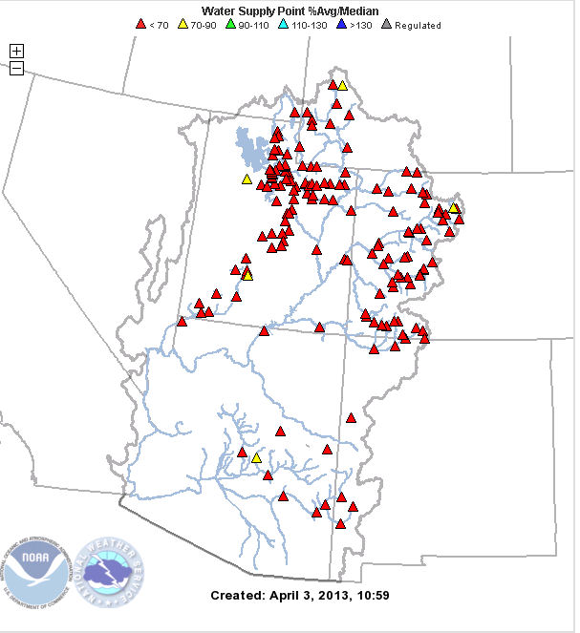
CBRFC Contacts
Basin Focal Points (Available to discuss forecasts: 801.524.5130)
Upper Colorado: Brenda Alcorn
Green: Ashley Nielson
San Juan / Gunnison: Greg Smith
Great Basin: Brent Bernard
Virgin / Sevier – Stacie Bender
Lower Colorado (below Lake Powell): Tracy Cox

Slide 29
Feedback, Questions, Concerns always welcome….
Greg Smith
CBRFC Senior Hydrologist
Phone: 801.524.5130 ext 332
Email: greg.smith@noaa.gov
Ashley Nielson
CBRFC Hydrologist
Phone: 801.524.5130 ext 333
Email: ashley.nielson@noaa.gov

