Slide 1
Colorado Basin River Forecast Center
Water Supply Forecasting Method
Michelle Stokes
Hydrologist in Charge
Colorado Basin River Forecast Center
April 28, 2014

Slide 2
Outline
Overview of Colorado Basin River Forecast Center (CBRFC)
CBRFC Hydrologic Model
Water Supply Forecasts Products
Improving the Forecasts

Slide 3
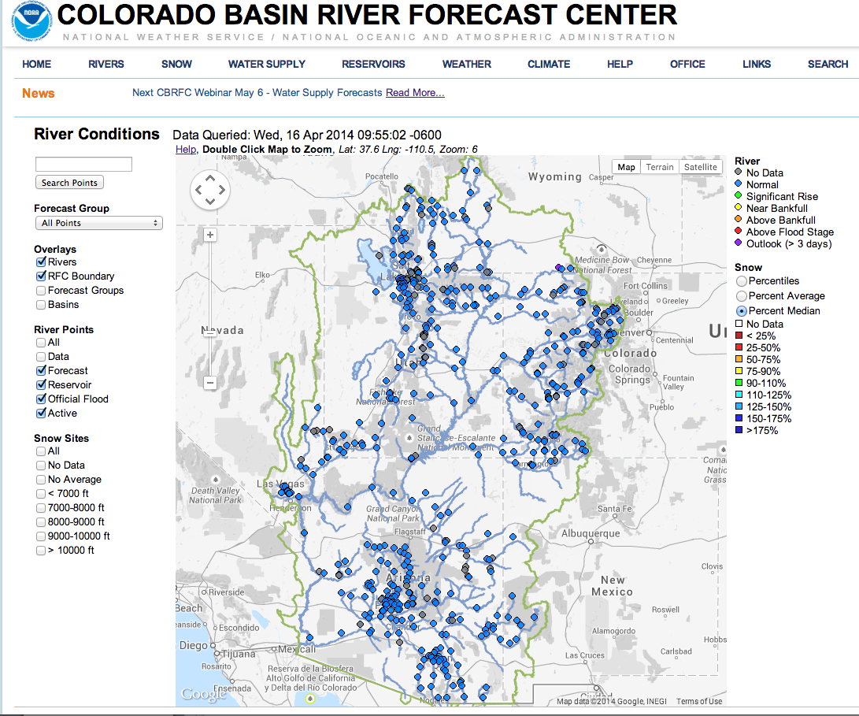
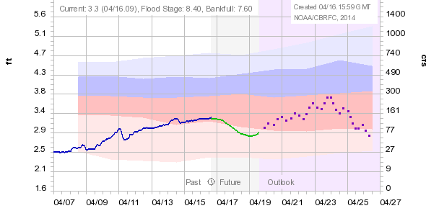
Streamflow Forecast
Hydrographs:
Flood forecasts
Recreational use
Deterministic
Updated daily
1-6 hour time step
10 days into the future
www.cbrfc.noaa.gov

Slide 4
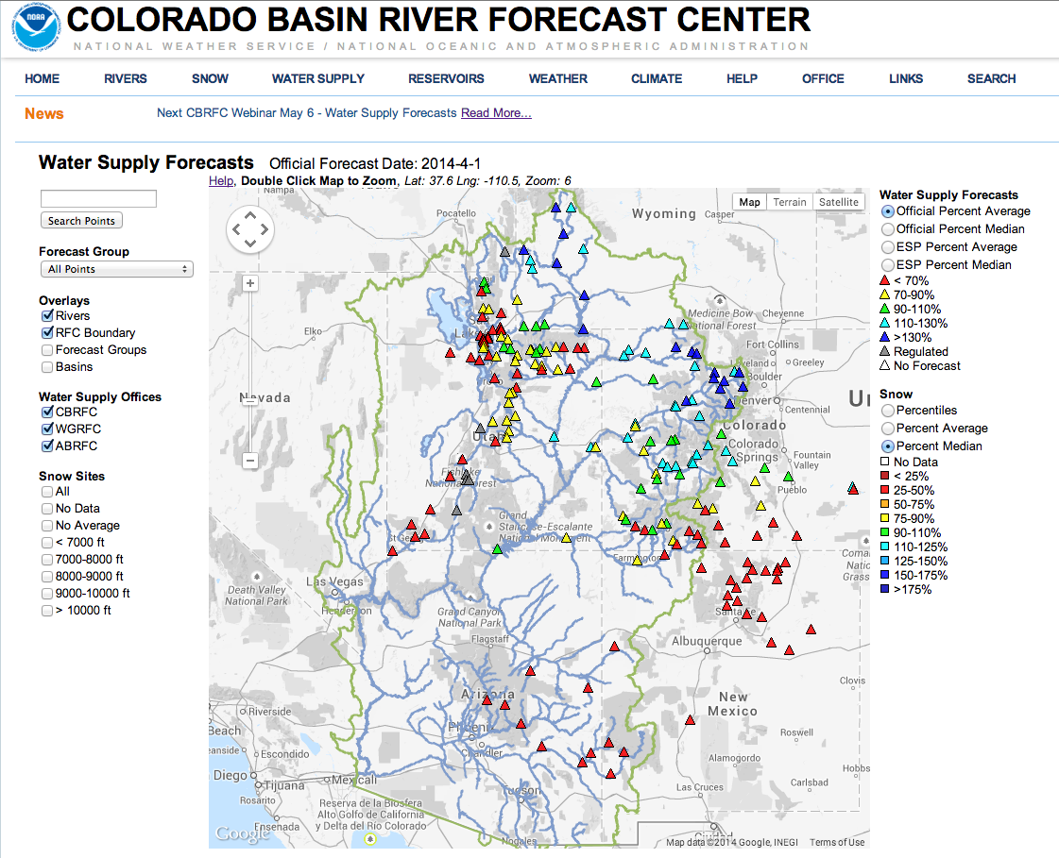
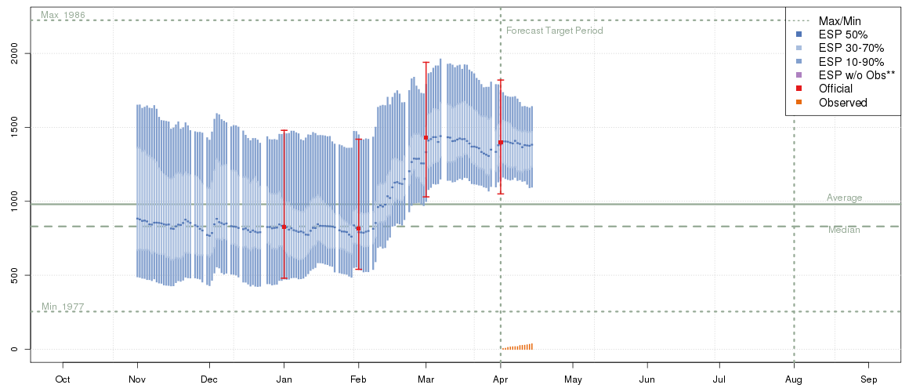
Water Supply Forecasts:
Forecast volume
Probabilistic
Usually monthly, or seasonal time step
Official forecast updated monthly – Guidance updated daily
1 to 5 years into the future
www.cbrfc.noaa.gov

Slide 5
CBRFC Hydrologic Model
Continuous – runs all the time, not just during events.
Conceptual – physically based, but uses parameters in place of hard-to-get data.
Lumped – uses mean areal inputs (temperature, precipitation); not distributed.

Slide 6
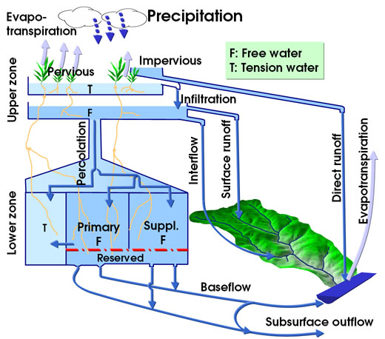
CBRFC Hydrologic Model
Conceptual Model
RFC forecast uses a snow model and a rainfall-runoff model:
  SNOW-17: Temperature index model for simulating snowpack accumulation and melt
  Sacramento Soil Moisture Accounting Model: Hydrologic model used to generate runoff

Slide 7
CBRFC Hydrologic Model
Composed of three major interrelated components.
Calibration System (CS)
determine model parameters
store historical data
Daily Operational Forecasts (DOF)
generate short term deterministic river forecasts
maintain model states
Ensemble Streamflow Prediction (ESP)
generate ensemble of hydrographs
generate probabilistic forecasts

Slide 8
Calibration System (CS)
Choose from a variety of models and processes
  Snow accumulation and ablation
  Soil moisture model
  Unit Hydrograph
  Channel routing
  Reservoir operations
Determine the optimal set of parameters for each model to best simulate flow
Store historical precipitation, temperature and flow time series for the basin
CS
DOF
ESP

Slide 9
Daily Operational Forecast(DOF)
Keeps track of model states, including soil moisture and snowpack
Quality Controlled Inputs
  Observed precipitation, temperature, and streamflow
  Forecast precipitation (5 days) and temperature (10 days)
Model adjusted by forecasters in real time
Run multiple times per day so there is continual quality control, updating and adjusting
Outputs 10 day regulated deterministic streamflow forecast
CS
DOF
ESP

Slide 10
Ensemble Streamflow Prediction (ESP)
Uses model states from DOF as starting point and can also use forecast precipitation (5 days) and temperature (10 days) inputs
Uses historical precipitation and temperature time series from CS and statistical distributions to derive probabilistic flow forecasts
Can adjust output for model bias
CS
DOF
ESP

Slide 11
Ensemble Streamflow Prediction Probabilistic Forecasts
Start with current conditions (from the daily model run)
Apply precipitation and temperature from each historical year
(1981-2010)
A forecast is generated for each of the years (1981-2010)
as if, going forward, that year will happen
This creates 30 possible future streamflow patterns.
Each year is given a 1/30 chance of occurring
Current hydrologic states :
River / Res. Levels
Soil Moisture
Snowpack
1981
1982
1983
….
2010
Past <-
-> Future Time

Slide 12
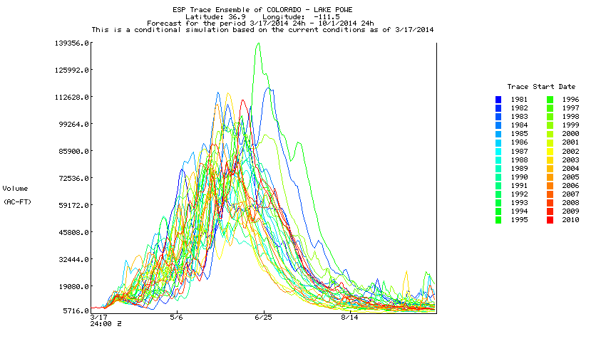
ESP Probabilistic Forecasts
# EMPIRICAL SAMPLE POINTS
# Cond.
#Trace Year Data Exceed.
# year Weight Point Prob.
# ---------------------------------
1981 0.033 10583427.0 0.290
1982 0.033 8372498.00 0.806
1983 0.033 12646544.0 0.065
1984 0.033 11904022.0 0.129
1985 0.033 11402967.0 0.161
1986 0.033 10406237.0 0.355
1987 0.033 8369501.00 0.839
1988 0.033 8719326.00 0.742
1989 0.033 7605042.50 0.935
1990 0.033 9761623.00 0.452
1991 0.033 9690117.00 0.484
1992 0.033 9298360.00 0.613
1993 0.033 10987106.0 0.226
1994 0.033 9395003.00 0.548
1995 0.033 14388755.0 0.032
1996 0.033 8611564.00 0.774
1997 0.033 10736442.0 0.258
1998 0.033 10159611.0 0.419
1999 0.033 12520652.0 0.097
2000 0.033 8252478.50 0.871
2001 0.033 9312369.00 0.581
2002 0.033 6439105.00 0.968
2003 0.033 9439112.00 0.516
2004 0.033 8867351.00 0.710
2005 0.033 10415361.0 0.323
2006 0.033 8235550.00 0.903
2007 0.033 8964843.00 0.645
2008 0.033 8954274.00 0.677
2009 0.033 11320183.0 0.194
2010 0.033 10185848.0 0.387
1
2
# Exceedance Conditional
# Probabilities Simulation
# -----------------------------
0.900 8237243.000
0.800 8420311.000
0.700 8893428.000
0.600 9303964.000
0.500 9564614.000
0.400 10175353.000
0.300 10533006.000
0.200 11253565.000
0.100 12458982.000
3
The flows are summed into volumes for the period of interest (typically April 1 – July 31)
The statistics are simplified
50% exceedance value approximates the most probable forecast

Slide 13
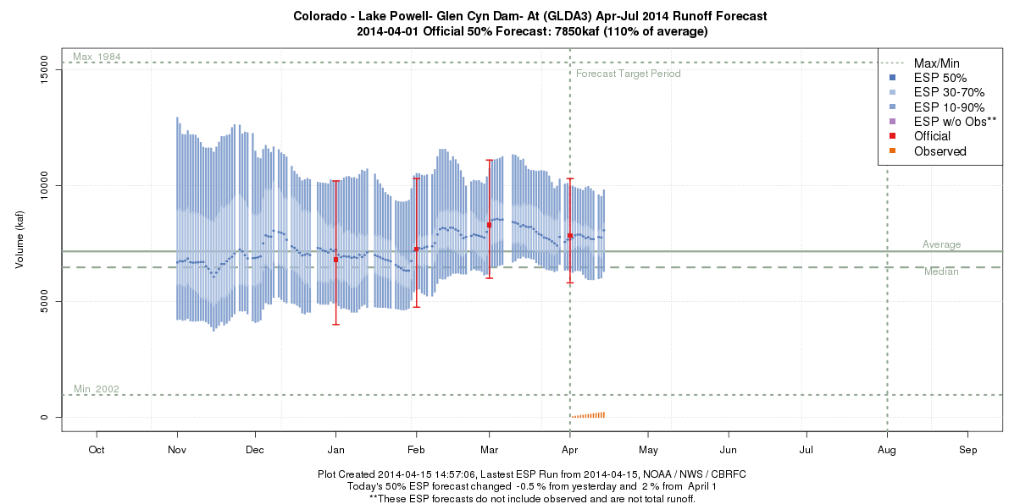
Water Supply Forecasts
Target is April-July unregulated runoff volume.
Mostly ESP; sometimes adjusted based on hydrologist expertise or additional model guidance
Official forecast issued once a month January through June
ESP guidance run daily

Slide 14
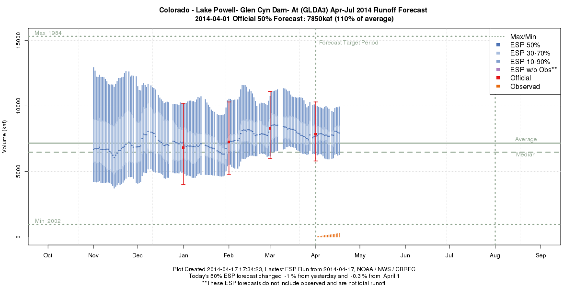
Forecast Evolution Plot
RAW ESP
OFFICIAL FORECAST
10%
30%
50%
70%
90%
10%
50%
90%

Slide 15
Water Year Outlooks for Reclamation’s 24-Month Study
Forecasts of monthly unregulated volumes through the end of the water year (September).
Uses the raw ESP monthly volumes along with the official April-July water supply forecast.
  Ensure individual month volumes for April through July equal official April-July total volume.
Issued the beginning of each month.
  Begin issuing the following water year in June.

Slide 16
24-MonthStudy Model
Unregulated Inflow Forecast
Upper Basin Inflows and Model Run Duration (Most Probable)
Notes:
Current year operations and tier determinations are based on official CBRFC forecasts
Out-year projections for planning purposes are based on historical statistics

Slide 17
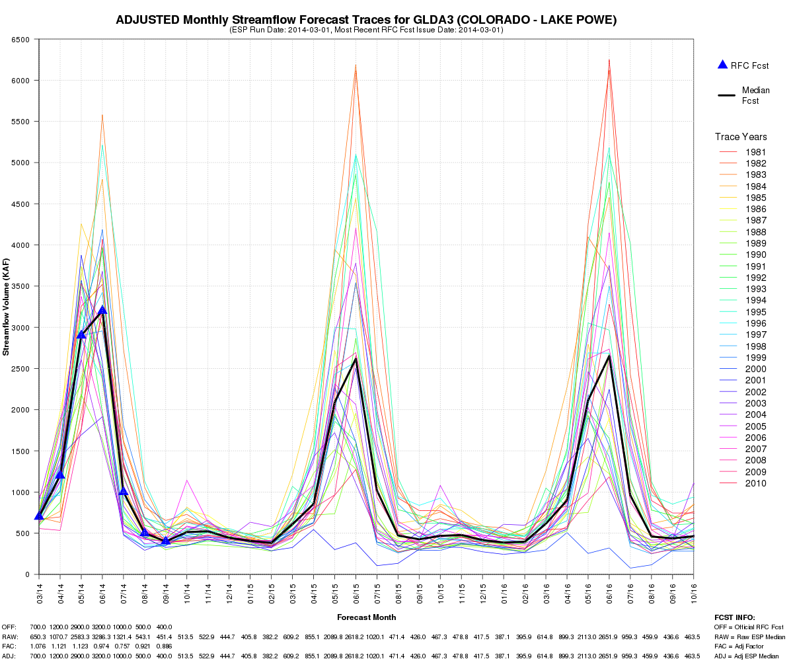

Slide 18
Improving CBRFC Forecasts
Improved snow modeling
  Collaboration with Utah State University
  Collaborations with Jet Propulsion Lab to use NASA snow cover grids to inform model
Incorporating climate information
  Hydrologic Ensemble Forecasting System (HEFS)
  Climate informed ESP
Post adjusting ESP

Slide 19
Thank you!
Michelle Stokes
Hydrologist in Charge
Colorado Basin River Forecast Center
Michelle.stokes@noaa.gov

