Slide 1
NOAA’s Colorado Basin River Forecast Center
CBRFC Efforts to Quantify
Water Supply Uncertainty
And Improve Skill
Michelle Stokes, Hydrologist in Charge
SCH Call
November 17, 2014

Slide 2
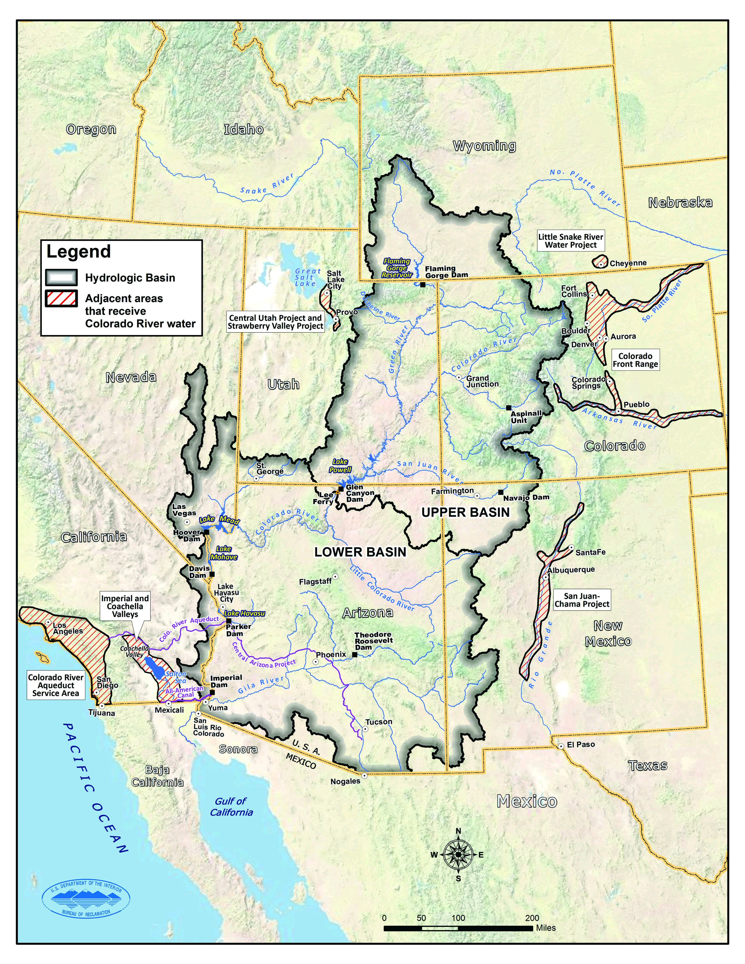
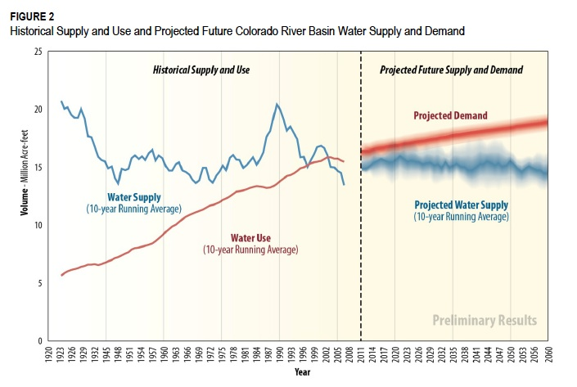
Colorado River
25 million people rely on Colorado River water
3.5 million acres of irrigation
85% of runoff comes from above 9000 feet

Slide 3
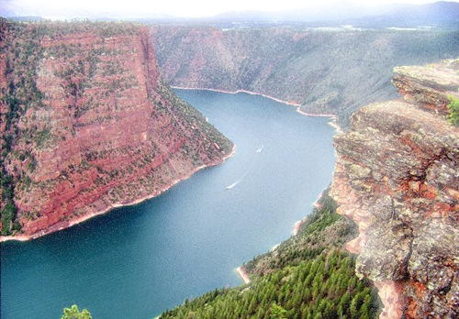
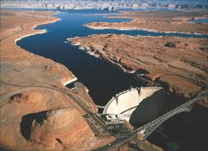
Water Supply = IDSS
Reservoir operators make important decisions every year on how to operate the major reservoirs on the Colorado, based on CBRFC forecasts
Millions of $ impacts (water supply, water storage, potential shortage, etc..)
-> Scrutiny of CBRFC forecasts
-> How to improve?

Slide 4
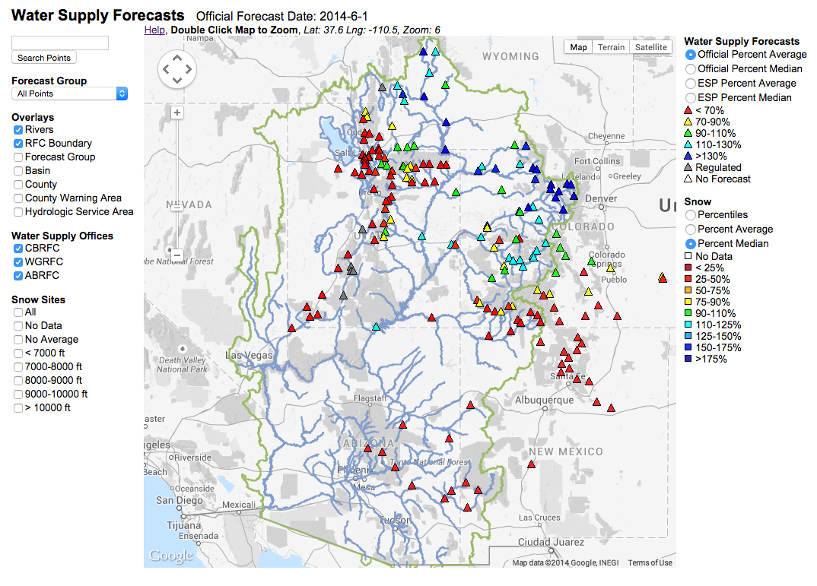
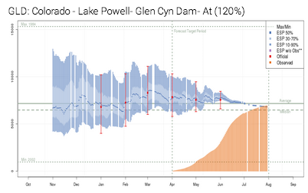
Water Supply at the CBRFC
159 locations
Mostly ESP – SWS as a check
Daily updates Nov – Jul
“Official” forecasts Jan 1 through Jun 1, once a month

Slide 5
Improving Snow Modeling
JPL/NASA remote sensed snow information (MODIS)
Help with mods snow during runoff
Impacts of dust on snow
New SNOTELs when possible
Funded by Stakeholders in some cases
Utah State University – Utah Energy Balance Snow Model
In CHPS with CBRFC config files
Currently looking at results
April 11, 2014

Slide 6
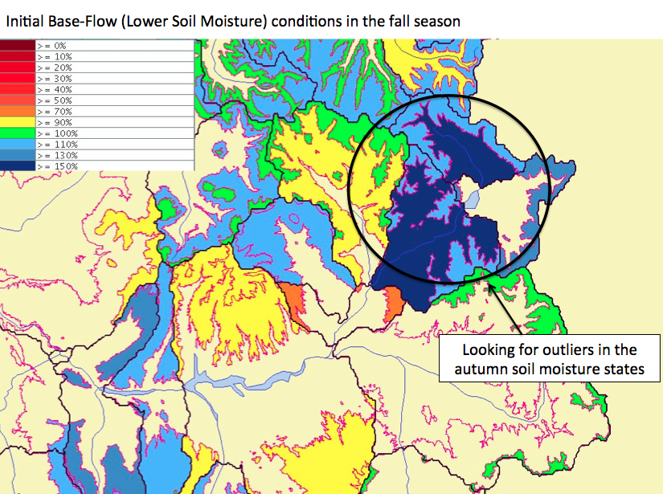
Improving Soil Moisture
Sensitivity analysis –> Modeled soil moisture can affect the volume forecast by up to 10%
CHPS spatial displays to help set model states for base flow in the fall
Looking at observed soil moisture data from SNOTELs

Slide 7
FROMUS
Forecast and Reservoir Operation Modeling Uncertainty Scoping Team
Stakeholder meeting focused on Drought
Main recommendation: NOAA and Reclamation to work together to conducts an analysis of sources of errors and uncertainty in forecasting and operation modeling

Slide 8
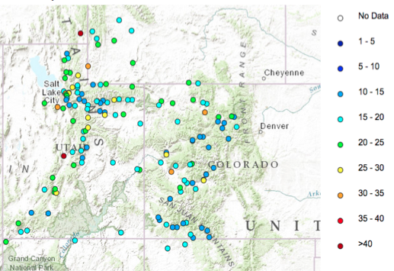
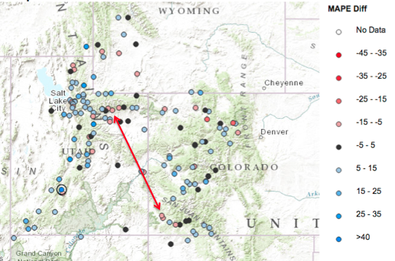
Verification
Model Mean Absolute Percent Error
2014 skill vs Mean Model Mean Skill

Slide 9
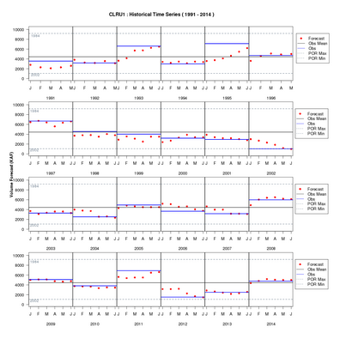
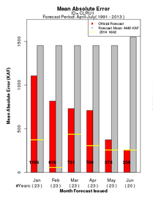
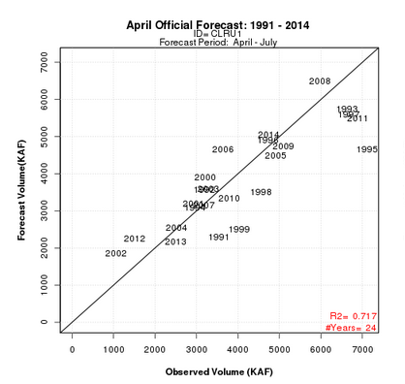
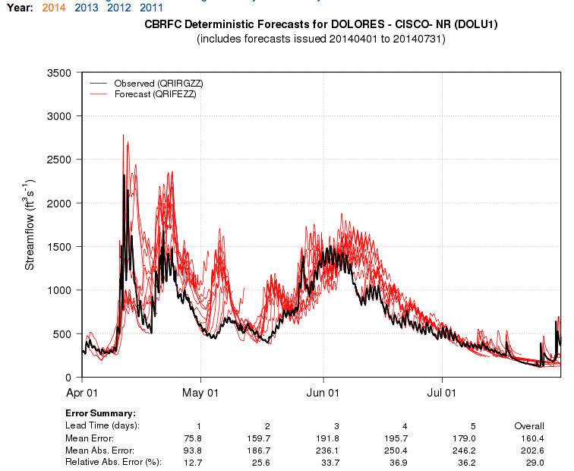
Verification - Cont

Slide 10
Questions?

