Slide 1
CBRFC Forecast Products: Where, When, and What is Issued?
NOAA’s National Weather Service
Colorado Basin River Forecast Center
CBRFC Fourth Annual Stakeholder Forum
February 25th– 26th, 2014
Salt Lake City, Utah
NOAA’s National Weather Service

Slide 2
Overview
Daily Model
Accessing
Interpretation
Daily ESP
Seasonal Water Supply Forecasts
Peak Flow Forecasts
Discussion

Slide 3
Overview
Seasonal
Water Supply/
Peak Flow
ESP Traces
Daily ESP
10-Day Forecast
Daily Forecast Operations
Increasing Stakeholder Reach
Increasing Stakeholder Engagement

Slide 4
What you should take away…
We incorporate information from a variety of sources to come up with our forecasts, which are distributed at various intervals throughout the month during the year.
ESP is becoming our primary forecasting tool for water supply.
Our products can evolve to meet your needs, so let us know!

Slide 5
Daily Model
Part 1:

Slide 6
Daily Model
Deterministic forecast that is updated at least once daily, though more frequently during times of hydrologic significance
Coupled, lumped, hydrologic model within the Community Hydrologic Prediction System (CHPS)
Sacramento Soil Moisture Accounting (SAC-SMA)
SNOW-17 (Temperature-indexed snow accumulation/melt model)
Dependent on observed temperature, precipitation, freezing level, and reservoir data

Slide 7
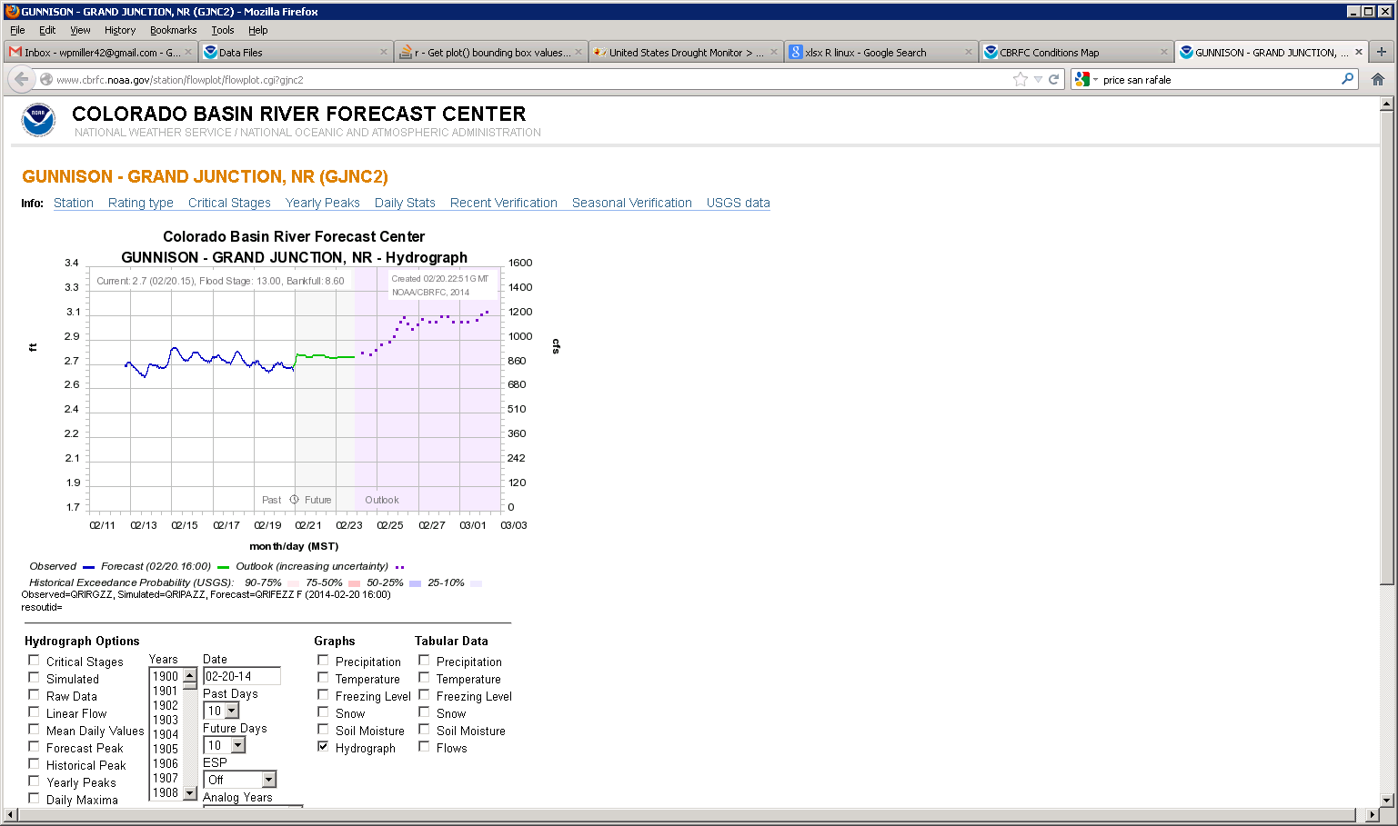
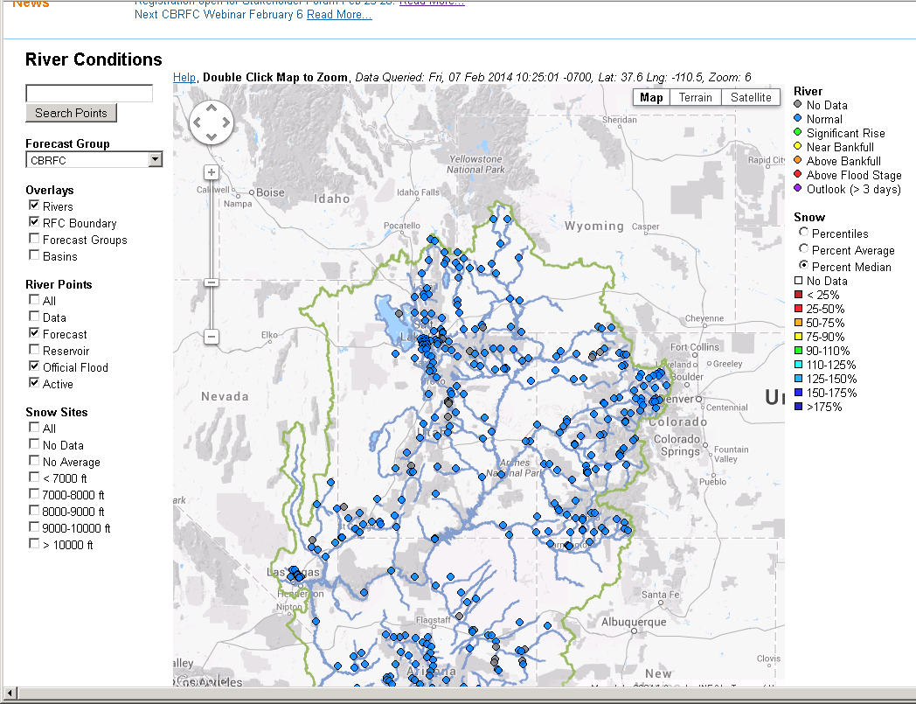
Daily Model
BIG COTTONWOOD CK - SALT LAKE CITY, NR BCTU1 925 430 798 176 05/16/14 5/18 - 6/7
The results of this model output are ultimately what is available through the CBRFC website
Click here to start web demonstration

Slide 8
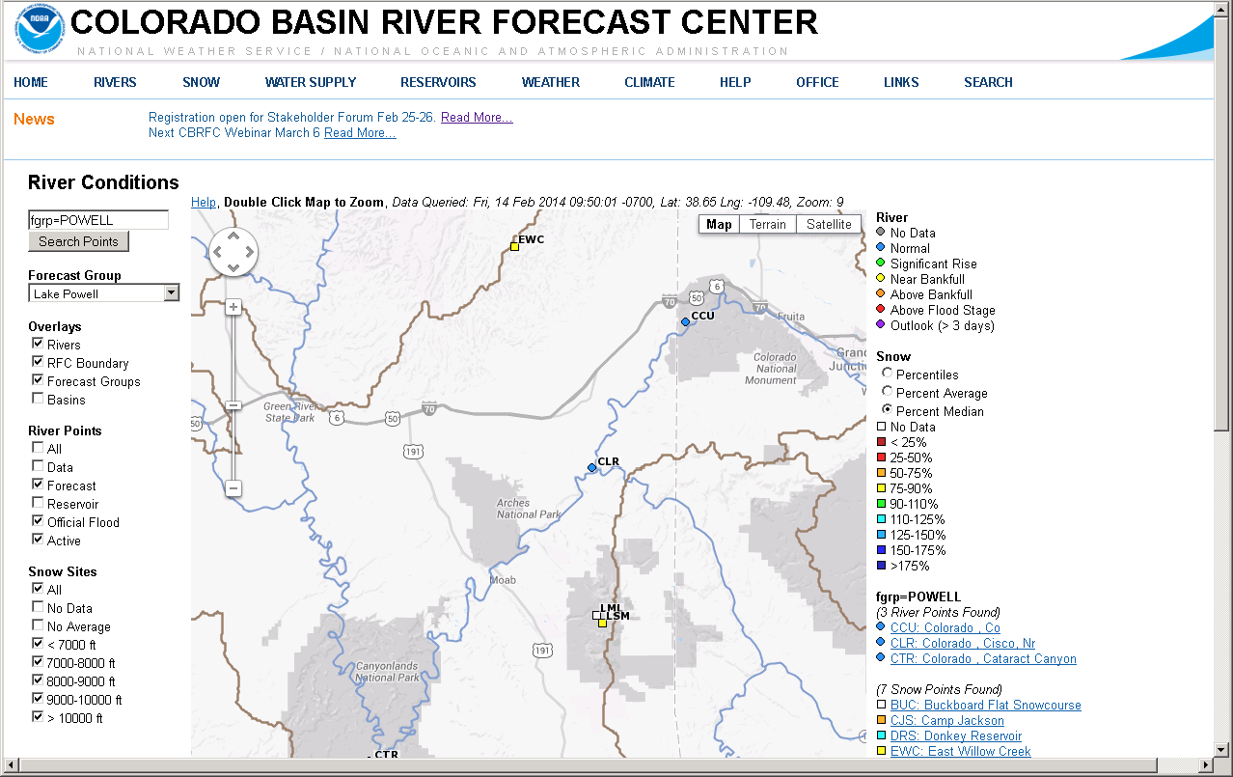
See areas of hydrologic interest
Conveniently zoom to
a selected area of interest
Options to customized your map
I’ve added SNOTEL sensors in the Lake Powell region

Slide 9
Observed Data
Forecasted Data
Options to customize the hydrograph

Slide 10
Daily Model
CBRFC forecasts and supporting data are available through the CBRFC website. Forecasts are plotted together with historical exceedance probabilities derived from the USGS gage record.
CBRFC incorporates 10 days of forecasted temperature data and 5 days of forecasted precipitation data into these forecasts. These are REGULATED values.
Because of their dependence on weather forecasts which become less certain with increasing lead time, CBRFC streamflow forecasts also become less certain with increasing lead time.
Forecasts are usually available by 10:00 a.m. every day.

Slide 11
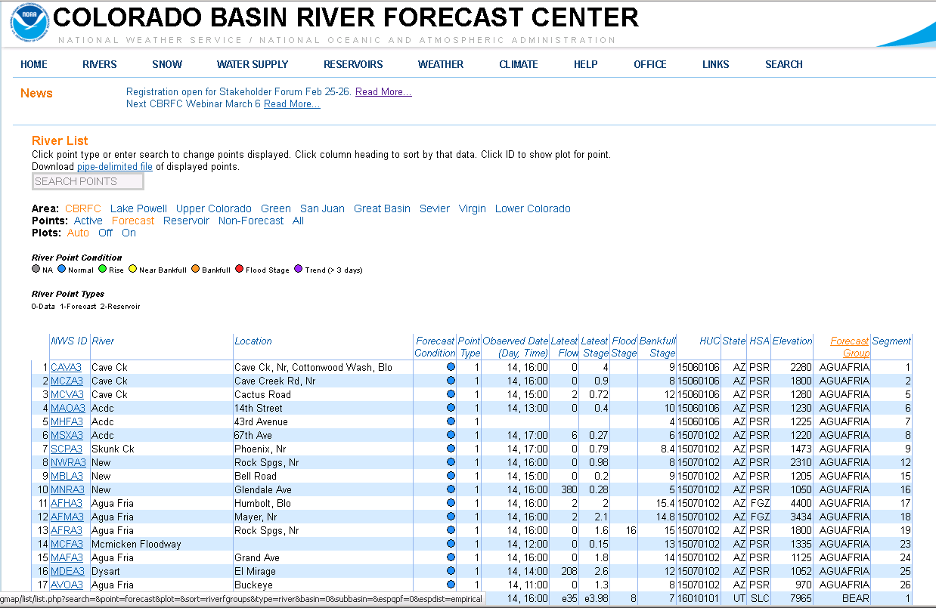

Slide 12
So….
What does Daily forecasting tell us?
It gives us a forecast of instantaneous flow at defined model points using current hydrologic conditions, along with 5 days of precipitation and 10 days of temperature forecasts. Any information we have regarding regulation and diversions is also included.
When does it tell us?
Every day at least, more frequently during times of hydrologic interest.

Slide 13
Daily ESP Forecast
Part 2:

Slide 14
Daily ESP Forecast
Ensemble Streamflow Prediction
Run daily with updated initial conditions
Uses historical temperature and precipitation (currently using 30 traces from 1981-2010)
Four separate runs are produced
Unregulated with 5 days QPF
Unregulated without QPF
Regulated with 5 days QPF
Regulated without QPF

Slide 15
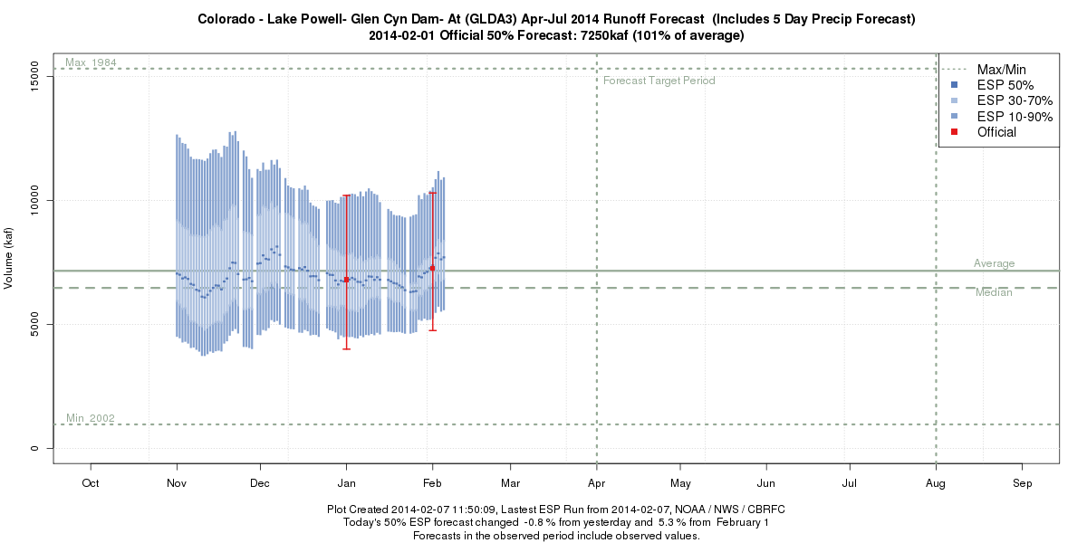
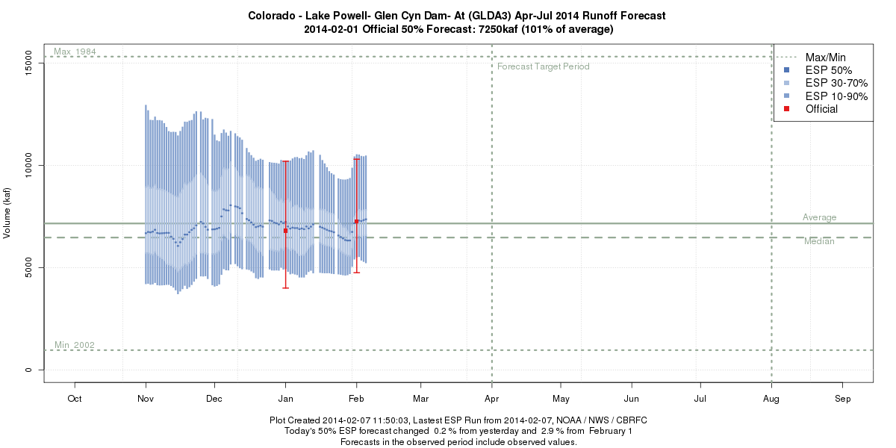
Daily ESP Forecast
With 5-day QPF
Without 5-day QPF
Click here to start web demonstration

Slide 16
Daily ESP Forecast
The daily ESP forecast period changes depending on whether or not we are in the forecast period
For example, in the Upper Colorado River Basin, we forecast for the April through July runoff volume
After April 1st, we forecast from the current day through July
It is important to account for the observed volume when we are in the forecast period

Slide 17
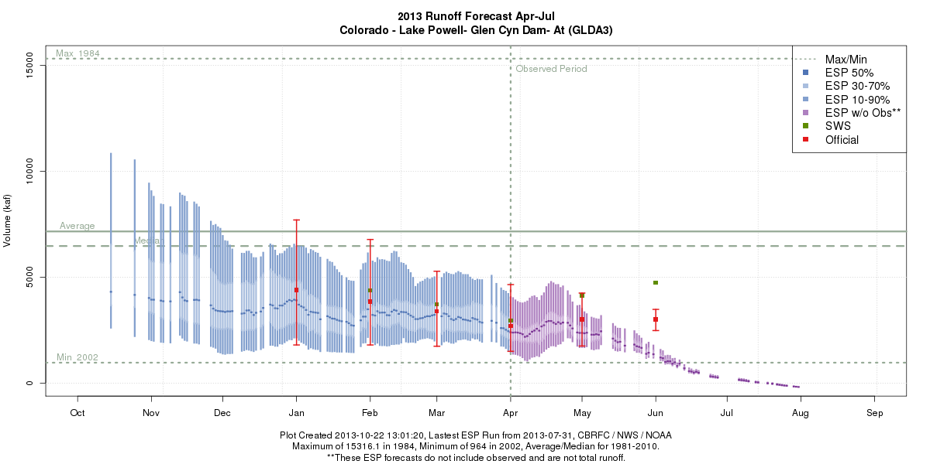
Daily ESP Forecast
Without observations, our forecast is not as intuitive.

Slide 18
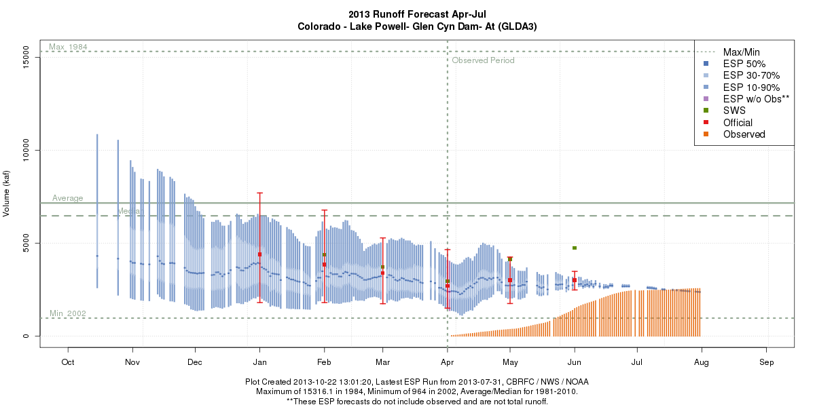
Daily ESP Forecast
Residual period needs to take into account observed volume within the forecast period

Slide 19
Daily ESP Forecast
Current Day | What Daily ESP Forecast Evolution Plot Shows
Early November through April 1st (January 1st in the Lower Colorado River Basin) | Daily ESP forecast for April through July (January through May* in the LCRB)
After April 1st (January 1st in the LCRB) | Observed streamflow volume for Apr 1 (Jan 1 in LCRB) to current day + Forecasted streamflow for the current day through July 31st (May 31st in the LCRB)
*Seasonal forecast for LCLA3 is January through June.

Slide 20
So….
What does our daily ESP water supply forecasts tell us?
They give us a forecast of (usually) April – July unregulated volume at specific forecast points. They give us an idea of the trend the forecasts are taking in response to current conditions.
When does it tell us?
Every day, shortly after the beginning of the water year, through July.

Slide 21
Seasonal Water Supply Forecasts
Part 3:

Slide 22
Seasonal Water Supply Forecasts
Water supply forecasts are issued monthly by the CBRFC, near the beginning of each month.
Forecasters rely on a combination of guidance from an analysis of ESP output, Statistical Water Supply (SWS) output, and expertise to develop water supply products
Water Supply Forecasts are typically UNREGULATED flow volume forecasts.
In the Upper Colorado River and Great Basins, forecasts are for the April through July season. In the Lower Colorado River Basin, forecasts are for the January through May season.

Slide 23
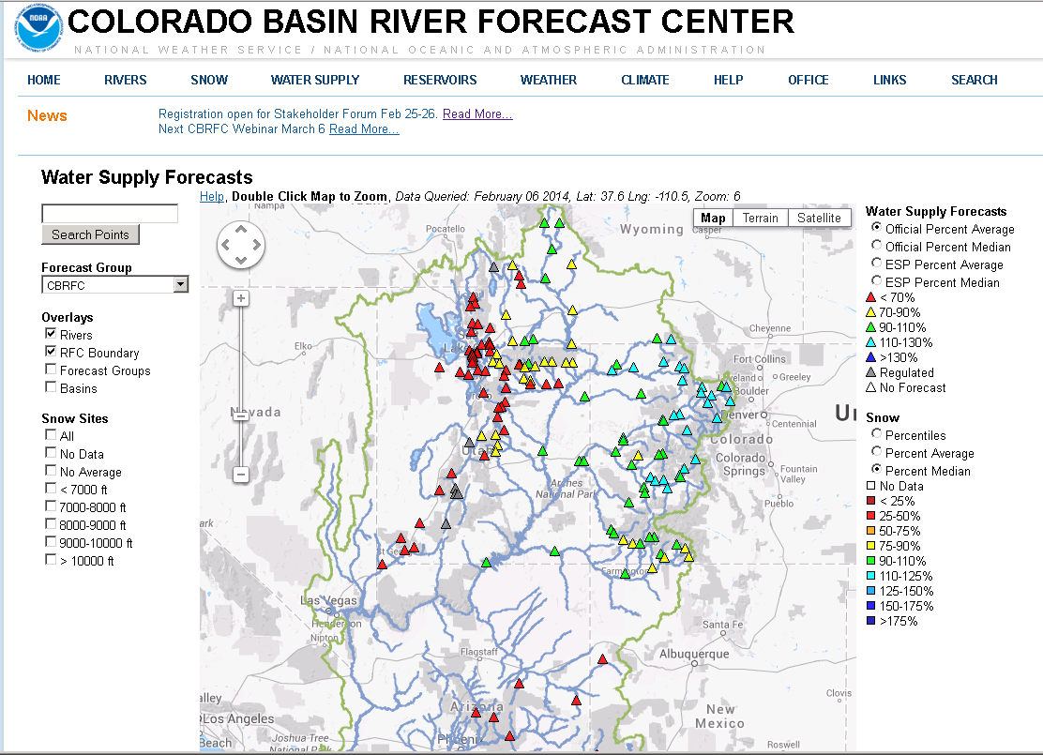
Click here to start web demonstration

Slide 24
Seasonal Water Supply Forecasts
On a day to day basis, ESP is approved by a forecaster; however, a detailed examination of model states and conditions is not done.
“Jumps” in daily ESP could be due to a number of factors.
Recent storm activity
Update to model states (e.g., snow, soil moisture, etc…)

Slide 25
So….
What do water supply forecasts tell us?
They give us a seasonal forecast of (usually) unregulated inflow volume at specific forecast points. They are based on guidance from SWS and ESP tools, as well as forecaster expertise.
When does it tell us?
Typically monthly. April – July forecasts are typically available from January through July.

Slide 26
Peak Flow Forecasts
Part 5:

Slide 27
Peak Flow Forecasts
The CBRFC generates peak flow forecasts throughout the snowmelt runoff season, as needed from March to end of runoff season
Represents mean daily peak flow during the April – July runoff period
Presented in terms of exceedance probabilities
Developed using ESP
Most applicable to headwater basins, for recreationalist, flood control, and wildlife managers

Slide 28
Peak Flow Forecasts
Probabilistic forecast
Issued monthly
10%, 25%, 50%, 75%, 90% exceedance probabilities
Approximately 80 points
Accounts for diversions and reservoir regulation, similar to daily forecasts

Slide 29
Spring Weather Really Matters
Runoff characteristics are largely determined by the day-to-day spring weather.
While large snow pack years increase chances for flooding, it is not an inevitability (dodged a bullet at many sites in 2011)
Small snow pack years can flood with the right sequence of spring temperatures and with flows enhanced by precipitation.
Rain events may play a larger role in the magnitude of the peak flow during very low snow years.
Keep an eye on our web page / daily forecasts

Slide 30
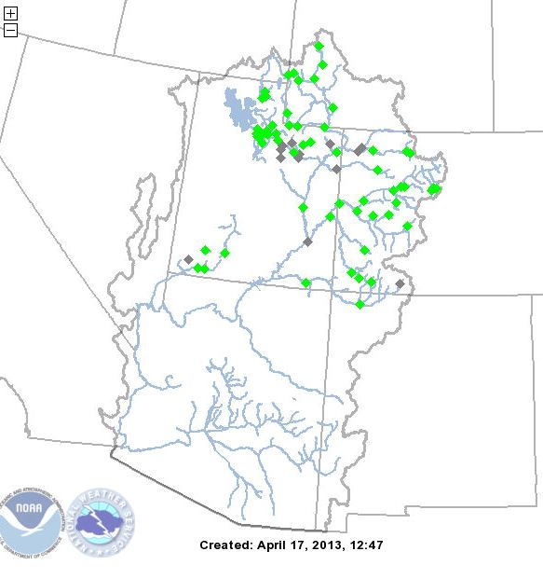
This is our old peak flow map. We’re hoping to have something similar for this season.

Slide 31
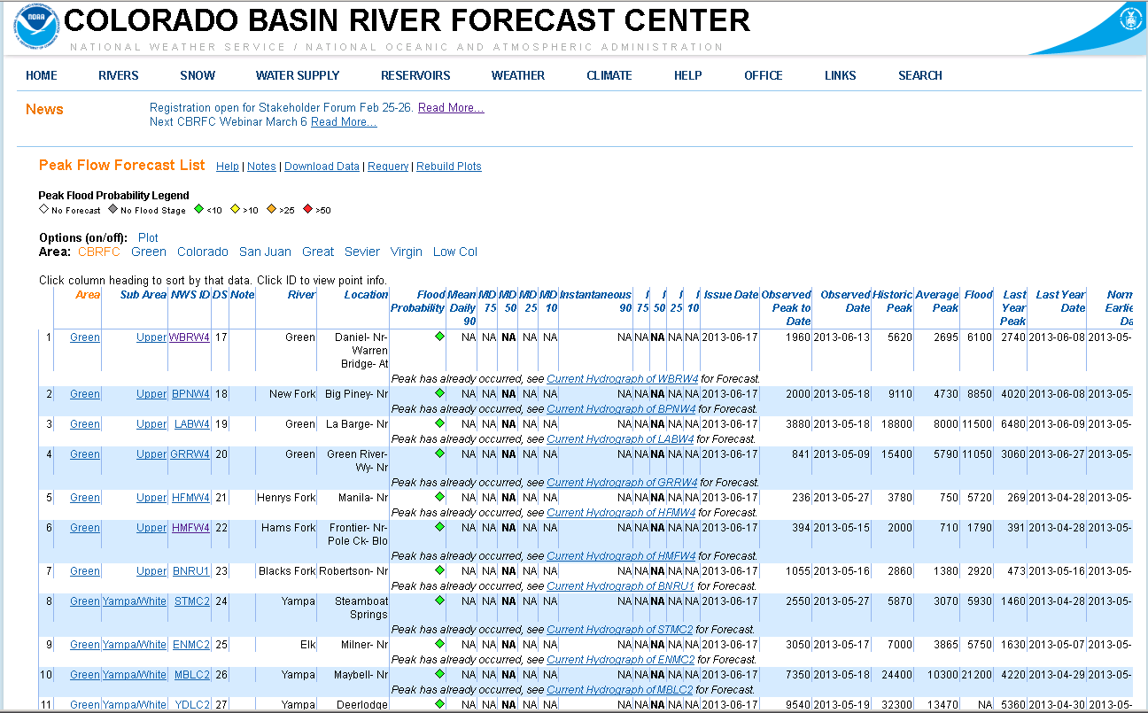
Click here to start web demonstration

Slide 32
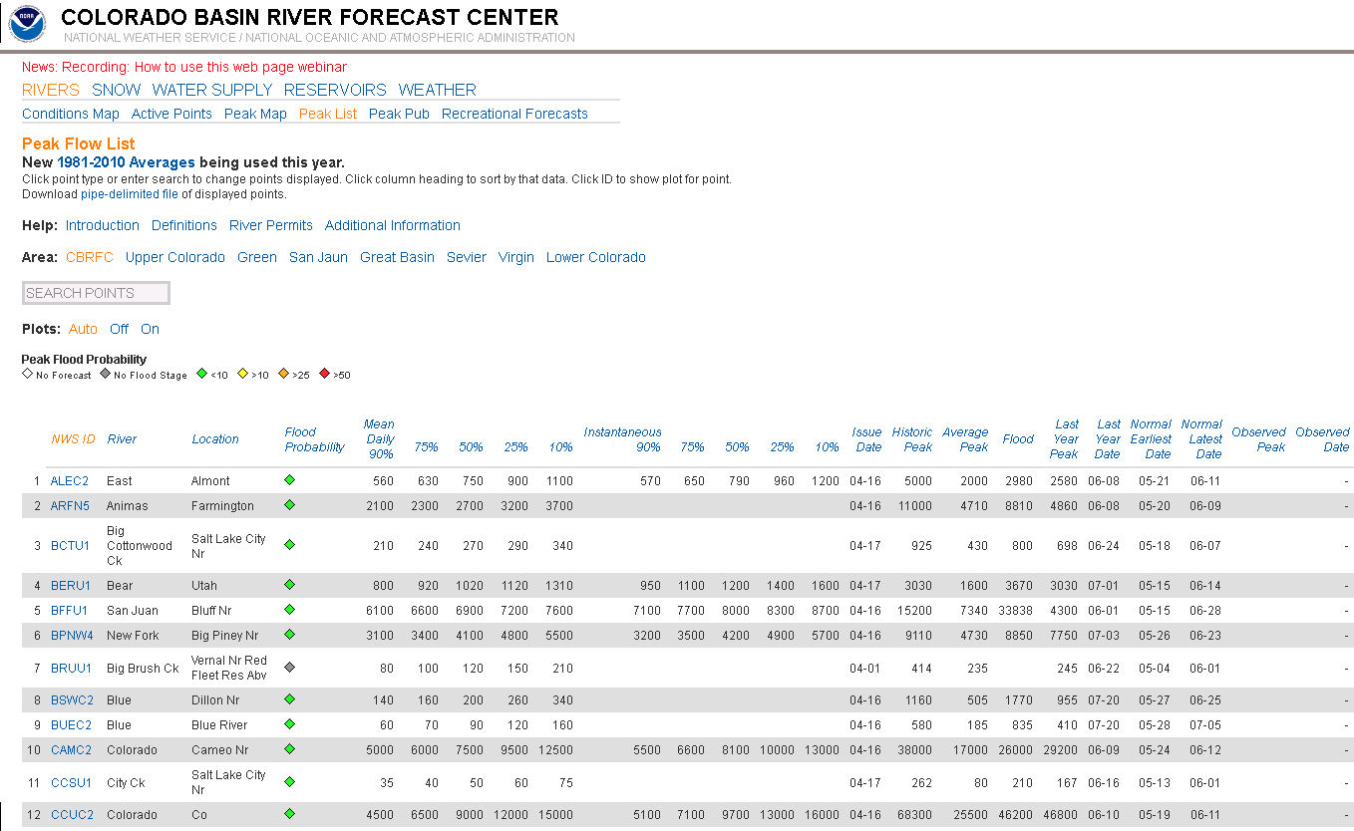
Previous years show probabilistic distribution of peak flows.

Slide 33
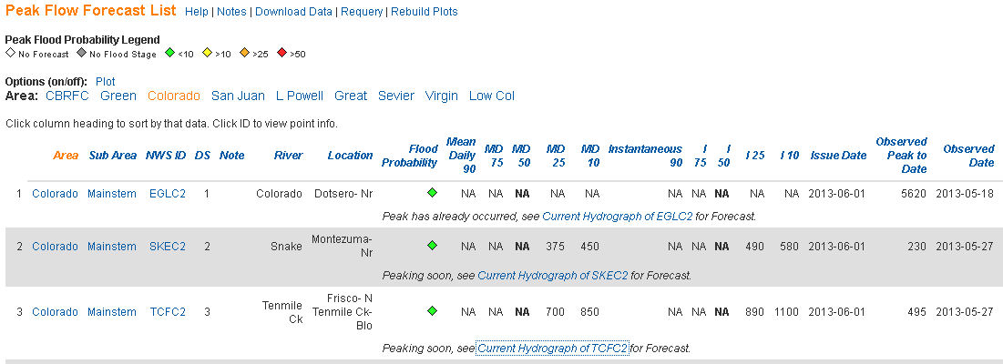
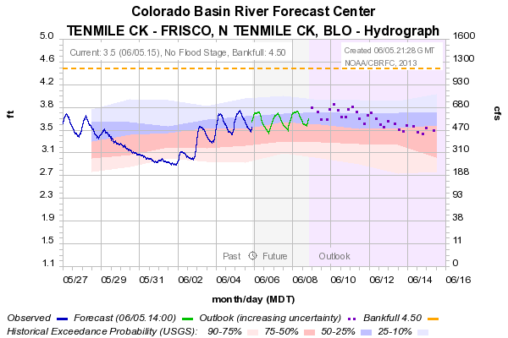
When a peak nears occurrence, DO NOT use the peak flow list. Instead, look at the daily hydrograph.

Slide 34
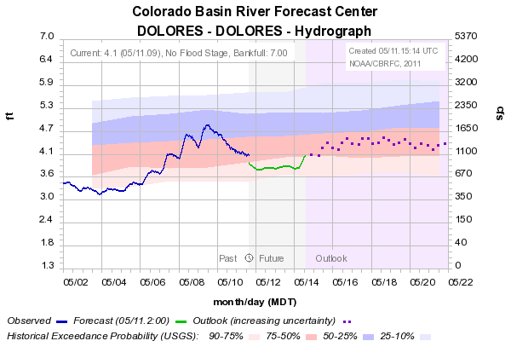
Accounting for diurnal variation daily mean to instantaneous peak adjustment
some rivers have predictable diurnal melt variations
instantaneous peak exceeds daily mean
RFC ESP forecasts simulate the daily mean (from 6 hr models)
we now use the observed relationship between daily mean and instantaneous peak to relate our daily mean peak forecast percentiles to instantaneous peaks

Slide 35
So….
What do peak flow forecasts tell us?
They tell us the highest expected daily mean flow value during the spring runoff period.
When does it tell us?
Monthly (or more as needed), between March and the end of the runoff period.

Slide 36
Discussion

Slide 37
Some thoughts…
Do you access the daily ESP graphics on the CBRFC website? Are they informative?
How do you receive CBRFC forecasts? How do you want to receive them?
Is the difference clear between what drives the short term deterministic vs. the long range probabilistic forecasts?

Slide 38
Extra Slides

Slide 39
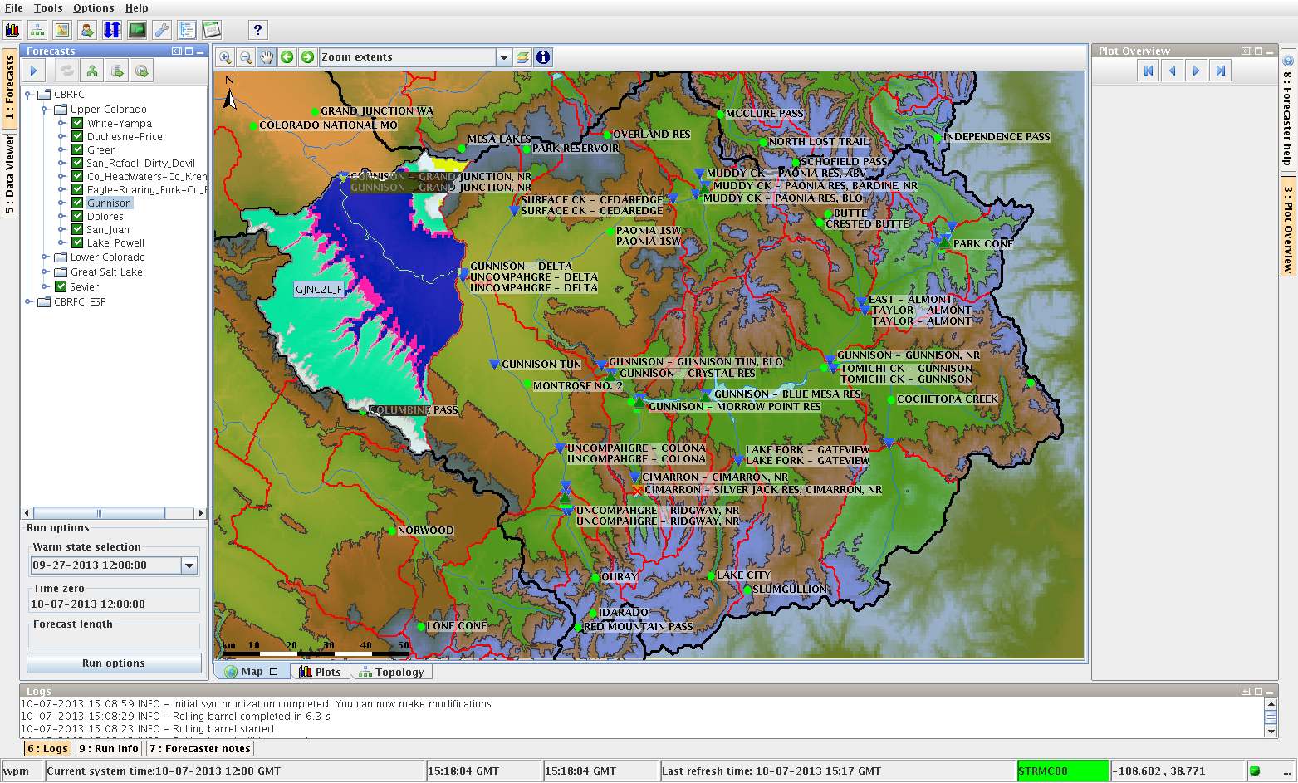
Daily Model
The Gunnison River Basin is divided into lumped catchments. Flow is typically routed from one catchment to downstream catchments. The furthest downstream catchment in the Gunnison is highlighted here.

Slide 40
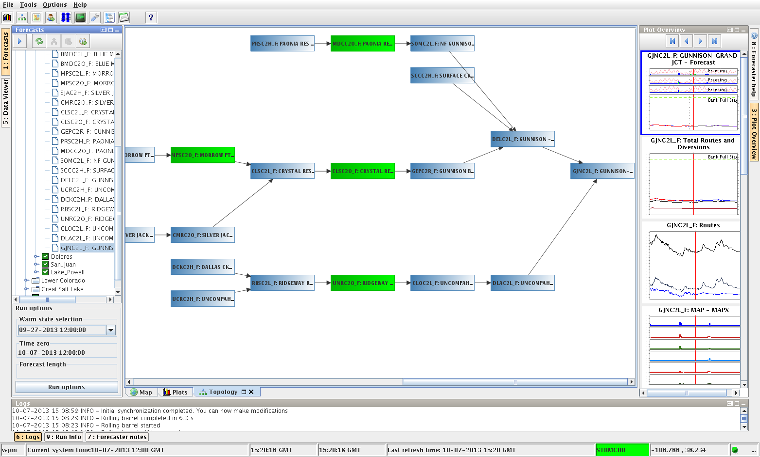
Daily Model
As shown in this stick diagram, headwater catchments flow into downstream catchments, which, in turn, contribute to flow further downstream.

Slide 41
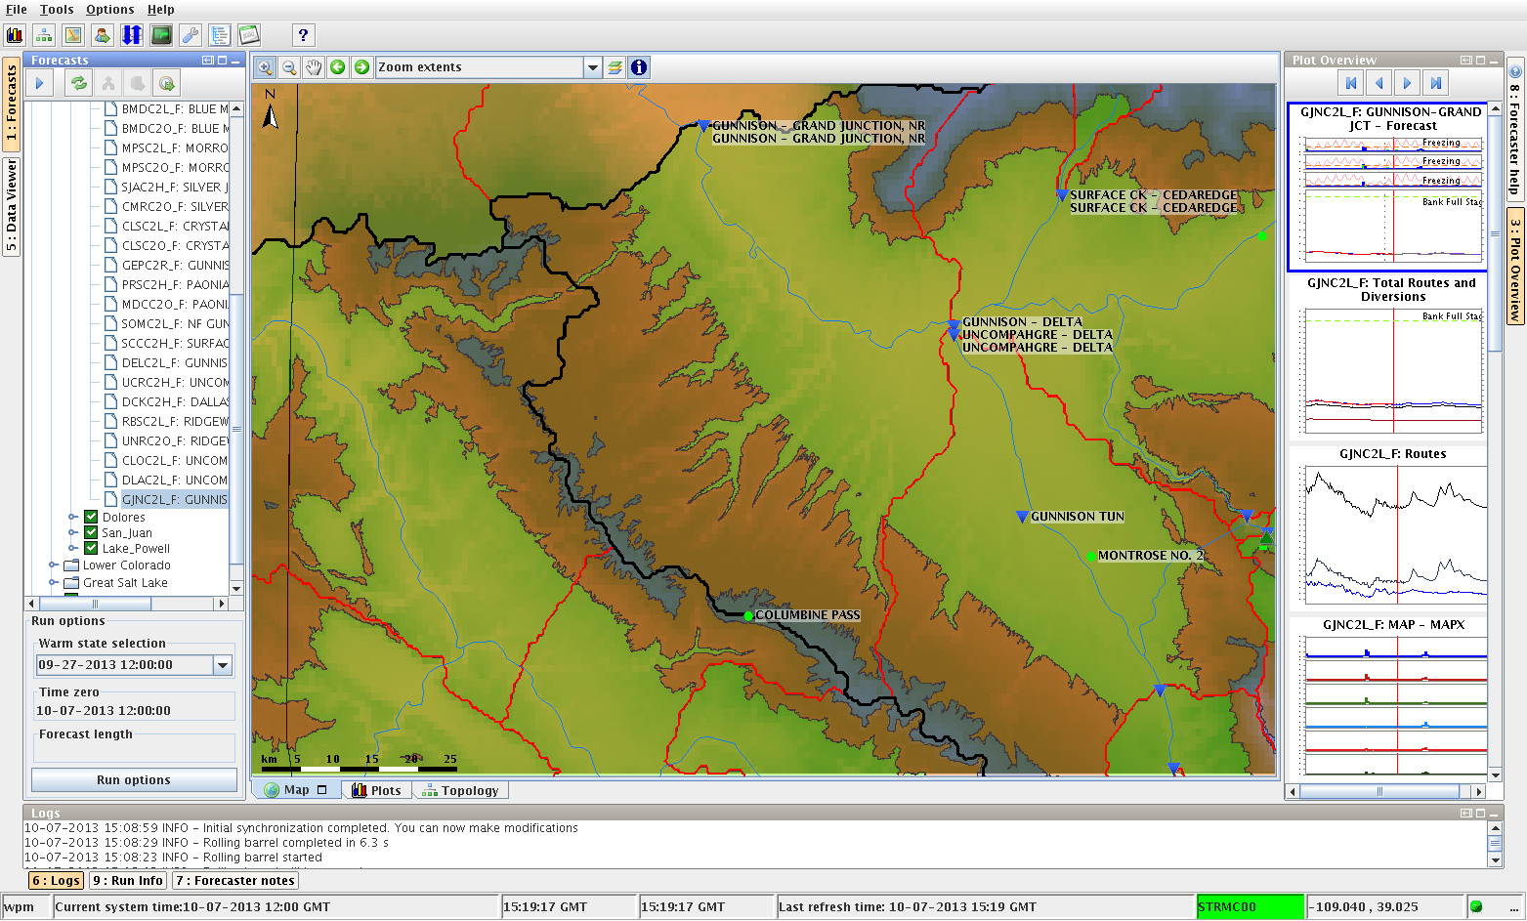
Daily Model
Each catchment is separated into 1 to 3 zones, depending on catchment size and topographic variability. Here, an upper (gray), middle (brown), and lower (green) zone are apparent.

Slide 42
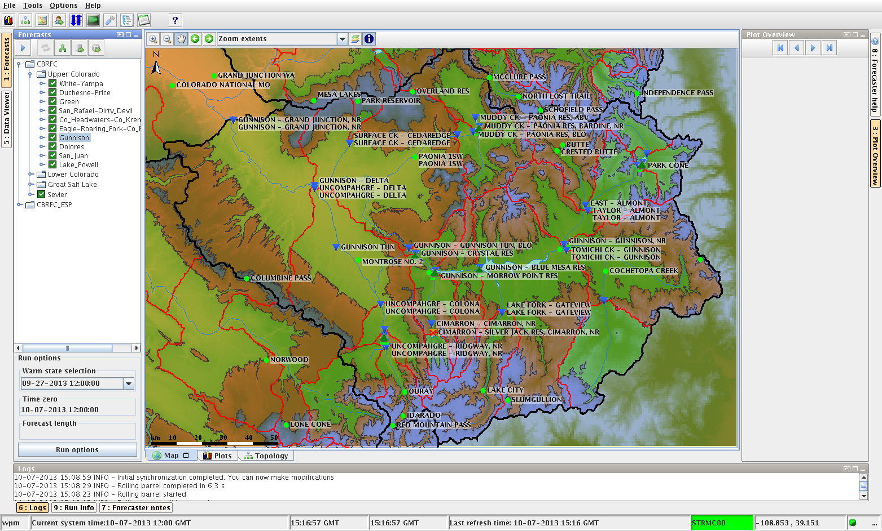
Daily Model
As an example, the Gunnison River Basin is shown here.

Slide 43
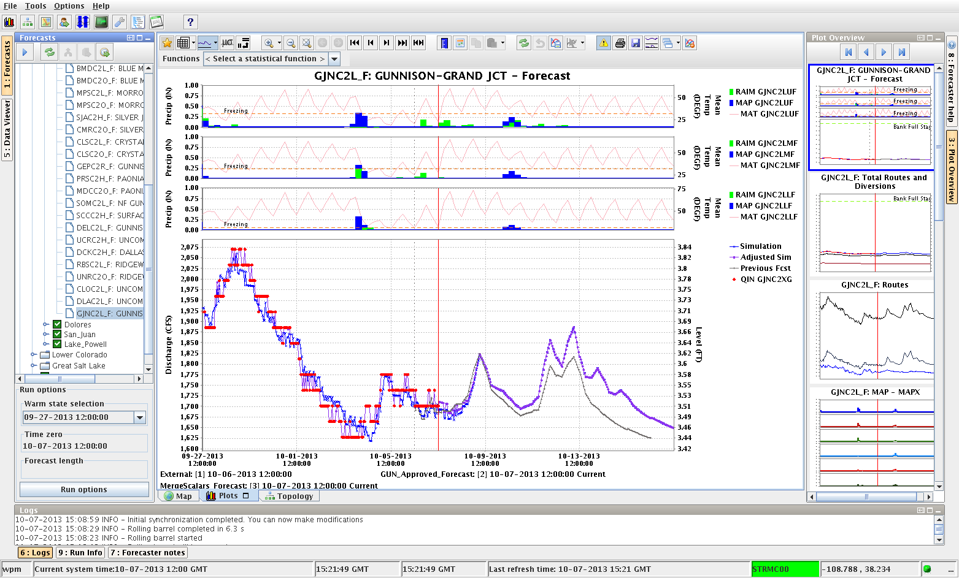
Daily Model
Forecasters adjust SAC-SMA and SNOW-17 input parameters within the CHPS framework in an effort to produce the most accurate forecast possible.

Slide 44
ESP Forecast Traces
ESP Forecast Traces are not equivalent to Daily ESP output. The traces are adjusted
It is important to note that the adjustment is solely done for the benefit of stakeholders in their modeling efforts
Allows Reclamation to compare 24 Month Study to MTOM output more directly
Adjustment factors are not representative of an ESP bias or error
Adjustment is done more for numerical or statistical purposes than for physical reasons

Slide 45
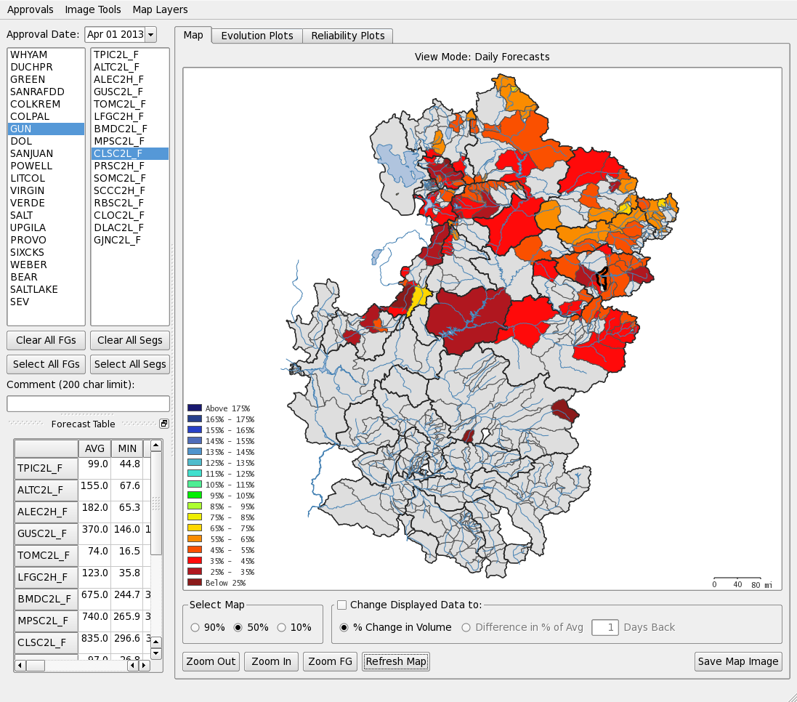
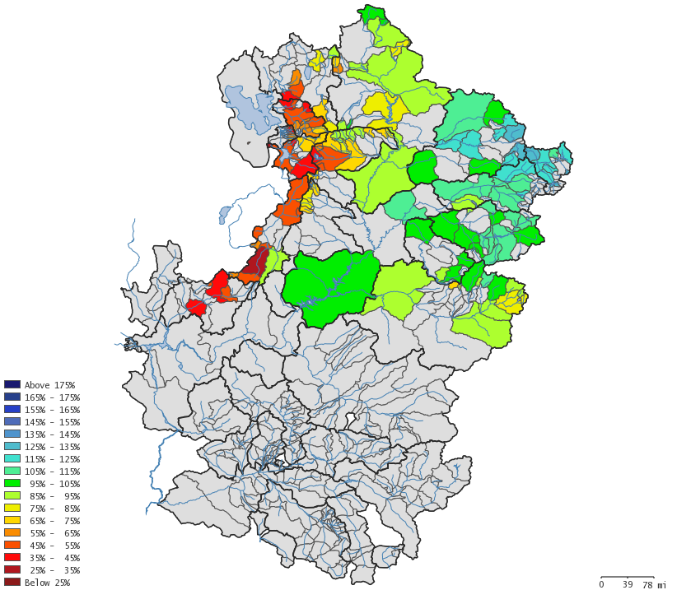
This Water Supply Approval Tool allows forecasters to compare output from SWS and ESP, historical flow volumes, and compare spatial differences between basins before publication.

Slide 46
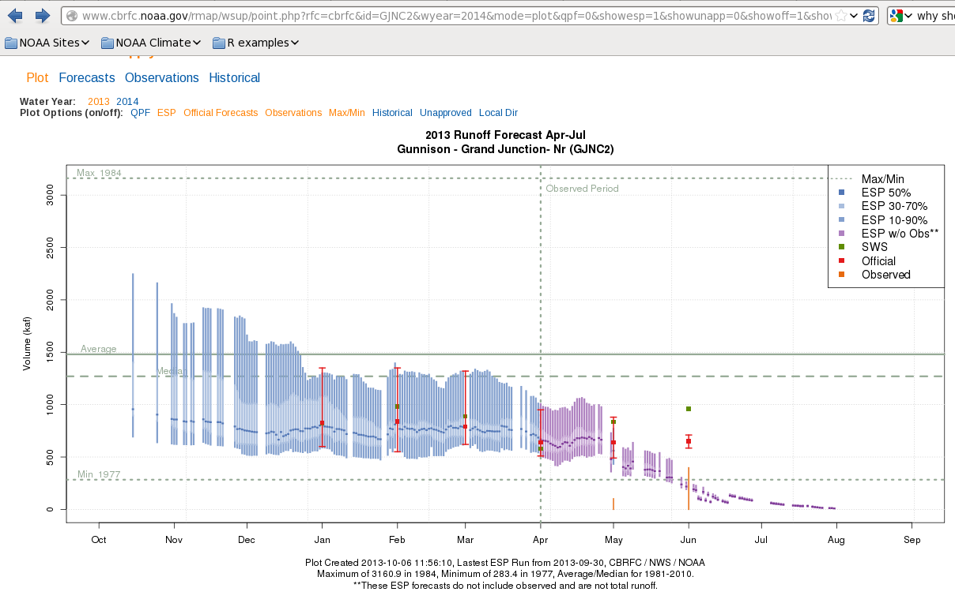
Monthly and Seasonal Water Supply Forecasts
Daily ESP forecasts provide an assessment of streamflow conditions, and typically indicates whether official forecasts are expected to rise or fall.

Slide 47
Seasonal Water Supply Forecasts
Unregulated Reservoir Inflow Forecasts issued approximately biweekly
3-Month Outlook, with Apr-Jul provided beginning in January
Precipitation summary provided as well

Slide 48
ESP Forecast Traces
Part 4:

Slide 49
ESP Forecast Traces
32-Month ESP traces have been generated for use by stakeholders in the development of probabilistic, operational resource-management models
Traces are adjusted such that the median of the traces is equivalent to the final forecast issued
This adjustment is applied so that the ensemble is comparable to the final forecast

Slide 50
ESP Forecast Traces
Note differences between RFC forecast (blue triangles) with median forecast derived from ensemble of 30 traces.

Slide 51
ESP Forecast Traces
Traces are adjusted such that the median forecast matches the RFC forecast.

Slide 52
ESP Forecast Traces
Currently, the raw traces are available via the CBRFC website in text form:
http://www.cbrfc.noaa.gov/outgoing/32month/
Adjusted ESP traces and graphics will be available on the CBRFC website in the near future

Slide 53
So….
What do ESP forecast traces tell us?
It is the entire ensemble of ESP output that we use in the determination of our water supply forecasts. They are typically scaled so that the median of the ensemble is equivalent to our final forecast. It is useful for probabilistic models.
When does it tell us?
Each month during the water supply forecasting season.

Slide 54
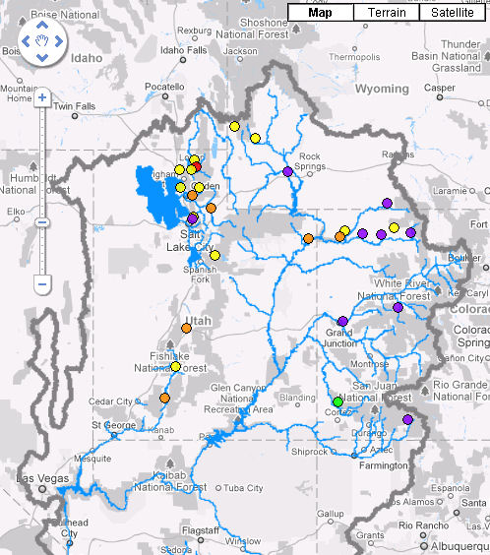
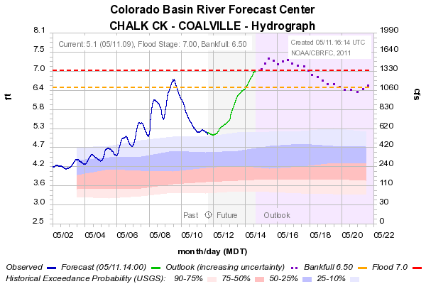
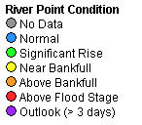
Transition from peak flow publication to our active conditions main web page:
Start looking at both at this time – focus on our active conditions map as the peak nears (not always obvious)
Frequent updates using recent observations and short term meteorological forecasts (active quality control)
Multiple peaks that exceed critical levels may occur (not represented in mean daily forecast)
Known regulation changes will be accounted for on active web page hydrographs
Planning vs real time

Slide 55
Seasonal Water Supply Forecasts
SWS relates observed data to seasonal streamflow through regression equations
Utilizes Monthly Data:
First of month SWE
Total precipitation (can be multiple months)
Flow volume
Climate indices (e.g., ENSO, PDO, SOI)
Output
Seasonal volume (e.g. April-July)
Conditional probability distribution; the equation result is the 50% exceedance

Slide 56
Seasonal Water Supply Forecasts
Ensemble Streamflow Prediction (ESP)
This is the CBRFC’s primary model for water supply forecasting
Run daily starting from current model snow and soil states
Uses historical temperature and precipitation from the calibration history to derive an ensemble of future hydrologic traces (currently using 30 traces from 1981-2010)
Daily timestep for 12 months into the future
Median (or 50% exceedance) value is not equivalent to water supply forecasts

Slide 57
Seasonal Water Supply Forecasts
SWS
ESP
Easy to calibrate, maintain and run.
Works only for seasonal volumes.
Equations are made to be run only at specific times (i.e. first of month and only for winter and spring).
Requires extensive calibration and maintenance.
Can compute many hydrologic variables over any period.
Can be run at any time.
Keeps track of soil moisture.

Slide 58
Seasonal Water Supply Forecasts
Informed by SWS, ESP, and forecaster expertise
Uncertainty comes from:
Density of gage network
Errors in historical observations
Variations in consumptive use
Limitations of models used (SAC-SMA and SNOW-17)

