Slide 1
Colorado Basin River Forecast Center
Stakeholder Forum
Welcome to the Colorado Basin RFC
Logistics & Introductions
Office layout
Breaks
Lunch (please fill out lunch order early)
Tuesday evening at Squatters
NOAA’s National Weather Service

Slide 2
Colorado Basin River Forecast Center
Stakeholder Forum
Welcome to the Colorado Basin RFC
Introductions
Name
Agency
What you hope to get out of this meeting
NOAA’s National Weather Service

Slide 3
Colorado Basin River Forecast Center
Stakeholder Forum
Overview of Meeting and Goals
Address responses to the questionnaire
Improve our understanding of your needs and operations
Improve your understanding of our abilities and services
Asking the proper questions to help the CBRFC:
Identify where to focus future development activities
Identify the best products and delivery method
Identify where we can best improve our services
Opportunities:
Meet with staff members
View our operational procedures & model interaction
NOAA’s National Weather Service

Slide 4
Colorado Basin River Forecast Center
Stakeholder Forum
Overview of Meeting and Goals
Agenda
Overview of Meeting and Goals
Summary: recent changes and roadmap
CBRFC Model Review
CBRFC Product Review
Forecast Product Dissemination/Accessibility
Verification
Customer Survey Results
Stakeholder Presentations
New Technologies / Wrap-Up

Slide 5
Colorado Basin River Forecast Center
Stakeholder Forum
Overview of Meeting and Goals
Shaping the Agenda
Summary of comments from questionnaire:
Discuss the methods used to generate forecasts
Soil moisture, precipitation impacts in the model
Discuss new products (Daily ESP, etc.)
Verification statistics availability
Website changes, simplification, consistency
How are others using forecasts (stakeholder presentations)
Update on new technologies / forecast tools
NOAA’s National Weather Service

Slide 6
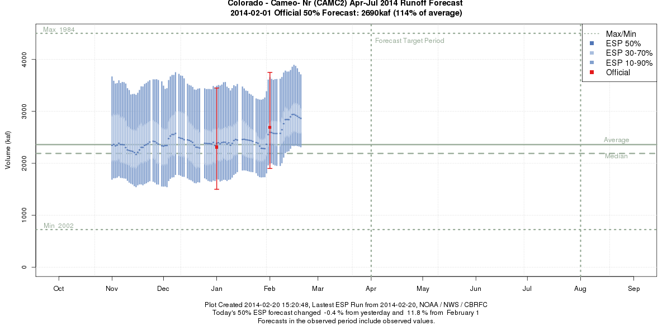
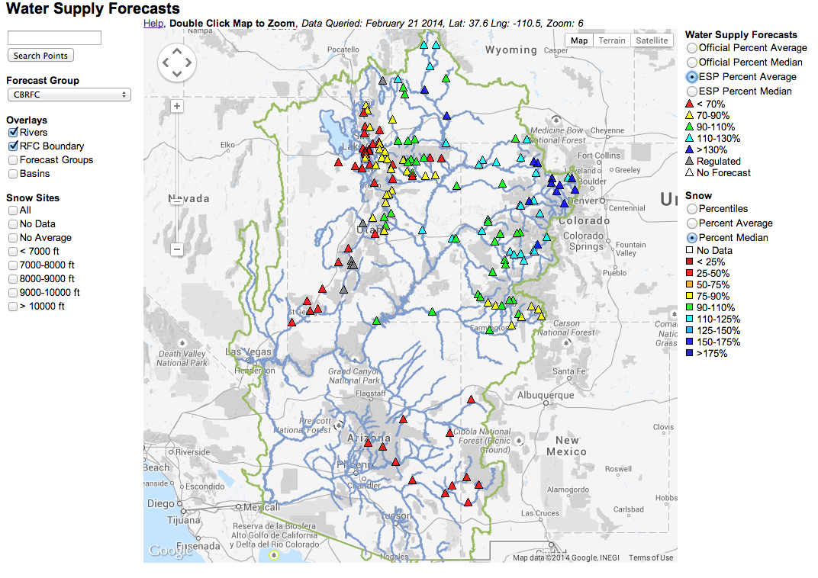
Colorado Basin River Forecast Center
Stakeholder Forum
Summary of product and web page changes
ESP Daily Updates

Slide 7
Colorado Basin River Forecast Center
Stakeholder Forum
Summary of product and web page changes
Web Page
Changes:
Google map
Search
Easy zoom
Reorganized header
Still lots to do….

Slide 8
Colorado Basin River Forecast Center
Stakeholder Forum
Roadmap: Incorporating New Science and Improving Services
Development work done through:
  Collaborations
  National Resources
  Local resources
Main goals are to meet stakeholder needs and improve our forecasts and services.

Slide 9
Colorado Basin River Forecast Center
Stakeholder Forum
Roadmap: Incorporating New Science and Improving Services
Collaborations - Goals:
1. Improve CBRFC forecast skill for water supply and snow melt through focused work on areas of our forecast process that have been shown to be deficient (e.g. Werner and Yeager, 2013). These include:
      Snow modeling
      Incorporating ensemble weather and climate forecasts
2. Improve decision support including connectivity with reservoir decision support systems

Slide 10
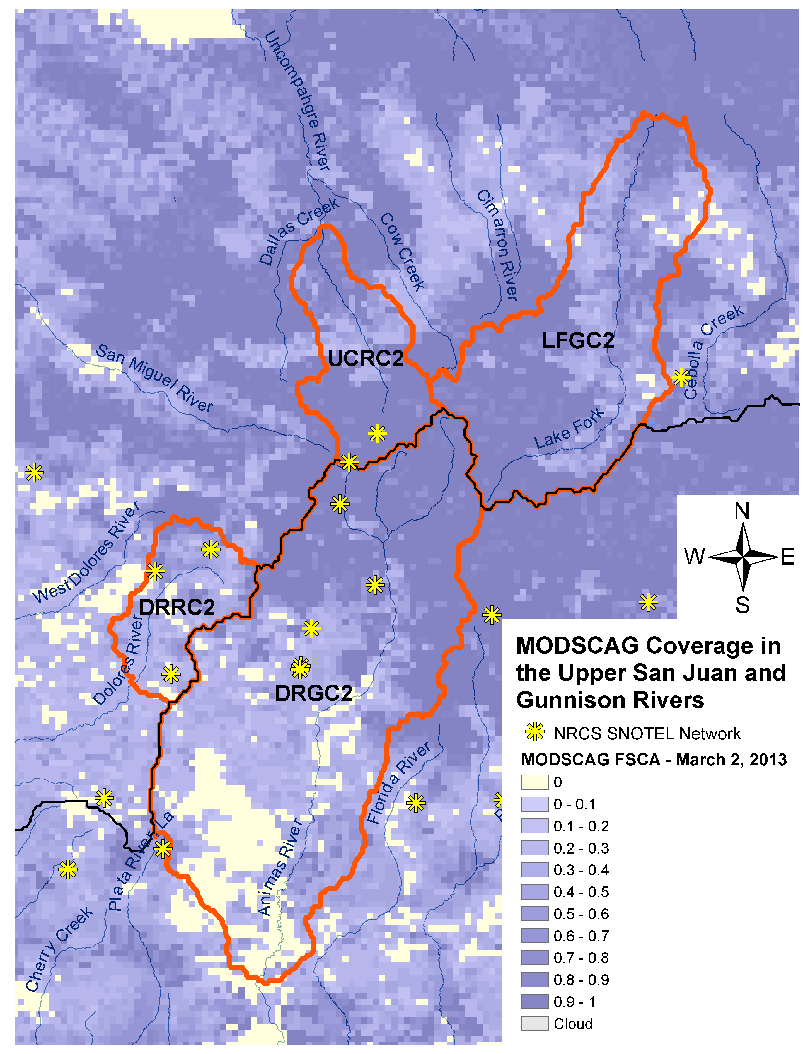
Colorado Basin River Forecast Center
Stakeholder Forum
Incorporating New Science - Collaborations
NASA JPL
Remote sensed snow information (MODIS)
Investigate how remote sensed gridded snow covered area and snow contamination can be used to improve our forecasts

Slide 11
Colorado Basin River Forecast Center
Stakeholder Forum
Incorporating New Science - Collaborations
Western Water Assessment (WWA) –
Impacts of dust on snow and beetle kill on forecast water supply
Analysis of Information Use by Stakeholders of the CBRFC

Slide 12
Colorado Basin River Forecast Center
Stakeholder Forum
Incorporating New Science - Collaborations
Utah State University – Dr Tarboton
Evaluate Utah Energy Balance Snow Model within CHPS to improve streamflow prediction

Slide 13
Colorado Basin River Forecast Center
Stakeholder Forum
Incorporating New Science - Collaborations
University of Massachusetts – SARP funded
Integrating Climate Forecasts and Reforecasts into Decision Making – Demonstrate potential usefulness of climate forecasts for Public utility planning and create an appropriate framework for their applications.

Slide 14
Colorado Basin River Forecast Center
Stakeholder Forum
Incorporating New Science – NWS Efforts
Hydrologic Ensemble Forecast System, HEFS
Provides short to long term probabilistic forecasts by incorporating climate and weather forecast information.
CBRFC is one of 5 test sites nationwide.

Slide 15
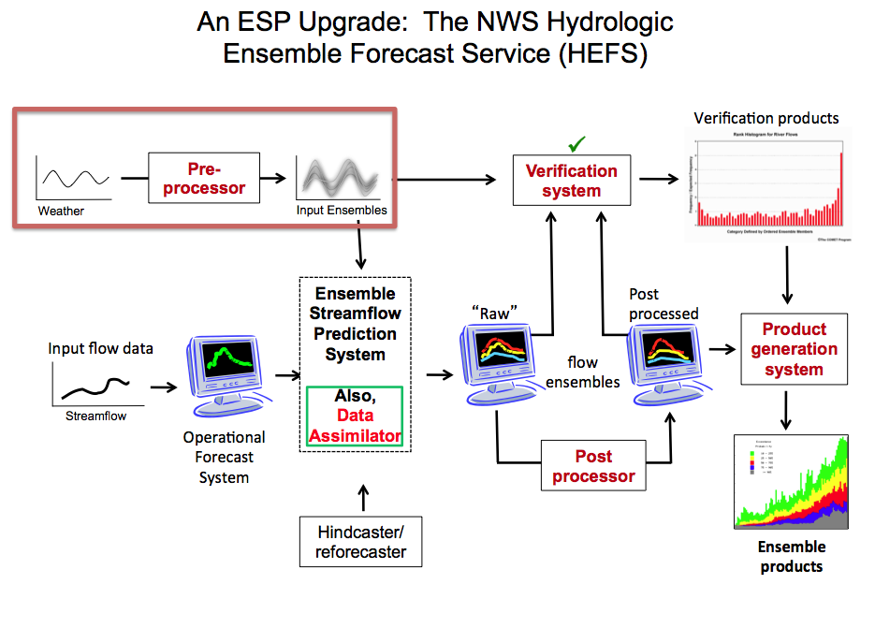

Slide 16
Colorado Basin River Forecast Center
Stakeholder Forum
Incorporating New Science and Improving Services – CBRFC local efforts
Web page improvements
New products, new ways to display information and forecasts
**Based on your feedback**

Slide 17
Colorado Basin River Forecast Center
Stakeholder Forum
Questions To Consider
What are 2-3 key products and services you wish you had but don’t from the CBRFC ?
Where would you like to see CBRFC invest its development and operational energies ?
What key upcoming decisions points do you have that you would like the CBRFC to be aware of ?

