Slide 1
Hydrologic Model Review
CBRFC Fourth Annual Stakeholder Forum
February 25 – 26, 2014
Salt Lake City, UT

Slide 2
Overview
Model Description
Calibration
Operations (current and planned methods)
Daily deterministic forecast mode
Ensemble Streamflow Prediction (ESP) mode
Unregulated
Regulated
Statistical Water Supply (SWS)

Slide 3
NWS River Forecast Model
Same model we have always run, but moved within the Community Hydrologic Prediction System (CHPS) framework at the start of Water Year 2012.
More/better graphics.
Provides ability to plug in new model modules.
Continuous – meant to be run all the time, not just during events.
Conceptual – physically based, but uses parameters in place of hard-to-get data.
Lumped – uses mean areal inputs; not distributed.

Slide 4
NWS River Forecast Model
Composed of three major interrelated components.
Calibration System
determine model parameters
store historical data
Daily Operational Forecasts
generate short term deterministic river forecasts
maintain model states
Ensemble Streamflow Prediction
generate ensemble of hydrographs
generate probabilistic forecasts

Slide 5
CBRFC Model Setup
Each river point in the model is called a segment.
There are 181 segments above Lake Powell
There are 486 total segments in the CBRFC area.
Segments are calibrated to the unregulated flow.
Remove effects of known diversions and reservoirs.
Individual segment areas only include the contributing area between it and any upstream point(s).
Headwater calibration: All water comes from this segment alone.
Local calibration: Upstream water is routed downstream and added to the local water to get the total.
Each segment is broken into 2-3 subareas by elevation.
These subareas should have similar soil, land cover, and snow accumulation/melt characteristics.
Because it is a lumped model each of these subareas is represented by a single point.
Model inputs needed to simulate unregulated river flow:
Precipitation
Temperature
Freezing level – calculated from temperature when not available.

Slide 6
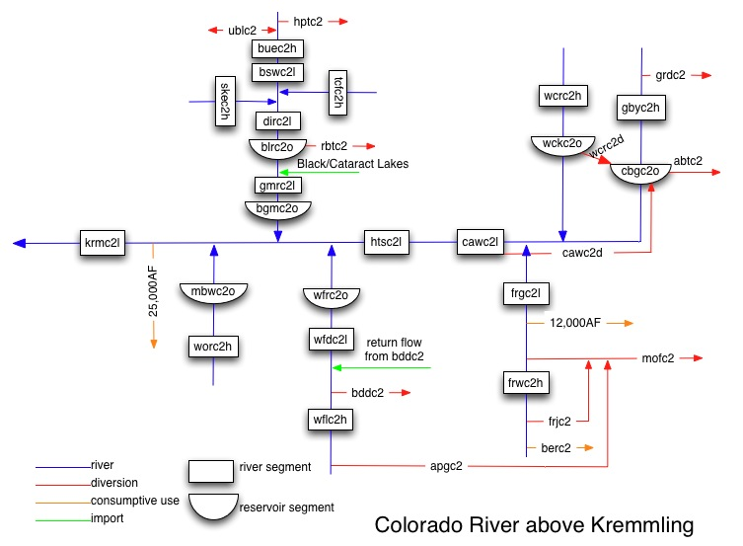
CBRFC Model Setup
Blue River Basin
Diversions (Regulation)
Headwater Calibration
Unregulated =
Observed + Diversions
Upper Area
11,500 ft – 13,779 ft
Headwater Calibration
Unregulated = Observed
Lower Area
9196 ft – 11,500 ft
Local Calibration
Total Unregulated =
Observed
+ Total Upstream Diversions

Slide 7
Calibration – Basics
Initial conditions are not important.
Evaporation is determined through water balance and is regionalized.
Forced by 30 years (1981-2010) of 6 hourly precipitation and temperature.
Mean Areal Precipitation (MAP) for each subarea is calculated using pre-determined station weights.
Mean Areal Temperature (MAT) for each subarea is calculated similarly to MAP.
Operationally MAP and MAT are calculated in a similar way to ensure our forecasts will have similar quality/characteristics to 30 years of calibration.

Slide 8
Calibration – Basics
The accuracy of the results are mostly dependent upon the quality of our temperature and precipitation network (mostly SNOTEL).
This network is not expected to change much in the next several years.
Therefore, improvements in the calibration process must come from:
Model improvement (e.g. , a higher resolution model physically based). However, any chance for significant improvement is strongly bound by the temperature and precipitation network!
Remote sensing (e.g. , areal extent of snow). Relating to SWE is not obvious.

Slide 9
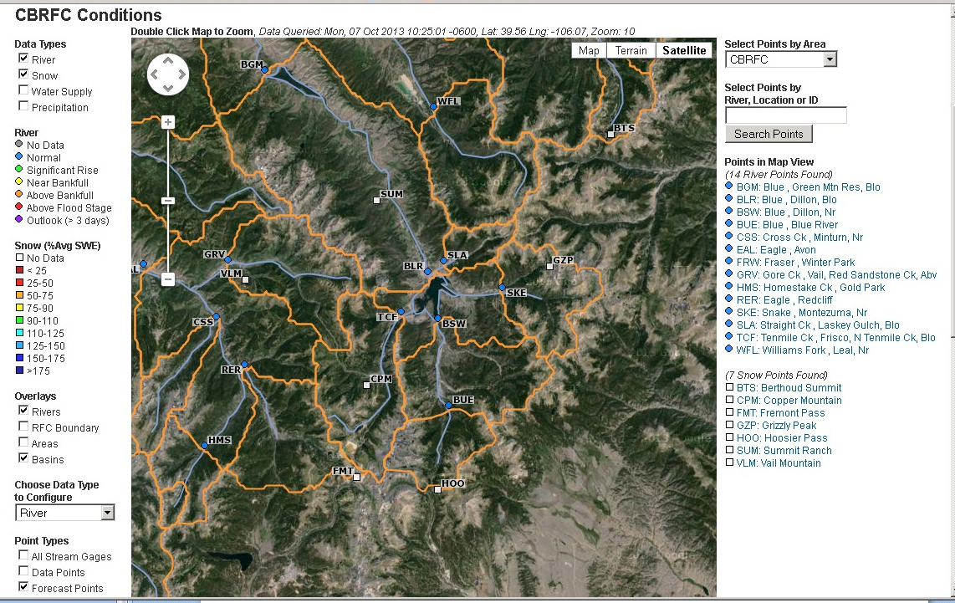
Blue River Basin Data Points
DLL
CLX
(2 COOP Temperature Points)
CLX: Climax
DLL: Dillon

Slide 10
Blue River Basin
Ten Mile Ck at Frisco
Headwater
No (known) upstream reservoirs or diversions
2 subareas
Lower: 9196 ft – 11,500 ft (56 mi²)
Upper: 11,500 ft – 13,779 ft (32 mi²)

Slide 11
Calibration – Precipitation
Each subarea MAP is calculated using precipitation stations that (hopefully) have similar characteristics to that area.
Weights are chosen to guarantee water balance in each area.
The water balance is calculated using the PRISM sets.
Station weights for TCFC2:
Upper area – Fremont Pass .67, Copper Mountain .67
Lower area – Fremont Pass .52, Copper Mountain .52

Slide 12
Calibration – Temperature
Each subarea MAT represents the mid-point elevation of the area.
Nearby stations (whose climatologies are known) are used to calculate the temperature of the MAT (whose climatology is calculated using the climatologies of the nearby stations).
Temperature is calculated by using the ratio between the station and area climatologies.
Temperature stations used by TCFC2:
Dillon COOP
Climax COOP
Vail SNOTEL

Slide 13
Precipitation
and
Air Temperature
SNOW ACCUMULATION
AND ABLATION MODEL (SNOW-17)
Rain
or
Snow
Accumulated
Snow Cover
Energy Exchange
at
Snow-Air
Interface
Areal Extent
of the
Snow Cover
Bare ground
or
snow cover
Snow Cover
Heat Deficit
Deficit = 0
Rain
on
Bare
Ground
Liquid Water
Storage
Ground
Melt
Transmission
of
Excess Water
This is a temperature index model
Snow
Cover
Outflow
Rain
plus
Melt

Slide 14
Sacramento Soil Moisture
Accounting Model
TENSION WATER STORAGE
UPPER ZONE
DIRECT
RUNOFF
FREE WATER STORAGE
SURFACE
RUNOFF
INTERFLOW
LOWER ZONE
PRIMARY
FREE
WATER
STORAGE
TENSION
WATER
STORAGE
TENSION
WATER
STORAGE
SUPPLEMENTARY
FREE WATER
STORAGE
BASEFLOW
SUBSURFACE
OUTFLOW

Slide 15
Calibration – Parameters
Determine calibration parameters for each subarea
SNOW-17
5 Major
Snow Correction Factor, Max and Min Melt Factors, Wind Function, Snow Cover Index, Areal Depletion Curve
5 Minor
Temperature indexes and minor melt parameters
SAC-SMA
11 Major
Tank sizes (5) and rates of drainage (interflow, percolation)
5 Minor
Impervious area, Riparian Vegetation effects
For TCFC2 this is done for 2 areas: Upper and Lower

Slide 16
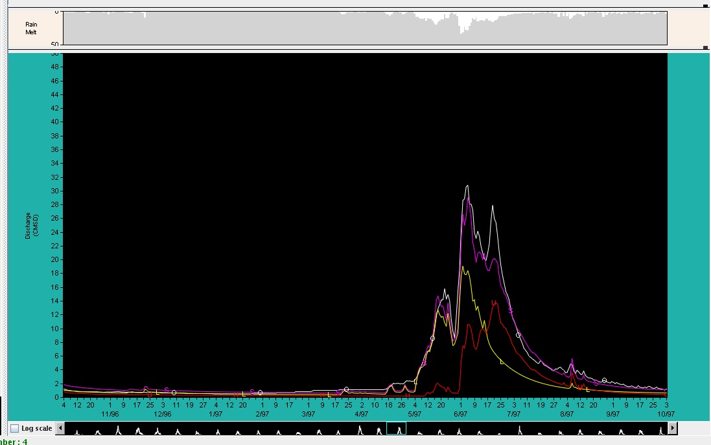
Calibration – Results
Observed
(unreg)
Simulated
(unreg)
Lower Area Sim
Upper Area Sim

Slide 17
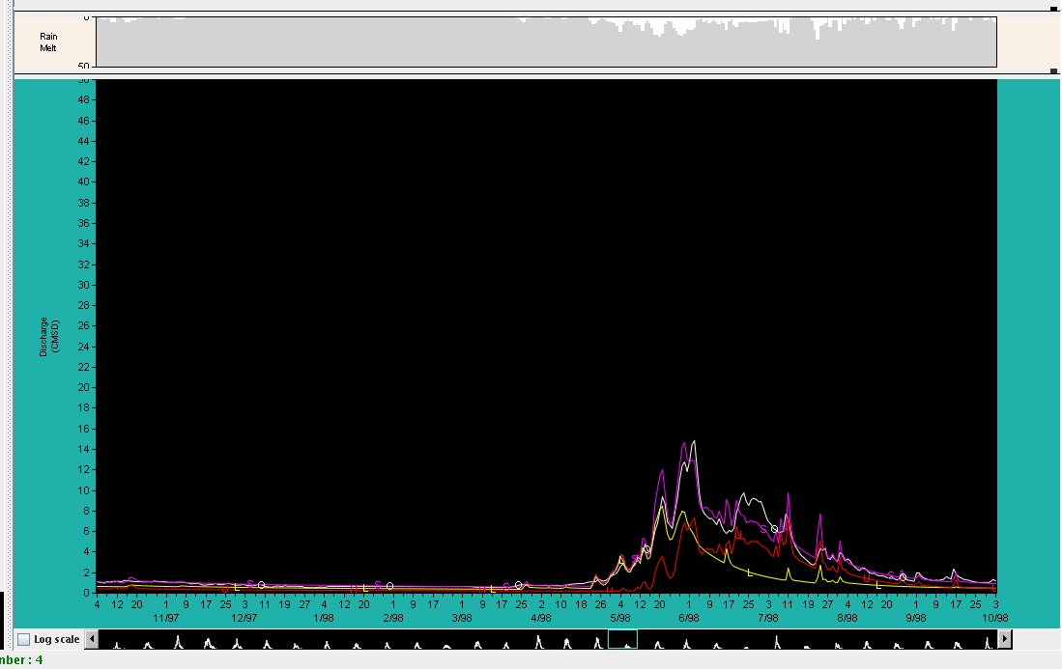
Calibration – Results
Observed
(unreg)
Simulated
(unreg)
Upper Area Sim
Lower Area Sim

Slide 18
Calibration – Techniques
The segment is calibrated using the total unregulated flow:
buec2unreg = buec2obs
+ublc2+hptc2
The simulated flow resulting from the calibration should be similar to this unregulated flow:
buec2sim ~ buec2unreg
We need to account for the diversions (ublc2, hptc2) at buec2. We add the daily diversion at ublc2 and hptc2 to the observed daily flow at buec2 to get the unregulated flow at buec2.
Blue River

Slide 19
Calibration – Techniques
We have to send the buec2unreg and buec2sim downstream to the next segment, bswc2l. Although there are no diversions at bswc2, we need to account for the diversions upstream. So the total unregulated flow is:
bswc2unreg = bswc2obs
+total upstream diversions
And the total simulated flow is:
bswc2sim=buec2sim+bswc2locsim
where bswc2locsim is the model simulation of the ‘local’ flow – the water from the area between buec2 and bswc2 only.
As we move downstream, we always make sure the total simulation and total unregulated flows have reasonably good balance.
Blue River

Slide 20
Calibration – Techniques
Finally, we need to calibrate the Dillon Reservoir inflow. The total unregulated flow for Dillon is:
dirc2unreg = dirc2outflow
+dirc2storage
+rbtc2
+total upstream diversions
We sum up all the simulations upstream:
dirc2sim=bswc2sim+tcfc2sim+skec2sim
+dirc2locsim
As before, the total simulation and the total unregulated flow are always checked: dirc2unreg ~ dirc2sim
For unregulated flow, all reservoirs are removed from the calculations. So the entire dirc2 unregulated flow and dirc2 simulated flow are passed downstream to the next segment, gmrc2l, which is the Green Mountain Reservoir inflow.
Blue River

Slide 21
Calibration – Techniques
This process is continued for all basins above Lake Powell, for instance.
When we reach the Lake Powell inflow point, we have the total simulation and total unregulated flow for the entire area.
In-stream diversions (consumptive use) are accounted for internally but not added back into the unregulated flow.
This is why we call our simulations and forecasts ‘unregulated’ vs. ‘natural’ flow.

Slide 22
Operations
Daily Deterministic Forecasts
ESP Probabilistic Forecasts
Regulated
INITIAL CONDITIONS ARE VERY IMPORTANT
Soil moisture
SWE
Reservoir elevations/releases
Diversions
Forcings are deterministic
Five days of forecast precipitation (QPF)
Zero beyond this
10 days of forecast temperature (QTF)
Climatological average beyond this
Creates and saves model states that become starting point for ESP
Unregulated or Regulated
INITIAL CONDITIONS ARE VERY IMPORTANT
Soil moisture
SWE
Current reservoir and diversion information not used in Unregulated mode.
Forcings are probabilistic
Uses 30 years of MAP and MAT from calibration to create 30 hydrologic traces/scenarios.
QPF and QTF
Deterministic QPF (5 days) and QTF (10 days)
Can use ensemble QPF and QTF from weather and/or climate models (test mode this year)

Slide 23
Operations Initial Conditions – Soil Moisture
LZFPC (baseflow or free water)
Carryover from previous season
Affected some by fall precipitation
Adjusted by flow observations in fall/early winter
Initial fall soil moisture
Can have a moderate impact on spring runoff (+/- 5-10 %)
Typical Capacity of LZTWC+LZFPC ~ 15 inches
LZTWC (tension water)
Little carryover from previous season
Affected strongly by fall precipitation
Regionally adjusted
TENSION WATER STORAGE
UPPER ZONE
FREE WATER STORAGE
SURFACE
RUNOFF
LOWER ZONE
INTERFLOW
LZFPC
LZTWC
PRIMARY
FREE
WATER
STORAGE
TENSION
WATER
STORAGE
TENSION
WATER
STORAGE
SUPPLEMENTARY
FREE WATER
STORAGE
NRCS soil moisture observations
BASEFLOW
SUBSURFACE
OUTFLOW

Slide 24
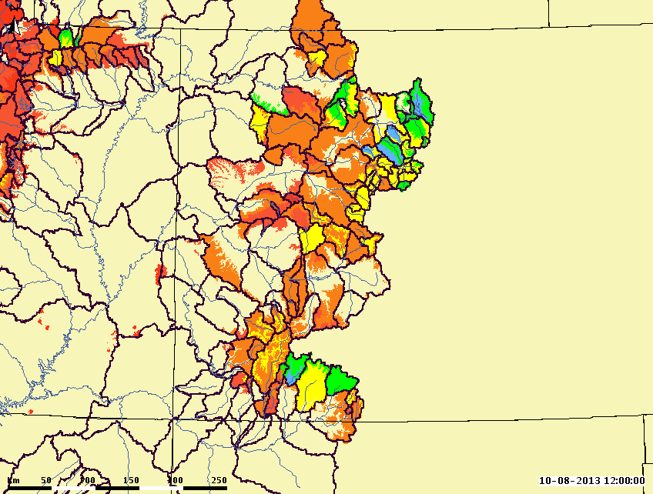
Operations
Initial Conditions – Soil Moisture
LZFPC
(baseflow)

Slide 25
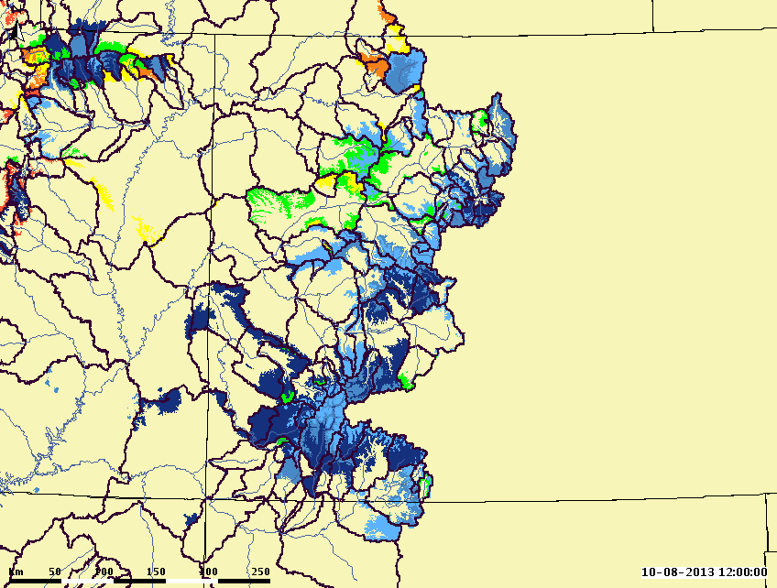
Initial Conditions – Soil Moisture
LZTWC
(tension water)

Slide 26
Operations Initial Conditions – SWE Accumulation Period
Daily quality control of:
Precipitation
Freezing level
Temperature
Create MAPS from points using pre-determined station weights (from calibration)
Update by calculating precipitation over a longer time step (weeks to months). This update done every 1-2 weeks.
SWE

Slide 27
Operations Initial Conditions – SWE Melt Period
Daily quality control of:
Precipitation
Freezing level
Temperature
Type precipitation using freezing level
Liquid
Frozen
Compare AESC with model AESC. Develop gross error check
SWE
Use temperature to calculate MAT and then melt
Snow contamination Grid
Modify melt rate using flow at Gauge (MFC)
RAIM (rain and melt)
Updated Land Cover Grid
To SAC-SMA model

Slide 28
Daily Deterministic Forecasts
Start run 10 days back so can see how model simulation compares to observed flows
Make sure inputs and forcings are correct
End 10 days into the future
Upper Colorado (above Powell) and Great Basin run on a 6 hour timestep
Lower Colorado (below Powell) and Sevier Basin run on a 1 hour timestep
Regulated (trying to match observed flow in river)
Future diversions:
Set to current
Specified
Best guess
Future reservoir releases:
Set to current
Specified
Spill
5 day deterministic precipitation forecast
6 hour timestep (evenly divided for 1 hour segments)
Zero beyond 5 days
10 day deterministic temperature forecast
Max/Min forecasts converted to 6 hour timestep

Slide 29
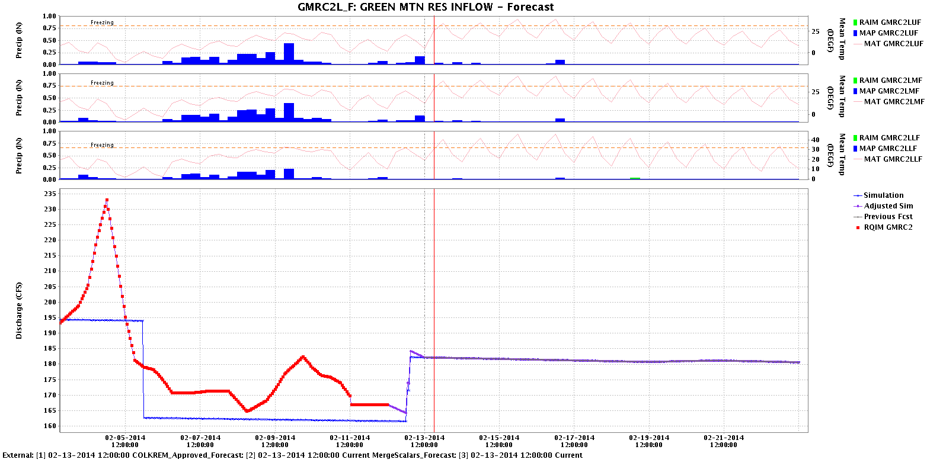
Daily Deterministic Forecasts
Upper Area
Mid Area
Lower Area
Observed MAP ‘s & MAT’s
Forecast MAP ‘s & MAT’s
Past
Future
Observed Flow
ForecastFlow
Model Simulated Flow

Slide 30
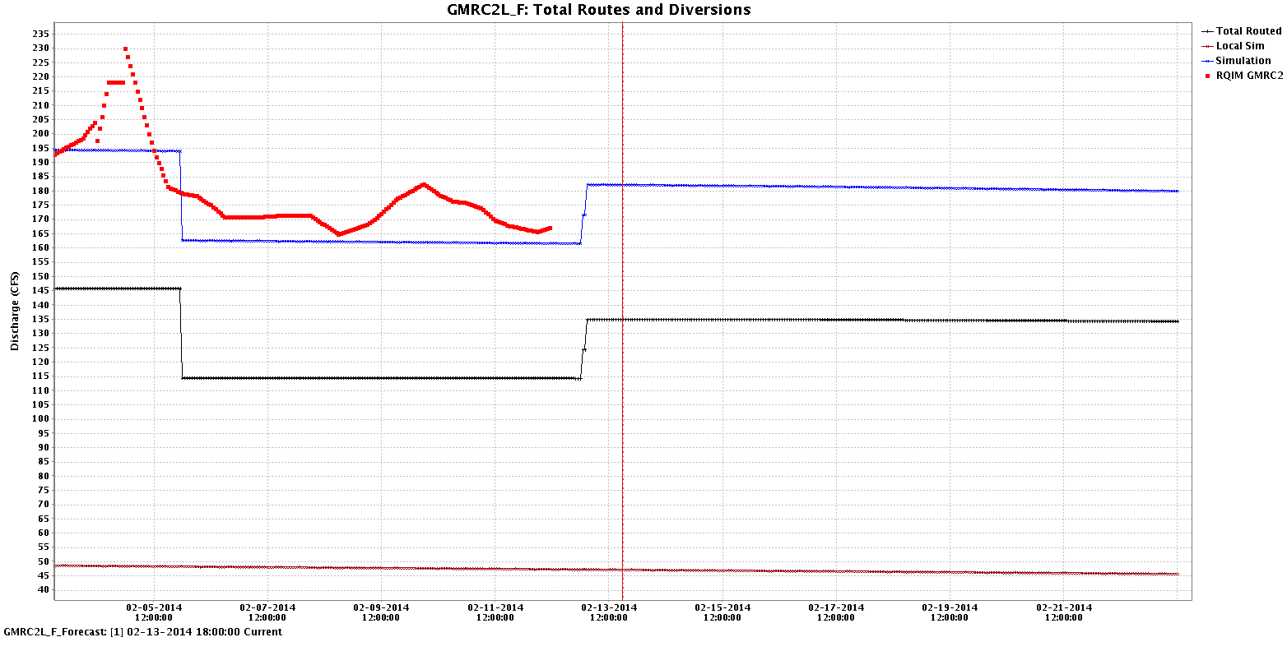
Daily Deterministic Forecasts
Past
Future
Observed Flow
Model Total Simulated Flow
Routed Upstream Flow
Model Local Simulated Flow

Slide 31
Ensemble Streamflow Prediction Probabilistic Forecasts
Start with current conditions
Apply precipitation and temperature from each historical year (1981-2010) going forward
A forecast is generated for each of the years (1981-2010) as if, going forward, that year will happen
This creates 30 possible future streamflow patterns. Each year is given a 1/30 chance of occurring
Current hydrologic states :
River / Res. Levels
Soil Moisture
Snowpack
1981
1982
1983
….
2010
Past <-
-> Future Time

Slide 32
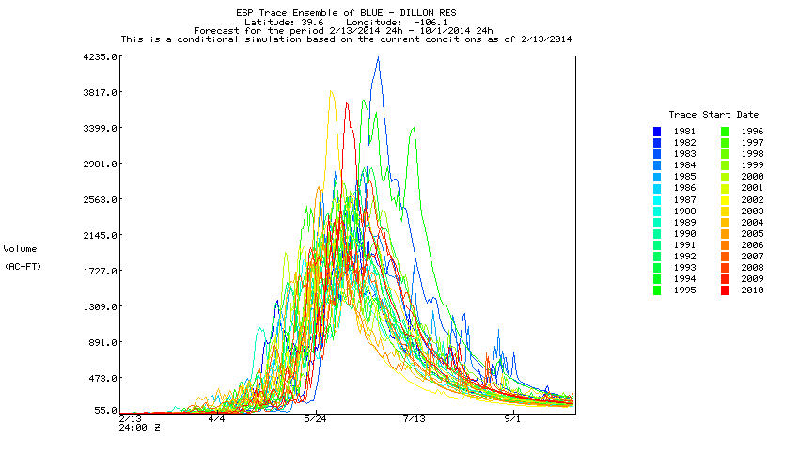
ESP Probabilistic Forecasts

Slide 33
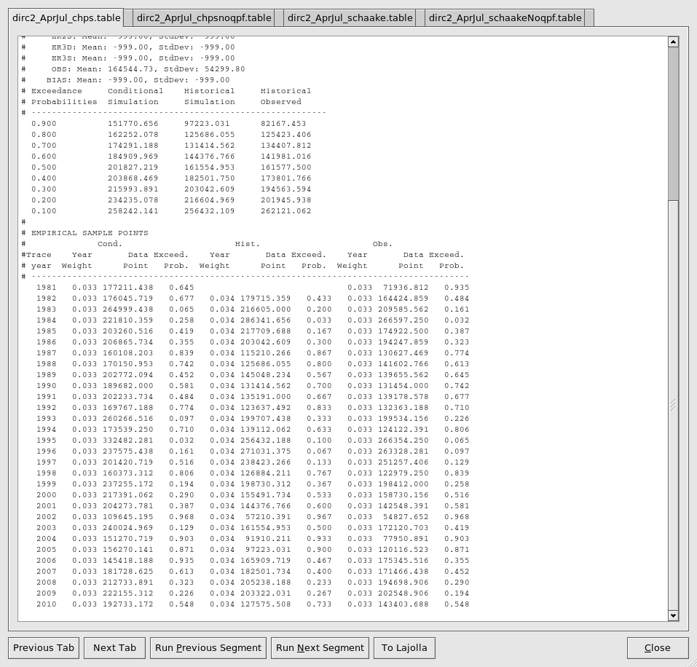
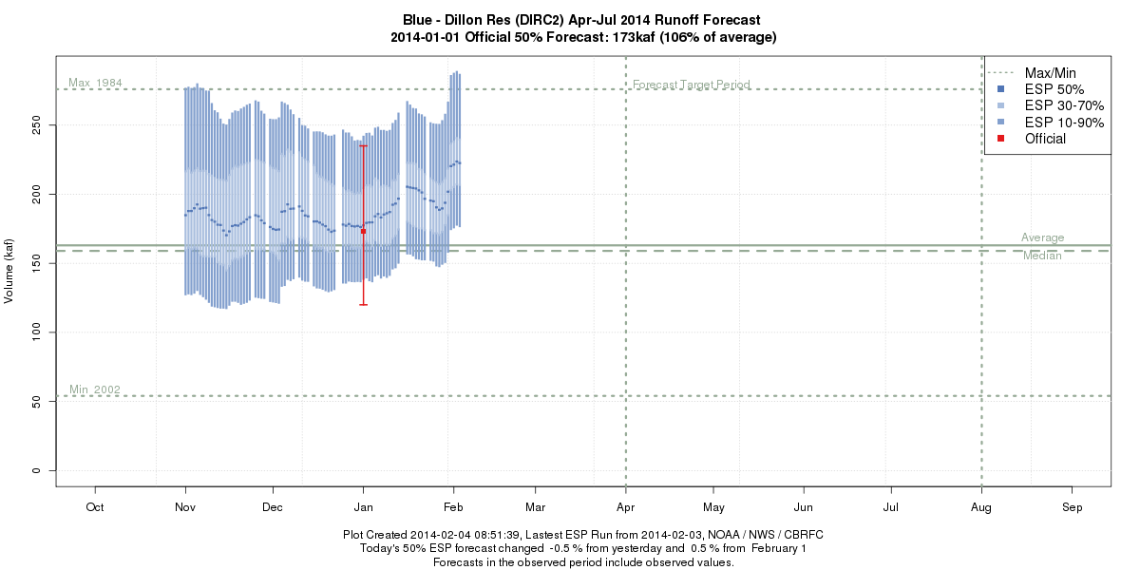
ESP Probabilistic Forecasts
The flows are summed into volumes for the period of interest (typically 4/1-7/31)
The statistics are simplified
And formatted for the web

Slide 34
ESP Probabilistic Forecasts
Unregulated Mode
Regulated Mode
Reservoirs ignored
Water is just passed through them.
Diversions ignored
All measured diversions into and out of the basin are set to zero.
Consumptive Use water still removed
Used for Water Supply volume forecasts
Some exceptions in Sevier and Great Basin
Reservoirs use rules defined in model
Releases set based on time of year or simulated elevation of reservoir.
Spill, pass flow.
Can input a single release schedule if known that far into future.
Diversions use historical data
Trace that uses 1995 MAP/MAT also uses 1995 diversions.
Consumptive Use water still removed
Used mostly for mean daily Peak Flow forecasts

Slide 35
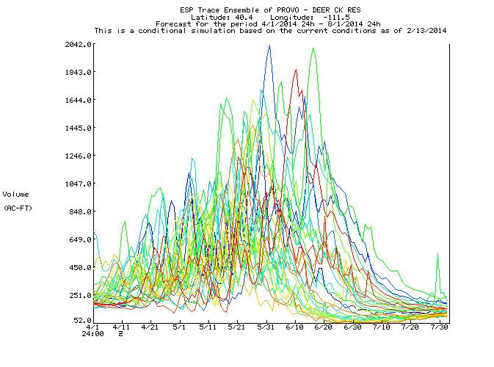
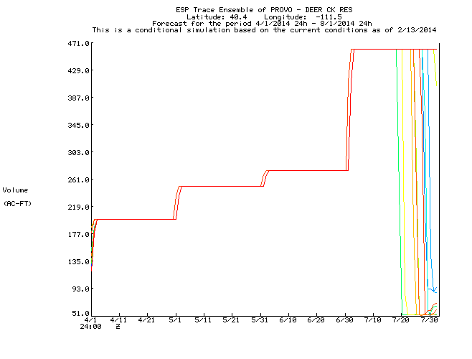
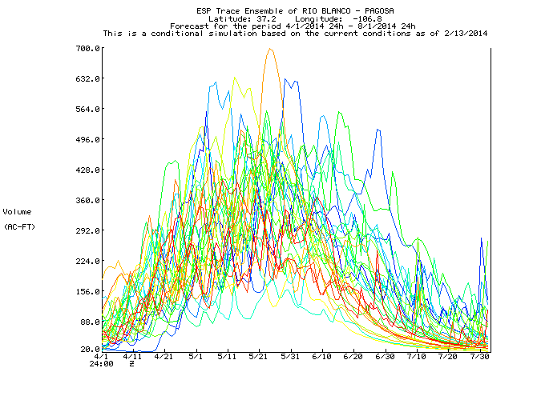
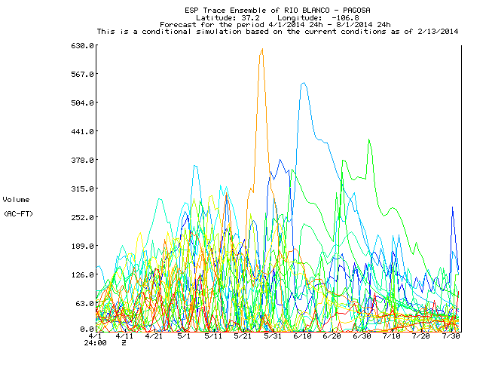
ESP Probabilistic Forecasts
Unregulated Mode
Regulated Mode
Reservoir
Diversion

Slide 36
Statistical Water Supply (SWS)
Regression equations that relate observed data to future seasonal streamflow volume.
Inputs are monthly values.
Total precipitation (can be multiple months)
First of month snow water equivalent
Monthly flow volume
Output is a seasonal volume (i.e. April-July).
It is really a conditional probability distribution, not a single value; the equation result is the 50% exceedance.
Other exceedance levels (10%, 90%, etc.) can be calculated by using the standard error.

Slide 37
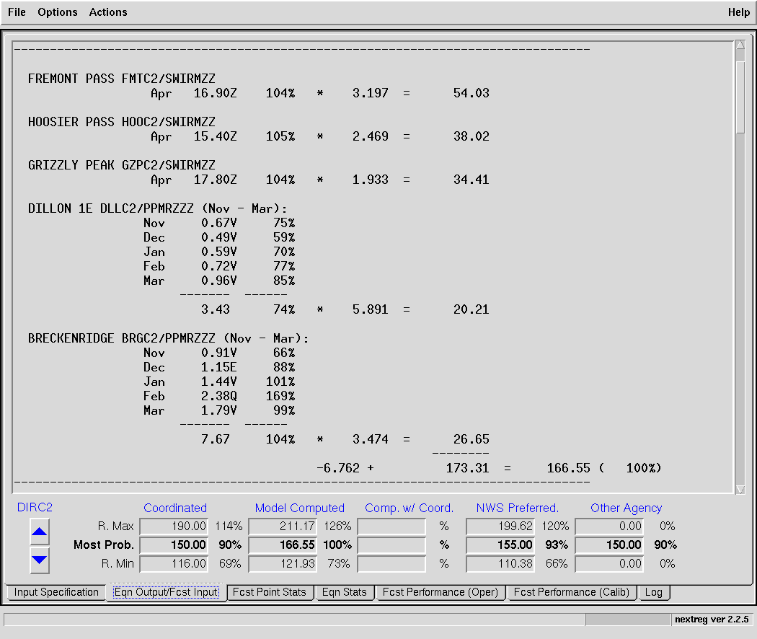
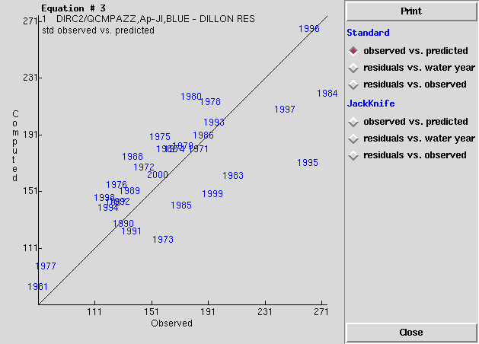
Statistical Water Supply (SWS)
r² = .60
Standard Error = 32.02
Average = 167

Slide 38
Sources of Error
Data
Undetected errors in historical as well as current observations
Errors in streamflow measurements due to poor channel ratings/controls
Data density
Ungaged/unknown diversions (especially in low years)
Consumptive use estimation
Distribution of snow vs. point measurements
Model
Initial conditions (see data errors)
Calibration error (bias)
Future weather
QPF (accuracy, distribution in space & time)
Spring temperatures affect melt/runoff pattern
Climate outlooks

Slide 39
Questions
Was this presentation helpful and what additional information would you like on CBRFC modeling techniques?
During low flow conditions, the consumptive use (largely unknown) can be larger than the observed flow and is the largest source of error in the forecast. What additional information would be useful during these conditions?

Slide 40
Simulated Unregulated=Natural-Consumptive use
Observed Unregulated=Regulated Observed + Known Diversions
Calibration attempts to make Simulated Unregulated =Observed Unregulated
Since Consumptive Use is not known, Neither is Natural

