Slide 1
Evaluating Forecasts in Reservoir Operations: The Role of Reforecast Products in Examining Extremes
Rebecca Guihan
Dr. Austin Polebitski, Dr. Richard Palmer
February 26, 2014
Notes:
Presenting results of SARP project, presentation given on behalf of Rebecca who is completing this work as part of her MS
In addition to Rick and myself I should acknowledge Kevin Werner and Ashley Nielson and others are CBRFC, Andy Wood at NCAR, and project partners…

Slide 2
NOAA SARP
Will our reservoir refill completely this year?
Should we initiate flood stage protocol or not?
I have a cool hydrology model!
I have a cool climate model!
When should I plant my corn? Should I buy crop insurance?
Notes:
Sectoral Applications Research Program (SARP)
Constantly new weather and climate related products being generated and there are continuously new questions and needs from user groups, sometimes these two things are not easily connected or parties are unaware of the possibility of connecting science to needs

Slide 3
NOAA SARP
Will our reservoir refill completely this year?
Should we initiate flood stage protocol or not?
I have a cool hydrology model!
I have a cool climate model!
When should I plant my corn? Should I buy crop insurance?
NOAA SARP
Notes:
The SARP program exists to connect existing and current research to those asking questions: “addresses the needs of a specific stakeholder or set of stakeholders within key socioeconomic sectors (e.g., water resources, agriculture, health, etc.) grappling with pressing climate-related issues”

Slide 4

NOAA SARP
Private/Consulting
End Users
Federal, State, Local Agencies
Academia/University
NOAA SARP
Notes:
A really neat thing about the SARP program is that it builds/requires a collaboration of numerous parties and strong buy-in from end users and is NOT solely just academic or federal or private but instead facilitates collaboration between all parties to achieve addressing climate related questions and issues for the partners

Slide 5
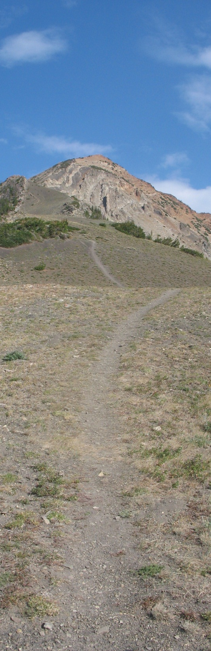
Project Goals
Demonstrate the potential usefulness of climate forecasts and create an appropriate framework for their application
Co-generate knowledge concerning system operations between researchers and water managers
Generate ESP streamflow using reforecasts at partner locations
Evaluate skill of GFS and CFSv2 and corresponding streamflow in the context of decision making
Disseminate data, case studies, and recommendations to the broader water community
Notes:
Ok, so what are the project goals for this research: Want to demonstrate the potential usefulness of climate forecasts and create an appropriate framework for their application as pertaining to water resource systems (specifically reservoirs)

Slide 6
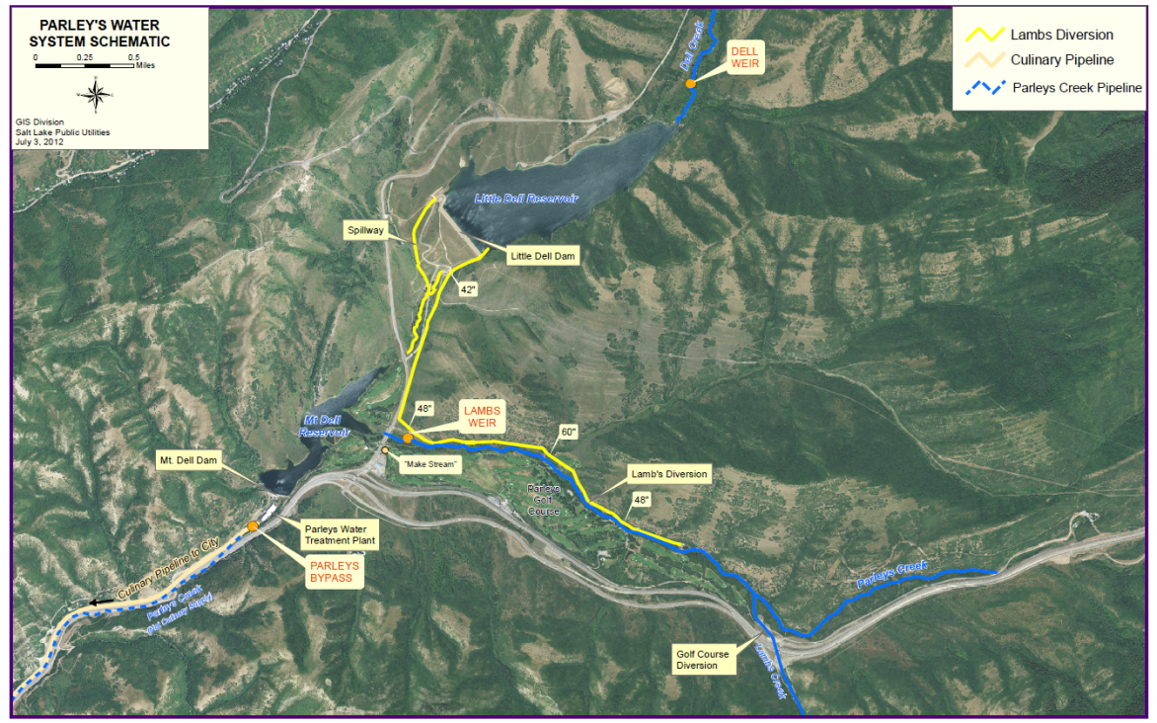
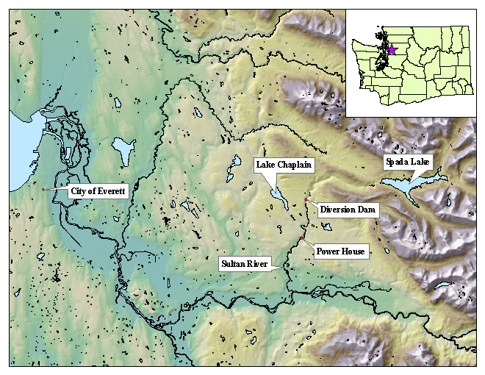
Project Partners - Case Studies
Snohomish County PUD
Jackson Hydropower System:
Multi-purpose
Salt Lake City
Parley’s System:
Drinking Water, Flood Control
Notes:
Who are our partners?
SLC- Parley’s systems ~ 20,000 acre feet of storage (flood, drinking water)
SnoPUD ~ 165000 acre feet (drinking water, hydropower, flood, environ, recreation)

Slide 7
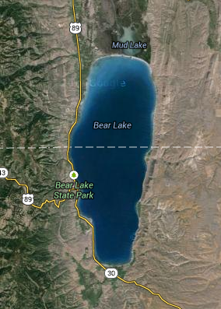

Project Partners - Case Studies
PacifiCorps Bear Lake:
Irrigation Supply, Flood Control
Dallas Water Utilities System:
Drinking Water
Notes:
Bear Lake ~ 6.5 Million acre-ft (flood, irrigation)
Dallas ~ multiple reservoirs (drinking water, some flood)

Slide 8
Project Goals
Demonstrate the potential usefulness of climate forecasts and create an appropriate framework for their application
Co-generate knowledge concerning system operations between researchers and water managers
Generate ESP streamflow using reforecasts at partner locations
Evaluate skill of GFS and CFSv2 and corresponding streamflow in the context of decision making
Disseminate data, case studies, and recommendations to the broader water community
Notes:
So very diverse needs for climate data, First step and maybe most important in project was to match needs and need scales to climate forecasts. A two day workshop/kick off meeting was held at CBRFC to introduce the team to one another and hear what scales of operation were important for each system and what system metrics should be evaluated. This provided a beginning point for the evaluation of climate forecasts and streamflow products

Slide 9
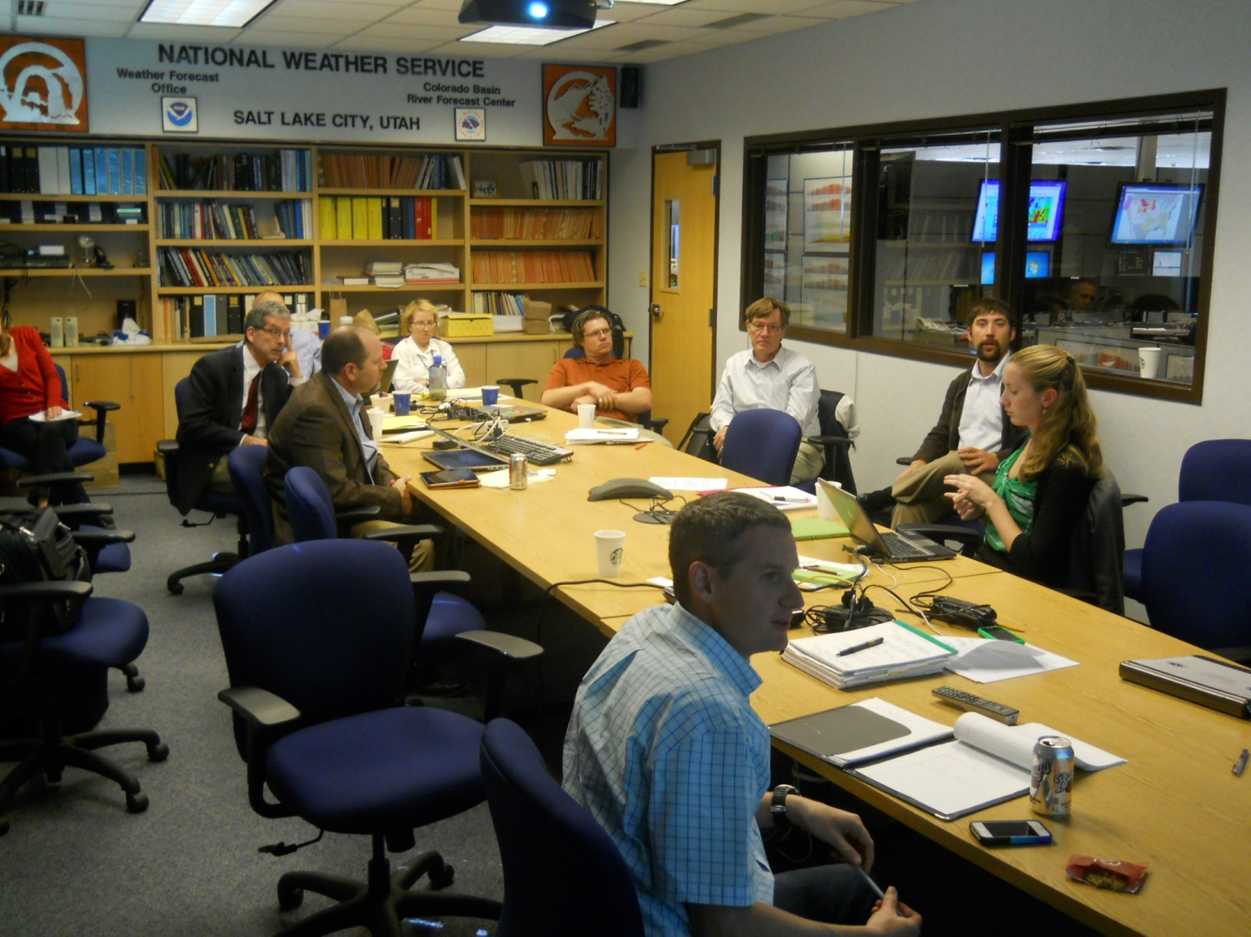
Workshop

Slide 10
Partner | Hydropower | Water Supply | Environmental Flows
Dallas | None | Firm yield Frequency of instituting voluntary or mandatory restrictions Total revenues generated Minimum storages in reservoirs | None
PacifiCorp Bear Lake | Energy production lost relative to baseline | Volume of water provided to irrigation Annual allocation of water Accuracy of forecast of water to be allocated Irrigation supply lost | None
Salt Lake City | None | Appropriate storage level at the beginning of water supply season Balancing water sources and supplies | Cannot divert into pipeline until >5 cfs at Lamb’s Diversion
SnoPUD | Mega-watts hours produced per year, Total avoided costs from other purchases Annual energy value | Water provided to Everett Need to implement curtailments | Number of times fish flows are unmet Minimizing peak releases that harm fish Provide “flushing flows” to move fish down stream
Notes:
This table is one part of larger table that was filled out collaboratively during the workshop

Slide 11
Partner | Hourly/Daily | Weekly | Monthly
PacifiCorp Bear Lake | None | Flood Control Decisions | Flood Control Decisions Irrigation Allocations Drought
Salt Lake City | Flood Mitigation | Flood Mitigation Drinking Water Deliveries | Flood Mitigation
SnoPUD | Hydropower Generation Channel forming flows | Drinking Water Hydropower Scheduling Flood Control Environmental Flows | Refill/Drafting Rates
Notes:
This table relates metrics to scale. Depending on system, scale has important implications on forecast products needed, for instance all three partners manage for floods, SnoPUD outlook more on weekly timestep because of capacity though new FERC license requires channel forming flows which is more daily/hourly
SLC is a daily to hourly operation during peak runoff to avoid flooding parts of the city, but the planning for managing during the peak flow seasons begins well in advance, as far back as February/March for releases as downstream releases are constrained
Lastly, Bear Lake operates flood control weekly during peak runoff due to larger capacity but must being looking out months in advance due to downstream flow restrictions
So scale is important for each decision point for each system, and the skill at each scale is equally important

Slide 12
Project Goals
Demonstrate the potential usefulness of climate forecasts and create an appropriate framework for their application
Co-generate knowledge concerning system operations between researchers and water managers
Generate ESP streamflow using reforecasts at partner locations
Evaluate skill of GFS and CFSv2 and corresponding streamflow in the context of decision making
Disseminate data, case studies, and recommendations to the broader water community
Notes:
Hindcasts from RFCs using HEFS are being generated to examine skill in forecasts and implications for use at each partners project
An important component of this project was that all project partners already used existing products in daily/weekly/monthly operations, many going directly to RFCs to obtain information
By generating hindcasts at RFCs we are able to evaluate similar products to those currently being used

Slide 13
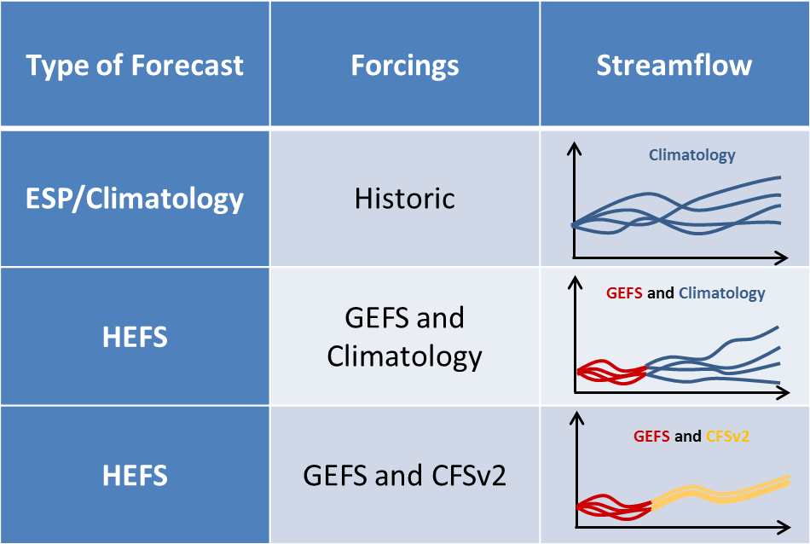
Types of Streamflow Forecasts Used
ESP – Ensemble Streamflow Prediction
HEFS – Hydrologic Ensemble Forecast System
CFS– Climate Forecast System
GEFS – Global Ensemble Forecast System
Notes:
What are the products we are using?

Slide 14
Types of Streamflow Forecasts Used
Expectation:
Variability
decreases
ESP – Ensemble Streamflow Prediction
HEFS – Hydrologic Ensemble Forecast System
CFS– Climate Forecast System
GEFS – Global Ensemble Forecast System

Slide 15
Types of Streamflow Forecasts Used
Expectation:
Variability
decreases
ESP – Ensemble Streamflow Prediction
HEFS – Hydrologic Ensemble Forecast System
CFS– Climate Forecast System
GEFS – Global Ensemble Forecast System
Notes:
Currently have access to ESP and HEFS, others are being generated

Slide 16
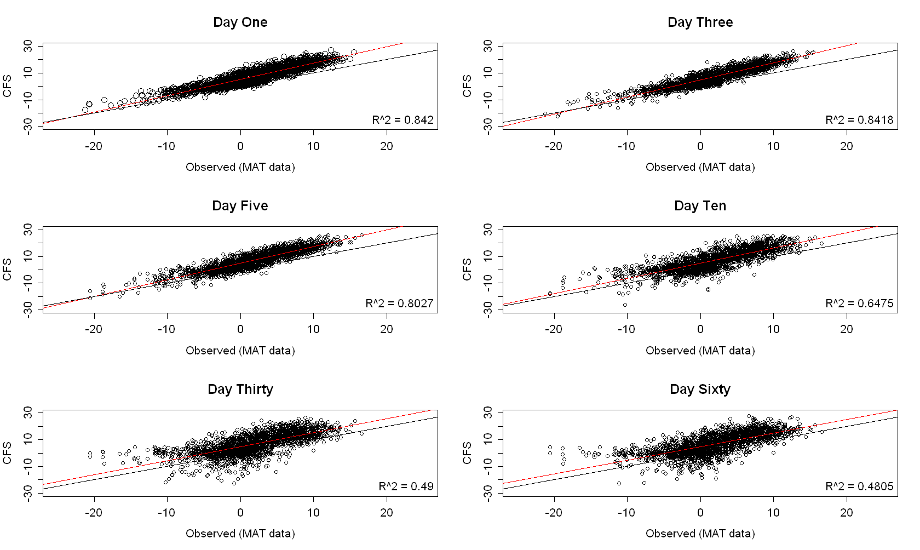
CFS Forecast vs. Observed Temperature (°C)
Notes:
What does some of this look like, for temperature it is as expected, pretty decent signal from CFS so some hope for improvement over climatology

Slide 17
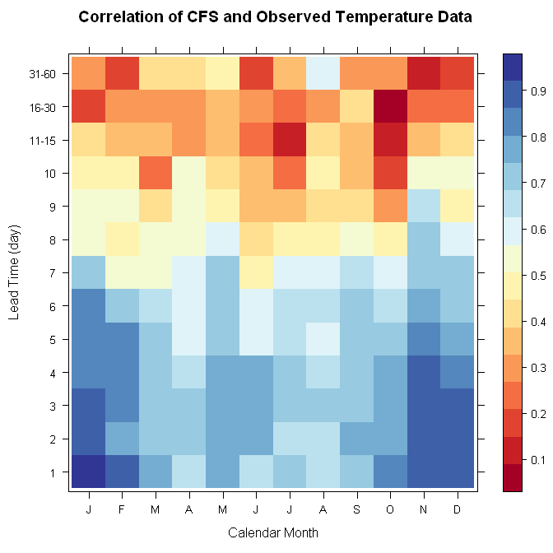
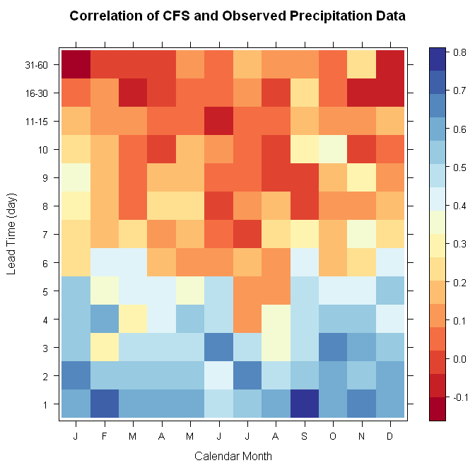
CFS Correlations by Lead Day
Notes:
Correlation plots of CFSv2 by lead time by month show ability for short term gains over pure ESP but mixed results, specifically for precip past lead time day 7

Slide 18
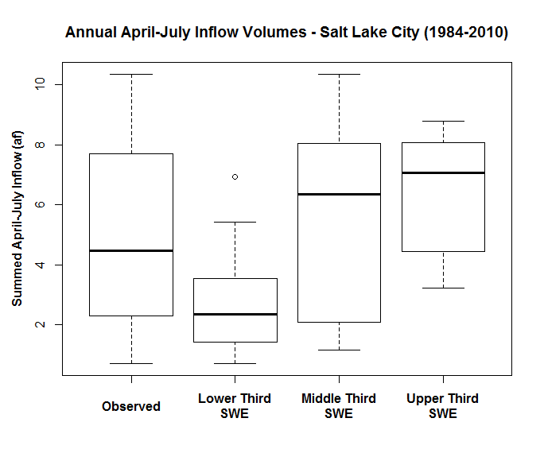
Snowpack as a Crude Forecasting Method: SLC
Notes:
So how might these help in making decisions? Currently two groups use NRCS as input forecast for decision making. This is not the NRCS forecast but a more crude method where we sperated SWE at a SnoTEL site near the Parley’s system into upper, middle and lower thirds and plotted the distribution against summed April to July inflows.
For low snowpack years, April to July runoff was generally low, for high years it was generally higher, which makes sense but there is considerable variability

Slide 19
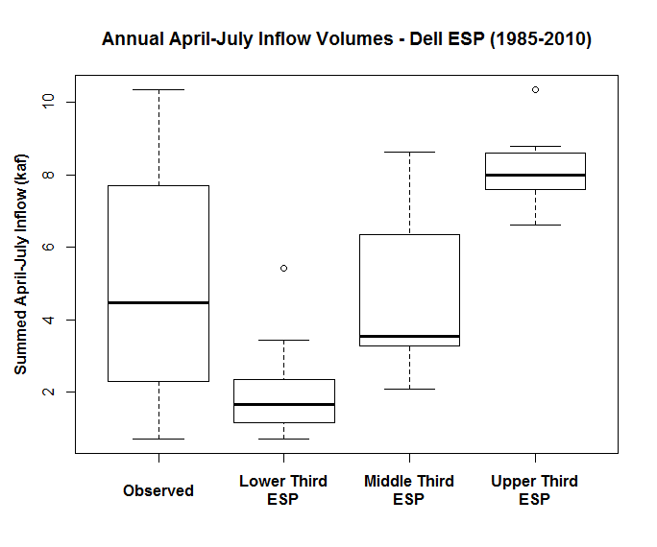
Additional skill when using ESP forecast
Notes:
If we switch that to current ESP products from the CBRFC, the mean trace from an ESP runoff ensemble yields much less variability in what the upper and lower thirds of streamflow might be. In this case, when the mean trace volume is in the upper third when the forecast is issued in April, we know in the past 25 years inflows have been above 5000 ac-ft.
This is useful operational knowledge as pertaining to how much water may need to be released to meet flood control objectives while retaining pool height for summer drinking water needs
My expectation was that CFSv2 would result in an improved version of this

Slide 20

Additional skill when using HEFS forecast
Notes:
But we have not seen that yet but there is more work to be done. It is not worse ☺

Slide 21
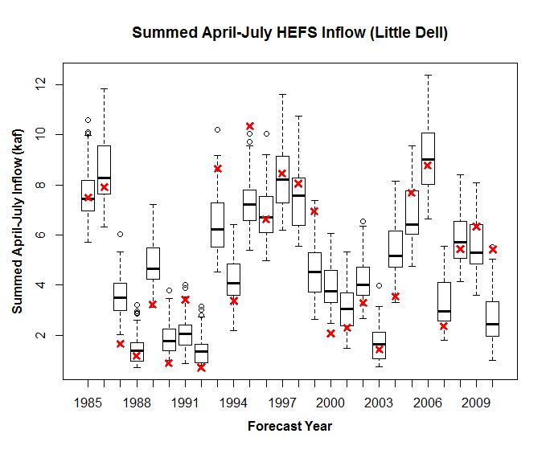
HEFS DELL
Notes:
This plot shows summed Apr-Jul inflows, red x’s are observed and box plots show dist of ensemble

Slide 22
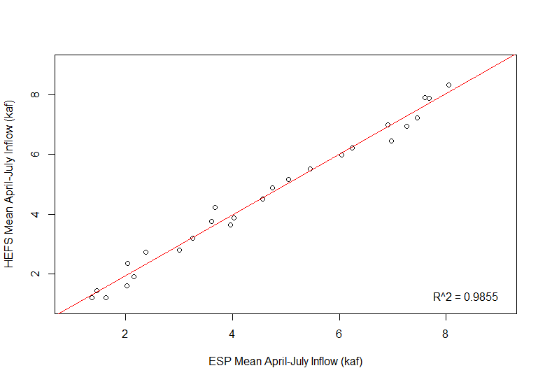
Means of ESP and HEFS (kaf)

Slide 23
Project Goals
Demonstrate the potential usefulness of climate forecasts and create an appropriate framework for their application
Co-generate knowledge concerning system operations between researchers and water managers
Generate ESP streamflow using reforecasts at partner locations
Evaluate skill of GFS and CFSv2 and corresponding streamflow in the context of decision making
Disseminate data, case studies, and recommendations to the broader water community
Notes:
Take

Slide 24
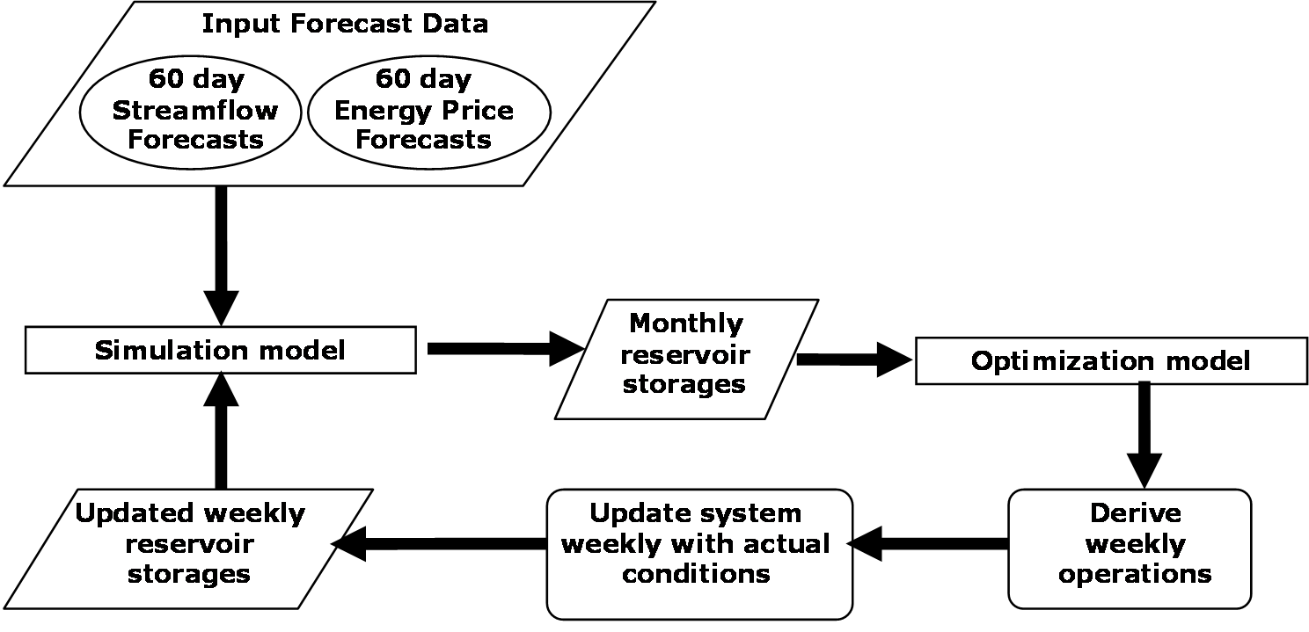
Proof of Concept - Method
Do this for each week, for 52 weeks to determine the benefit of 60 day forecasts.

Slide 25
Proof of Concept - Results
Use DSS to evaluate revenue gains in three hydrologically different years
Compare the use of forecast information against ‘perfect knowledge’

Slide 26
Proof of Concept - Results

Slide 27
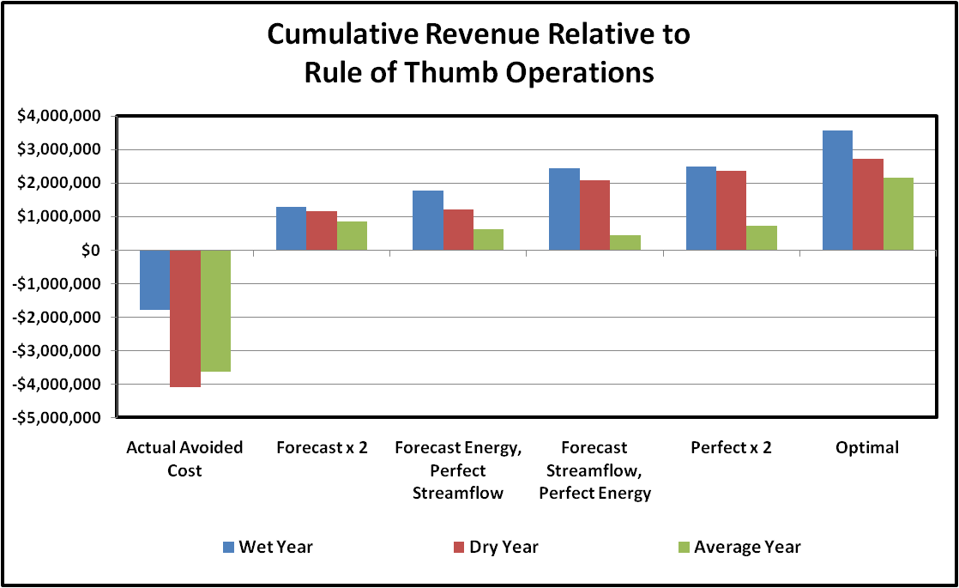
Proof of Concept - Results

Slide 28
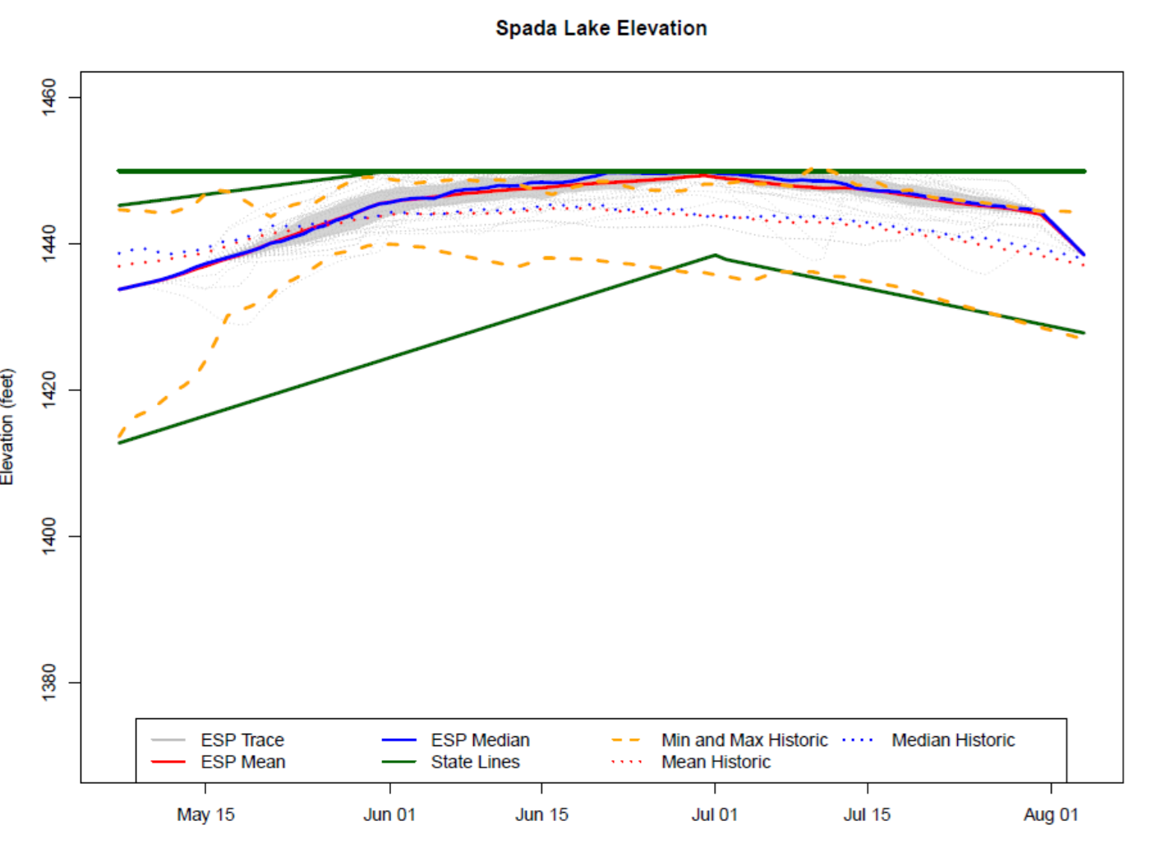
Current Operations and Forecast Use

Slide 29
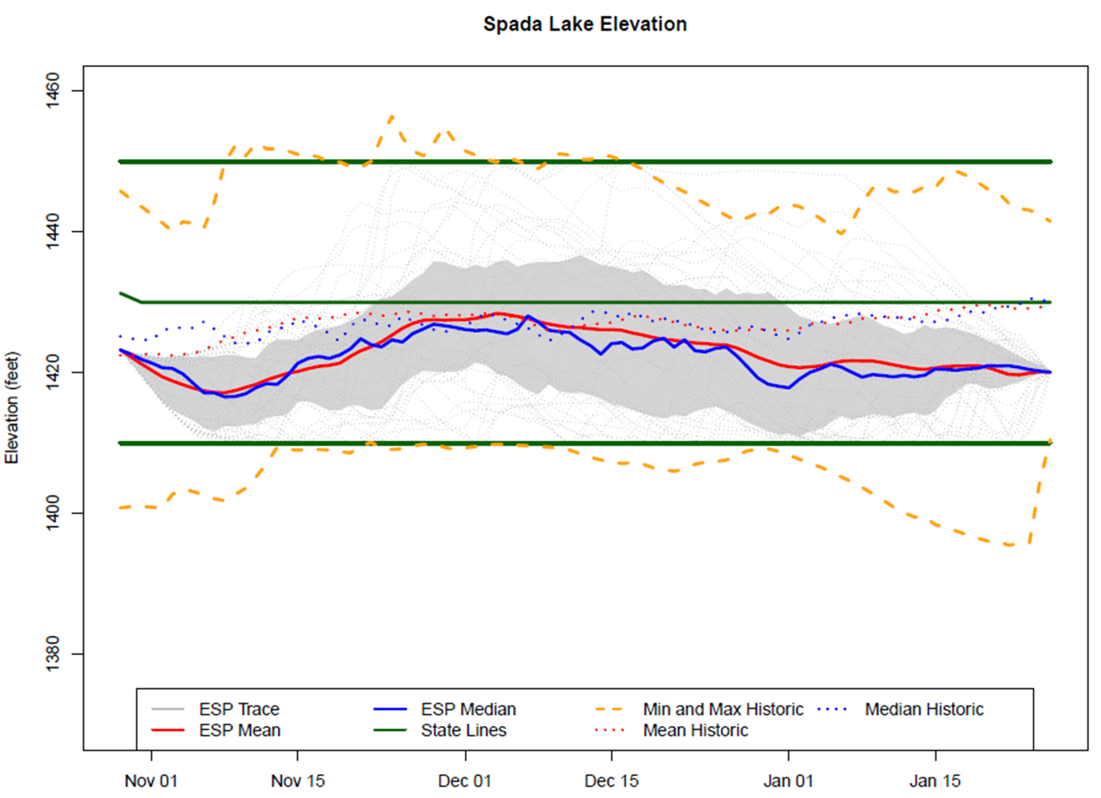
Current Operations and Forecast Use

Slide 30
Incorporating Forecasts
Simulation Model – Stella or R
Simulates system operations
Calculates how water is routed through the system

Slide 31
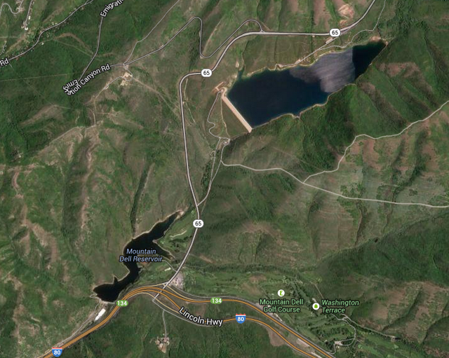
Incorporating ESP Forecasts: Parley’s System
Operated by Salt Lake City
Releases to supply drinking water
Releases for flood management

Slide 32
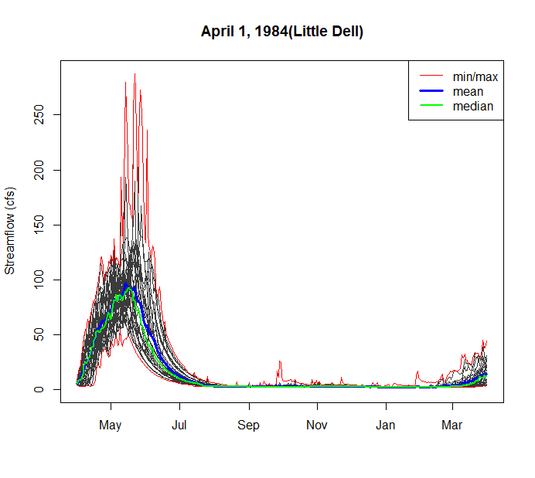
Incorporating Forecasts: Salt Lake City
For today’s example:
ESP traces used as inflow to the model
2. Static Rule Curve based on the median historic storage determines how releases are made
Reservoir Storage
Inflows
Releases

Slide 33
Potential Benefits of Using Forecast
Critical Period | Concern | Value
Low inflow or low pool elevation | Not providing enough water | How much releases should be reduced
High inflows or high pool elevation | Spilling, flooding | Chance of spilling, potential peak inflows

Slide 34
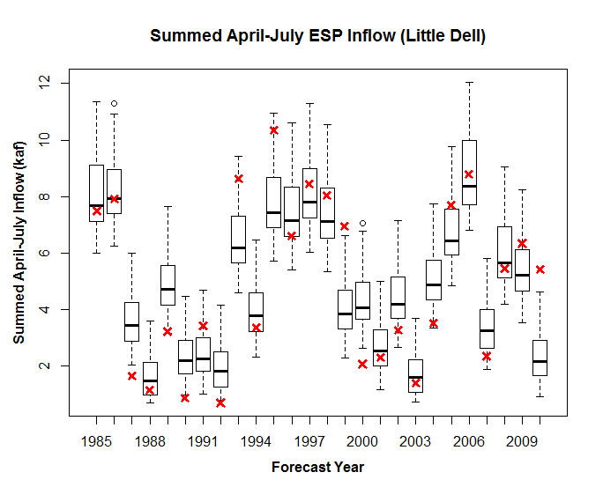
ESP DELL

Slide 35
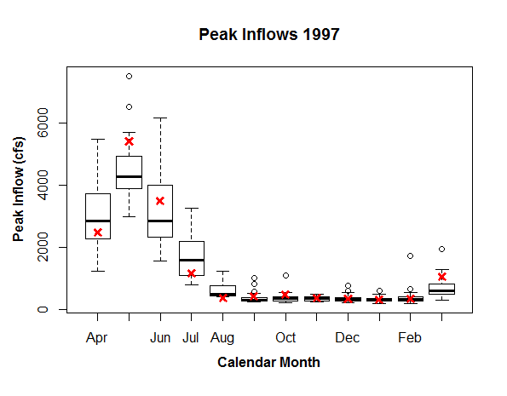
Example of Results: High Flow Year

Slide 36
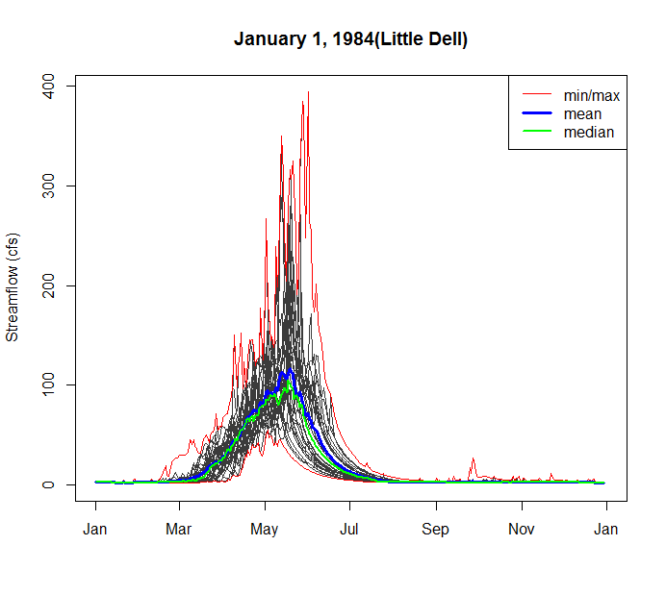
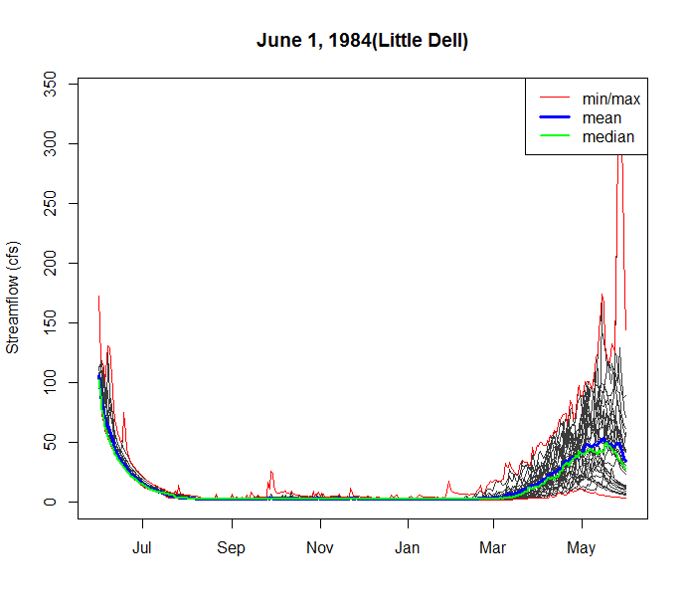
ESP Streamflow – High Inflow Year

Slide 37
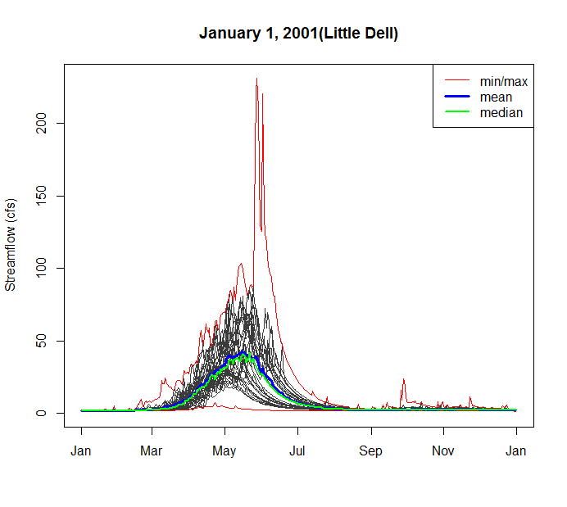
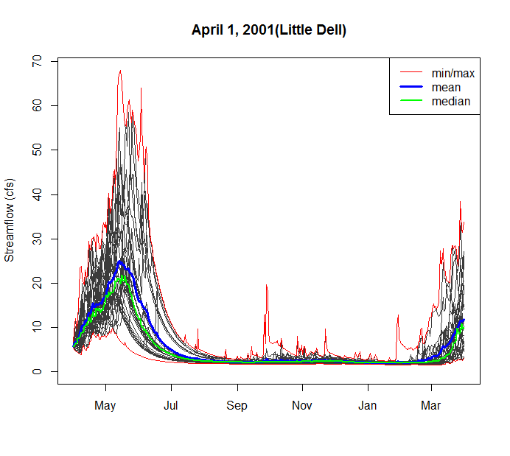
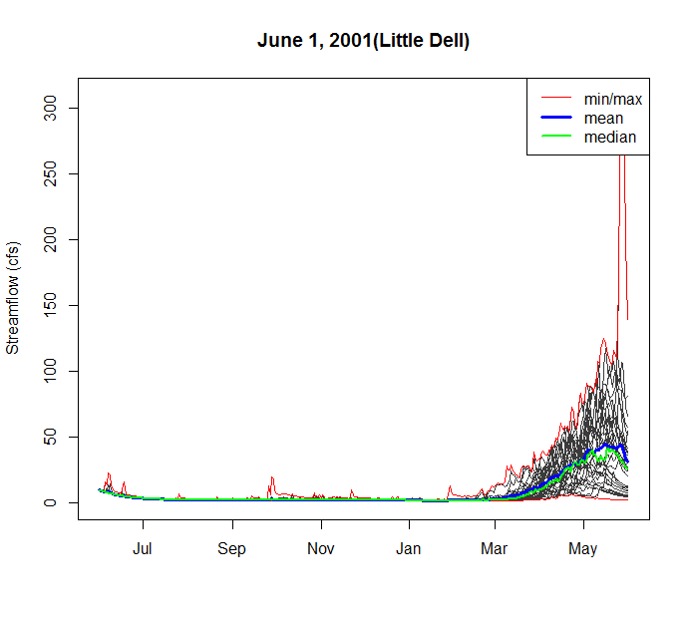
ESP Streamflow – Low Inflow Year
Notes:
Note order of magnitude on y-axis is half of the 1984 example

Slide 38
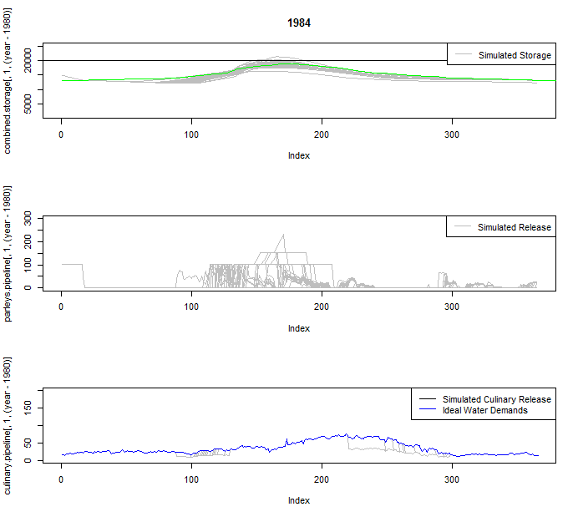
January ESP – Operational Output (af)
Combined Storage
Jan 1
Dec 31
Releases
Jan 1
Dec 31
Water Releases
Jan 1
Dec 31

Slide 39
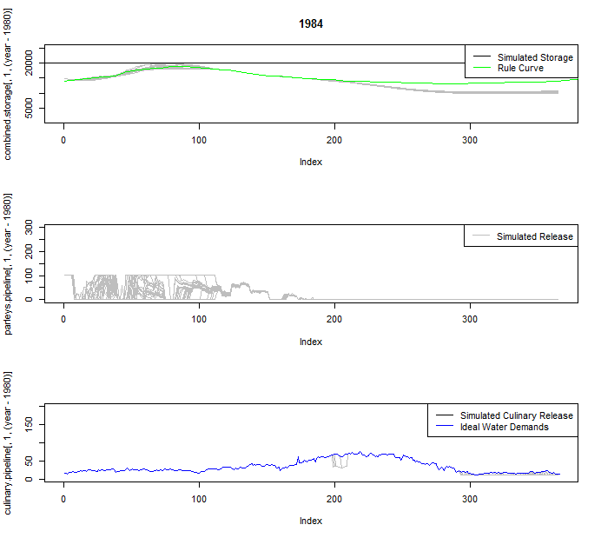
April ESP - Operational Output (af)
Combined Storage
Apr 1
Mar 31
Releases
Apr 1
Mar 31
Water Releases
Apr 1
Mar 31

Slide 40
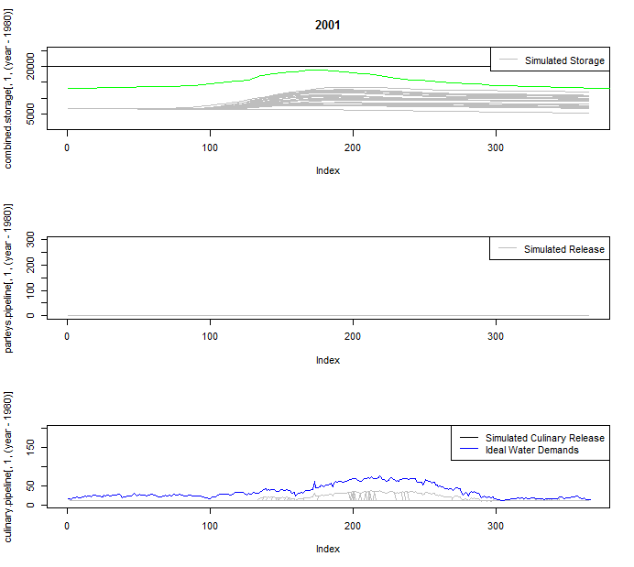
January ESP - Operational Output (af)
Combined Storage
Jan 1
Dec 31
Releases
Jan 1
Dec 31
Water Releases
Jan 1
Dec 31

Slide 41
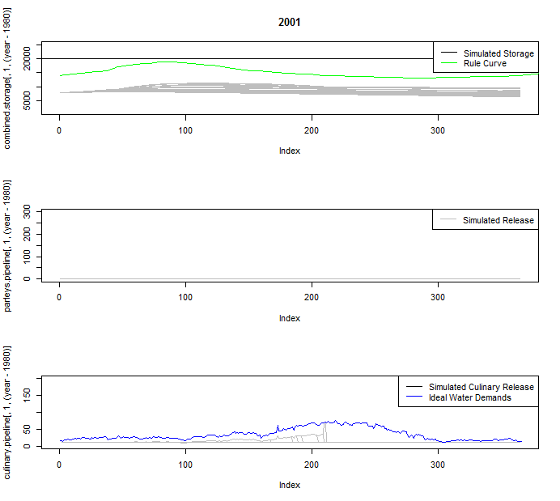
April ESP - Operational Output (af)
Combined Storage
Apr 1
Mar 31
Releases
Apr 1
Mar 31
Water Releases
Apr 1
Mar 31

Slide 42
Iterative Process Getting New Tech Into Ops
Our new models are awesome, let’s use them!
How come you are not using X at an X frequency?
We’re Operational Hydrologists!
Floods are our priority
We’re Research Hydrologists!

Slide 43
Iterative Process Getting New Tech Into Ops
Our new models are awesome, let’s use them!
How come you are not using X at an X frequency?
We’re Operational Hydrologists!
Floods are our priority
We’re Research Hydrologists!
NOAA SARP

Slide 44
Final Thoughts and Future Work
ESP and HEFS/CFSv2 traces applied in operational framework will provide benefits,
we are finishing evaluating at what scales and for what decisions, final evaluations completed by September
Generating hindcast data for evaluating system in existing framework is iterative process
generating data, processing through system, trouble shooting…
Matching End User needs (update frequency, forecast length, etc.) must be priority in beginning of process

Slide 45

Acknowledgements
NOAA SARP – Nancy Beller-Simms
Advisors: Dr. Austin Polebitski,
Dr. Richard Palmer
CBRFC: Kevin Werner, Ashley Nielson
Dr. Andy Wood
Case Study Partners: Bruce Meaker, Connely Baldwin, Jeff Niermeyer,
Tracie Kirkham, Denis Qualls

Slide 46
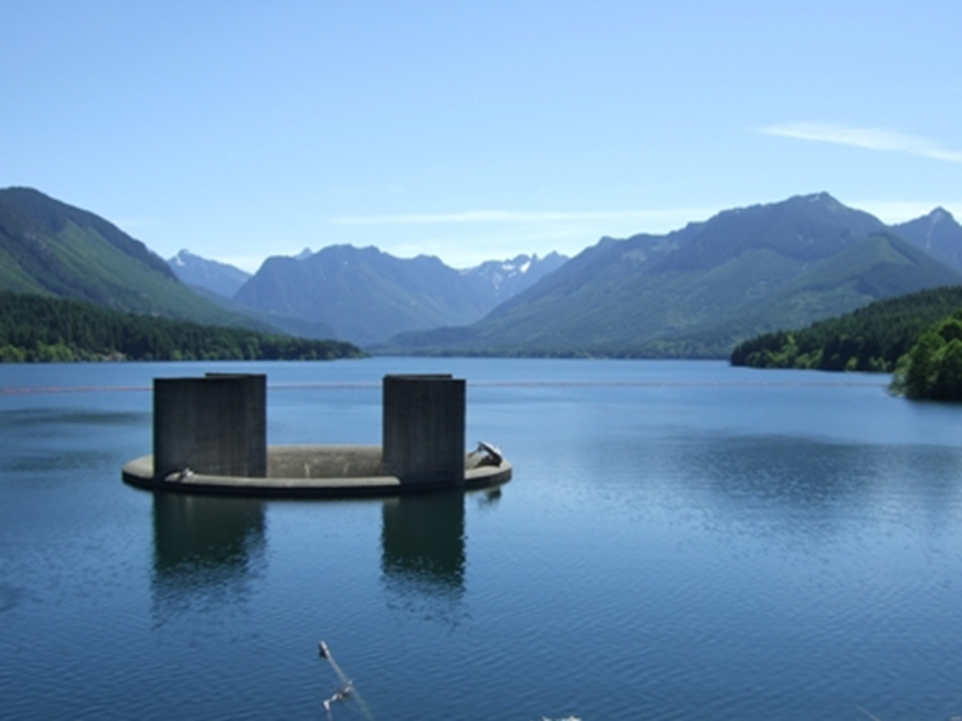
Thank You!
Questions?

Slide 47
Project Goals
Analyze the quality of climate forecast products,
Work with study partners to develop ways to use products in reservoir operations.
Water Managers
Researchers
Forecasters

Slide 48
Future Work
Quantitatively compare the results against perfect forecast information
Is this a useful seasonal prediction tool?
Does including the GEFS forecast improve the regular ESP forecast?
What benefits do CFS model provide?
CONCLUSION: Preliminary analysis of these data suggest that climatological skill between the ESP and CFS are similar. More work is needed as the data are still very new.
Notes:
EXAMPLE METRICS
% of promised allocation delivered
Increased R
Deviations from perfect

Slide 49
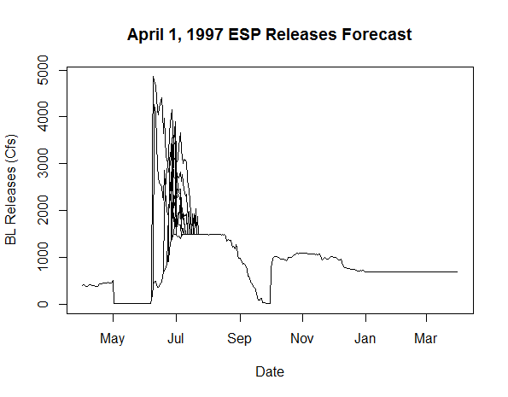
Example of Results: High Flow Year

Slide 50
Example of Results: High Flow Year
*9/30 expected releases would exceed 1500 cfs for an average of 19 days

Slide 51
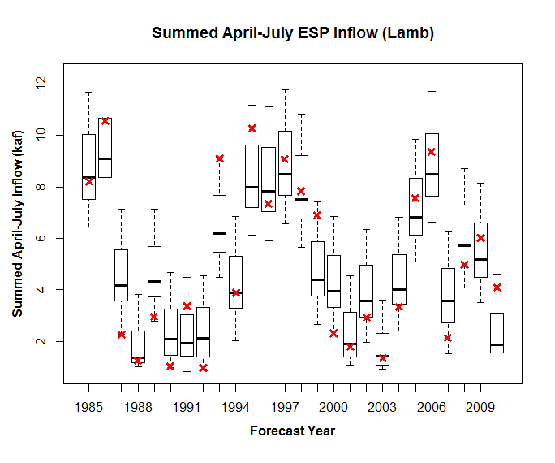
ESP LAMB

Slide 52
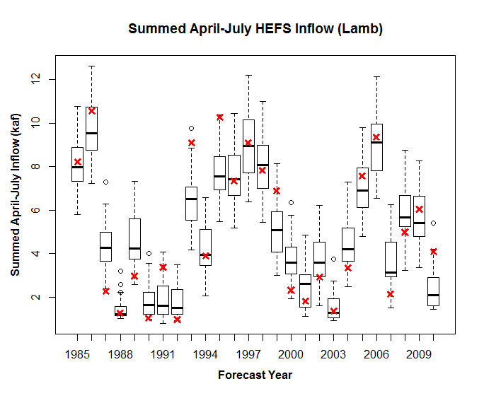
HEFS LAMB

Slide 53
ESP DELL

Slide 54
Example of Results: High Flow Year

Slide 55
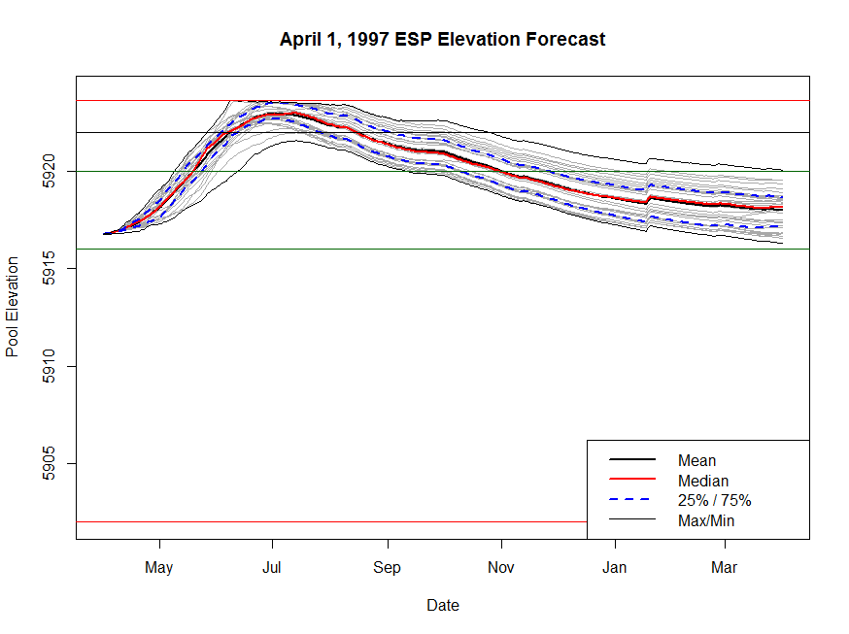
Example of Results: High Flow Year
Max Storage
Critical Flood Threshold
Target Range
Min Storage

Slide 56
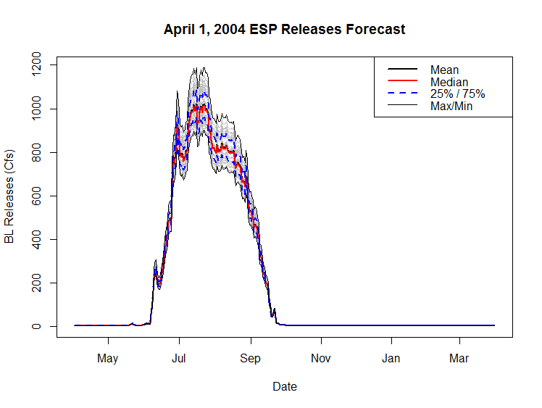
Example of Results: Low Flow Year

Slide 57
Example of Results: High Flow Year
Max Storage
Critical Flood Threshold
Target Range
Min Storage

