Slide 1

Southern Nevada and the Colorado River
Tom Maher
Senior Resource Analyst
Southern Nevada Water Authority
February 26, 2014

Slide 2
Southern Nevada Water Authority
The SNWA is a cooperative agency formed in 1991.
SNWA’s mission is to manage the region’s water resources and develop solutions that will ensure adequate future water supplies for the Las Vegas Valley.
Member Agencies
Big Bend Water District
City of Boulder City
City of Henderson
City of Las Vegas
City of North Las Vegas
Clark County Water Reclamation District
Las Vegas Valley Water District

Slide 3
Southern Nevada’s Water Resources
Other Water
Resources, 10%
Colorado River, 90%

Slide 4
SNWA Perspective
Water Resources
Operations
Infrastructure
Notes:
4
4

Slide 5
SNWA Water Resource Plan
2009 Resource Plan
Water Demands (acre-feet)

Slide 6
Monitoring Drought - Historical Lake Powell Annual Inflows
Normal
Historical 14-Year Average Inflow: 71% of normal

Slide 7
Monitoring Projected Lake Mead Elevation
Top of Spillway
WY2014 release - 7.48 maf; WY2015 projected release: - 9.0 maf
Source: Bureau of Reclamation, January and February 2014 24-Month Study.
Notes:
7
7

Slide 8

Colorado River Shortage
The Basin States developed a framework to manage shortages, utilizing Lake Mead water elevations as triggers.
Nevada/Arizona’s share of Colorado River shortages
1,075 ft.
Nevada: 13,000 af / Arizona: 320,000 af
1,050 ft.
Nevada: 17,000 af / Arizona: 400,000 af
1,025 ft.
Nevada: 20,000 af / Arizona: 480,000 af
Initiate reconsultation for shortage below 1,025 ft.
Lake Mead

Slide 9

Regional Water System
Between 1995 and 2008,
SNWA completed a $2.5 billion
Capital Improvements Program
which added major components to
the regional water system.
North
Las
Vegas
Las Vegas Valley
Water District
Lake
Mead
Intake No. 2
Henderson
Alfred Merritt Smith Treatment Plant
Boulder City
River Mountains Facility

Slide 10
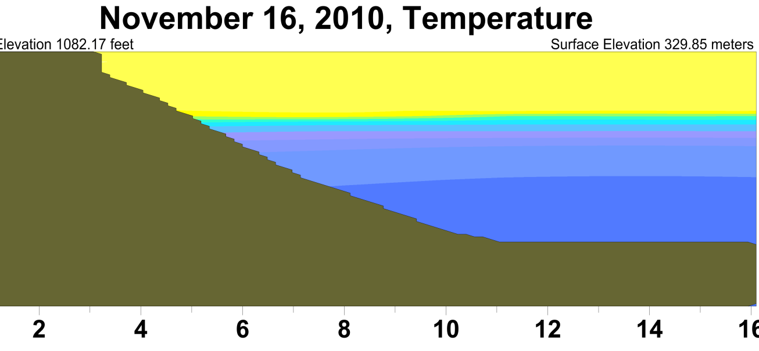
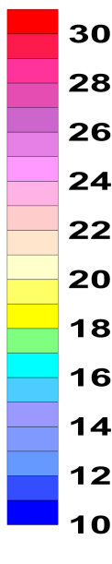
Lake Mead Infrastructure, Intake No. 3
Typical November temperatures in Lake Mead
86
Temp.
(°F)
Saddle
Island
82
79
Thermocline Thermocline
75
72
Intake 1
68
Intake 2
64
Elevation 860’
61
Intake 3
57
54
Intakes below the thermocline substantially avoid the impacts
of poor water quality effects from Las Vegas Wash discharges
50
Notes:
Sometime around November, the seasonal change in air temperature reduces the heat load to the lake water and the thermal stratification begins to dissipate. As a result, the THERMOCLINE can sink deeper into the lake such that, for a short time, even when the lake level is relatively high, the THERMOCLINE glides past the existing intakes as it spreads and dissipates.

Slide 11
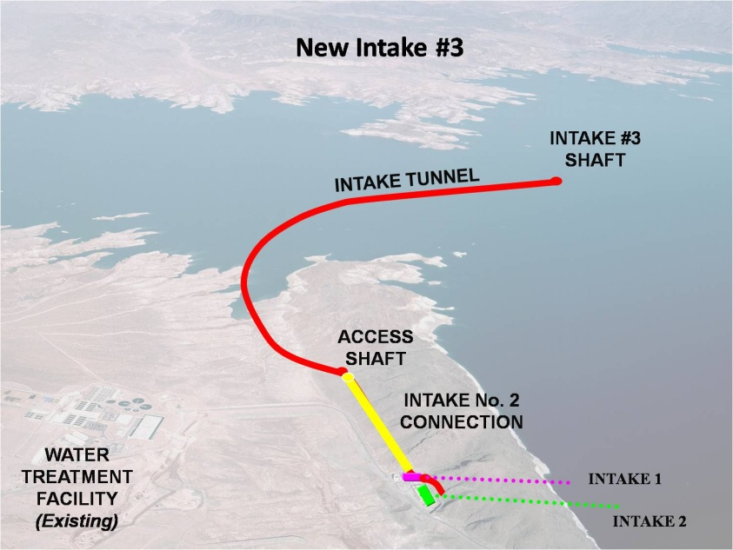
Lake Mead Intake No. 3
Existing Drinking Water Intakes at elevations 1,050 ft and 1,000 ft
Loss of Intake #1 between elevation 1,065 – 1,050 ft
Completion of Intake No. 3 at elevation 860 ft

Slide 12
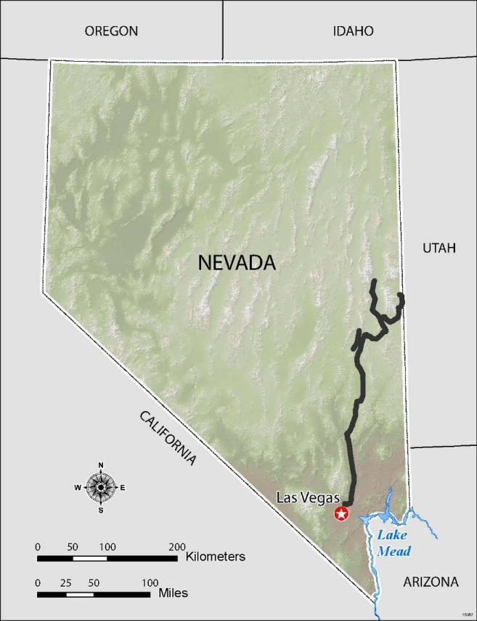
In-State Groundwater Resources
In 2012, the Nevada State Engineer granted nearly 84,000 acre-feet per year of permitted groundwater rights from four groundwater basins located in eastern Nevada.
12

Slide 13
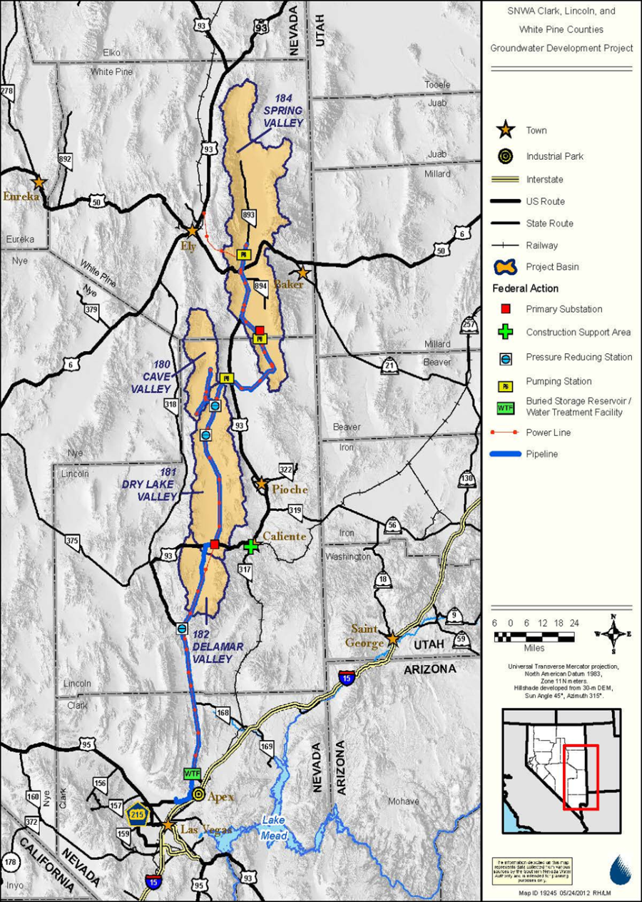
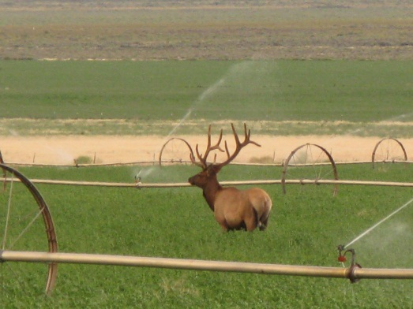
Groundwater Development
120,000 afy of groundwater from 5 basins
8-year public environmental analysis process
500 environmental measures, including over 35 separate environmental plans
Additional data collection and environmental analysis will be required

Slide 14
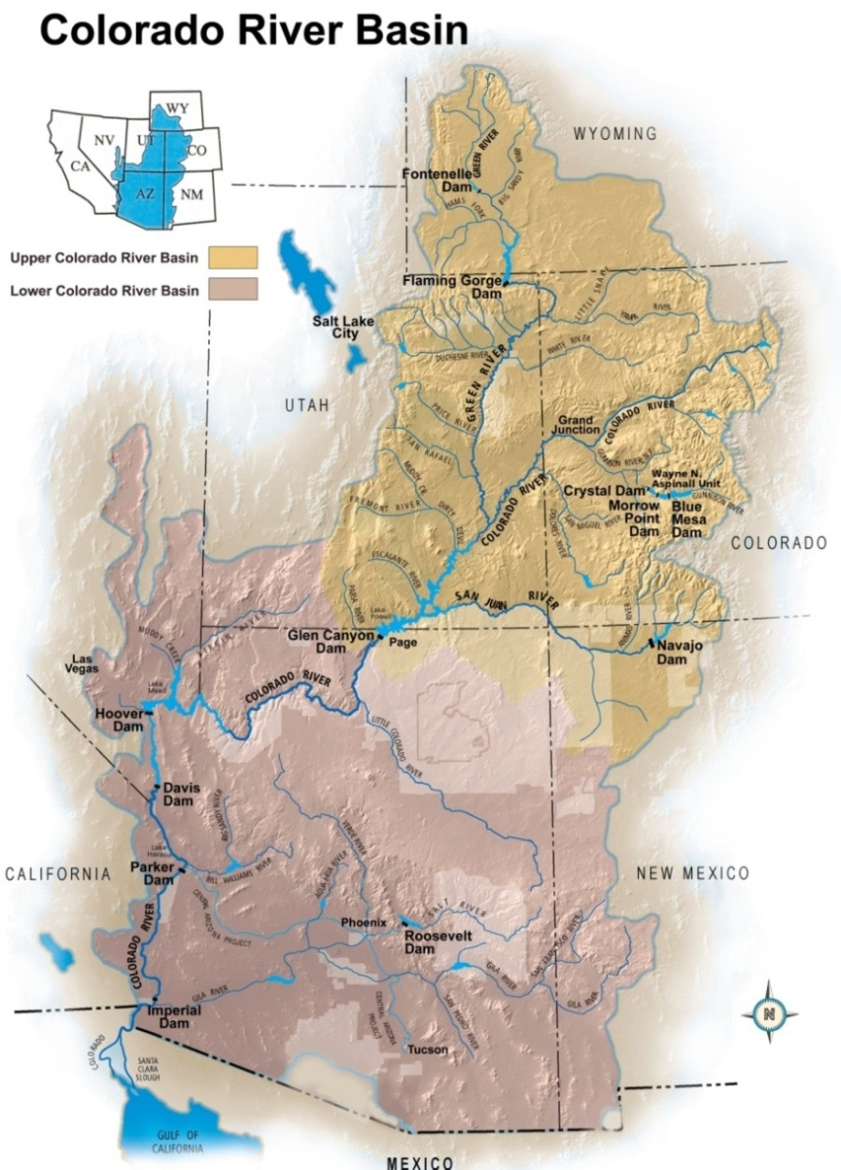
CBRFC Forecasting – Water Supply Perspective
Colorado River Water Supply
  Inflows into the System (Lake Powell)
  Lake Mead conditions
Federal/State/CBRFC Stakeholder Collaboration
Notes:
14
Engage Federal Agencies to assess vulnerabilities
Colorado River makes up 90% of current supply to Southern NV
Basin study was completed in 2012
Most recent and comprehensive assessment of risks to the basin resources from potential future impacts of climate change
3 year study - 50% Federal 50% State funded - $7M total - $500K+ contributed by SNWA

Slide 15
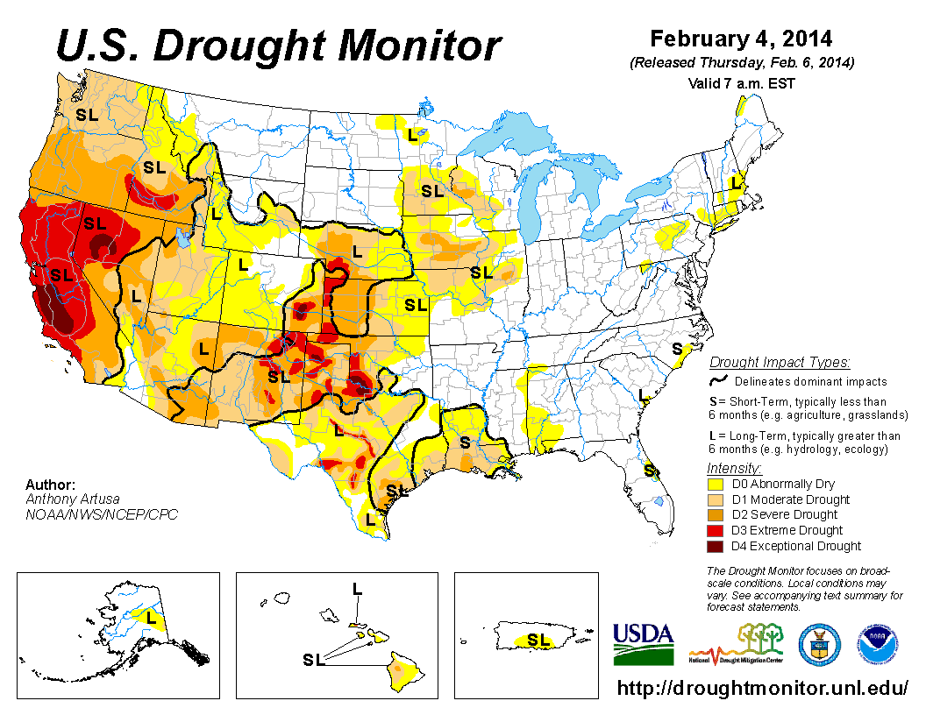
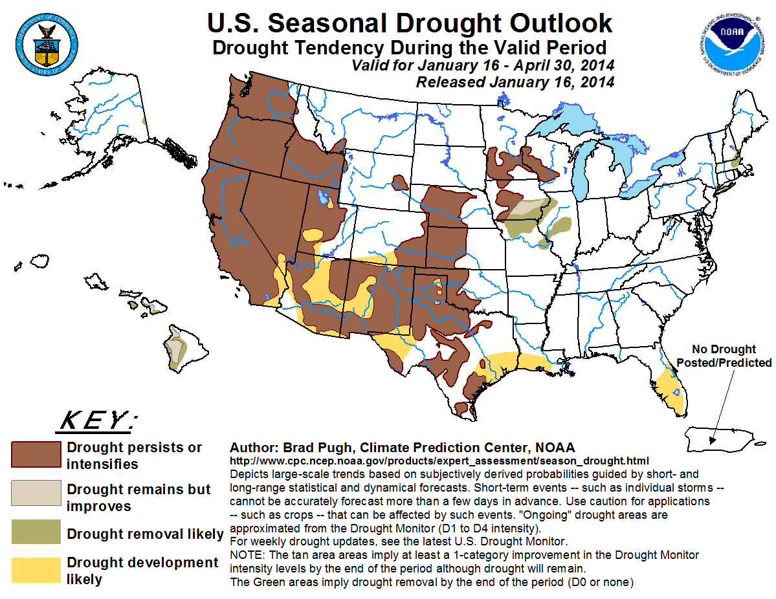
Monitoring Drought Conditions
U.S. Drought Monitor
Source: National Oceanic Atmospheric Administration and the U.S. Department of Commerce
Notes:
15

Slide 16
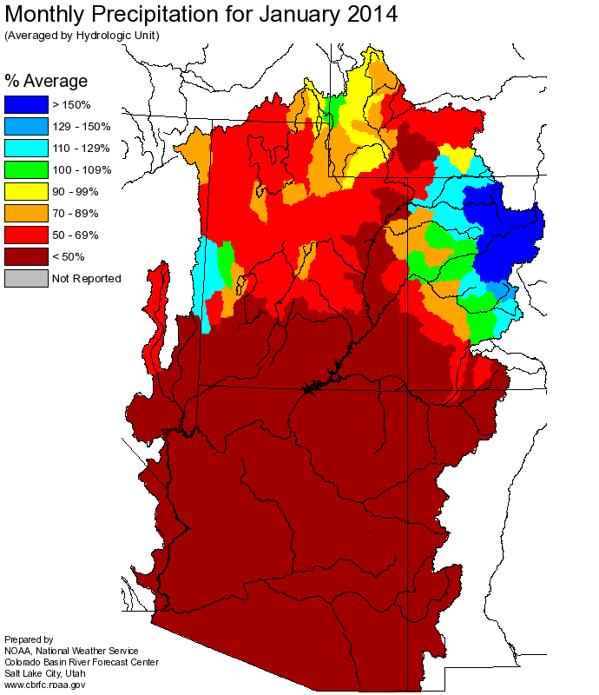
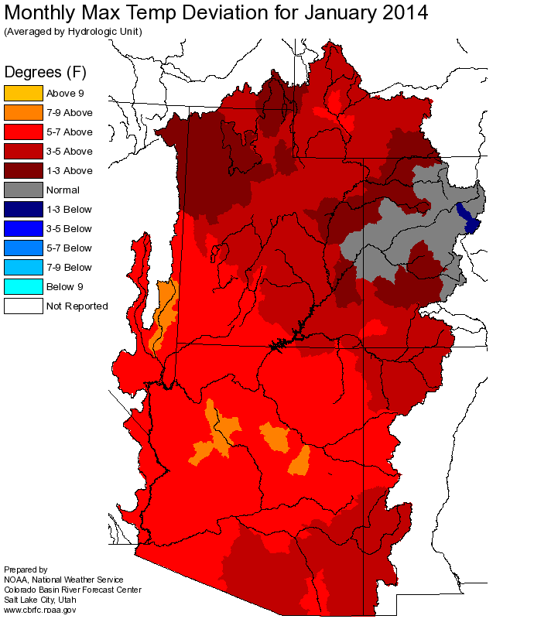
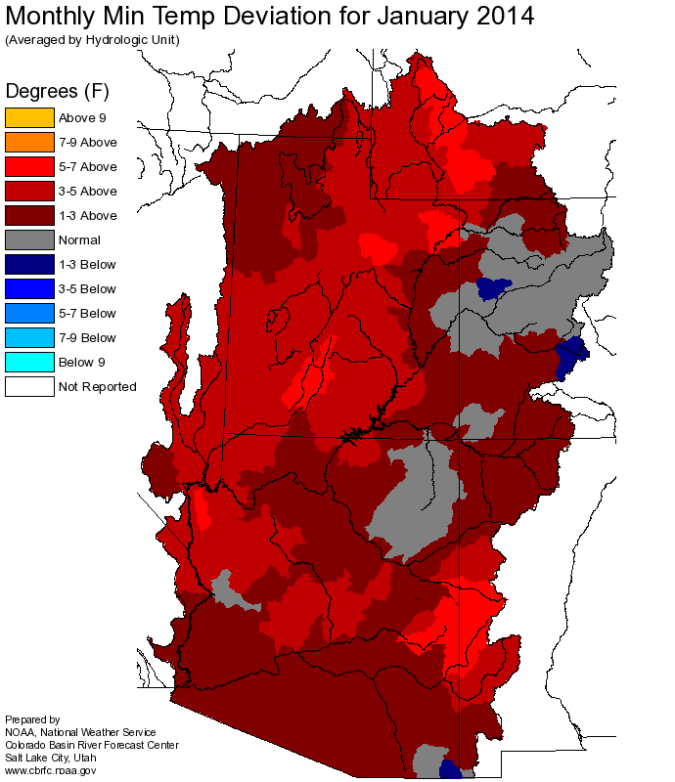
Monitoring Colorado River Basin Conditions
Monthly Precipitation
Monthly Min/Max Temperature Deviation
Source: NOAA / NWS / CBRFC
Notes:
16
16

Slide 17
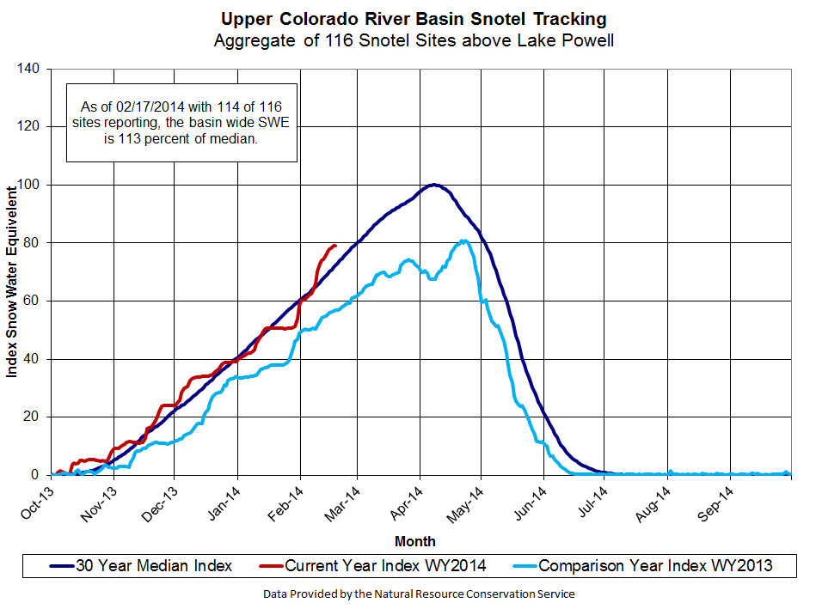
Monitoring Colorado River Basin Conditions
Notes:
17

Slide 18
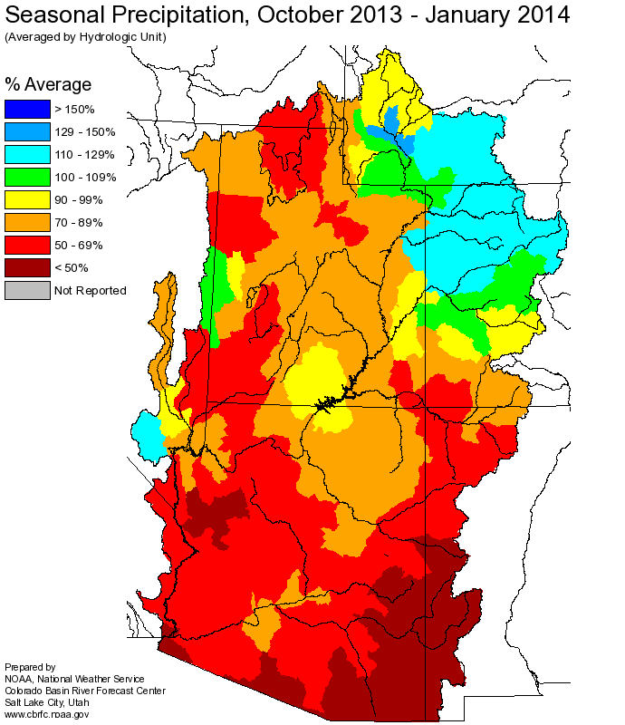
Monitoring Colorado River Basin Conditions
January inflow to Lake Powell: 75% of average
Snow Pack: 112% of average
Water Year 2014 Precipitation:
103% of average
Forecasted Water Year 2014 Inflow to Lake Powell: 101% of average
Notes:
18

Slide 19
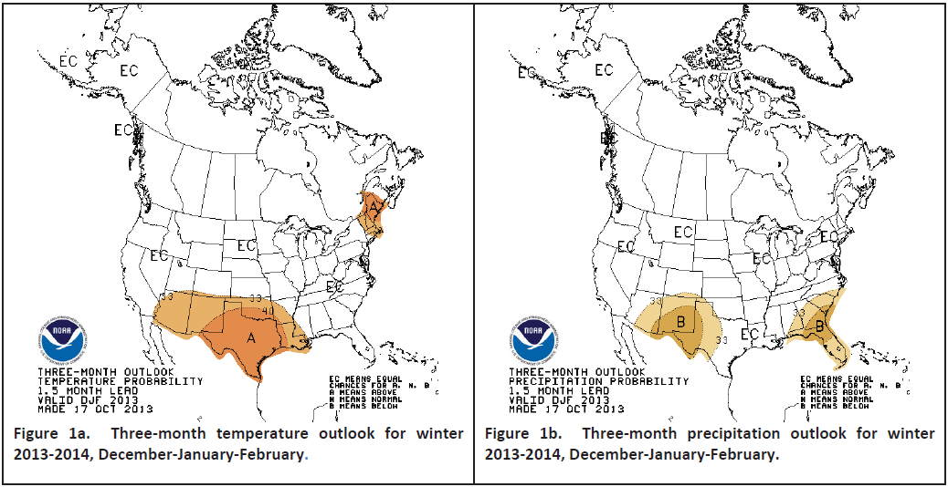
Monitoring Colorado River Basin Conditions
U.S. Winter Outlook (December – February)
No clear signal in the Upper Basin
(equal chance of above- and below-normal temperature and precipitation)
Source: NOAA CPC/ NWS / CBRFC
Notes:
19

Slide 20
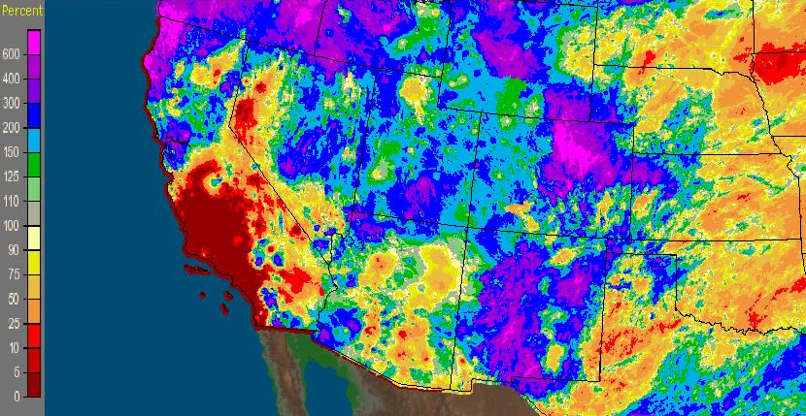
September 2013 Precipitation
Monitoring Colorado River Basin Conditions
The observed inflow into Lake Powell was 210% of normal
Source: NOAA / NWS / CBRFC

Slide 21
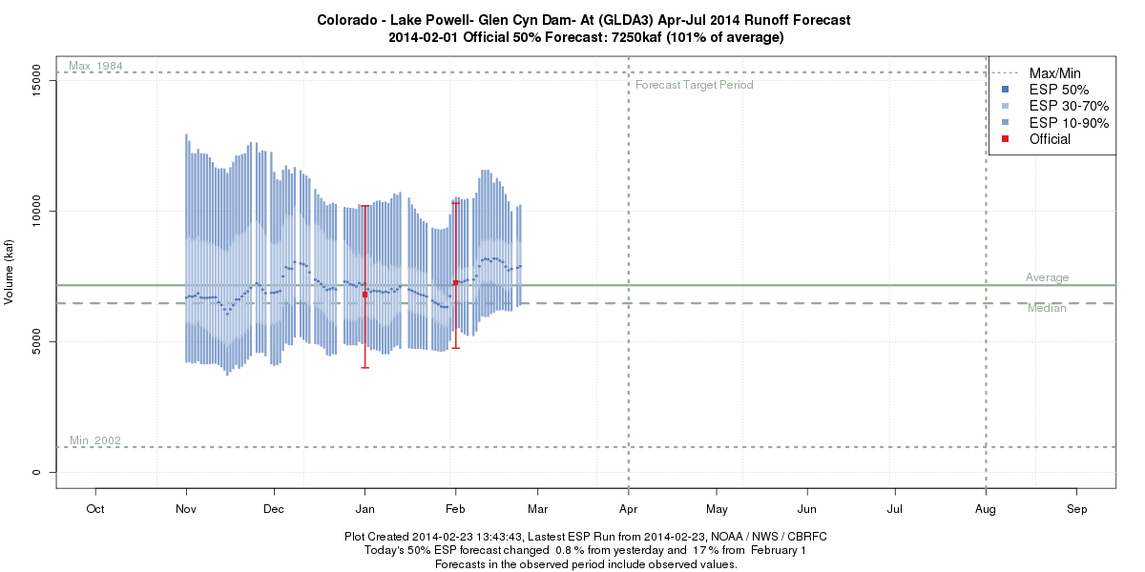
Lake Powell Evolution Plot
Source: CBRFC
Notes:
21
21

Slide 22
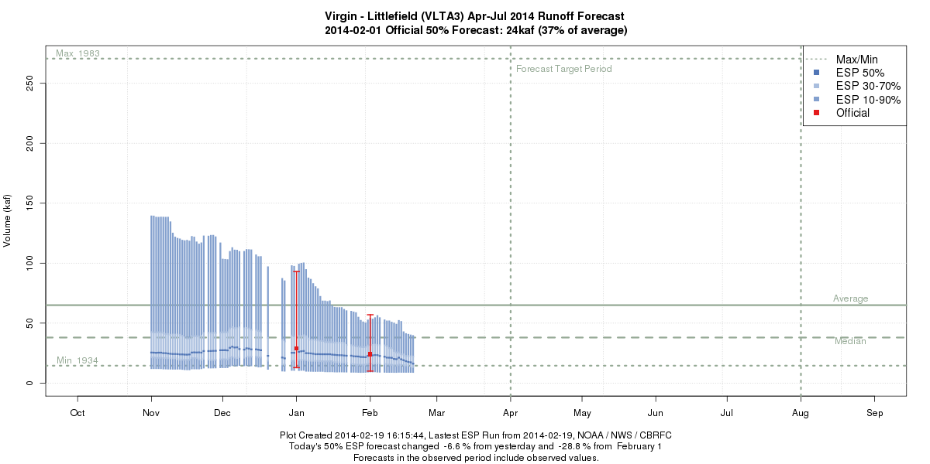
Lower Virgin River Evolution Plot
Source: CBRFC
Notes:
22
22

Slide 23
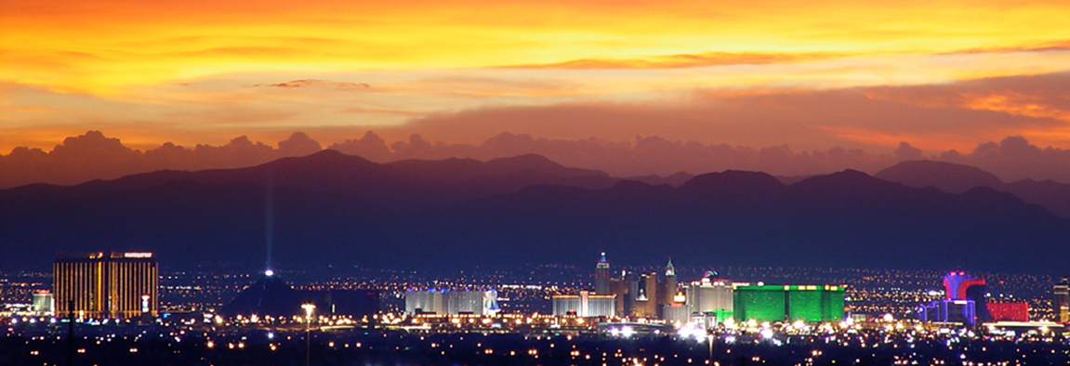
Questions

