Slide 1
Colorado Basin River Forecast Center
Stakeholder Forum
Beyond The Streamflow Forecast
What is affecting short term forecasts
Tracking conditions within the River Basin
Seasonal discussions / Seasonal trends
Providing the most pertinent information
Future Improvements (keeping it simple yet informative)
CBRFC Web Page Navigation

Slide 2
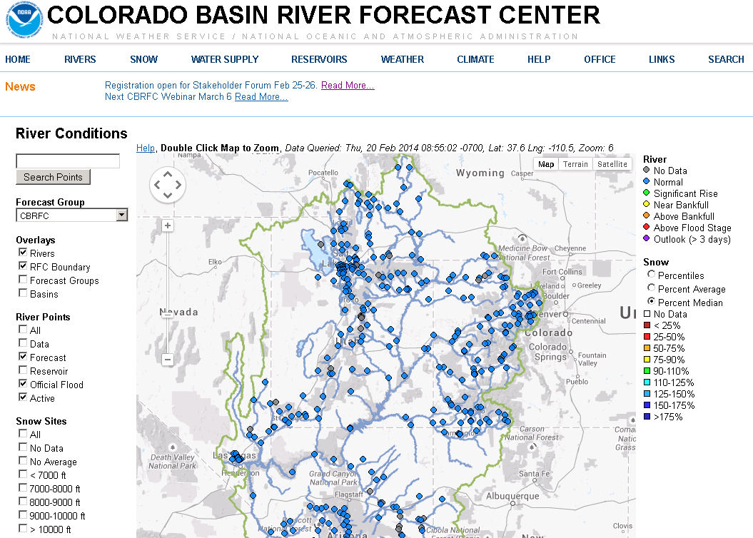

Slide 3
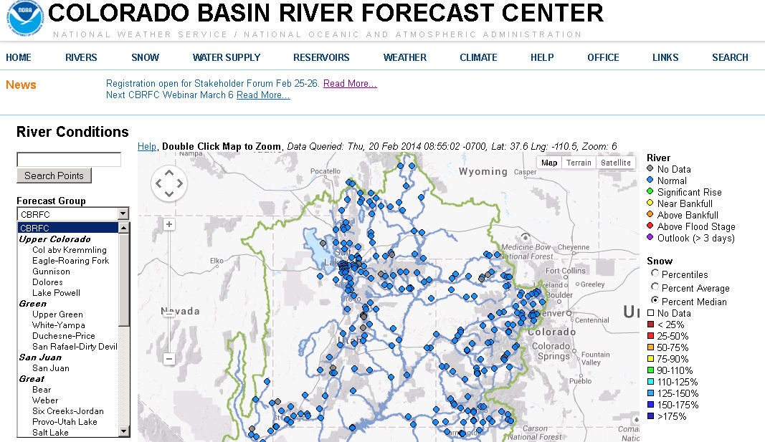

Slide 4
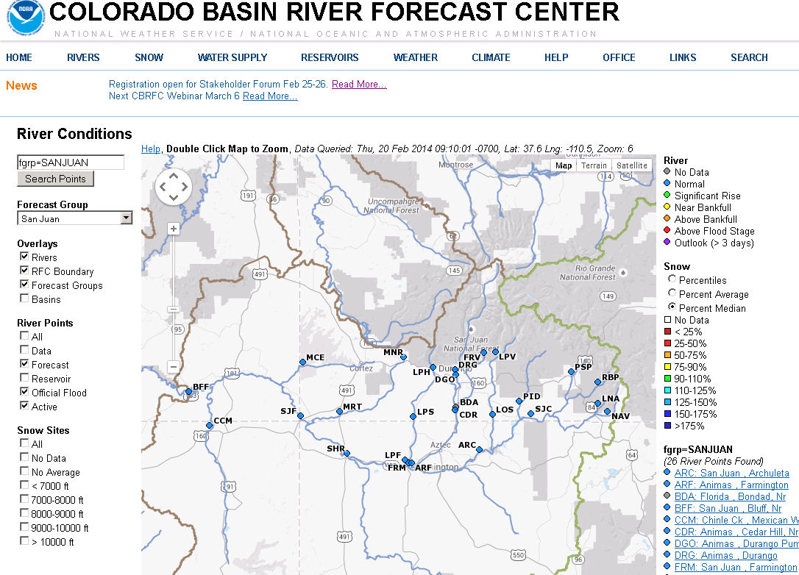

Slide 5
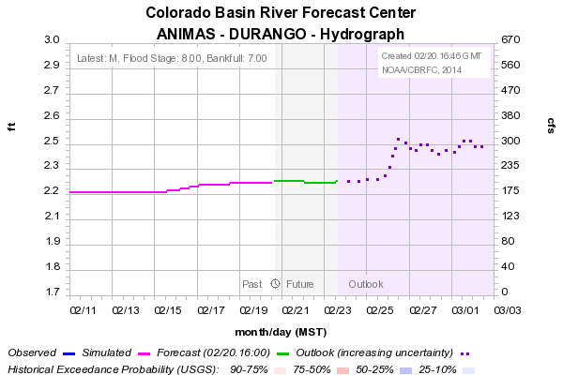
Future Rise – Precipitation ?
Temperature ?
Upstream Regulation ?

Slide 7
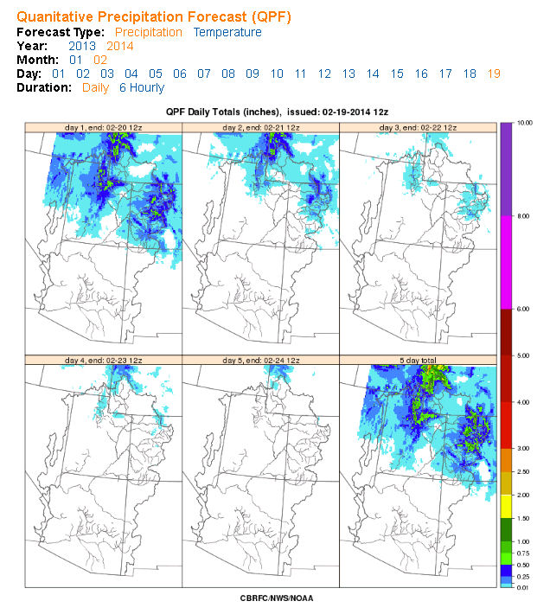

Slide 8
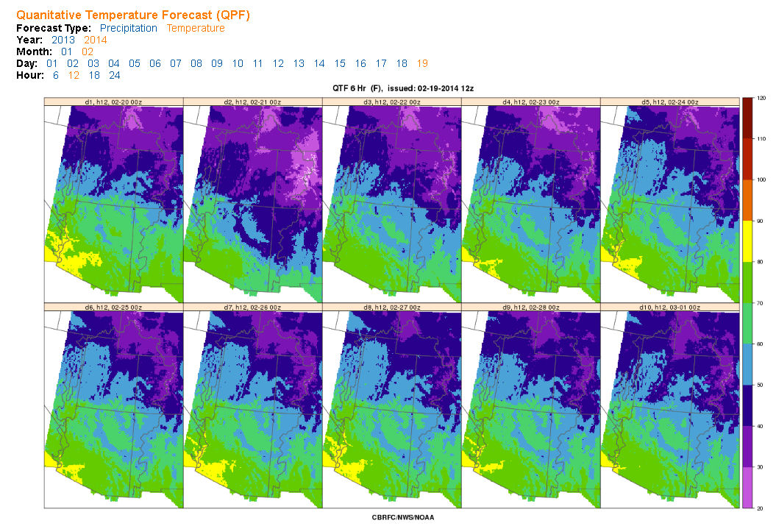

Slide 9
Colorado Basin River Forecast Center
Stakeholder Forum
Beyond The Streamflow Forecast
Tracking conditions within the River Basin
Precipitation (recent, monthly, seasonal)
Snow conditions (points, basins, comparison abilities)
Soil Moisture (Impacts to forecasts & runoff)

Slide 11
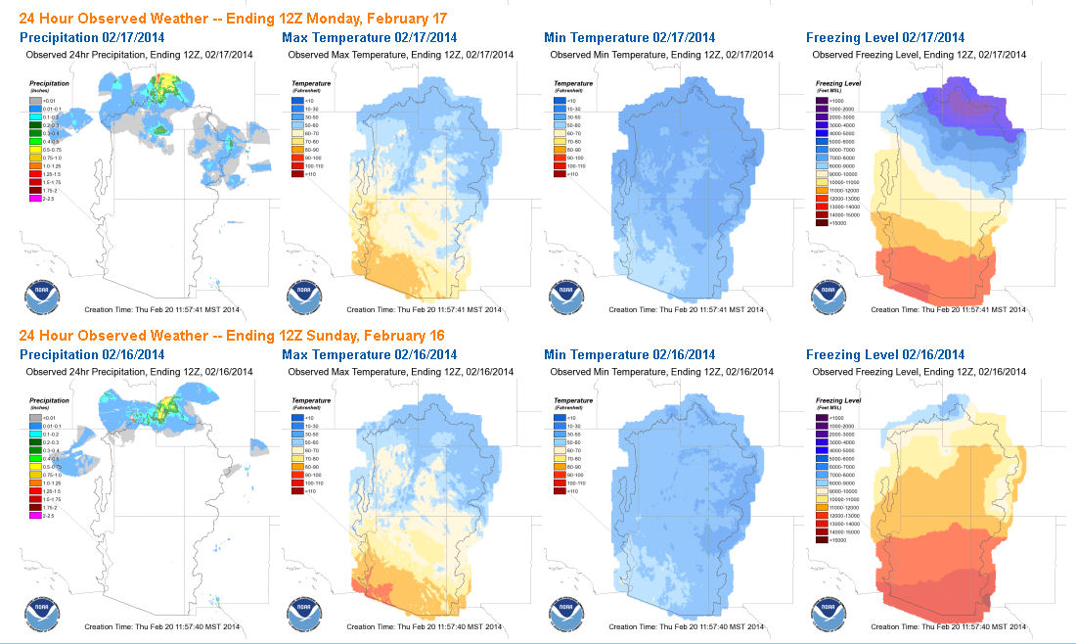
Recent Weather

Slide 12
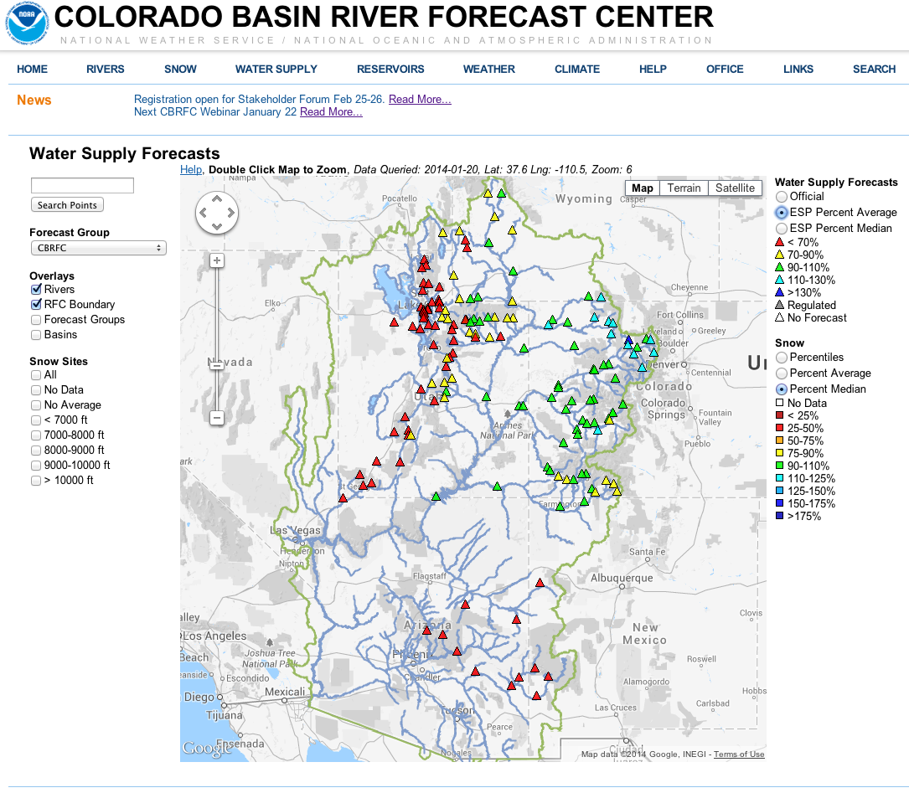

Slide 13
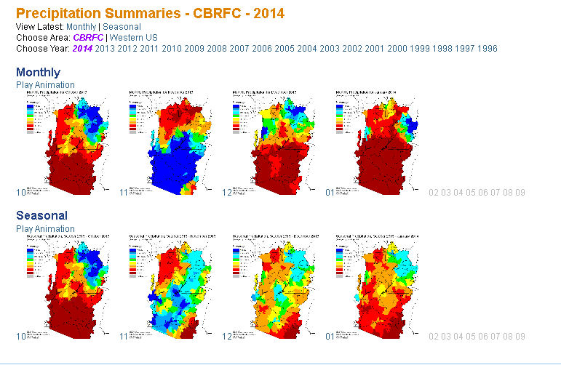
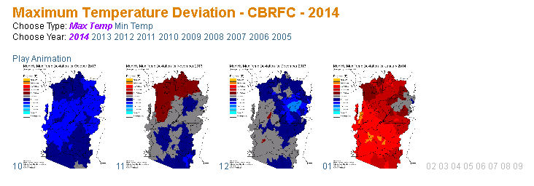

Slide 14
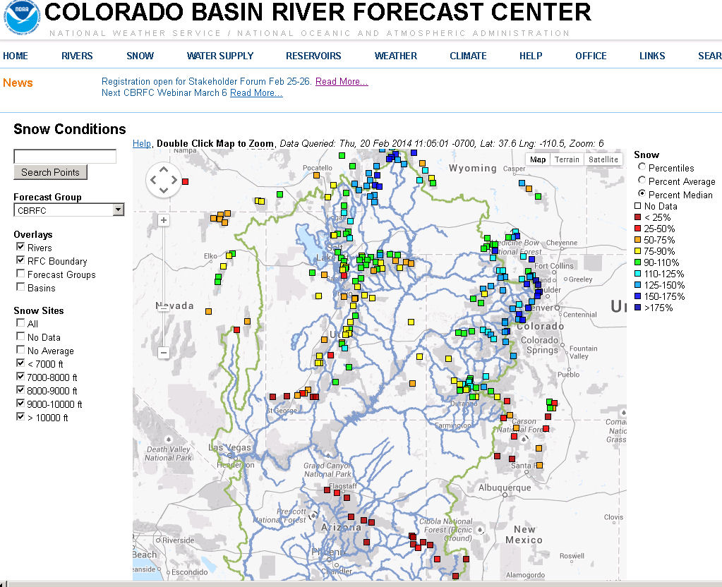

Slide 15
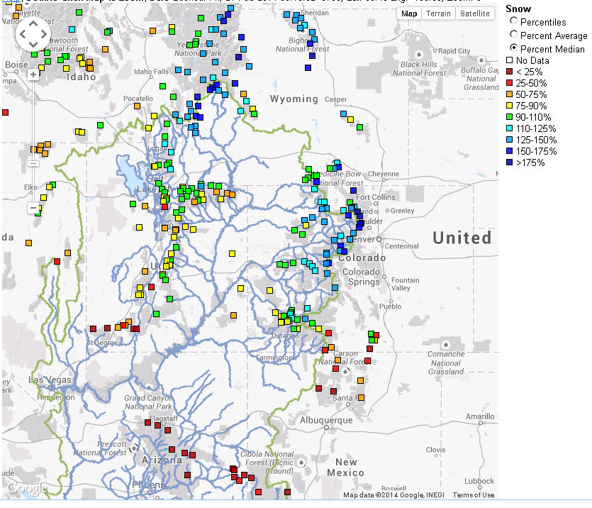
As of 2/21/2014

Slide 16
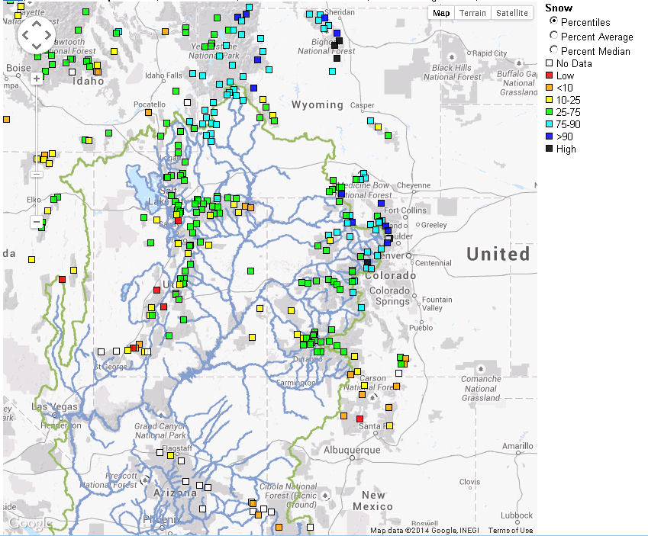

Slide 17
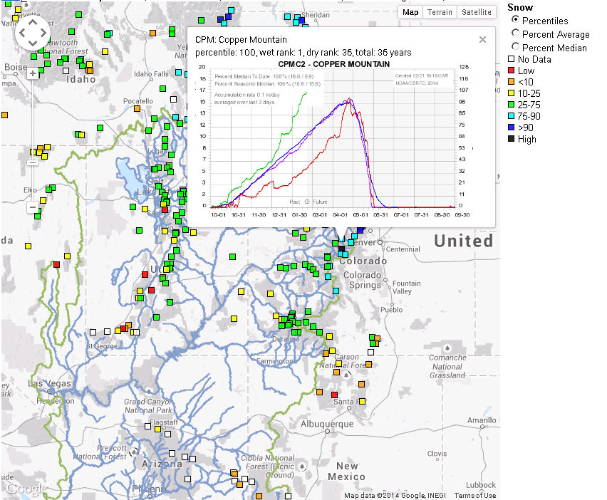

Slide 18
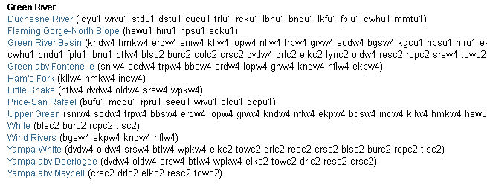
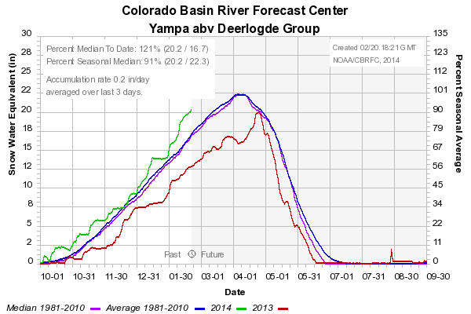
Basin Info: Snow Products
February 5th Snow
Snow Groups

Slide 19
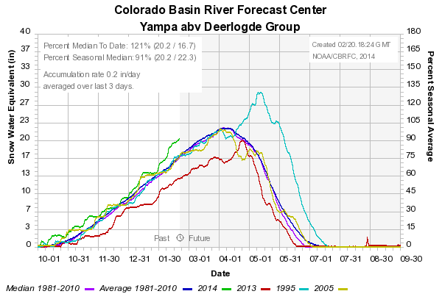
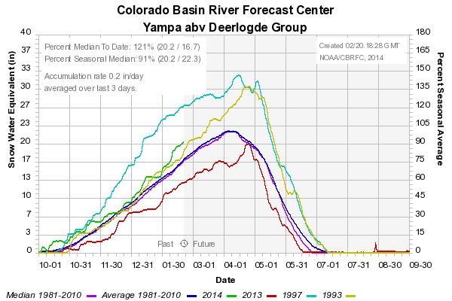
Basin Info: Snow Products
Comparison Ability
February 5th Snow
closest pattern to current year
maximum years

Slide 20
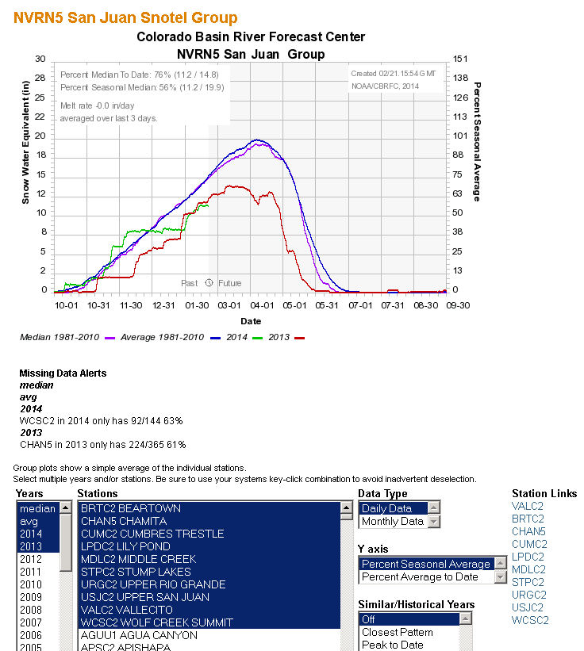
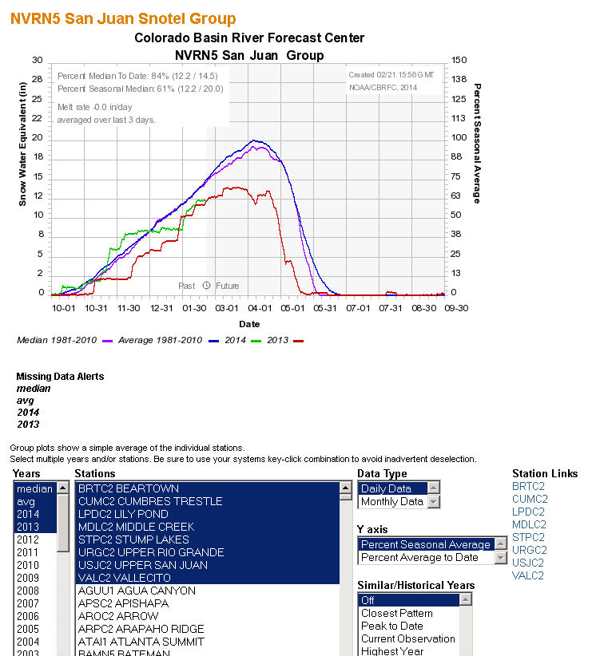
: Snow Products
Make sure you are comparing apples to apples

Slide 21
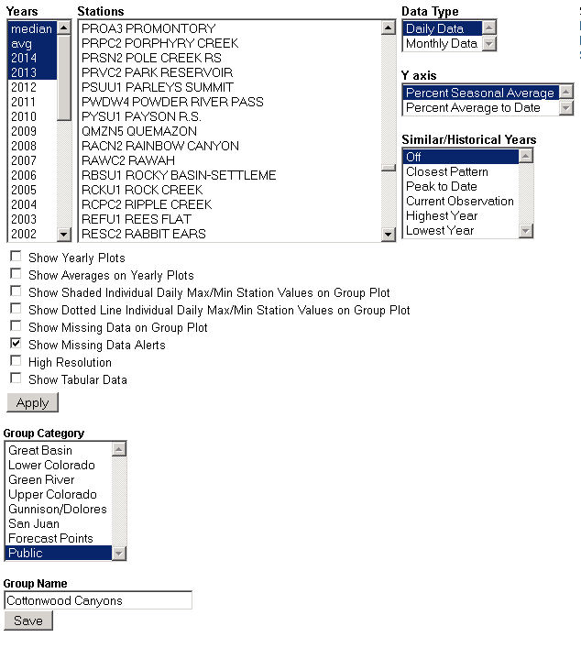
Interface exists to create snow groups
Check existing groups first

Slide 23
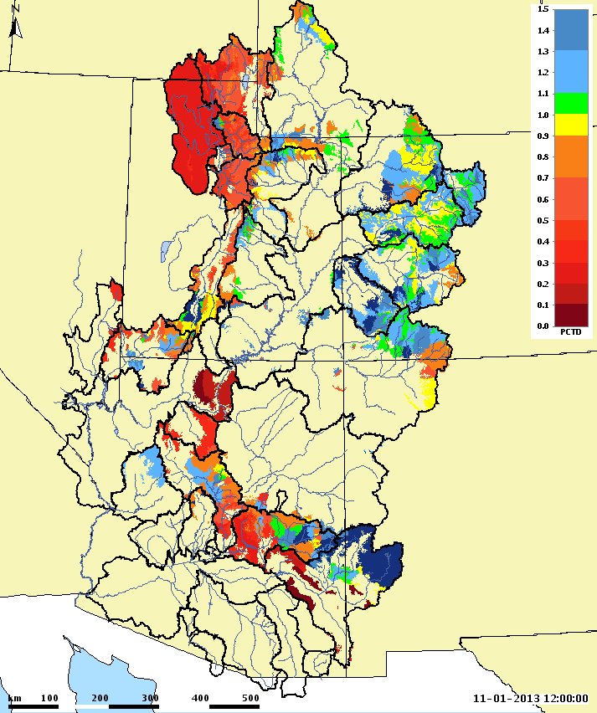
Model Soil Moisture

Slide 24
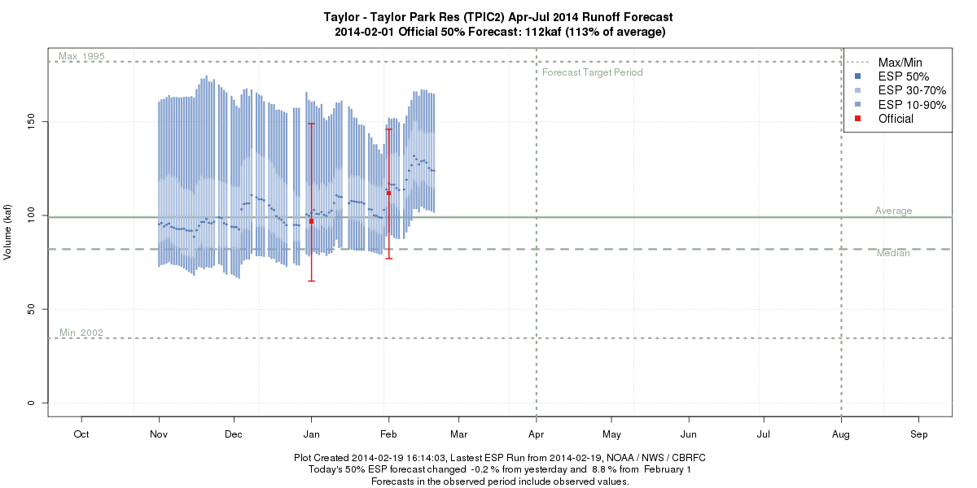
Tracking basin conditions to explain model trends
Recent Precipitation / Increase in Snowpack
Soil Moisture
(base flow)
Changing Snowpack

Slide 25
Colorado Basin River Forecast Center
Stakeholder Forum
Beyond The Streamflow Forecast
Seasonal Discussions / Seasonal Trends
Provide water supply forecast discussions
Update more frequently than once/month
Started pushing these out via email subscription
Graphics to summarize basin conditions / trends

Slide 27
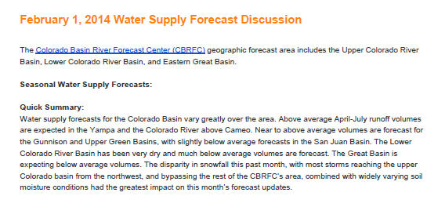
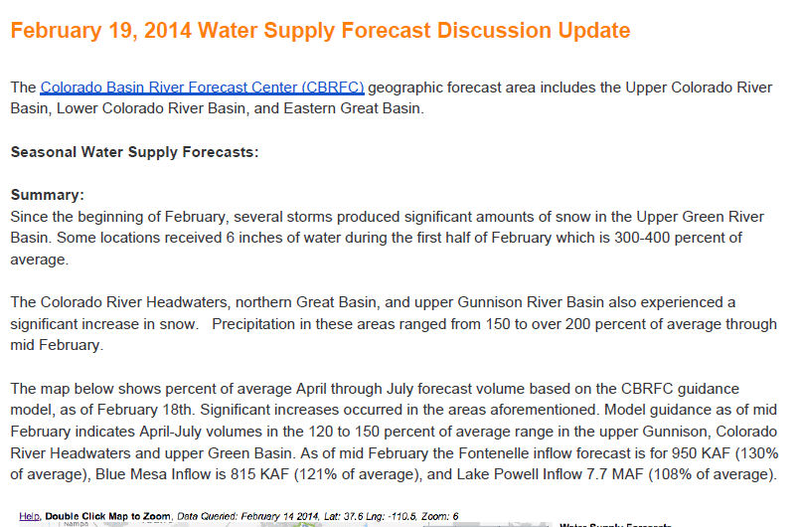
Dramatic change in conditions the first 2 weeks of February 2014
Providing updated discussions and daily ESP guidance are ways to keep up on changes between official forecast updates

Slide 28
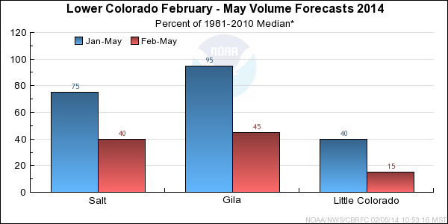
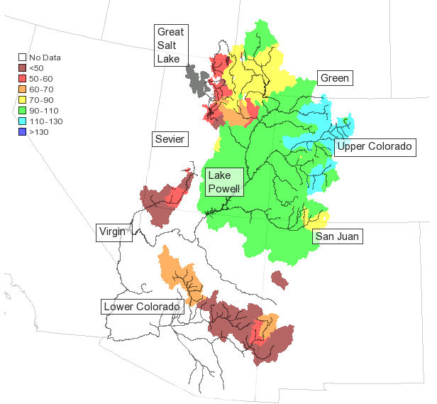
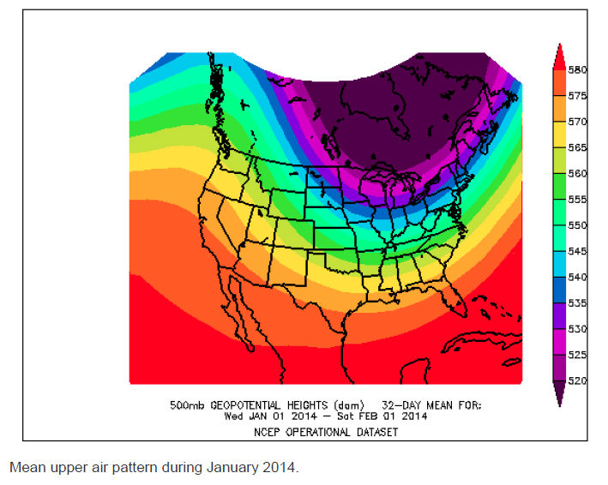
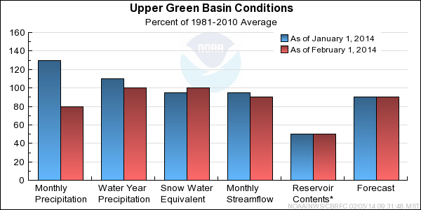
Graphics to help describe the situation

Slide 29
Colorado Basin River Forecast Center
Stakeholder Forum
Beyond The Streamflow Forecast
What is the most pertinent information and how can we best provide it ?
How do we keep it simple to access yet informative ?
How useful is the information we currently provide ?

Slide 30
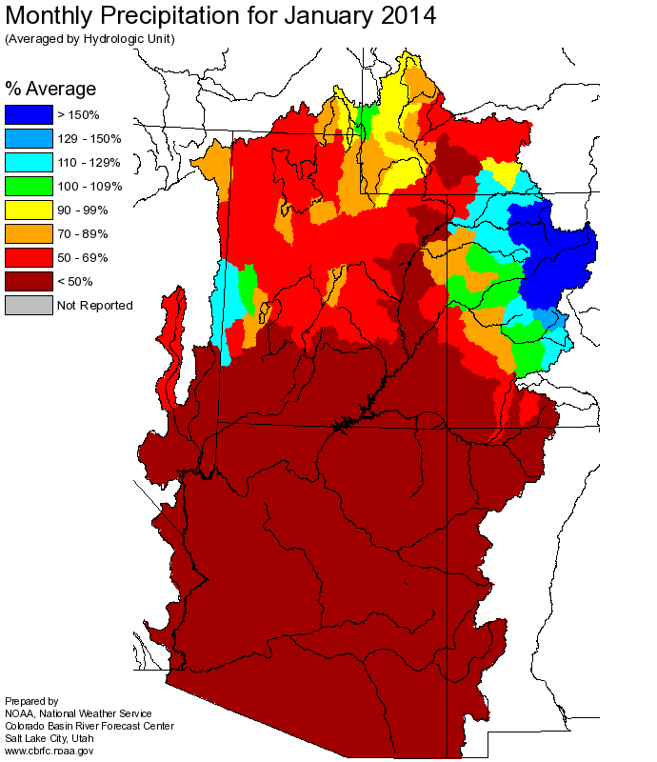
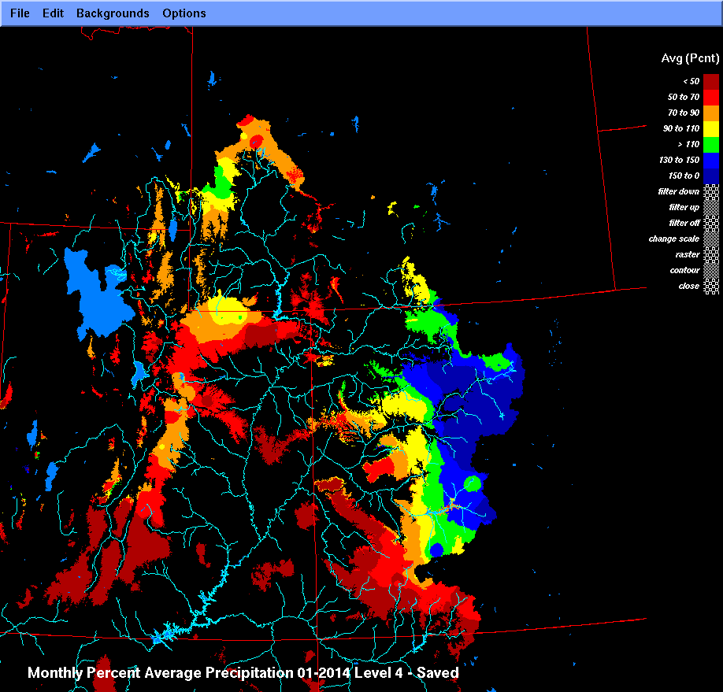
Refocus on what is important: Areas that are primary contributors to seasonal runoff
January 2014 Precipitation – contributing areasareas

Slide 31
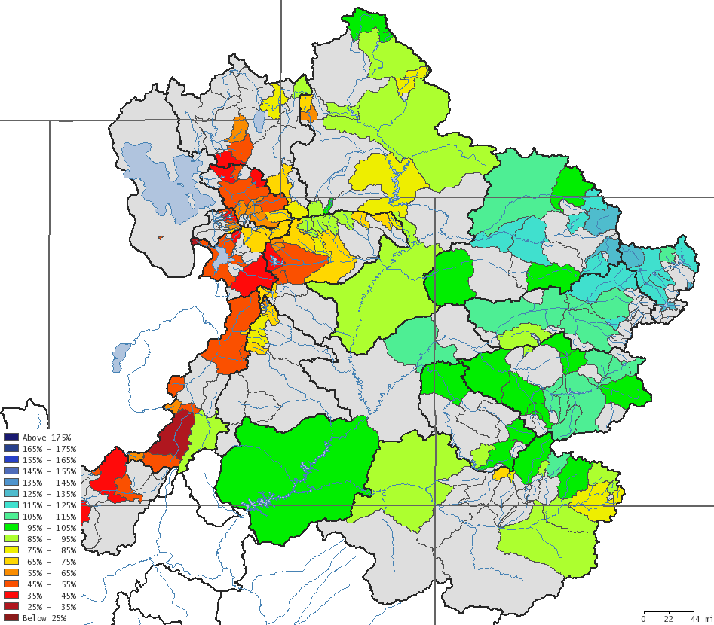
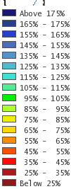
February 1st Water Supply Forecasts
Spatial displays in addition to plots and lists

Slide 32
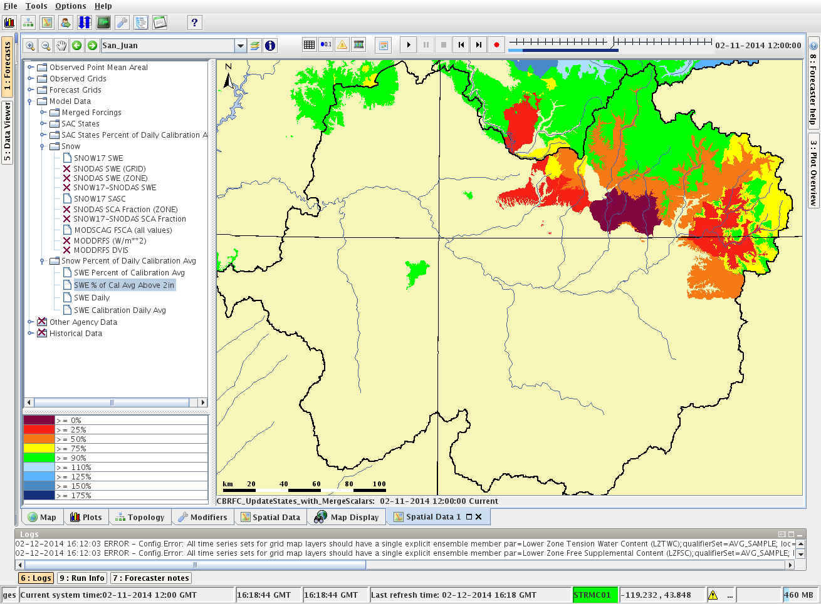
Snow – As our model sees it
San Juan Basin Snow
San Juan Basin

Slide 33
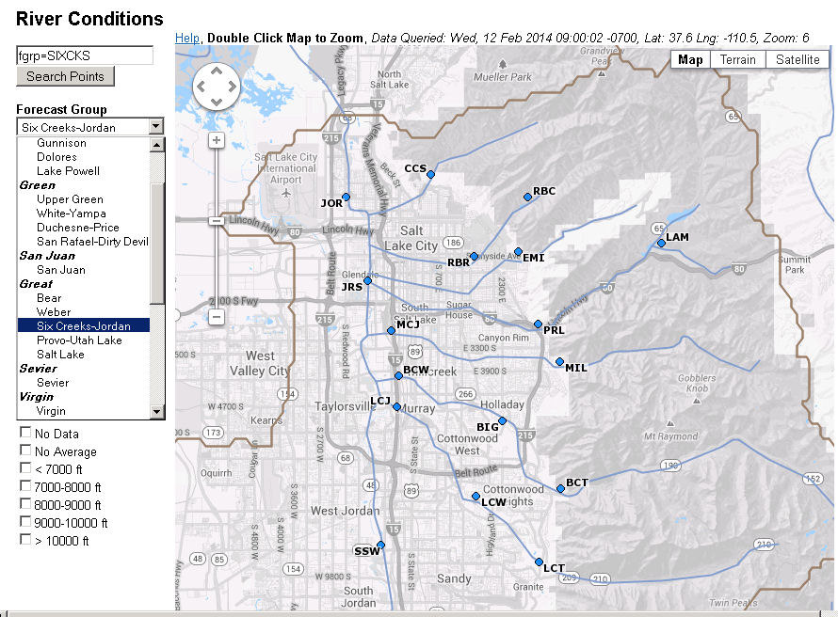
Obtain Information by River Basin
Access Information by River Basin of Interest

Slide 34
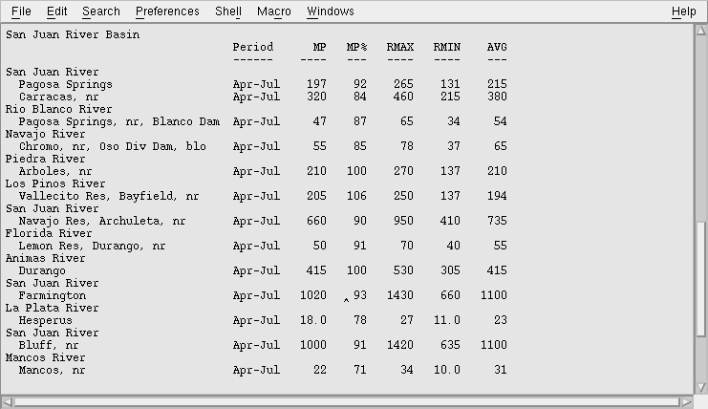
Colorado Basin River Forecast Center
Stakeholder Forum
Simple Text Format – Pushed Via Email
NOAA’s National Weather Service

Slide 35
Colorado Basin River Forecast Center
Stakeholder Forum
Beyond The Streamflow Forecast
What is the most pertinent information and how can we best provide it ?
How do we keep it simple to access yet informative ?
How useful is the information we currently provide ?

