Slide 1

The Colorado Basin River Forecast Center and the Decision Making Process
Bobbie Klein¹
Lisa Dilling^{1, 2}
Western Water Assessment
¹Center for Science and Technology Policy Research, University of Colorado Boulder
²Environmental Studies Program, University of Colorado Boulder
Notes:
This project is funded by the Western Water Assessment, a RISA program.
RISA = Regional Integrated Sciences and Assessments. As Tim mentioned, part of WWA’s mission is to develop information, products and processes to assist decision makers in the Intermountain West.

Slide 2
The Colorado
Motivation for study
Consistent with WWA’s mission to provide information that can assist decision makers, we wanted to learn:
Who are CBRFC stakeholders, what do they feel are their current and future vulnerabilities, and how do they cope?
How can the dust on snow and bark beetle research be useful to CBRFC stakeholders?

Slide 3
Methodology
Reviewed literature on decision maker use of forecasts. While a variety of factors explain non-use of forecasts, generally a key determinant of forecast use is perception of risk based on previous experience. Forecast skill is generally not as critical to use.
In consultation with CBRFC, developed a survey covering 3 areas:
  background information about stakeholders
  vulnerability (weather and climate events respondents have experienced or expect to experience) and coping mechanisms
  how stakeholders use forecasts; knowledge of/concern about dust on snow and bark beetle
Pretested survey with water managers
Compiled list of current and potential CBRFC stakeholders including CBRFC stakeholder meeting attendees, managers of ~80 reservoirs monitored by CBRFC, NWS forecasters, Bureau of Reclamation roster of water users in the Upper Colorado Region, emergency managers
Distributed survey to 141 stakeholders via Survey Monkey last summer; 70 stakeholders responded
Notes:
Literature: variety of factors go into use or non-use of forecasts. General finding is that a key determinant of forecast use is risk perception, based on having had problems with weather events. Managers don’t use forecasts if they think they are unlikely to face problems from weather and climate events. Based on this finding we wanted to look at which weather and climate events the respondents had experienced or expected to experience.
Reasons water managers don’t use forecasts: lack of certainty, poor communication, lack of focus on users’ needs, insufficient trust, lack of resources, poor timing of forecasts, lack of training among users, lack of awareness of their existence, distrust of their accuracy, perceived irrelevance to management decisions, competition from other technological innovations, etc.
Forecast skill not the key issue as water managers who find forecasts reliable are no more likely to use them.
Reservoir managers: we attempted to find the manager for each reservoir for which conditions are reported on the CBRFC website.

Slide 4

Background information about stakeholders

Slide 5
Survey respondents work for:
federal agencies (23)
water conservancy districts (11)
regional water entities (9)
municipal water utilities (8)
flood control districts (3)
organizations providing either research, consulting, or work on policy issues (3)
state agencies (2)
irrigation districts (2)
electric power providers (2)
~half describe affiliation as water management, 14% govt forecasting, 8% emergency mgmt/flood control; the remainder scattered among ag, research, energy, water treatment, recreation, environmental, etc.

Slide 6
Service area (select all that apply)
Colorado, including municipalities and counties within the state | 34%
Colorado River Basin | 31%
Utah, including municipalities and counties within the state | 23%
Other (please specify) | 21%
Arizona, including municipalities and counties within the state | 18%
Southwest region (Arizona, New Mexico, Colorado, Utah) | 13%
Western U.S. | 13%
New Mexico, including municipalities and counties within the state | 8%
Wyoming, including municipalities and counties within the state | 8%
National | 3%
U.S.-Mexico border | 3%
Global | 2%

Slide 7
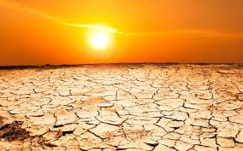
II. Vulnerability and Coping Mechanisms

Slide 8
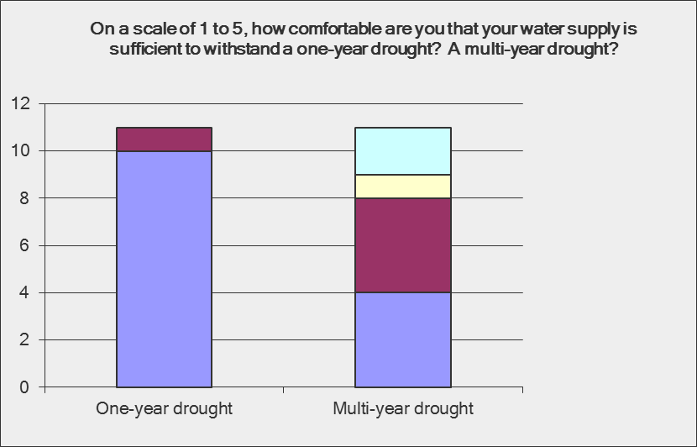
Notes:
Asked of M&I water managers only, which were 19% of respondents with an average system size of 2.5 million (range of 1,000-many millions)

Slide 9
Events experienced in past 10 years
Notes:
Select all that apply.

Slide 10
Problems caused by events
 | Lost revenue | Unanticipated expenses | Difficulty assuring system reliability
Drought | 52% | 52% | 61%
Floods | 29% | 71% | 49%
Wildfire | 32% | 86% | 32%
Unusual change in snow melt or snow melt peak flow timing | 13% | 33% | 83%
Unusual change in annual runoff volumes | 33% | 29% | 79%
Unusual change in magnitude of snow melt peak flow | 9% | 41% | 68%
Unusual change in melt season runoff volumes | 33% | 29% | 81%
Unusually high temps | 21% | 53% | 53%
Unusual change in snow accumulation timing | 16% | 21% | 79%
Unusual change in summer and fall baseflow | 27% | 20% | 80%
Unusual change in monsoon season flow | 0% | 44% | 67%
Notes:
Problems caused by these events. Respondents could choose as many problems as they want; the percentages are of people who answered that question, not total respondents. Unanticipated expenses was problem for 86% of respondents experiencing wildfire; reliability was problem for 83% of respondents experiencing unusual change in timing of snowmelt.

Slide 11
Perception of likelihood of future events
 | Likely | 50/50 chance | Unlikely | Don't know
Drought | 88% | 11% | 0% | 2%
Unusually high temperatures | 72% | 17% | 0% | 11%
Wildfire | 62% | 17% | 8% | 13%
Unusual change in snow melt or snow melt peak flow timing | 55% | 33% | 0% | 12%
Unusual change in annual runoff volumes | 54% | 22% | 4% | 20%
Floods | 53% | 32% | 8% | 8%
Unusual change in melt season runoff volumes | 53% | 24% | 4% | 18%
Unusual change in magnitude of snow melt peak flow | 47% | 28% | 4% | 21%
Unusual change in snow accumulation timing | 44% | 24% | 11% | 20%
Unusual change in summer and fall baseflow | 33% | 38% | 7% | 22%
Unusual change in monsoon season flow | 30% | 26% | 7% | 37%
Notes:
Likelihood that system will experience impacts from these events in next 5-10 years. Drought, unusually high temps, wildfire clearly perceived as most likely. Percentages are of people who answered the question.

Slide 12
Past use and effectiveness of coping mechanisms
 | Has used | Very effective | Somewhat effective | Not at all effective
Increased use of CBRFC forecasts | 75% | 44% | 56% | 0%
Increased use of other weather or climate forecasts* | 71% | 29% | 69% | 2%
Instituted water conservation program | 50% | 52% | 48% | 0%
Developed drought plan | 45% | 36% | 59% | 5%
Trained personnel | 43% | 48% | 52% | 0%
Developed emergency management plan | 34% | 27% | 60% | 13%
Increased storage | 32% | 67% | 33% | 0%
Transbasin diversion | 25% | 67% | 33% | 0%
Purchased water rights or shares | 25% | 54% | 31% | 15%
Financial incentives (rates, surcharges, budgets) | 25% | 33% | 67% | 0%
Instituted outdoor water restrictions | 21% | 73% | 27% | 0%
Changed staffing level | 21% | 40% | 60% | 0%
*Other products used by at least half of respondents: U.S. Drought Monitor, U.S. Seasonal Drought Outlook, Climate Prediction Center Precipitation and Temperature Products, CBRFC Forecast Briefings, NRCS State Basin Outlook Reports
Notes:
List of coping mechanisms used by 20% or more of respondents and their effectiveness. Increased use of forecasts most popular, and for CBRFC forecasts, 100% thought they were very or somewhat effective. While the highest percentage of respondents rated outdoor water restrictions very effective (73%)…
< 20% answered water banks, use of groundwater, building levees, warning systems, evacuations.

Slide 13
Likelihood of using coping mechanisms in future
 | Highly likely | 50/50 chance | Highly unlikely
Increased use of CBRFC forecasts | 75% | 20% | 6%
Increased use of other forecasts | 73% | 23% | 4%
Train personnel | 66% | 17% | 17%
Develop drought plan | 65% | 13% | 23%
Institute water conservation program | 63% | 8% | 29%
Develop emergency management plan | 45% | 18% | 37%
Purchase water rights or shares | 37% | 14% | 49%
Transbasin diversion | 35% | 9% | 56%
Financial incentives (rates, surcharges, budgets) | 34% | 16% | 50%
Increase storage | 32% | 21% | 47%
Lease alternative water source/use water bank | 31% | 20% | 49%
Institute outdoor water restrictions | 31% | 6% | 63%
Conjunctive use of groundwater and surface water | 27% | 12% | 61%
Institute warning system | 27% | 14% | 59%
Change staffing level | 23% | 51% | 26%
Notes:
63% thought it was highly unlikely they would institute outdoor water restrictions (though perhaps many of them aren’t in a position to use this mechanism). Much more popular were increased use of CBRFC and other forecasts, training personnel, developing drought plan and water conservation programs. <20% would institute G/W pumping, apply for disaster assistance, floodplain zoning, evacuation, build flood control dam or levees

Slide 14
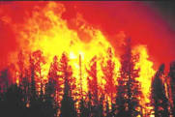
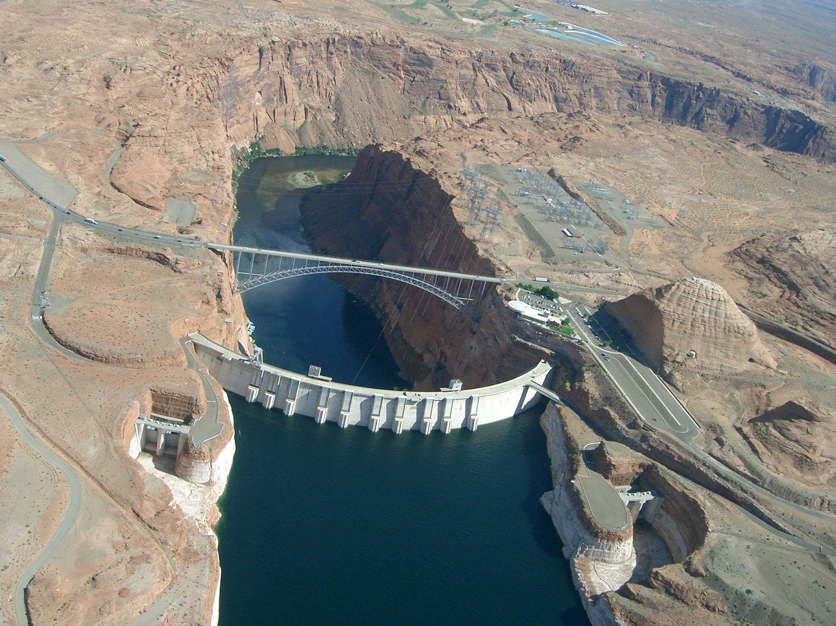
Top short- and long-term concerns
Short-term
Climate variability/change incl extreme events and drought
Water supply/demand balance
Budget issues
Wildfire
Long-term
Climate variability/change incl extreme events and drought
Water supply/demand balance
Colorado River Compact issues
Population growth
Notes:
Open-ended question, many answers provided, this is our categorization of answers

Slide 15
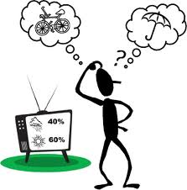
III. Use of forecasts and decision making

Slide 18
Decision for which CBRFC forecasts are useful
Reservoir operations such as timing and volume of releases (15)
Flooding (7)
Issuing warnings (6)
Drought response (4)
Environmental issues (3)
Power (2)
Irrigation, maintenance, treatment plant, purchases, field work (1 each)
Notes:
Open-ended questions, our categorization. Number of responses in parentheses

Slide 19
Factors that limit use of CBRFC forecasts
Difficulty determining quality of CBRFC forecasts | 41%
Other (please specify) | 27%
Difficulty knowing which CBRFC forecasts are useful | 22%
Inaccuracy of CBRFC forecasts | 22%
Lack of familiarity with CBRFC forecasts | 22%
My organization's operating procedures | 19%
Conflict between CBRFC forecasts and other forecasts I use | 19%
Difficulty interpreting CBRFC forecasts | 16%
Conflict between CBRFC forecasts & non-forecast factors | 8%
Conflict between CBRFC forecasts & our organization's internal tools | 5%
Legal constraints | 3%
Notes:
“Other” = forecasts don’t apply to certain basins, forecasts can’t forecast flash floods, unsure if forecasts contain operational decisions, need to learn more about system, slow webpage, we do our own

Slide 23
Next steps
One-on-one interviews of ~10-15 survey respondents. Possible areas of inquiry:
Short and long-term organizational concerns
Coping mechanisms – past and future
How CBRFC forecasts and other information are used in decision making; how much weight is given to this information
What information about the dust on snow and bark beetle research would be useful to decision makers; what form should the information take
Notes:
Ask for input

Slide 24
For questions about CBRFC stakeholder survey: Bobbie Klein
Center for Science and Technology Policy Research, University of Colorado Boulder
bklein@colorado.edu
For questions about WWA dust on snow and bark beetle research:
Ben Livneh
ben.livneh@gmail.com

Slide 25
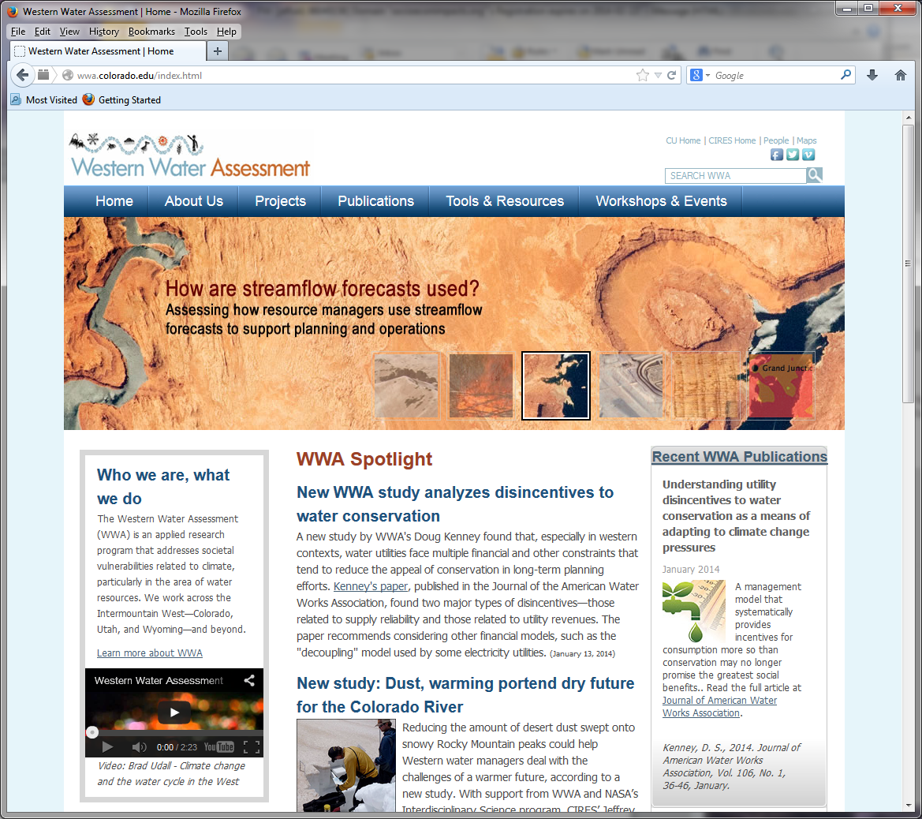
For more information and contacts for all of the projects mentioned and many more:
Western Water Assessment website: http://wwa.colorado.edu/

