Slide 1
CBRFC Stakeholder Forum February 24, 2014
CBRFC Forecast Verification
Ashley Nielson
Kevin Werner
NWS Colorado Basin River Forecast Center

Slide 2
Outline
Forecast Tool Evaluation
Next Steps
Current Verification Tools
Water Supply Forecasts
Official forecasts and reforecasts
Daily Forecasts
Discussion

Slide 3
Motivation / Goals
Motivation: ESP is well positioned for:
Daily forecast updates leveraging daily updating observations (e.g. SNOTEL, other precipitation, temperature, and streamflow)
Probabilistic forecasts for full hydrograph including peak flows, time to peak, volumes, etc.
Incorporating both weather and climate prediction
NOAA investing in improvements to ESP (but not SWS) including data assimilation, connection to ensemble weather and climate prediction, and bias correction.
Key Question: Is the current ESP forecast tool as skillful and reliable as SWS? What are the strengths and weaknesses of each forecast tool?

Slide 4
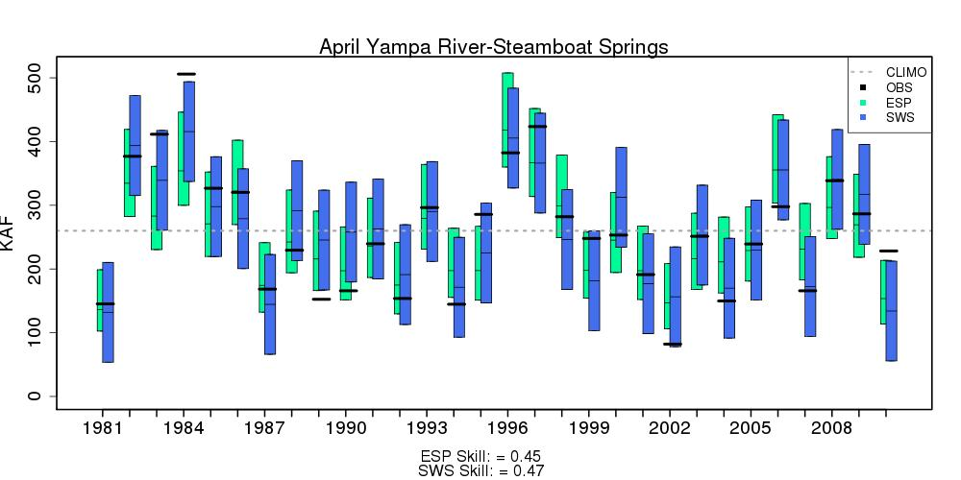
Methodology
Reforecasts generated for first of month for winter and spring months 1981-2010 using similar assumptions
Assumptions: No weather climate forecast, 1981-2010 climatology, no bias adjustment,

Slide 5
Methodology (con’t)
Reforecasts verified against unregulated streamflow observations:
Skill – MAE SS
Reliability – Assessed against traditional 10,50,90% forecast thresholds
Results conditioned on:
Lead Time (e.g. Jan 1 issuance, Feb 1 issuance, etc)
Forecast Point

Slide 6
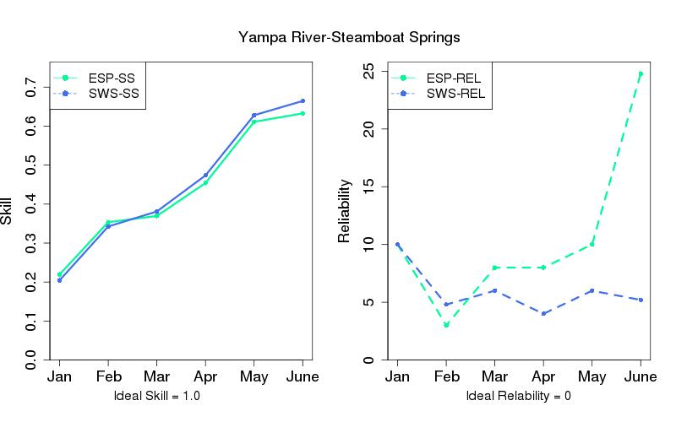
Results: Lead Time

Slide 7
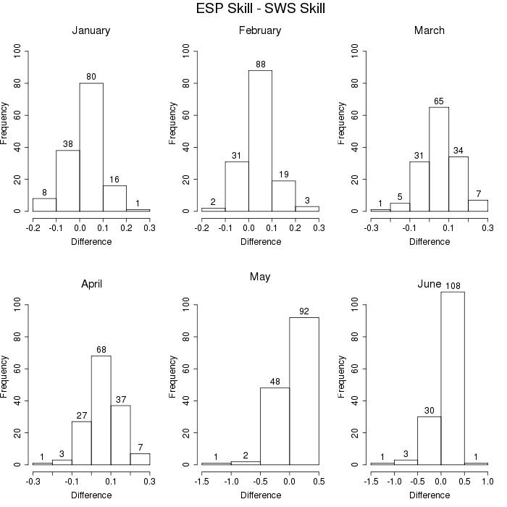
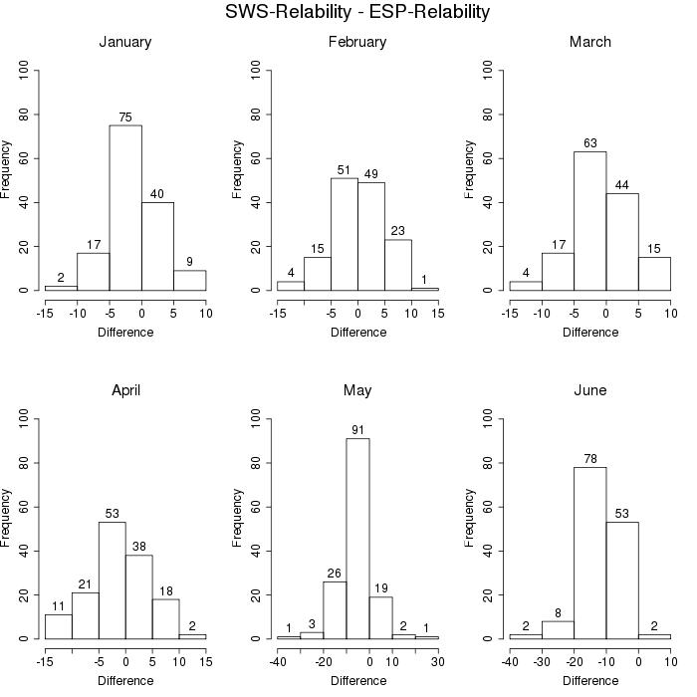
Results: Forecast Point

Slide 8
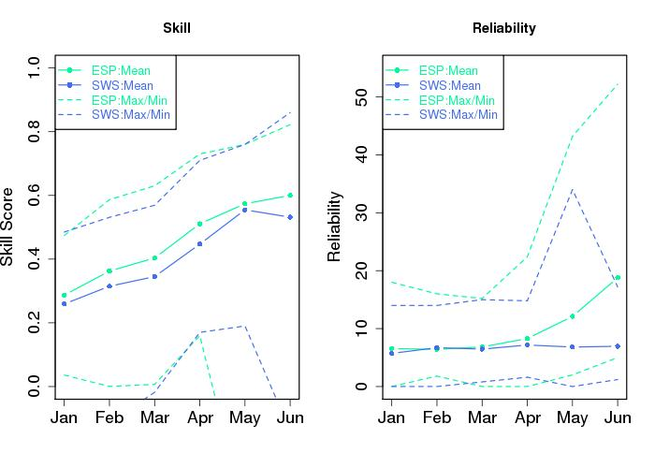
Results: All Points

Slide 9
Conclusions
ESP and SWS have generally comparable skill. ESP generally slightly more skillful.
ESP and SWS have generally comparable reliability January through April. ESP is very under-dispersive during the runoff season (e.g. May and June forecasts).
ESP and SWS likely have strengths in specific regimes that we have not fully understood.

Slide 10
So What?
CBRFC is using verification for:
Tool development and application (e.g. ESP and post adjustment)
Annual lessons learned
Identification of errors in forecast process

Slide 11
Next Steps
Study validates a focus on ESP particularly given enhancements
Similar verification studies should assess improvements proposed to ESP:
Bias adjustment
Headwater vs downstream points
Incorporation of weather, climate forecasts
Weather generator technique
Incorporation of new data sets (e.g. MODIS)

Slide 12
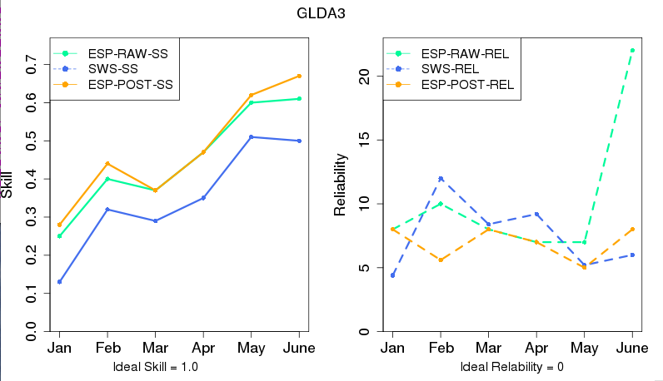
Example: Bias Adjustment

Slide 13
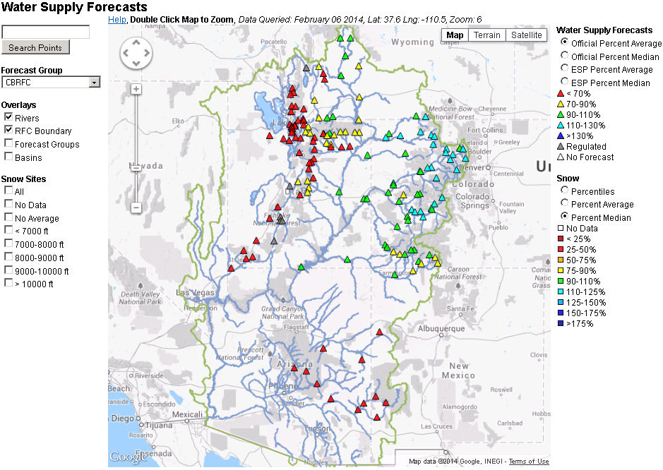
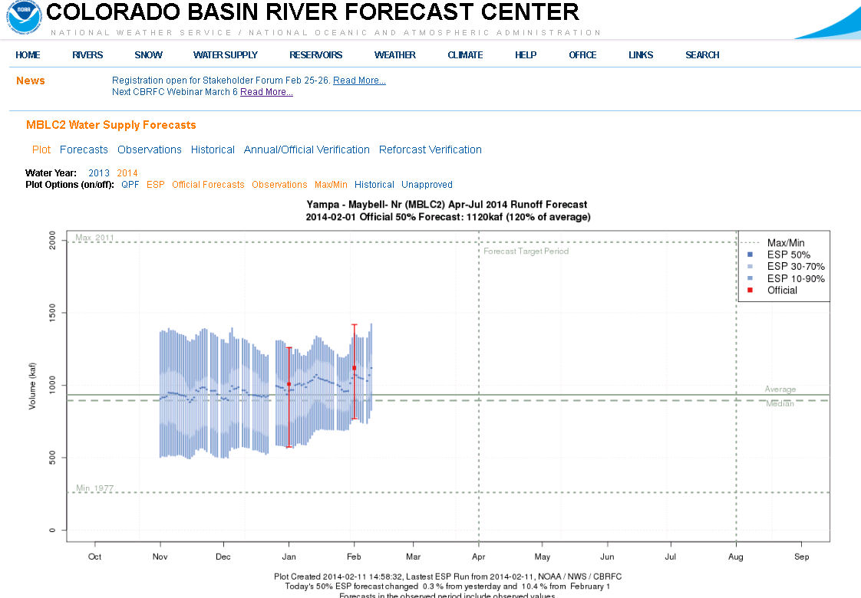
Current Verification Tools
Water Supply Forecasts

Slide 14
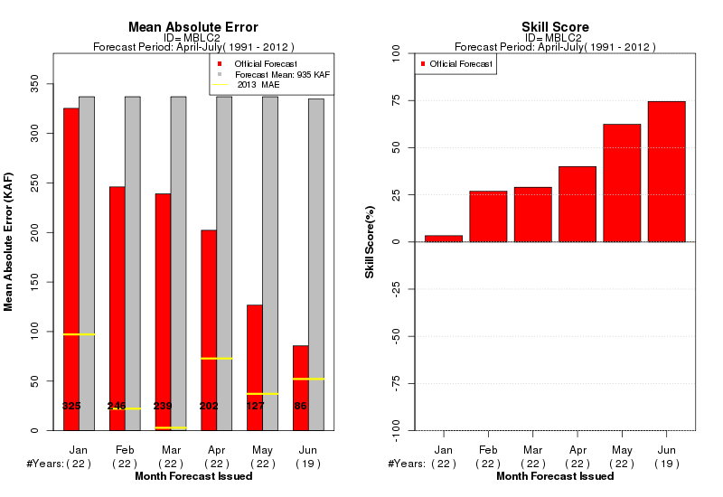
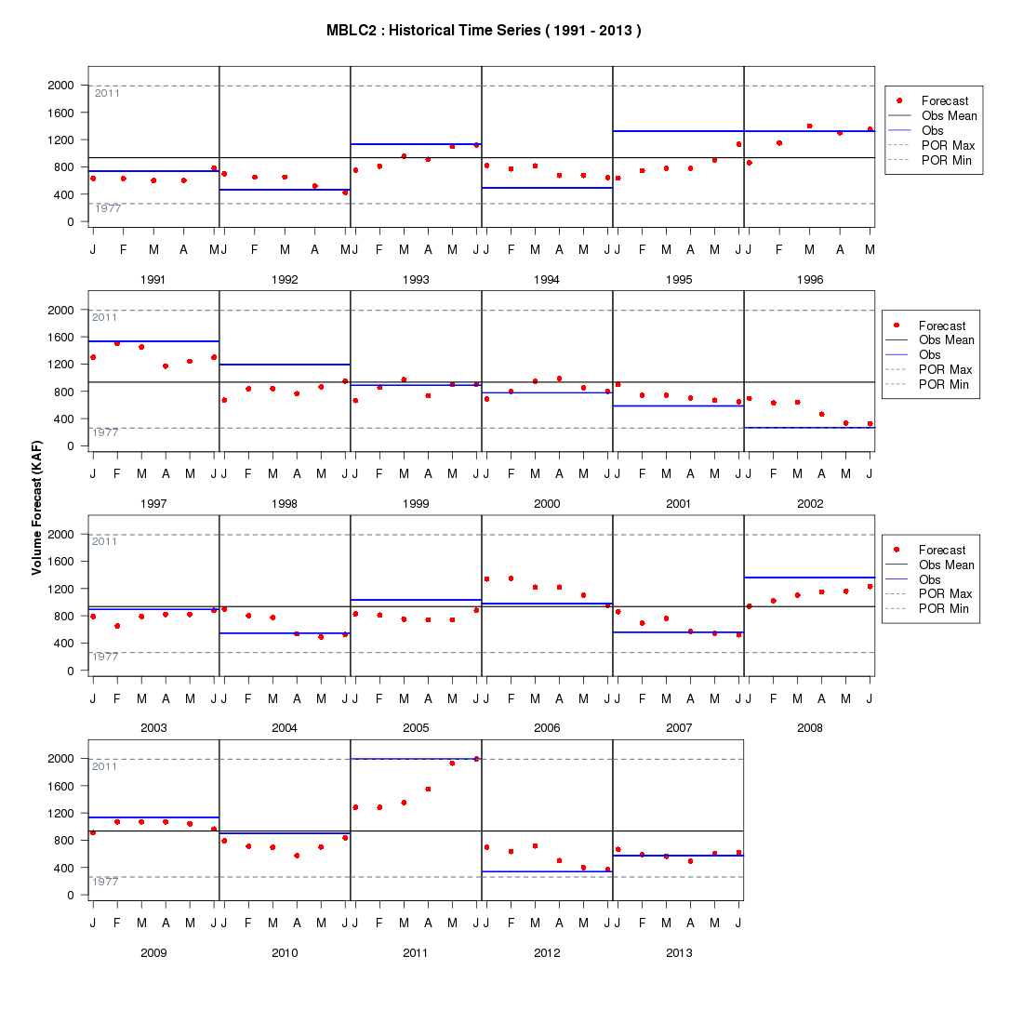
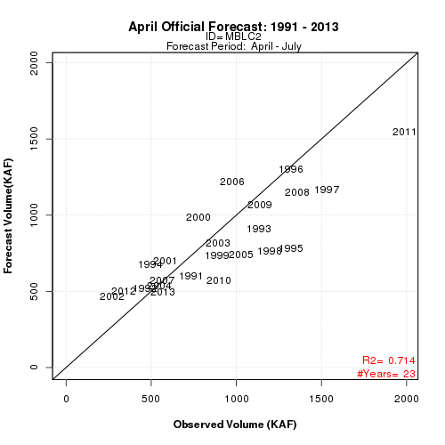
Current Verification Tools
Water Supply Forecasts

Slide 15
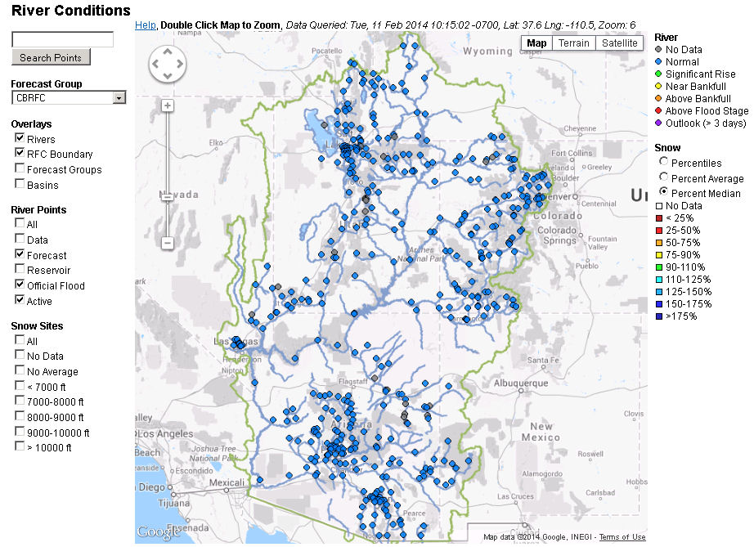
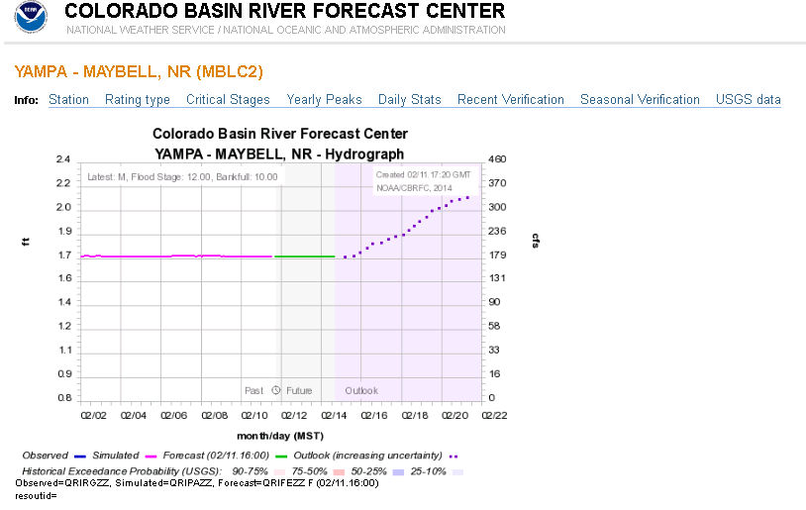
Current Verification Tools
Daily Streamflow Forecasts

Slide 16
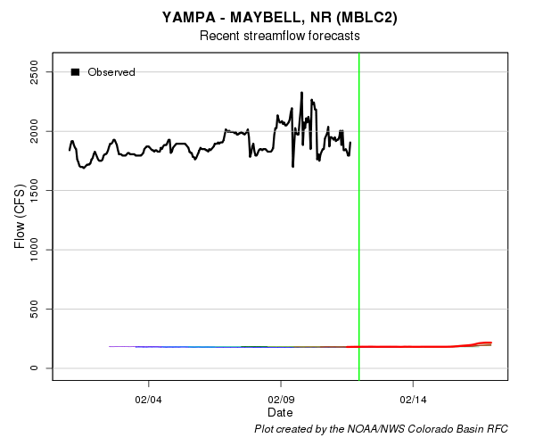
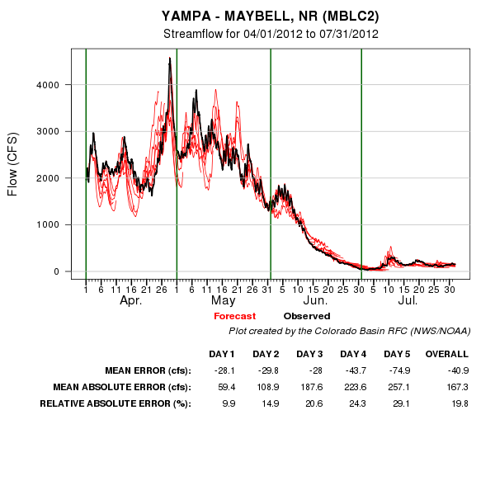
Current Verification Tools
Daily Forecasts
Stacie! Help fix please!!

Slide 17
Online tour

Slide 18
Website Coming Attractions: Verification
Verification web consistency
DOCUMENTATION (we know)
Spatial view
One stop shop
Similar to defunct western water page
Monthly verification (for USBR MTOM and others)

Slide 19
Verification Discussion
How does CBRFC use verification?
How easy is it find/understand the verification?
How useful is the verification information presented here?
How do you currently use or want to use verification?
How good do forecasts need to be for your use?

