Slide 1
Including Meteorological Models in Ensemble Streamflow Prediction (ESP)

Slide 2
Meteorological Forecasts in ESP
Ensemble Post-Processor (EnsPost)
= forcing unc.
= hydro. unc.
= users
WPC/RFC
forecasts
(1-5 days)
Flow bias / uncertainty accounting
Correct flow bias
Add spread to account for hydro. model uncertainty
GEFS
forecasts
(1-15 days)
Meteorological Ensemble Forecast Processor (MEFP)
Hydrologic
models (CHPS)
Bias-corrected ensemble flow forecasts
Correct forcing bias
Merge in time
Downscale (basin)
CFSv2
forecasts
(16-270 days)
Climatology
(271+ days)
NWS and external user applications
(MEFP forcing also available to users)

Slide 3
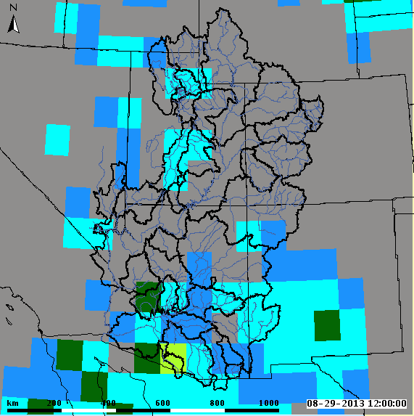
Global Ensemble Forecast System (GEFS)
short term forecast 15 days out
precipitation and temperature max/min
comes as gridded product
1 degree resolution
use the average of the GEFS 20 traces
reforecasts available for 1985-2010
http://www.emc.ncep.noaa.gov/GEFS/faq.php

Slide 4
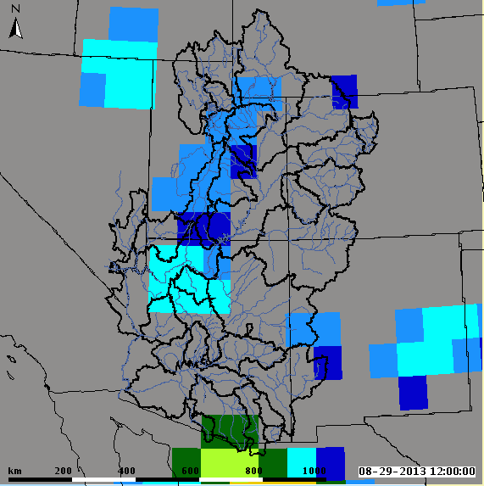
Climate Forecast System (CFSv2)
long term forecast out 9 months (270 days)
precipitation and temperature max/min
comes as gridded product
1 degree resolution
use the lagged ensemble mean
reforecasts available for 1982-2011
http://cfs.ncep.noaa.gov/cfsv2.info

Slide 5
GEFS and CFSv2 Processor (MEFP)
Meteorological Ensemble Forecast Processor
Historical Observation, precipitation and max/min temperature, are statically related to GEFS and CFSv2 hindcasts to develop a bivariate relationship
Parameters used in forecast process
One time process
Joint distribution
1
Y
Model Space
Ensemble members for that particular time step
x₁
…
NQT⁻¹
Observed
Probability
x_{n}
x_{fcst}
X
0
Forecast
x₁
x_{i}
x_{n}
Ensemble forecast
http://www.nws.noaa.gov/oh/hrl/general/HEFS_doc/Aug_2014_Seminar/Seminar_D_MEFP_Theory.pdf

Slide 6
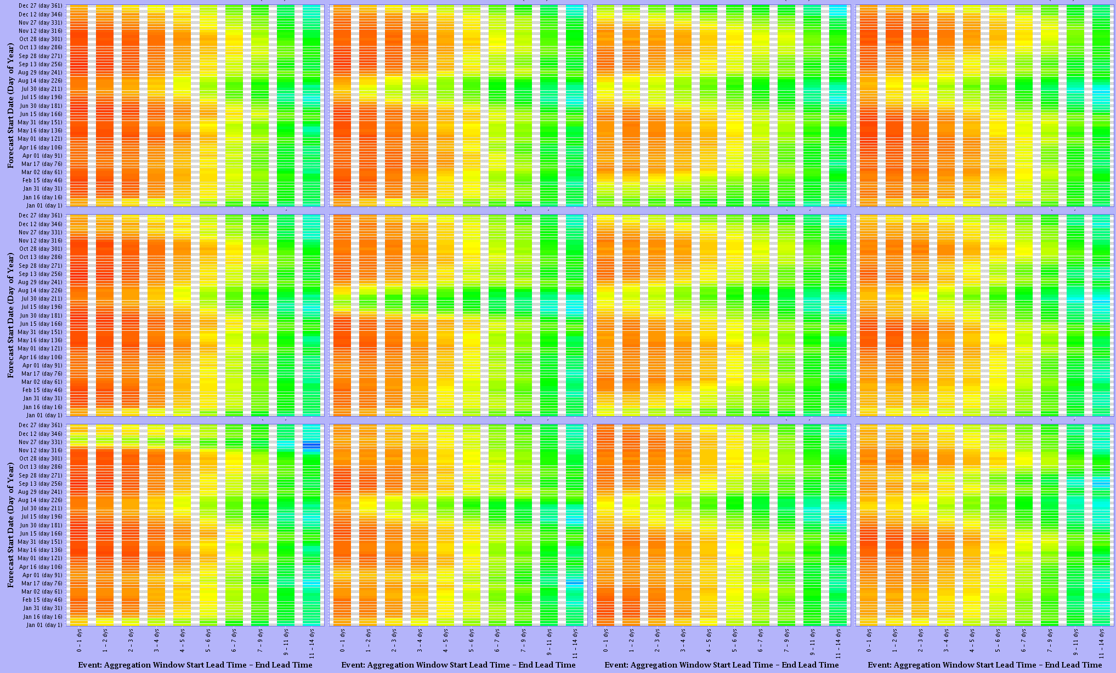
GEFS Temperature MAX Skill
Green: Warren Bridge
Elk: Milner
East: Almont
Animas: Durango
Lower
Mid
Upper

Slide 7
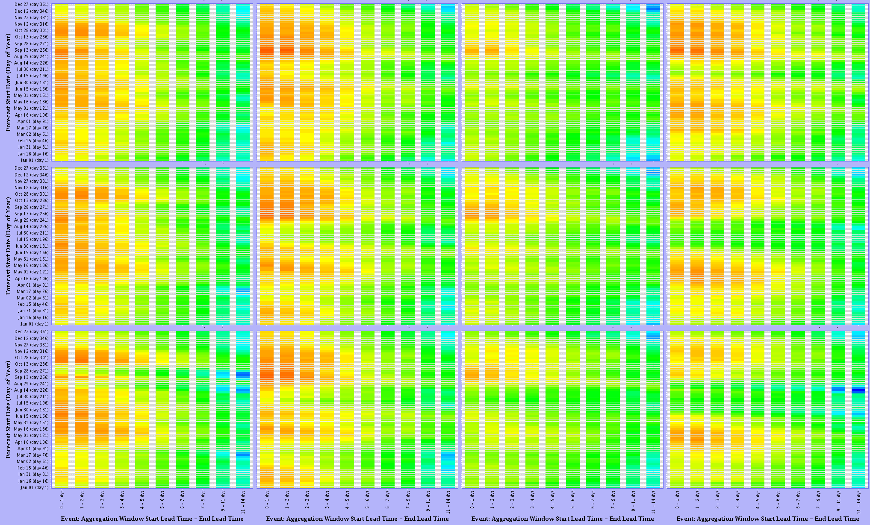
GEFS Temperature MIN Skill
Green: Warren Bridge
Elk: Milner
East: Almont
Animas: Durango
Lower
Mid
Upper

Slide 8
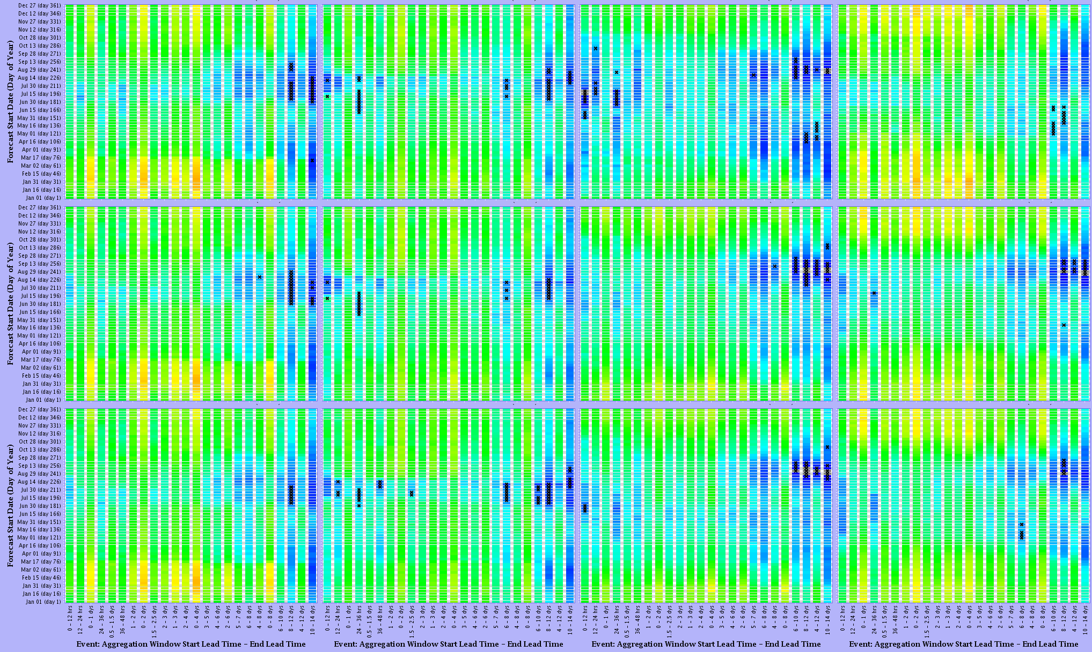
GEFS Precipitation Skill
Green: Warren Bridge
Elk: Milner
East: Almont
Animas: Durango
Lower
Mid
Upper

Slide 9
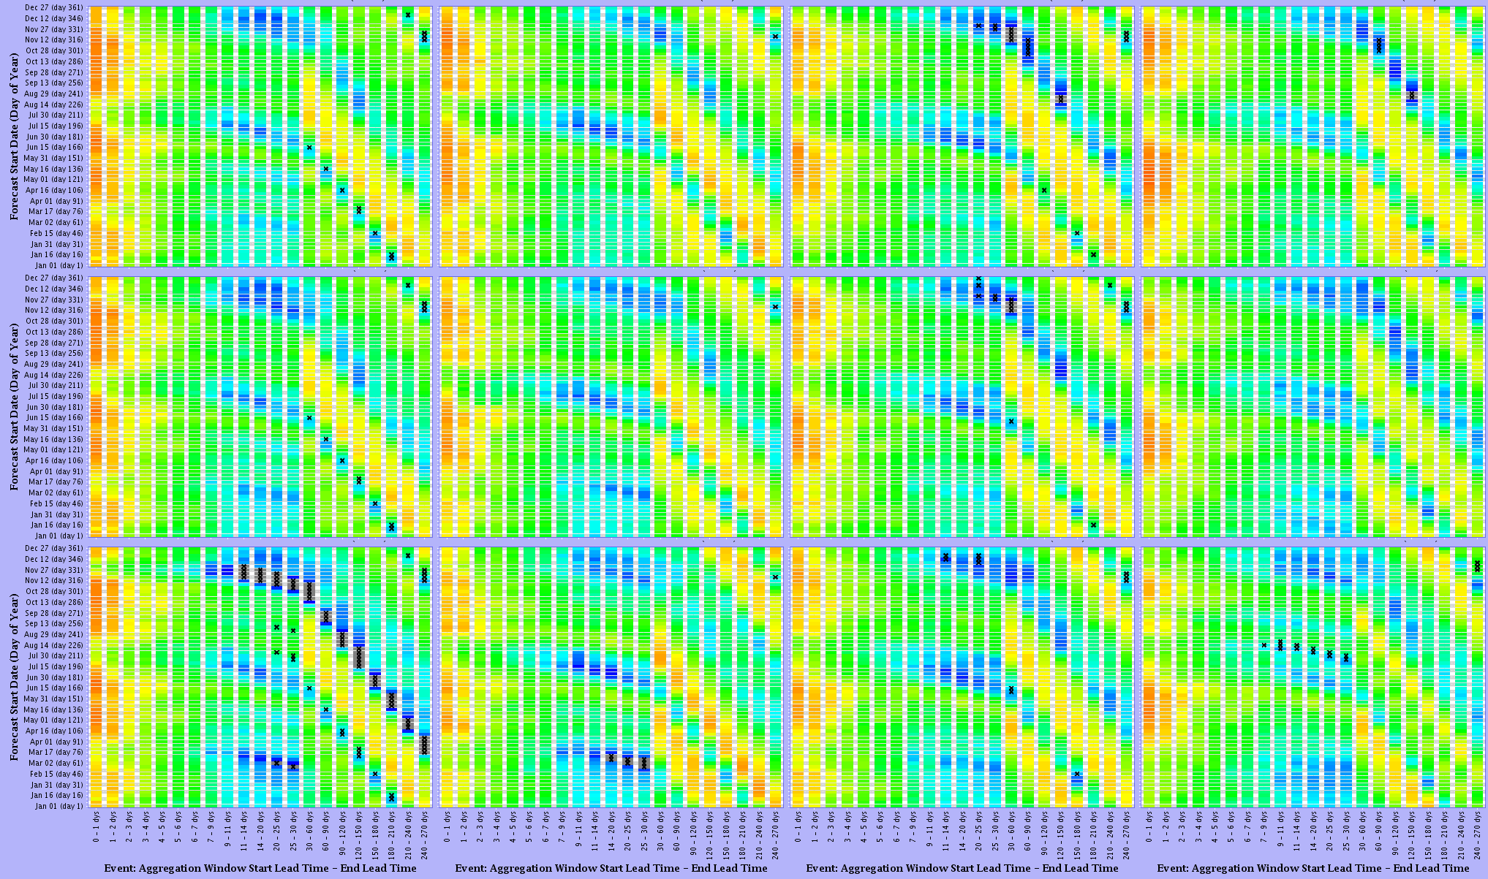
CFSv2 Temperature MAX Skill
Green: Warren Bridge
Elk: Milner
East: Almont
Animas: Durango
Lower
Mid
Upper

Slide 10
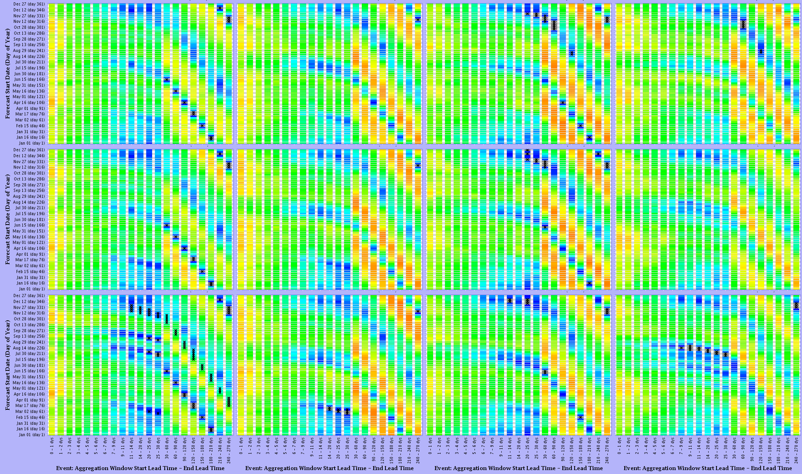
CFSv2 Temperature MIN Skill
Green: Warren Bridge
Elk: Milner
East: Almont
Animas: Durango
Lower
Mid
Upper

Slide 11
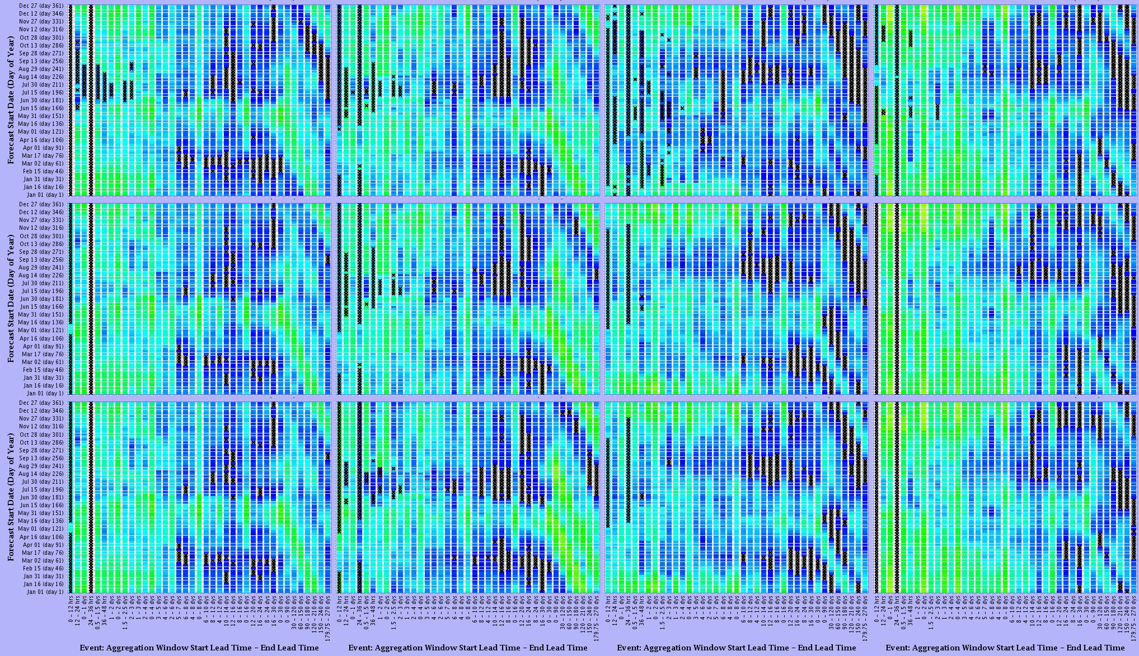
CFSv2 Precipitation Skill
Green: Warren Bridge
Elk: Milner
East: Almont
Animas: Durango
Lower
Mid
Upper

Slide 12
GEFS and CFSv2 in Stream Forecast
Forcings are used in ESP
Output is a standard mean daily flow
This is the Hydrologic Ensemble Forecast Service (HEFS)

Slide 13
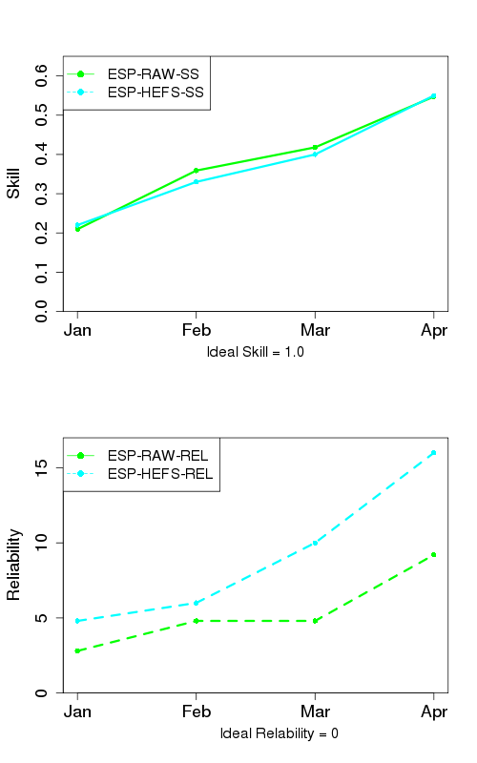
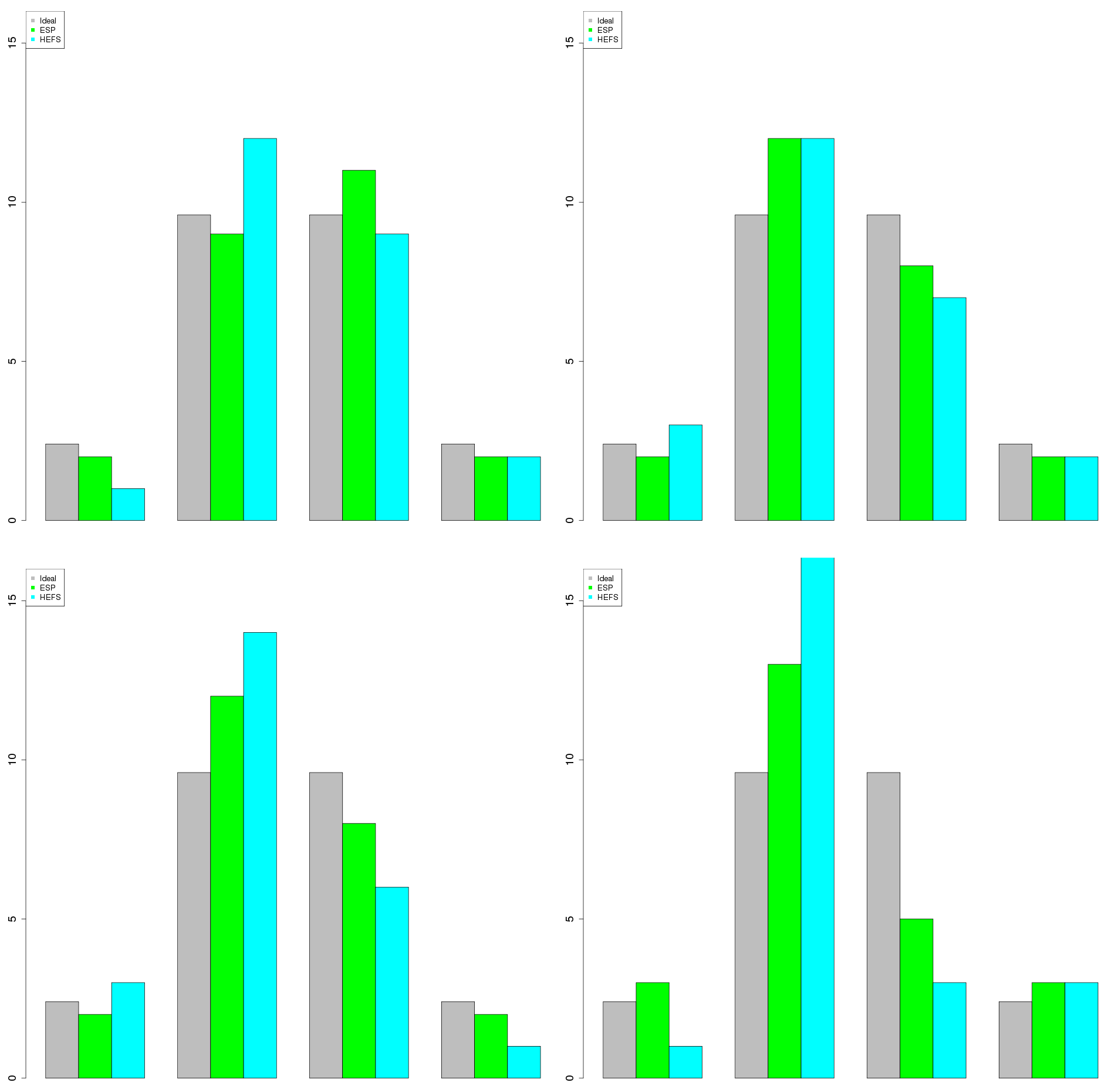
April - July Volume HEFS Skill
Green Warren Bridge
January
February
number of observations
March
April
number of observations
<90%
90-50%
50-10%
>10%
<90%
90-50%
50-10%
>10%

Slide 14
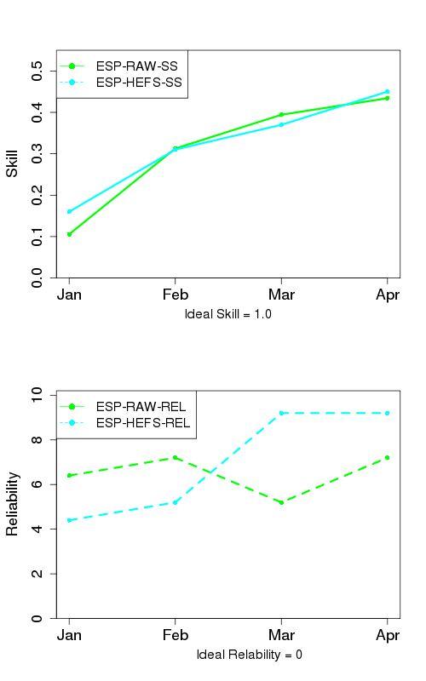
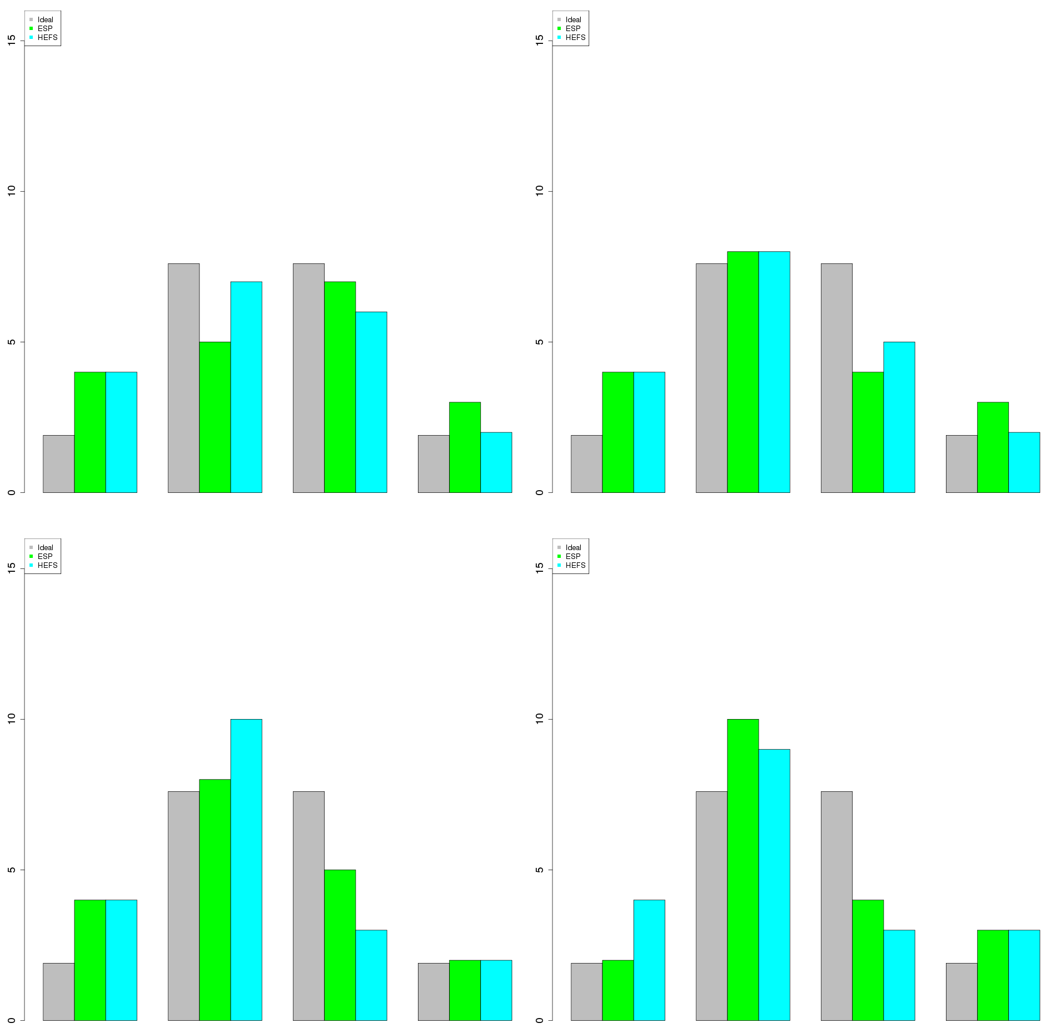
April - July Volume HEFS Skill
Elk - Milner
January
February
number of observations
March
April
number of observations
<90%
90-50%
50-10%
>10%
<90%
90-50%
50-10%
>10%

Slide 15
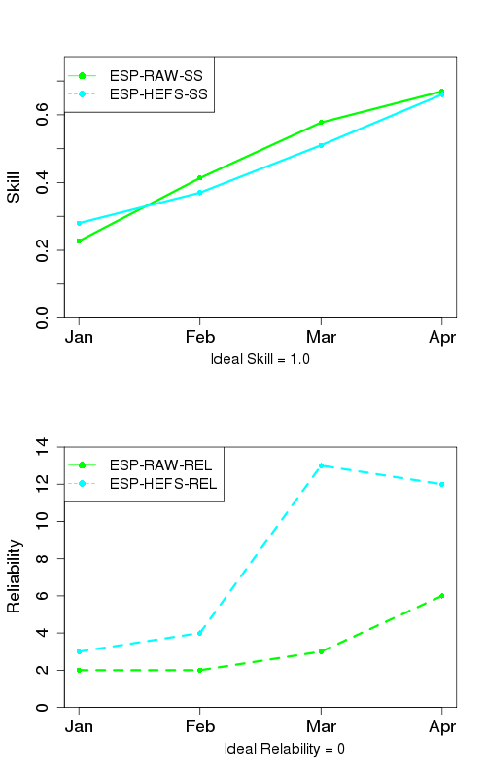
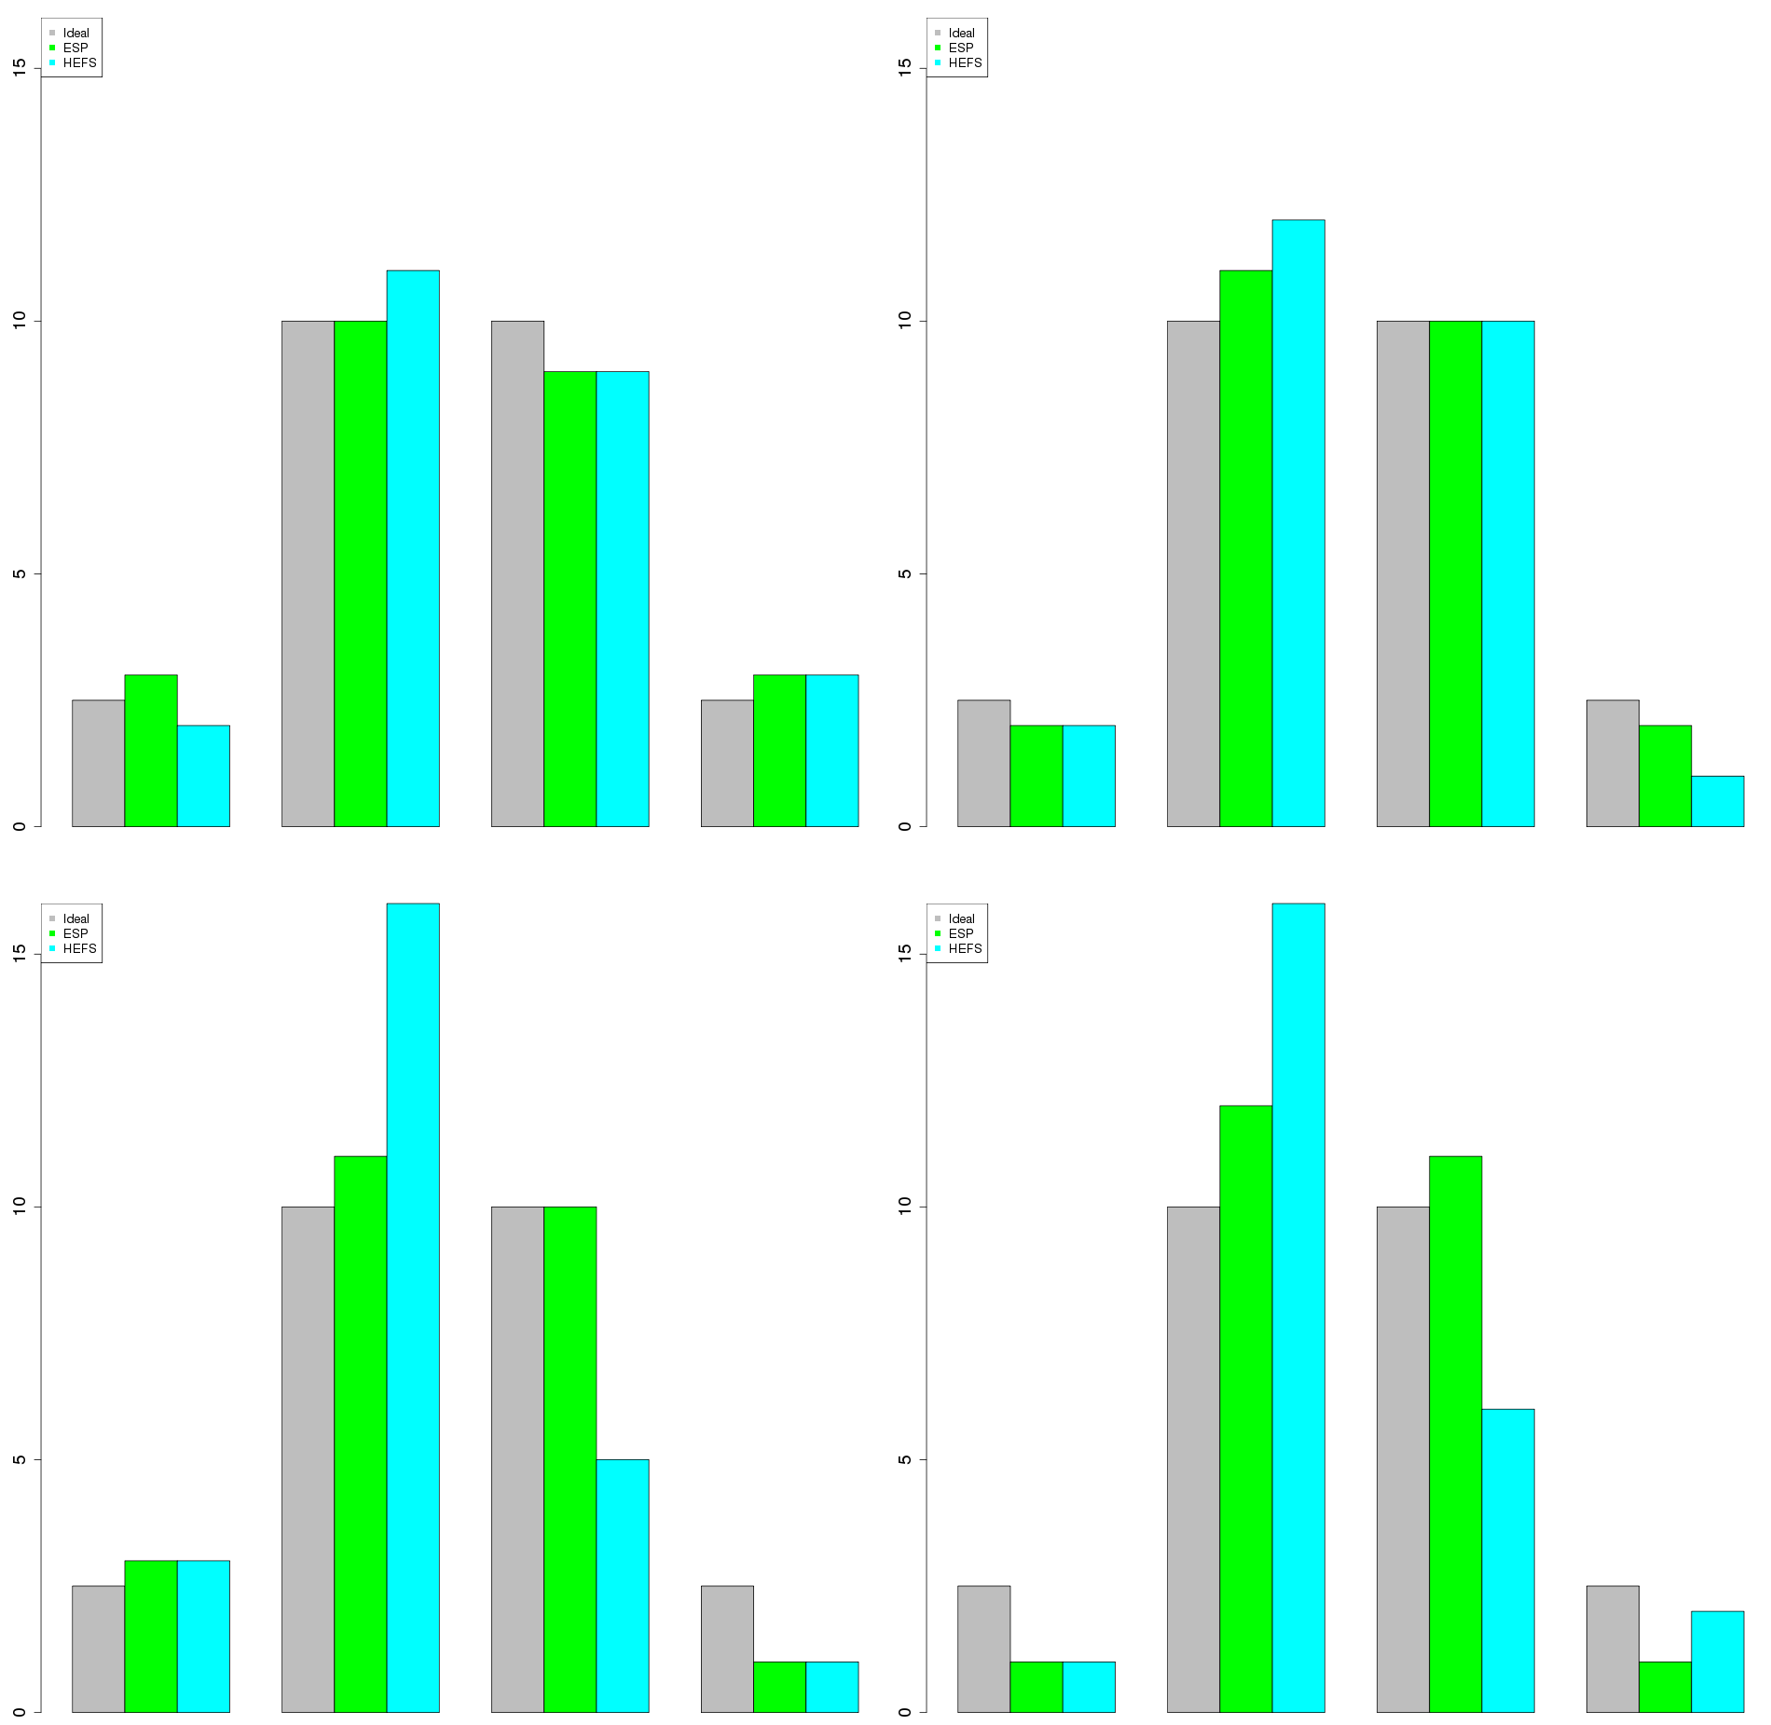
April - July Volume HEFS Skill
East - Almont
January
February
number of observations
March
April
number of observations
<90%
90-50%
50-10%
>10%
<90%
90-50%
50-10%
>10%

Slide 16
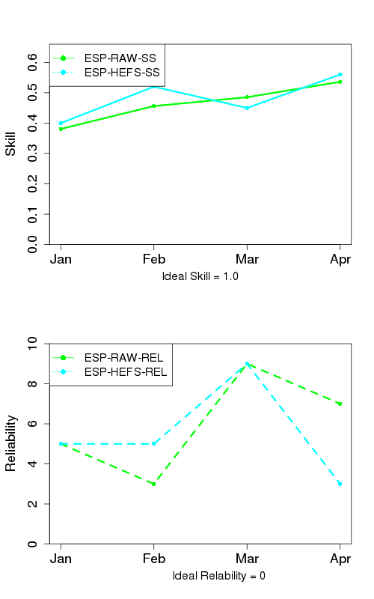
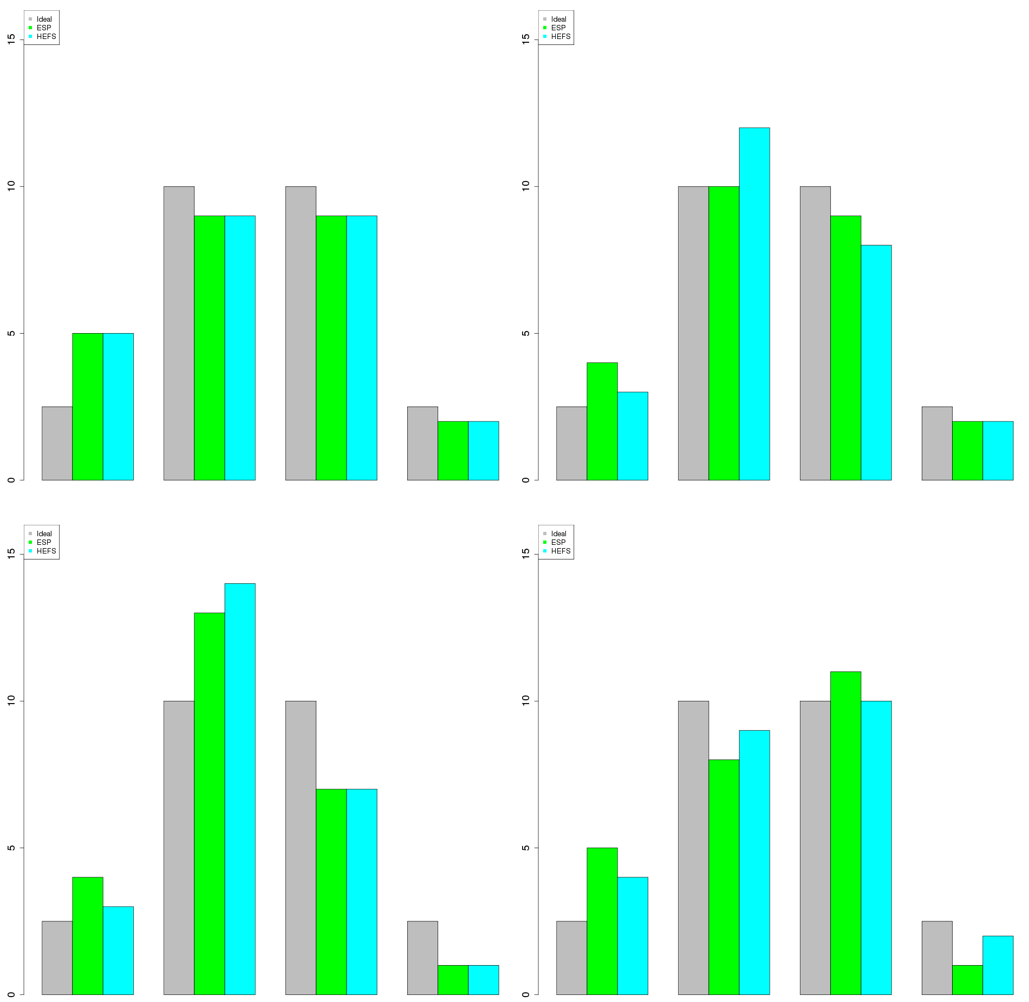
April - July Volume HEFS Skill
Animas - Durango
January
February
number of observations
March
April
number of observations
<90%
90-50%
50-10%
>10%
<90%
90-50%
50-10%
>10%

Slide 17
Initial Conclusions / More Questions
Little, if any, skill added with GEFS/CFS forecast
not unexpected given not much skill in CFSv2
Need to do more analysis on a monthly scale
Does adding GEFS/CFS improve forecasts in Lower Basin
in process of generating parameters
How does CFS forecast fair when looking at ENSO signal
limited sample size so it will be difficult to draw any conclusions from

