Slide 1
Forecast Interpretation
CBRFC Stakeholder Forum
October 20, 2015
Notes:
1

Slide 2
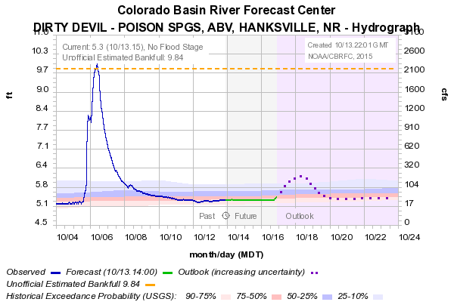
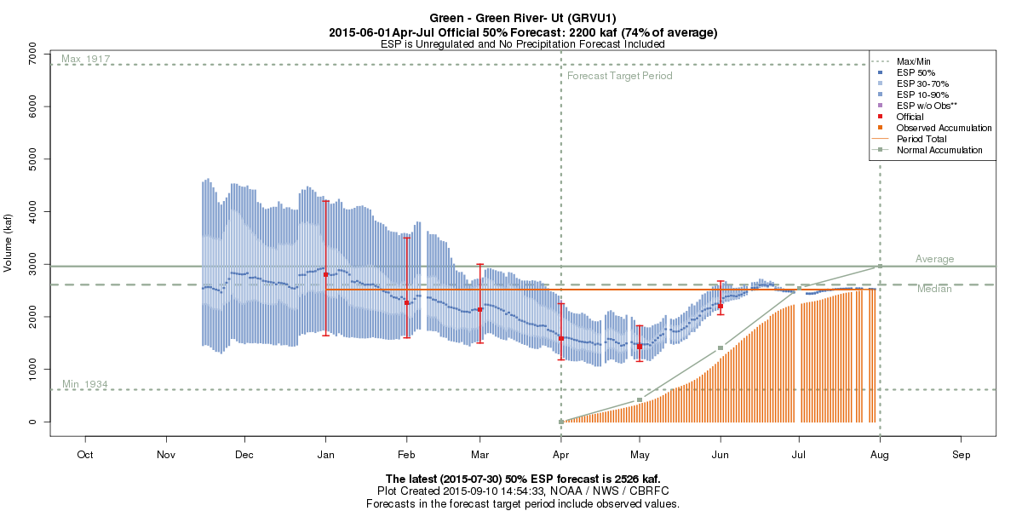
Forecast Interpretation
Deterministic Forecasts – Single Valued
Example: 10 Day Streamflow forecasts
No “measure” of uncertainty
Easy to Understand
Probabilistic Forecasts - Range of Possible Outcomes
Example: Water Supply Forecasts, Peak Flow Forecasts
A way to express uncertainty
More difficult to understand
Notes:
2

Slide 3
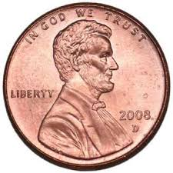

Forecast Interpretation
Probability = likelihood a particular event will happen
Probability = event/s * 100
# of outcomes
Example #1: Flipping a Coin
Example #2: Odds of “Your Favorite Team” beating “Team You Hate”
Odds 9:4 for “Your Favorite Team”
Odds = # desired outcomes : # undesired outcomes
Two Possible Outcomes:
1. Heads
2. Tails
What is the probability of landing on heads?
Odds -> Probability of YFT Winning
Total outcomes = 9 / (9+4)
Probability = 9/13 * 100 = 69%
½ * 100 = 50%
Easy Right?..... Or is it?
Probability is simple and easy to understand! Right?
Or is it?
Notes:
3

Slide 4
Forecast Interpretation: NPR Series
NPR Special Series - Risk and Reason: How people interpret probability
Notes:
4

Slide 5
Forecast Interpretation: NPR Series
One of the most common encounters we have with probability has to do with the weather……
NCAR Survey to understand how people understand weather forecasts
Journal Article :
Morss, R.E, Demuth,J.L, and Lazo,JK (2008). Communicating Uncertainty in Weather Forecasts: A Survey of the U.S. Public, Weather and Forecasting,23, 974-991
Notes:
5

Slide 6
Forecast Interpretation: NPR Series
NPR Online Results
Many Different Conclusions
20% Chance = definitely bring an umbrella
20% Chance= maybe a drizzle
Notes:
6

Slide 7
Forecast Interpretation: NPR Series
Bottom Line:
- General public in confused about probability
- Forecasters add to confusion with poor explanations
- Probability is simple
- Interpretation of probability is not simple
Oh and the correct answer to the survey question is ……
Notes:
7

Slide 8
Forecast Interpretation: NPR Series
Notes:
8

Slide 9
Forecast Interpretation: CBRFC Forecasts
- 30 possible future streamflow scenarios 1981-2010
Each year is given a 1/30 chance of occurring
Statistics are simplified
Notes:
9

Slide 10
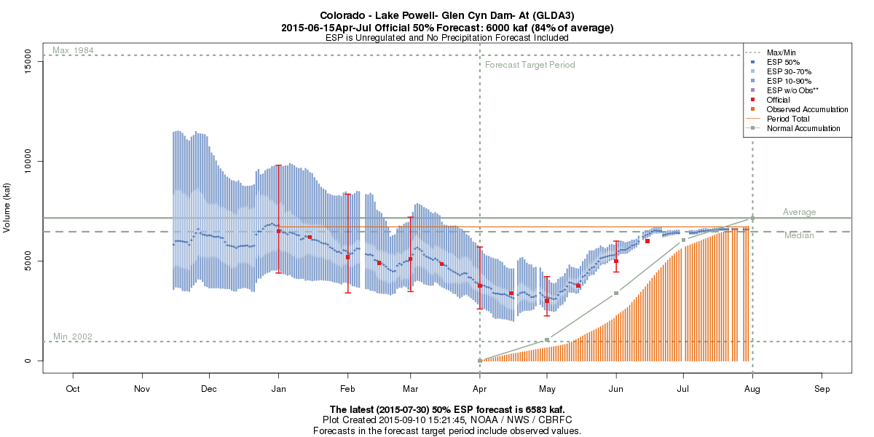
Forecast Interpretation: CBRFC Forecasts
3/30 scenarios should be higher than the 10% probability
9800 KAF
10% chance Apr-Jul observed could be > than 9800
6500 KAF
50% chance Apr-Jul observed could be > than 6500
50% chance Apr-Jul observed could be < than 6500
24/30 scenarios should fall in between the 90%-10% range
4400 KAF
90% chance Apr-Jul observed will be > than 4400
3/30 scenarios should be lower than the 90% probability
Notes:
10

