Slide 1
Forecast Verification
CBRFC Stakeholder Forum
October 20, 2015
Notes:
1

Slide 2
Forecast Verification
Current Forecast Verification
Types of Forecasts | Daily Verification | Seasonal Verification April-July
 |  | Raw Model | Official Forecasts
Daily Deterministic | x |  | x
Water Supply |  | x | x
Peak Flow |  |  | x
Notes:
2

Slide 3
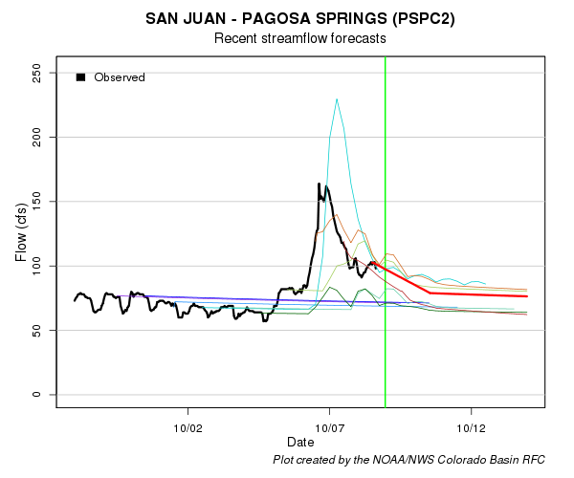
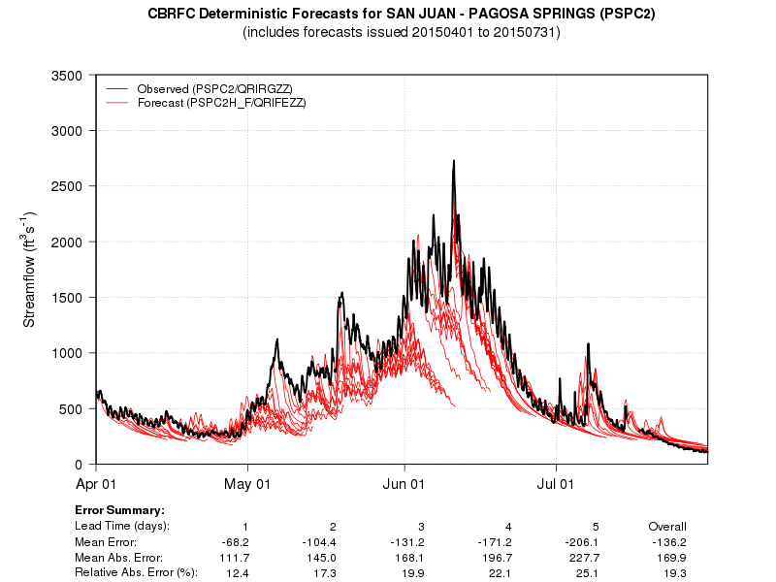
Forecast Verification: Daily Forecasts
Daily
Seasonal
Notes:
3

Slide 4
Forecast Verification: Water Supply Forecasts
Raw Model Verification
What is on the map?
Mean Absolute Percent Error
Based on 30 years of (1981-2010) reforecasts
Indicator of quality of model calibration
Only analyzes 50% exceedance forecast
April-June forecast lead times
“Help” Option
Notes:
4

Slide 5
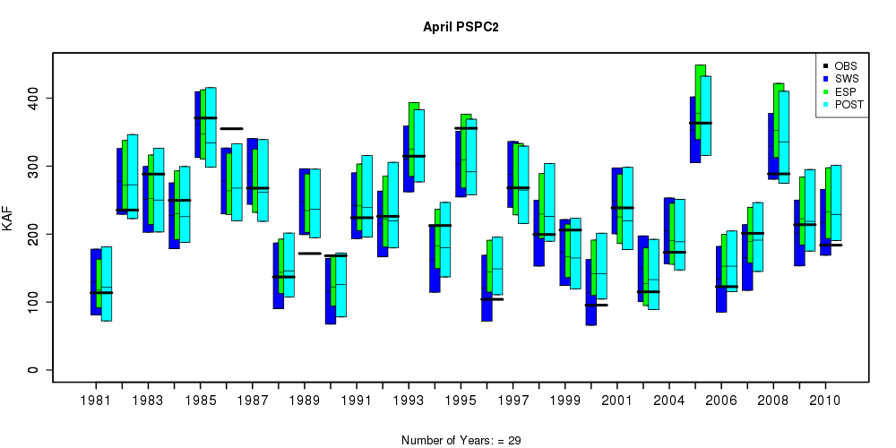
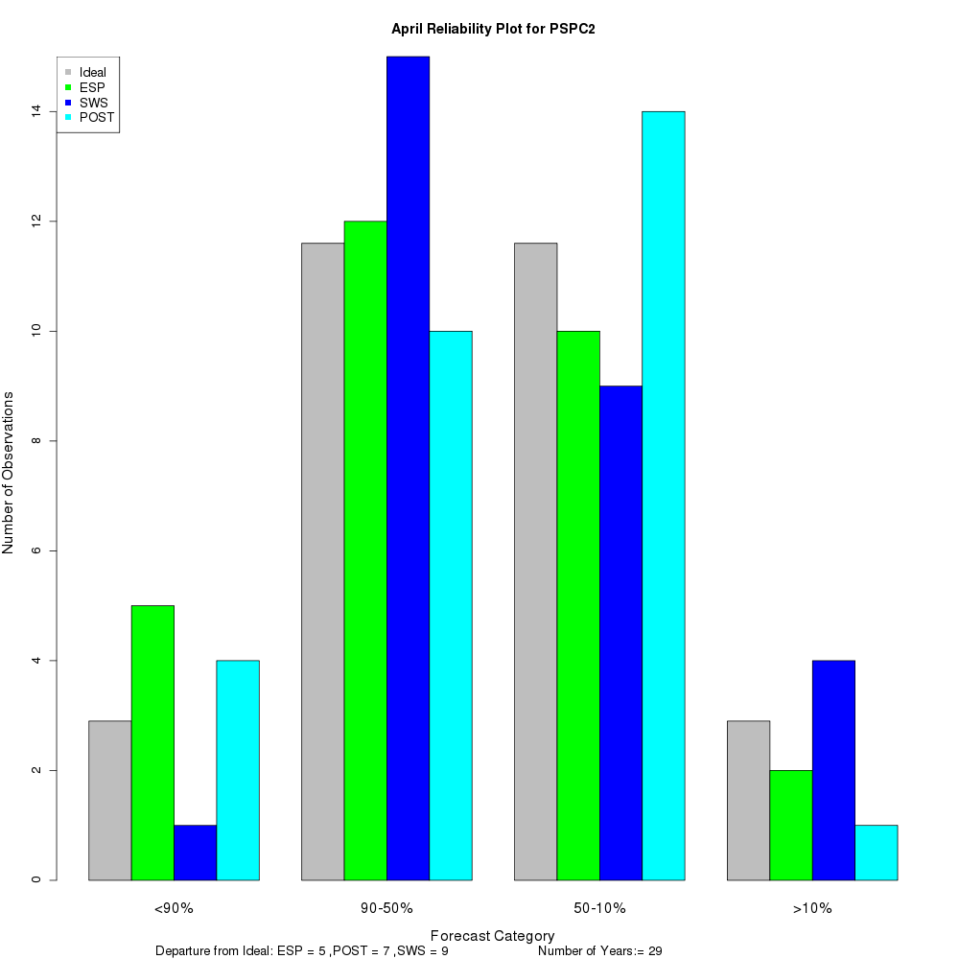
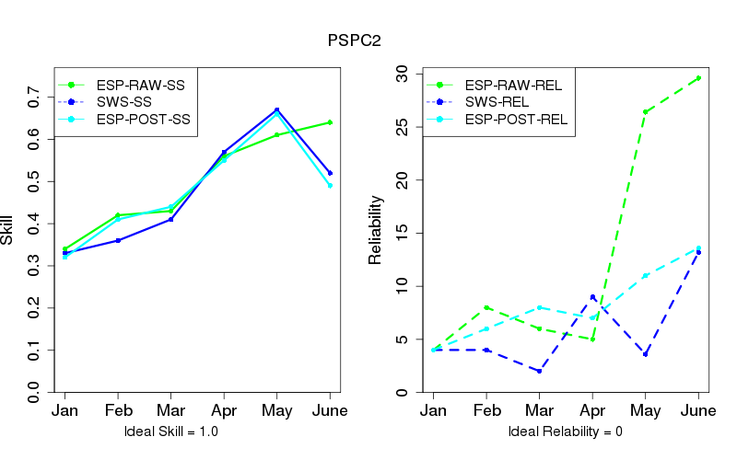
Forecast Verification: Water Supply Forecasts
Raw Model Verification
Based on 30 years of reforecasts
Skill and spread of ensembles and statistical regressions
Notes:
5

Slide 6
Forecast Verification: Water Supply Forecasts
Official Forecasts Verification
What is on the map?
2015 Forecast Error vs Mean Model Error (previous map)
% Error Difference
April-June forecast lead times
Only analyzes 50% exceedance forecast
“Help” Option
What does the map mean?
Positive = 2015 Forecast performed BETTER
Negative = 2015 Forecast performed WORSE
-5 to 5 = 2015 Forecast normal performance
Notes:
6

Slide 7
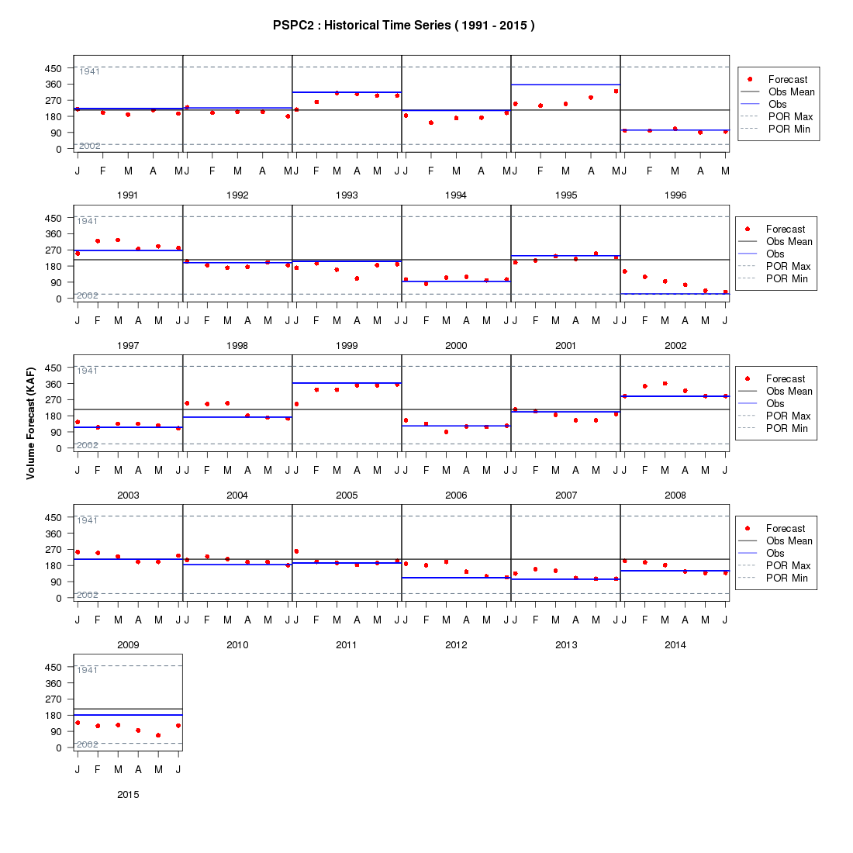
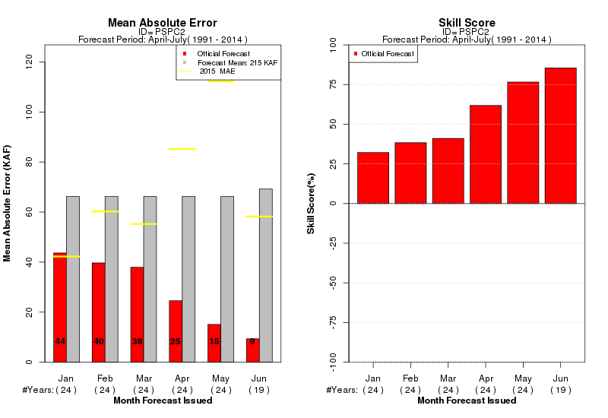
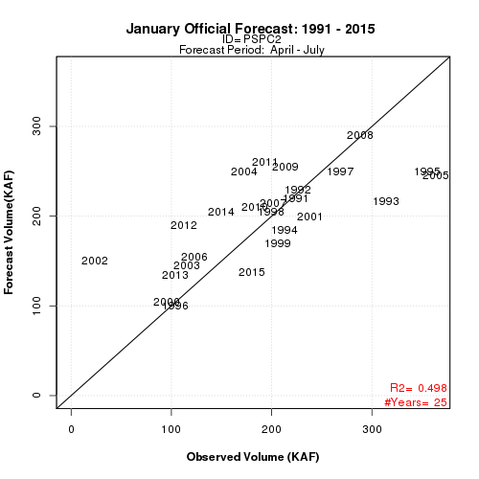
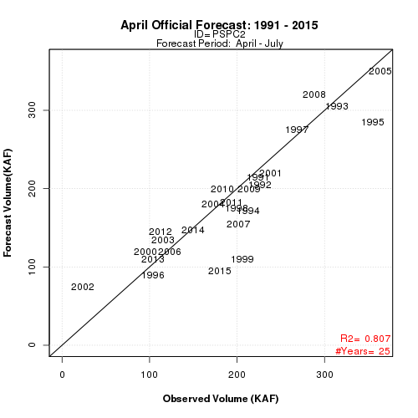
Forecast Verification: Water Supply Forecasts
Official Forecasts Verification
Annual 50% Forecasts
Notes:
7

Slide 8
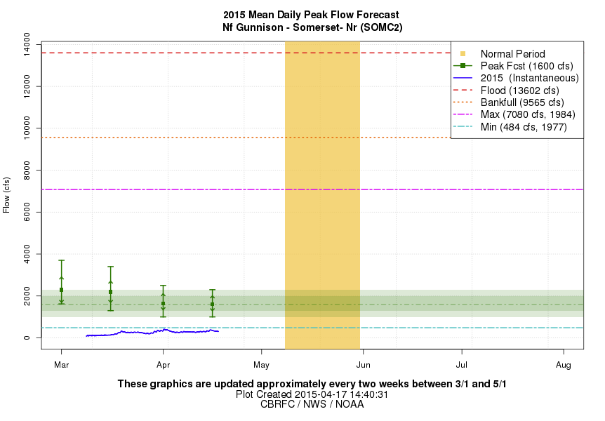
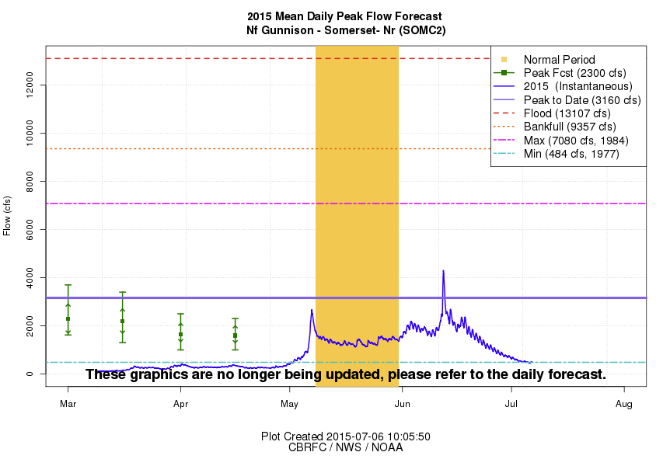
Forecast Verification: Peak Flow Forecasts
Mid-April Forecast
April-July Season
Observed Peak
Notes:
8

Slide 9
Forecast Verification: What’s Next?
More Web Documentation
Easier Web Access
User Requests
Daily Forecasts
QPF(5 day) and Temperature Forecast (10 day) Verification
Water Supply Forecasts
Monthly Forecasts
HEFS (Climate Forecasts and Streamflow)
Post Adjust Techniques
Notes:
9

