Slide 1
Did The Model Get It Right?
Assessing the Model Performance
Inaccurate Forecasts Can Be Caused By Many Things:
Bad initial model states (snow, soil moisture, flows)
Incorrect or missing gage data
Data network density limitations (affects calibration)
Daily quality checking issues
Limited information about diversions (affects calibration)
Extreme weather in the future (Precipitation and Temperature)
Weather events not represented in the calibration period

Slide 2
Ensemble Prediction Model – Starting on January 1st 2015 – April through July Forecast
Many runoff scenarios are possible. Some are more likely than others.
Important to look at the full distribution

Slide 3
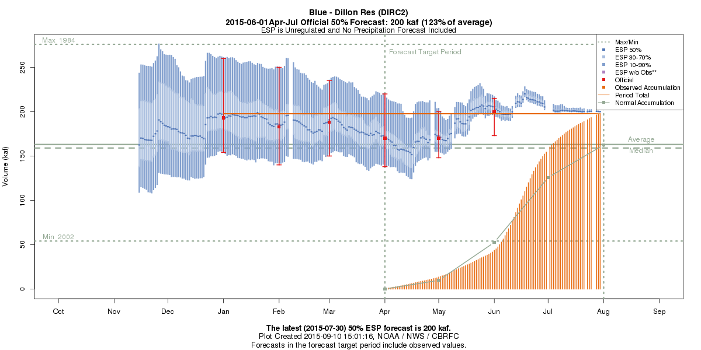
Range of possible outcomes are summarized in the forecast spread
January 1st 2015 Forecast
Jan 1 – A primary goal is to capture the resulting runoff in the forecast range

Slide 4
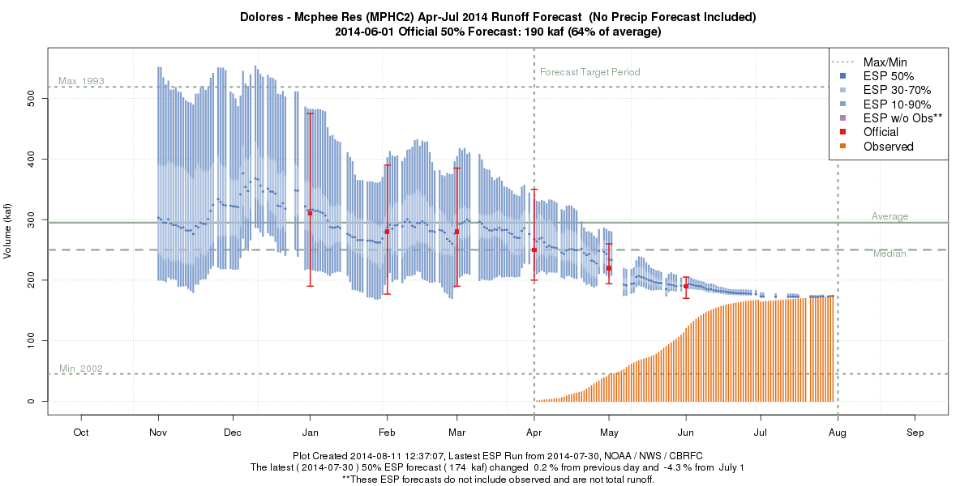
Did The Model Get It Right (perform as expected) ?
No
2014 Forecast for McPhee Reservoir Inflow

Slide 5
McPhee Reservoir Inflow Forecasts 2014 : Initial States Issues
Snow state adjustments once we were in the runoff period
Probably started the season too “wet”
Dry spring also had a big impact – model handled it reasonably well
Most likely an issue with early season soil moisture and then snow representation
Questionable Initial States

Slide 6
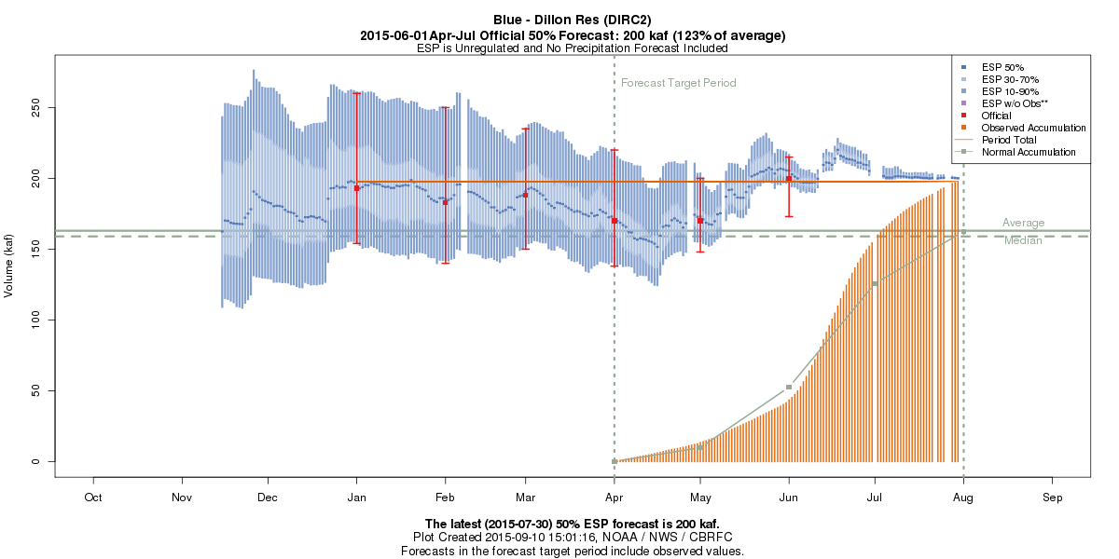
Did The Model Get It Right (perform as expected) ?
Yes, but data issues late season
Early June Snow Adjustments & Precipitation Event
2015Forecast for Blue – Dillon Reservoir
Minor gage Issues but also late season storms.
However in this case the model did reasonably well
Large precipitation event 12/21-23
2/25 Snow adjustment
Due to bad SNOTEL Data

Slide 7
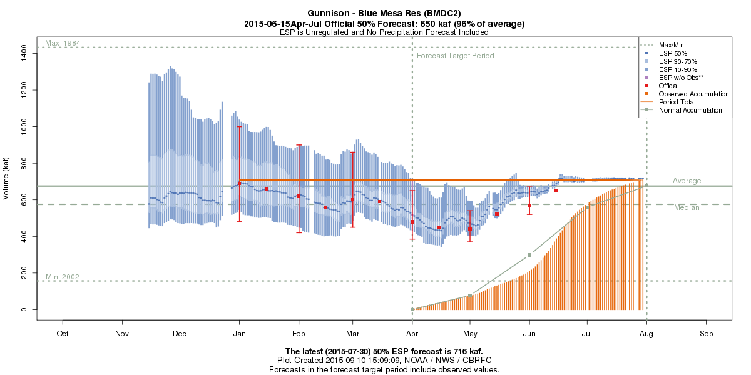
Did The Model Get It Right (perform as expected) ?
Yes
2015 Forecast for Blue Mesa Reservoir Inflow

Slide 8
Gunnison – Blue Mesa 2015: Extreme Weather
Forecast: 440 KAF
10%: 540 KAF
90%: 370 KAF
Apr-Jul Observed
708 KAF / 105%
Largest Error was during the period where historical performance is best

Slide 9
Ensemble Prediction Model – Starting on May 1st 2015 – May through July Forecast
1995
1984

Slide 10
Model / Forecast Performance & Uncertainty
Blue Mesa Reservoir Inflow Forecast Progression 2015
1st of month Forecasts
Jan: 690 KAF (102%)
Feb: 620 KAF (92%)
Mar: 600 KAF (89%)
Apr: 480 KAF (71%)
May: 440 KAF (65%)
June: 570 KAF (84%)
July: 700 KAF (104%)
10 % Chance of Exceeding : 540 KAF
50% Chance of Exceeding: 440 KAF
April-July Observed
708 KAF (105%)
90 % Chance of Exceeding: 370 KAF
Highest Forecast Trace (volume) on May 1 was 741 KAF: (3% exceedance probability) - 1995
Second Highest Trace (volume) on May 1 was 604 KAF: (7% exceedance probability) - 1984

Slide 11
Gunnison River Basin May-July 1984 SNOTEL Precipitation
Percent of Average

Slide 12
Gunnison River Basin May-July 1984 SNOTEL Precipitation
Historical Ranking
Several sites in the top 1-4 of their historical record
Precipitation fell in the 3-10% historical exceedance probability for several sites

Slide 13
Gunnison River Basin May-July 1995 SNOTEL Precipitation
Percent of Average

Slide 14
Gunnison River Basin May-July 1995 SNOTEL Precipitation
Historical Ranking
Several sites in the top 1-2 of their historical record)
Precipitation fell in the 3-7% historical exceedance probability for several sites

Slide 15
Model / Forecast Performance & Uncertainty
Blue Mesa Reservoir Inflow Forecast Progression 2015
1st of month Forecasts
Jan: 690 KAF (102%)
Feb: 620 KAF (92%)
Mar: 600 KAF (89%)
Apr: 480 KAF (71%)
May: 440 KAF (65%)
June: 570 KAF (84%)
July: 700 KAF (104%)
10 % Chance of Exceeding : 540 KAF
50% Chance of Exceeding: 440 KAF
April-July Observed
708 KAF (105%)
90 % Chance of Exceeding: 370 KAF
Highest Forecast Trace on May 1 was 741 KAF: (3% exceedance probability) - 1995
Second Highest Forecast Trace on May 1 was 604 KAF: (7% exceedance probability) - 1984
We would expect May-July precipitation to be in that top percentile of historical record to reach the observed volume of 708 KAF.
So was it ?

Slide 16
Gunnison River Basin May-July 2015 SNOTEL Precipitation
Percent of Average

Slide 17
Gunnison River Basin May-July 2015 SNOTEL Precipitation
Historical Ranking
SNOTEL | Anomaly (in) | % of Avg
Park Reservoir | +8.9 | 240%
Overland Reservoir | +4.8 | 173%
Schofield Pass | +8.0 | 216%
Butte | +4.1 | 178%
Porphyry Creek | +3.5 | 162%
Slumgullion | +3.6 | 169%
Columbine Pass | +6.7 | 260%
May-July precipitation at SNOTEL sites were in the top 1-3 of the historical record (30-36 yrs)
Precipitation fell in the 3-9% historical exceedance probability range for several sites

Slide 18
Model / Forecast Performance & Uncertainty
Navajo Reservoir Inflow Forecast Progression 2015
1st of month Forecasts
10 % Chance of Exceeding : 490 KAF
Jan: 450 KAF (61%)
Feb: 400 KAF (54%)
Mar: 415 KAF (56%)
Apr: 310 KAF (42%)
May: 230 KAF (31%)
June: 405 KAF (55%)
July: 600 KAF (81%)
50% Chance of Exceeding: 310 KAF
April-July Observed
619 KAF (84%)
90 % Chance of Exceeding: 225 KAF
Highest Forecast Trace on April 1 was 698 KAF: (3% exceedance probability)
Second Highest Forecast Trace on April 1 was 584 KAF: (7% exceedance probability)
We would expect spring precipitation to be among the top percentile of record to reach the observed volume of 600 KAF.
So was it ?

Slide 19
San Juan May-July SNOTEL Precipitation
Historical Ranking
SNOTEL | Anomaly (in) | % of Avg
Red Mountain | +6.9 | 196%
Molas Lake | +7.0 | 235%
Spud Mt | +11.6 | 301%
Cascade | +7.8 | 227%
Columbus | +11.5 | 254%
Stump Lakes | +6.3 | 201%
Upper San Juan | +9.6 | 242%
Wolf Creek | +11.7 | 281%
Many sites registered the wettest May-July period in their historical record (30-35 years)
Precipitation fell in the 3-7% historical exceedance probability range

Slide 20
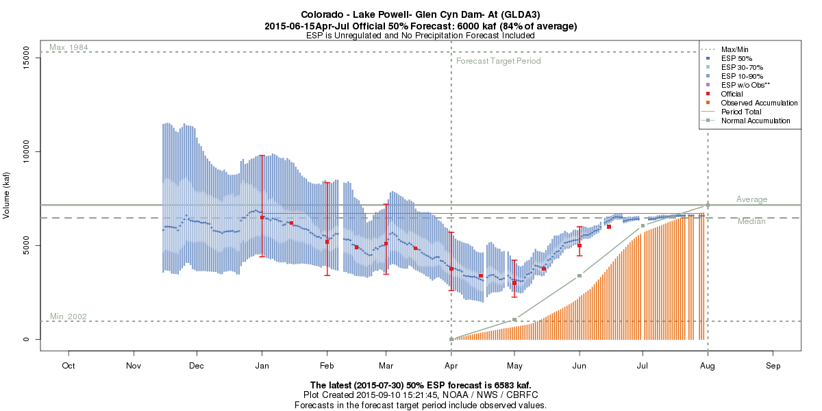
2015 Forecast Progression: Lake Powell

Slide 21
Model / Forecast Performance & Uncertainty
Lake Powell Inflow Forecast Progression 2015
10%: 9800 KAF
1st of month Forecasts
Jan: 6500 KAF (91%)
Feb: 5200 KAF (73%)
Mar: 5100 KAF (71%)
Apr: 3750 KAF (52%)
May: 3000 KAF (42%)
June: 5000 KAF (70%)
July: 6290 KAF (88%)
50%: 6500 KAF
10%: 4220 KAF
90%: 4400 KAF
50%: 3000 KAF
90%: 2250 KAF
April-July Observed
6712 KAF (94%)
Lowest Forecast Trace on Jan 1 was 2374 KAF: (97% exceedance probability)
Second Lowest Forecast Trace on Jan 1 was 4371 KAF: (93% exceedance probability)
Highest Forecast Trace on May 1 was 5836 KAF: (3% exceedance probability)
Second Highest Forecast Trace on May 1 was 4390 KAF: (7% exceedance probability)

Slide 22
Colorado River above Lake Powell : SNOTEL Precipitation Rankings – Two Extreme Periods
January through April 2015
May through July 2015
Many sites driest 1-2 on record
Many sites wettest 1-3 on record

Slide 23
What can we take-away from this?
Model error exists, in a large part due to poor data inputs, but extreme weather can
result in large forecast errors.
Model in general performed as expected in 2015..but we were not focusing on the
extreme end of the runoff scenarios we were provided with that were closer to the
actual observed runoff volumes.
The ability to catch such future weather extremes in water supply forecasts is very
limited (& depends upon events in the calibration period used).
Early season forecasts (50% exceedance) are likely to miss the mark if future
conditions end up extremely wet or dry.
The forecast distribution is important to consider depending on your level of risk.
The ability to catch extreme events in the forecast distribution is dependent upon
the variety of scenarios in the calibration period data.
Simply comparing the observed runoff with the 50% exceedance forecast isn't
always a solid indicator of the model performance for a particular year.

