Slide 1
Post Adjusting Ensemble Streamflow Forecasts
Evaluating two methods
Ensemble Post-processor (EnsPost)
daily time step
can have different parameters for different times of year
John Schaake method
monthly time step
each month has a separate adjustment factor
Objective
adjust ensemble stream flows to remove bias from calibration in a repeatable way

Slide 2
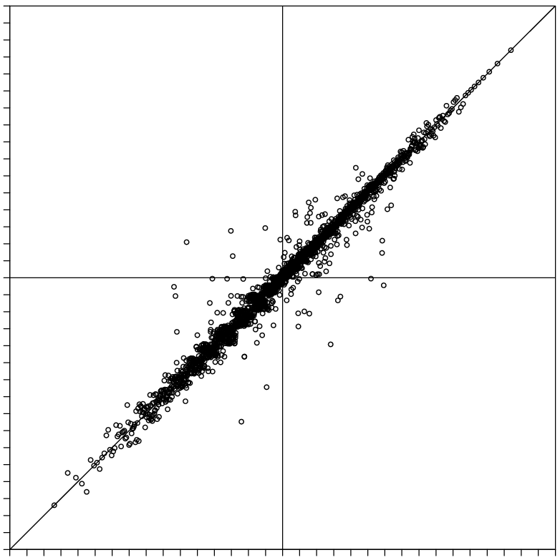
EnsPost
EnsPost (“flow processor”)
Does two things to flow forecast
Adds spread to account for hydrologic model errors
Corrects systematic biases
Uses linear regression between observed flow and historical simulated flow (observed forcing)
Scatter around line of best fit represents the hydrologic error (i.e. no forcing uncertainty)
Prior observation (“persistence”) also included in regression (not shown here)
Observed flow (normalized units), Z_{obs}(t+1)
Simulated flow (normalized units), Z_{mod}(t+1)

Slide 3
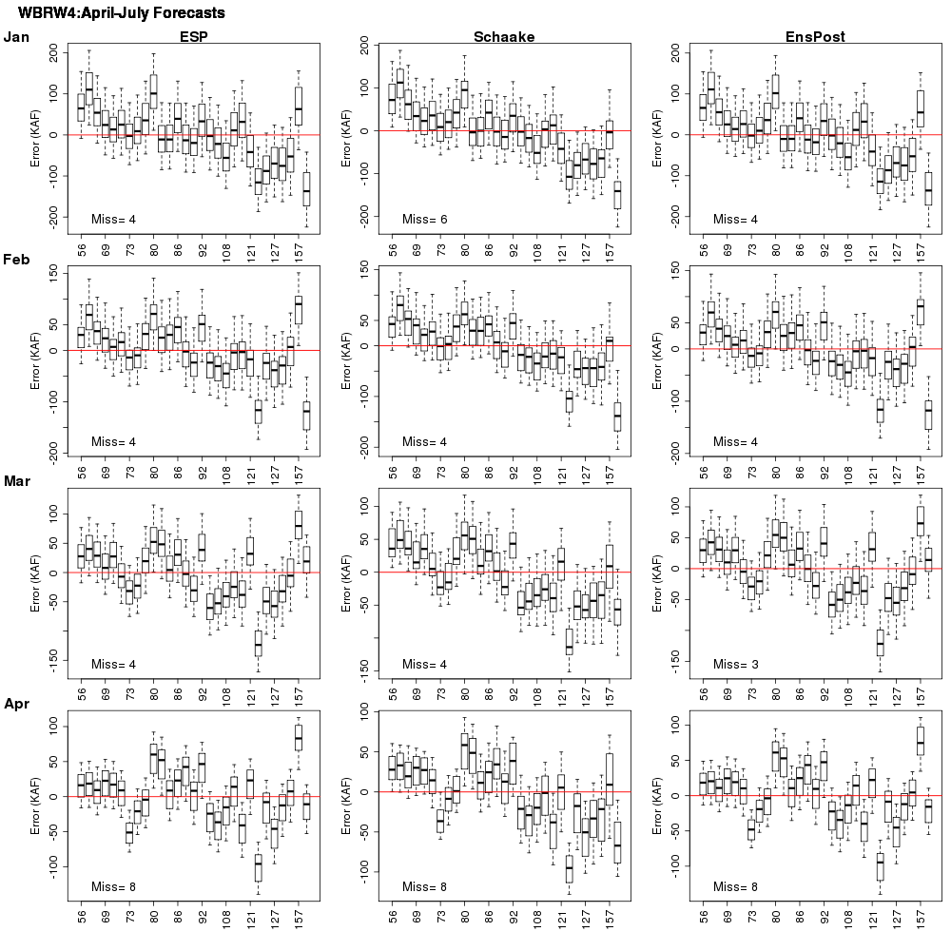
April - July Volume Post Adjustment Skill

Slide 4
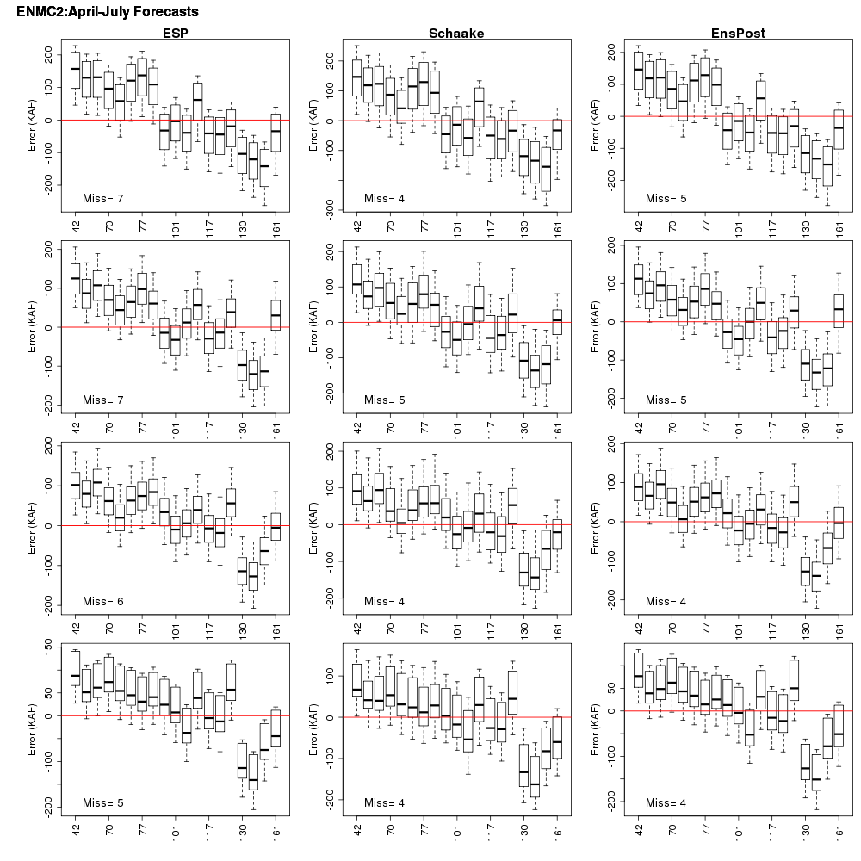
April - July Volume Post Adjustment Skill

Slide 5
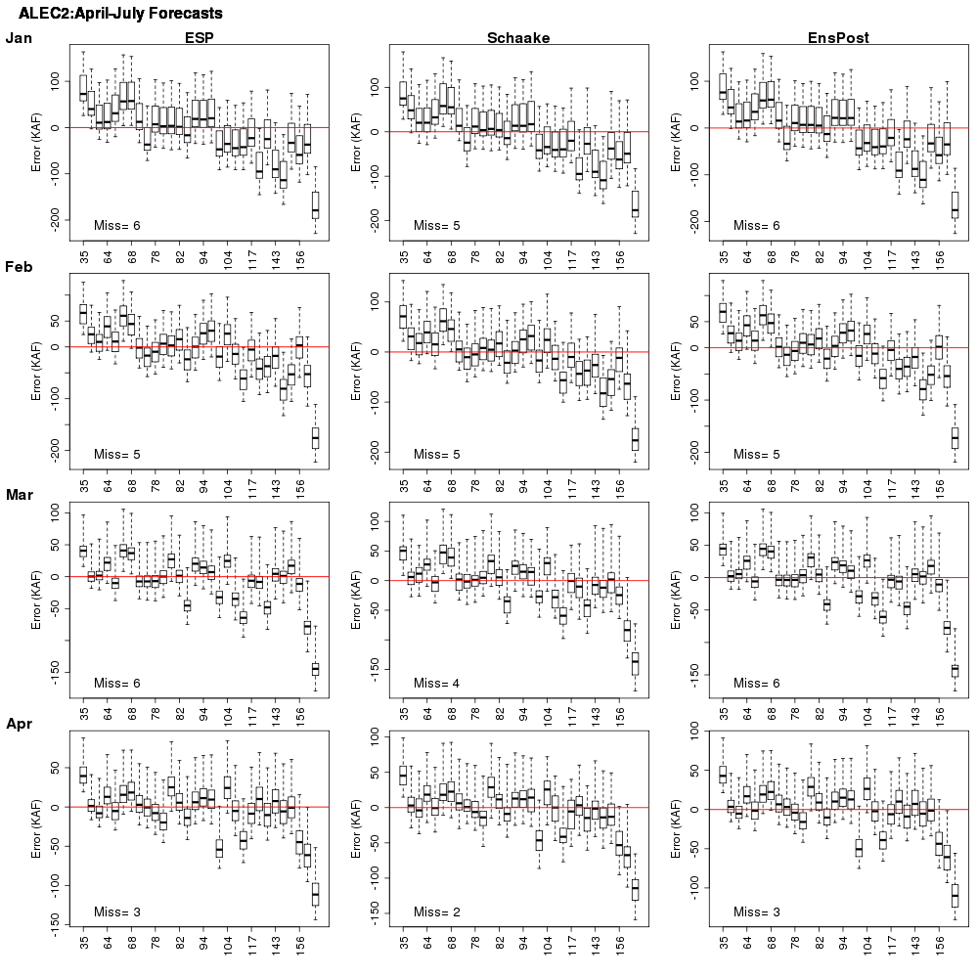
April - July Volume Post Adjustment Skill

Slide 6
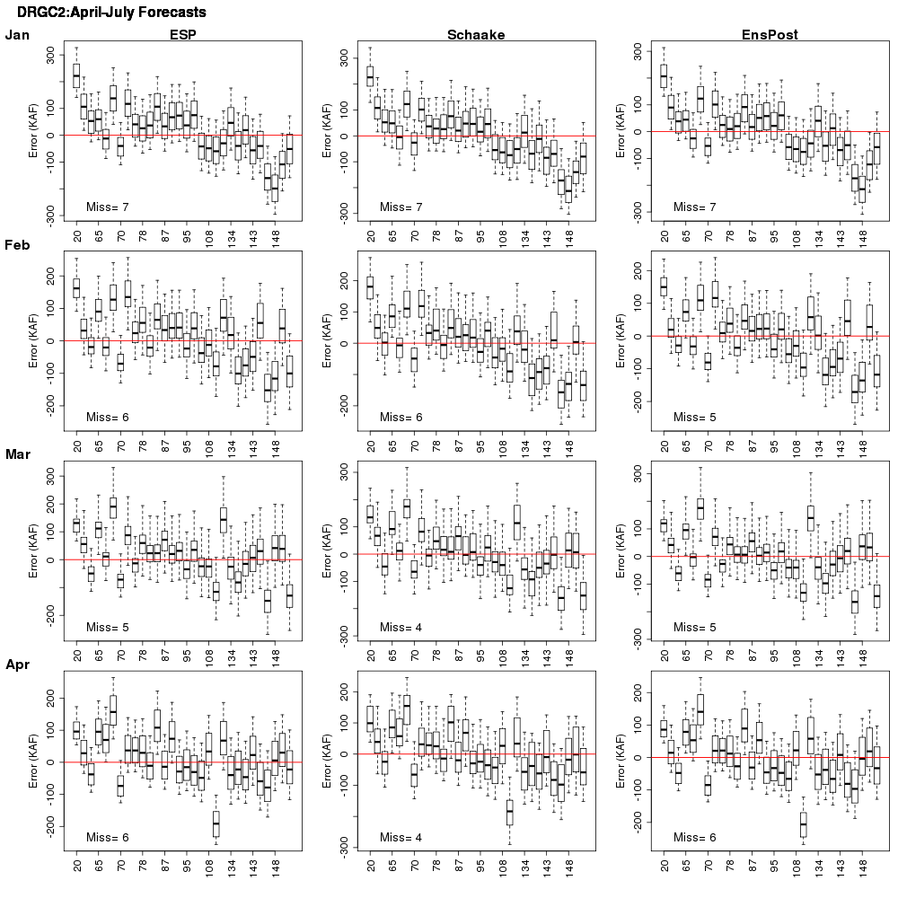
April - July Volume Post Adjustment Skill

