Slide 1
Colorado Basin River Forecast Center
2017 Water Supply Verification / Year in Review
November 14th 2017
Greg Smith
Sr. Hydrologist
Please mute your phone until ready to ask a question - Thank You

Slide 2
2017 Water Supply Review / Verification Webinar
Why Do Verification?
It’s a path to improvement
Reviewing the season helps us know where to focus efforts
Primary sources of error in the forecast:
Future weather (largest uncertainty and impact)
Hydrology model uses climatology going forward
Extreme future weather results in largest forecast errors
Data Issues (impact model states such as snowpack)
Bad data quality, non-functioning gages, network outages
Data availability, network density
Model calibration limitations
Quality / availability of historical data
Unknown / Ungaged Diversions
Changes in the river basin

Slide 3
2017 Water Supply Review / Verification Webinar
Understanding the forecasts – what are we providing?
Weather recap – primary impacts to the 2017 runoff
Forecasts and verification for key sites – basin highlights
Summary / Conclusion & the next steps toward improvement

Slide 4
Probabilistic Forecasts
Start with current conditions of streamflow, soil moisture, snowpack
Apply precipitation and temperature from each historical year used in model calibration
(1981-2015) from current date into the future.
A forecast is generated for each of the years (1981-2015)
as if, going forward, that year will happen
This creates 35 possible future streamflow patterns.
Each year is given a 1/35 chance of occurring
Current hydrologic model states :
River / Res. Levels
Soil Moisture
Snowpack
1981
1982
1983
….
2010
Past <-
-> Future Time

Slide 5
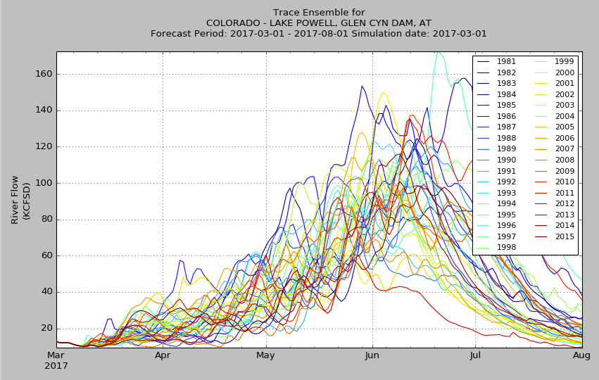
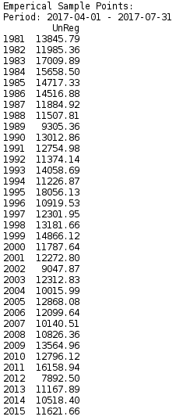
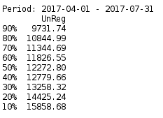
Ensemble Prediction System (ESP) - Probabilistic Forecasts
March 1st 2017 Forecast Guidance for Lake Powell
1
2
3
The flows are summed into volumes for the period of interest(typically April 1 – July 31)
The statistics are simplified
50% exceedance value approximates the most probable forecast. A range of probable outcomes is also provided.

Slide 6
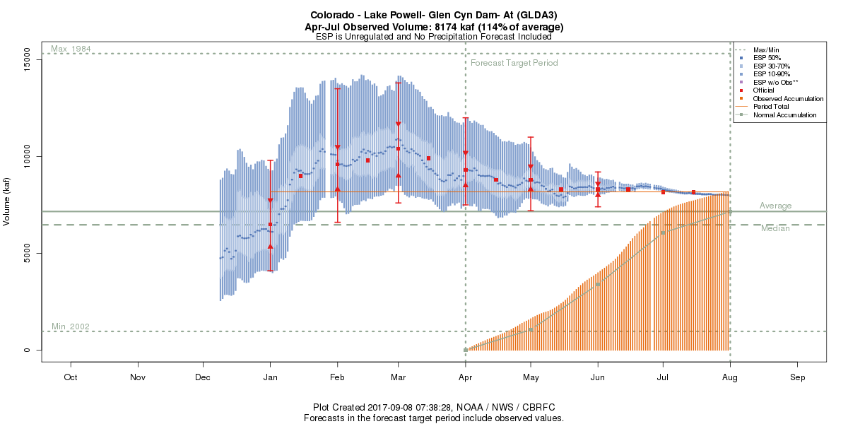
The range of probable outcomes are summarized graphically.
These “forecast evolution plots” are updated daily throughout the season
Period: 2017-04-01 – 2017-07-31
10% 15858.69
20% 14425.24
30% 13258.32
40% 12779.66
50% 12272.80
60% 11826.55
70% 11344.69
80% 10844.99
90% 9731.74

Slide 7
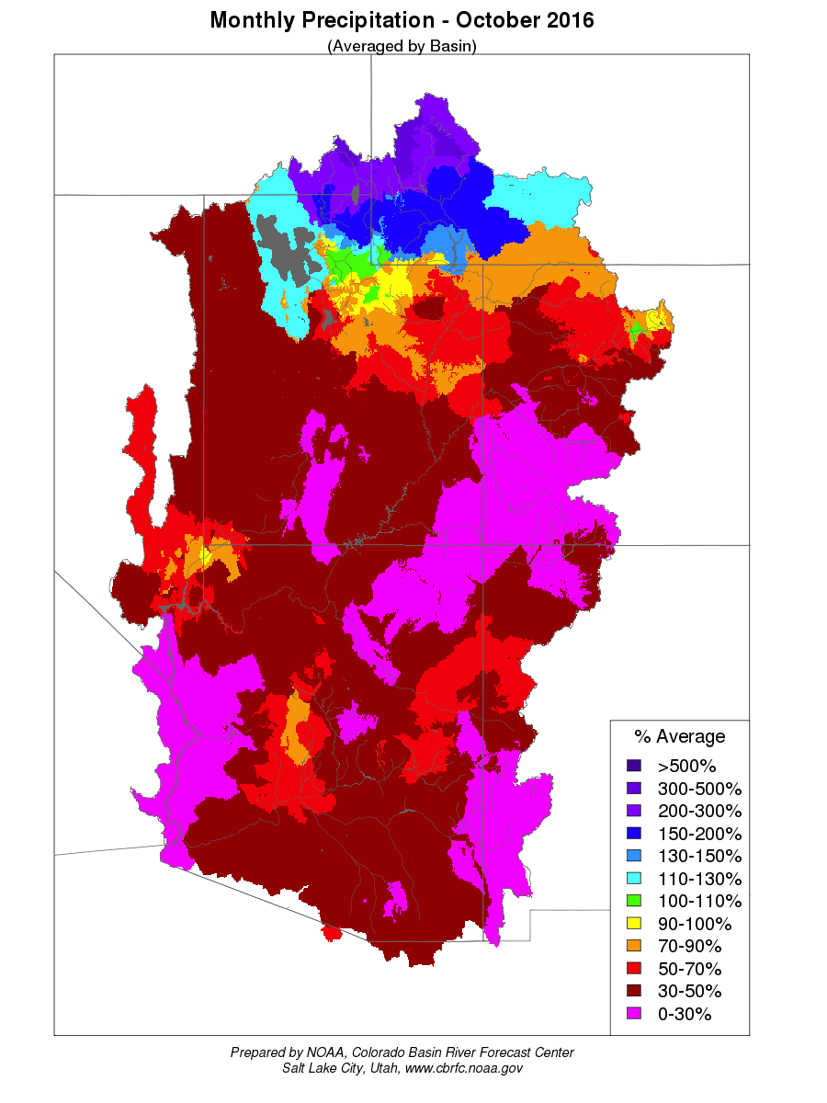
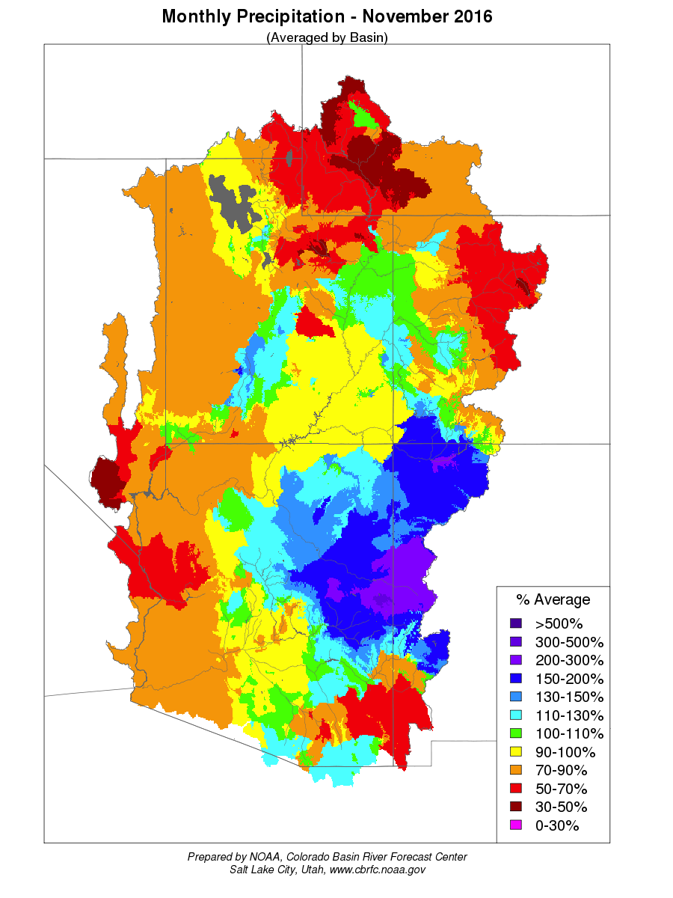
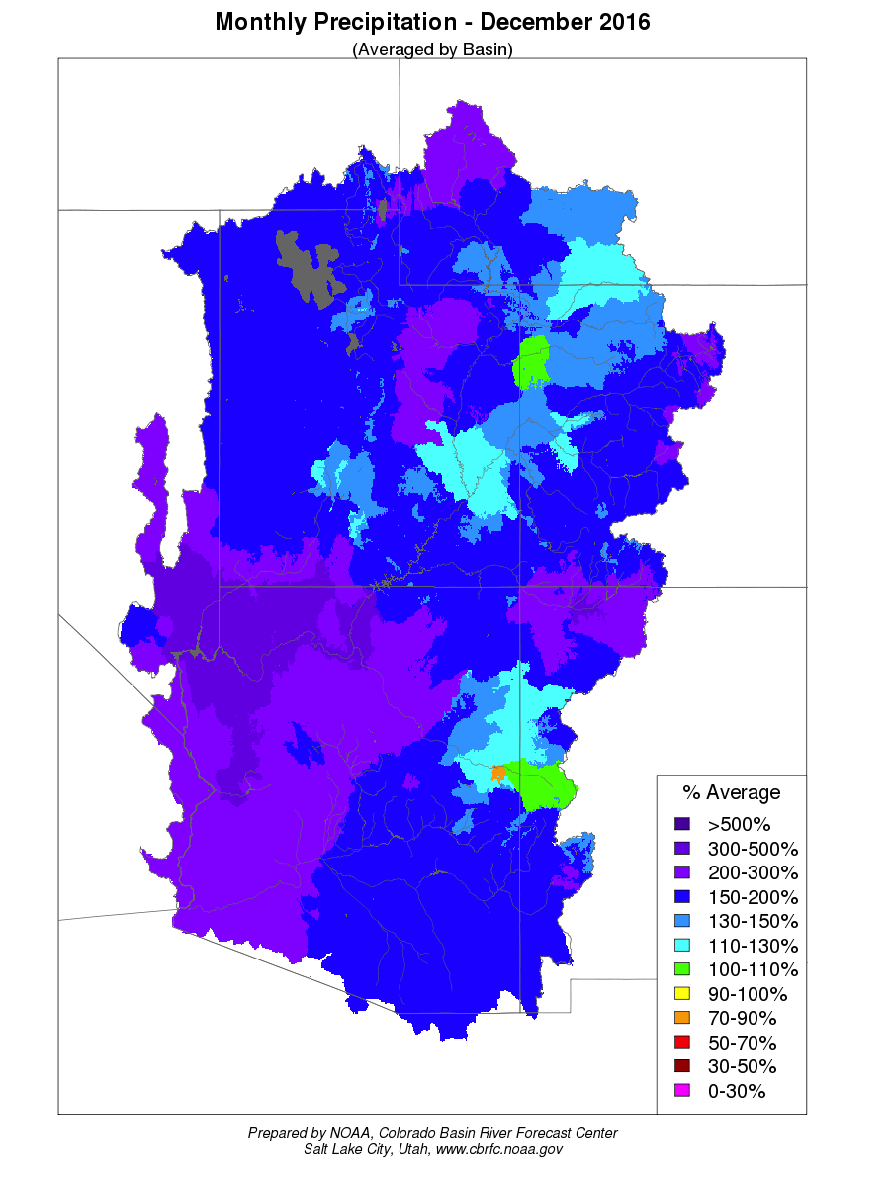
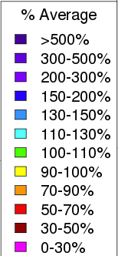
Precipitation: Fall was dry but winter was wet
December – Big Change
Very Dry October
Dry in much of the Upper Colorado & Great Basins. A mix in the Lower Colorado Basin

Slide 8
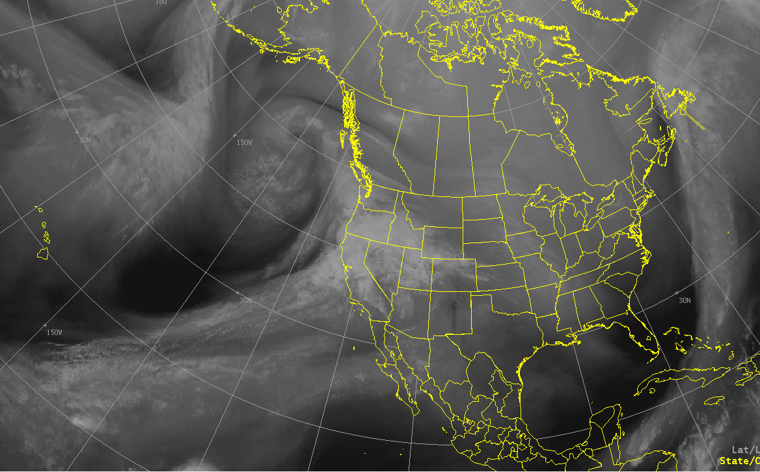
In fact winter was Very Wet !
Mid December through January: significant moisture impacted the western U.S.
Narrow corridor of significant moisture transport in the atmosphere

Slide 9
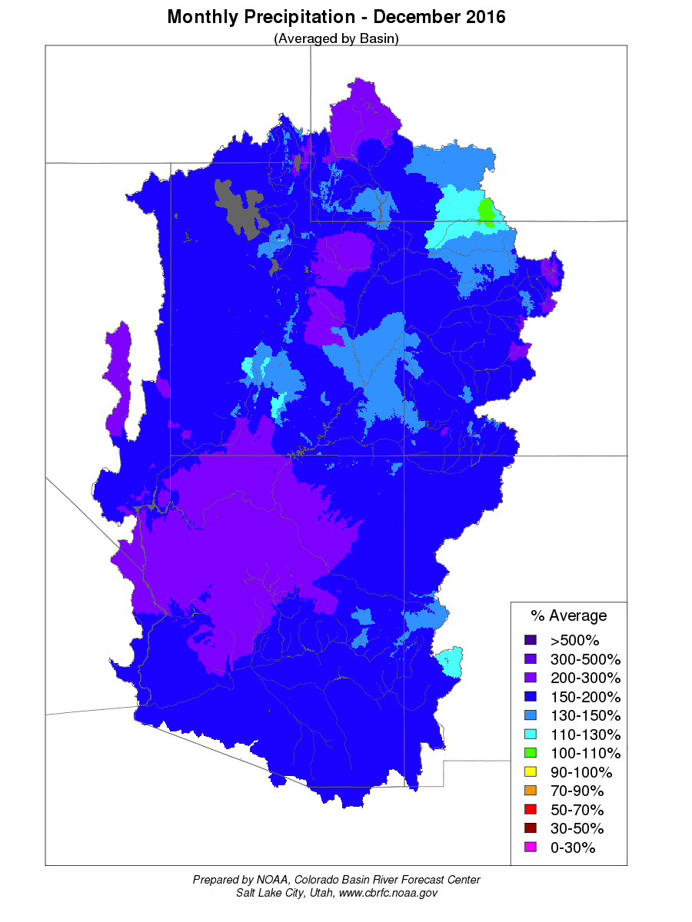
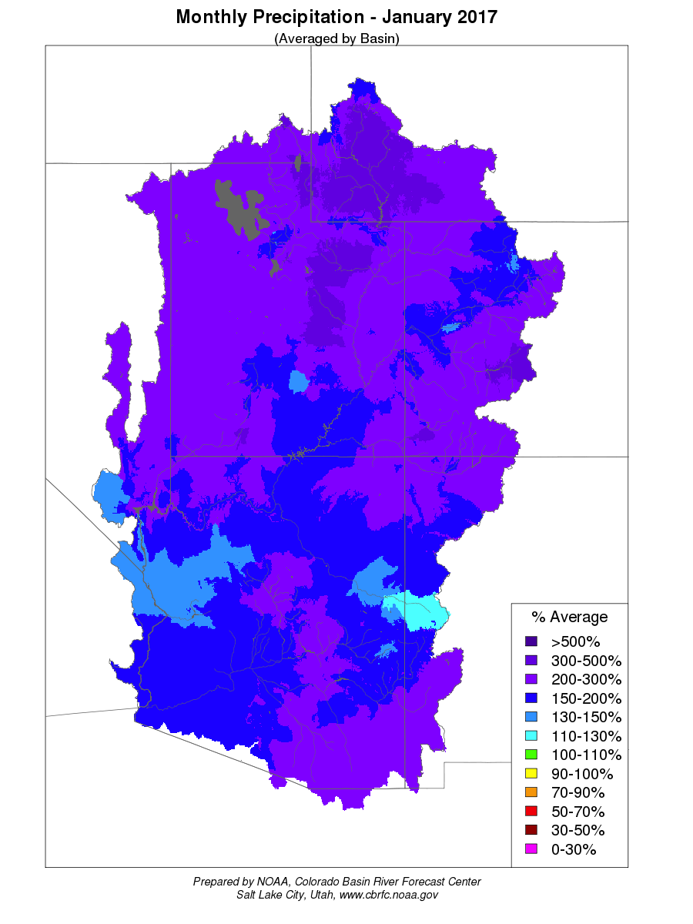
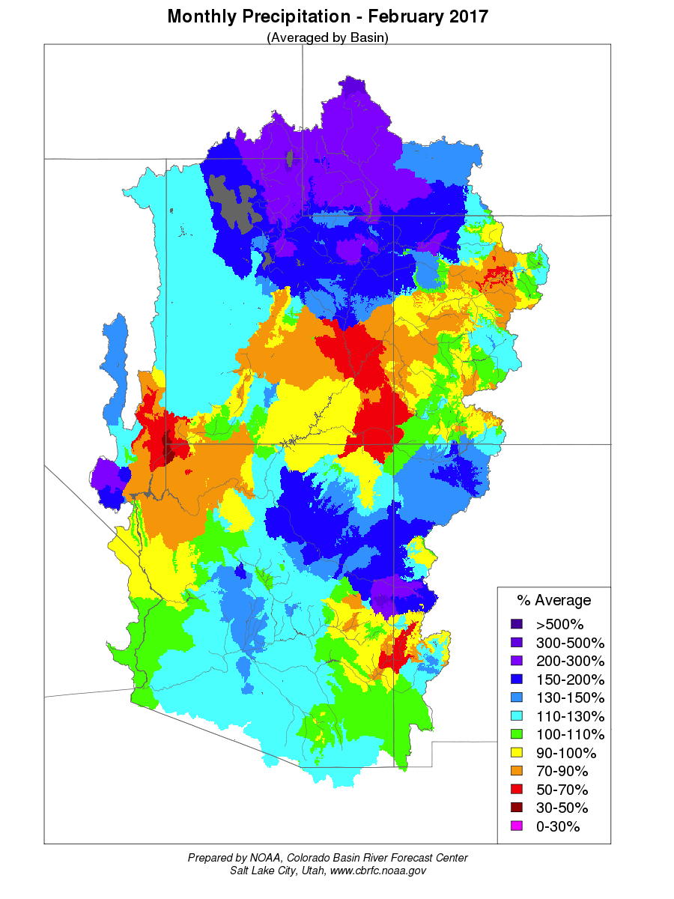
December-January: Very Wet
February: Continued wet in Green, Great, part of Lower Colorado Basins
December 2016
January 2017
February 2017

Slide 10
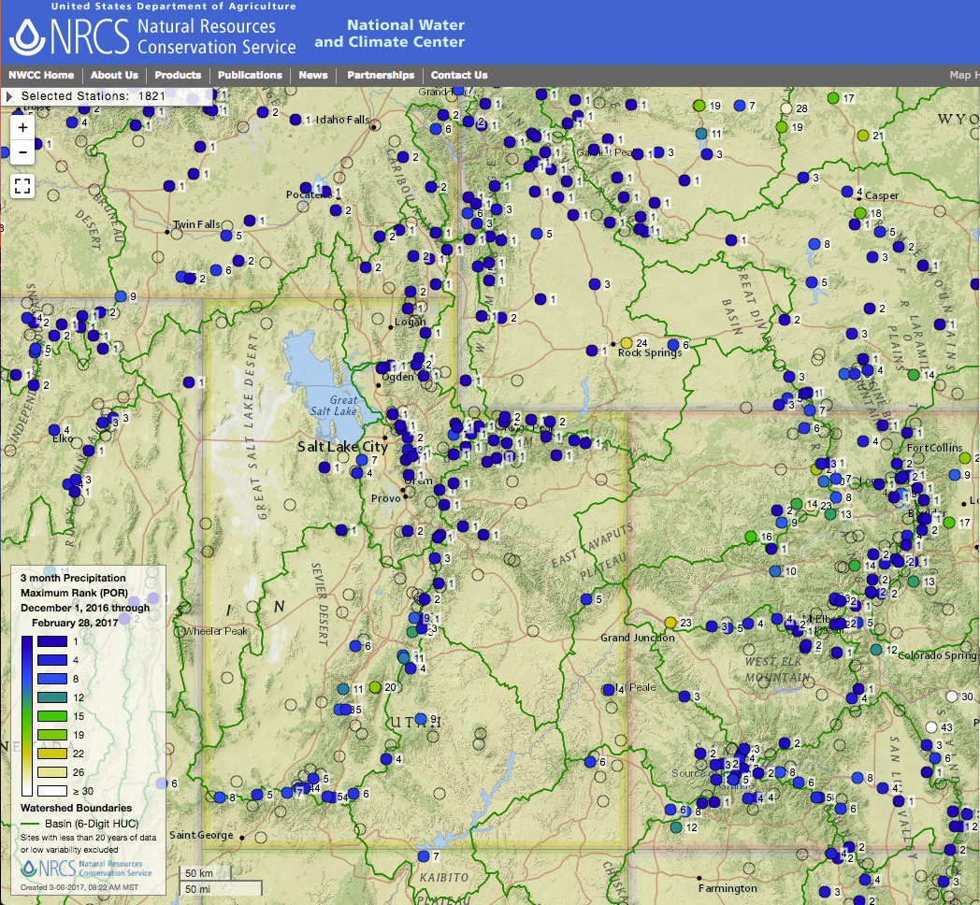
Dec-Feb Precipitation Ranking

Slide 11
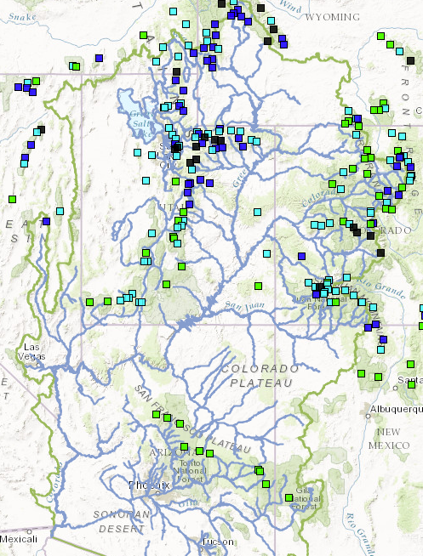
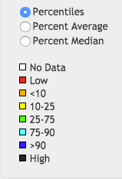
Snow Conditions
SNOTEL ranking for March 6th 2017
Black – Highest on record (upper Gunnison, Dolores, Duchesne, Great Basin, Green above Fontenelle)
Period of record 34-39 years most sites

Slide 12
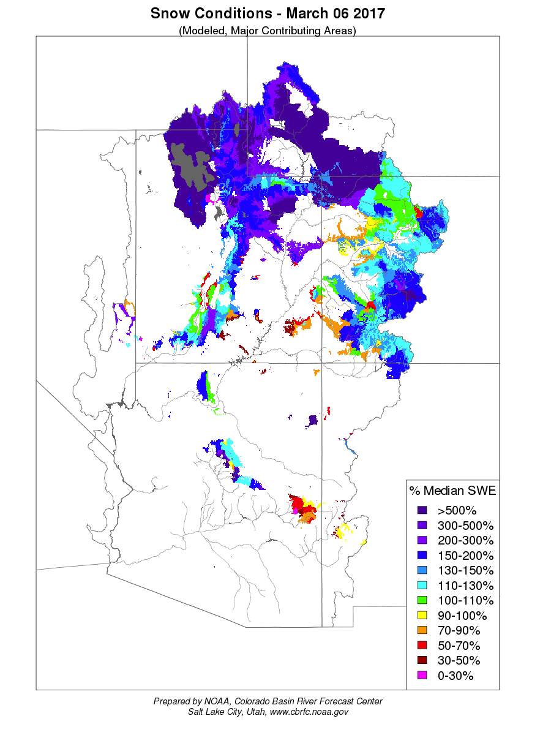
Snow Conditions
CBRFC Model Snow for March 6th 2017
Significant Snowpack: Green River Basin, Great Basin, Gunnison River Basin.
Above average snow many other areas.
Significant lower elevation snow in Green River Basin, Gunnison River Basin, Great Basin

Slide 13
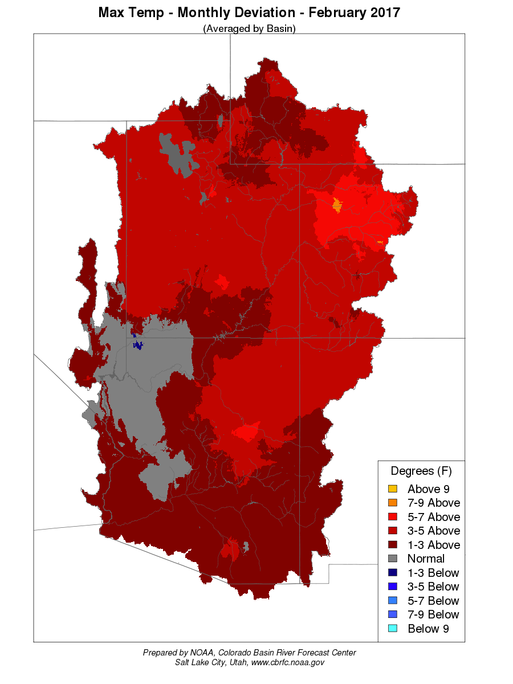
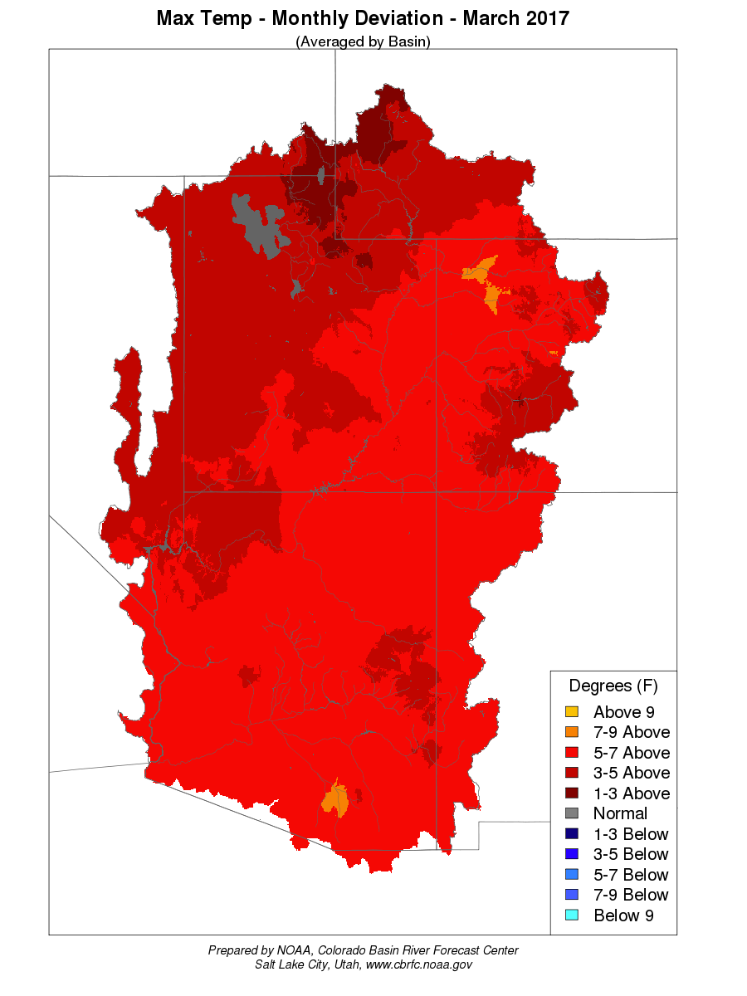
Temperature Impacts: Warm later winter / spring temperatures
Some daily temperatures 10-25 degrees above average in February and March

Slide 14
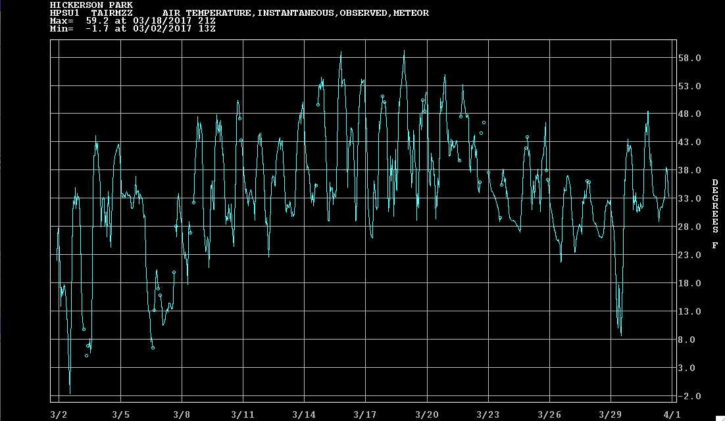
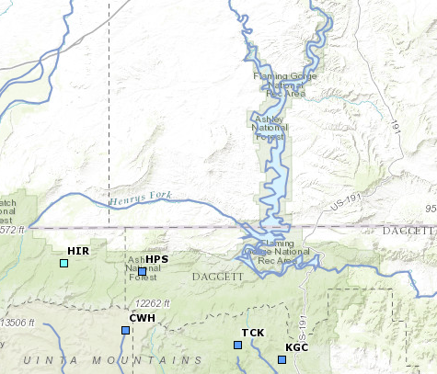
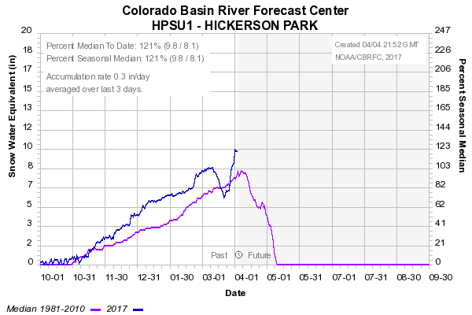
March Weather – Temperature Impacts
Hickerson Park SNOTEL
Elevation: 9,145 Feet
Upper Green River Basin
Above Freezing
Temperatures
Instantaneous Temperature Plot
Significant snowmelt
Above average temperatures

Slide 15
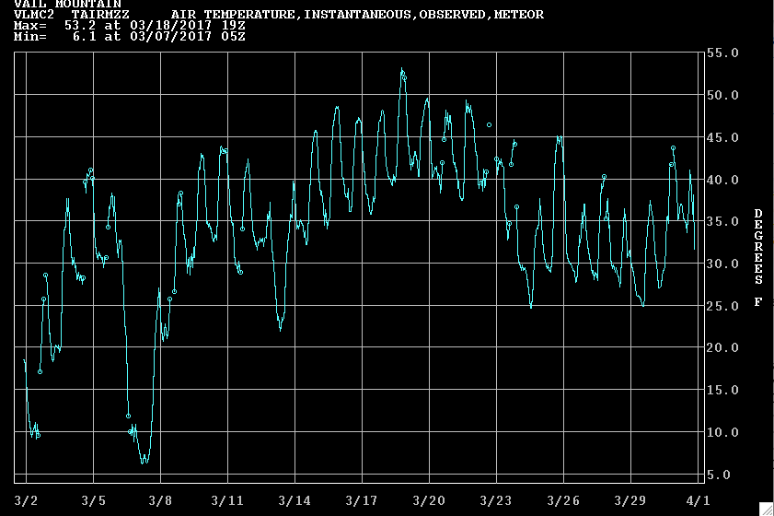
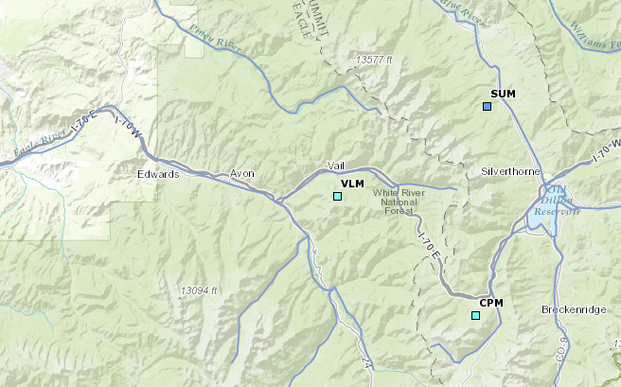
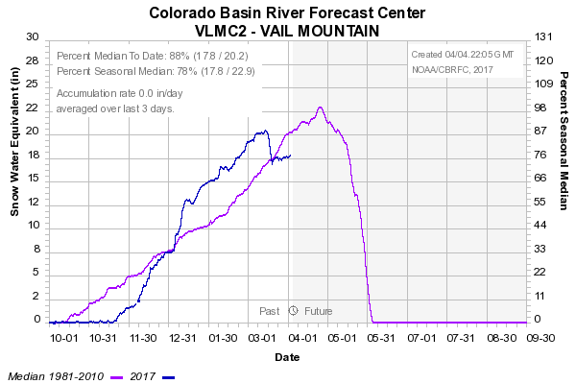
March Weather – Temperature Impacts
Vail Mountain SNOTEL
Elevation: 10,300 Feet
Colorado River Headwaters
Above Freezing
Temperatures
Instantaneous Temperature Plot
Cooler
temperatures
Significant snowmelt
Above average temperatures

Slide 16
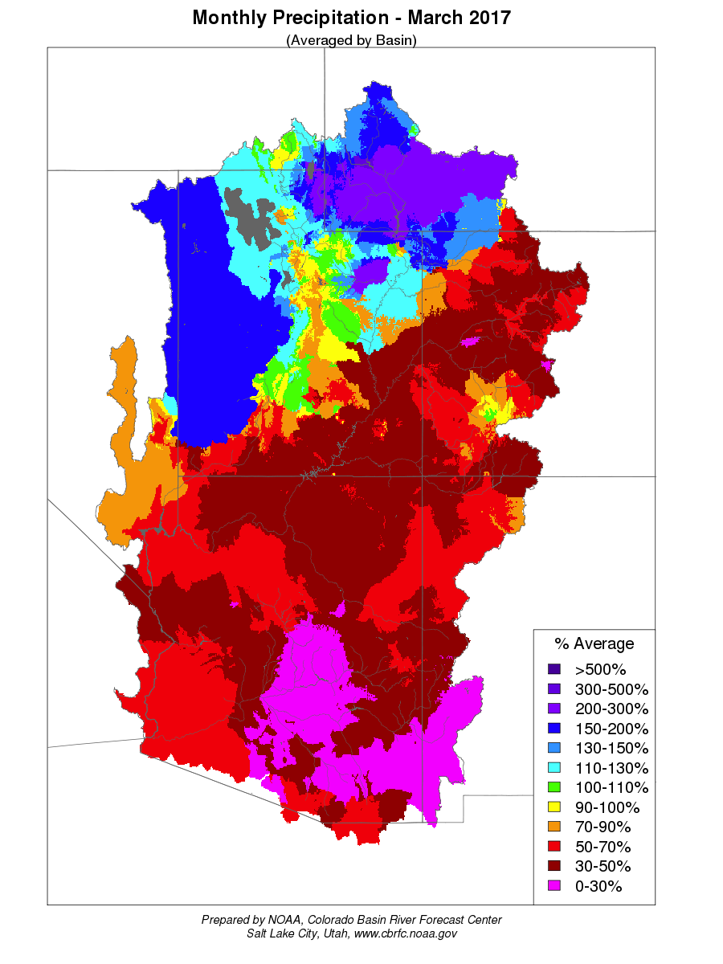
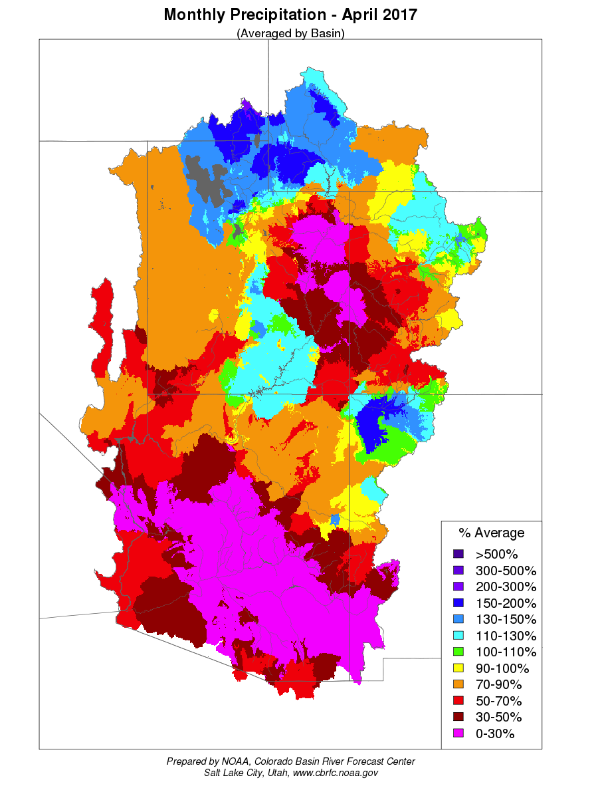
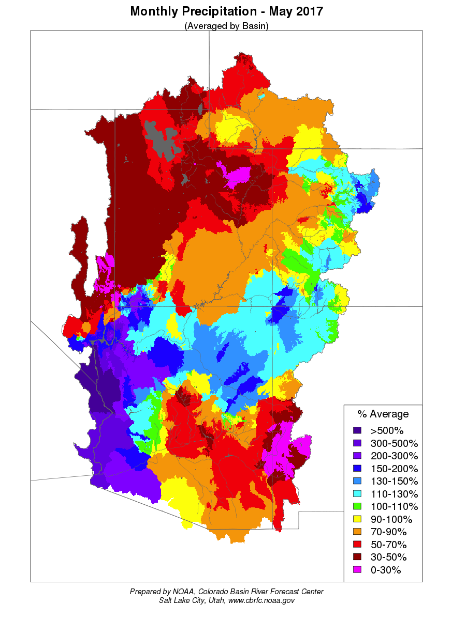
March-May: Generally wetter in northern areas and drier to the south
March 2017
April 2017
May 2017

Slide 17
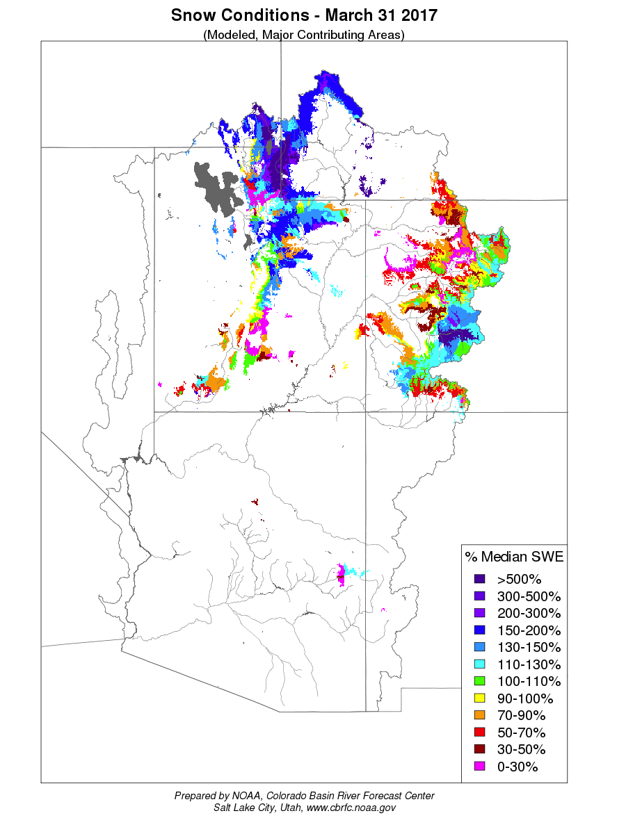
March Weather – Impacts to the snowpack

Slide 18
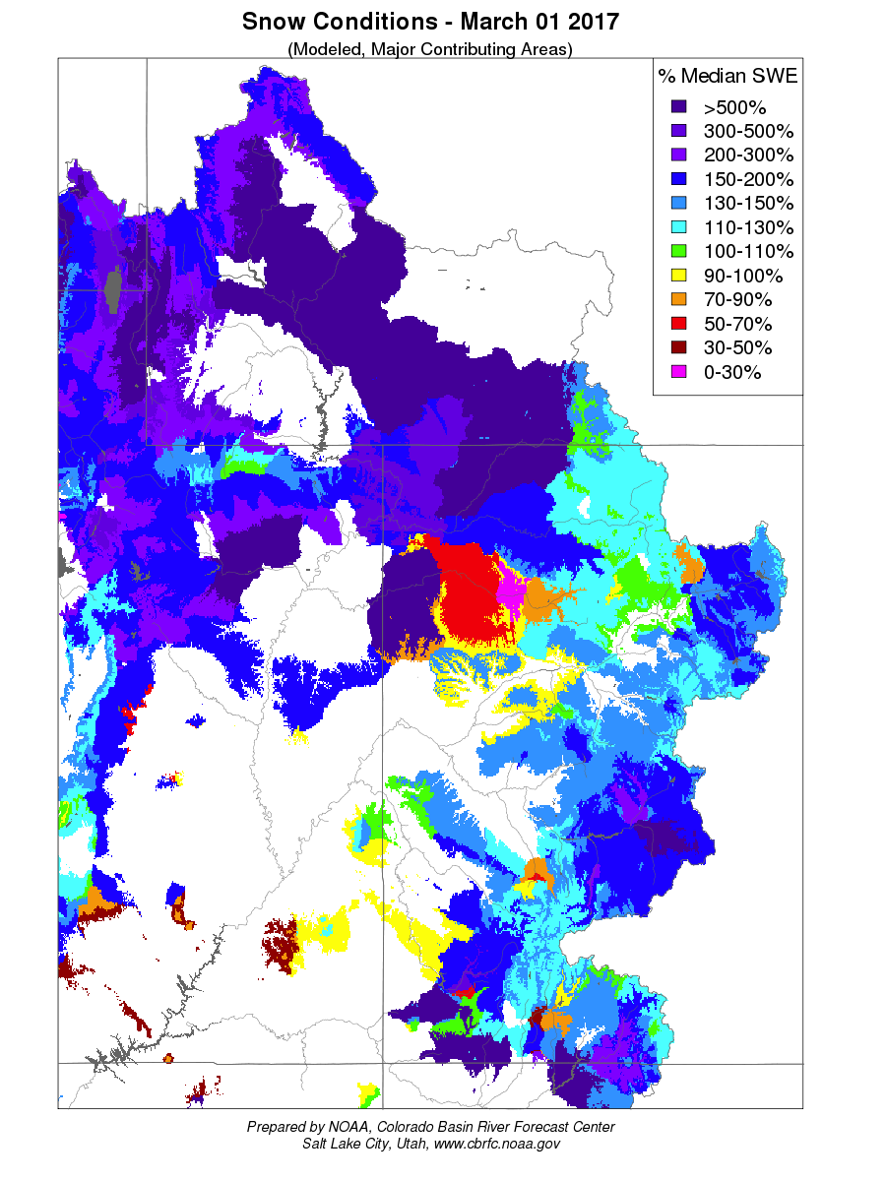
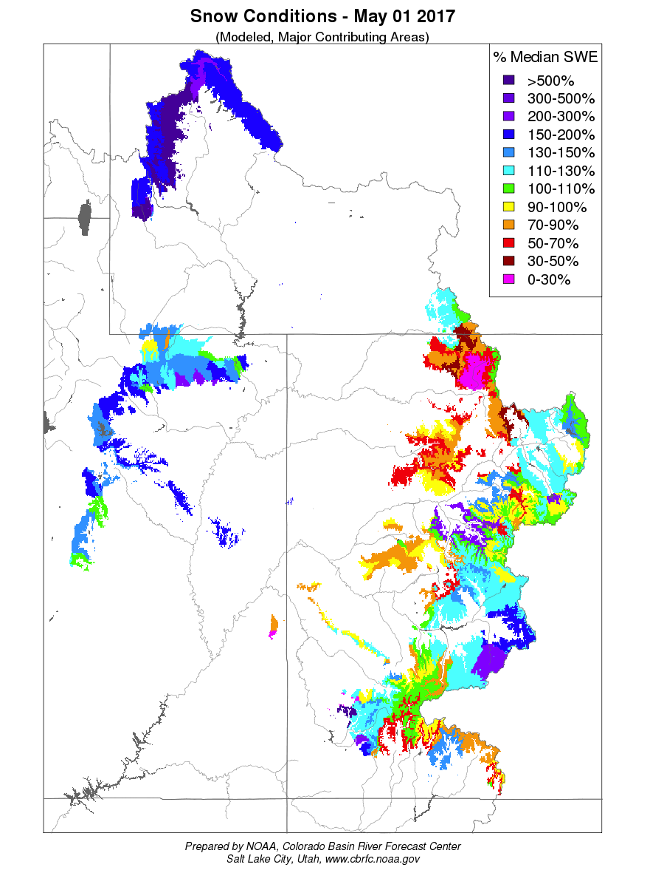
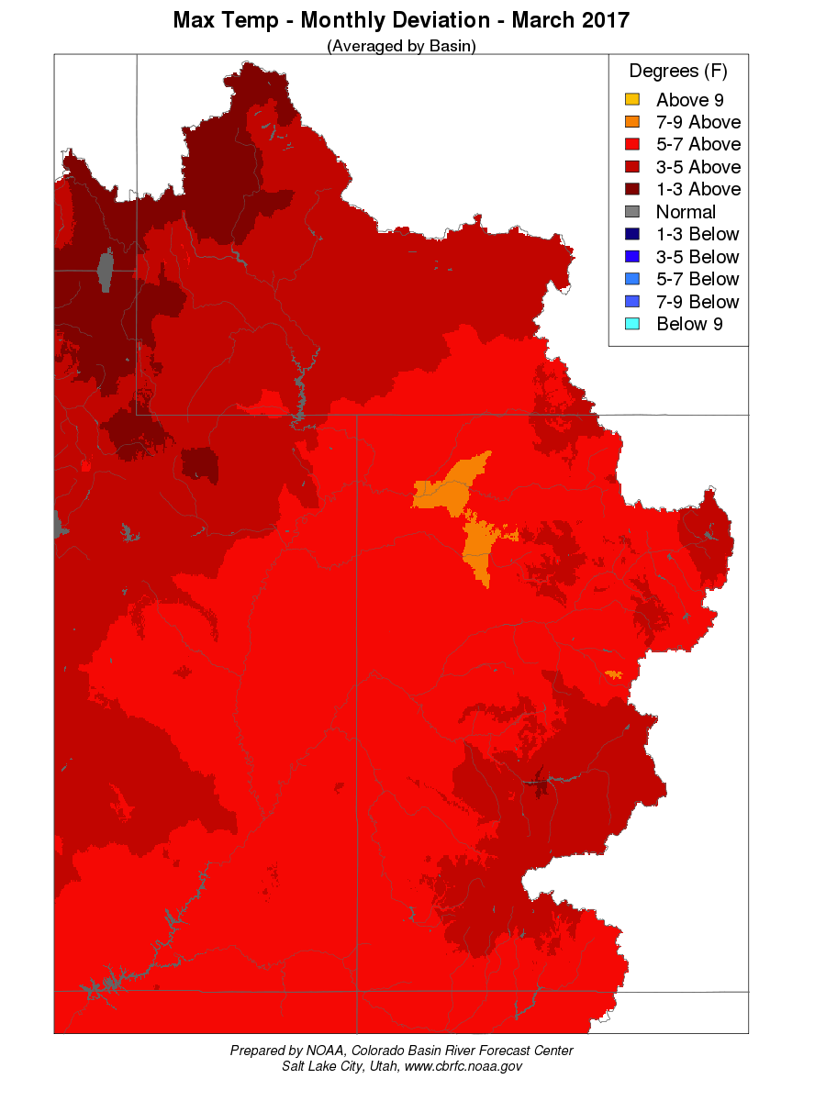
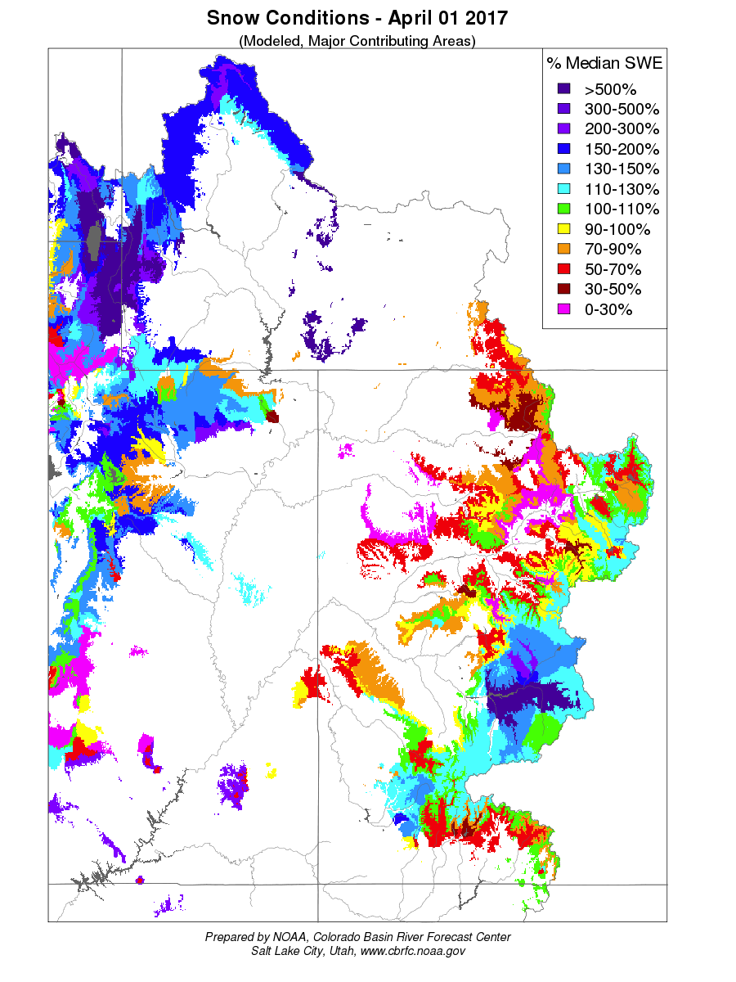
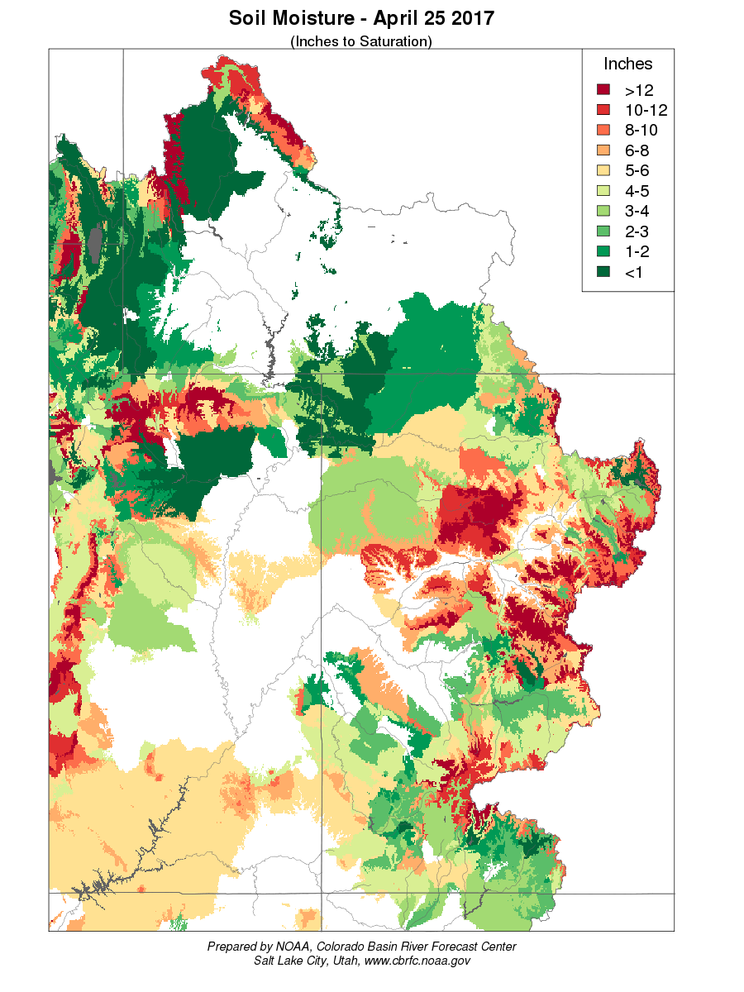
Low Elevation Snowmelt in March/April
Modeled March 1st Snow
March Max Temp Monthly Deviation
Modeled April 1st Snow
Significant low elevation snowpack melted with above normal temperatures in March. Resulted in record streamflows for the month of March and saturated soil conditions.
Lower elevation areas were saturated prior to runoff due to the melt of a significant low elevation snowpack and rain.

Slide 19
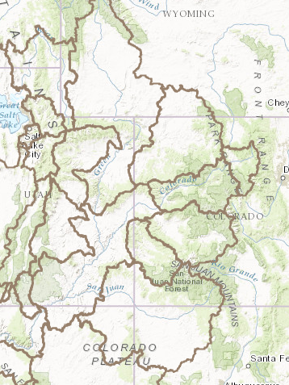
March Weather Impacts: Record March Runoff
River Basin % average streamflow for March
(approximate)
Notable March Volumes
Site (Rank/POR) – Mar Vol KAF / % Avg – old record (year)
Fontenelle (1/52)* 180 / 343% 99 (1986)
Flaming Gorge (1/55)* 400 / 392% 237 (1997)
Granby (1/90)* 9.7 / 206% 9.1 (2015)
Willow Creek (1/98)* 3.1 / 254% 2.3 (1920)
Green Mtn (1/80)* 14.9 / 153% 14.4 (2015)
Colo-Kremmling (1/55)* 52 / 167% 52 (2015)
Blue Mesa (1/49)* 70 / 193% 55 (1951)
Mcphee(2/37) 57 / 270% 59 (1997)
Vallecito (1/76)* 24 / 285% 16 (2007)
Navajo (4/47) 177 / 191% 198 (1995)
Lemon Res(1/54)* 4.1 / 259% 3.8 (1989)
Lake Powell(3/54) 1109 / 167% 1141 (1985)
Upper Green
375%
Yampa
135%
Duchesne
190%
Colorado
130%
Gunnison
120%
Dolores
140%
Lake Powell
167%
San Juan
190%
Many more sites in top 2 or 3 of record
Data is provisional – not all basin stream flow sites included

Slide 20
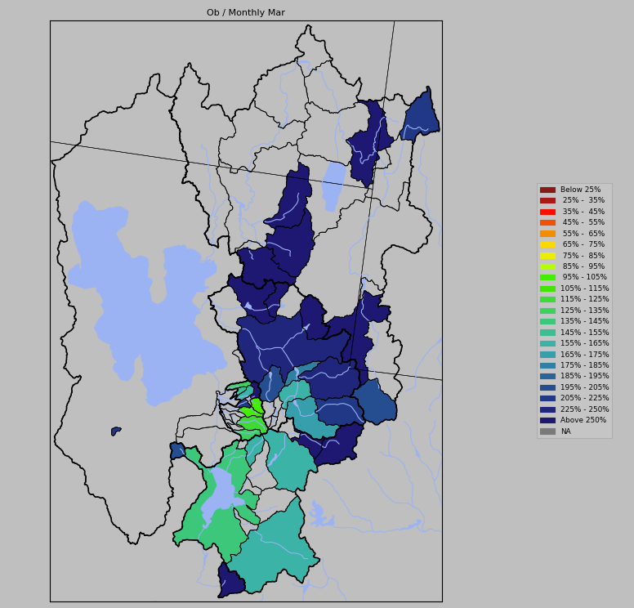
March Weather Impacts: Record March Runoff
March % of Average Unregulated Streamflow for March
Notable March Volumes
Site (Rank/POR) – Mar Vol KAF / % Avg – old record (year)
Bear-UT/WY (1/75)* 5.8 /200% 4.8 (2015)
Smiths Fork (1/75)* 8.8 /224% 6.2 (2015)
Stewart Dam (1/89)* 98 /407% 82 (1986)
Logan River (1/52)* 25 /306% 23 (1986)
Blacksmith Fork (1/99)* 23 /336% 22 (1986)
Little Bear River(1/73)* 29 /380% 24 (1986)
South Fork Ogden (1/94)* 29/400% 25 (1986)
Pineview Inflow (1/79)* 80/330% 72 (1986)
Provo-Woodland(1/52)* 11.6/265% 11.4 (1986)
Provo-Hailstone(1/62)* 18.3/319% 16.5 (1986)
407%
306%
336%
380%
330%
329%
245%
225%
Saturated conditions, warm temperatures, low elevation snowmelt and precipitation resulted in record flows at many locations.
Many more sites in top 2 or 3 of record
200%
123%
155%
Data is provisional
Notes:
Lower elevations of the Bear River Basin in northern Utah and southern Idaho are saturated according to the model.
This area has already experienced some flooding issues and will continue to experience very efficient runoff through the sprin

Slide 21
April Weather Impacts: Record April Runoff
River Basin % average streamflow for April
(approximate)
Notable April Volumes
Site (Rank/POR) – Apr Vol KAF / % Avg – old record (year)
Fontenelle (1/52)* 225 / 264% 180 (1986)
Flaming Gorge (1/55)* 350 / 262% 299 (1969)
Granby (2/90) 26 / 191% 30 (1962)
Willow Creek (2/98) 15 / 357% 16 (1962)
Blue Mesa (1/49)* 145/ 188% 137 (1985)
McPhee(7/37) 95 / 134% 162 (1985)
Vallecito (1/76)* 45 / 192% 42 (2005)
Navajo (8/47) 234 / 138% 392 (1985)
Lemon Res(5/54) 10 / 173% 13 (2005)
Lake Powell(5/54) 1607 / 152% 2708 (1985)
Upper Green
265%
Yampa
105%
Duchesne
200%
Colorado
120%
Gunnison
155%
Dolores
125%
At least 9 sites in Upper Green River and Duchesne basins with records
Many more sites in top 5 of record across the area
Lake Powell
152%
San Juan
145%
Data is provisional – not all basin stream flow sites included

Slide 22
Forecast Verification:
What impacts might we expect from the weather scenario that played out?
Extreme wet conditions Dec-Feb
Anticipate large forecast errors with early season forecasts.
Forecasts too low since precipitation received was much above normal.
Dry and very warm conditions developed by March
Forecasts would trend down in many areas – drier than climatology
Forecast errors may be on the high side some areas.
Impacts of the early snow melt in many areas.
Did we shift some of the April-July runoff into March ?
Did the model handle the melt properly – could impact the accuracy of late
season snow states in the model ?

Slide 23
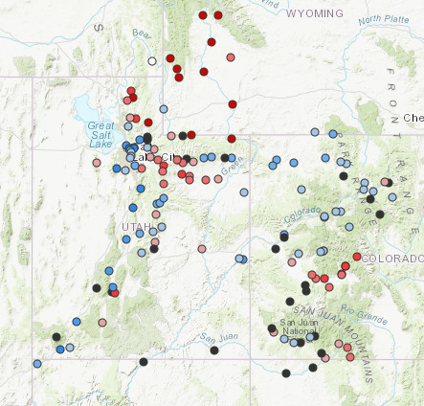
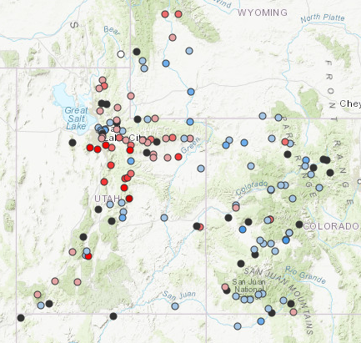
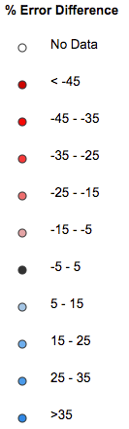
2017 Forecast Verification Map:
January 2017 Verification Map
April 2017 Verification Map
improvement
worse
improvement
Reds – This years forecast higher than ESP historical model error.
Blues – This years forecast lower than the ESP historical model error.
Blacks – This years forecast similar to the ESP historical model error.

Slide 24
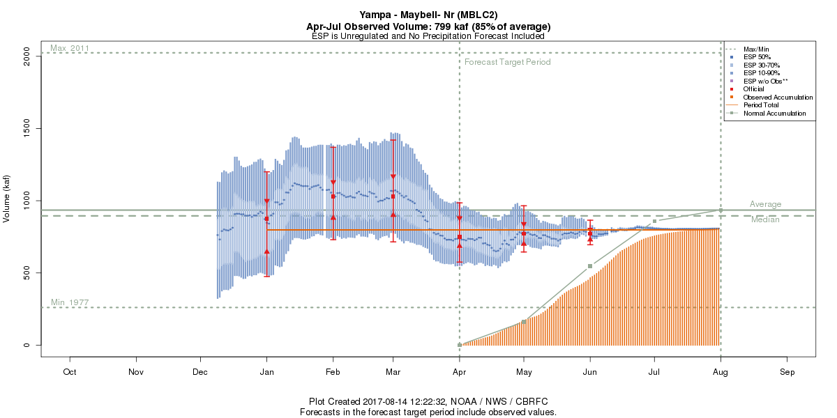
Forecast Verification Plots: So what are we looking for ?
Like to see the observed volume fall within the forecast range (the blue line)
If it does not, it may be due to extreme weather in the future. It may not be a bad forecast. However, It could indicate an error in the model states (snow etc.) or other issues.

Slide 25
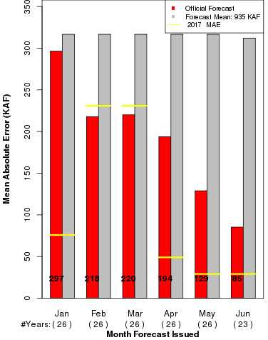
2017 Error Plots: So what are we looking for ?
Mean Absolute Error
Grey Bars – If we just forecast average every month, this would be the historical error.
Red Bars - The historical forecast error. So we do provide information that is better than just going with average.
2017 error in yellow
Worse than the historical forecast error *
Better than the historical forecast error
* does not necessarily mean a bad forecast

Slide 26
2017 Forecast/Runoff Impacts
Upper Green River Basin
Early season forecast errors due to extreme wet weather that followed.
Seasonal forecasts and the model performed very well despite concerns of higher forecast uncertainty due to record conditions
Yampa River Basin
Largest forecast errors were in February and March. Errors were primarily weather related as March was very dry and warm.
Seasonal forecasts and the model performed well with no major adjustments required.
Duchesne River Basin
Largest forecast errors were early and again in May. Extreme wet followed by very dry and warm conditions April-June.
Seasonal forecasts and the model guidance too high. Possible model snow states were a little off but conditions were also very dry later in spring.

Slide 27
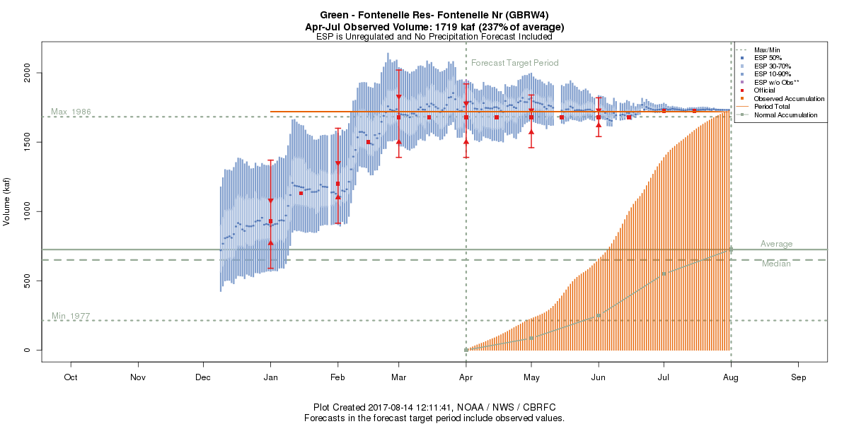
Forecast Evolution Plot: Fontenelle Reservoir Inflow
APRIL-JULY OBSERVED
1719 KAF/237%
Highest on Record
PREVIOUS RECORD=1683 KAF
Flaming Gorge
Mar-Jun weather near normal
Record precipitation Dec-Feb
April-July Observed Volumes
Near record snow + saturated soil conditions +June rain event = record runoff!
Notes:
Focus on uncertainty
-January forecast. Still a chance for below average volumes
-forecast continued to increase- we can’t forecast extremes the model isn’t going ot handle 3 months of record precipitation well

Slide 28
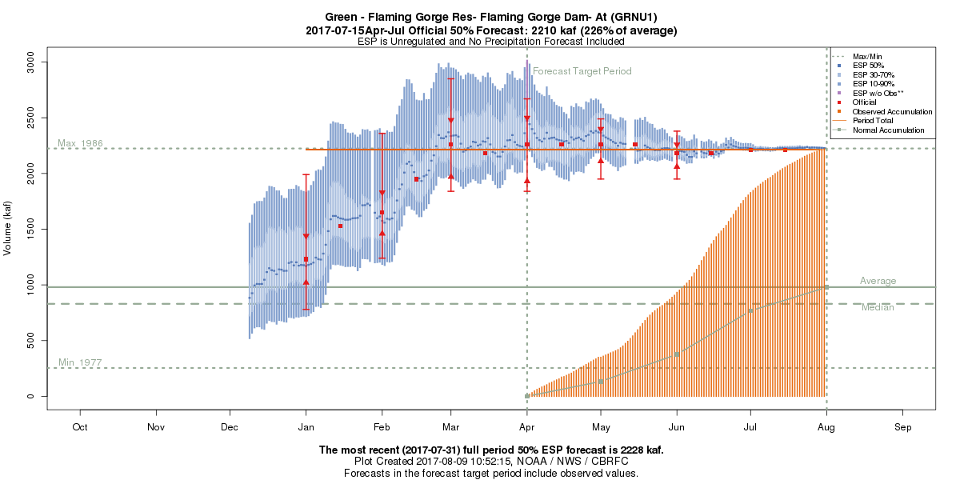
Forecast Evolution Plot: Flaming Gorge Inflow
APRIL-JULY OBSERVED
2214 KAF/226%
2nd Highest on Record
RECORD=2224 KAF (1986)
Flaming Gorge
Mar-Jun weather near normal
Record precipitation Dec-Feb
April-July Observed Volumes
April-July volume impacted more by March warm up and snowmelt.
2017 March-July Observed = 2614 KAF
March-July Record (1986) = 2385 KAF
Notes:
Focus on uncertainty
-January forecast. Still a chance for below average volumes
-forecast continued to increase- we can’t forecast extremes the model isn’t going ot handle 3 months of record precipitation well

Slide 29
Forecast Evolution Plot: Yampa River-Maybell
Wet Dec and Jan
Warm dry March and snowmelt
Average Apr-May weather
APRIL-JULY OBSERVED
799 KAF/85%
Flaming Gorge
*231%
1030 KAF
110%
750 KAF
80%
152%
*Record volume forecasted

Slide 30
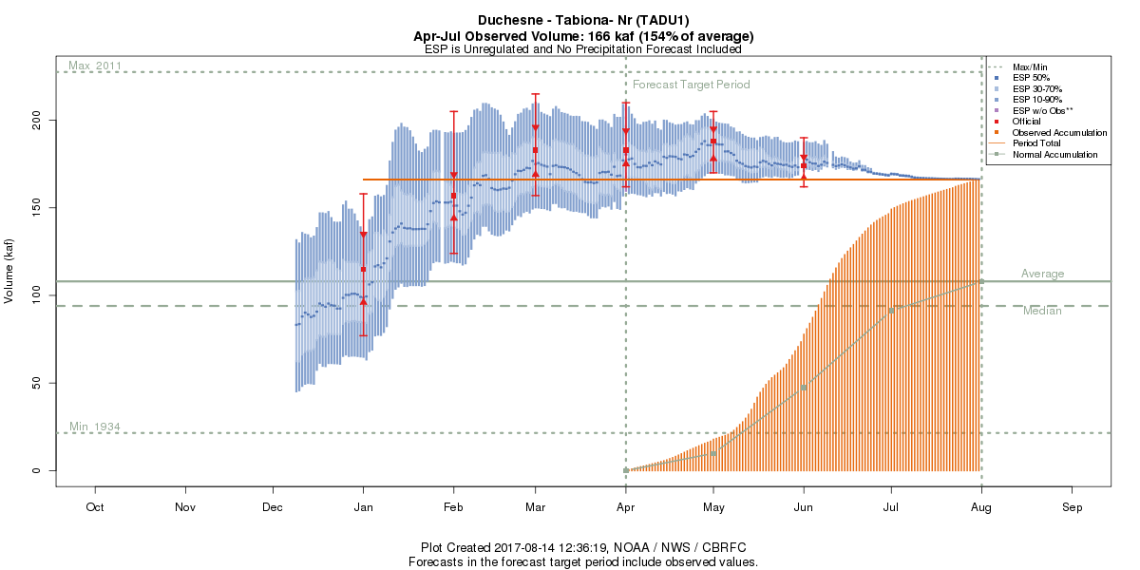
Forecast Evolution Plot: Duchesne River-Tabiona
Storm prior to/during water supply then dried out…..
APRIL-JULY OBSERVED
167 KAF/155%
Below average precip
*231%
Record precipitation Dec-Feb
Forecasts were too high from March on.
Conditions were dry but model snow states may have been off.

Slide 31
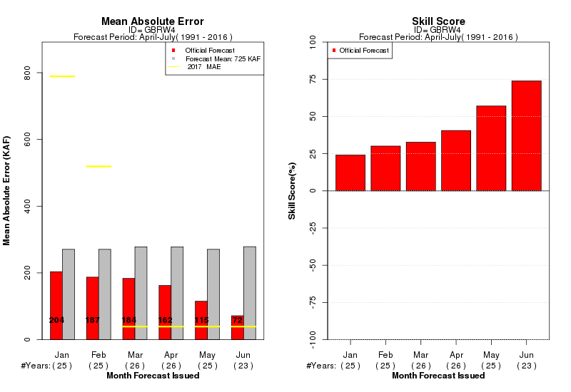
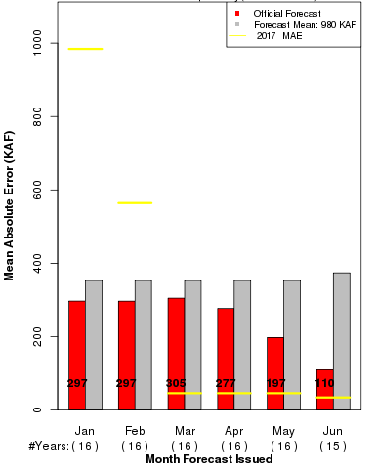
Forecast Verification: Fontenelle and Flaming Gorge Inflows
Fontenelle Reservoir Inflow
Flaming Gorge Reservoir Inflow
Flaming Gorge
Notes:
Focus on uncertainty
-January forecast. Still a chance for below average volumes
-forecast continued to increase- we can’t forecast extremes the model isn’t going ot handle 3 months of record precipitation well

Slide 32
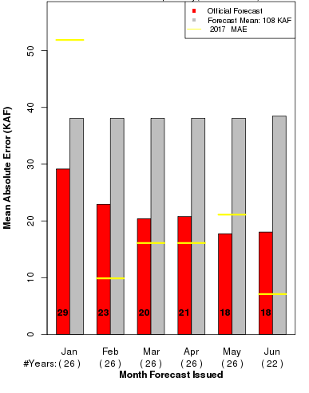
Forecast Verification:
Yampa - Maybell
Duchesne - Tabiona
Flaming Gorge
*231%
152%
*Record volume forecasted

Slide 33
2017 Forecast / Runoff Impacts
Colorado River Headwaters
Early season forecast errors were better than usual. Forecast errors increased above historical errors most likely due to snow state issues as well as the dry warm March.
Farther downstream (Colorado-Cameo) forecast errors were minimized as upstream errors (too high, too low) cancelled each other out.
Model performed as expected. Issues with the snow states have been identified as due to data limitations. The use of newer SNOTEL sites, once they have a sufficient record, may result in better snowpack representation.

Slide 34
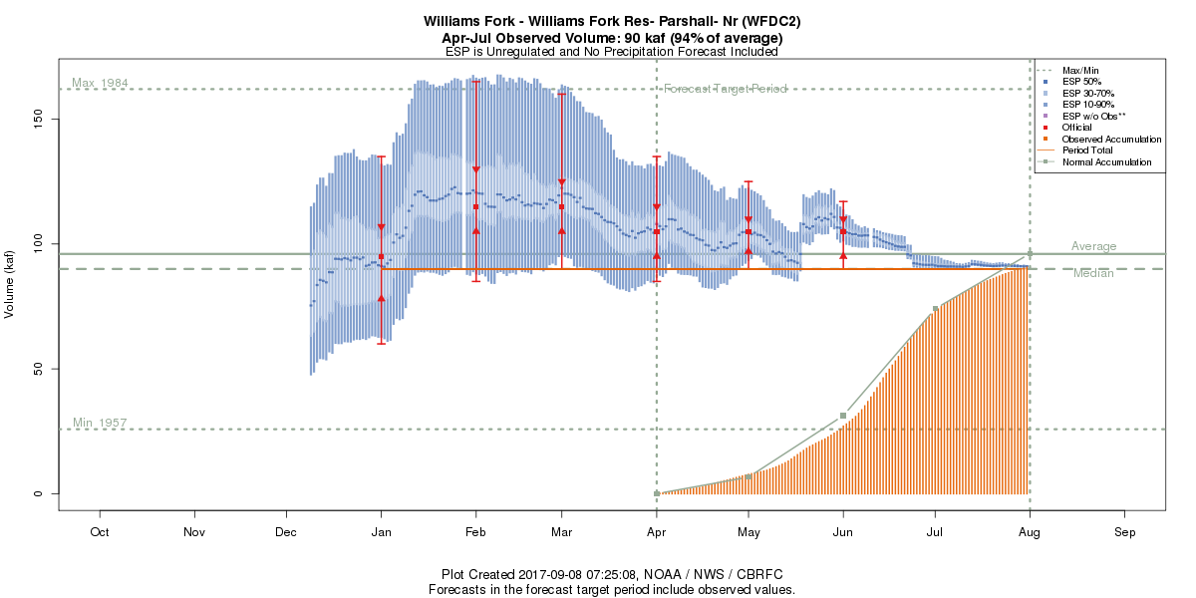
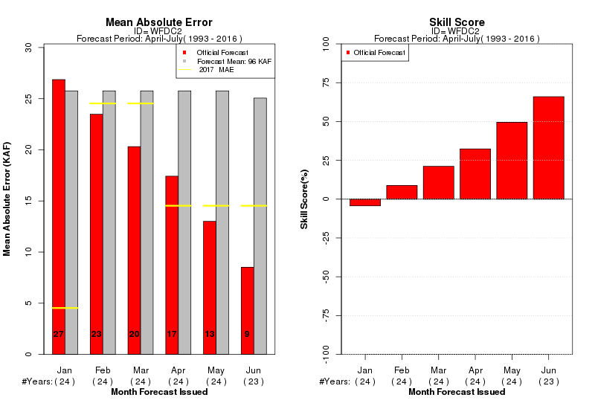
Forecast Evolution Plot: Williams Fork Reservoir
May storm, too much precipitation indicated
Best forecast
APRIL-JULY OBSERVED
90 KAF/94%
Warm, Dry, Snowmelt
Williams Fork was the highest forecast (as a percent of average) in the area.
Snow States / Data availability issue

Slide 35
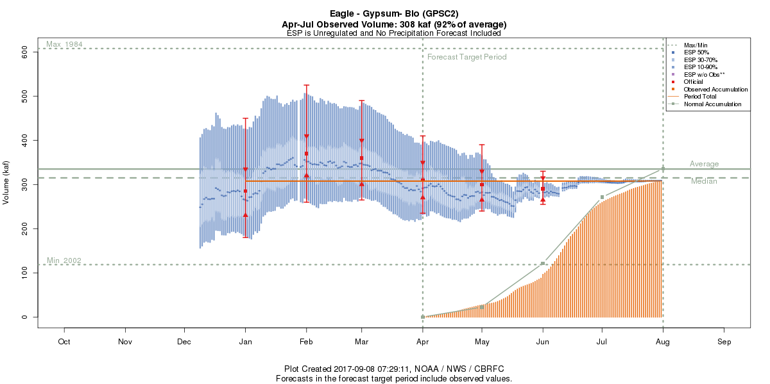
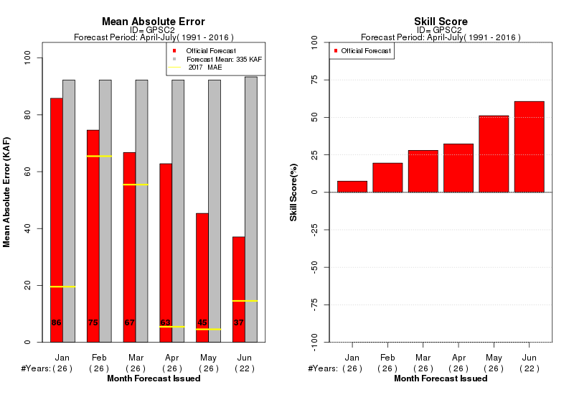
Forecast Evolution Plot: Eagle Bellow Gypsum
APRIL-JULY OBSERVED
308 KAF/92%
Warm, Dry, Snowmelt
Model performed rather well. Observed volumes fell within the 10/90 forecast range throughout the season.

Slide 36


Forecast Evolution Plot: Ruedi Reservoir Inflow
APRIL-JULY OBSERVED
140 KAF/101%
Model tends to have a low bias. This may be a candidate for recalibration.

Slide 37
2017 Forecast/Runoff Impacts
Gunnison
Largest errors were at the beginning of the season. Errors climbed above historical errors late in the season.
Early season errors were explained by the extreme wet weather that followed. Late season errors were due to inaccurate model snow states at the highest elevations. Too much snow melted out of these areas in the model during the very warm periods earlier in spring.
Dolores
Largest errors were February – April, above historical error. These improved later in the season.
Forecast error was easily attributed to a record / near record snowpack that developed early to be followed by very dry and warm conditions March-April.
San Juan
Early season errors due to wet weather that followed. Some late season errors due to snow states at high elevations too low. Animas and eastern tributaries of the San Juan River.

Slide 38


Forecast Evolution Plot: Blue Mesa Inflow
Late season snow adjustment
APRIL-JULY OBSERVED
915 KAF / 136%
Warm, Dry, Snowmelt
Record precipitation Dec-Feb
Increase in error (compared to historical) late in season. Not enough snow at high elevations of the model

Slide 39


Forecast Evolution Plot: McPhee Reservoir Inflow
Warm, Dry,
Snowmelt
APRIL-JULY OBSERVED
346 KAF / 117%
Model performed well. No significant adjustments to model states were necessary. Another dry warm spring had significant impacts on evolving forecasts and runoff.

Slide 40


Forecast Evolution Plot: Vallecito Reservoir Inflow
APRIL-JULY OBSERVED
214 KAF / 110%
Very wet Dec-Feb
Forecast declined due to dry March-April. May was wetter. Model performed very well with consistent forecasts mid March forward

Slide 41


Forecast Evolution Plot: Navajo Reservoir Inflow
Model state adjustment to add snow
APRIL-JULY OBSERVED
778 KAF / 106%
Early season error due to wet weather that followed. Late season error was due to a model snow states being too low in eastern headwaters of the San Juan. (Rio Blanco,Navajo).

Slide 42


Forecast Evolution Plot: Lake Powell
APRIL-JULY OBSERVED
8174 KAF / 114%
10400
145%
9600
134%
9300
130%
8800
123%
8300
116%
6500
91%
Reflected the basin as a whole with early season errors due to wet weather that followed. Forecasts decreased due to warm dry March-April. Overall model performed as expected. Largest error was in March.

Slide 43
2017 Forecast/Runoff Impacts
Eastern Great Basin
Errors greater than historical existed throughout the forecast season for many sites. Largest errors were early in the season and again in March
Several things contributed to forecast errors larger than the historical errors. Early season errors can be attributed to the extreme wet conditions that followed. Significant snow at lower elevations melted in February and early March due to warm temperatures. Saturated soils and flooding was the result. Models most likely struggled with soil moisture states as well as how much high elevation snow remained later in the season.
Sevier
Errors a little above the historical error Feb-May, however historical errors are generally small in the spring. The dry spring weather may have resulted in a little too much melt out of high elevation snow in the model
Virgin
Forecast errors were below the historical error throughout the season.

Slide 44


Forecast Evolution Plot: Pineview Reservoir Inflow
APRIL-JULY OBSERVED
178 KAF / 158%
Warm, Dry, Snowmelt
Record wet Dec-Feb
Forecast error was above historical throughout the season. The extreme back and forth weather had a large impact. Model snow states may have been too high.

Slide 45


Forecast Evolution Plot: Weber River at Oakley
APRIL-JULY OBSERVED
163KAF / 138%
Model performed much better at this higher elevation site.

Slide 46


Forecast Evolution Plot: Sevier River at Hatch
Not enough
snow in model
APRIL-JULY OBSERVED
58 KAF / 121%
Historical errors are low here. Model performed fairly well but may have melted too much high elevation snow during the warm March-April period.

Slide 47


Forecast Evolution Plot: Virgin at Virgin
APRIL-JULY OBSERVED
85 KAF / 112%
A good forecast throughout as the forecast / model error was lower than the historical error.

Slide 48
2017 Forecast / Runoff Impacts
Lower Colorado – Little Colorado, Gila, Salt, Verde
Forecasts are developed based on current snowpack, soil moisture conditions, ENSO (El Nino outlook), and short term rainfall outlook. Snowpack plays a role but the winter rain events are what really generates the seasonal volumes.
Above average observed Dec-Feb. Weak La Nina conditions gave way to weak El Nino conditions By February. Forecasts correctly called for above median volumes as the season progressed.
Notice the forecast range is quite large, anticipating the potential of winter rain events. A wet period from mid January into February had the largest impact on the forecasts.

Slide 49


Forecast Evolution Plots: Lower Colorado River Basin
Jan-May OBSERVED
458 KAF / 156% median
Jan-May OBSERVED
158 KAF / 282% median

Slide 50


Wrapping things up….
2017 observed
April-July runoff volumes
Percent of Average

Slide 51


Upper Green Snow (Modeled May –July) – Late Melt !
CBRFC MODEL SNOW (% median )
Significant Runoff Areas
May 1
June 1
July 1
March/April warm up did not impact high and mid elevation snow. Significant snow remained through July. Diurnal snowmelt pattern was seen well into summer.
Notes:
Melt pattern. Snotels melted out by 6/1

Slide 52

Potential data issues due to deep snow
Very deep snow in places this year impacted SNOTEL precipitation gages.
Issues with precipitation gage. Estimated during winter. May have resulted in model/snow state issues?
Hard to say how significant but impacts to model snow states were possible.

Slide 53


New SNOTEL sites will provide an opportunity to improve model calibrations
Williams Fork Reservoir Basin
SITES WITH 30+ YEARS
ALL SITES
11,150 FT
11,300 FT
8,940 FT
10,400 FT
9,400 FT
11,100 FT
JNPC2 installed 2000
MFKC2 installed 2002
FCVC2 installed 2012

Slide 54
2017 Forecast Review / Verification Summary
2017 had a little bit of everything – we learn a lot in years like this
We felt we could account for the majority of errors that occurred in the 2017 forecasts
  Extreme weather in the future
    Not much can be done pending more advanced / accurate meteorological guidance
    Adding additional years when recalibrating – wider range of forecast possibilities
    Communicating the situation, uncertainties, and possibilities continue to be important
  Late season high elevation snow not represented well by the model in some areas
    Verify model is handling early season snow melt correctly.
    Attempting to take advantage of newer SNOTEL sites as soon as realistic to do so.
    Working to best use potential satellite snow products (ongoing projects with JPL)
In many ways the model performed very well
  Upper Green River Basin of Wyoming
2018 improvements
  Expand Great Basin calibration period to 35 years (1981-2015)
  Add additional stream forecast segments to the model in the Gunnison Basin
Feedback is always welcome - We are happy to discuss any specific forecast with you.
A first look at 2018 is scheduled for Thursday December 7th at 11 am MT. Please go to cbrfc.noaa.gov and follow the webinars link to register.

