Slide 1
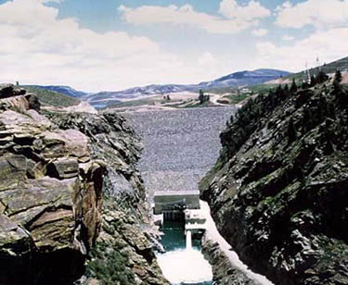
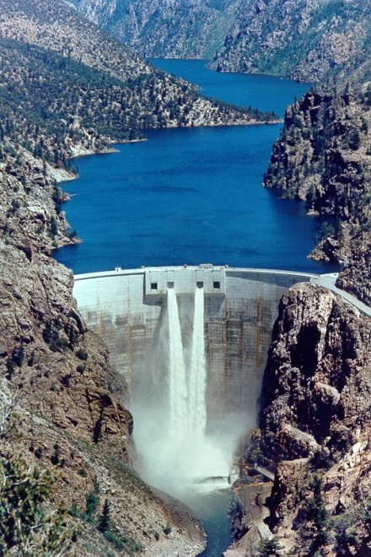
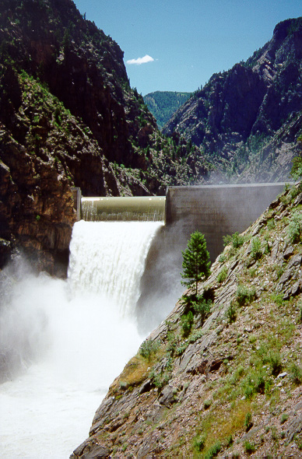
Aspinall Operations
2011

Slide 2
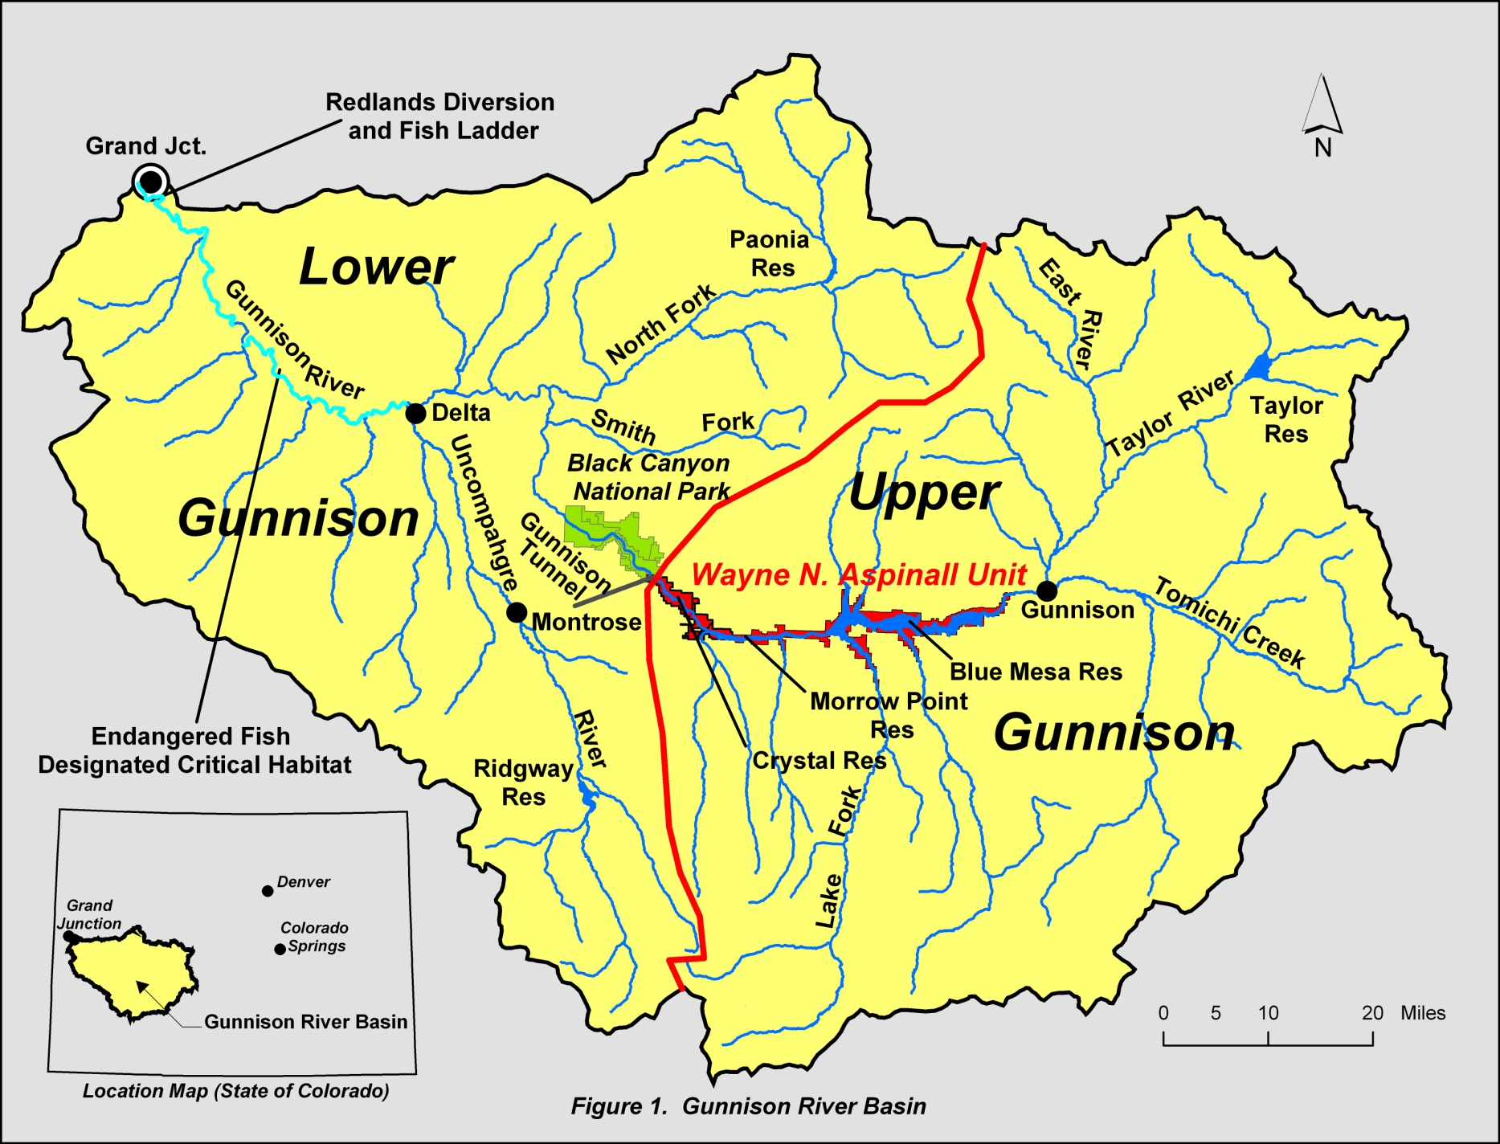

Slide 3
Operational Considerations
Aspinall Unit Purposes
Water storage / Compact Development
Power Production
Flood Control
Downstream Flow Requirements - including Senior Water Rights, timing side-inflows
Target Elevations
Future ESA flow targets
Other - Including Recreation and Safety

Slide 6
Why was there a jump in the forecast from 800 Kaf on April 15 to 945 Kaf on May 1?

Slide 7
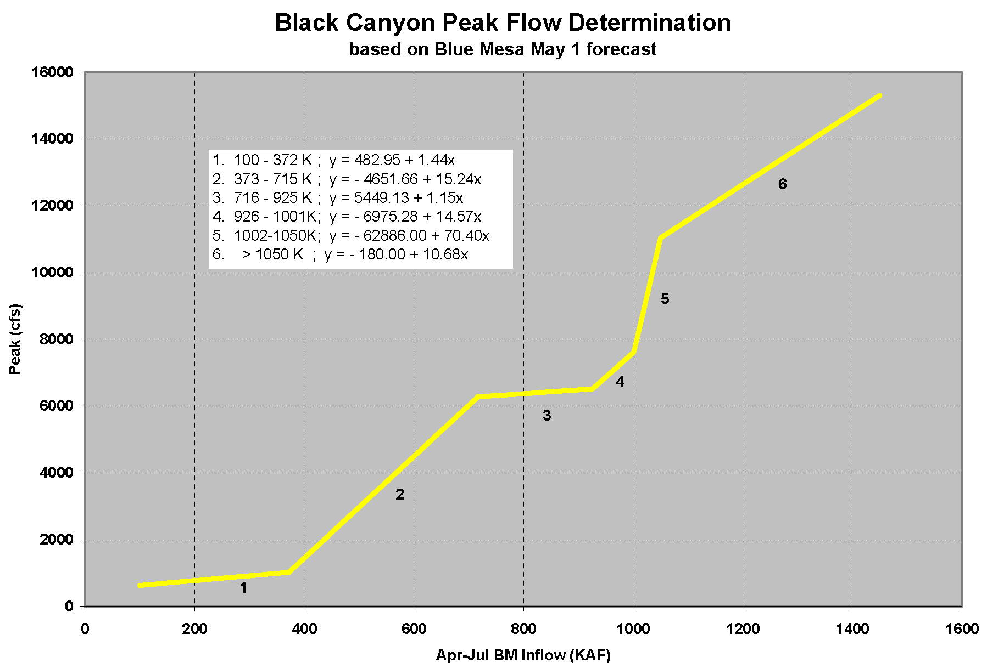
6793 cfs
Actual 24 Hr Peak
7180 cfs
May 1 Forecast
945 KAF

Slide 8
2011 Spring Operational Goals
Black Canyon Water Right
One Day Peak Target 6,793 cfs
85 Day Inundation Flow 879 cfs
ESA Peak Flow at Whitewater
14,350 cfs (10 days in EIS)
8,070 cfs (40 days in EIS)
<14,000 cfs at Delta, CO
Safe Ramping Rates
Fill Blue Mesa

Slide 11
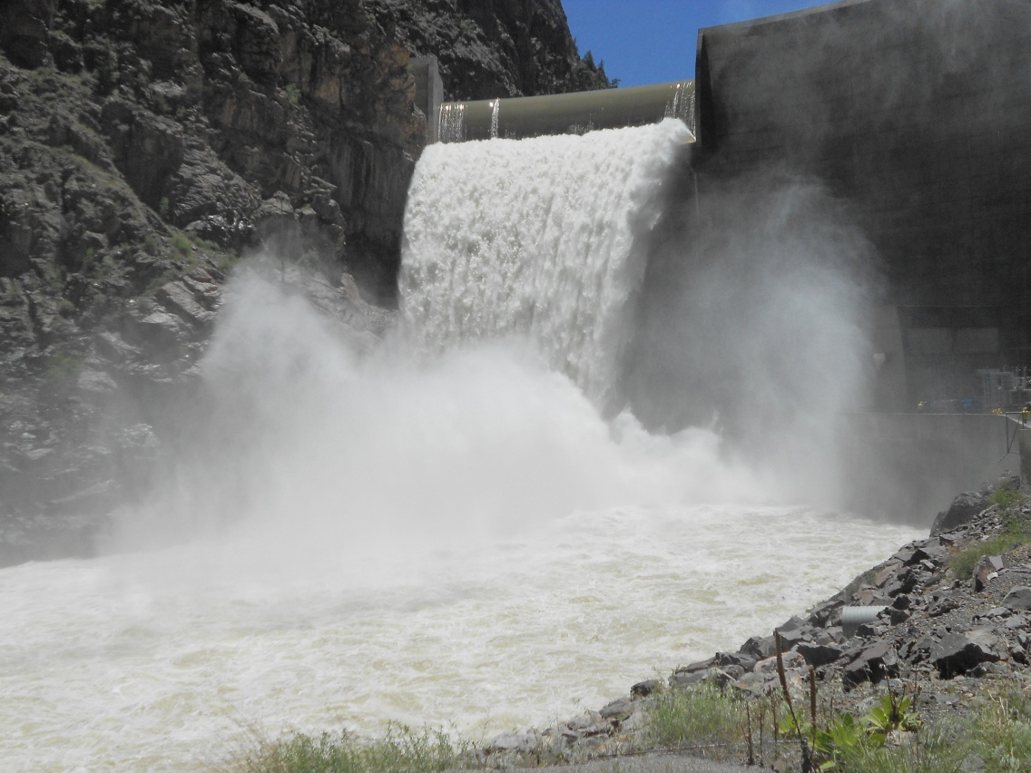

Slide 12
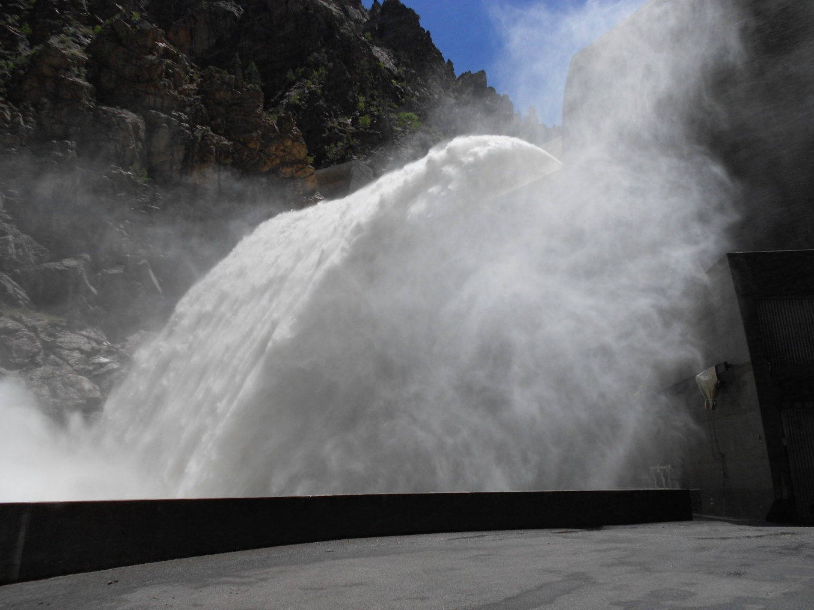

Slide 13
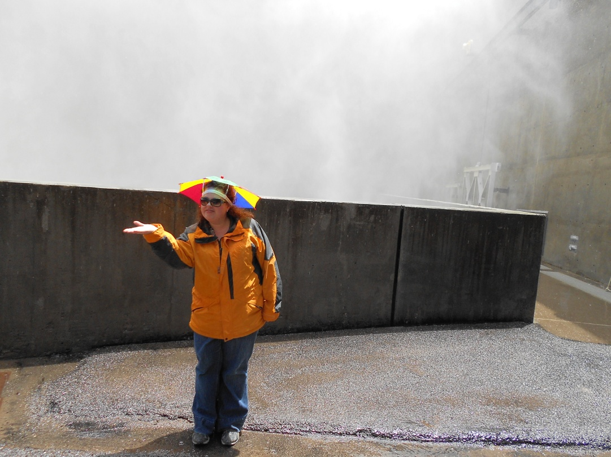

Slide 14
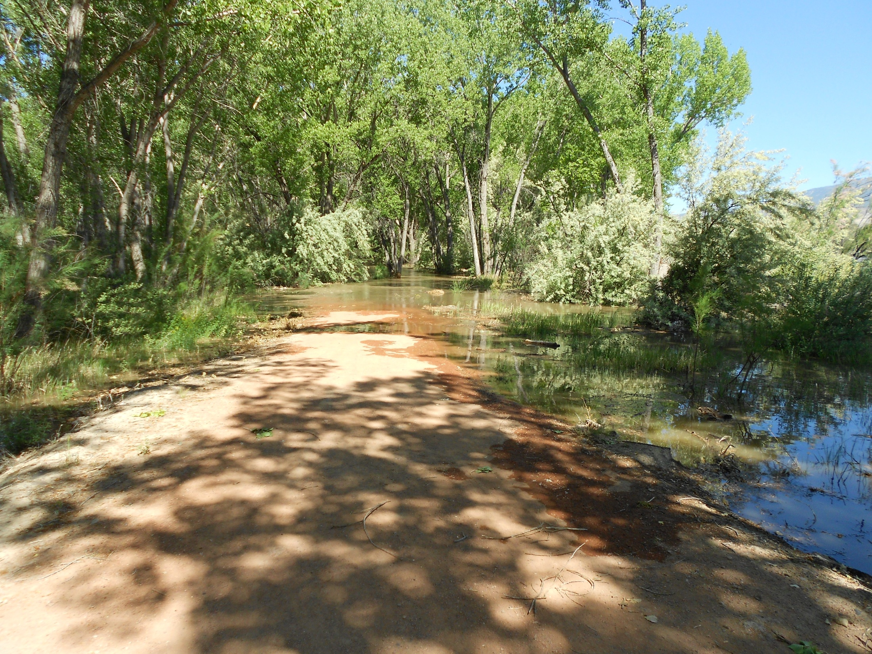

Slide 15
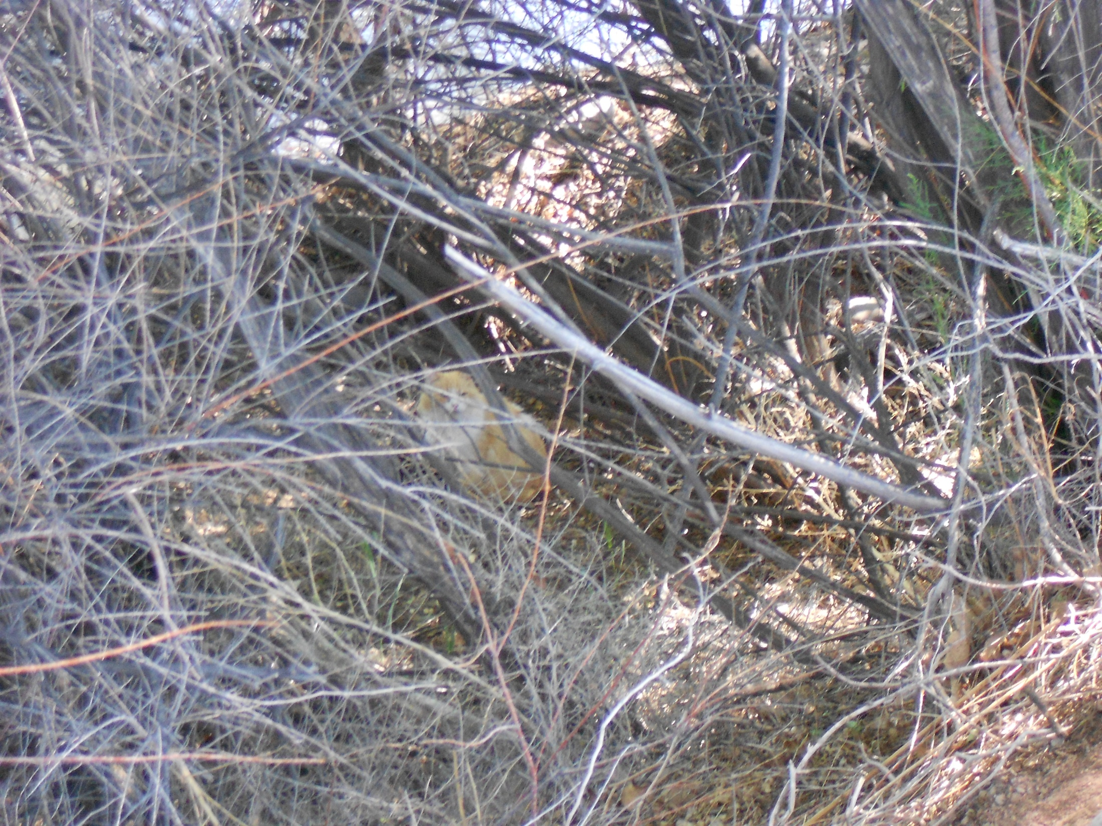
I’m safe and dry!!

Slide 17
Given the amount of rainfall in the upper Gunnison Basin in early July , why did the CBRFC daily model under-forecast inflows to Blue Mesa Reservoir for the first 2 weeks of July?
Blue Mesa Inflow

Slide 18
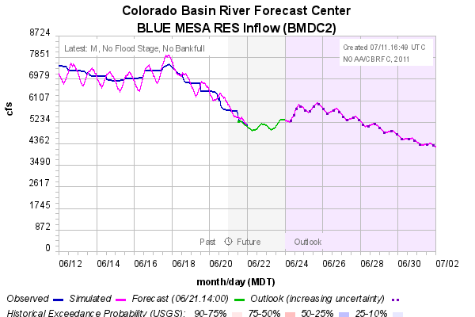

Slide 19
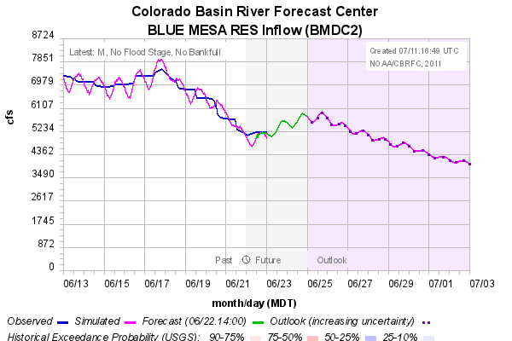

Slide 20
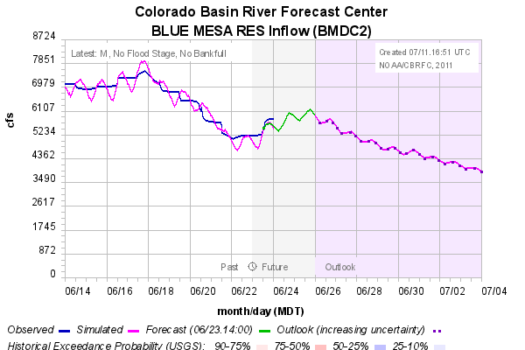

Slide 21
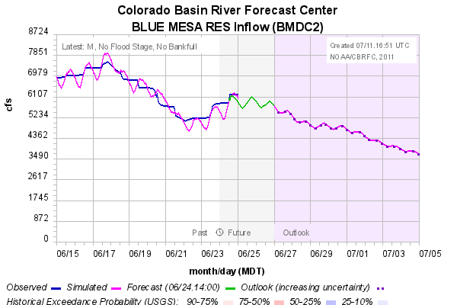

Slide 22
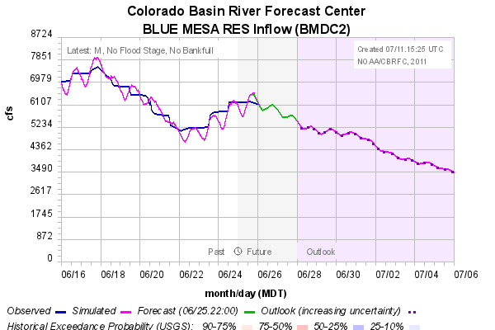

Slide 23
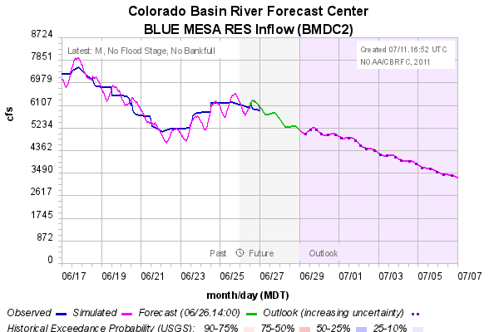

Slide 24
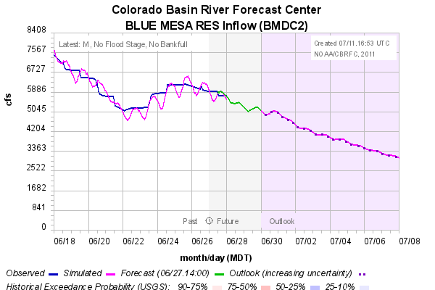

Slide 25
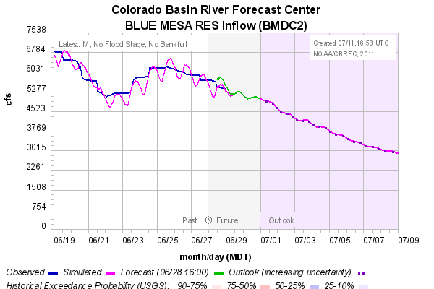

Slide 26
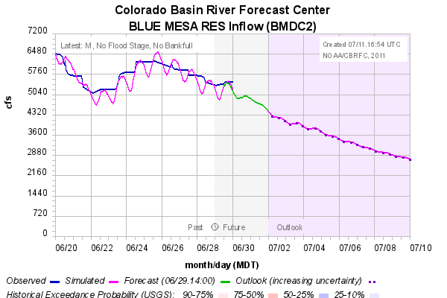

Slide 27
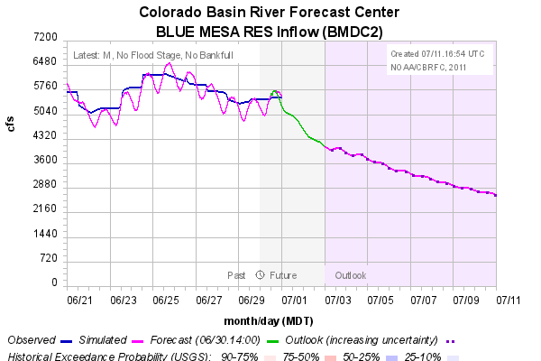

Slide 28
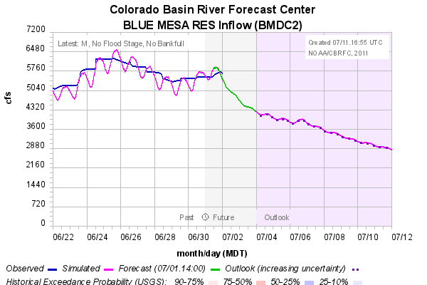

Slide 29
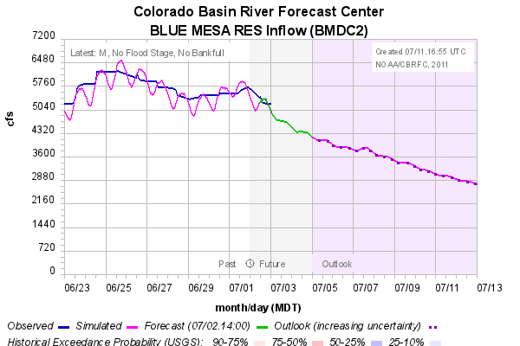

Slide 30
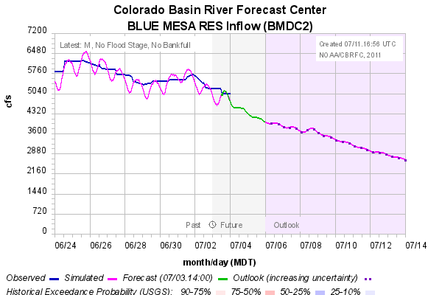

Slide 31
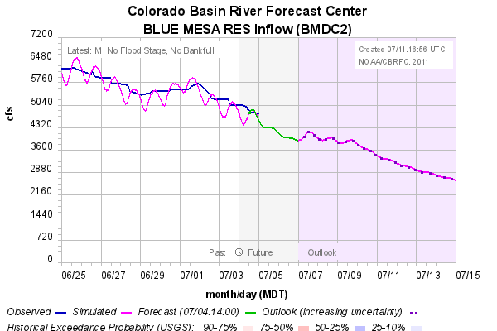

Slide 32
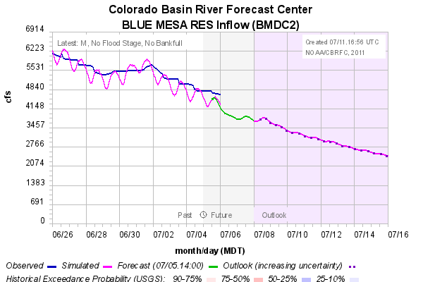

Slide 33
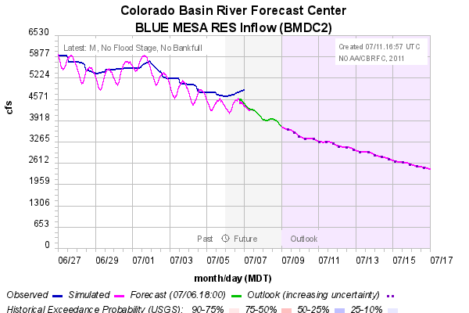

Slide 34
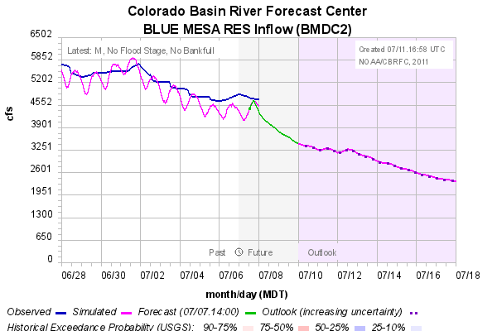

Slide 35
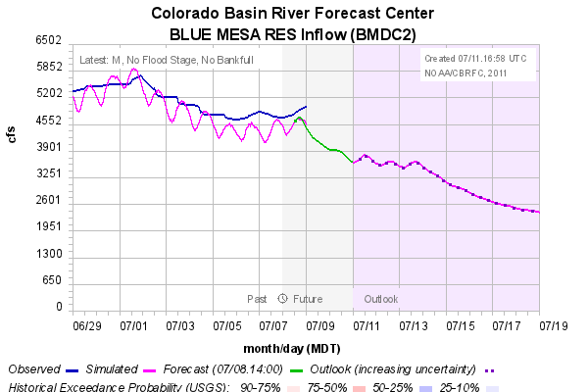

Slide 36
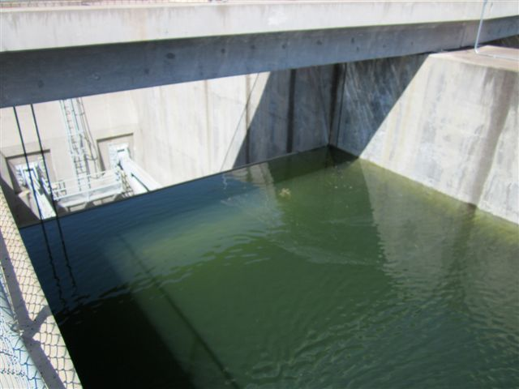

Slide 37
Lots of Water!
Lots of Concerns….. Complaints?
Concerns from the fishing community
Black Canyon peak is too high
Black Canyon peak is occurring too late
Don’t increase flows during the rainbow trout emergence
No high flows around the Stonefly hatch!
Concerns from the rafting community
Timing with the Cimarron River causes the river to fluctuate
More advanced notice when operation plans will change
Operation plans change too often
River flows are fluctuating too often, there needs to be more consistency
There is no accountability with these operation plans, they can change at any time!
If we can’t tell our clients what the river conditions will be, we look bad

Slide 38
Sources of Forecast Error
Precipitation forecasts (5 days into future) - Forecasting summertime convection is extremely challenging. Precip forecasts can be very generalized and may not specify locations of heavy rainfall.
Precipitation Estimation – Precipitation observation network in Gunnison Basin probably underestimated July precip. Result of relatively sparse network of rain gauges and long distance from nearest weather radars.
EvapoTranspiration (ET) - Cloud cover during monsoon also affects ET rates. ET modeled as a constant for some times of the year.
Snow – Possibly more snow in higher parts of the basin than what was modeled. Difficult to accurately model snow at end of season. May have been easier to determine and correct without all the rain.

Slide 39
Sources of Forecast Error
Precipitation forecasts (5 days into future) - Forecasting summertime convection is extremely challenging. Precip forecasts can be very generalized and may not specify locations of heavy rainfall.
Precipitation Estimation – Precipitation observation network in Gunnison Basin probably underestimated July precip. Result of relatively sparse network of rain gauges and long distance from nearest weather radars.
EvapoTranspiration (ET) - Cloud cover during monsoon also affects ET rates. ET modeled as a constant for some times of the year.
Snow – Possibly more snow in higher parts of the basin than what was modeled. Difficult to accurately model snow at end of season. May have been easier to determine and correct without all the rain.
What do we need?
More Data! (snotels, rain gauges, snowcams, etc…we’ll take anything)

Slide 40
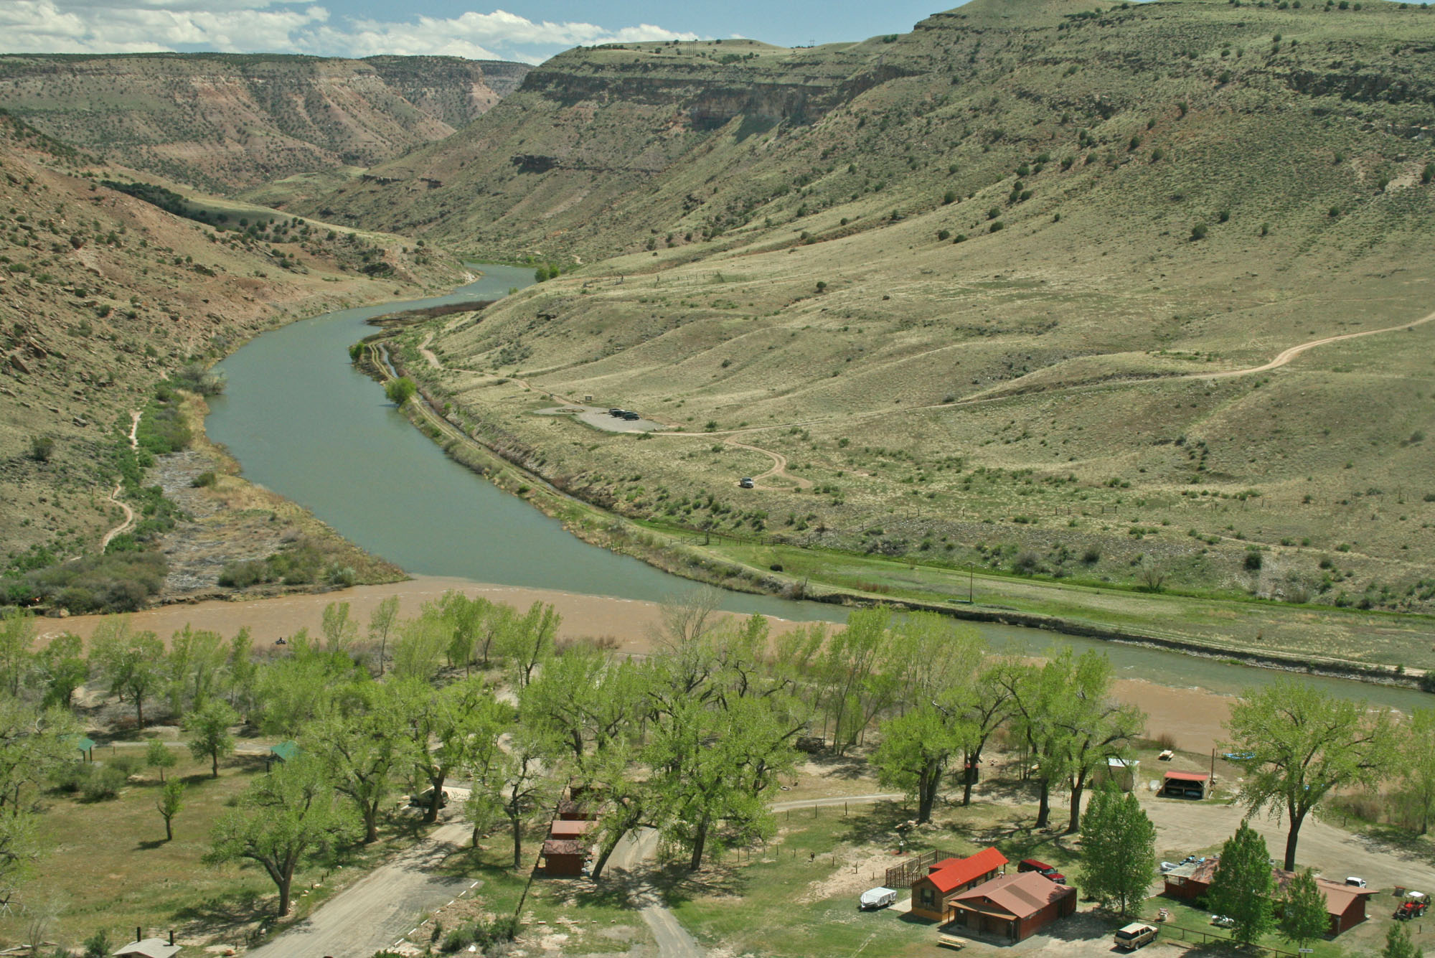
May 15th

Slide 41
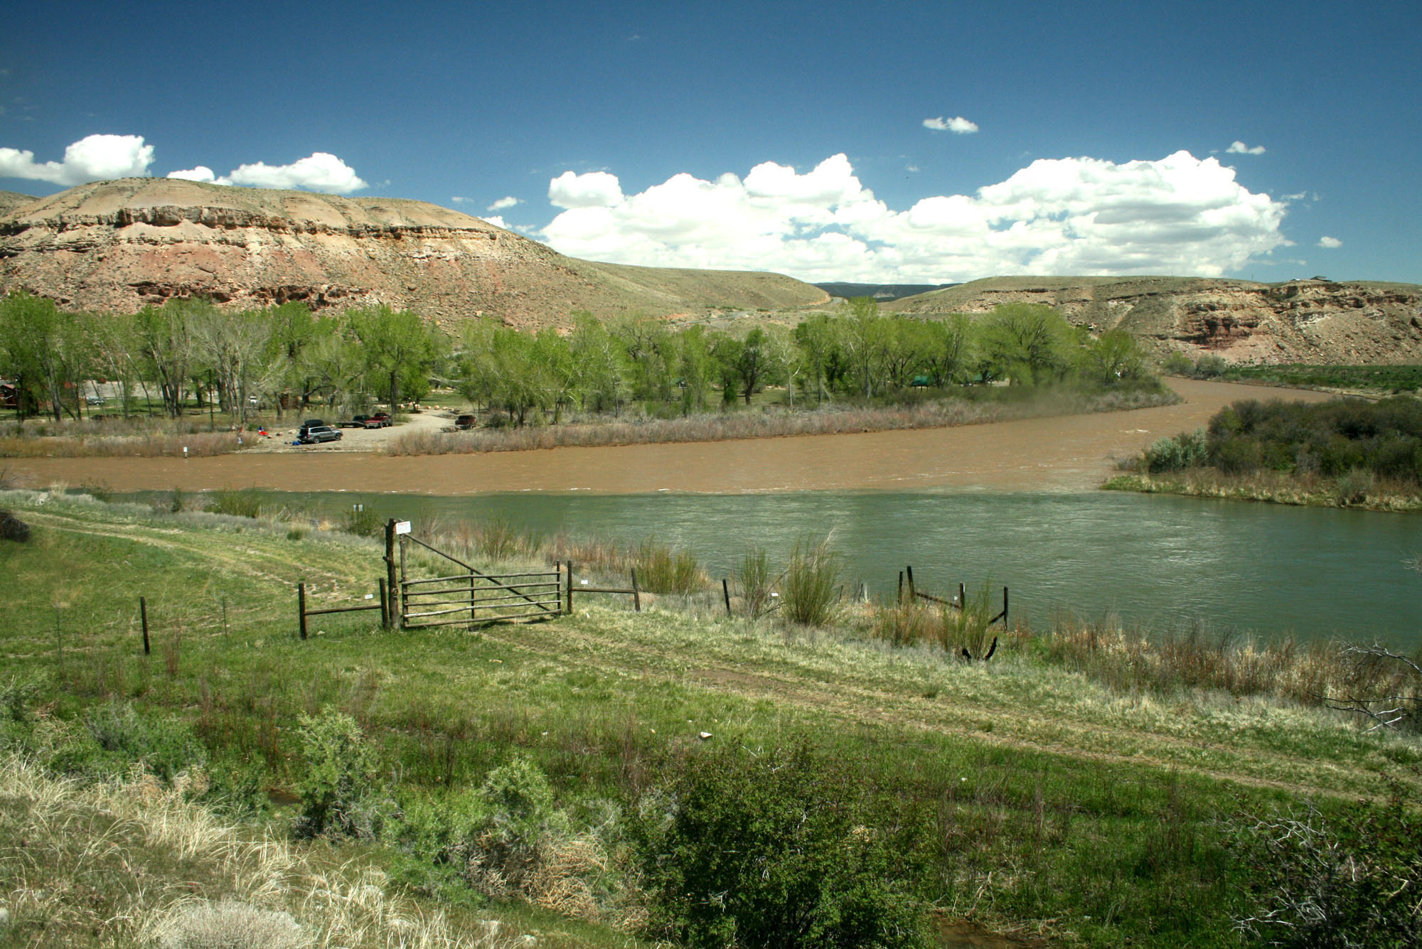
May 15th

Slide 42
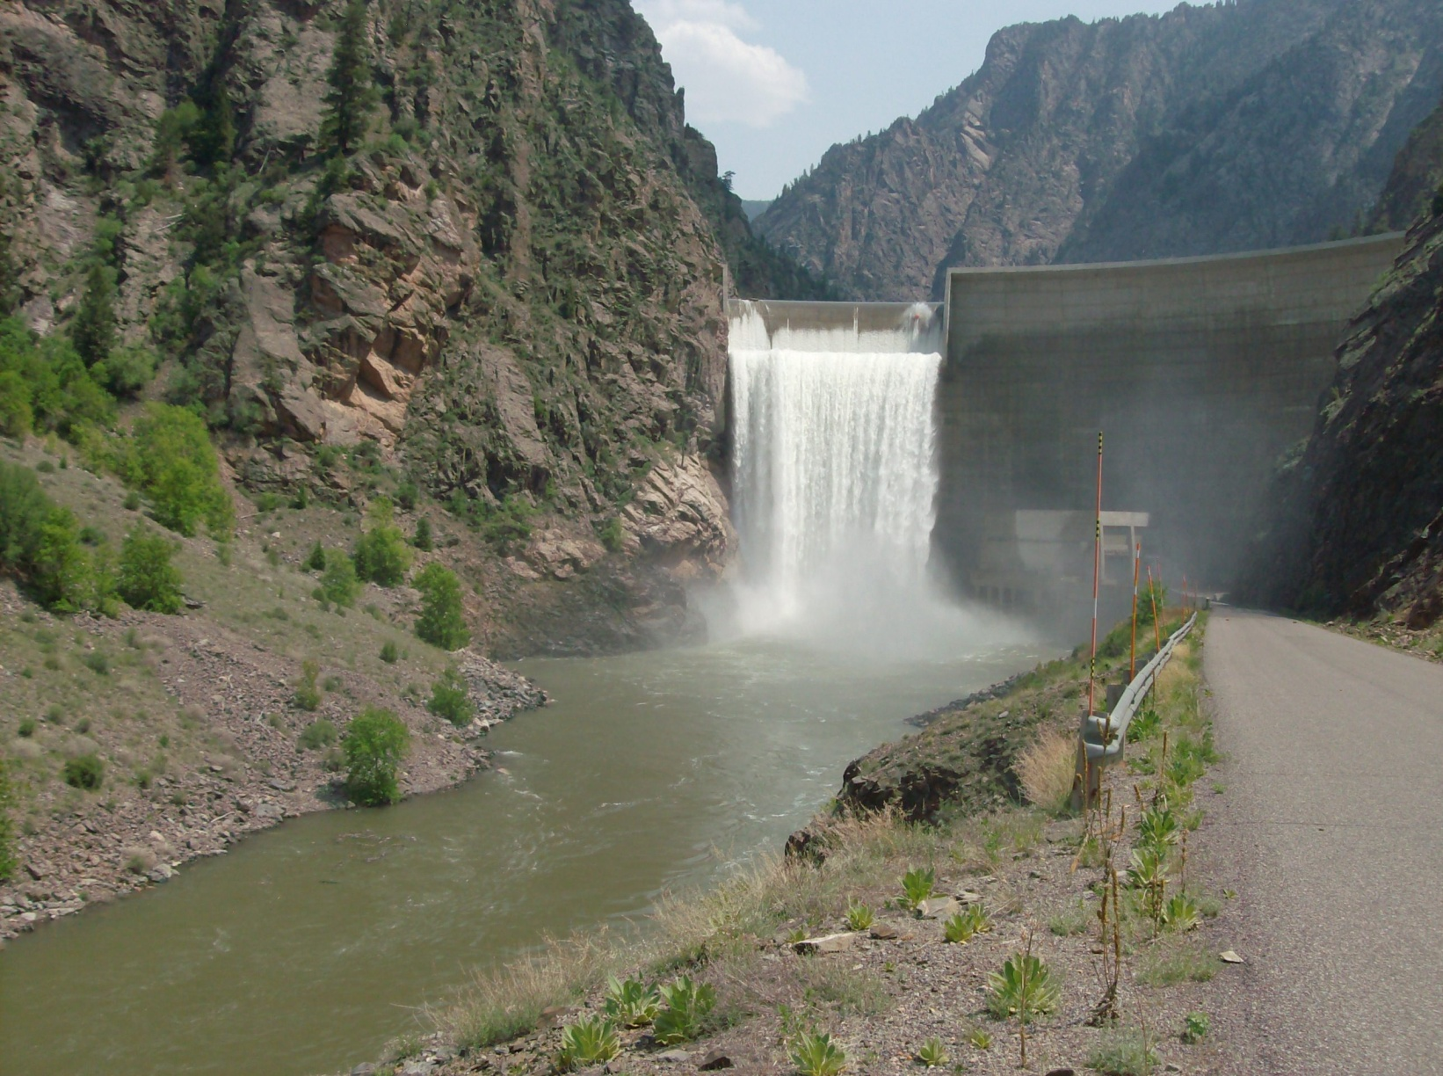
http://www.usbr.gov/uc/wcao/water/rsvrs/mtgs/amcurrnt.html

