Slide 1
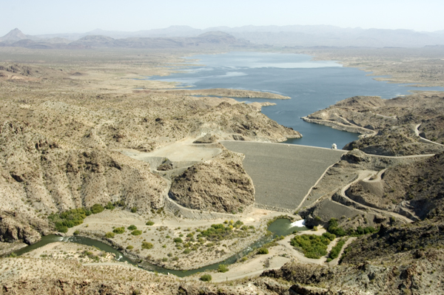

November 2011 CRFS Meeting
Greg Peacock
213-452-3536
gregory.peacock@usace.army.mil

Slide 2
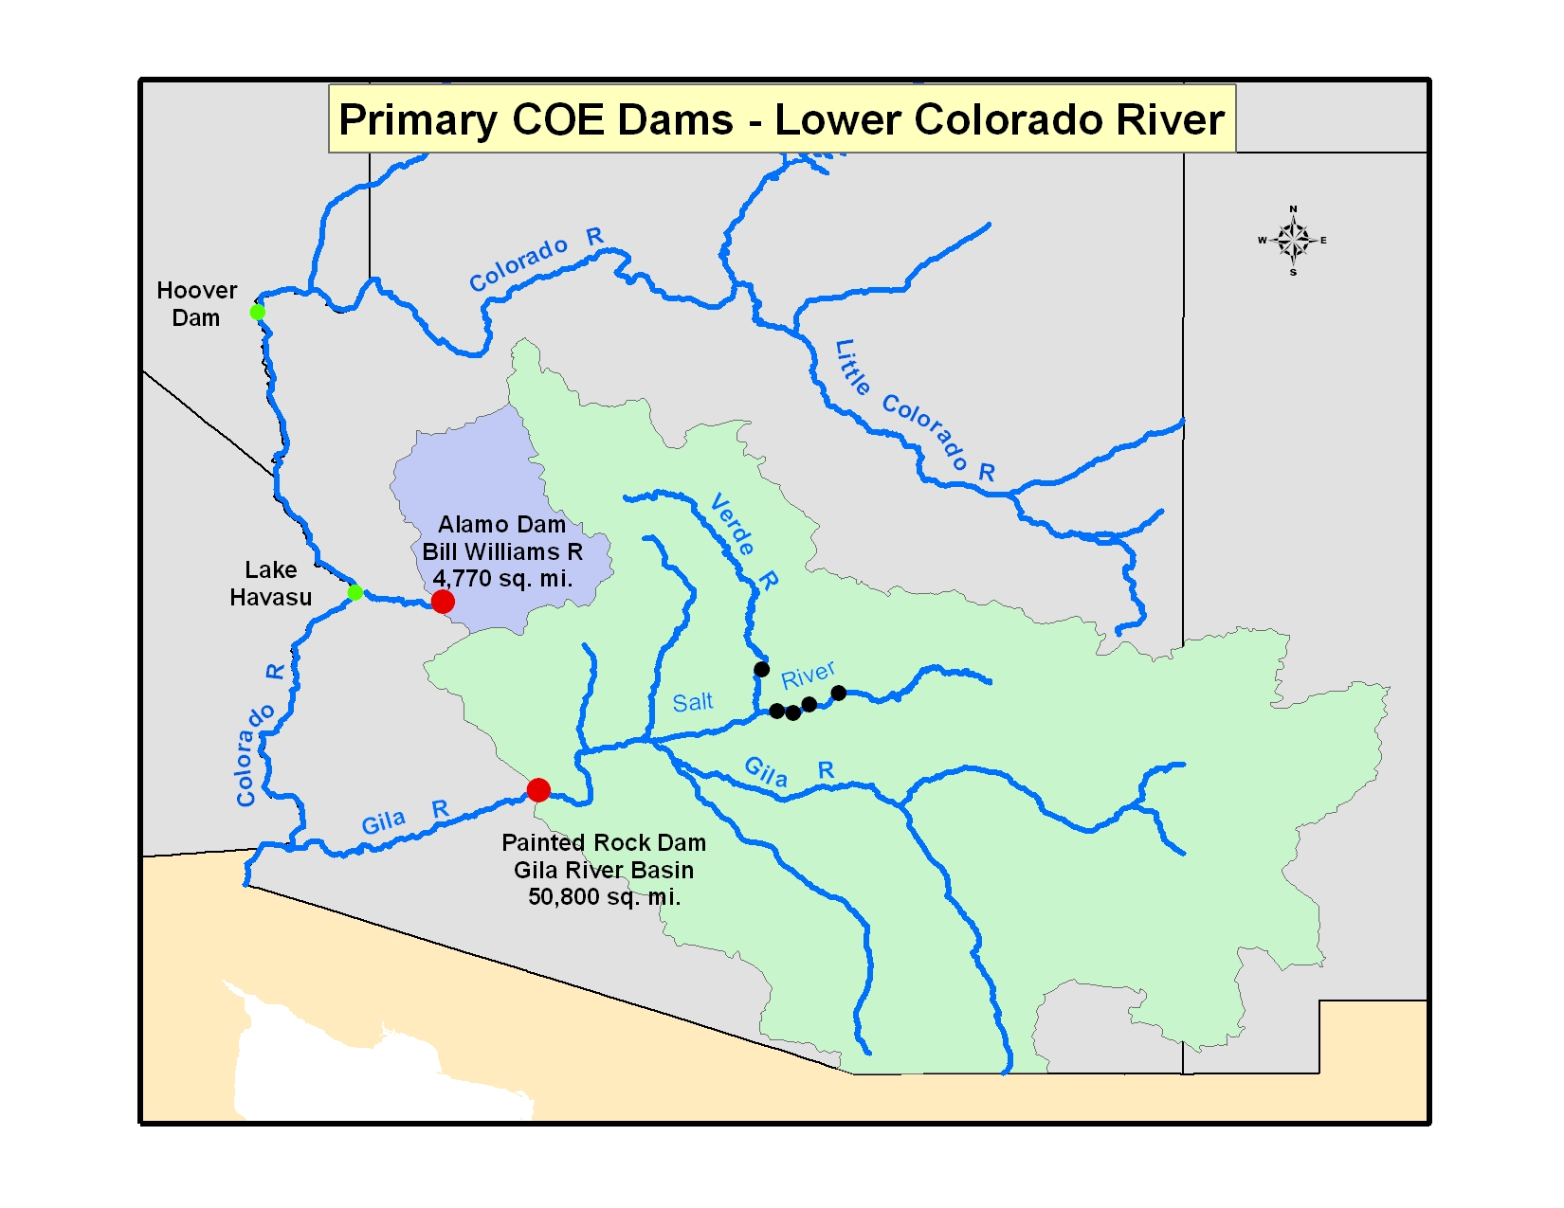

Slide 3
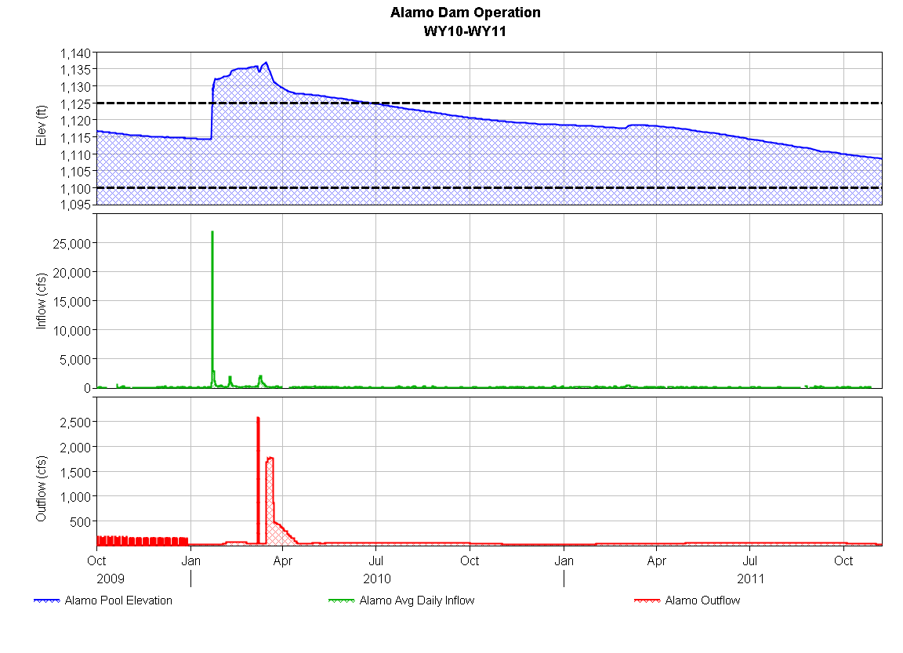

Target Pool 1125’ (161,000 ac-ft)
Outflow Reductions @ 1100’ (80,400 ac-ft)
Currently 1108.6’ (104,400 ac-ft)

Slide 4
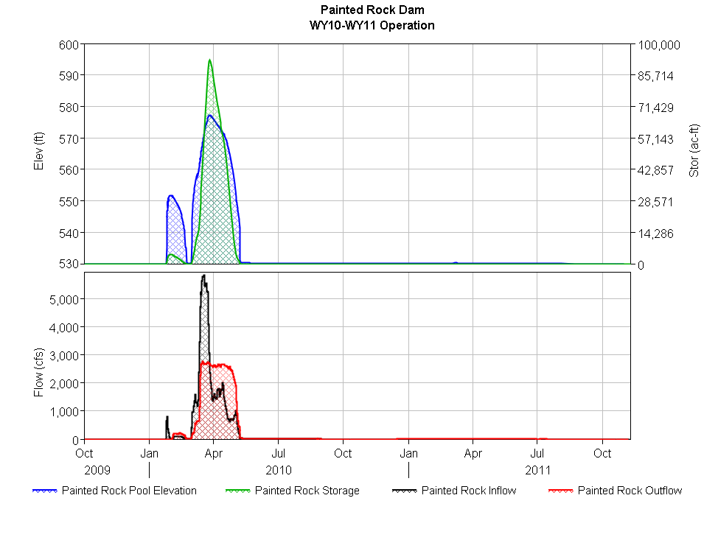
Painted Rock Dam Operation - 2010
Dry since 2010

