Slide 1
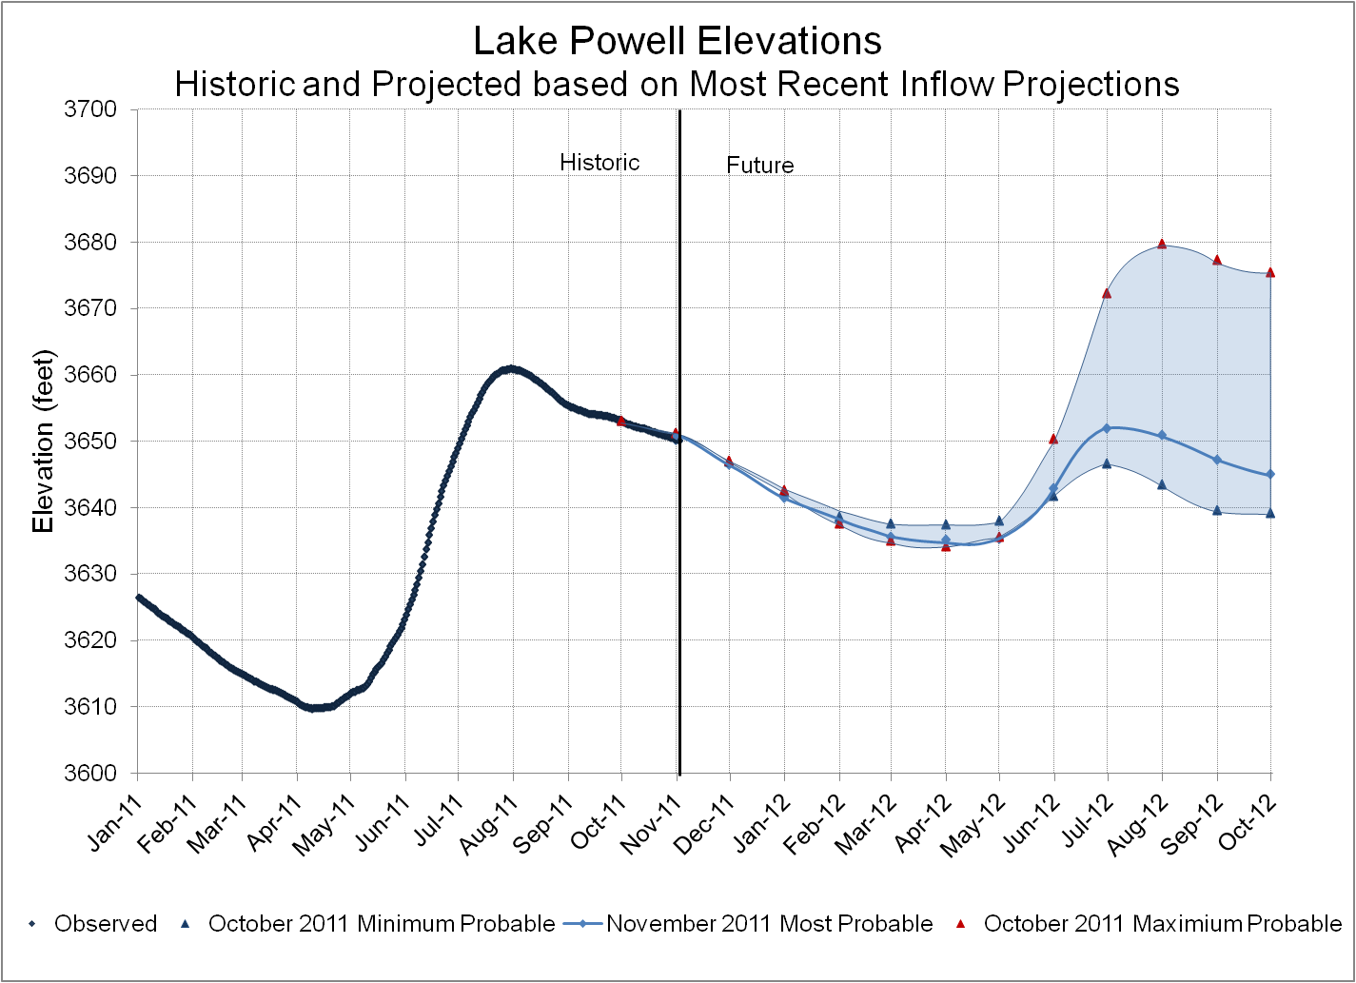
Notes:
Shows the elevation historically with future projections. The range reflects the level of uncertainty of the inflow forecast based on the Min and Max Probable we received in October. The November most probable is reflected by the heavy blue line within the range.

Slide 2
Notes:
Roughly shows the relationship between annual unregulated inflow to Lake Powell and annual release from Lake Powell. 2012 is an Equalization year determined in August of 2012. This relationship is based on how the Equalization Tier would play out under different hydrologic scenarios. How the upstream reservoirs are operated will impact this relationship and this graphic assumes no adjustments are made to operations at the upstream reservoirs.
The Most probable release volume for 2012 is controlled by the Equalization Level for 2012 which is 3645. If conditions are wetter by about 1.5 MAF the Equalization Tier would be controlled by equal volumes in Powell and Mead. If we see a year as wet as 2011 we would again be in a situation where we have to carry some of the Eq water over into 2013.
You can see on the dry side that the min release in 2012 is 9.46 maf which is based on 8.23 + carryover (1.233 maf).

Slide 3
Glen Canyon Power Plant Planned Unit Outage Schedule for Water Year 2012
(updated 10-27-2011)
Unit Number | Oct 2011 | Nov 2011 | Dec 2011 | Jan 2012 | Feb 2012 | Mar 2012 | Apr 2012 | May 2012 | Jun 2012 | Jul 2012 | Aug 2012 | Sep 2012
1
2
3
4
5
6 (3/4 Unit)
7
8
Units Available | 5 | 5.5 | 5.75 | 6.75 | 4.75 |  | 6.75 | 6.75 | 6.75 | 6.75 | 6.75 | 4.75
Capacity (cfs) | 15,500 | 20,750 | 20,750 | 20,750 | 14,400 |  | 23,000 | 23,000 | 23,000 | 23,800 | 23,800 | 14,800
Capacity (kaf/month) | 1060 | 1100 | 1340 | 1360 | 980 | 1160 | 1350 | 1320 | 1320 | 1380 | 1380 | 1020
Max (kaf) | 953 | 1100 | 1225 | 1300 | 980 | 1160 | 1350 | 1320 | 1320 | 1380 | 1380 | 1020
Most (kaf) | 953 | 1100 | 1225 | 1000 | 800 | 900 | 1000 | 1000 | 1100 | 1199 | 1125 | 833
Min (kaf) | 953 | 1100 | 1225 | 1000 | 651 | 604 | 605 | 605 | 605 | 805 | 805 | 476
4.75
6.75
14,400
23,800
Notes:
This graphic shows the unit outages that are projected for WY2012. These are subject to change depending on contractor and staff availability and also what is discovered as the work is performed. Just like in life…”Life is like a box of Chocolates….You never know what you are going to get….”
The Max-Most-Min rows show what Reclamation projects as the releases throughout the year depending on how hydrology plays out. The Maximum release for the WY is about 14.5 maf and limited by these outages. The minimum WY release is 9.463 maf and is based on 8.23 maf + carryover which was 1.233 maf. The carryover is being released during the months of Oct-Nov-Dec and should be completed near the end of December.

Slide 4
Notes:
Blue line shows the plan, red line shows actual. While we have a plan….it can change. During November, Western is instructed to release the greatest practical volume it can and the blue line marks the current estimate of that. But if opportunities occur that allow higher releases, Western is instructed to take advantage of those opportunities.

Slide 5
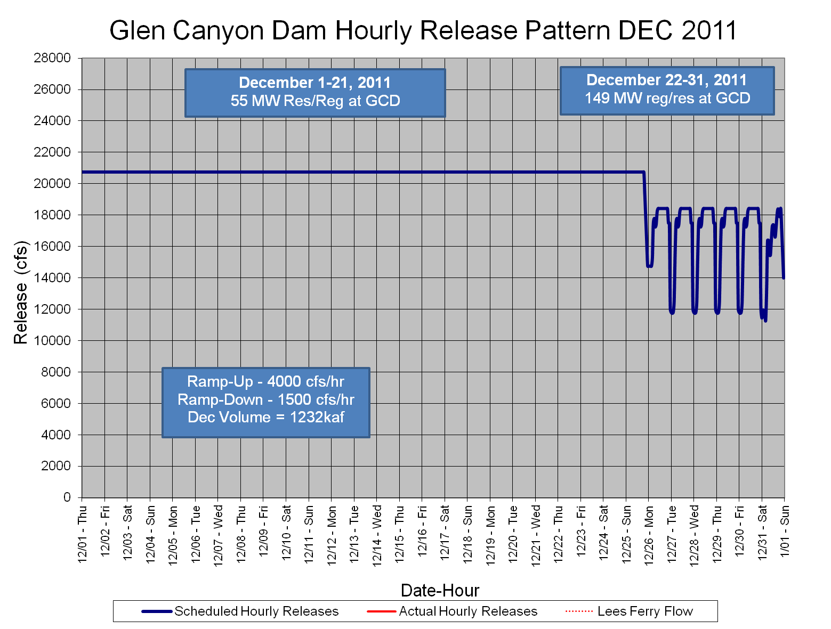
Notes:
Will maximize release until we release all of the carryover for 2011 (1.233 maf). Currently this is projected to occur on Christmas Day.

Slide 6
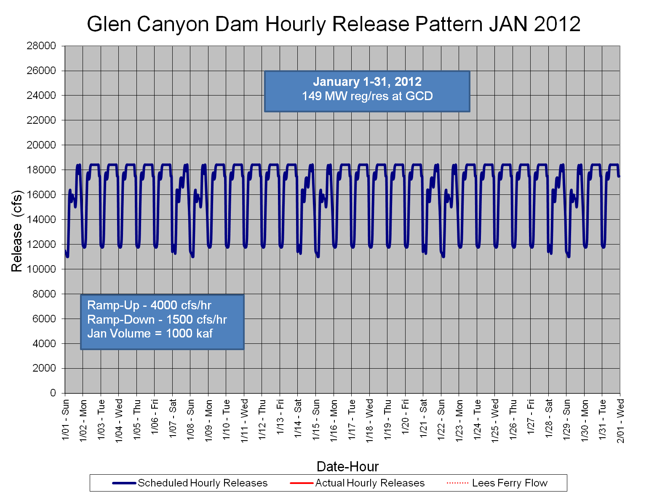

Slide 7
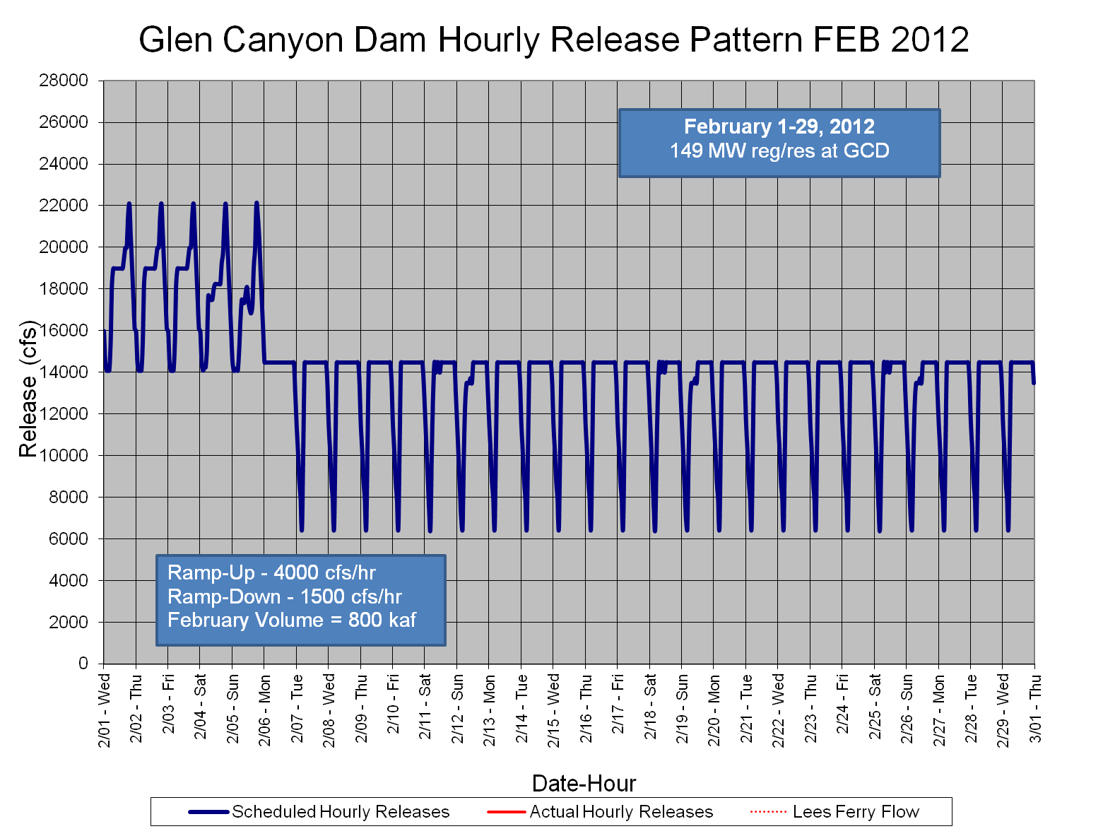
Notes:
I think I will be talking to Western about February. The first five days look troublesome. I think I will suggest that they maintain January schedule if they want to go high during these first 5 days. Or perhaps I will ask that they have a consistent pattern for the entire month. Either way this graph is suspect and will likely change.

