Slide 1
Weekly ESP

Slide 2
Residual forecasts not directly comparable with (1) official forecasts or (2) previous week forecasts

Slide 3
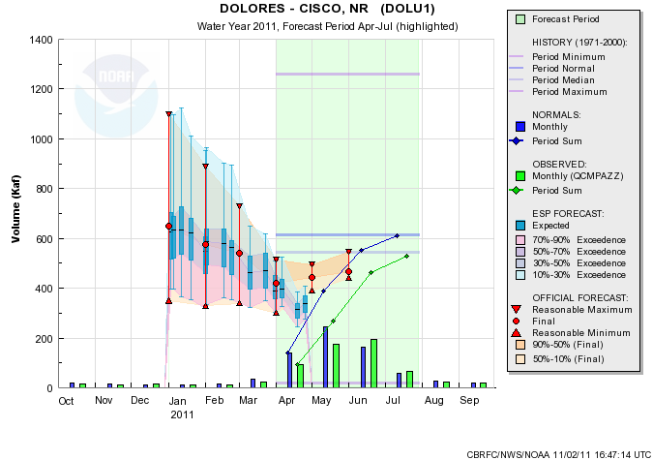
Visualization

Slide 4
Enhancements
Add Observed to Forecast during forecast period (e.g. April-July)
Official and weekly ESP will be comparable
More frequent updates? How frequent?
Anything else?

