Slide 1
1981-2010 Averages
CRFS
November 8, 2011

Slide 2
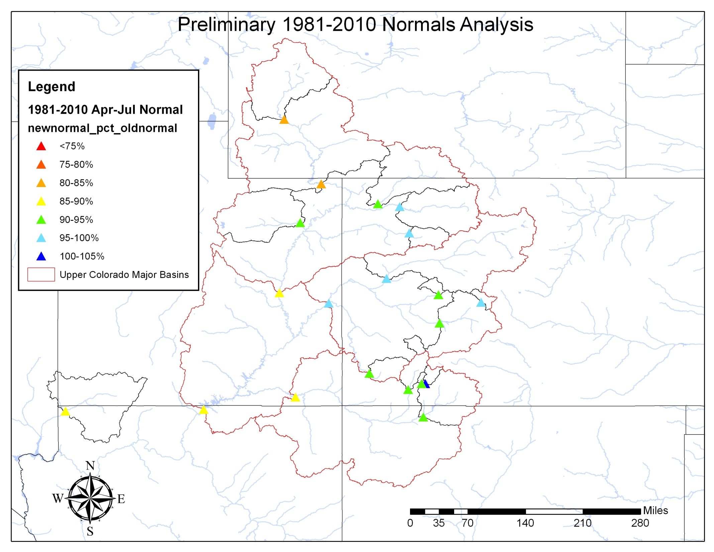

Slide 3
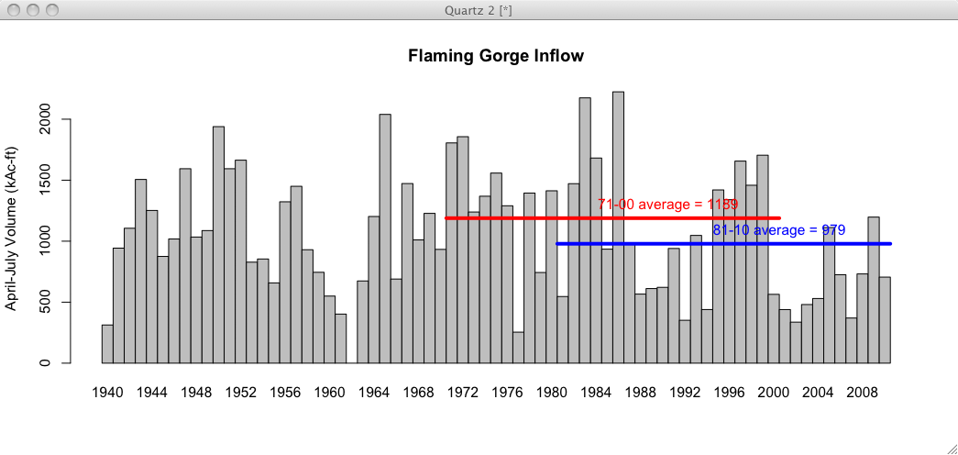
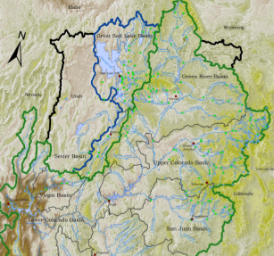
Preliminary Data
18% reduction in mean

Slide 4
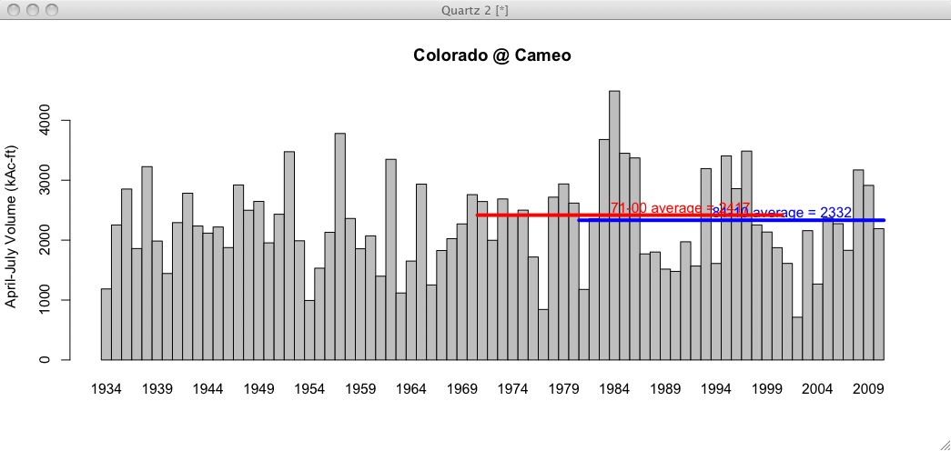
Preliminary Data
4% reduction in mean

Slide 5
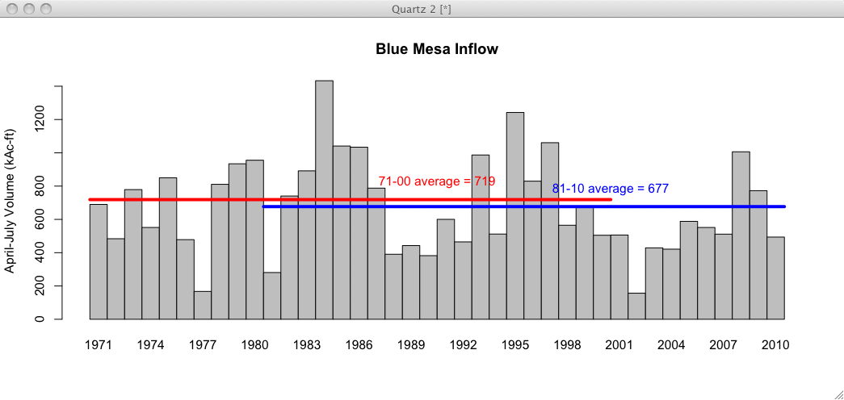
Preliminary Data
6% reduction in mean

Slide 6
Preliminary Data
6% reduction in mean

Slide 7
3 Gage Method
Mass Balance:
71-00 = 7927 MAF
81-10 = 7158 MAF
Preliminary Data
11% reduction in mean

Slide 8
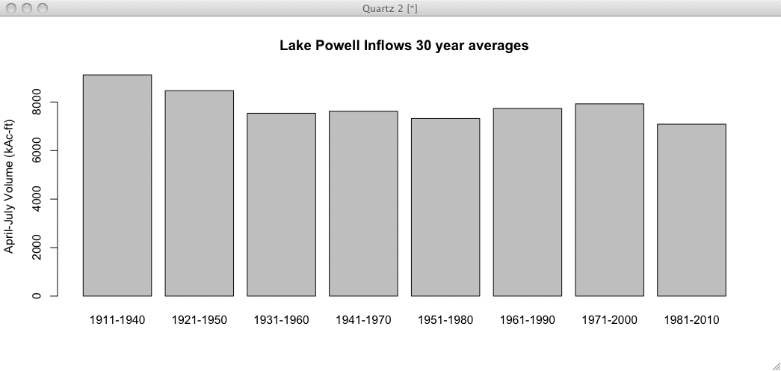
1981-2010 is the driest 30 year period on record

Slide 9
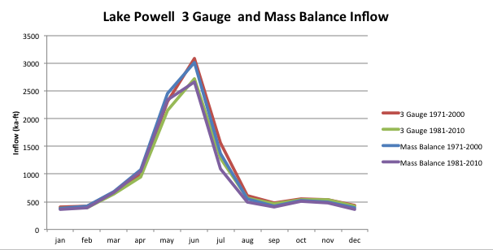
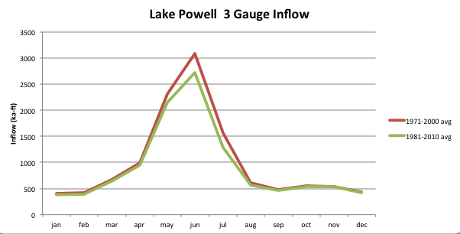
Lake Powell Monthly

Slide 10
Effect on Forecasts
WY2012 forecasts will be based on 1981-2010 inputs in both forecast models
ESP and SWS will both use the same period
SNOTEL network much stronger for 1981-2010 period than in 1970s. This network is critical for forecast skill.
All things equal, these forecasts will be lower since input data sets are drier in the 30 year average
Especially true in early season forecasts
Later season forecasts more controlled by observed snowpack
Percent of normal forecast values should remain largely unchanged (since normals AND forecasts will be lower)

Slide 11
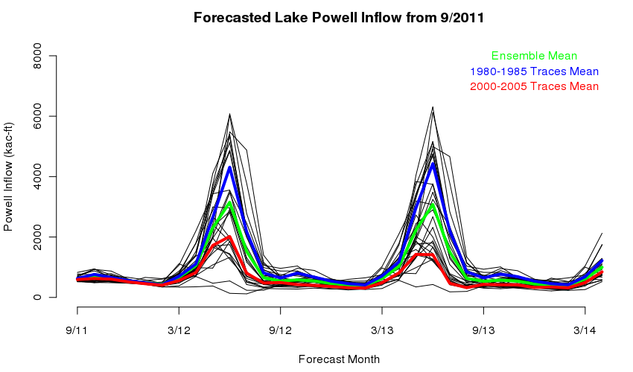
Example: ESP forecasts Mean influencing year out forecast

Slide 12
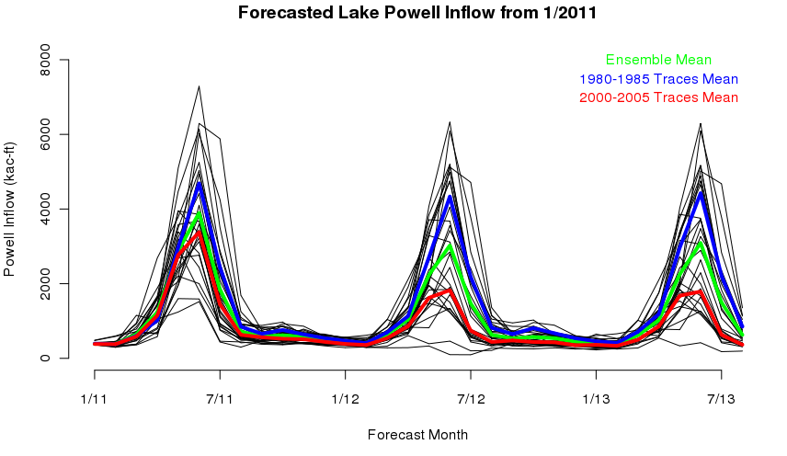
Example: ESP forecasts Mean influence to early season forecasts somewhat less

Slide 13
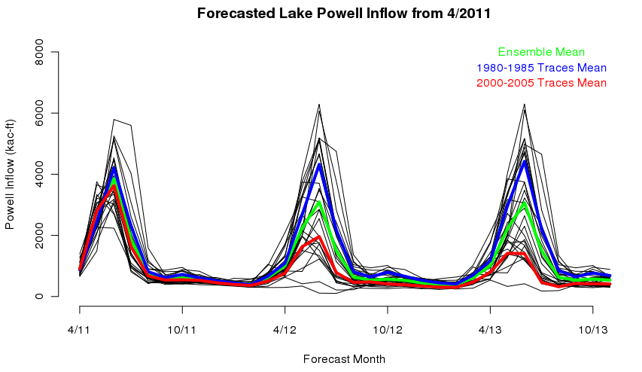
Example: ESP forecasts Mean influence to late season forecasts small

