Slide 1
Water Year 2011: Review of Conditions and Forecasts in the Colorado River Basin
CRFS
November 8, 2011

Slide 2
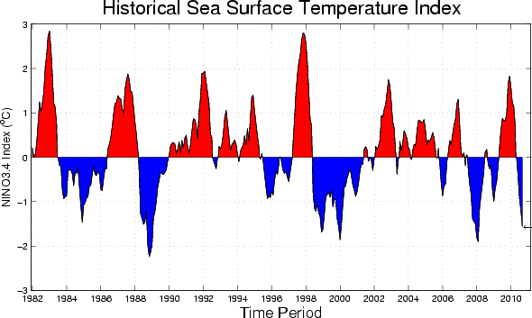
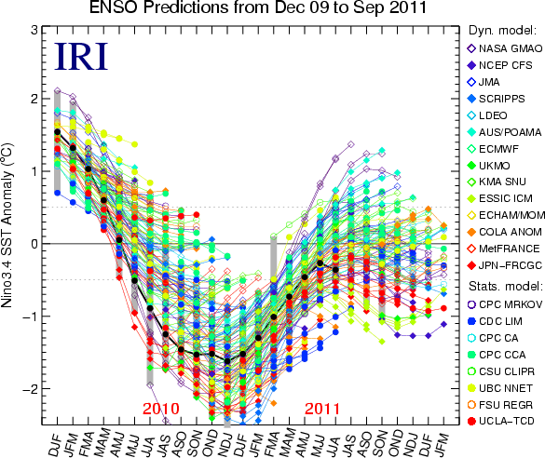
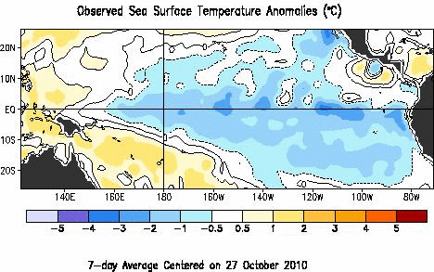
La Nina
Sources: cpc.ncep.noaa.gov and iri.columbia.edu/climate/ENSO

Slide 4
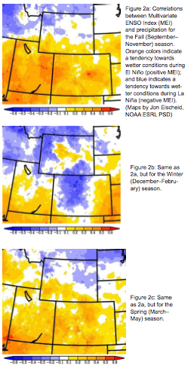
La Nina and the Upper Colorado
Some analyses (e.g. Klaus Wolter, right) have shown seasonal teleconnections to precipitation in the Upper Colorado basin
Possible tendency toward drier fall and spring and wetter winters in La Nina
Credit: Klaus Wolter http://wwa.colorado.edu/IWCS/2010_October.html

Slide 5
U.S. Precipitation Departures (mm) and Frequency of Occurrence (%) for La Niña during Oct.-Dec.
FREQUENCY (right panel) indicates the percentage of La Niña years that the indicated departure (left panel) occurred. For example, below-average seasonal precipitation over the Middle Mississippi Valley occurred in 70%-90% of the La Niña years.

Slide 6
U.S. Precipitation Departures (mm) and Frequency of Occurrence (%) for La Niña during Dec.-Feb.
Source: cpc.ncep.noaa.gov

Slide 7
U.S. Precipitation Departures (mm) and Frequency of Occurrence (%) for La Niña during Mar.-May
Source: cpc.ncep.noaa.gov

Slide 8
CPC Precipitation Outlooks

Slide 9
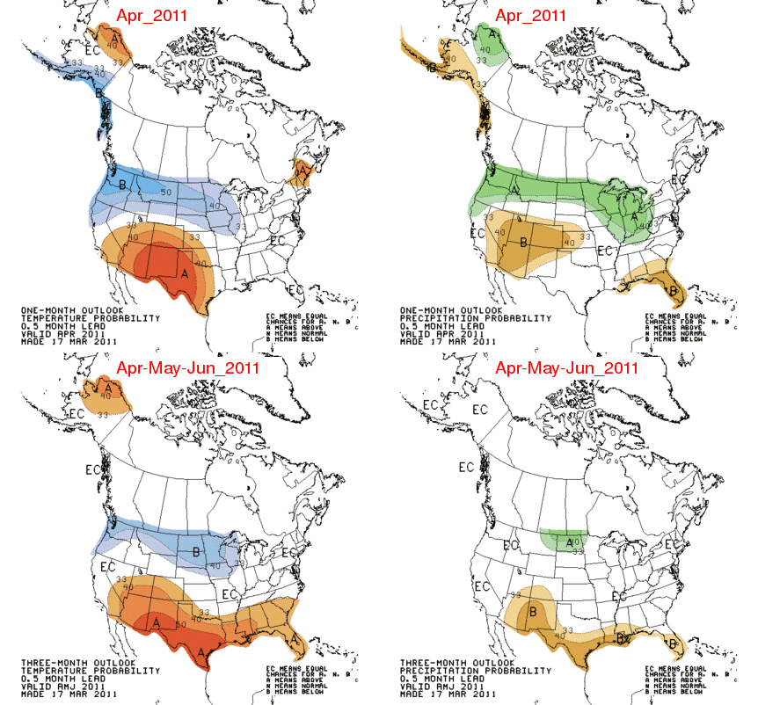

Slide 10
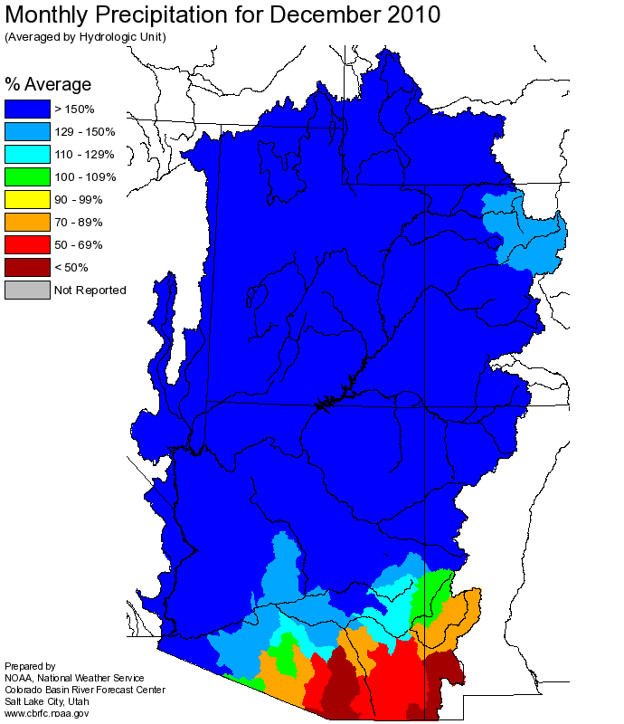
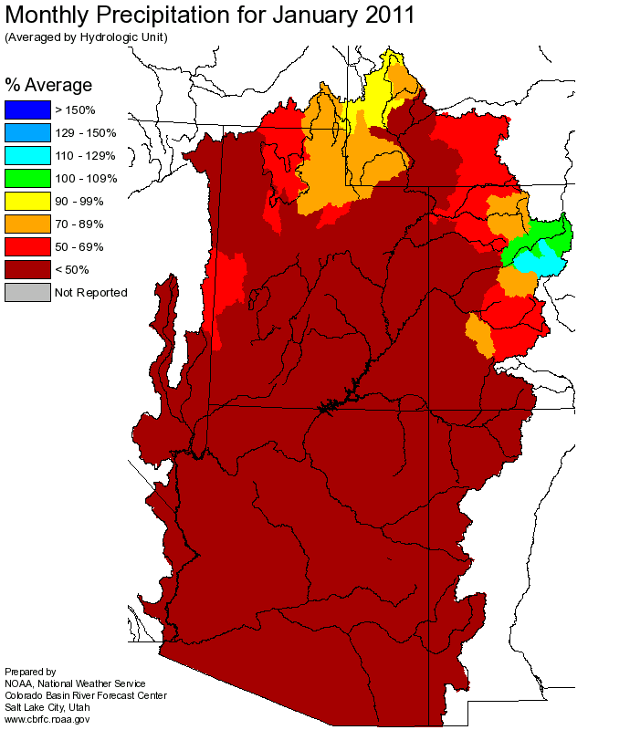
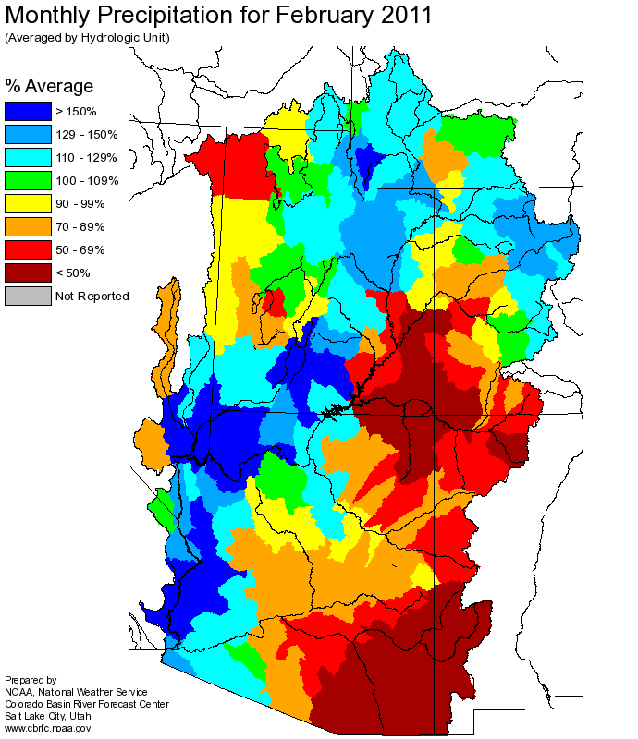
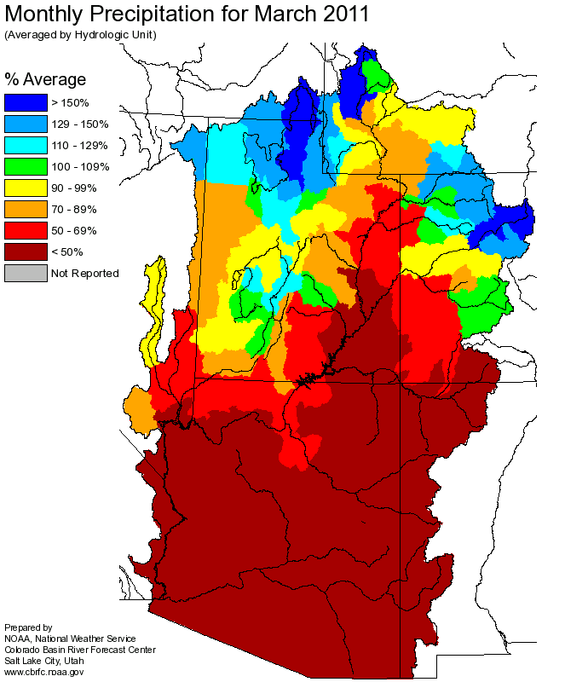
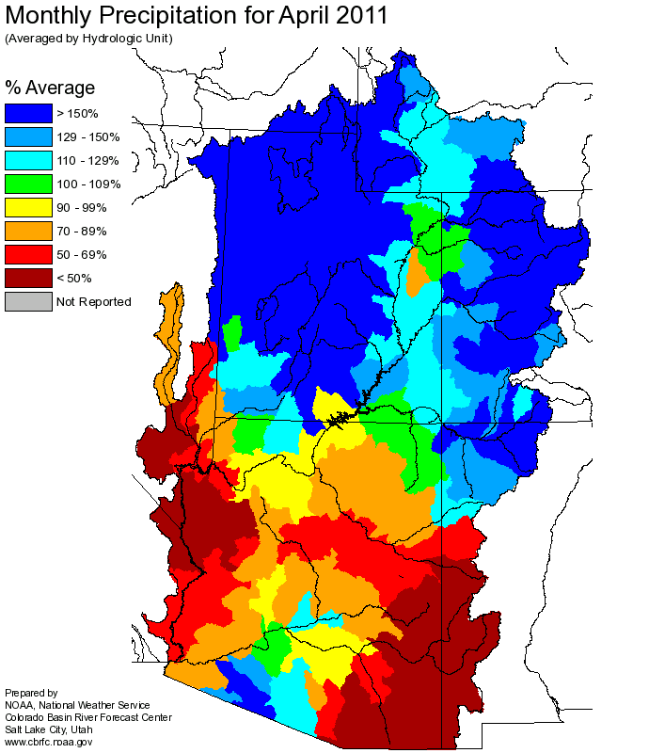
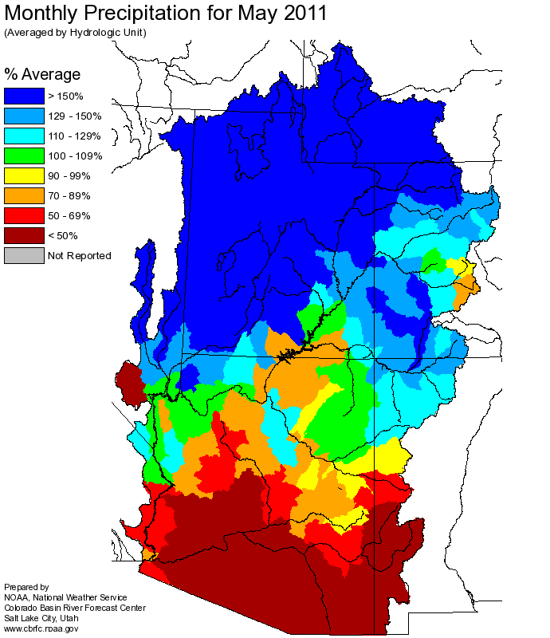
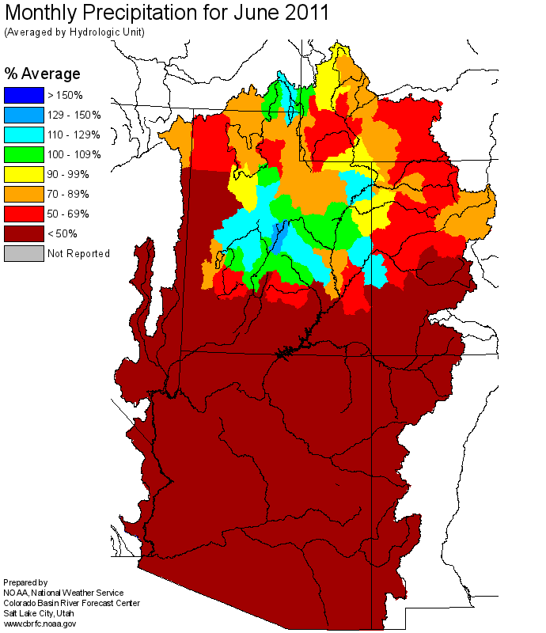
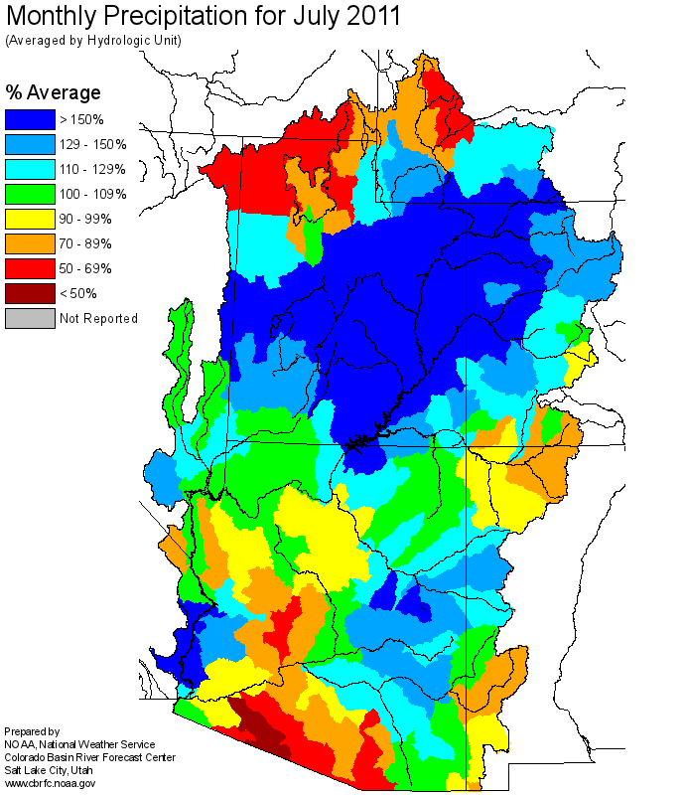
WY 2011 Monthly Precipitation

Slide 11
Spring 2011, Monthly Precipitation
April
May

Slide 12
Spring 2011, Monthly Precipitation
June
July

Slide 13
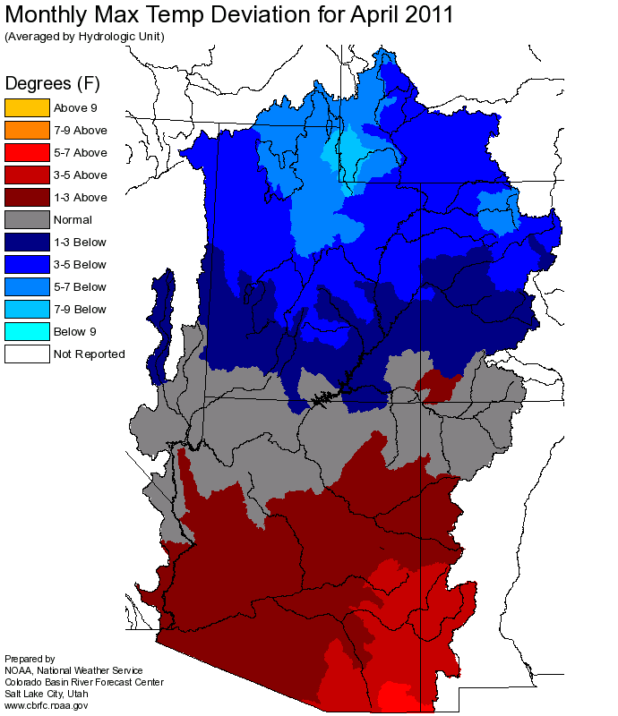
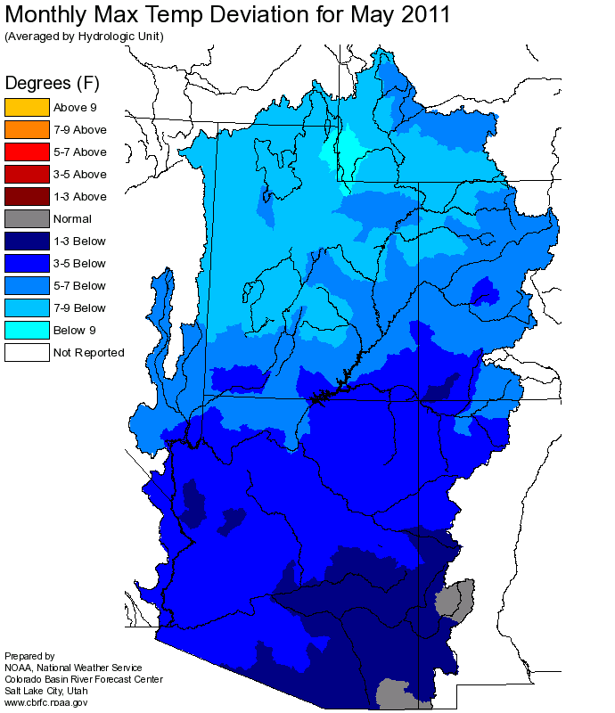
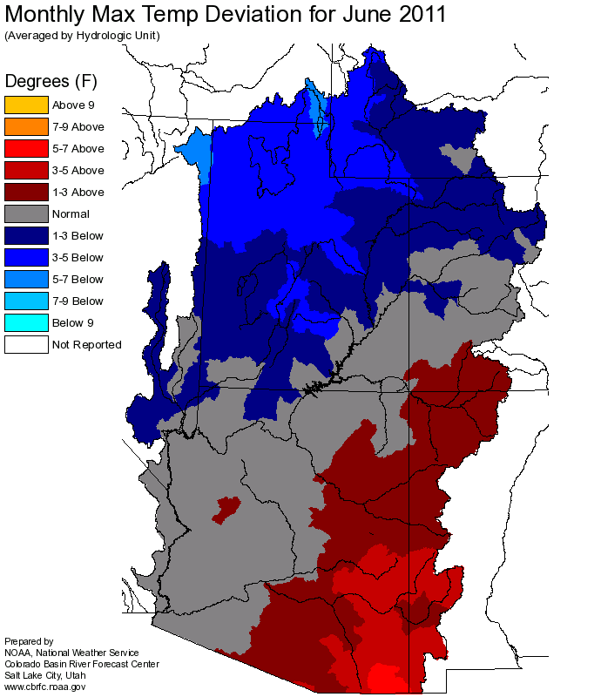
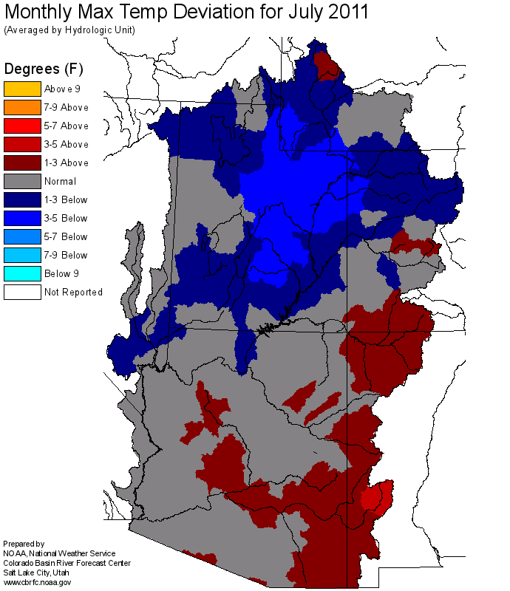
Spring and Summer Temperature Departures from Average Maximum
April and May departures were the most extreme at > 7 degrees F below normal. Cool temperatures continued though July.

Slide 14
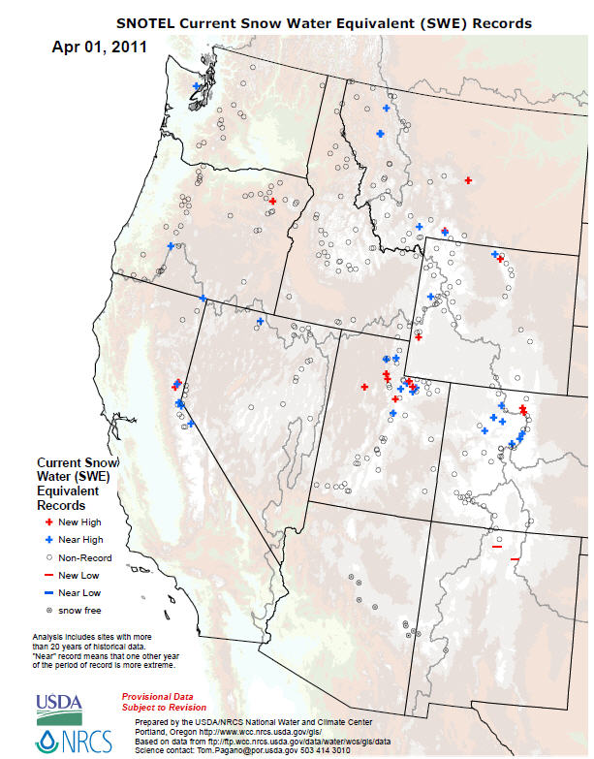
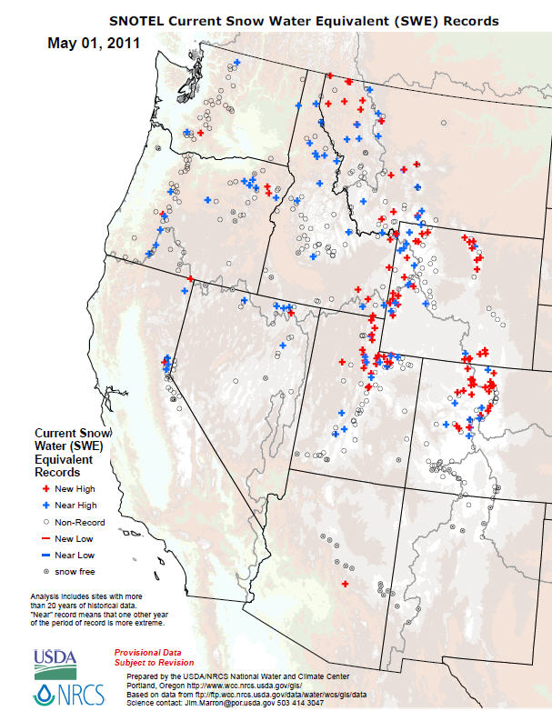
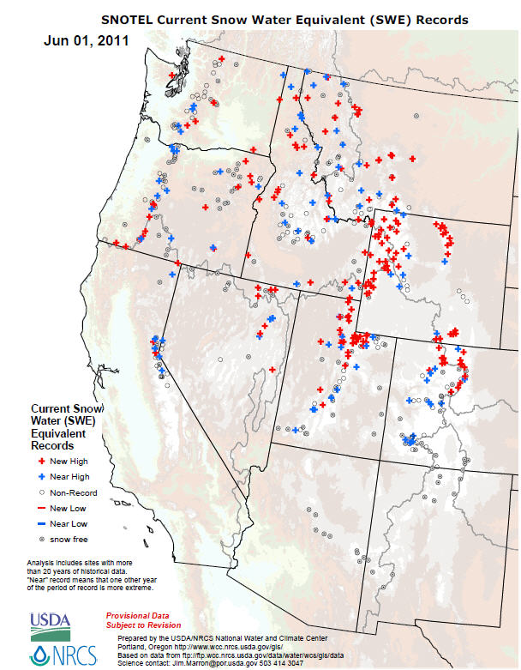
Daily SWE Records, 2011

Slide 15
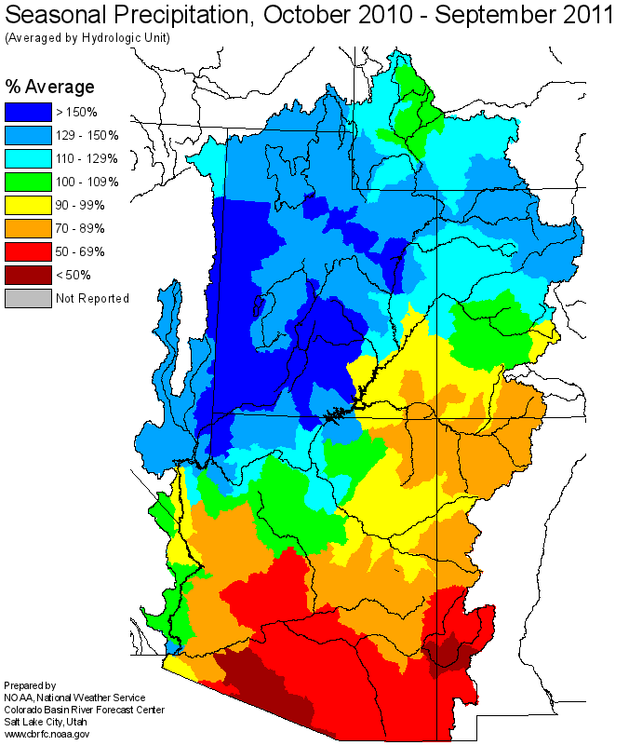

Slide 16
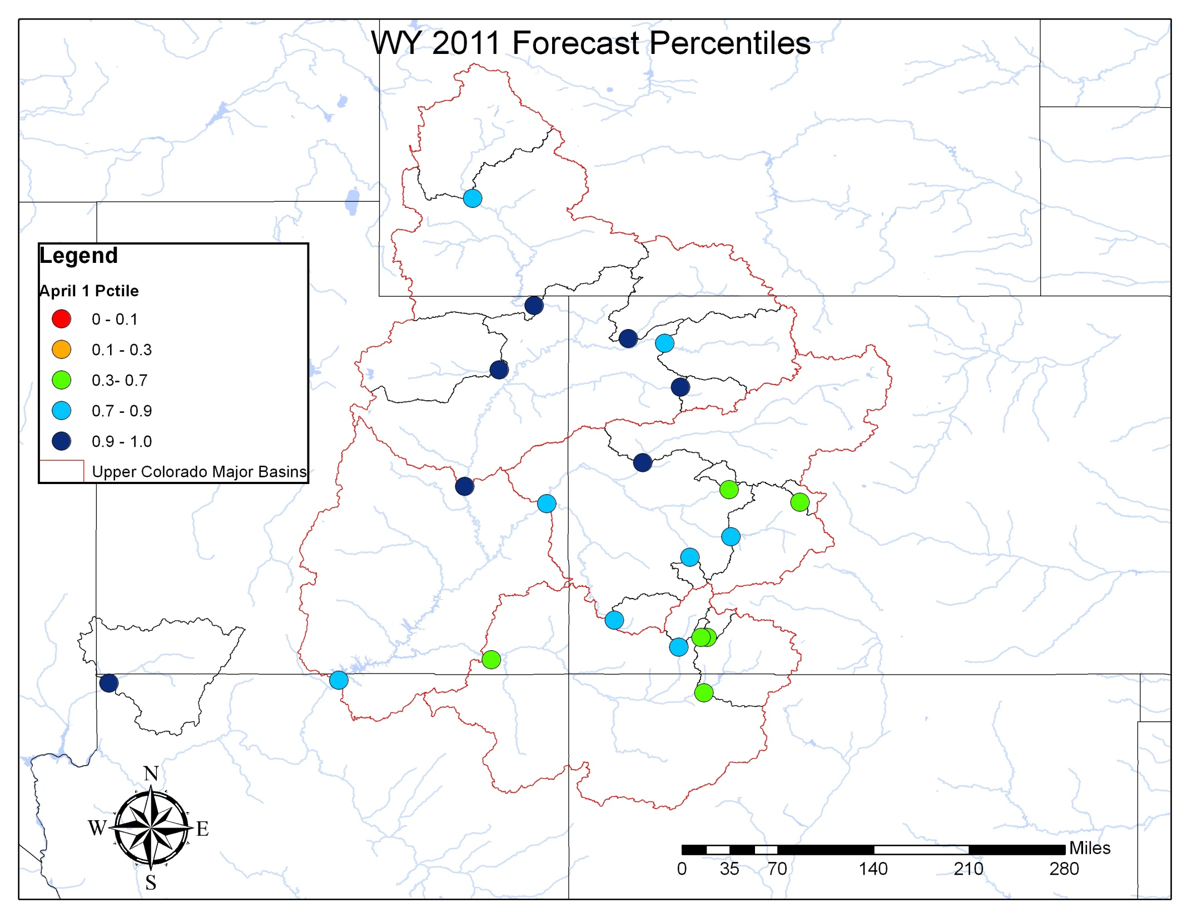

Slide 17
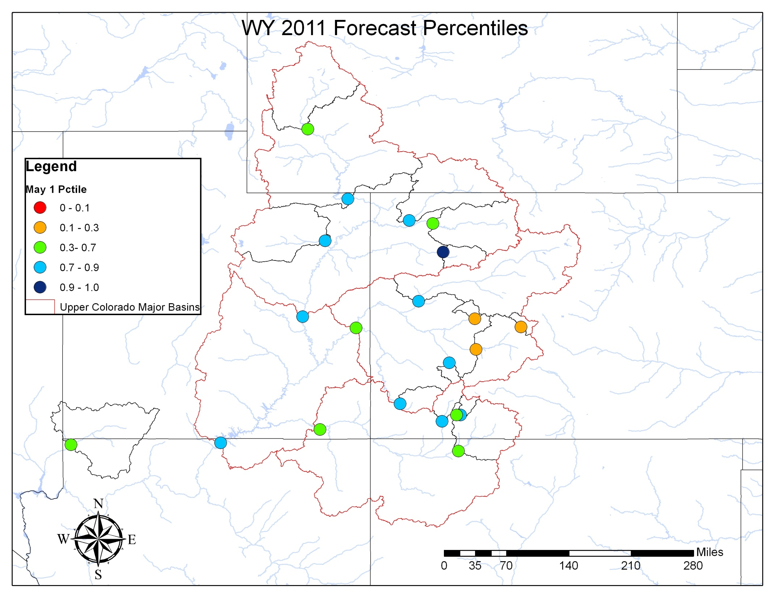

Slide 18
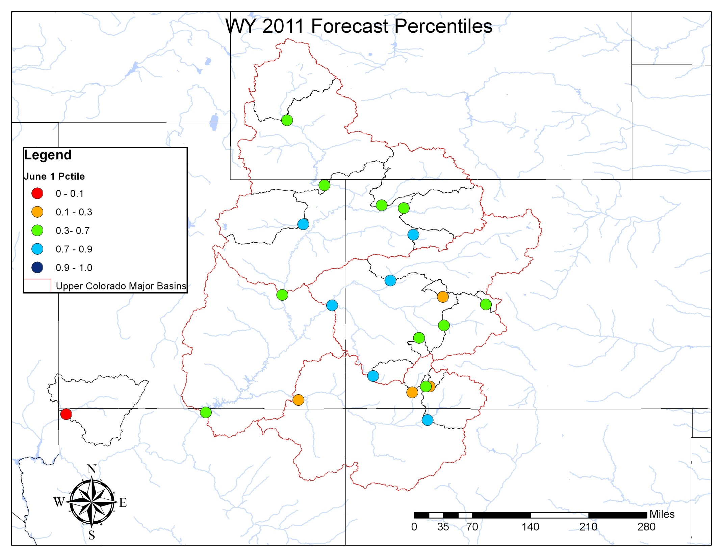

Slide 19
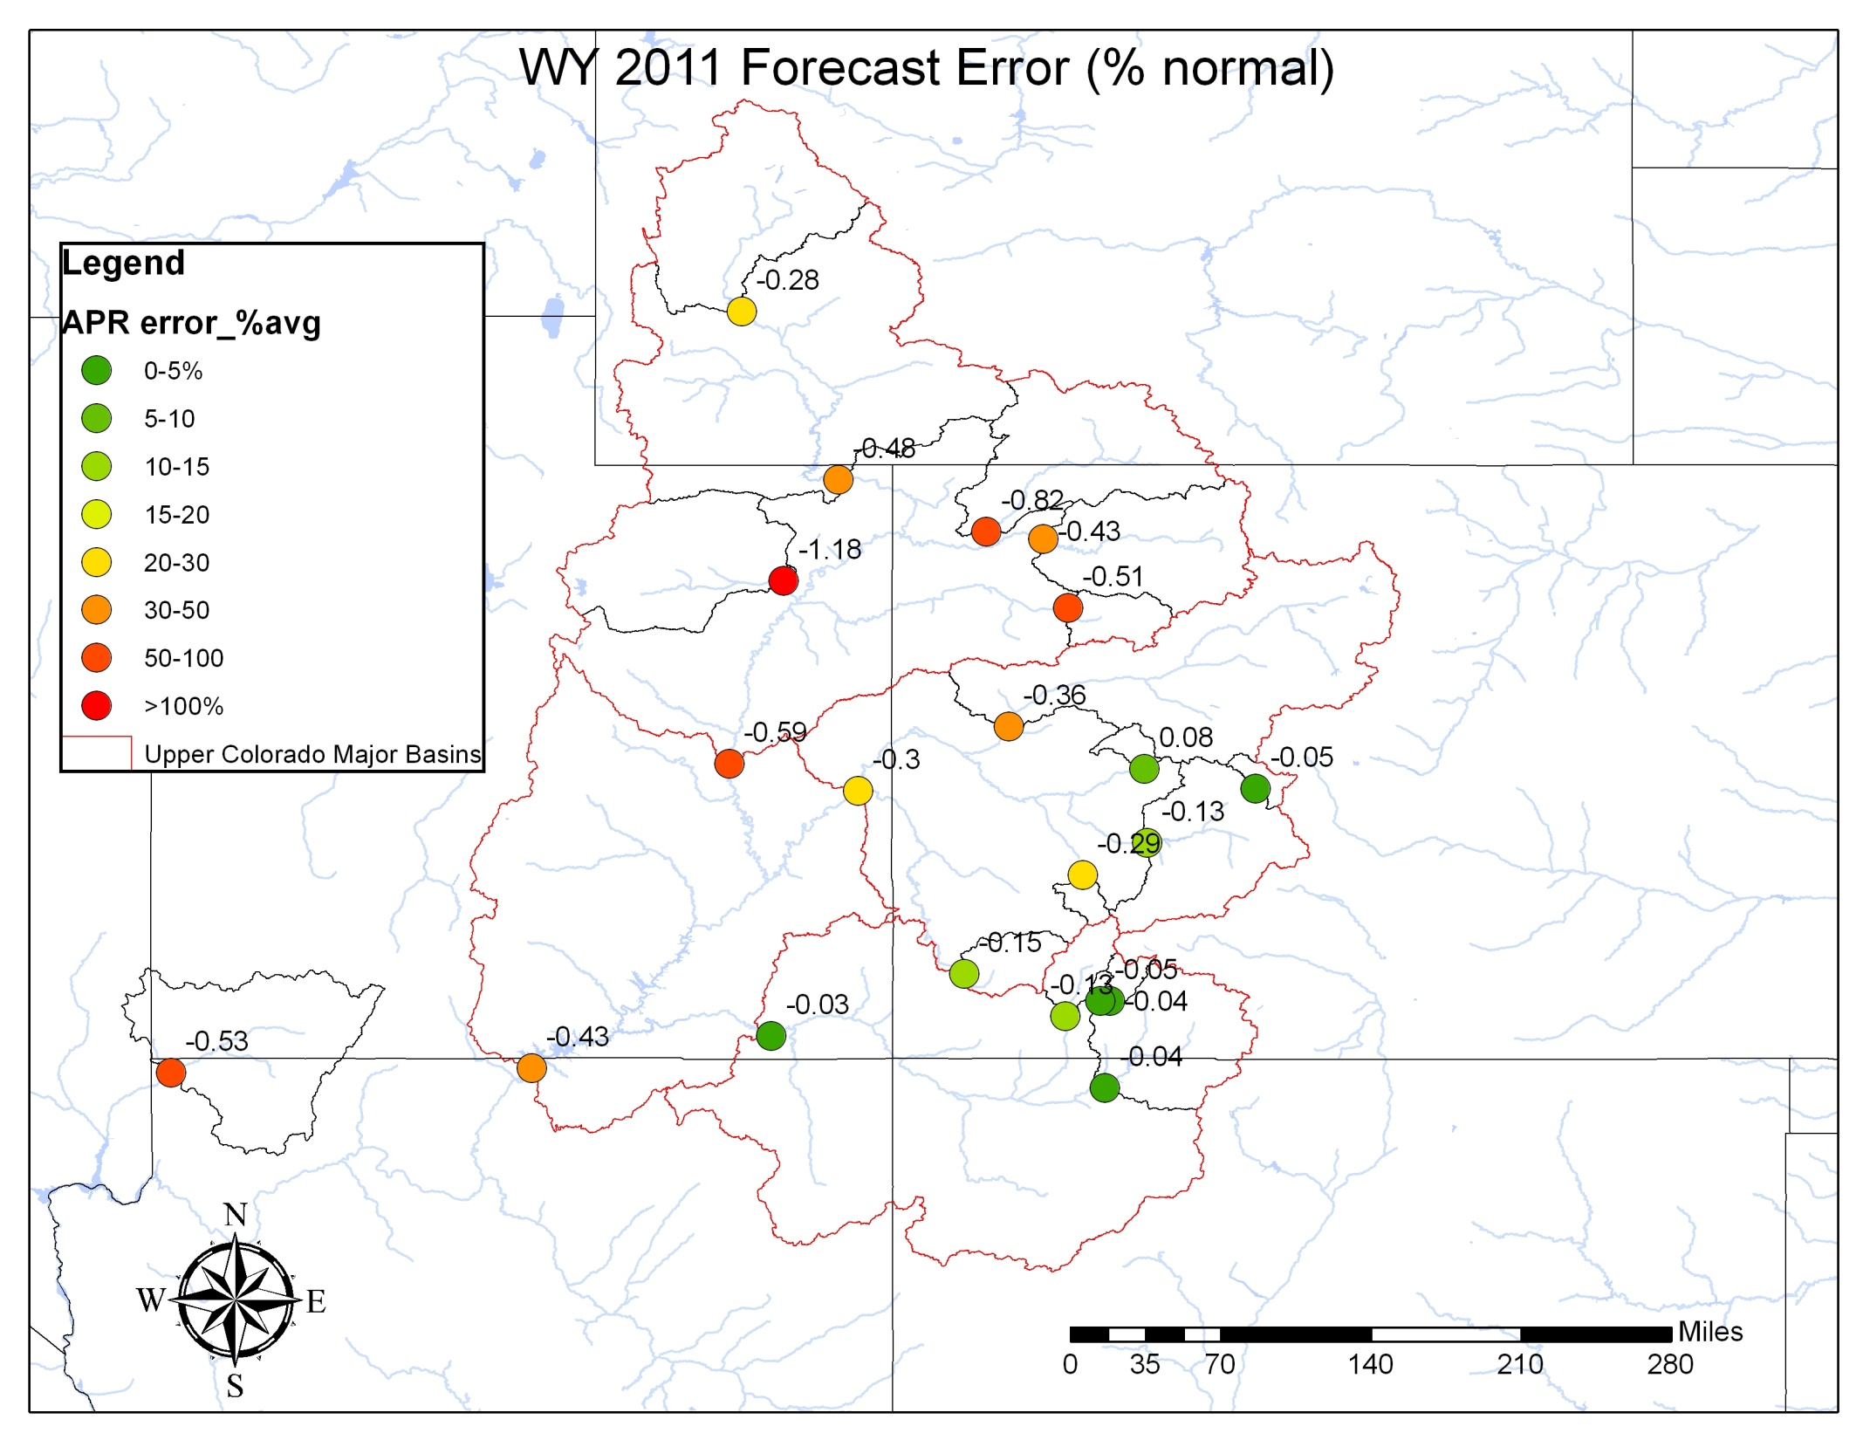

Slide 20
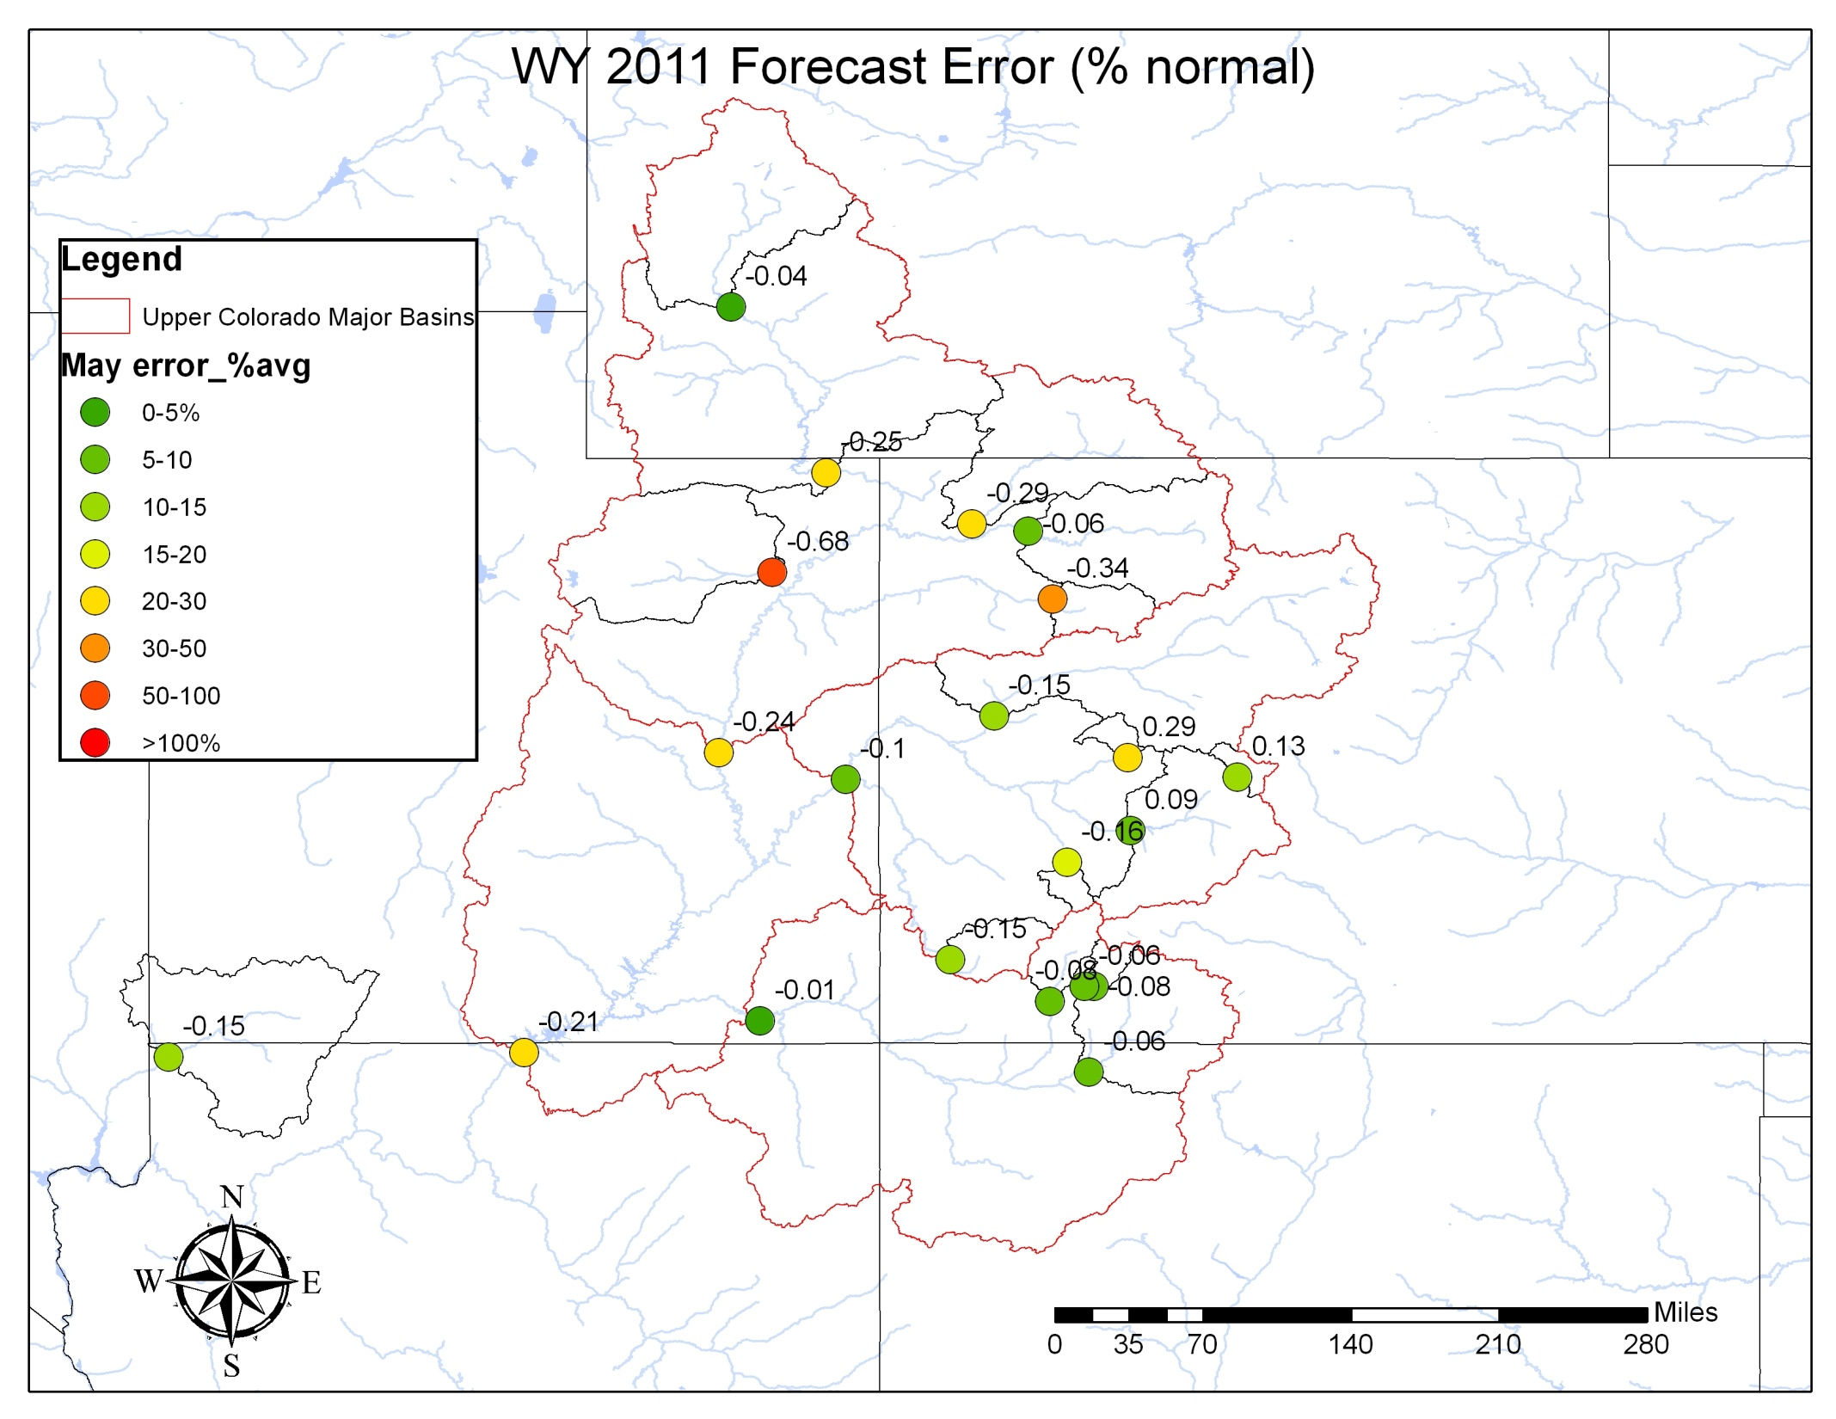

Slide 21
