Slide 1
Water Year 2011: Review of Water Supply Forecasts in the Colorado River Basin
CRFS
November 8, 2011

Slide 2
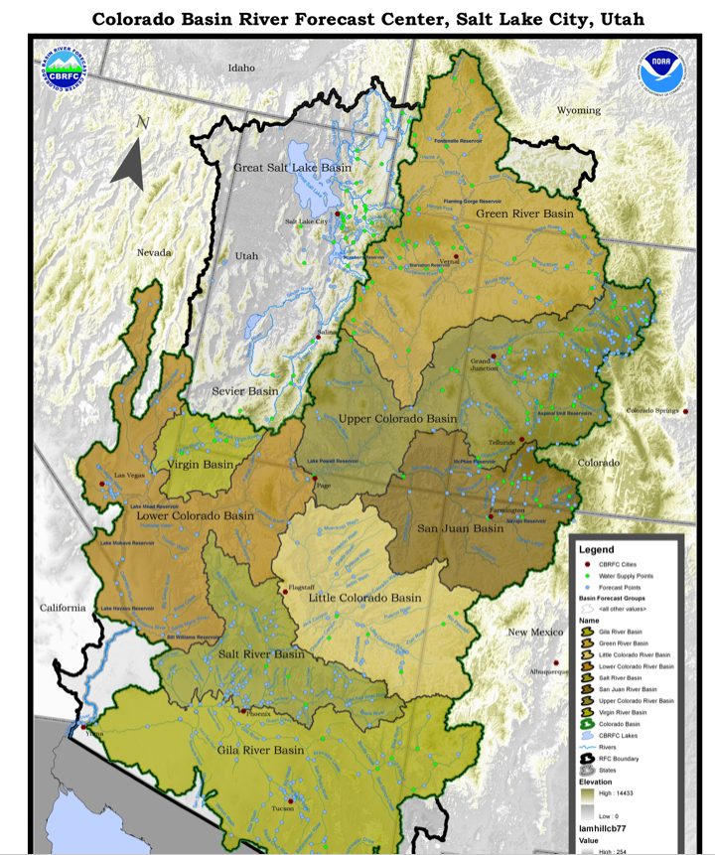
Green River Basin
Slightly above normal seasonal precipitation through March 2011
Sustained cool and wet period April-June
Runoff delayed (especially to the north and west)
Many record or near records for precipitation, runoff volumes, etc
Upper Green
Duchesne
Yampa

Slide 3
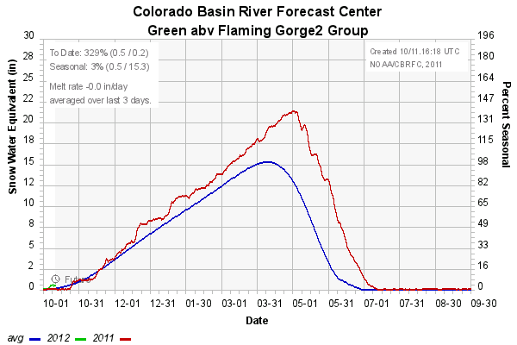
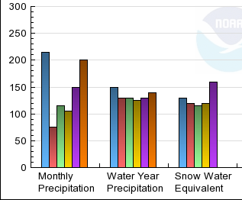
Upper Green Basin Conditions
160 %
120 %
115 %
Two new records for April-July volume at points coming off the north slope of the Uintas.

Slide 4
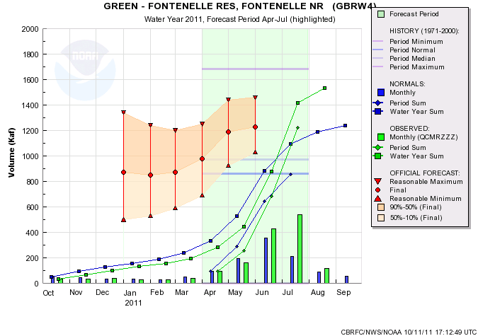
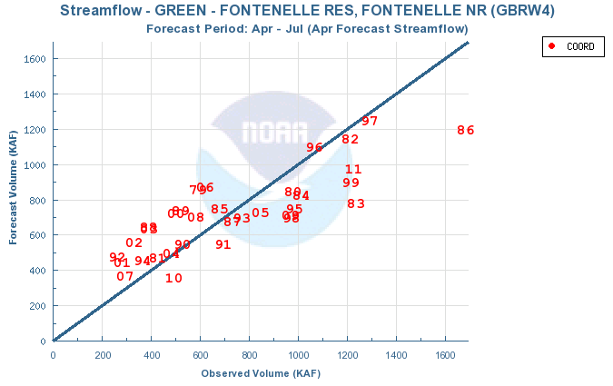
FONTENELLE RESERVOIR
1222 KAF
142%
 | ESP | SWS | NRCS | COOR | %
Jan | 840 | 840 | 900 | 870 | 101%
Feb | 822 | 844 | 850 | 850 | 99 %
Mar | 860 | 860 | 870 | 870 | 101%
April | 1020 | 977 | 1000 | 980 | 114%
May | 1206 | 1166 | 1192 | 1190 | 138%
Jun | 1243 | 1232 | 1230 | 1230 | 143%

Slide 5
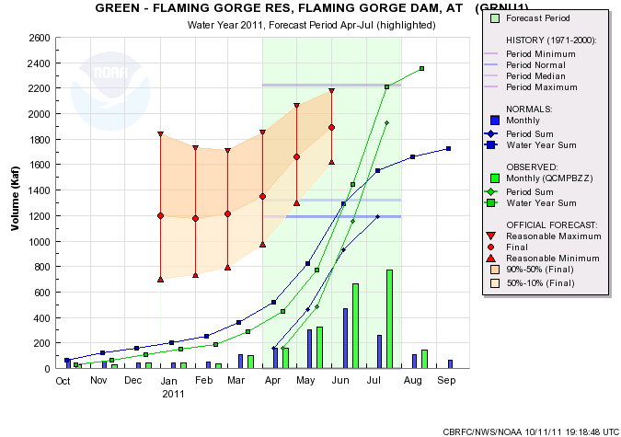
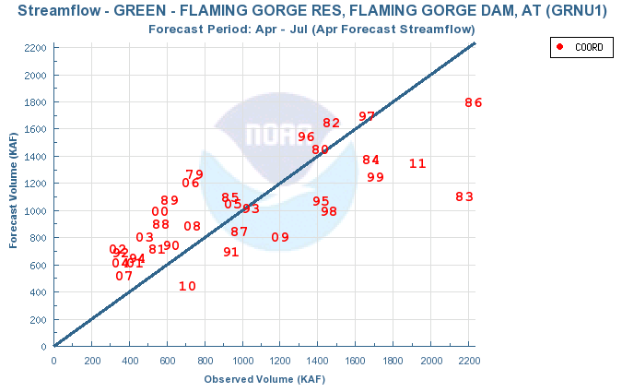
FLAMING GORGE
1926 KAF
162%
 | ESP | SWS | NRCS | COOR | %
Jan | 1117 | 1225 | 1300 | 1200 | 101%
Feb | 1090 | 1190 | 1180 | 1180 | 99%
Mar | 1190 | 1217 | 1210 | 1210 | 102%
April | 1330 | 1350 | 1380 | 1350 | 113%
May | 1684 | 1640 | 1659 | 1660 | 139%
Jun | 1902 | 1735 | 1886 | 1890 | 159%
#1:1986
#2:1983
#3: 2011

Slide 6
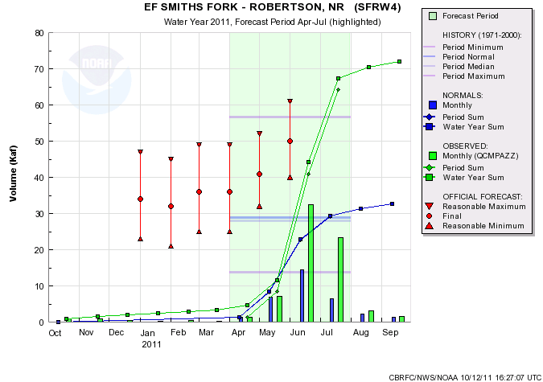
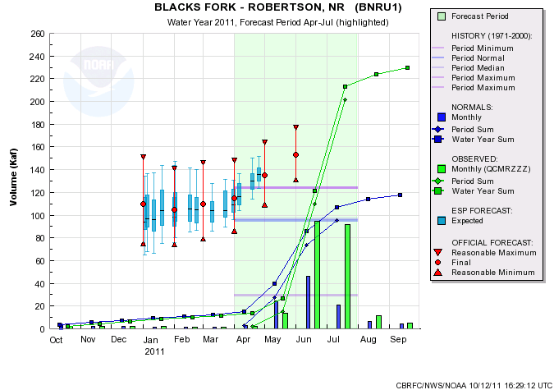
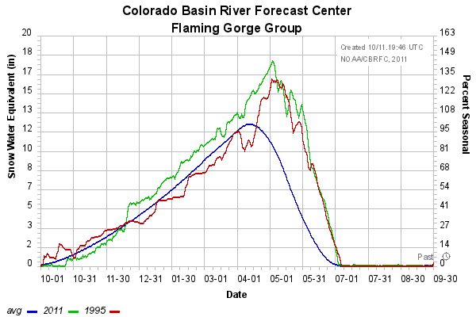
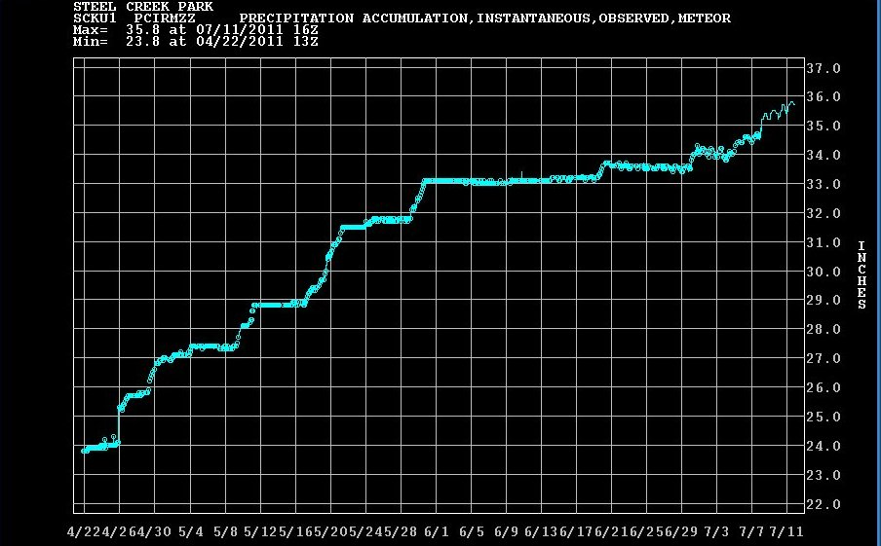
FLAMING GORGE LOCAL……..
RECORD!
RECORD!
64 KAF
221%
202 KAF
212%
~2.0in
~1.5in
~3.0in
~1.5in
Notes:
Also big sandy spilling

Slide 7
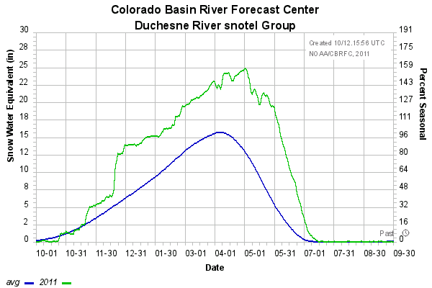
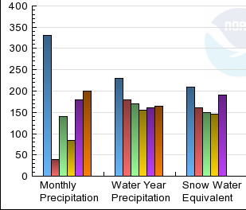
Duchesne Basin Conditions
10/16 forecast points set records for April-July volume.
Notes:
3/1 120%
4/1

Slide 8
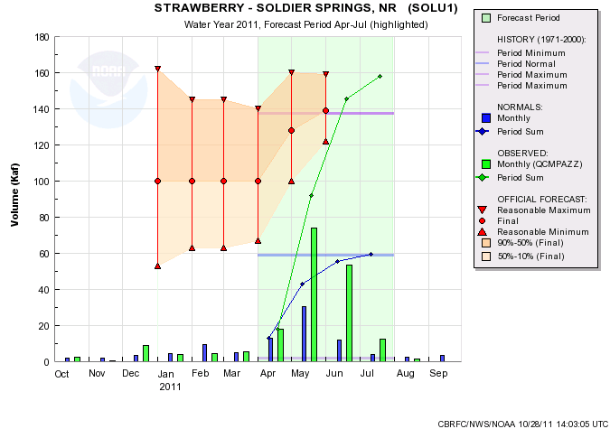
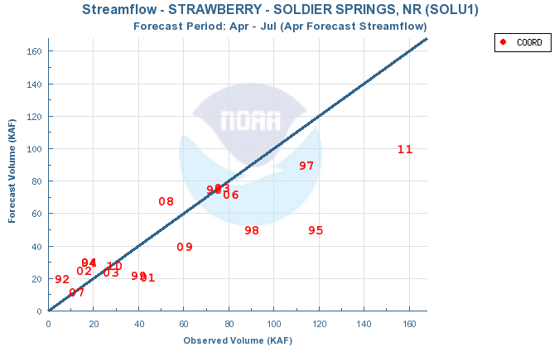
158
268%

Slide 9
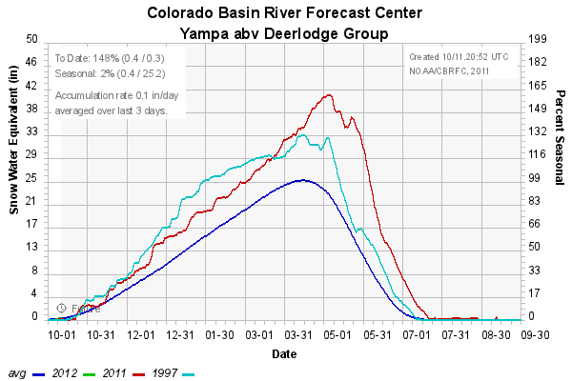
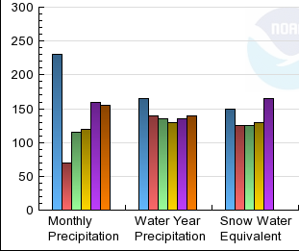
Yampa Basin Conditions
Record Snowpack
All forecast points set records for April-July volume.
Notes:
3/1 120%
4/1

Slide 10
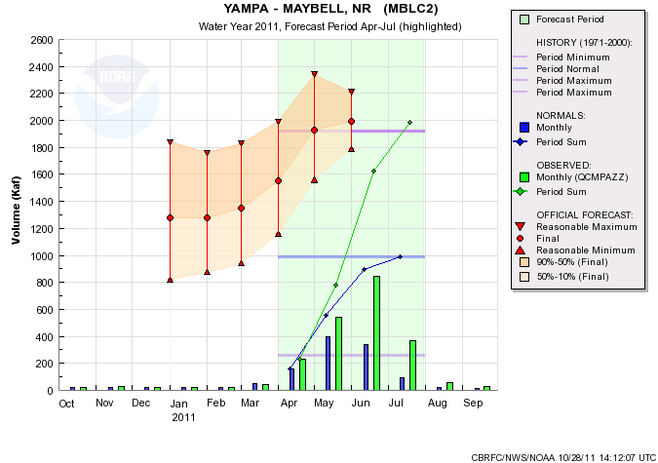
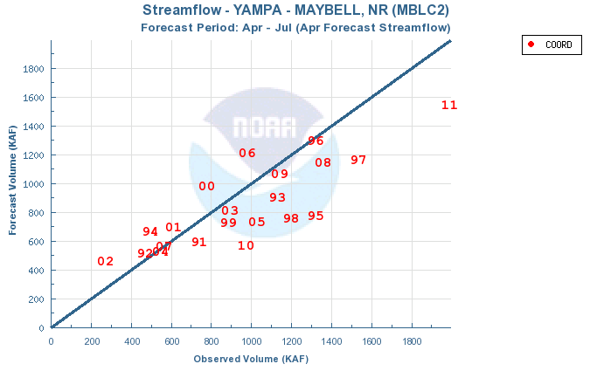
1988
201%

Slide 11
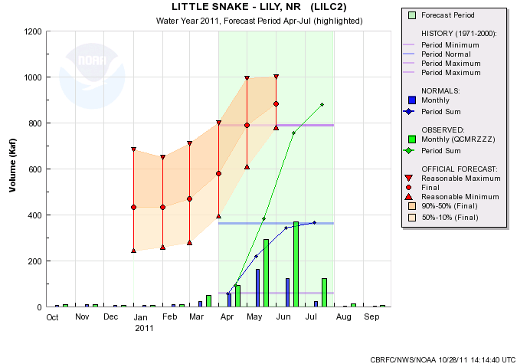
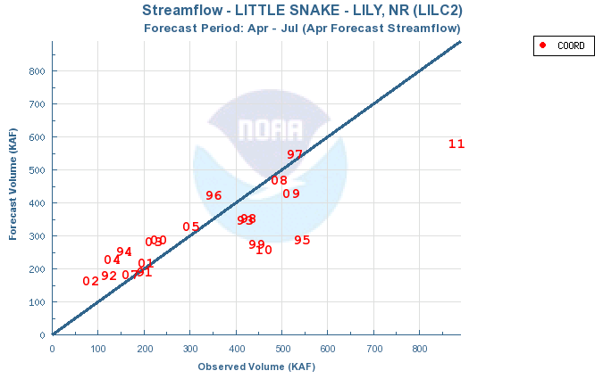
881
241%

Slide 12
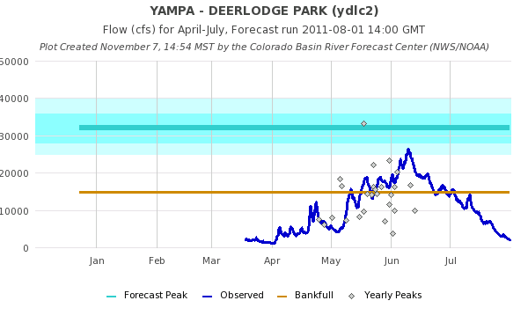
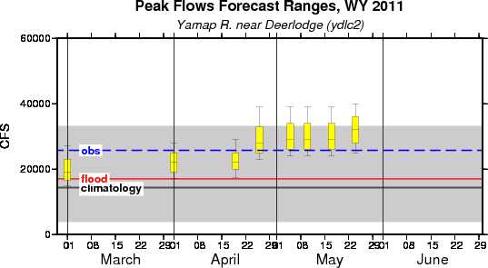

Slide 13
Green River Basin Records
LOCATION | NEW RECORD | OLD RECORD | % DIFF | OLD RECORD YEAR
East Fork of Smiths Fork | 64 | 57 | 12% | 1983
Blacks Fork nr Robertson | 202 | 125 | 62% | 1975
Yampa abv Stagecoach | 69 | 56 | 23% | 1997
Yampa at Steamboat Springs | 507 | 506 | 0% | 1984
Elk nr Milner | 742 | 552 | 34% | 1917
Elk Head nr Hayden | 171 | 119 | 44% | 1997
Yampa at Maybell | 1988 | 1921 | 3% | 1984
Little Snake nr Slater | 353 | 281 | 26% | 1984
Little Snake at Dixon | 775 | 754 | 3% | 1984
Little Snake at Lily | 881 | 790 | 12% | 1984
White River nr Meeker | 521 | 519 | 0% | 1984
West Fork Duchesne | 44 | 38 | 16% | 1986
Duchesne nr Tabiona | 217 | 189 | 15% | 1952
Upper Stillwater-Rock Creek | 153 | 136 | 13% | 1986
Rock Creek | 186 | 158 | 18% | 1986
Strawberry nr Solider Springs | 158 | 137 | 15% | 1986
Lake Fork- Moon Lake | 127 | 112 | 13% | 2005
Yellowstone nr Altonah | 125 | 114 | 10% | 2005
Duchesne-Myton | 824 | 766 | 8% | 1952
Duchesne-Randlett | 1011 | 942 | 7% | 1983
Green River-Green River,UT | 6490 | 5856* | 11% | 1983
RED=Single Month Volume > April-July Average
*POR after regulation
White/Yampa=10 /10
Duchesne=10/16

Slide 14
Upper Colorado Basin
Slightly above normal seasonal precipitation through March 2011
Sustained cool and wet period April-June
Many record or near records for precipitation, runoff volumes, etc
Precipitation and runoff volumes greater to the north (e.g. Granby, Dillon, etc) and less to the south (e.g. Gunnison) and still less in the Dolores
Mainstem
Gunnison
Dolores

Slide 15
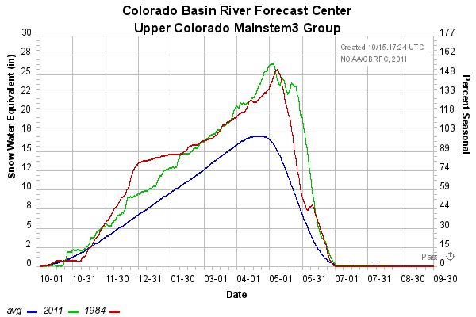
Upper Colorado Mainstem Basin Conditions
As of July 1, 2011
As of August 1, 2011

Slide 16
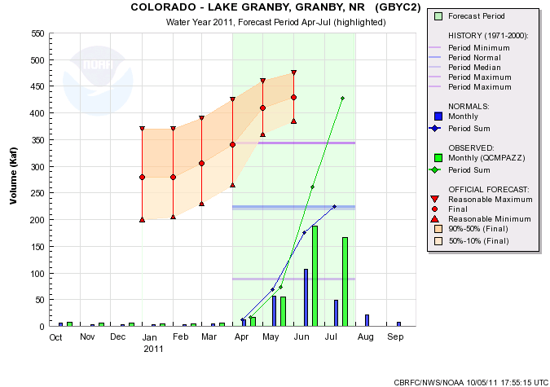
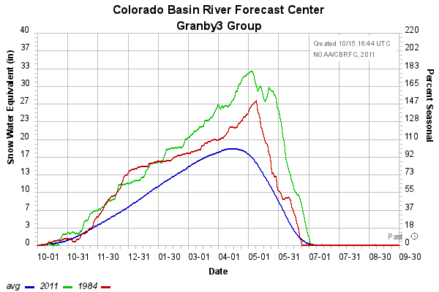
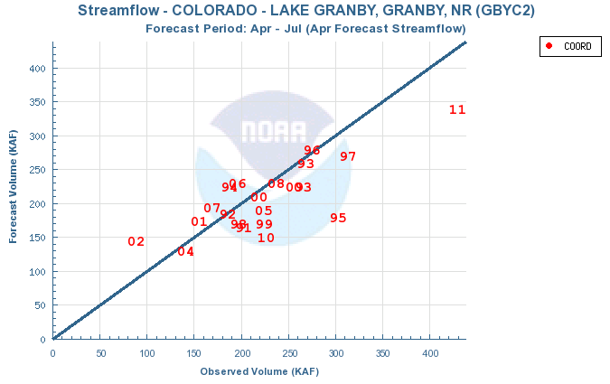
Record Runoff
428
190%
343 (1984)
225

Slide 17
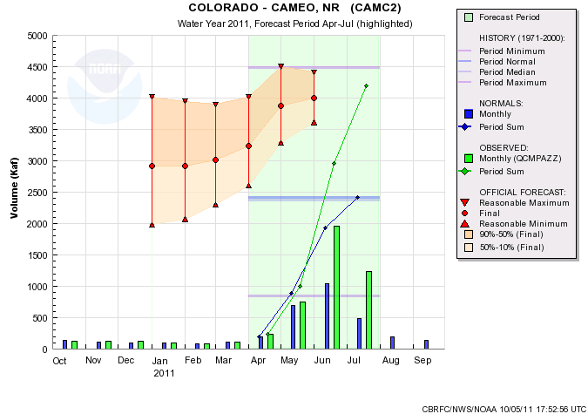
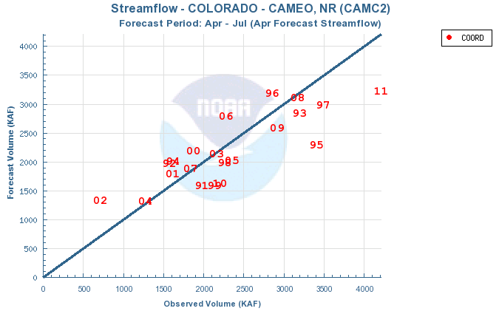
4489 (1984)
4200
174%
2420
 | ESP | SWS | NRCS | COOR | %
Jan | 2953 | 2910 | 2910 | 2910 | 120%
Feb | 2900 | 2910 | 2950 | 2910 | 120%
Mar | 3033 | 3000 | 3090 | 3020 | 125%
April | 3119 | 3180 | 3330 | 3240 | 134%
May | 3783 | 3924 | 3870 | 3870 | 160%
Jun | 4102 | 3995 | 4013 | 4000 | 165%

Slide 18
Upper Colorado Mainstem 2011 Volumes
 | April - July 2011 |  | Historical
 | Volume (kaf) | % avg | Ranking | Max (kaf) | Year
Lake Granby | 428 | 190% | 1 / 84 | 343 | 1984
Willow Creek Res | 125 | 245% | 1 / 92 | 85 | 1986
Fraser - Winter Park | 32 | 159% | 2 / 41 | 34 | 1984
Williams Fork Res | 155 | 163% | 2 / 52 | 162 | 1984
Dillon Res | 268 | 161% | 2 / 52 | 276 | 1984
Green Mountain Res | 468 | 167% | 3 / 74 | 490 | 1984
Wolford Mountain Res | 114 | 190% | 1 / 30 | 112 | 1984
Colorado - Kremmling | 1,767 | 203% | 1 / 41 | 1,562 | 1984
Eagle - Gypsum | 577 | 172% | 2 / 65 | 608 | 1984
Colorado - Dotsero | 2,720 | 189% | 1 / 71 | 2,496 | 1984
Ruedi Res | 218 | 154% | 2 / 42 | 255 | 1984
Roaring Fork - Glenwood | 1,026 | 145% | 3 / 42 | 1,244 | 1984
Colorado -Glenwood | 3,730 | 173% | 1 / 55 | 3,716 | 1984
Colorado - Cameo | 4,200 | 174% | 2 / 78 | 4,489 | 1984
Plateau Ck - Cameo | 164 | 142% | 13 / 76 | 318 | 1983
Colorado - Cisco | 6,894 | 148% | 5 / 42 | 8,988 | 1984
Lake Powell | 12,920 | 163% | 3 / 48 | 15,406 | 1984

Slide 19
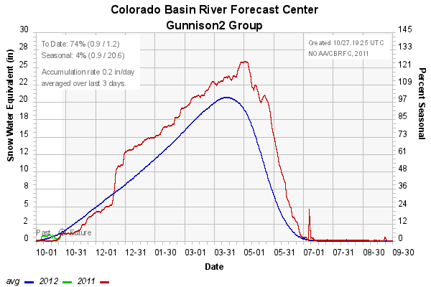
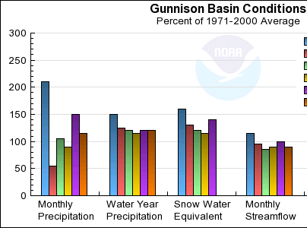
Gunnison Basin Conditions

Slide 20
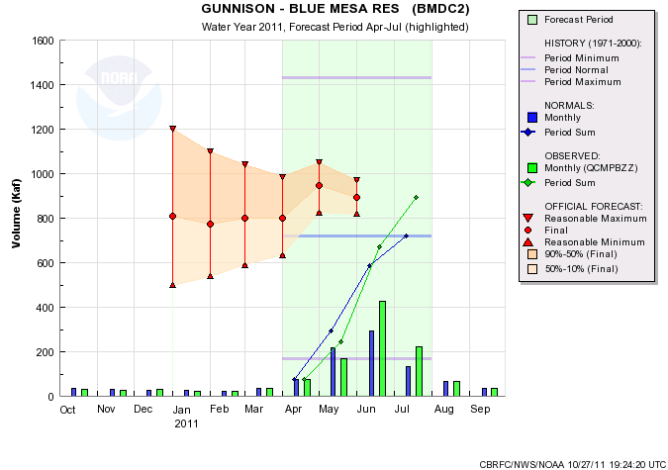
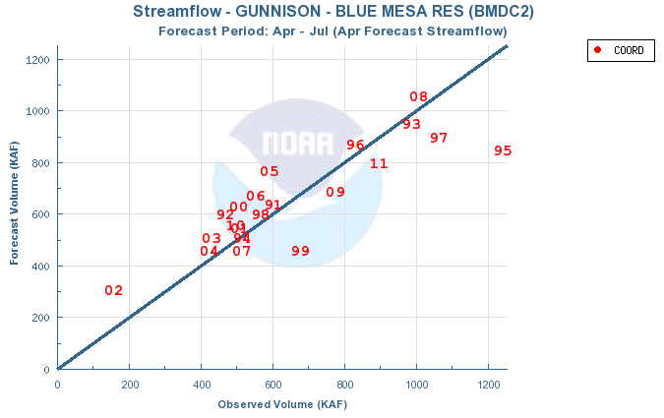
893
124%
 | ESP | SWS | NRCS | COOR | %
Jan | 730 | 962 | 907 | 810
Feb | 716 | 838 | 850 | 775
Mar | 744 | 861 | 882 | 800
April | 759 | 872 | 939 | 800
May | 844 | 925 | 1080 | 945
Jun | 850 | 773 | 885 | 895

Slide 21
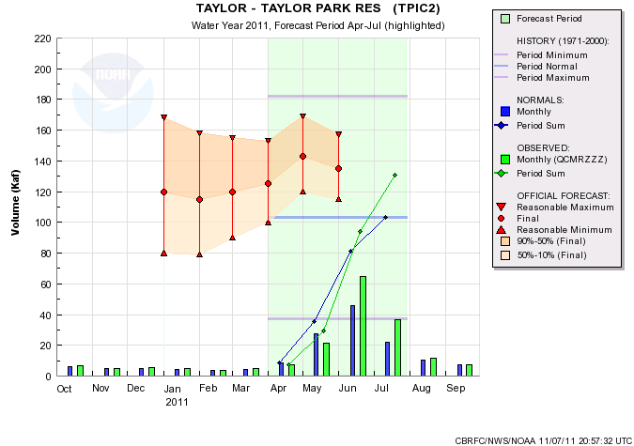
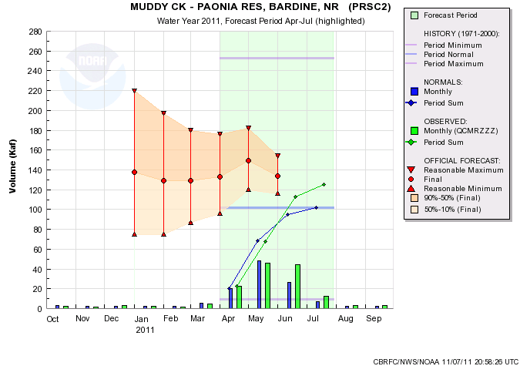
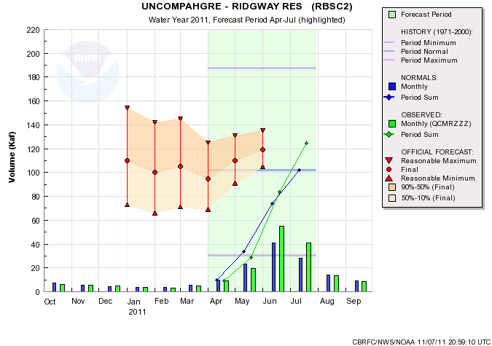
131
127%
125
123%
125
123%

Slide 22
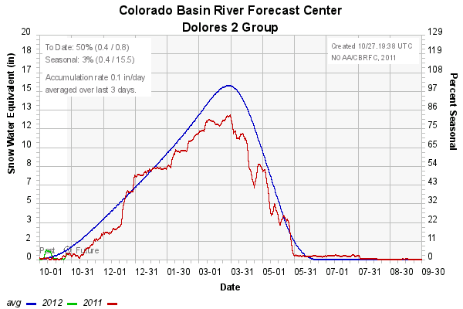
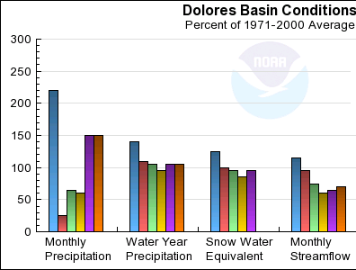
Dolores Basin Conditions

Slide 23
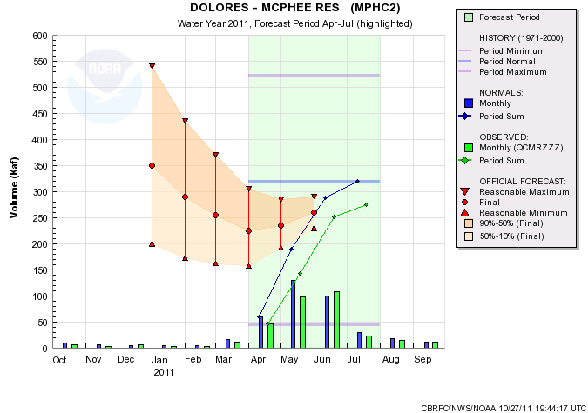
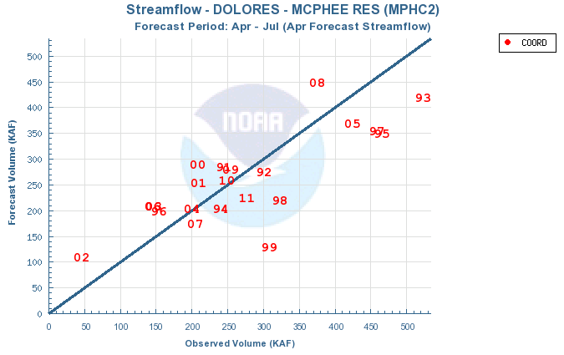
275
86%
 | ESP | SWS | NRCS | COOR | %
Jan | 307 | 363 | 368 | 350
Feb | 271 | 319 | 300 | 290
Mar | 244 | 316 | 284 | 255
April | 200 | 244 | 262 | 225
May | 220 | 265 | 292 | 235
Jun | 260 | 231 | 289 | 259

Slide 24
San Juan Basin
Near to Below normal year
Evidence of La Nina

Slide 25
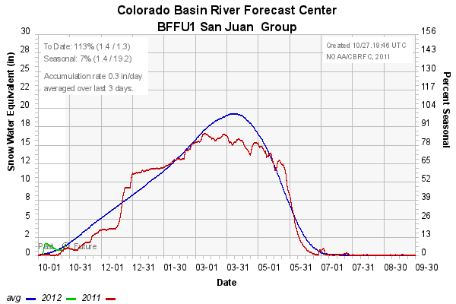
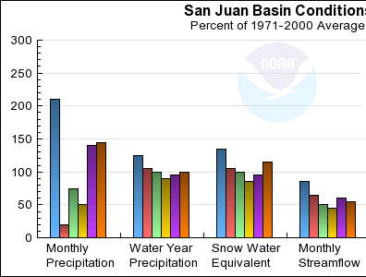
San Juan Basin Conditions

Slide 26
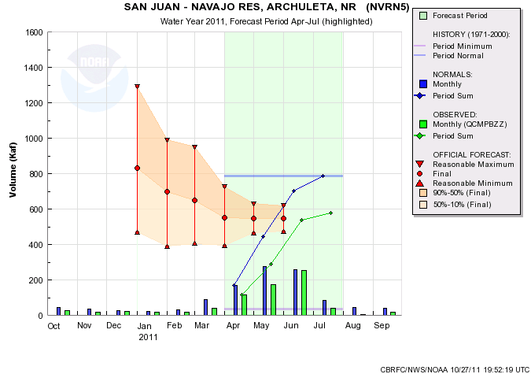
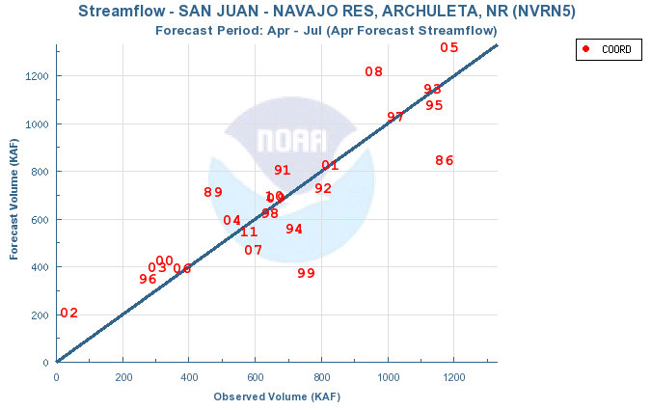
579
75%
 | ESP | SWS | NRCS | COOR | %
Jan | 823 | 922 | 869 | 830
Feb | 742 | 796 | 620 | 700
Mar | 651 | 794 | 647 | 650
April | 524 | 675 | 543 | 550
May | 534 | 719 | 578 | 545
Jun | 581 | 663 | 555 | 545

Slide 27
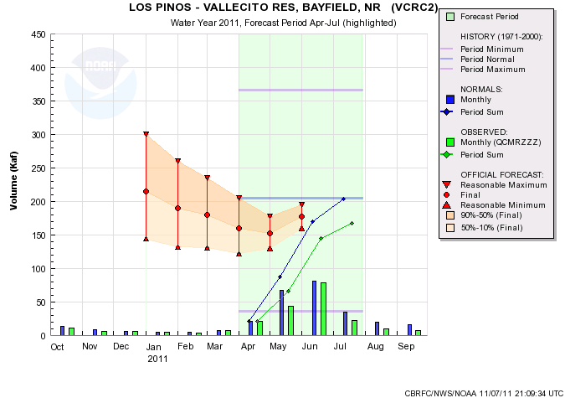
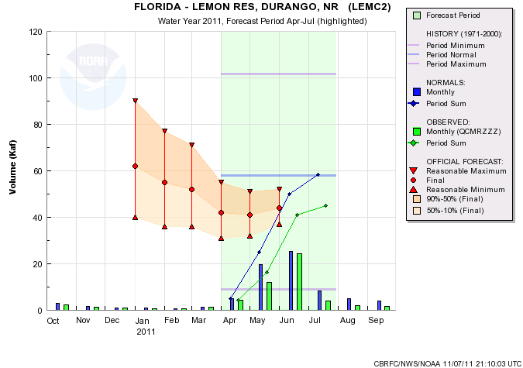
168
82%
45
78%

Slide 28
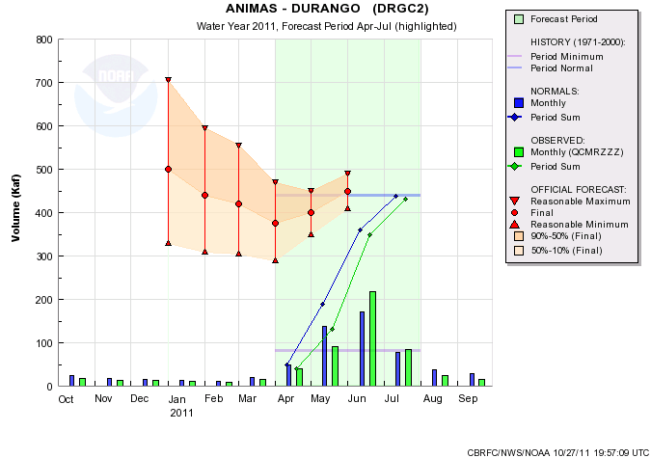
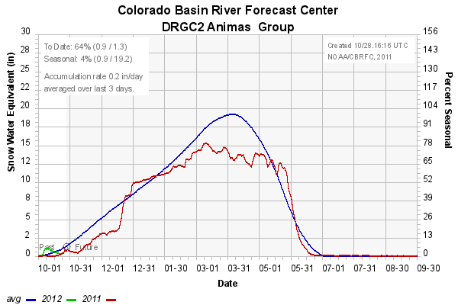
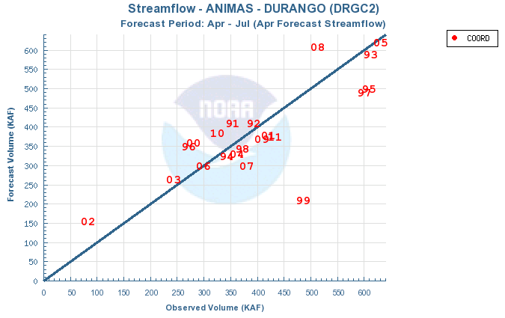
431
98%

Slide 29
Lake Powell
Historical Observed Apr-Jul Volumes (kaf) 1970-2010 (winter ENSO status)
( 1) - 1984 - 15406.41 (neutral)
( 2) - 1983 - 14838.93 (el nino)
( 3) - 1986 - 12601.21 (neutral)
( 4) - 1995 - 11833.18 (el nino)
( 5) - 1985 - 11701.11 (la nina)
( 6) - 1997 - 11320.89 (neutral)
( 7) - 1973 - 11262.74 (el nino)
( 8) - 1979 - 11104.25 (neutral)
( 9) - 1980 - 10606.60 (neutral)
( 10) - 1993 - 9984.42 (neutral)
( 11) - 1975 - 9953.16 (la nina 2)
( 12) - 2008 - 8908.50 (la nina)
( 13) - 2005 - 8844.02 (el nino)
( 14) - 1978 - 8678.09 (el nino 2)
( 15) - 1998 - 8510.14 (el nino)
( 16) - 1982 - 8210.63 (neutral)
( 17) - 1971 - 8180.35 (la nina)
( 18) - 1970 - 8037.76 (neutral)
( 19) - 2009 - 7806.72 (neutral)
( 20) - 1999 - 7788.09 (la nina)
( 21) - 1987 - 7758.54 (el nino)
( 22) - 1996 - 7233.47 (la nina)
( 23) - 1974 - 6915.13 (la nina)
( 24) - 2010 - 5795.43 (el nino)
( 25) - 1972 - 5494.26 (neutral)
( 26) - 2006 - 5319.56 (neutral)
( 27) - 1976 - 5297.75 (la nina 3)
( 28) - 1991 - 5159.33 (el nino)
( 29) - 1988 - 4567.47 (el nino 2)
( 30) - 2000 - 4367.05 (la nina 2)
( 31) - 2001 - 4320.62 (la nina 3)
( 32) - 1992 - 4124.42 (neutral)
( 33) - 2007 - 4053.47 (el nino)
( 34) - 2003 - 3910.17 (el nino)
( 35) - 1994 - 3766.48 (neutral)
( 36) - 2004 - 3542.00 (neutral)
( 37) - 1989 - 3524.63 (la nina)
( 38) - 1990 - 3228.85 (neutral)
( 39) - 1981 - 3058.61 (neutral)
( 40) - 1977 - 1277.39 (el nino)
( 41) - 2002 - 1126.76 (neutral)
2011 – 12,920 (la nina)
3rd highest April-July volume since the closure of the dam

Slide 30
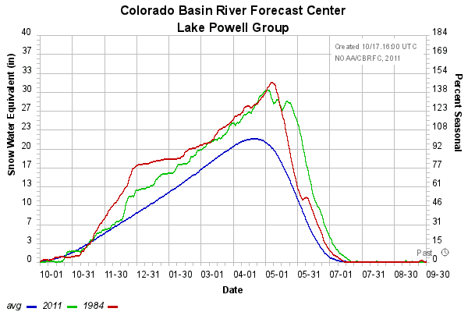
Lake Powell Basin Conditions

Slide 31
15.7 (1917)
12.9 maf
163%
7.9
 | ESP | SWS | NRCS | COOR | %
Jan | 9785 | 9770 | 9500 | 9500 | 120%
Feb | 8989 | 9500 | 8800 | 9000 | 113%
Mar | 9520 | 9370 | 9200 | 9200 | 116%
April | 9519 | 9800 | 9500 | 9500 | 120%
May | 11521 | 12000 | 11500 | 11500 | 145%
Jun | 12590 | 12700 | 12470 | 12600 | 159%

Slide 32
6490
205%
6894
148%
12.9
163%
888
72%

Slide 33
Lower Colorado Basin
Much below average except in northwest (e.g. Virgin, Muddy, etc)
Virgin:
December 2010 storm track was important, but also wet April-May.
Snowpack persisted due to cool temperatures, melt delayed.
Virgin
Phoenix dust storm

Slide 34
December Precipitation

Slide 35
Virgin Basin Conditions

Slide 36
149
217%

Slide 37
Pre Holiday Storm:
Lake Mead up ~2 feet from local runoff
Large snow accumulation

