Slide 1

CRFS Technical Committee
Fall Meeting
LC Operations Update
November 20, 2014

Slide 2
Topics
LC Current Conditions Update
LC Operations Update

Slide 3
Colorado River Basin Storage
(as of November 18, 2014)
Current Storage | Percent Full | Storage (maf) | Elevation (feet)
Lake Powell | 49% | 11.97 | 3,602
Lake Mead | 40% | 10.40 | 1,085
Lake Mohave | 82% | 1.49 | 635
Lake Havasu | 89% | 0.55 | 446
Total System Storage* | 50% | 29.83 | NA
*Total system storage was 29.50 maf or 49% this time last year
Notes:
3

Slide 4
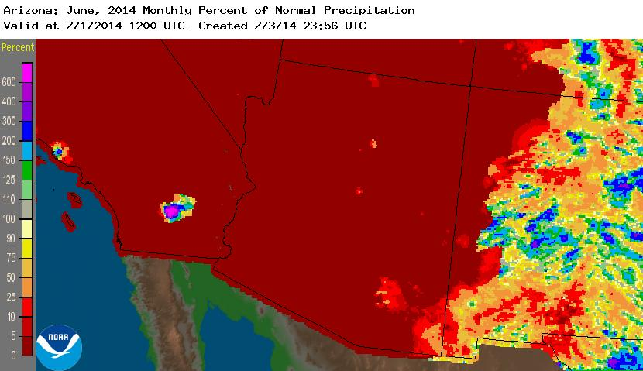
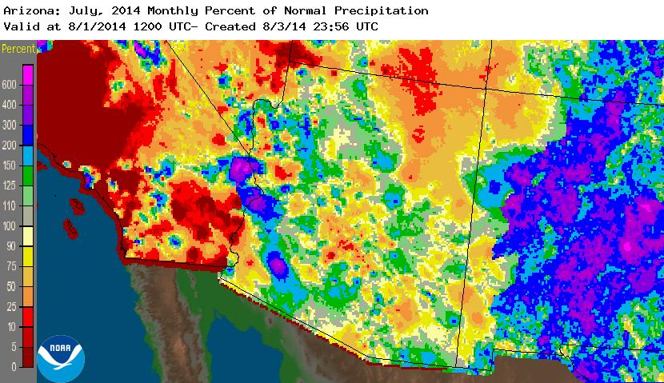
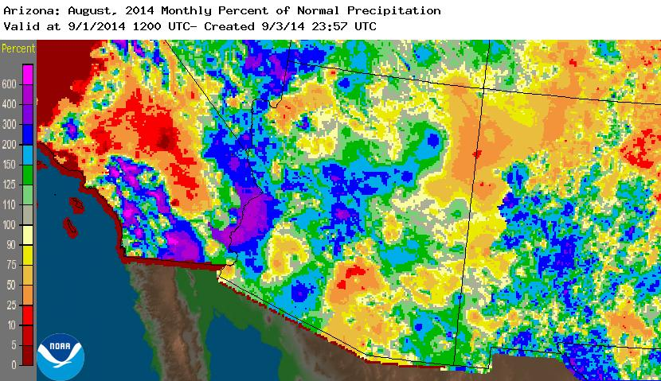
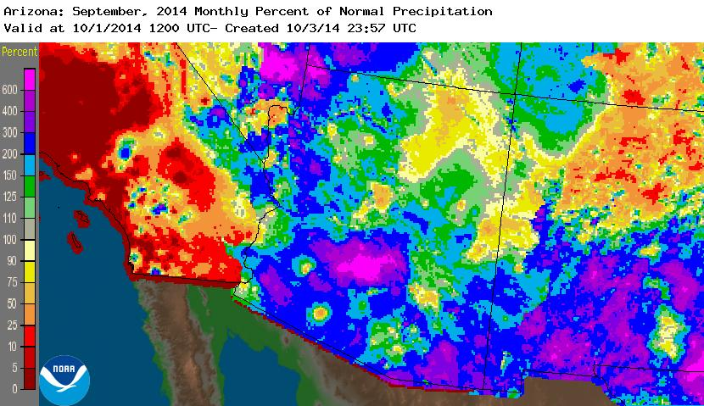
Monsoonal Storm Results
Source: http://water.weather.gov/precip/

Slide 5
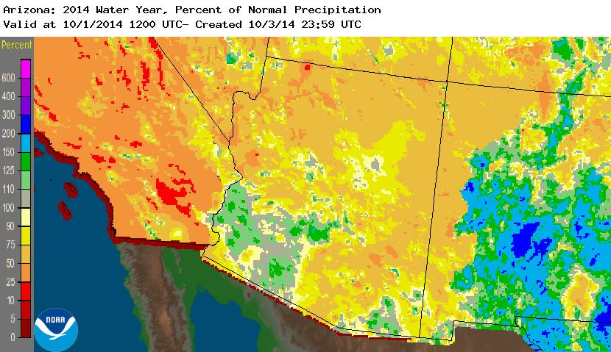
Water Year 2014 Precipitation
Source: http://water.weather.gov/precip/

Slide 6
Lower Basin Side Inflows – WY/CY 2014^{1,2}
Intervening Flow from Glen Canyon to Hoover Dam
Month in WY/CY 2014 |  | 5-Year Average Intervening Flow (KAF) | Observed Intervening Flow (KAF) | Observed Intervening Flow (% of Average) | Difference From 5-Year Average (KAF)
HISTORICAL | October 2013 | 52 | 38 | 73% | -14
 | November 2013 | 52 | 101 | 194% | 49
 | December 2013 | 95 | 43 | 45% | -52
 | January 2014 | 75 | 45 | 60% | -30
 | February 2014 | 78 | 76 | 97% | -2
 | March 2014 | 68 | 29 | 43% | -39
 | April 2014 | 80 | 17 | 21% | -63
 | May 2014 | 60 | 13 | 22% | -47
 | June 2014 | 23 | 10 | 43% | -13
 | July 2014 | 64 | 54 | 84% | -10
 | August 2014 | 116 | 113 | 97% | -3
 | September 2014 | 97 | 140 | 144% | 43
 | October 2014 | 52 | 66 | 127% | 14
PROJ | November 2014 | 52
 | December 2014 | 95
 | WY 2014 Totals | 860 | 679 | 79% | -181
 | CY 2014 Totals | 860 | 710 | 83% | -150
¹ Values were computed with the LC’s gain-loss model for the most recent 24-month study.
² Percents of average are based on the 5-year mean from 2009-2013.

Slide 7
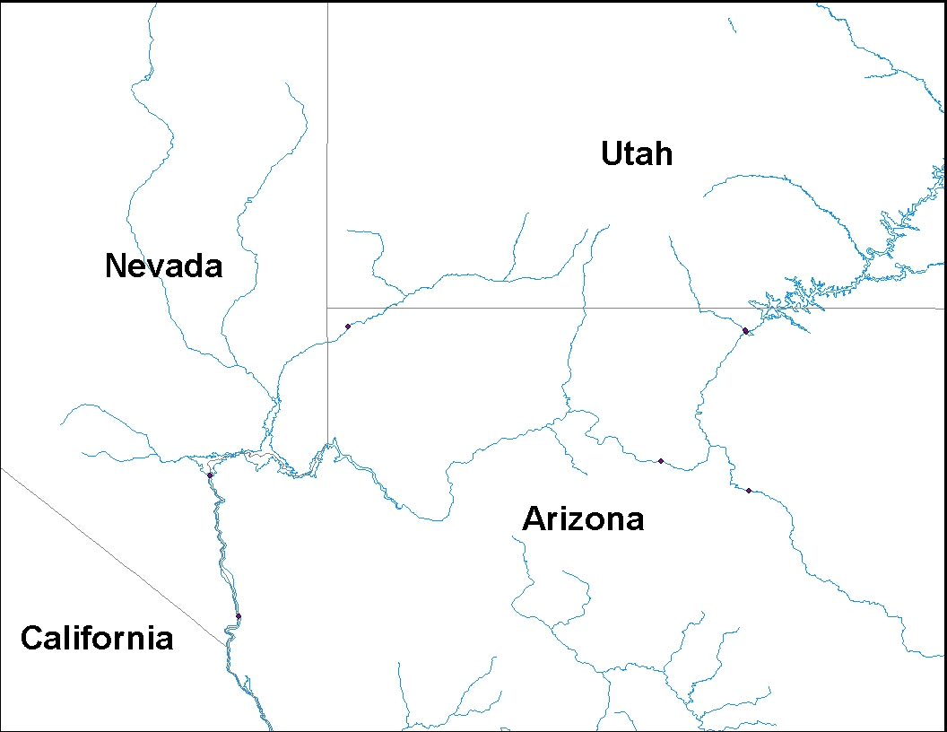
Lake Mead Intervening Flow Forecast – November 2014
Based on CBRFC Forecast dated November 17, 2014
Total Intervening Flow: 45 KAF (79% of average from 1981-2010)
24-Month Study Intervening Flow¹: 52 KAF
Lake Powell
Virgin River
8.0 KAF (66% / 68%)
Paria River
1.5 KAF (110% / 117%)
Lake Mead
Little Colorado River
0.5 KAF (13% / 130%)
(% of Average / % of Median)
¹ This value is based on the 5-year average from 2009-2013.
The 24-month study uses a 5-year average to model intervening flows between Glen Canyon Dam and Lake Mead.

Slide 8
LC’s intervening flow values were computed with the gain-loss model for the most recent 24-month study.

Slide 9
Lower Basin Side Inflows Comparison
WY 2008 – WY 2014
Pearson R: 0.811
Pearson R: 0.801
Pearson R: -0.748
Pearson R: 0.907
LC’s intervening flow values were computed with the gain-loss model for the most recent 24-month study.

Slide 10
Lower Basin Side Inflows Comparison
WY 2008 – WY 2014
Pearson R: -0.001
Pearson R: 0.082
Pearson R: -0.971
Pearson R: 0.666
LC’s intervening flow values were computed with the gain-loss model for the most recent 24-month study.

Slide 11
End of Water Year 2014 Conditions
Observed Unregulated Inflow into Powell¹ = 10.38 maf (96% of average)
Lake Mead
Lake Powell
1,219.6
26.120 maf
24.322 maf
3,700
17.0 maf
3,648
1,145
16.2 maf
1,105
12.2 maf
3,605.53 feet
12.29 maf in storage
51% of capacity
1,081.33 feet
10.12 maf in storage
39% of capacity
9.5 maf
3,575
1,075
9.6 maf
5.9 maf
3,525
1,025
6.0 maf
7.48 maf
0.0 maf
3,370
895
0.0 maf
Dead Storage
1.9 maf
2.5 maf
Dead Storage
Not to Scale
¹ Percent of average inflow is based on the 30-year period of record from 1981-2010 .

Slide 12
Lower Basin Operations
Calendar Year 2015
Lake Mead Operating Conditions
Operating under the Normal/ICS Surplus Condition
  Lower Basin projected water use of 7.5 maf +/- ICS created or delivered
  Mexico projected to take delivery of 1.5 maf +/- any water deferred or delivered

Slide 13
End of Calendar Year 2014 Projections
November 2014 24-Month Study Most Probable Inflow Scenario¹
Based on a 9.00 maf release pattern from Lake Powell in Water Year 2015
Lake Mead
Lake Powell
1,219.6
26.120 maf
24.322 maf
3,700
17.1 maf
3,649
1,145
16.2 maf
1,105
12.2 maf
3,598.24 feet
11.58 maf in storage
48% of capacity
1,087.52 feet
10.64 maf in storage
41% of capacity
9.5 maf
3,575
1,075
9.6 maf
5.9 maf
3,525
1,025
6.0 maf
0.0 maf
3,370
895
0.0 maf
Dead Storage
1.9 maf
2.5 maf
Dead Storage
Not to Scale
¹ WY 2015 unregulated inflow into Lake Powell is based on the CBRFC outlook dated 11/3/14.

Slide 14
End of Water Year 2015 Projections
November 2014 24-Month Study Most Probable Inflow Scenario¹
Projected Unregulated Inflow into Powell¹ = 9.55 maf (88% of average)
Lake Mead
Lake Powell
1,219.6
26.120 maf
24.322 maf
3,700
17.1 maf
3,649
1,145
16.2 maf
3,603.47 feet
12.08 maf in storage
50% of capacity
1,105
12.2 maf
9.5 maf
3,575
1,075
1,075.24 feet
9.62 maf in storage
37% of capacity
9.6 maf
5.9 maf
3,525
1,025
6.0 maf
9.00 maf
0.0 maf
3,370
895
0.0 maf
Dead Storage
1.9 maf
2.5 maf
Dead Storage
Not to Scale
¹ WY 2015 unregulated inflow into Lake Powell is based on the CBRFC outlook dated 11/3/14.

Slide 15
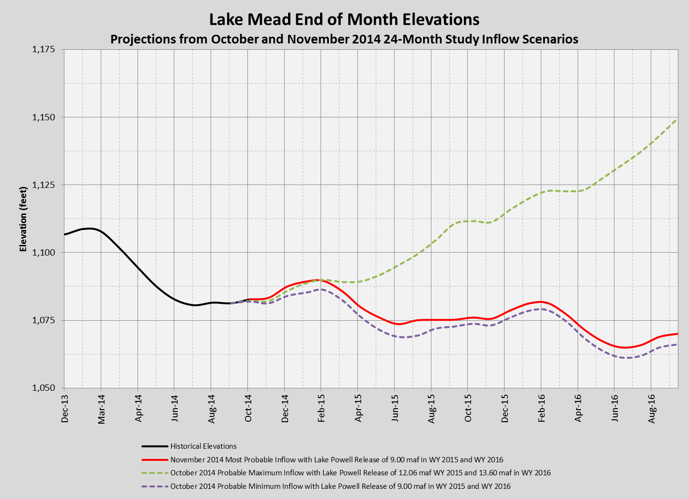
Most Probable Scenario:
EOY Elevation: 1,087.52 feet
CY14 Decline: 19.2 feet
Most Probable Scenario
EOY Elevation: 1,078.70 feet
CY15 Decline: 8.8 feet

Slide 16
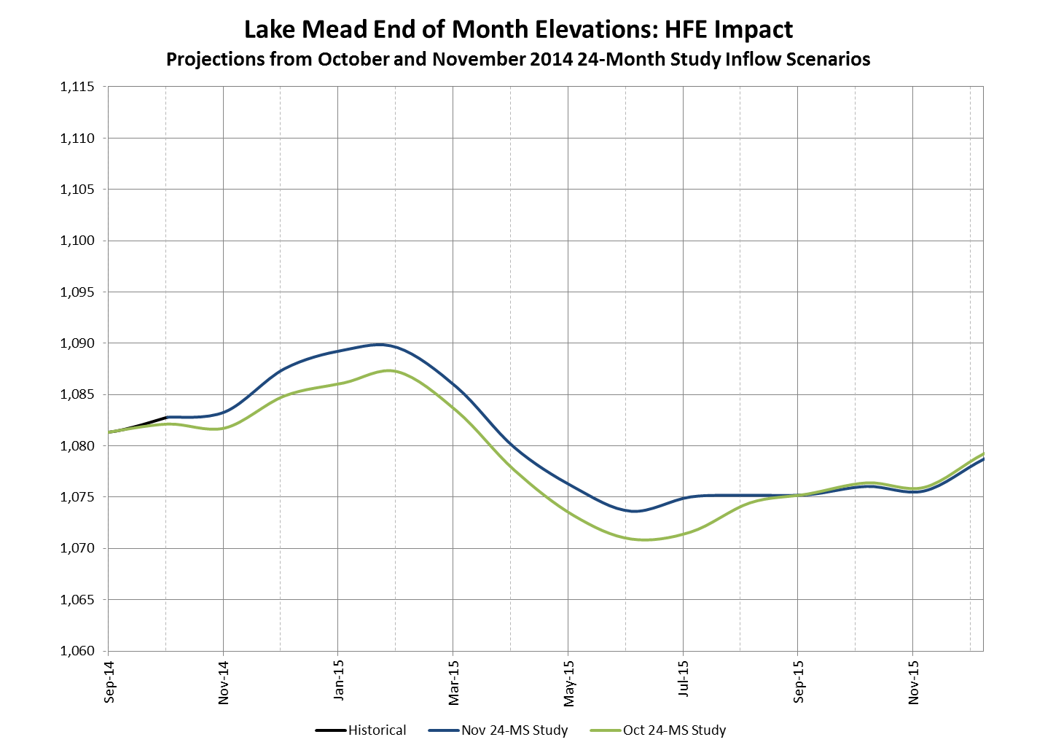
Oct Study: WY 15 Glen Canyon Release = 9.0 maf
Nov Study: WY 15 Glen Canyon Release = 9.0 maf
Elev. Diff: +1.6 feet
Elev. Diff: +2.6 feet
Elev. Diff: +3.2 feet
Elev. Diff: +2.7 feet

Slide 17
Percent of Traces with Event or System Condition
Results from October 2014 CRSS^{1,2,3} (values in percent)
 | Event or System Condition | 2015 | 2016 | 2017 | 2018 | 2019
Upper Basin – Lake Powell | Equalization Tier | 8 | 23 | 25 | 26 | 30
 | Equalization – annual release > 8.23 maf | 8 | 23 | 25 | 26 | 29
 | Equalization – annual release = 8.23 maf | 0 | 0 | 0 | 0 | 1
 | Upper Elevation Balancing Tier | 92 | 59 | 55 | 54 | 45
 | Upper Elevation Balancing – annual release > 8.23 maf | 49 | 47 | 43 | 41 | 33
 | Upper Elevation Balancing – annual release = 8.23 maf | 43 | 10 | 11 | 10 | 12
 | Upper Elevation Balancing – annual release < 8.23 maf | 0 | 2 | 1 | 3 | 0
 | Mid-Elevation Release Tier | 0 | 18 | 18 | 11 | 17
 | Mid-Elevation Release – annual release = 8.23 maf | 0 | 0 | 0 | 1 | 3
 | Mid-Elevation Release – annual release = 7.48 maf | 0 | 18 | 18 | 10 | 14
 | Lower Elevation Balancing Tier | 0 | 0 | 2 | 9 | 8
Lower Basin – Lake Mead | Shortage Condition – any amount (Mead ≤ 1,075 ft) | 0 | 25 | 53 | 62 | 61
 | Shortage – 1st level (Mead ≤ 1,075 and ≥ 1,050) | 0 | 25 | 40 | 44 | 37
 | Shortage – 2nd level (Mead < 1,050 and ≥ 1,025) | 0 | 0 | 13 | 14 | 14
 | Shortage – 3rd level (Mead < 1,025) | 0 | 0 | 0 | 4 | 10
 | Surplus Condition – any amount (Mead ≥ 1,145 ft) | 0 | 0 | 6 | 9 | 15
 | Surplus – Flood Control | 0 | 0 | 0 | 1 | 2
 | Normal or ICS Surplus Condition | 100 | 75 | 41 | 29 | 24
¹ Reservoir initial conditions based on the most probable October 24-month Study projected levels for December 31, 2014.
² Hydrologic inflow traces based on resampling of the observed natural flow
record from 1906-2010.
³ Percentages shown may not be representative of the full range of future
possibilities that could occur with different modeling assumptions.

Slide 18
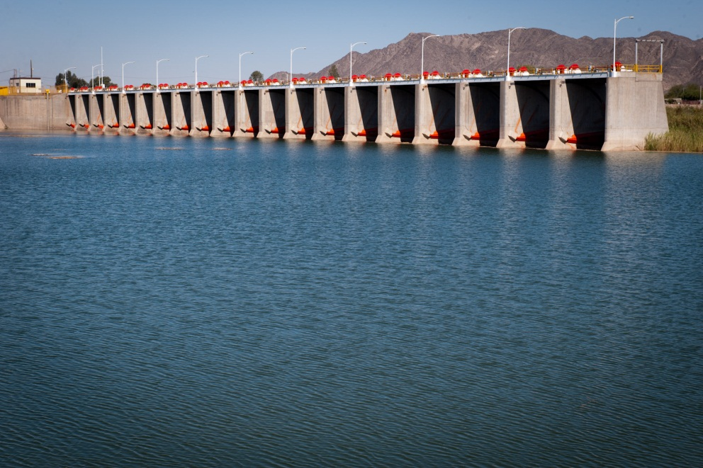
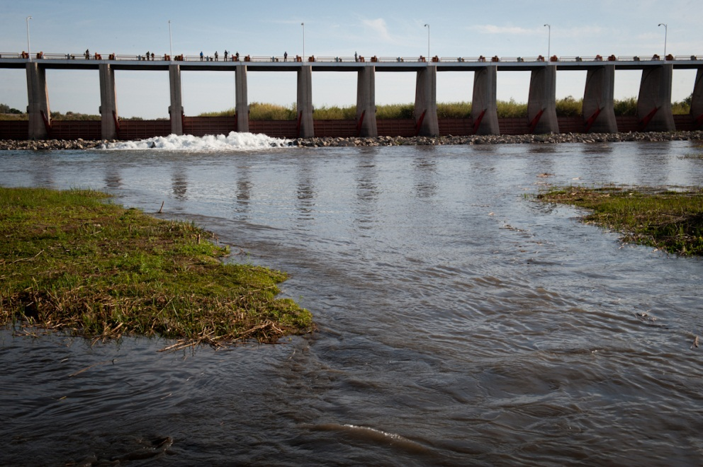
Additional Operational Data
(provisional year-to-date values)
Mexico Excess Flows (af) | Brock Reservoir Stored (af) | Senator Wash Stored (af)
31,376 | 130,340 | 86,570
Through 11/18/14 | Through 11/7/14 | Through 11/7/14
Morelos Dam Pictured Above – April 2014
Alexander Stephens (USBR)

Slide 19

Lower Colorado River
Operations
For further information: http://www.usbr.gov/lc/region
Email at:
bcoowaterops@usbr.gov

