Slide 1
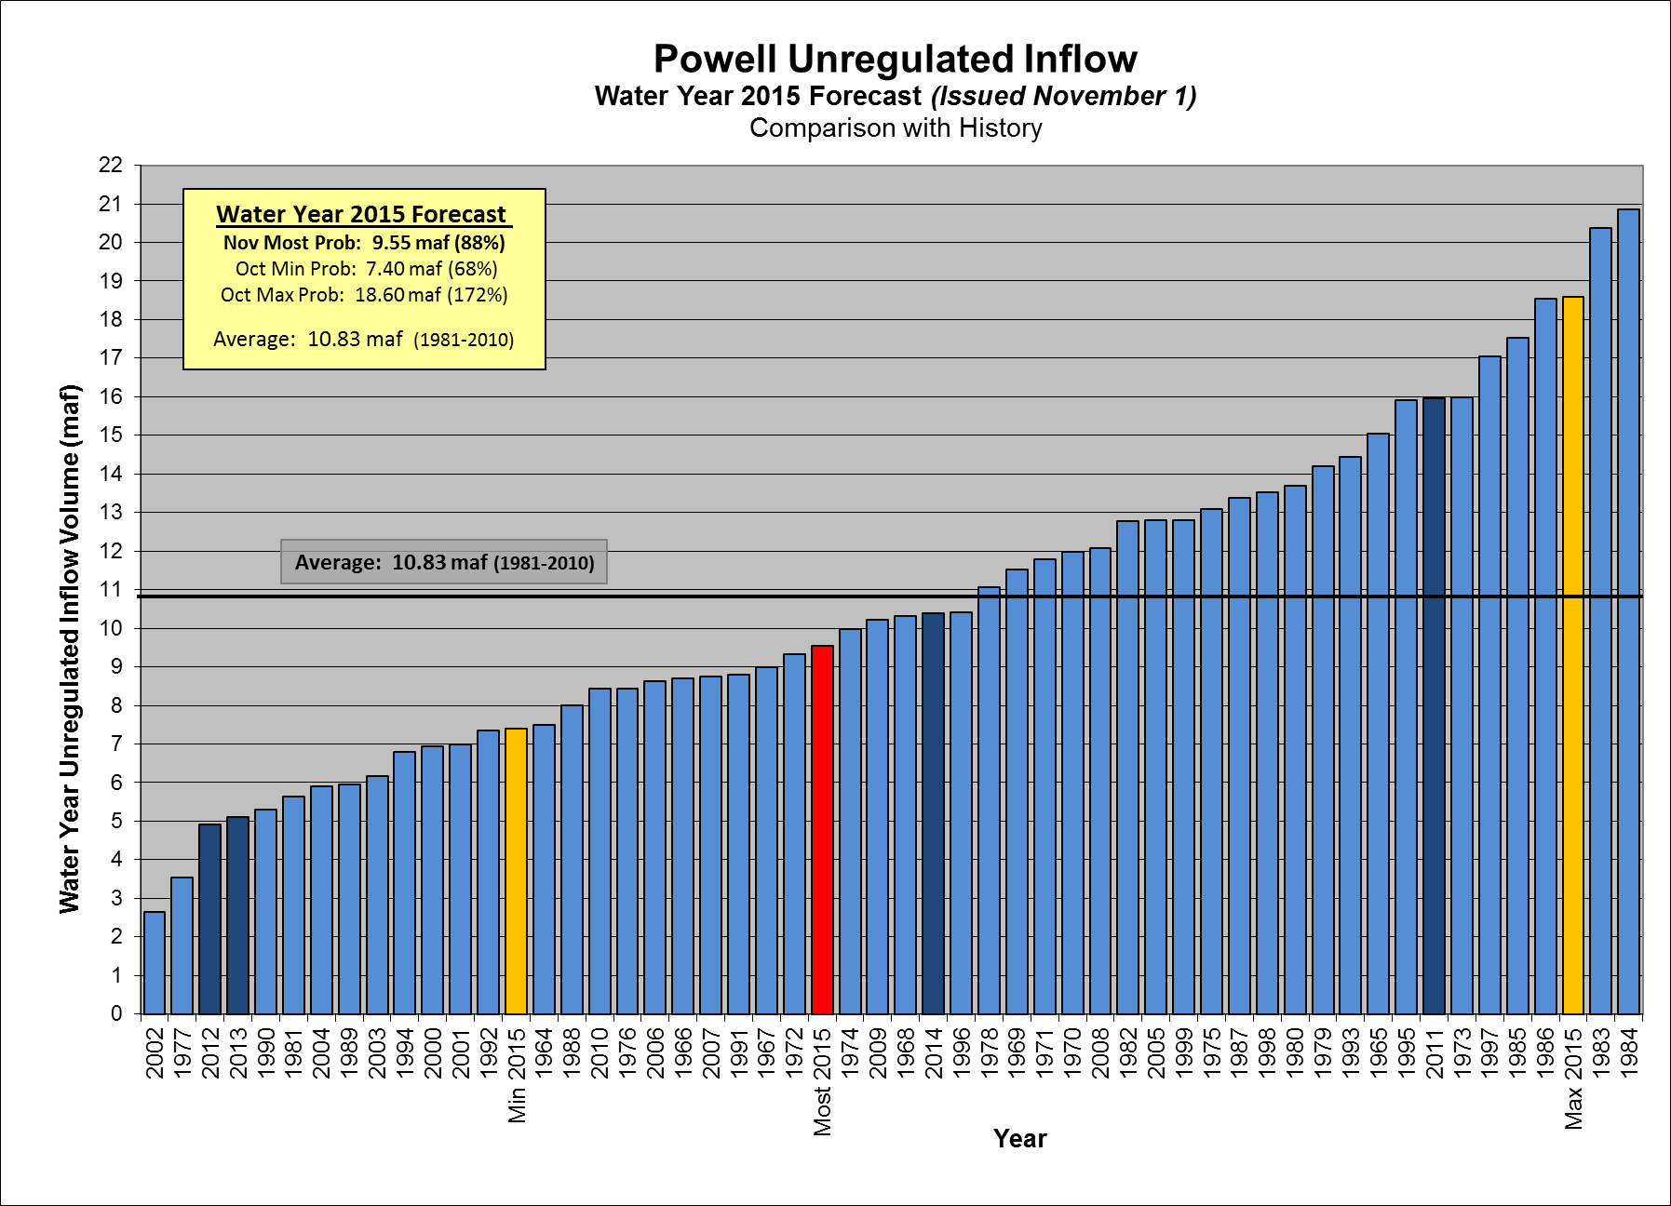

Slide 2
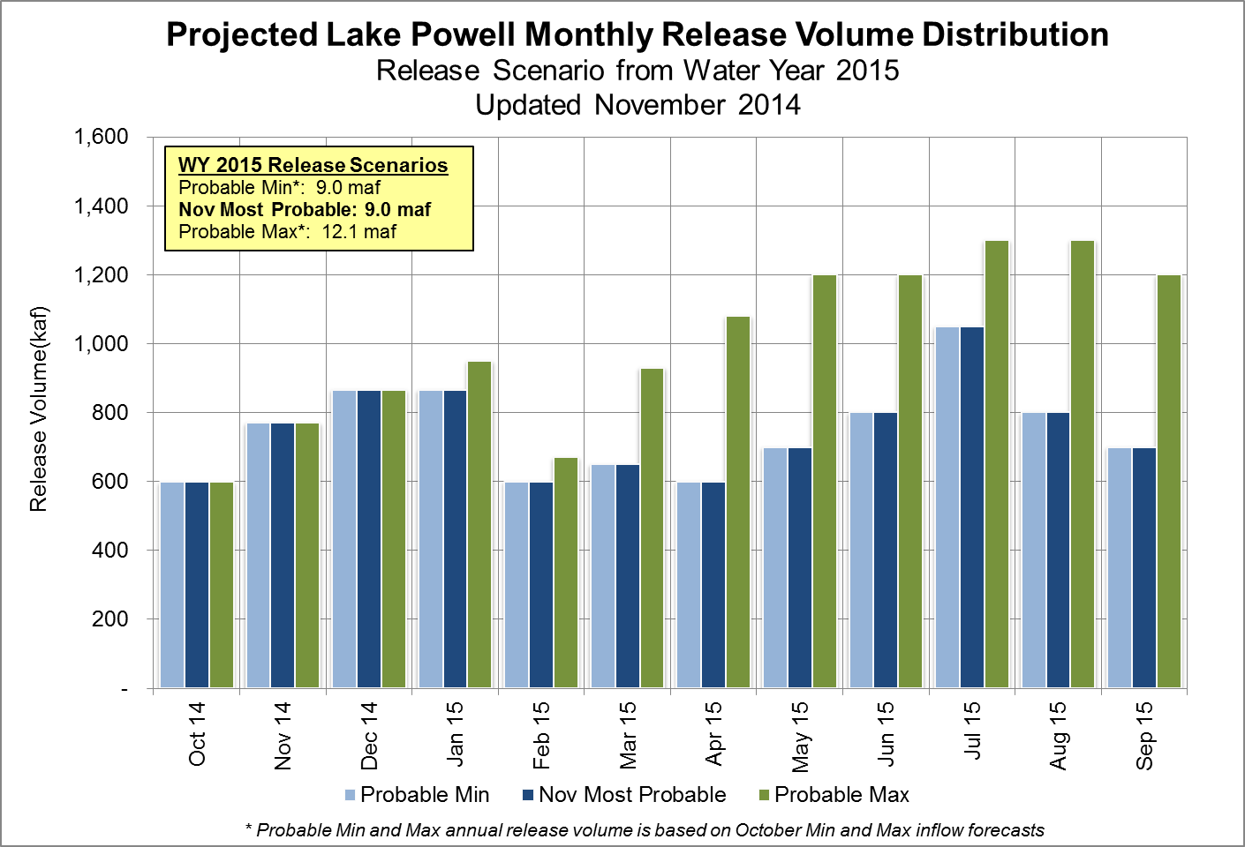

Slide 3
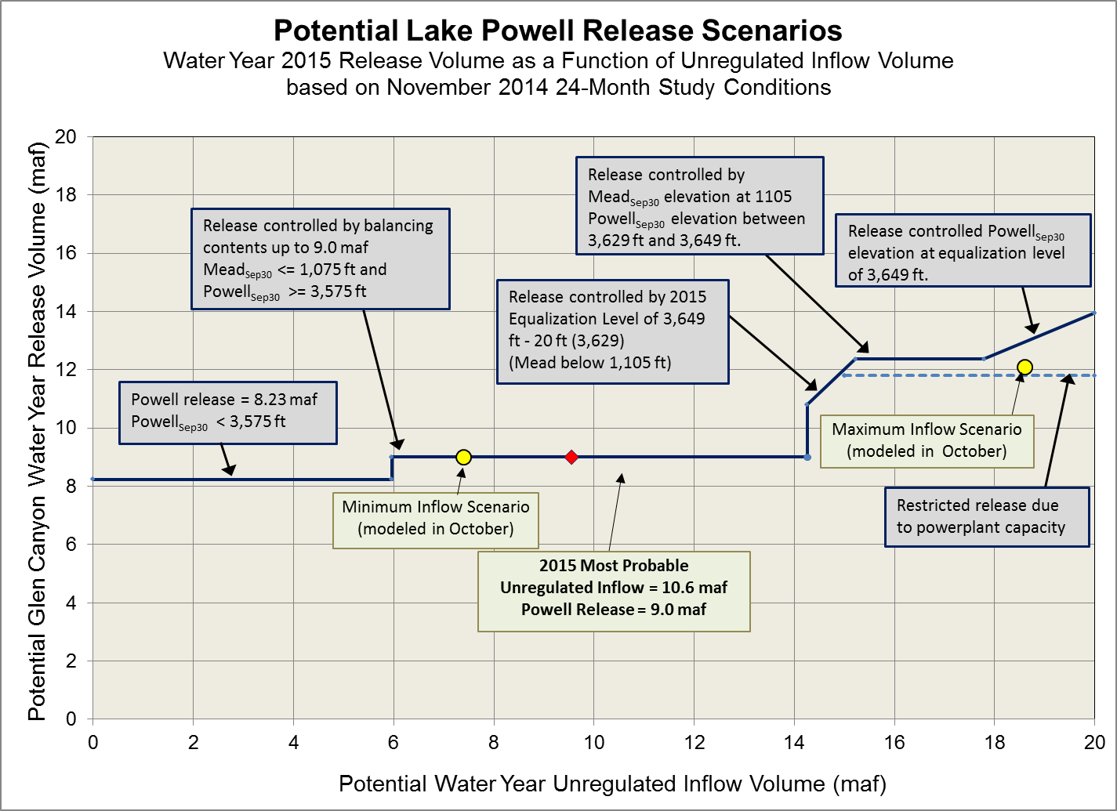

Slide 4
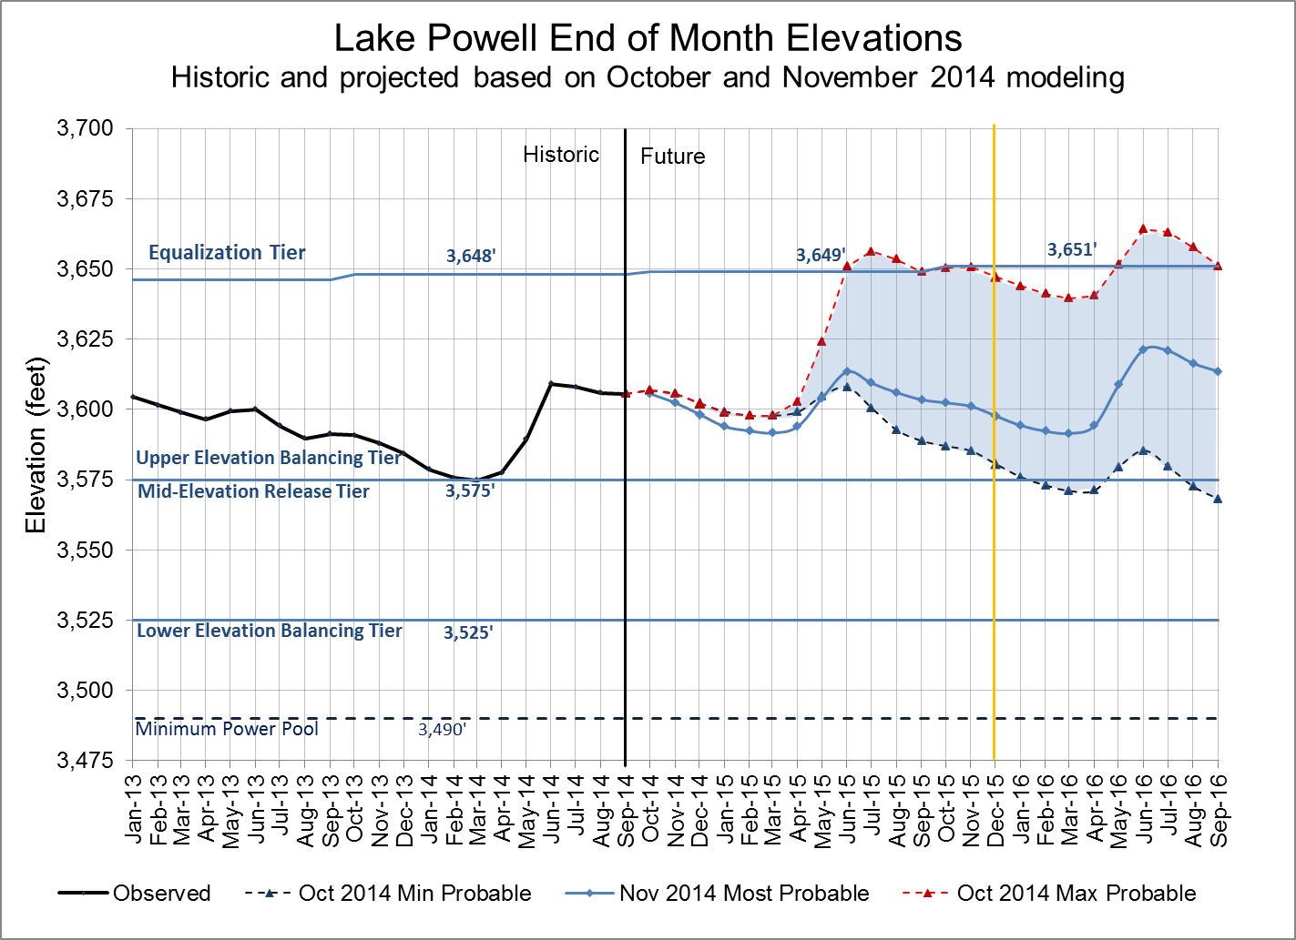
Water Year 2015 projections
Most: 9.0 maf release
Max: 12.1 maf release
Min: 9.0 maf release
Notes:
Excel file: U:\1_Powell Ops\5_Spreadsheets\24 Month Study Data\Powell_Projected_Ele_Nov2012.xlsx

Slide 5
Glen Canyon Power Plant Provisional Unit Outage Schedule for Water Year 2015
Unit Number | Oct 2014 | Nov 2014 | Dec 2014 | Jan 2015 | Feb 2015 | Mar 2015 | Apr 2015 | May 2015 | Jun 2015 | Jul 2015 | Aug 2015 | Sep 2015
1
2
3
4
5
6
7
8
Units Available | 5 | 7 | 6 | 6 | 4 |  | 6 |  | 6 | 6 | 6 | 6
Capacity (cfs) | 14,400 | 21,500 | 18,100 | 18,100 | 11,300 |  | 18,100 |  | 18,100 | 18,100 | 18,100 | 18,000
Capacity (kaf/month) | 910 | 1280 | 1110 | 1110 | 670 | 940 | 1080 | 980 | 1080 | 1110 | 1180 | 1150
Max (kaf) ¹ | 600 | 600 | 800 | 950 | 670 | 940 | 1084 | 1220 | 1300 | 1300 | 1300 | 1300
Most (kaf) ² | 600 | 600 | 800 | 800 | 650 | 650 | 600 | 650 | 800 | 1000 | 1050 | 800
Min (kaf) ¹ | 600 | 600 | 800 | 800 | 650 | 650 | 600 | 650 | 800 | 1000 | 1050 | 800
4
6
6
5
11,300
18,100
18,100
14,500
12.1
9.0
9.0
Projected release, based on October 2014 Min and Max Probable Inflow Projections and 24-Month Study model runs
Projected release, based on October 2014 Most Probable Inflow Projections and 24-Month Study model runs
(updated 10-10-2014)
Notes:
Annuals 2014
Annual 5-6 start 10/14/2013 finish 11/01/2013
Annual 7-8 start 02/03/2014 finish 02/21/2014 Includes Digital Governor Replacement
Annual 3-4 start 02/24/2014 finish 03/14/2014 Includes Digital Governor Replacement
Annual 4 start 04/28/2014 finish 05/15/2014 Fixed Wheel Gate 8 Year
Annual 1-2 start 09/01/2014 finish 09/19/2014 Includes Digital Governor Replacement
Annual 5-6 start 09/22/2013 finish 10/10/2013 Includes Digital Governor Replacement
Replacements 2014
Unit 3 start 09/23/2013 finish 06/27/2014 Turbine Runner Replacement
Unit 6 start 04/01/2014 finish 04/03/2015 Generator Rebuild
Unit 2 start 07/01/2014 finish 04/06/2015 Turbine Runner Replacement

Slide 6
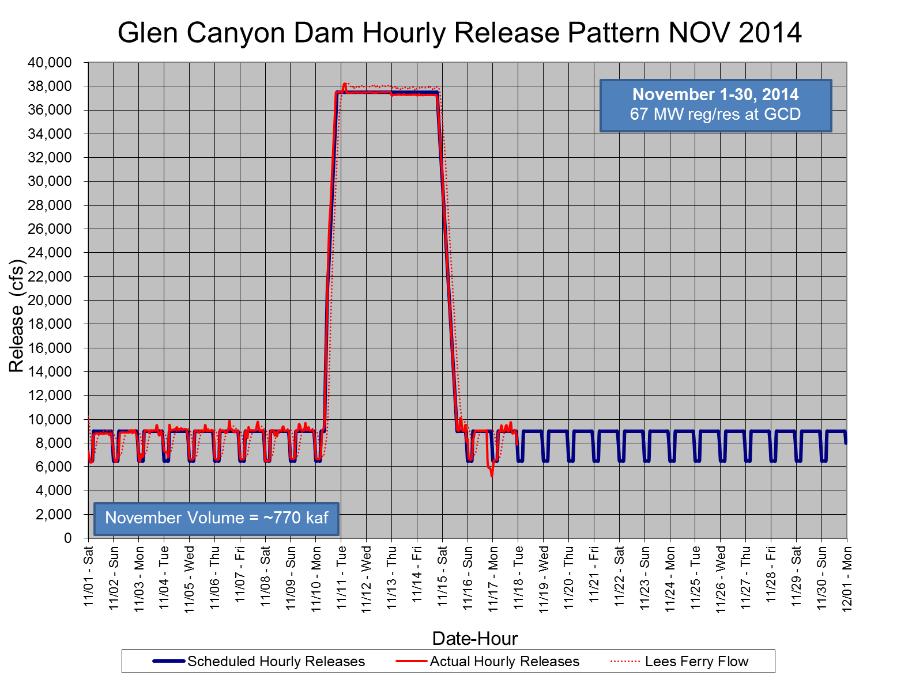
Nov

Slide 7
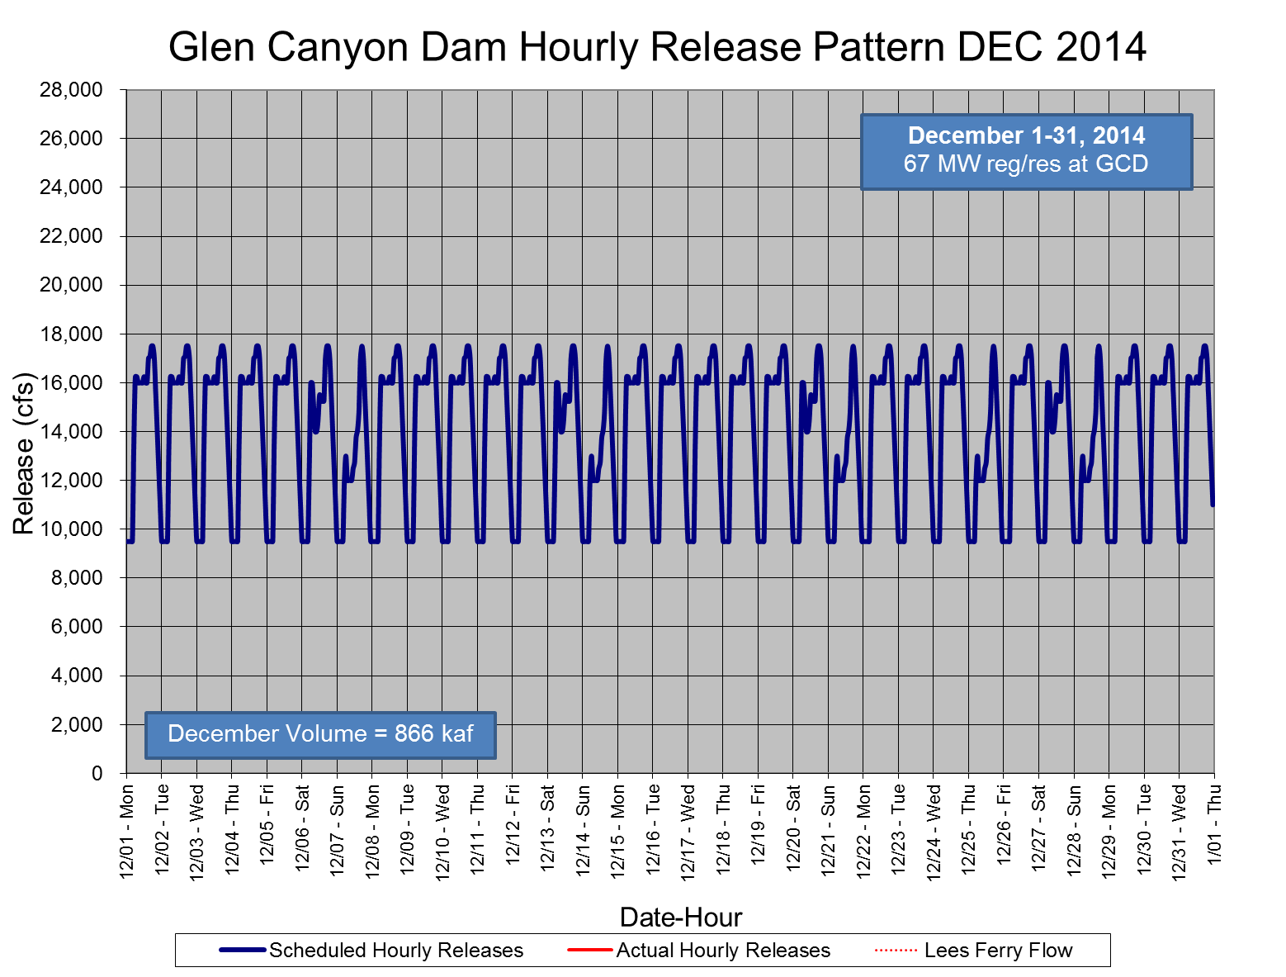
Dec

