Slide 1
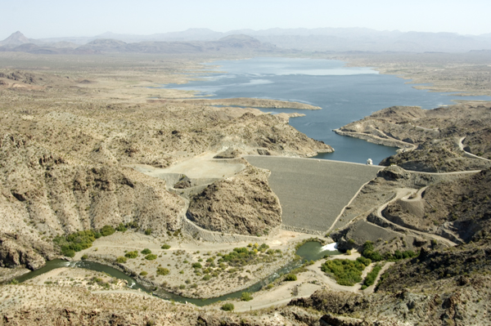

November 2014 CRFS Meeting
Kim Gilbert
213-452-3533
moon.h.kim@usace.army.mil

Slide 2
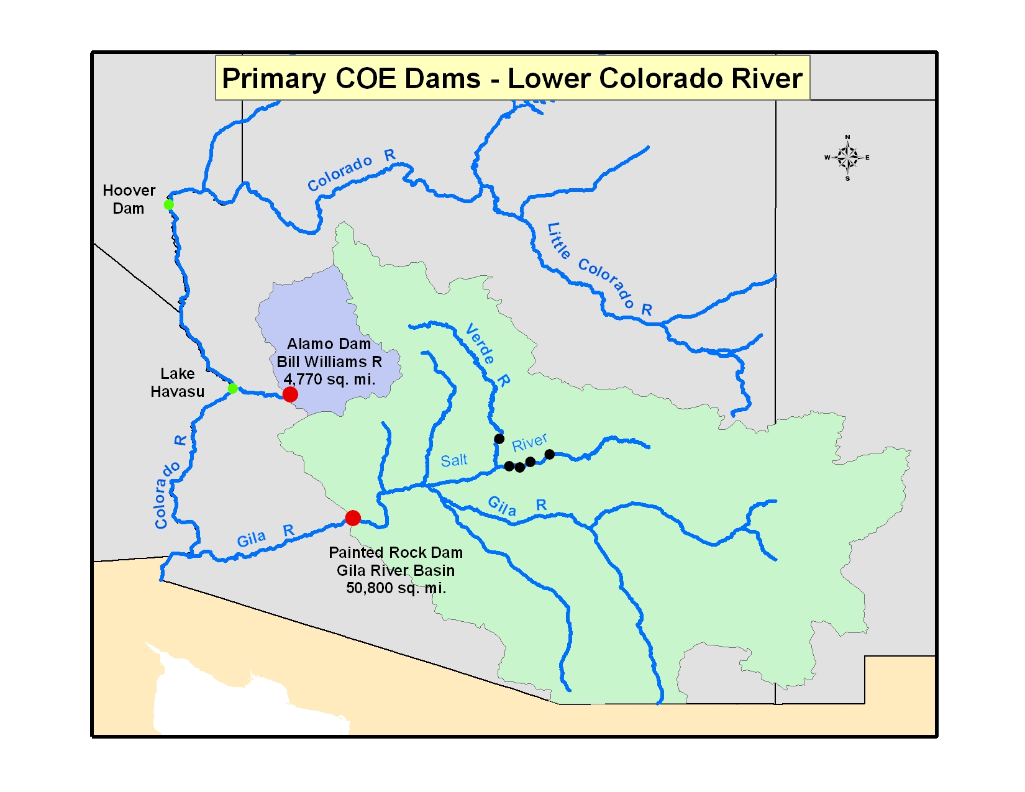

Slide 3
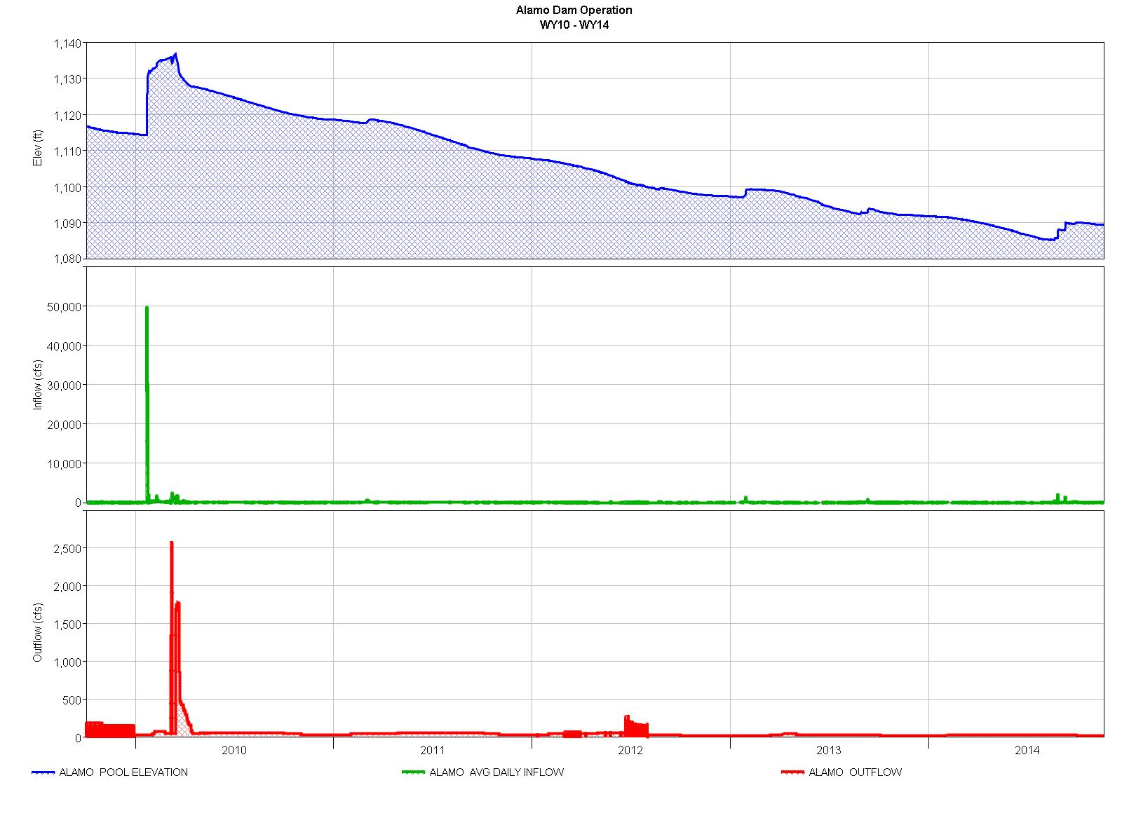

Optimal Pool 1125’ (161,000 ac-ft)
Currently 1,089.2’
(55,000 ac-ft)

Slide 4
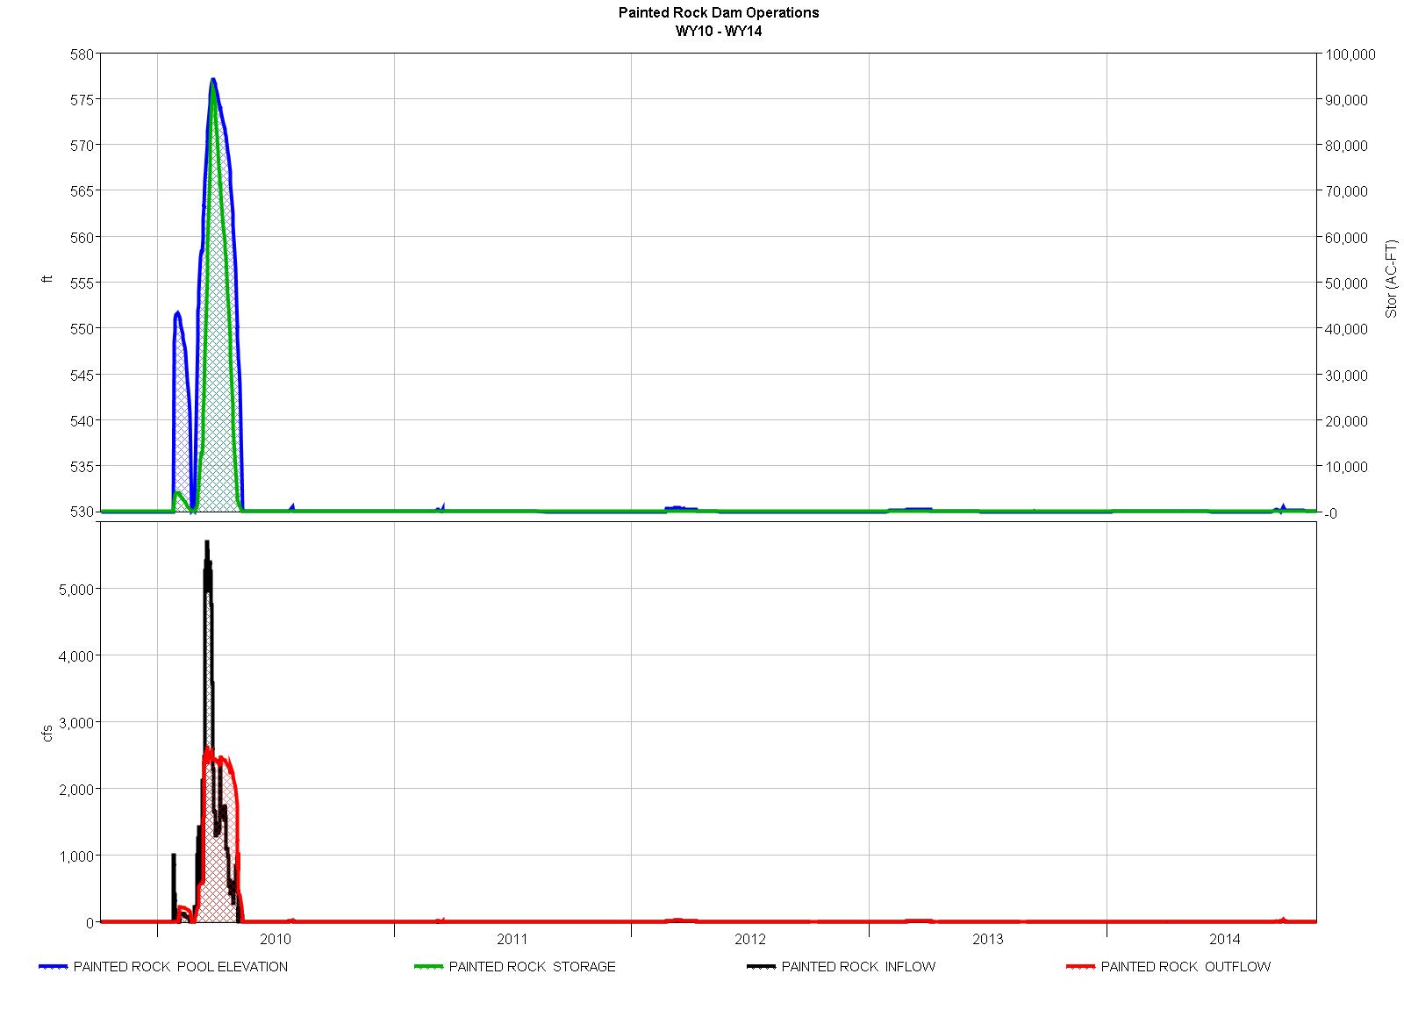
Elev (ft)
Dry since 2010
Flow (cfs)

Slide 5
Others
    Water Control Manual Update
        Painted Rock Dam
    Corps Water Management
  System (CWMS) Modeling
        Alamo Dam (FY 2015)
        Painted Rock Dam (FY 2016)
    RFC Inflow Forecasts
        Alamo
        Gila River Basin

